Slide 1
Iowa’s Clean Air Attainment Program
Funding Recommendation

Slide 2
Iowa’s Clean Air Attainment Program
Iowa’s Clean Air Attainment Program (ICAAP) was created in 1994.
Modeled after the federal Congestion Mitigation and Air Quality Improvement Program established in 1991.
Available to cities, counties, public transit agencies, MPOs, RPAs, and state agencies. Private non-profit or for-profit entities when co-sponsored by an eligible public agency through an annual application program.
Purpose is to award funds to projects with the highest potential for reducing transportation-related congestion and air pollution.

Slide 3
Project Evaluation Criteria
Vehicle traffic flow improvements (25 points)
Vehicle miles of travel (VMT) or single-occupant vehicle (SOV) reduction (25 points)
Estimated vehicle emission reduction (20 points)
Degree of transportation-related air pollution or traffic congestion (15 points)
Project cost effectiveness relative to air quality benefits (30 points)

Slide 4
Available Funding and Application Summary
Available Funding:
Iowa’s Clean Air Attainment Program funds available: $4,000,000
Application Summary:
Total number of projects: 17
Total project costs: $20,772,552
Total amount requested: $10,971,776

Slide 5
List of Applications Recommended
PROJECT NAME | SPONSOR | SCORE | TOTAL PROJECT COST | REQUESTED AMOUNT (% of Total Project Cost) | RECOMMENDED AMOUNT (% of Total Project Cost)
Traffic Signal Communication Network - Phase 2 | Ames | 81.3 | $1,750,000 | $1,400,000 (80%) | $1,400,000 (80%)
West Ames Changes | Ames Transit Agency | 71.6 | $400,466 | $320,372 (80%) | $320,372 (80%)
Traffic Signal System Timing Update - Phase 4 | Des Moines | 70.7 | $275,000 | $220,000 (80%) | $220,000 (80%)
Traffic Signal Network Communication Project | Grimes | 67.8 | $1,094,000 | $875,200 (80%) | $875,200 (80%)
#11 Cherry Night Service | Ames Transit Agency | 63.8 | $41,930 | $33,544 (80%) | $33,544 (80%)
Iowa 28 Traffic Signal System | Norwalk | 62.7 | $883,000 | $706,400 (80%) | $706,400 (80%)
Jump to applications not recommended for funding

Slide 6
List of Applications Recommended
PROJECT NAME | SPONSOR | SCORE | TOTAL PROJECT COST | REQUESTED AMOUNT (% of Total Project Cost) | RECOMMENDED AMOUNT (% of Total Project Cost)
#6 Brown Night Service | Ames Transit Agency | 60.9 | $37,481 | $29,984 (80%) | $29,984 (80%)
#12 Lilac Midday Service | Ames Transit Agency | 59.4 | $39,569 | $31,655 (80%) | $31,655 (80%)
Grand Avenue (U.S. 71) Signal Equipment Upgrades | Spencer | 57.2 | $274,635 | $219,708 (80%) | $219,708 (80%)
Route #17 Extension to Bondurant | Des Moines Regional Transit Authority (DART) | 57.1 | $63,432 | $50,745 (80%) | $50,745 (80%)
Logan Avenue (U.S. 63) Adaptive Traffic System | Waterloo | 46.0 | $145,000 | $116,000 (80%) | $112,392 (78%)
Jump to applications not recommended for funding

Slide 7
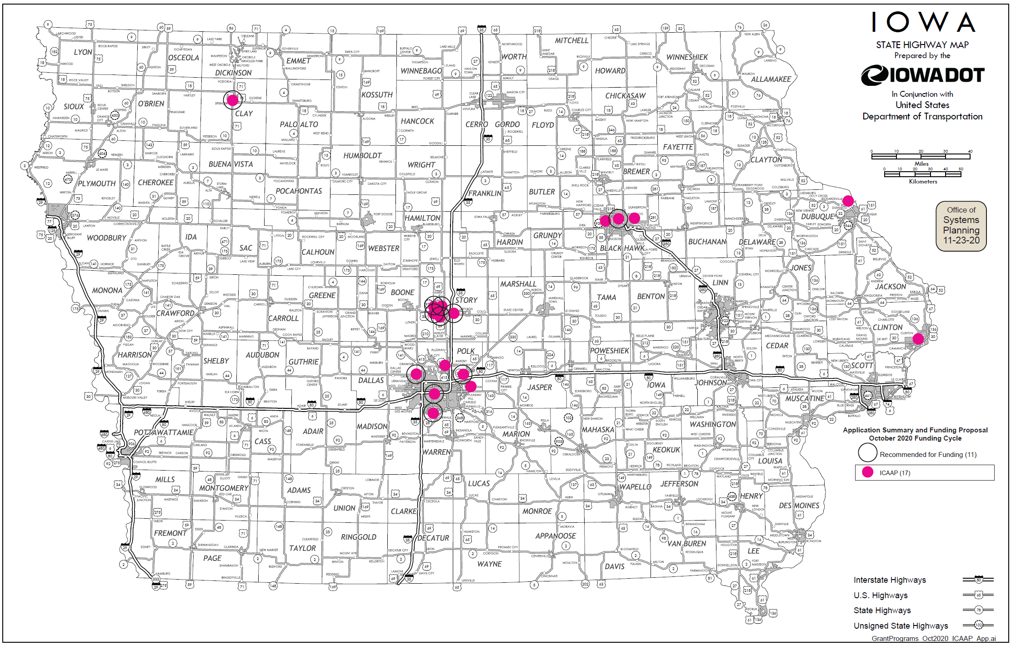
Map of Applications Received

Slide 8
Estimated Annual Benefits of Recommended Projects
Reduction of Vehicle Hours of Travel: 698,709
Reduction of Vehicle Miles of Travel: 5,490,742
Improved Air Quality
Reduced CO, VOCs, & NOx Emissions: 333,039 lbs.

Slide 9
QUESTIONS?
Jared Smith
Iowa’s Clean Air Attainment program manager
Jared.Smith@iowadot.us

Slide 10
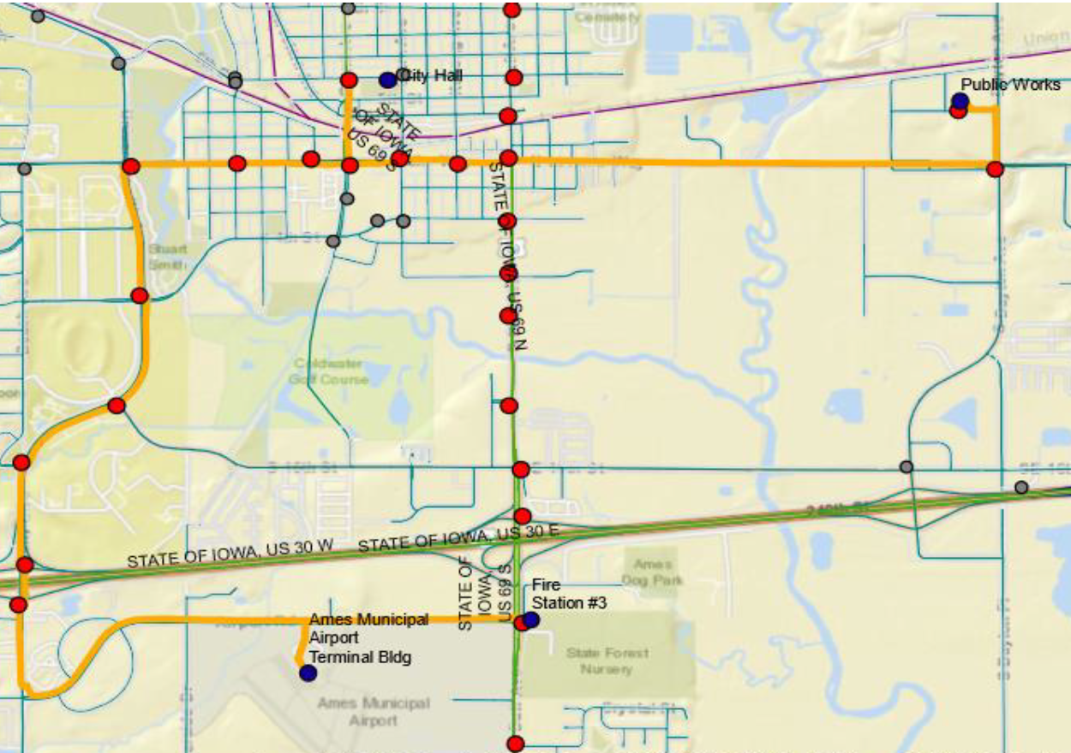
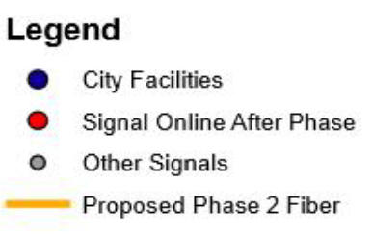
Traffic Signal Communication Network – Phase 2
(Ames)
Install fiber optic cable and network switching equipment, traffic signal cabinets, Advanced Traffic Controllers, Advanced Traffic Management System, and software to provide communication and traffic management capabilities along a portion of Dayton Avenue, Grand Avenue, East Lincoln Way, South University Boulevard, and Airport Road.
Total Cost: $1,750,000
Requested: $1,400,000 (80%)
Return to List of Applications Recommended

Slide 11
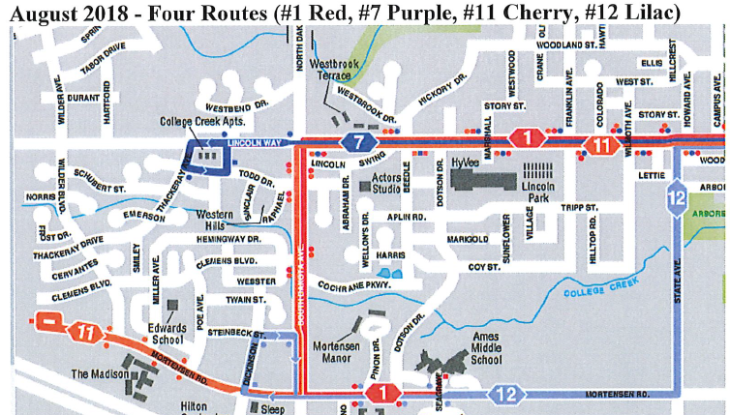
West Ames Changes – Year 3
(Ames Transit Agency)
Provides year three operating support of the #12 Lilac expansion route and adds frequency to three routes (#1 Red, #11 Cherry, & #7 Purple). These changes were made together to the system as part of a recent system redesign in response to the growth of high-density residential development in west Ames.
Total Cost: $400,466
Requested: $320,372 (80%)
Return to List of Applications Recommended

Slide 12
Traffic Signal System Timing Update – Phase 4
(Des Moines)
Review and update signal timing and phasing plans for the traffic signal system in Des Moines. This is the fourth phase of a project to update signal operations throughout the entire city of Des Moines.
Total Cost: $275,000
Requested: $220,000 (80%)
Return to List of Applications Recommended

Slide 13
Traffic Signal Network Communication Project
(Grimes)
This project will include a systems engineering analysis and identification and implementation of system upgrades including conduit and fiber optic interconnect of the existing network, traffic signal management software, signal cabinet equipment upgrades, detection upgrades, and traffic monitoring camera installation.
Total Cost: $1,094,000
Requested: $875,200 (80%)
Return to List of Applications Recommended

Slide 14
#11 Cherry Night Service – Year 2
(Ames Transit Agency)
Add new night service trips to the #11 Cherry route to improve safety and due to residential demand.
Total Cost: $41,930
Requested: $33,544 (80%)
Return to List of Applications Recommended

Slide 15
Iowa 28 Traffic Signal System
(Norwalk)
This project will include a systems engineering analysis and identification and implementation of system upgrades including conduit and fiber optic interconnect of the existing network, traffic signal management software, signal cabinet equipment upgrades, detection upgrades, and traffic monitoring camera installation.
Total Cost: $883,000
Requested: $706,400 (80%)
Return to List of Applications Recommended

Slide 16
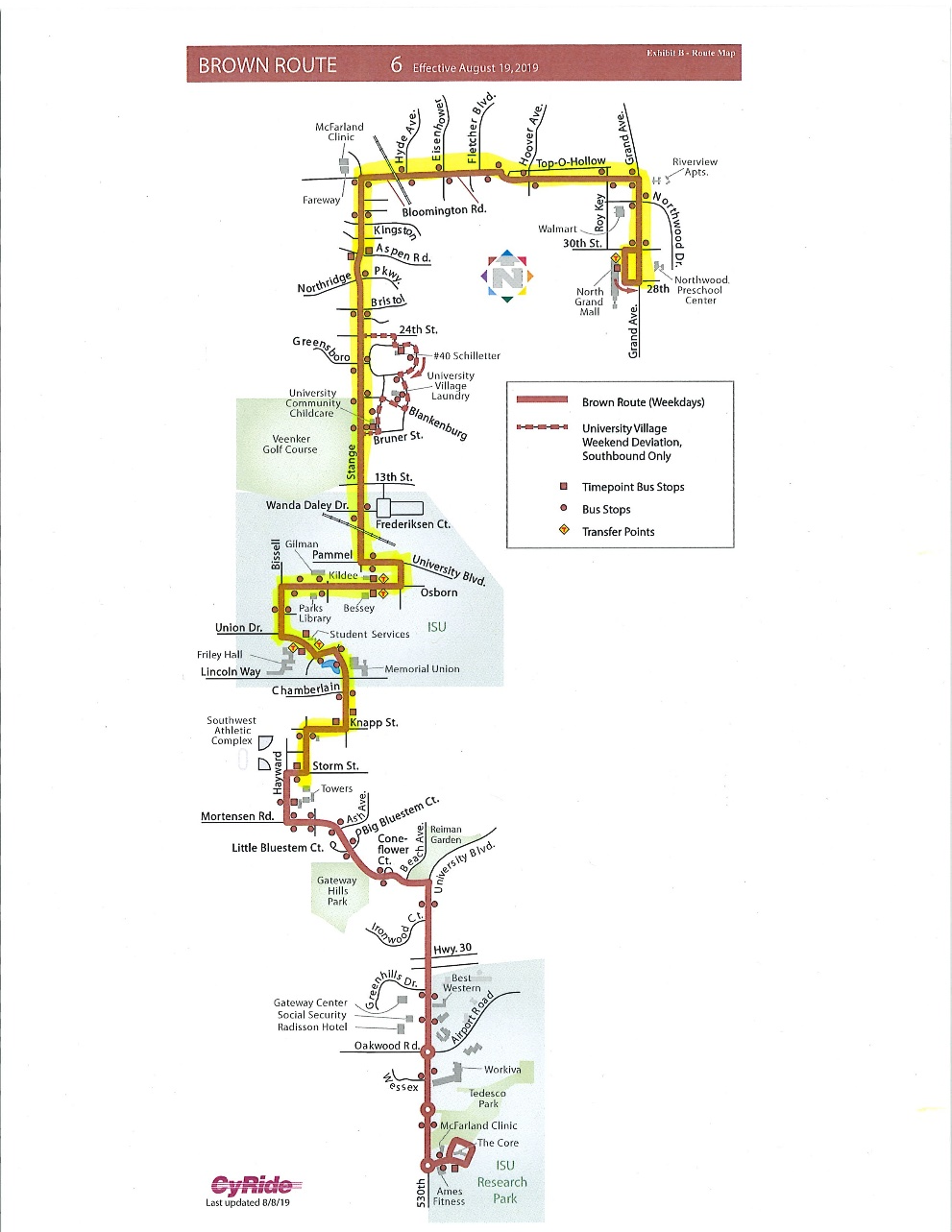
#6 Brown Night Service – Year 2
(Ames Transit Agency)
Add new night service trips to the #6 Brown route to improve safety and due to residential demand.
Total Cost: $37,481
Requested: $29,984 (80%)
Return to List of Applications Recommended

Slide 17
#12 Lilac Midday Service – Year 2
(Ames Transit Agency)
Add new midday service trips to the #12 Lilac route due to residential demand.
Total Cost: $39,569
Requested: $31,655 (80%)
Return to List of Applications Recommended

Slide 18
Grand Avenue (U.S. 71) Signal Equipment Upgrades
(Spencer)
This project will update signal timing and equipment along Grand Avenue (U.S. 71) from 1st Street to 8th Street.
Total Cost: $274,635
Requested: $219,708 (80%)
Return to List of Applications Recommended

Slide 19
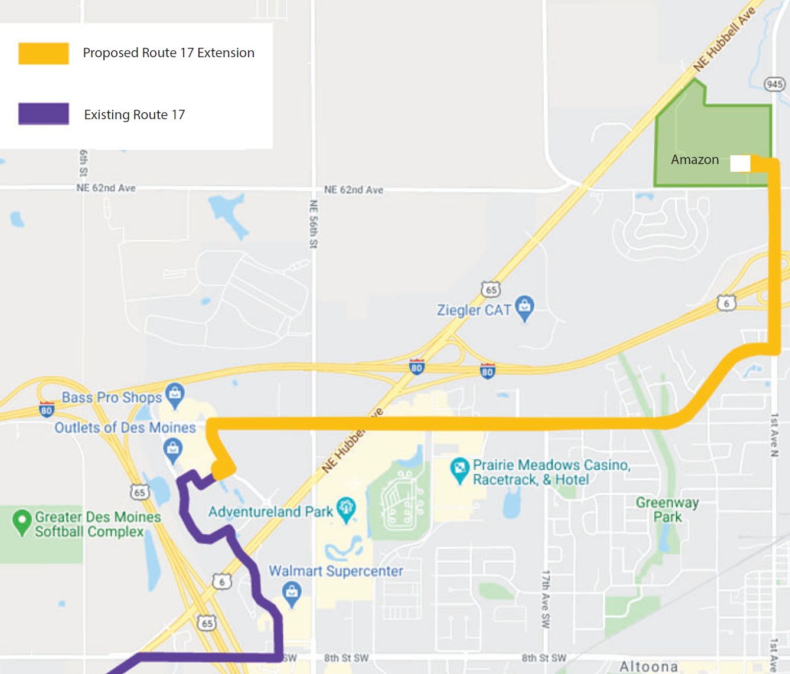
Route #17 Extension to Bondurant
(Des Moines Area Regional Transit Authority)
The existing route #17 travels to Altoona via Hubbell Avenue. This project extends service to Bondurant via Adventureland Drive and 1st Avenue North and will assist workforce transportation to the Amazon site location.
Total Cost: $63,432
Requested: $50,745 (80%)
Return to List of Applications Recommended

Slide 20
Logan Avenue (U.S. 63) Adaptive Traffic System (Waterloo)
This project will install adaptive traffic signal equipment and technology upgrades along five intersections on Logan Ave.
Total Cost: $145,000
Requested: $116,000 (80%)
Recommended: $112,392 (78%)
Return to List of Applications Recommended

Slide 21
List of Applications Not Recommended for Award
PROJECT NAME | SPONSOR | SCORE | TOTAL PROJECT COST | REQUESTED AMOUNT (% of Total Project Cost) | RECOMMENDED AMOUNT (% of Total Project Cost)
Iowa 160/SW Oralabor Road and Iowa 415/ SW State Street Intersection Improvements | Ankeny | 58.4 | $1,847,000 | $925,000 (50%) | $0
Broadway Street Traffic Signal Control System Upgrade | Waterloo | 43.3 | $560,000 | $448,000 (80%) | $0
Intersection Improvement to Roundabout at Manufacturing Drive and South 19th Street | Clinton | 42.8 | $930,300 | $744,200 (80%) | $0
Return to List of Applications Recommended

Slide 22
List of Applications Not Recommended for Award
PROJECT NAME | SPONSOR | SCORE | TOTAL PROJECT COST | REQUESTED AMOUNT (% of Total Project Cost) | RECOMMENDED AMOUNT (% of Total Project Cost)
West 27th Street Reconstruction | Cedar Falls | 42.3 | $1,500,000 | $1,200,000 (80%) | $0
John Deere Improvements | Dubuque County | 41.5 | $6,992,029 | $500,000 (7%) | $0
1st Avenue Widening at Roundabout – Phase 2 | Altoona | 29.4 | $3,938,710 | $3,150,968 (80%) | $0
Return to List of Applications Recommended

