Slide 1
Federal Recreational Trails Program
Funding Recommendation

Slide 2
Federal Recreational Trail Program
Federal program created in 1991
Available to federal, state, and local government agencies. Private individuals and organizations may apply with a government co-sponsor.
Purpose is to develop and maintain recreational trails and trail related facilities for both motorized and non-motorized trail users.
Eligible projects include:
Maintenance and restoration of existing trails, development of trailside and trailhead facilities, purchase of trail construction and maintenance equipment, construction of new trails, and acquisition of land for trails.

Slide 3
Project Evaluation Criteria
Degree to which motorized and non-motorized trail use are accommodated. (10 points)
Greatest number of compatible multi-purpose uses. (10 points)
Access and use for persons with disabilities, older citizens, economically challenged and other special populations or groups. (10 points)
Provides development of trail linkages. (10 points)
Opportunities for new partnerships between trail users and private interests. (10 points)
Identified in or furthers a specific goal of a state, regional, or local plan. (10 points)
Leverages greater public or private investments. (10 points)
Citizen involvement in the project’s conception and implementation (10 points)
Degree to which project ties in to other trails. (10 points)
Public/private partnerships to continue operation and maintenance. (15 points)
Trails with national designation or resulting in the cleanup of an area. (10 points)

Slide 4
Available Funding and Application Summary
Available Funding:
Annual appropriation: $1,300,000
Underrun/withdrawals: $ 38,337
Funds awarded: $1,338,337
Application Summary:
Total number of projects: 20
Total project costs: $12,428,406
Total amount requested: $5,282,922

Slide 5
List of Motorized Applications Recommended
PROJECT NAME | SPONSOR | SCORE | TOTAL PROJECT COST | REQUESTED AMOUNT (% of Total Project Cost) | RECOMMENDED AMOUNT (% of Total Project Cost)
Bridge Installation at Gypsum City OHV Park | Iowa DNR & Iowa Off-Highway Vehicle (OHV) Association | 53.33 | $120,900 | $96,720 (80%) | $96,720 (80%)
Building Replacement at Bluff Creek OHV Park | Iowa DNR & Iowa Off-Highway Vehicle (OHV) Association | 47.83 | $138,500 | $110,800 (80%) | $110,800 (80%)
Jump to applications not recommended for funding

Slide 6
List of Non-motorized Applications Recommended
PROJECT NAME | SPONSOR | SCORE | TOTAL PROJECT COST | REQUESTED AMOUNT (% of Total Project Cost) | RECOMMENDED AMOUNT (% of Total Project Cost)
Support for Program and Bicycle Summit | Iowa DOT | N/A | $8,750 | $7,000 (80%) | $7,000 (80%)
Clay County Connection Phase I | Dickinson County | 75.17 | $680,222 | $285,690 (42%) | $285,690 (42%)
Carlisle Connection Multi-Use Trail | Des Moines | 75.00 | $2,800,000 | $400,000 (14%) | $400,000 (14%)
Iowa River’s Edge Trail Paving from Radio Tower Road Towards the Iowa River | Marshalltown | 73.17 | $950,000 | $300,000 (32%) | $300,000 (32%)
Jump to applications not recommended for funding

Slide 7
List of Non-motorized Applications Recommended
PROJECT NAME | SPONSOR | SCORE | TOTAL PROJECT COST | REQUESTED AMOUNT (% of Total Project Cost) | RECOMMENDED AMOUNT (% of Total Project Cost)
Wapsipinicon Trail Phase 2 | Jones County Conservation Board | 70.83 | $513,240 | $170,000 (33%) | $138,127 (27%)
Jump to applications not recommended for funding

Slide 8
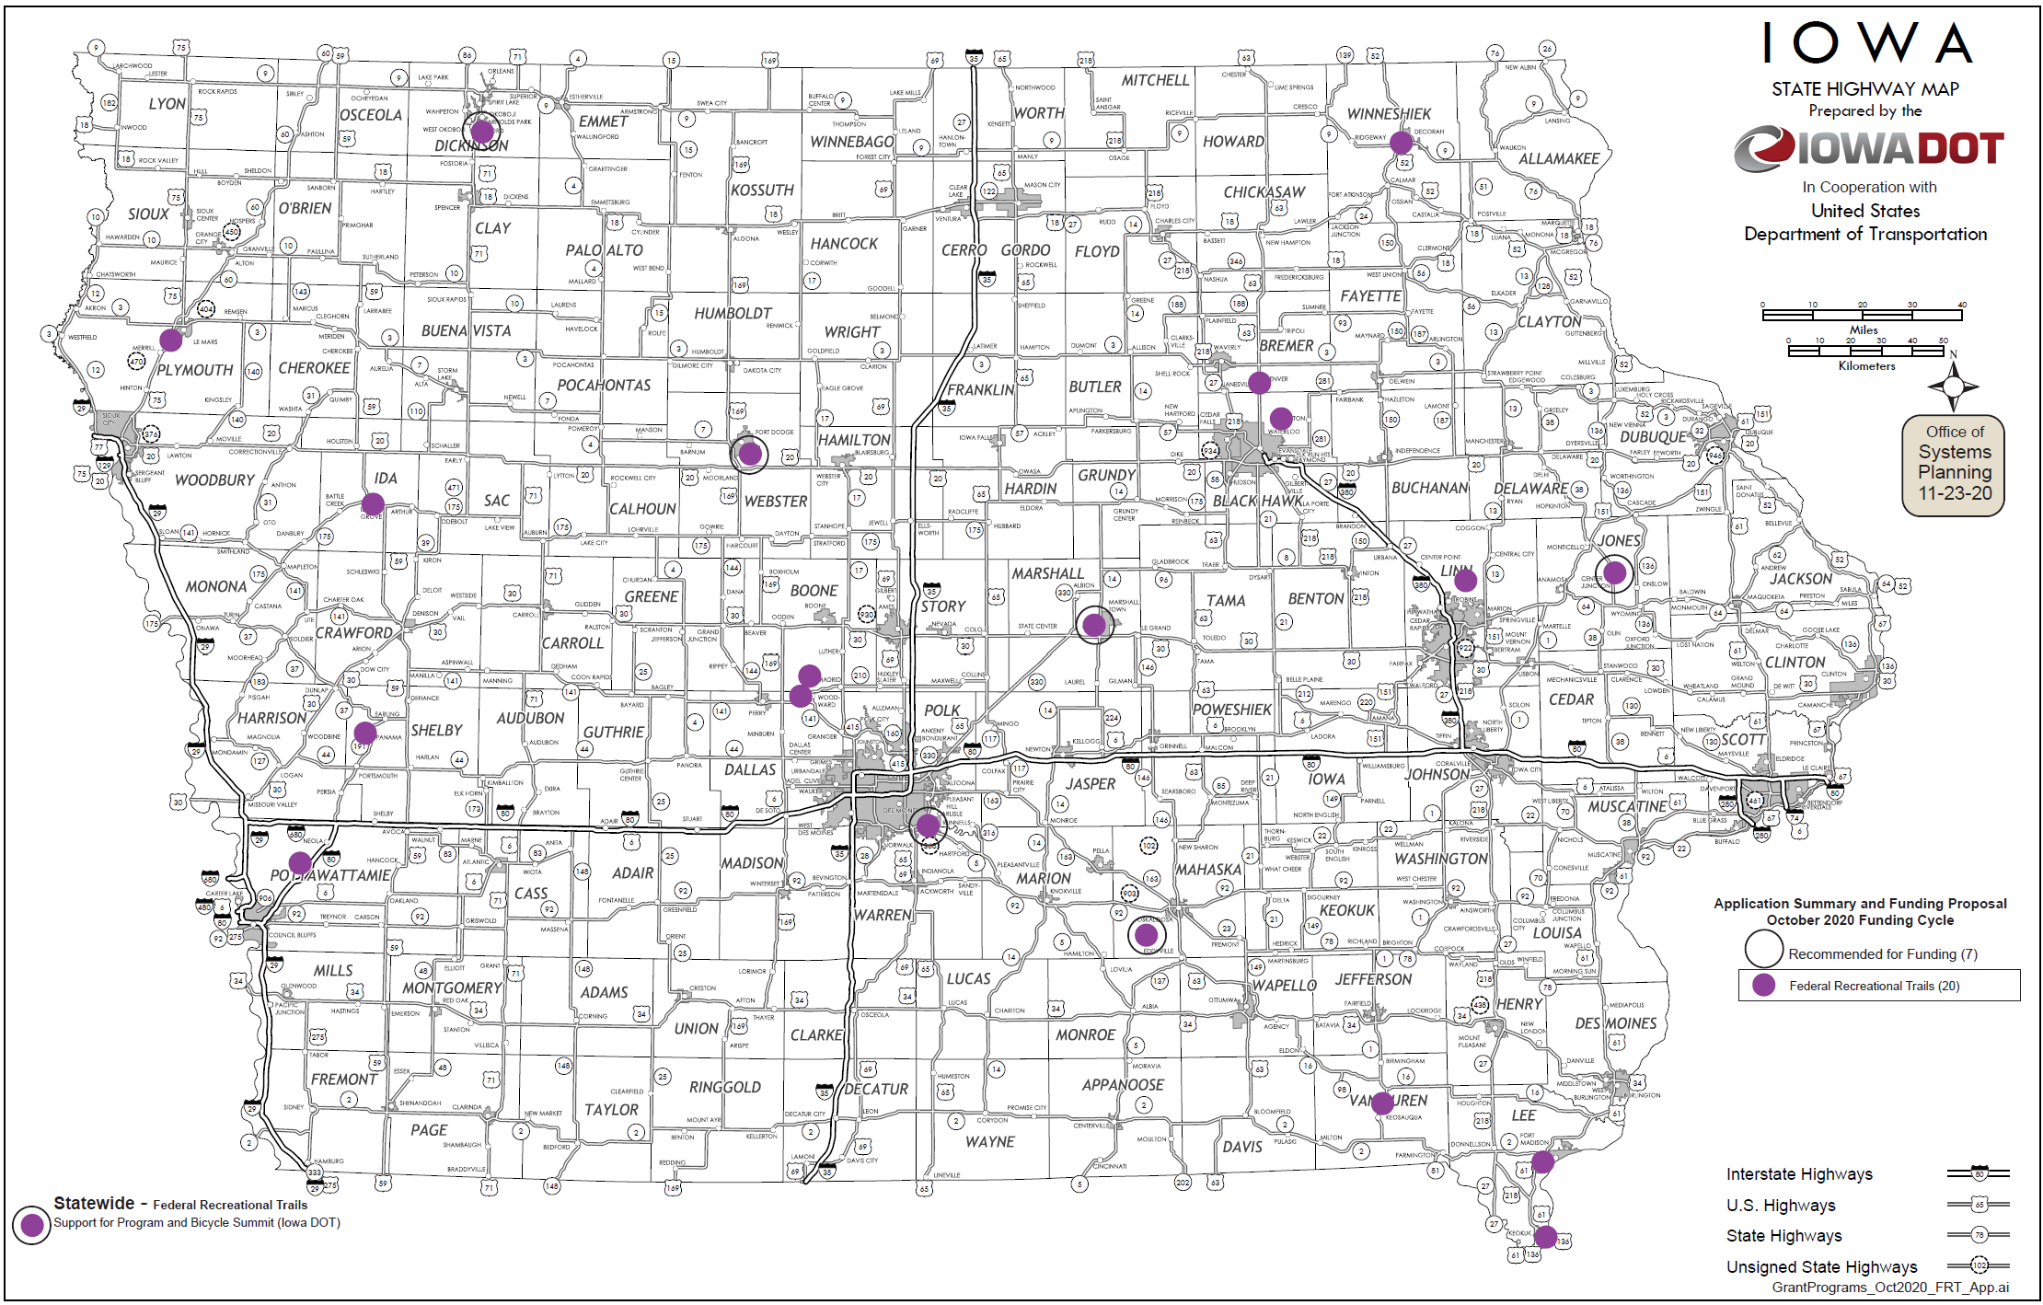
Map of Applications Received

Slide 9
QUESTIONS?
Scott Flagg
Federal/State Recreational Trail Program Manager
Scott.Flagg@iowadot.us

Slide 10
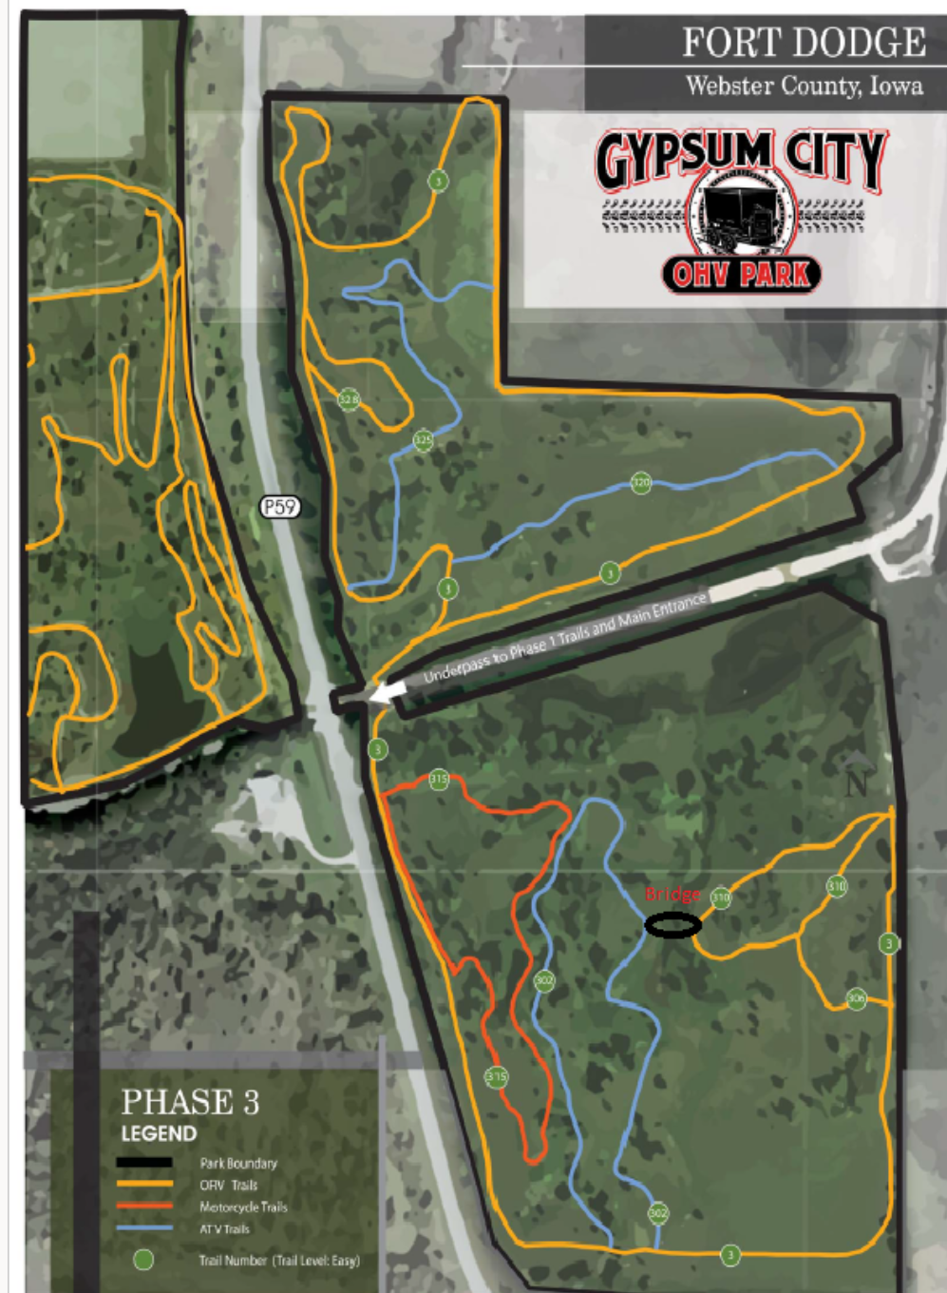
Bridge Installation at Gypsum City OHV Park
(Iowa Department of Natural Resources & Iowa Off-Highway Vehicle Association)
Installation of 65-foot bridge at Gypsum City OHV Park to provide trail linkage in Phase 3 of the park.
Total Cost: $120,900
Requested: $96,720 (80%)
Return to List of Applications Recommended

Slide 11
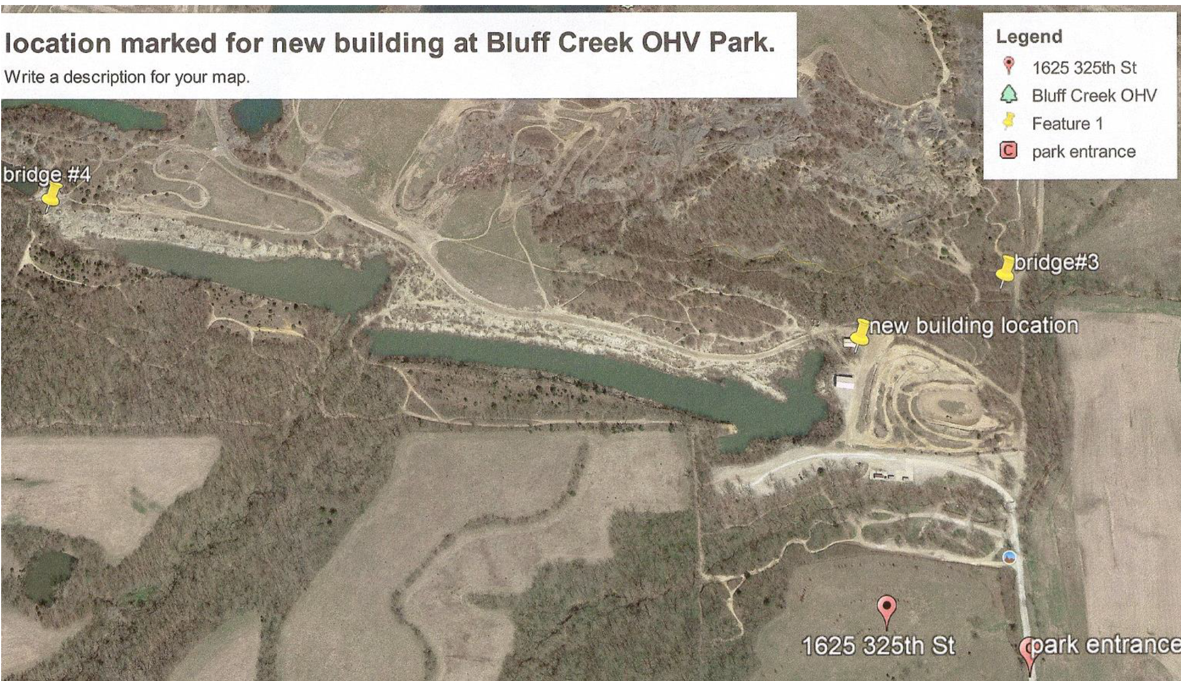
Building Replacement at Bluff Creek OHV Park
(Iowa Department of Natural Resources & Iowa Off-Highway Vehicle Association)
Replacement of existing equipment maintenance and storage building at Bluff Creek OHV Park.
Total Cost: $138,500
Requested: $110,800 (80%)
Return to List of Applications Recommended

Slide 12
Support for Program and Bicycle Summit (Iowa DOT)
This project provides funding to pay for costs related to operation of the Federal Recreational Trails Program for 2022 and for the 2022 Iowa Bicycle Summit. The Iowa Bicycle Summit is an annual conference providing education on the latest bicycle facilities, technology, and programming. It brings national speakers to Iowa to share bicycle facility successes and best practices from around the United States. Many of the lessons learned at the Summit have manifested into trail facilities and safety.
Total Cost: $8,750
Requested: $7,000 (80%)
Return to List of Applications Recommended

Slide 13
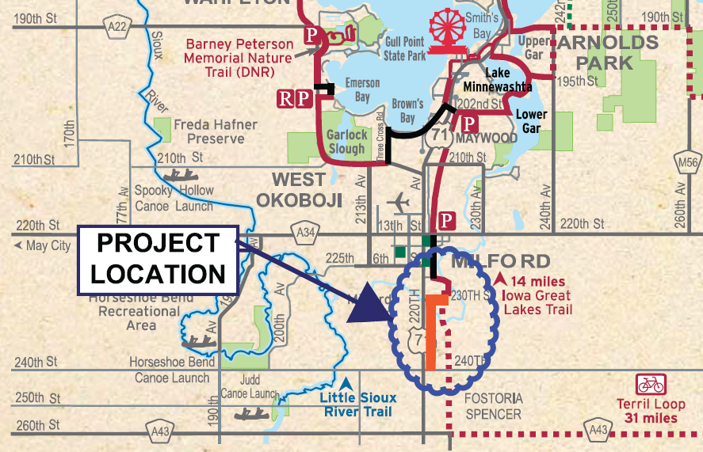
Clay County Connection Phase I
(Dickinson County Trail Board)
Phase I will include 6,876 feet of paved recreational trail starting at the southern end of the Dickinson County Spine Trail in Milford to 240th Street as part of the Iowa Great Lakes Connection Trail.
Total Cost: $680,220
Requested: $285,690 (42%)
Return to List of Applications Recommended

Slide 14
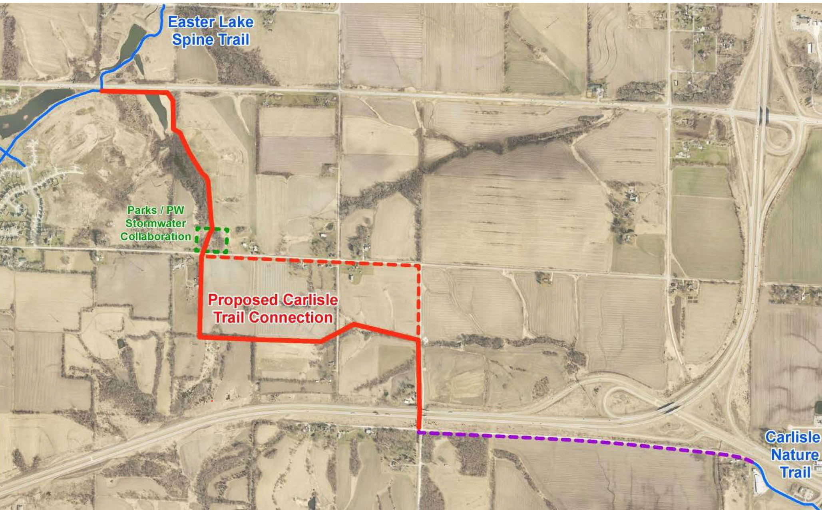
Carlisle Connection Multi-Use Trail
(Des Moines)
This project consists of a 3-mile trail from East Army Post Road in Des Moines southeast to 150th Avenue connecting the Easter Lake Spine Trail to the Carlisle Nature Trail upon completion of one last segment.
Total Cost: $2,800,000
Requested: $400,000 (14%)
Return to List of Applications Recommended

Slide 15
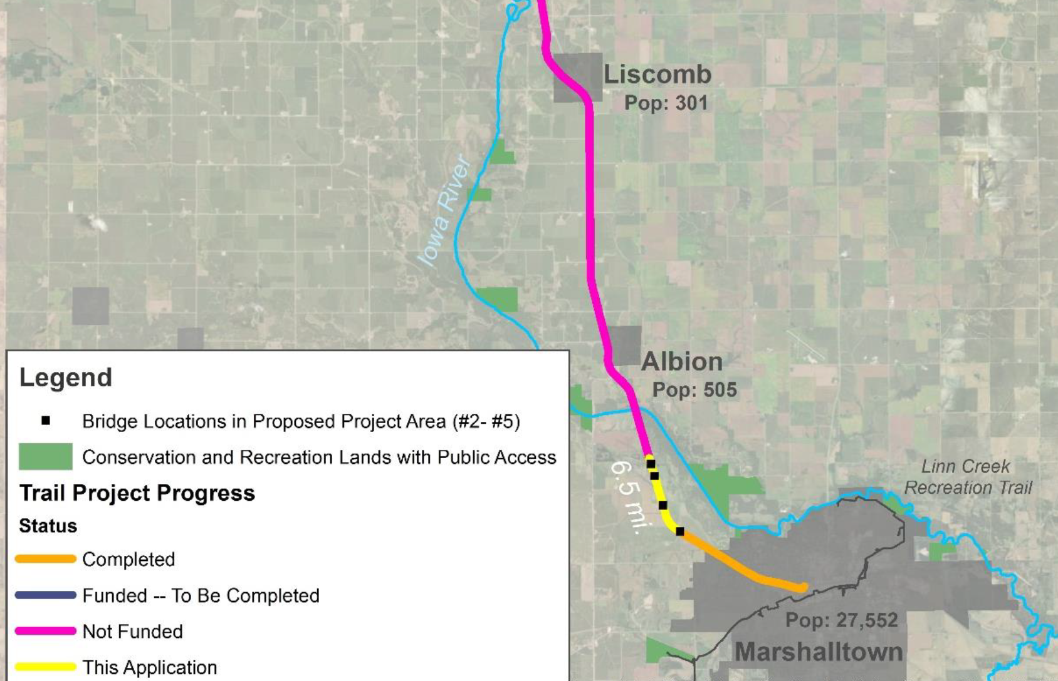
Iowa River’s Edge Trail Paving from Radio Tower Road Towards the Iowa River
(Marshalltown)
This project starts at Radio Tower Road and paves an additional 1.78 miles of the Iowa River’s Edge Trail to Bridge #5.
Total Cost: $950,000
Requested: $300,000 (32%)
Return to List of Applications Recommended

Slide 16
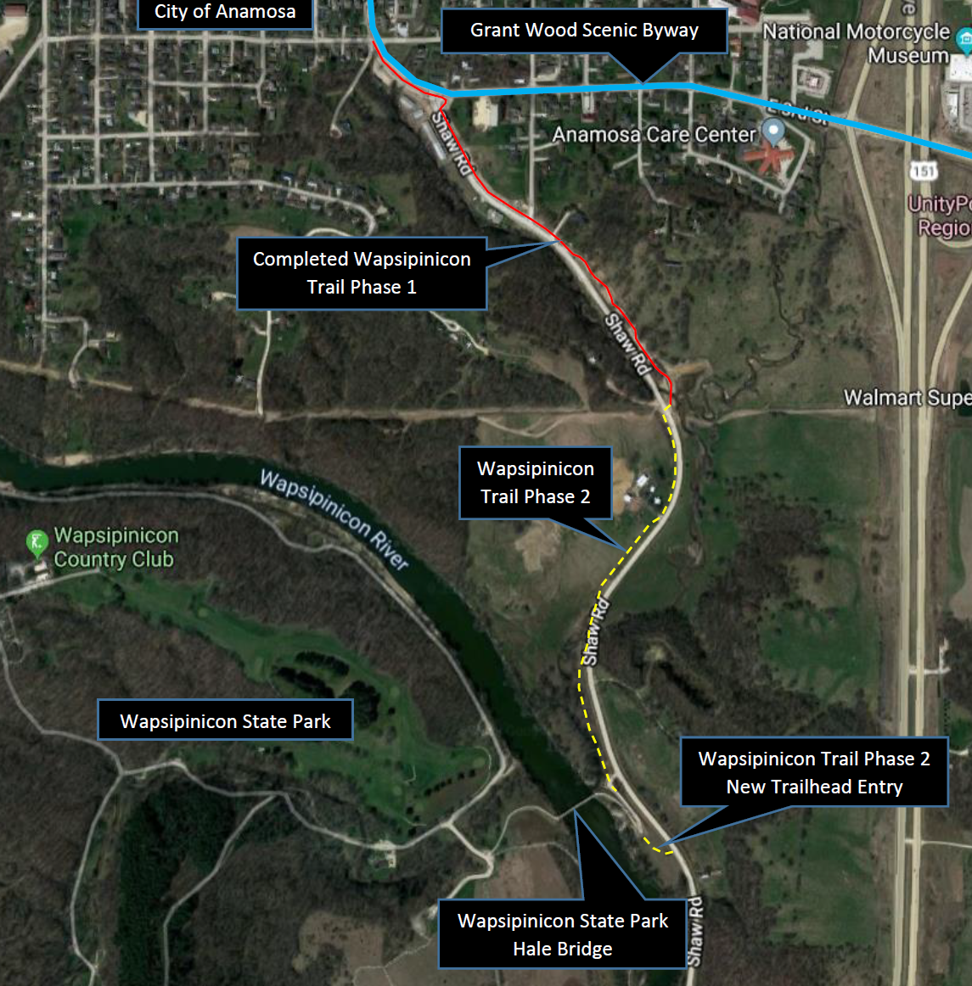
Wapsipinicon Trail Phase 2
(Jones County Conservation Board)
This project will construct 0.5 miles of paved trail from the intersection of Stallion Creek and Shaw Road in Anamosa to the Hale Bridge. Project also includes construction of a new trailhead entry.
Total Cost: $513,240
Requested: $170,000 (33%)
Recommended: $138,127 (27%)
Return to List of Applications Recommended

Slide 17
List of Applications Not Recommended for Award
PROJECT NAME | SPONSOR | SCORE | TOTAL PROJECT COST | REQUESTED AMOUNT (% of Total Project Cost) | RECOMMENDED AMOUNT (% of Total Project Cost)
Dry Run Trail-Phase III Decorah to the Greenbelt | Winneshiek County Conservation Board | 69.67 | $794,880 | $500,000 (63%) | $0
RRVT to HTT Connector Phase V Construction | Dallas County Conservation Board | 68.67 | $425,000 | $340,000 (80%) | $0
Plywood Trail Phase 1 and Phase 1A | Le Mars | 63.00 | $1,512,711 | $350,000 (23%) | $0
Connecting Fort Madison! Phase 4 - 48th Street Trail Connection | Fort Madison | 62.50 | $440,840 | $325,000 (74%) | $0
Return to List of Applications Recommended

Slide 18
List of Applications Not Recommended for Award
PROJECT NAME | SPONSOR | SCORE | TOTAL PROJECT COST | REQUESTED AMOUNT (% of Total Project Cost) | RECOMMENDED AMOUNT (% of Total Project Cost)
Austin Park Water Trail Access | Van Buren County Conservation Board | 60.00 | $268,000 | $208,000 (78%) | $0
Grant Wood Trail Paving: Waldo's Rock Park to Oxley Road | Linn County Conservation Board | 60.00 | $710,000 | $350,000 (49%) | $0
High Trestle Trail to City of Boone Trail, Phase I, Division IA | Boone County Conservation Board | 60.00 | $304,800 | $143,840 (47%) | $0
Miller Creek Bridge Repairs | Black Hawk County Conservation Board | 59.33 | $198,800 | $159,040 (80%) | $0
Let's Konnect! Riverfront Trail | Keokuk | 57.67 | $1,058,316 | $334,072 (32%) | $0
Return to List of Applications Recommended

Slide 19
List of Applications Not Recommended for Award
PROJECT NAME | SPONSOR | SCORE | TOTAL PROJECT COST | REQUESTED AMOUNT (% of Total Project Cost) | RECOMMENDED AMOUNT (% of Total Project Cost)
Ballpark to Ballpark Phase One | Shelby County | 55.00 | $426,900 | $341,520 (80%) | $0
Pleasant Valley Trail Repair Project | Ida Grove | 44.83 | $120,000 | $96,000 (80%) | $0
Underwood Trail | Underwood | 34.83 | $950,400 | $760,320 (80%) | $0
Jefferson City Trail Angle Broom Purchase | Denver | 7.97 | $6,150 | $4,920 (80%) | $0
Return to List of Applications Recommended

