Slide 1
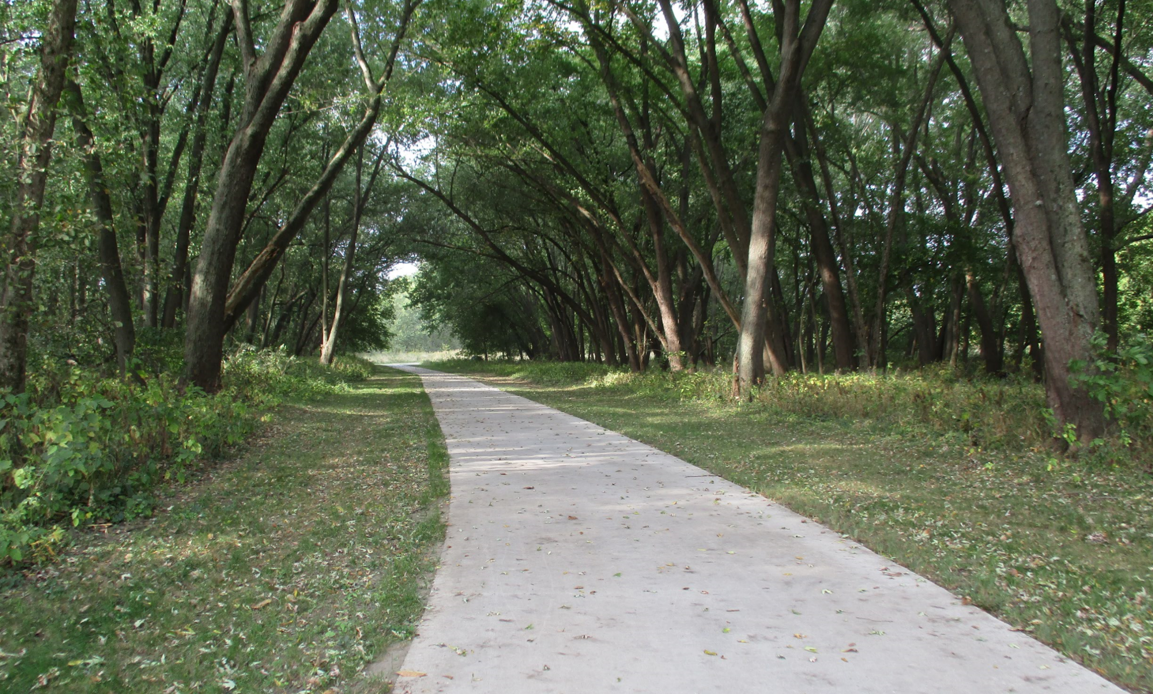

Statewide Iowa’s Transportation Alternatives Program
Funding Recommendation

Slide 2

Statewide Iowa’s Transportation Alternatives Program
Current version of former Transportation Enhancement program that has existed since 1991.
Majority of funding is distributed to Iowa’s RPAs and MPOs with $1 million reserved for statewide projects
Eligible activities include:
On-road and off-road non-motorized trail facilities, safe routes for non-drivers, conversion of abandoned rail corridors for trails, preservation/rehabilitation of historic transportation facilities among others
Federal Recreational Trails Program eligible activities
Infrastructure-related or non-infrastructure related Safe Routes to School Projects (if local TAP funds are used as well)
Scenic Byways (if local TAP funds are used as well)

Slide 3
Project Evaluation Criteria
Statewide or multi-regional impact of the project (35 points)
Degree of enhancement of the quality or utility of the state surface transportation system (20 points)
State or multi-regional tourism benefits (10 points)
Degree of statewide or multi-regional planning implemented (35 points)

Slide 4
Available Funding and Application Summary
Estimated FY 2021 Appropriation: $10,764,227
$1,374,817 set aside for Recreational Trails.
Half ($4,694,705) reserved for local projects, half stays at the state level.
The set-aside for Statewide TAP is $1,000,000
Remaining $3,694,705 of state level funding is reserved for eligible local projects:
Transportation Alternatives Program
Highway
Bridge
Transit

Slide 5
Available Funding and Application Summary
Available Funding:
Statewide Iowa’s TAP funds available: $1,000,000
Application Summary
Total number of projects: 5
Total project costs: $2,525,256
Total amount requested: $1,280,087

Slide 6
List of Applications Recommended
PROJECT NAME | SPONSOR | SCORE | TOTAL PROJECT COST | REQUESTED AMOUNT (% of Total Project Cost) | RECOMMENDED AMOUNT (% of Total Project Cost)
UNI Integrated Roadside Vegetation Management | University of Northern Iowa/Tallgrass Prairie Center | 90 | $1,128,944 | $586,037 (52%) | $586,037 (52%)
Iowa Safe Routes to School Partnership | Iowa Northland Regional Council of Governments | 85 | $276,312 | $221,050 (80%) | $221,050 80%)
3rd Avenue Middle/High School Rec Central Trail Link | Audubon | 20 | $140,000 | $42,000 (30%) | $42,000 (30%)
NE 2nd Street Safe Routes to School Sidewalk Project | Stuart | 20 | $270,000 | $81,000 (30%) | $81,000 (30%)
Jump to applications not recommended for funding

Slide 7
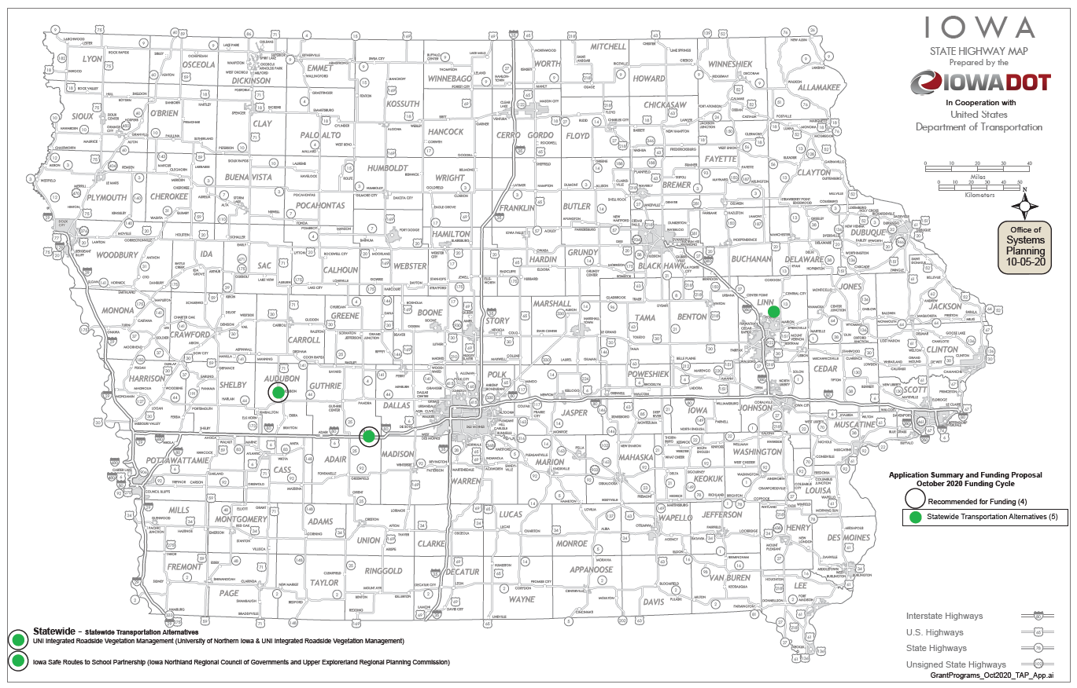
Map of Applications Received

Slide 8

QUESTIONS?
Pamella Lee
Transportation Alternatives program manager
Pamella.lee@iowadot.us

Slide 9
UNI Integrated Roadside Vegetation Management (University of Northern Iowa/Tallgrass Prairie Center)
Native grass and wildflower seed are to be planted in county road or city (population < 10,000) rights-of-way. This allows counties and cities that apply Integrated Roadside Vegetation Management to more cost effectively establish native roadside vegetation for habitat, biodiversity, erosion control and improved hydrology across Iowa's landscape.
Total Cost: $1,128,944
Requested: $ 586,037 (52%)
Return to List of Applications Received

Slide 10
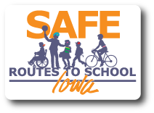
Iowa Safe Routes to School Partnership (Iowa Northland Regional Council of Governments and Upper Explorerland Regional Planning Commission)
A comprehensive program that provides support to communities by implementing SRTS initiatives, including pedestrian and bicycle safety education through encouragement activities both inside and outside the classroom.
Total Cost: $276,312
Requested: $221,050 (80%)
Return to List of Applications Recommended

Slide 11
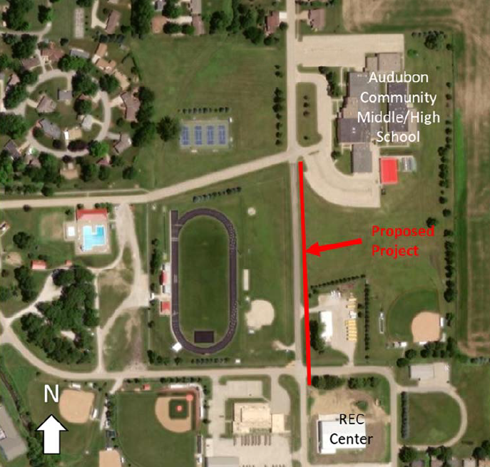
3rd Avenue Middle/High School Rec Center Trail Link (Audubon)
This project would construct a sidewalk along 3rd Avenue from the Audubon Middle/High School to the Audubon Rec Center in support of providing a safe route to school for middle schoolers and assisting K-8 students accessing after school programs after being bussed to the school.
Total Cost: $140,000
Requested: $42,000 (30%)
Return to List of Applications Recommended

Slide 12
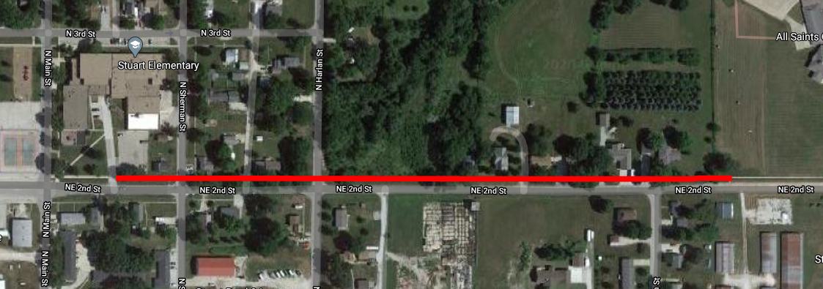
NE 2nd Street Safe Routes to School Sidewalk Project (Stuart)
This project will construct a sidewalk along NE 2nd Street to the West Central Valley Stuart Elementary School. The project will connect three residential neighborhoods to the elementary school and help with additional connectivity to various points of interest in the community.
Total Cost: $270,000
Requested: $ 81,000 (30%)
Return to List of Applications Recommended

Slide 13
List of Applications Not Recommended for Award
PROJECT NAME | SPONSOR | SCORE | TOTAL PROJECT COST | REQUESTED AMOUNT (% of Total Project Cost) | RECOMMENDED AMOUNT (% of Total Project Cost)
Grant Wood Trail Paving: Waldo's Rock Park to Oxley Road | Linn County Conservation | 20 | $710,000 | $350,000 (49.30%) | $0
Return to List of Applications Recommended

