Slide 1
IOWA DOT PROJECT PRIORITIZATION & SCOPING TOOL CRITERIA WEIGHTS
December 8, 2020
Bryan Bradley Location & Environment Bureau
Notes:
Thank you for allowing some time to let me talk about the Project Prioritization and Scoping Tool. Charlie and I are going to focus on the weights that are applied to the scoring criteria used to evaluate and compare projects and how those projects developed and used. You were probably expecting Brad Hofer, but Brad has moved to the ROW Bureau and I get to continue the development of this cool tool.

Slide 2
TAM Principles
Transportation
Asset
Management
Good asset management is:
Policy Driven Funding reflects the vision of the future.
Performance Based Decisions are based on future targets and condition of asset.
Quality Information Based Decisions supported by data and analytical tools.
Transparent and Accountable Decisions are documented, performance is monitored, progress tracked and reported
Trade-offs to Balance Weigh the information for best path.
Asset management is policy driven Funding decisions reflect the vision for
how the transportation system should look in the future.
Asset management is performance based We understand the condition of its assets, define performance targets, and make decisions that support these targets.
Asset management involves making trade-offs We have options for how to allocate transportation funding. We evaluate these options and makes informed decisions regarding the best path forward.
Asset management relies on quality information We use data and analytical tools to support our decisions.
Asset management requires transparency and accountability We document how funding decisions are made, monitor performance, track progress towards performance targets, and report on results.
Notes:
Transportation Asset Management is bigger than the tool but the tool can be an integral part of the process. If we are able to be Policy Driven, Performance Based using Quality Information and be Transparent and Accountable we get to the point of Trades-Offs where we can weigh all of the information and end up with the best path forward, resulting in the best use of our limited resources. The Prioritization and Scoping Tool is part of our system to make sure we follow these principles and practice good Transportation Asset Management.

Slide 3
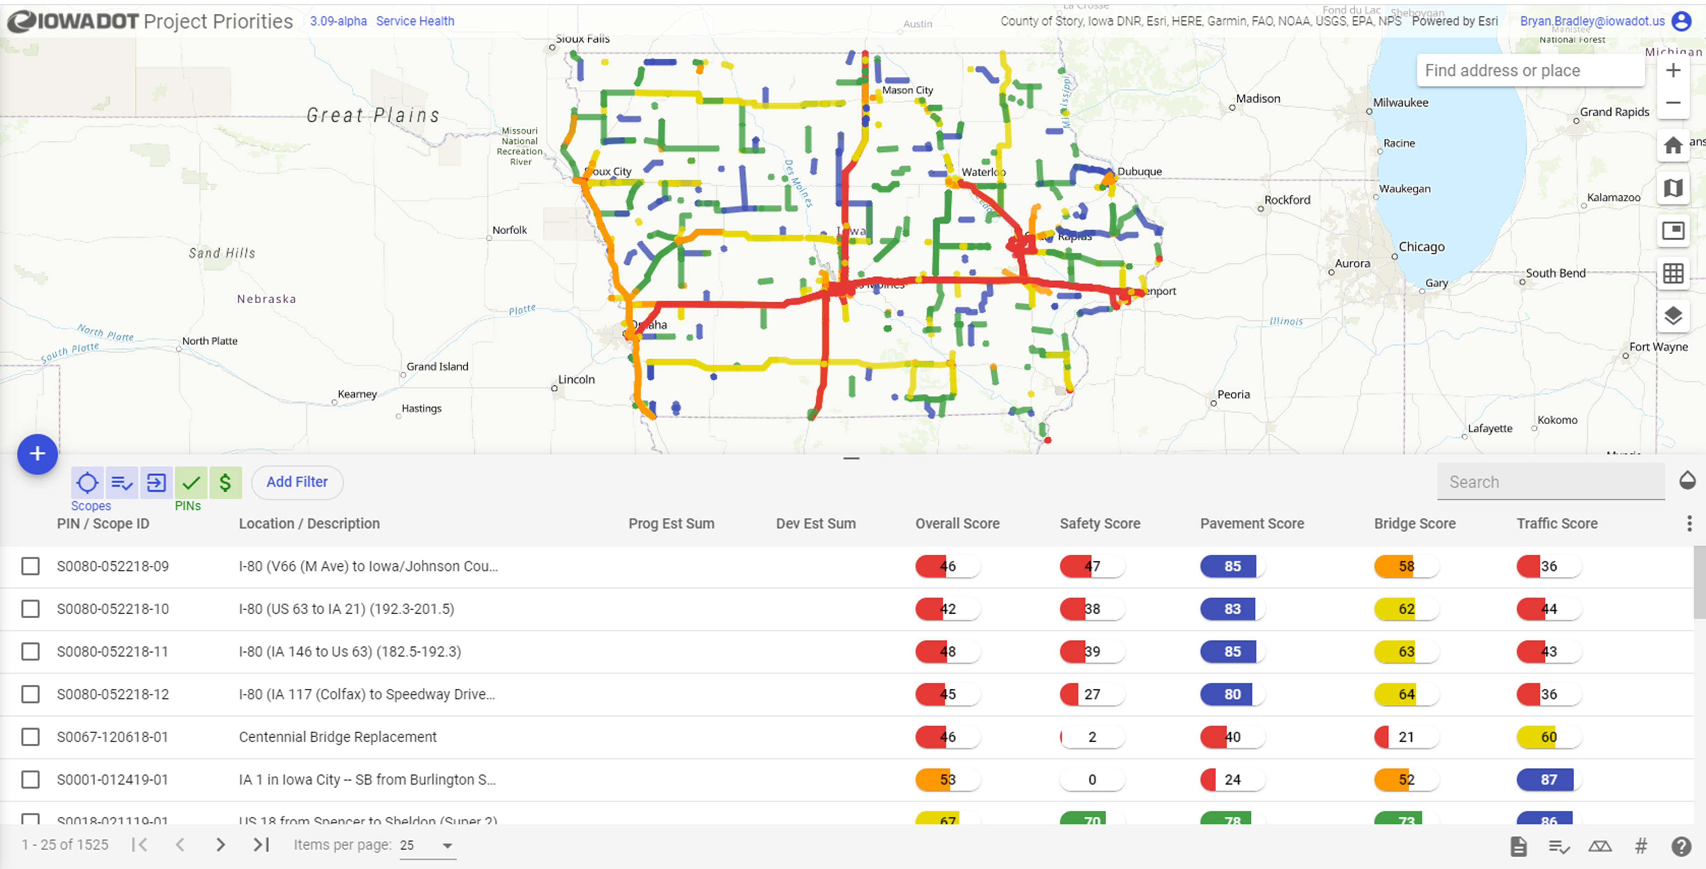
How do we evaluate the universe of possible projects?
Notes:
So we can put a bunch of proposed projects in a tool and get a nice map like this, but how do we evaluate all of these to produce an asset management plan for the future. The answer is to score them and be able to compare them with other scores to get an initial ranking of projects to consider.

Slide 4
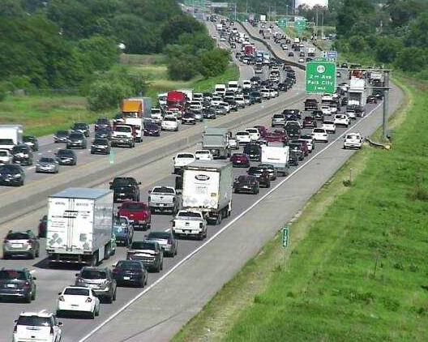
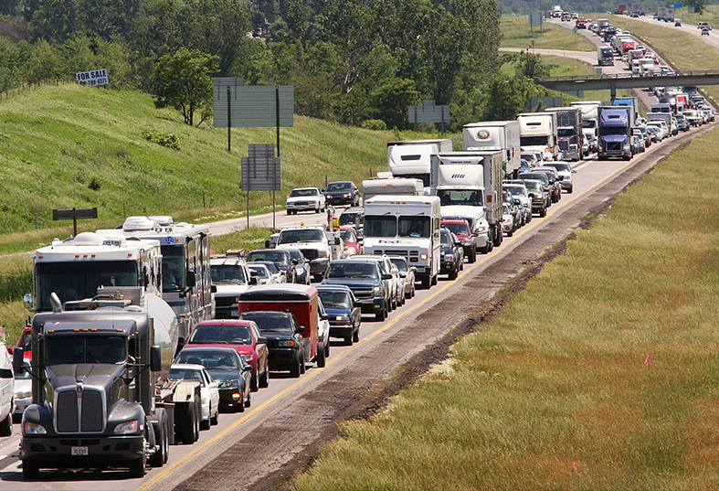
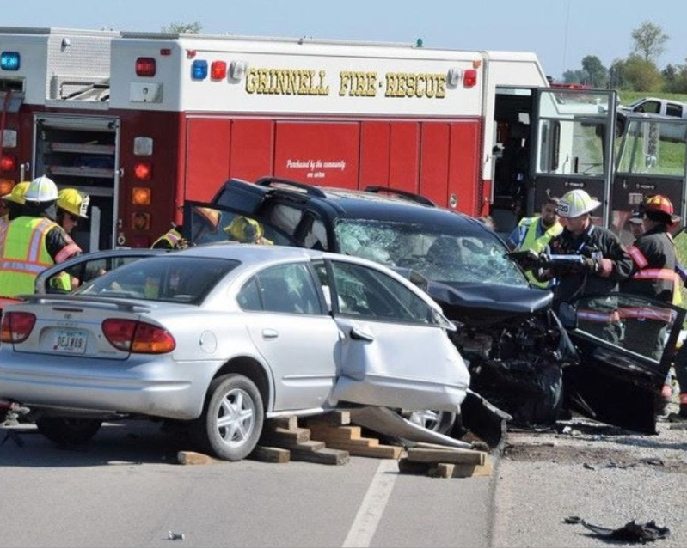
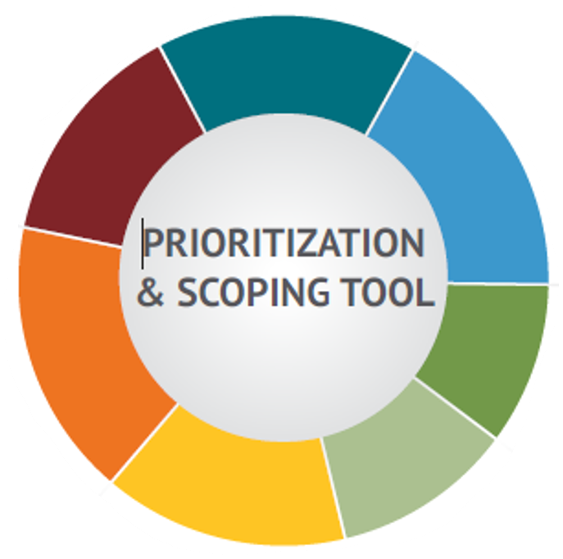
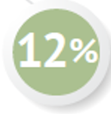
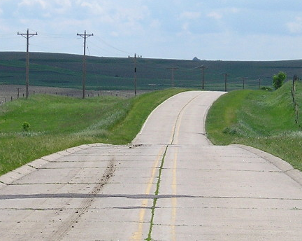
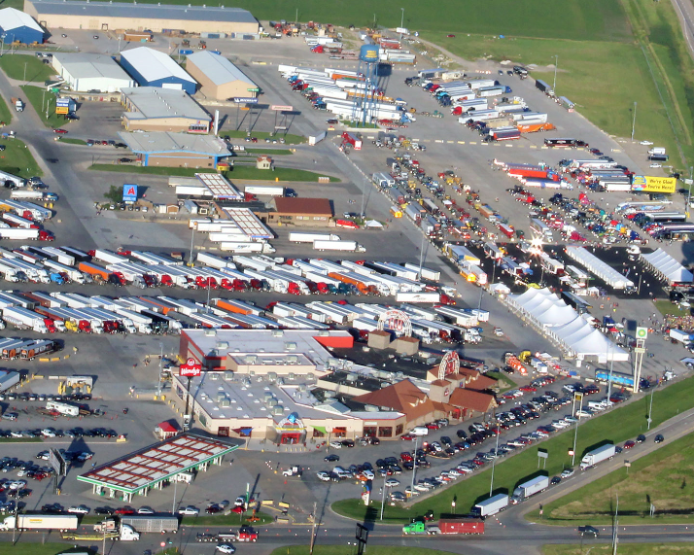
MOBILITY
Based on actual hours of delay when available, or when not available, the relationship between numbers of access points and traffic volumes.
TRAFFIC
A measure of the volume of traffic that each road is carrying in comparison to what it can carry.
14%
SAFETY
Weighted average crash rate from intersection to intersection giving more criticality to fatal and injury crashes.
15%
18%
BRIDGE
ROADWAY CLASS
Bridge condition index, which includes age, load capacity, traffic count, and a few other factors.
15%
10%
Projects inclusion on important Iowa networks like the CIN.
12%
16%
PAVEMENT
FREIGHT
Overall condition of the pavement while also considering it’s smoothness and rideability.
Projects criticality to the statewide freight network. Lower score indicates greater criticality.
Notes:
We have a set of 7 criteria that are used to evaluate projects, these scores are then modified by the weighting factor to come up with a composite score. The composite scores are used as well as the scores for individual criteria in the evaluations of future projects. You have probably seen this graphic before, this was Brad Hofer’s baby, that I have adopted. I would like to go into a little explanation of the criteria and the weighting factors that you see here.

Slide 5
Based on actual hours of delay when available, or when not available, the relationship between numbers of access points and traffic volumes.
TRAFFIC
18%
A measure of the volume of traffic that each road is carrying in comparison to what it can carry.
14%
15%
BRIDGE
ROADWAY CLASS
Bridge condition index, which includes age, load capacity, traffic count, and a few other factors.
SAFETY
15%
10%
Projects inclusion on important Iowa networks like the CIN.
Weighted average crash rate from intersection to intersection giving more criticality to fatal and injury crashes.
12%
16%
PAVEMENT
FREIGHT
Overall condition of the pavement while also considering it’s smoothness and rideability.
Projects criticality to the statewide freight network. Lower score indicates greater criticality.
Notes:
Safety data is evaluated to determine its score based on the weighted average crash rates from intersection to intersection giving more weight to fatal and injury crashes

Slide 6
MOBILITY
Based on actual hours of delay when available, or when not available, the relationship between numbers of access points and traffic volumes.
TRAFFIC
A measure of the volume of traffic that each road is carrying in comparison to what it can carry.
14%
SAFETY
Weighted average crash rate from intersection to intersection giving more criticality to fatal and injury crashes.
15%
18%
BRIDGE
ROADWAY CLASS
Bridge condition index, which includes age, load capacity, traffic count, and a few other factors.
15%
10%
Projects inclusion on important Iowa networks like the CIN.
12%
16%
PAVEMENT
FREIGHT
Overall condition of the pavement while also considering it’s smoothness and rideability.
Projects criticality to the statewide freight network. Lower score indicates greater criticality.

Slide 7
MOBILITY
Based on actual hours of delay when available, or when not available, the relationship between numbers of access points and traffic volumes.
16%
TRAFFIC
A measure of the volume of traffic that each road is carrying in comparison to what it can carry.
14%
SAFETY
Weighted average crash rate from intersection to intersection giving more criticality to fatal and injury crashes.
15%
18%
PAVEMENT
BRIDGE
ROADWAY CLASS
Overall condition of the pavement while also considering it’s smoothness and rideability.
Bridge condition index, which includes age, load capacity, traffic count, and a few other factors.
15%
10%
Projects inclusion on important Iowa networks like the CIN.
12%
FREIGHT
Projects criticality to the statewide freight network. Lower score indicates greater criticality.
Notes:
Each section of pavement is evaluated to determine its score based on the pavement condition index, and adjustments based on smoothness and other factors.

Slide 8
MOBILITY
Based on actual hours of delay when available, or when not available, the relationship between numbers of access points and traffic volumes.
TRAFFIC
A measure of the volume of traffic that each road is carrying in comparison to what it can carry.
14%
SAFETY
Weighted average crash rate from intersection to intersection giving more criticality to fatal and injury crashes.
15%
18%
BRIDGE
ROADWAY CLASS
Bridge condition index, which includes age, load capacity, traffic count, and a few other factors.
15%
10%
Projects inclusion on important Iowa networks like the CIN.
12%
16%
PAVEMENT
FREIGHT
Overall condition of the pavement while also considering it’s smoothness and rideability.
Projects criticality to the statewide freight network. Lower score indicates greater criticality.

Slide 9
MOBILITY
Based on actual hours of delay when available, or when not available, the relationship between numbers of access points and traffic volumes.
15%
14%
SAFETY
Weighted average crash rate from intersection to intersection giving more criticality to fatal and injury crashes.
18%
BRIDGE
ROADWAY CLASS
TRAFFIC
Bridge condition index, which includes age, load capacity, traffic count, and a few other factors.
15%
10%
Projects inclusion on important Iowa networks like the CIN.
A measure of the volume of traffic that each road is carrying in comparison to what it can carry.
12%
16%
PAVEMENT
FREIGHT
Overall condition of the pavement while also considering it’s smoothness and rideability.
Projects criticality to the statewide freight network. Lower score indicates greater criticality.
Notes:
Each Segment of traffic data is evaluated to determine its score based on the desired level of service (LOS) for the road section.

Slide 10
MOBILITY
Based on actual hours of delay when available, or when not available, the relationship between numbers of access points and traffic volumes.
TRAFFIC
A measure of the volume of traffic that each road is carrying in comparison to what it can carry.
14%
SAFETY
Weighted average crash rate from intersection to intersection giving more criticality to fatal and injury crashes.
15%
18%
BRIDGE
ROADWAY CLASS
Bridge condition index, which includes age, load capacity, traffic count, and a few other factors.
15%
10%
Projects inclusion on important Iowa networks like the CIN.
12%
16%
PAVEMENT
FREIGHT
Overall condition of the pavement while also considering it’s smoothness and rideability.
Projects criticality to the statewide freight network. Lower score indicates greater criticality.

Slide 11
MOBILITY
Based on actual hours of delay when available, or when not available, the relationship between numbers of access points and traffic volumes.
TRAFFIC
A measure of the volume of traffic that each road is carrying in comparison to what it can carry.
14%
SAFETY
Weighted average crash rate from intersection to intersection giving more criticality to fatal and injury crashes.
15%
15%
18%
ROADWAY CLASS
10%
Projects inclusion on important Iowa networks like the CIN.
BRIDGE
Bridge condition index, which includes age, load capacity, traffic count, and a few other factors.
12%
16%
PAVEMENT
FREIGHT
Overall condition of the pavement while also considering it’s smoothness and rideability.
Projects criticality to the statewide freight network. Lower score indicates greater criticality.
Notes:
Each bridge if evaluated to determine its score based on condition, age, and deck area. Thresholds for poor conditions or very old age are also identified.

Slide 12
MOBILITY
Based on actual hours of delay when available, or when not available, the relationship between numbers of access points and traffic volumes.
TRAFFIC
A measure of the volume of traffic that each road is carrying in comparison to what it can carry.
14%
SAFETY
Weighted average crash rate from intersection to intersection giving more criticality to fatal and injury crashes.
15%
18%
BRIDGE
ROADWAY CLASS
Bridge condition index, which includes age, load capacity, traffic count, and a few other factors.
15%
10%
Projects inclusion on important Iowa networks like the CIN.
12%
16%
PAVEMENT
FREIGHT
Overall condition of the pavement while also considering it’s smoothness and rideability.
Projects criticality to the statewide freight network. Lower score indicates greater criticality.

Slide 13
TRAFFIC
A measure of the volume of traffic that each road is carrying in comparison to what it can carry.
SAFETY
14%
Weighted average crash rate from intersection to intersection giving more criticality to fatal and injury crashes.
15%
18%
BRIDGE
ROADWAY CLASS
Bridge condition index, which includes age, load capacity, traffic count, and a few other factors.
15%
10%
MOBILITY
Projects inclusion on important Iowa networks like the CIN.
Based on actual hours of delay when available, or when not available, the relationship between numbers of access points and traffic volumes.
12%
16%
PAVEMENT
FREIGHT
Overall condition of the pavement while also considering it’s smoothness and rideability.
Projects criticality to the statewide freight network. Lower score indicates greater criticality.
Notes:
The mobility score is a measure of how efficiently traffic moves within the project area. The score is derived by evaluating accessibility, cross road density, real time and historical delays, and traffic incidents within the project area

Slide 14
MOBILITY
Based on actual hours of delay when available, or when not available, the relationship between numbers of access points and traffic volumes.
TRAFFIC
A measure of the volume of traffic that each road is carrying in comparison to what it can carry.
14%
SAFETY
Weighted average crash rate from intersection to intersection giving more criticality to fatal and injury crashes.
15%
18%
BRIDGE
ROADWAY CLASS
Bridge condition index, which includes age, load capacity, traffic count, and a few other factors.
15%
10%
Projects inclusion on important Iowa networks like the CIN.
12%
16%
PAVEMENT
FREIGHT
Overall condition of the pavement while also considering it’s smoothness and rideability.
Projects criticality to the statewide freight network. Lower score indicates greater criticality.

Slide 15
MOBILITY
Based on actual hours of delay when available, or when not available, the relationship between numbers of access points and traffic volumes.
TRAFFIC
A measure of the volume of traffic that each road is carrying in comparison to what it can carry.
14%
SAFETY
12%
Weighted average crash rate from intersection to intersection giving more criticality to fatal and injury crashes.
15%
18%
BRIDGE
ROADWAY CLASS
Bridge condition index, which includes age, load capacity, traffic count, and a few other factors.
15%
10%
FREIGHT
Projects inclusion on important Iowa networks like the CIN.
Projects criticality to the statewide freight network. Lower score indicates greater criticality.
16%
PAVEMENT
Overall condition of the pavement while also considering it’s smoothness and rideability.
Notes:
Each project is assigned a freight score based on the percentage of freight traffic and proximity to bottlenecks.

Slide 16
MOBILITY
Based on actual hours of delay when available, or when not available, the relationship between numbers of access points and traffic volumes.
TRAFFIC
A measure of the volume of traffic that each road is carrying in comparison to what it can carry.
14%
SAFETY
Weighted average crash rate from intersection to intersection giving more criticality to fatal and injury crashes.
15%
18%
BRIDGE
ROADWAY CLASS
Bridge condition index, which includes age, load capacity, traffic count, and a few other factors.
15%
10%
Projects inclusion on important Iowa networks like the CIN.
12%
16%
PAVEMENT
FREIGHT
Overall condition of the pavement while also considering it’s smoothness and rideability.
Projects criticality to the statewide freight network. Lower score indicates greater criticality.

Slide 17
MOBILITY
Based on actual hours of delay when available, or when not available, the relationship between numbers of access points and traffic volumes.
TRAFFIC
A measure of the volume of traffic that each road is carrying in comparison to what it can carry.
14%
SAFETY
Weighted average crash rate from intersection to intersection giving more criticality to fatal and injury crashes.
10%
15%
18%
BRIDGE
Bridge condition index, which includes age, load capacity, traffic count, and a few other factors.
15%
ROADWAY CLASS
12%
16%
Projects inclusion on important Iowa networks like the CIN.
PAVEMENT
FREIGHT
Overall condition of the pavement while also considering it’s smoothness and rideability.
Projects criticality to the statewide freight network. Lower score indicates greater criticality.
Notes:
The Road classification score indicates a road’s importance in the overall system. Scoring is based on the commercial/Industrial Network (CIN) and the Federal Functional Class of the roadway

Slide 18
MOBILITY
Based on actual hours of delay when available, or when not available, the relationship between numbers of access points and traffic volumes.
TRAFFIC
A measure of the volume of traffic that each road is carrying in comparison to what it can carry.
14%
SAFETY
Weighted average crash rate from intersection to intersection giving more criticality to fatal and injury crashes.
15%
18%
BRIDGE
ROADWAY CLASS
Bridge condition index, which includes age, load capacity, traffic count, and a few other factors.
15%
10%
Projects inclusion on important Iowa networks like the CIN.
12%
16%
PAVEMENT
FREIGHT
Overall condition of the pavement while also considering it’s smoothness and rideability.
Projects criticality to the statewide freight network. Lower score indicates greater criticality.
Notes:
So we end up back here with the tool criteria and the weights that each one has in the composite score. So where do these percentages come from?

Slide 19
How do we set the Criteria Weighting?
DOT staff 2018
17%
15%
14%
17%
16%
11%
10%
SAFETY
PAVEMENT
TRAFFIC
BRIDGE
MOBILITY
FREIGHT
ROADWAY CLASS
Notes:
In other words how do we set the Criteria Weighting? In 2018 DOT staff had an extensive workshop to establish weights. All major functional DOT groups were represented and the results are the percentages shown.

Slide 20
Commissioners 2018
18%
16%
15%
15%
14%
12%
10%
SAFETY
PAVEMENT
TRAFFIC
BRIDGE
MOBILITY
FREIGHT
ROADWAY CLASS
DOT staff 2018
17%
15%
14%
17%
16%
11%
10%
SAFETY
PAVEMENT
TRAFFIC
BRIDGE
MOBILITY
FREIGHT
ROADWAY CLASS
Notes:
IN 2018, Commissioners attended a workshop to determine the criteria weights. and resulting weightings were very similar to the DOT staff weightings and all were within 2% and 5 of the 7 were within 1%. So there was a general consensus on the weight each criteria should have.

Slide 21
Commissioners 2020
18%
16%
15%
15%
14%
12%
10%
SAFETY
PAVEMENT
TRAFFIC
BRIDGE
MOBILITY
FREIGHT
ROADWAY CLASS
Commissioners 2018
18%
16%
15%
15%
14%
12%
10%
SAFETY
PAVEMENT
TRAFFIC
BRIDGE
MOBILITY
FREIGHT
ROADWAY CLASS
DOT staff 2018
17%
15%
14%
17%
16%
11%
10%
SAFETY
PAVEMENT
TRAFFIC
BRIDGE
MOBILITY
FREIGHT
ROADWAY CLASS
Notes:
Early in 2020 the commissioners were again asked to weigh the criteria and the completely independent results were identical to the earlier commission numbers. So we have 3 different rankings and resulting weightings of the criteria are very consistent.

Slide 22
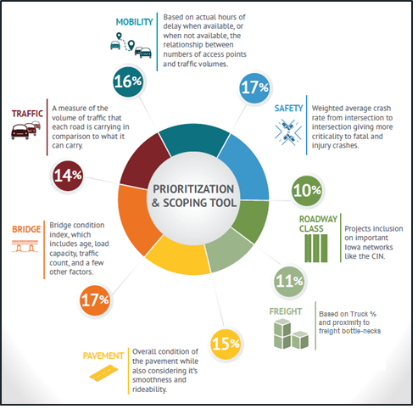
Current criteria that correlate to economic development and growth
Freight
Traffic
Mobility
Road Class
Notes:
People want to consider Economic growth and development when evaluating where to invest in the transportation system. Several of the criteria we use for project evaluation do correlate with economic growth. They do tend to be lagging indicators, for example, as an area develops and traffic counts increase the Traffic criteria will indicate increasing infrastructure needs after the growth. Another example is a low freight score resulting from high truck traffic and bottlenecks that may be a hinderance to growth but improving the Freight score for particular roads by investing in improvements may or may not lead to economic development and growth. All of the criteria have some relationship to ED&G but the 4 identified have a higher correlation to ED&G, those 4 are Freight, Traffic, Mobility, and Road Class.

Slide 23
Correlating Data Relationships
ECONOMIC DEVELOPMENT
TRANSPORTATION
INDICATORS
Population growth
Presence of an educated workforce
Proximity to markets
Community and county interlinkages
Local economic development policies
Amenities
Traffic
Freight
Mobility
Road Class
Notes:
This graphic helps to show that criteria like population growth, Workforce quality, Local economic development policies are considered factors and can be Leading Indicators of ED&G. The transportation sector can have impacts on development but rarely is a driver.

Slide 24
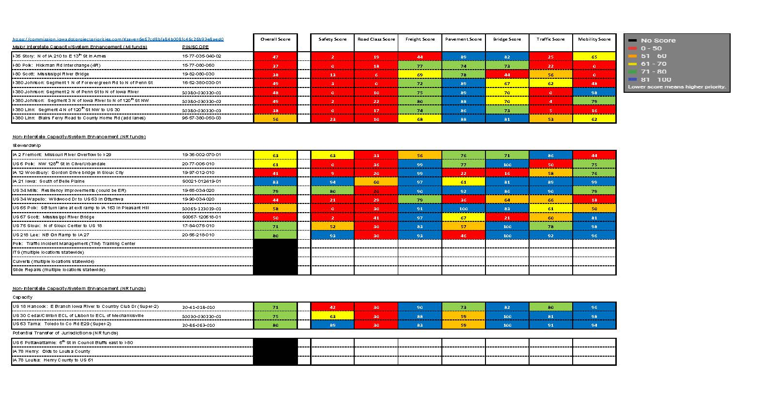
Notes:
The goal of the criteria and weightings are reports that can be used to compare projects on a data driven empirical basis and be a guide for projects to include in future programs.

Slide 25
Notes:
These tables clearly show the overall scores and what the data indicated reasons for those scores are in relation to the individual criteria.

Slide 26
Statewide map
Notes:
So here we are back at the map with all of these projects that are ranked and can be evaluated based on criteria that are weighted to give us a data driven ranking through the prioritization of factors that are deemed the most important. So our tool is on part of the process to achieve the best Transportation Asset Management within the limits of our budget.

Slide 27
Statewide map
Notes:
Charlie will now address the use of the tool in our decision process and our project prioritization process.

Slide 28
Project Prioritization Process
Good fit?
(level of need based on prioritization score)
Chartered projects from the Project Prioritization Tool
Good value?
(return on investment)
When can we deliver?
(funding availability and development lead time)
Projects recommended for programming

Slide 29
BRYAN BRADLEY
LOCATION ENGINEER / ASSISTANT OFFICE DIRECTOR
LOCATION & ENVIRONMENT BUREAU
Bryan.bradley@iowadot.us
Office: 515-239-1787
QUESTIONS ???

