Slide 1
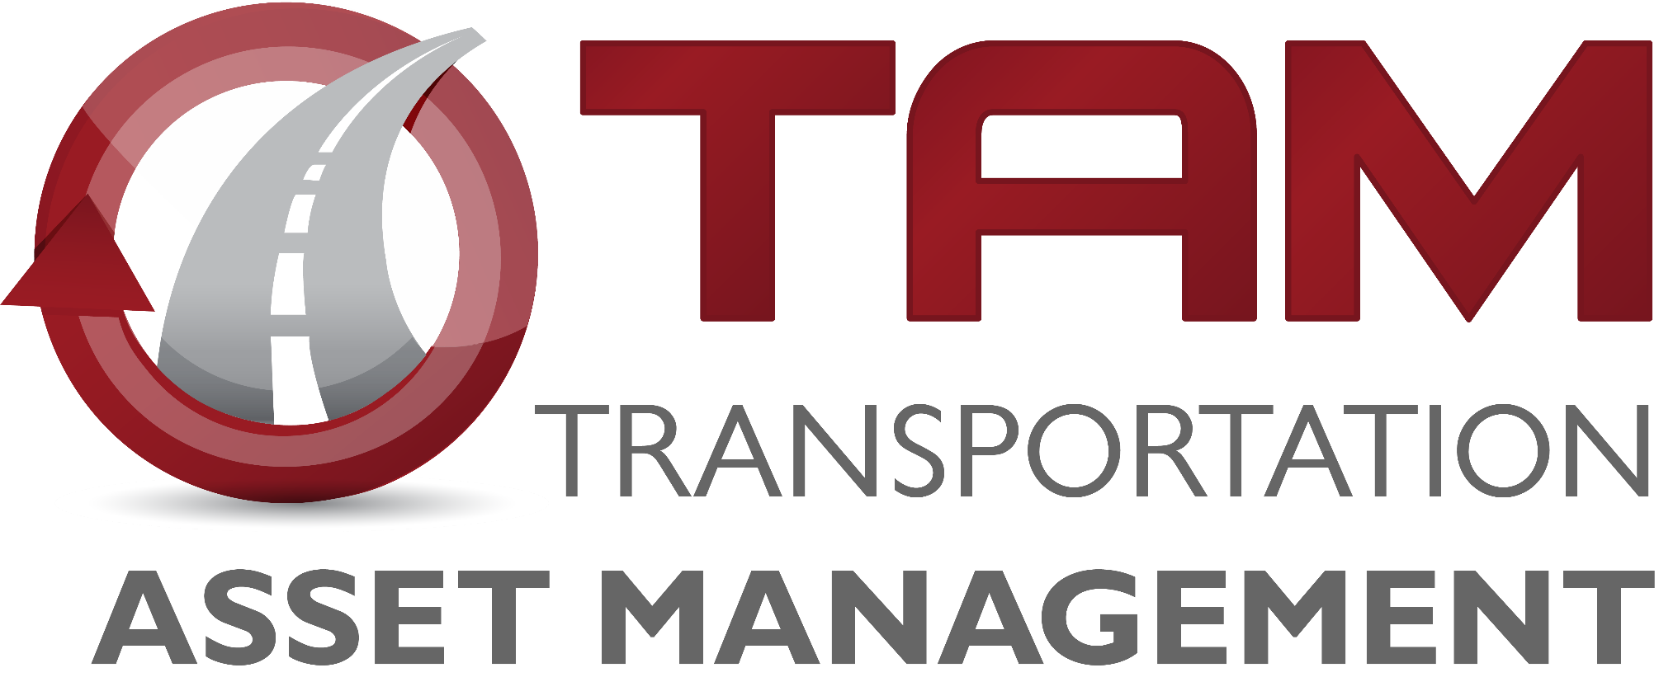
Iowa Interstate Investment Plan
2040
I
P
3
Commission Update
December 8, 2020
Phil Mescher
Project Management Bureau

Slide 2
Goal for Today:
Iowa Interstate Investment Plan for 2040
Iowa Interstate Investment Plan
2040
I
P
A fiscally-constrained plan to address all Interstate system needs through the year 2040.
3
Review Reason for the Plan
Overview of Plan Development
Present Goals and Strategies of the Interstate Plan
Gain feedback from the Commission
No Formal Actions

Slide 3
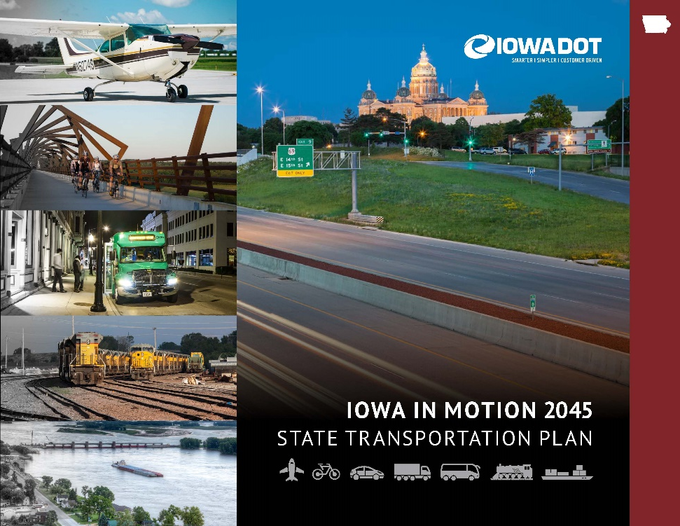
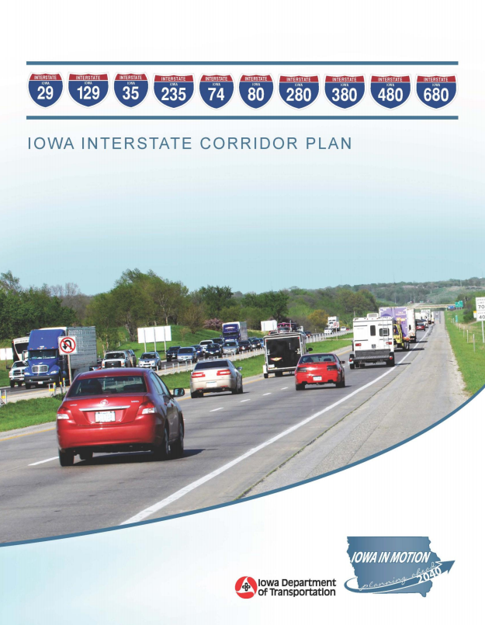
Planning Efforts Highlight that Transportation Needs Exceed Funding
I-80 PEL alone calls for ¾ Interstate Funds to complete VISION by 2040.
With the option of tolling eliminated, the PEL concludes:
Based on current funding limitations, these assumptions are likely untenable in the long term

Slide 4
Genesis of the I3P-2040
Desire to develop a “Plan for Every Section”
Need to be fiscally constrained
$330 million – ½ of the annual program identified for the Interstate System
How to “right size” the interstate system?
How to get the biggest return on investment?
How to account for an uncertain future?
Connected/Autonomous Vehicles
Funding Availability
Construction Costs
Process: Leverage data and collective wisdom of the Iowa DOT to develop a new plan
Charette Workshop (Summer 2018)
Develop Plan
Implementation & monitoring
Revision of Priorities

Slide 5
Charette Workshop
Stewardship - Focus should be on preservation to maintain state of good repair.
$80m of pavement stewardship was included each year
Widening Options – Take advantage of good pavement.
Limit Adding Capacity - Some areas are not warranted for additional capacity by 2040.
Delay with Technology - Expansion projects in urban corridors will be limited and focus on technology solutions and other management strategies first

Slide 6
Initial Plan Result

Slide 7
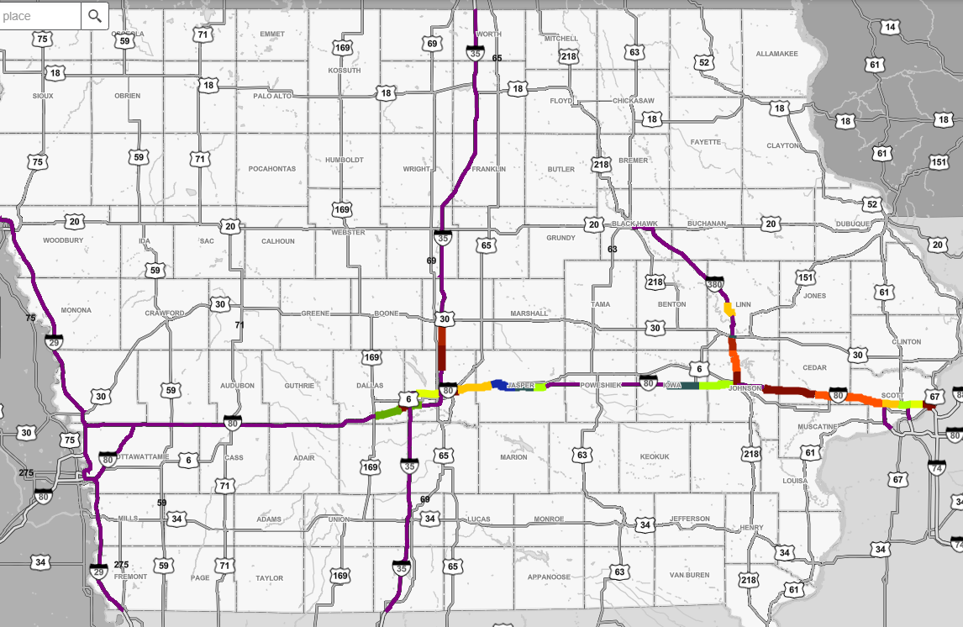
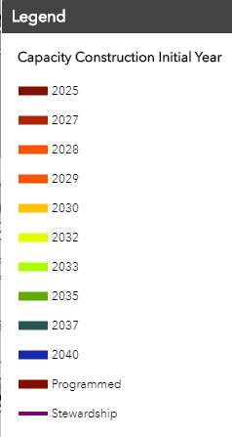
Initial Plan in Place

Slide 8
I3P Annual Update – 2021 to 2025 Highway Program
Despite Tight I3P Budgets for Capacity Projects – the 5-Year Program Cannot Fund All Interstate Projects within the Plan Horizon
Prioritization Choices Should be Data Driven
Project Prioritization Tool - Utilize Traffic and Mobility Data to Assist in Determining Project Priorities
2021 - 2025 Program Changes
Scaled back I-80 Cedar County to focus on Sugar Creek bridges
Added I-80 Dallas County west of Des Moines
Although a priority, there was not capacity to add I-380 Penn Street interchange

Slide 9
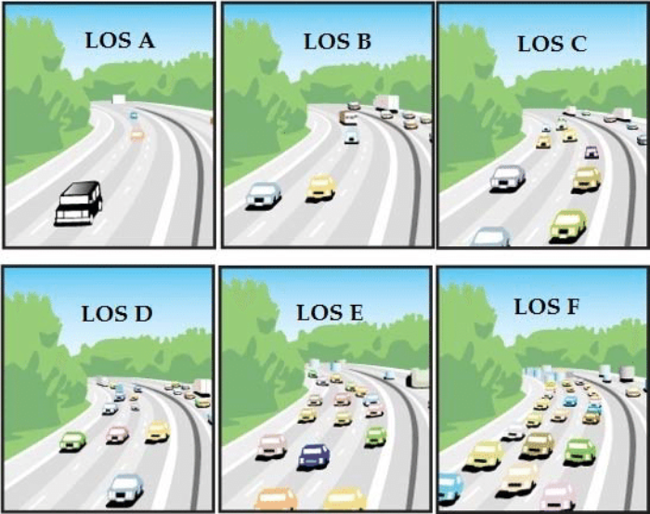
Traffic Drives Need for Capacity
How do we measure this?
Traffic Score
Traffic Volume
Accounts for Trucks
Roadway Capacity
Level of Service
Metric of Traffic Flow
Measure of Driver Comfort
Mobility
Traffic Delay, Incidents and Bottlenecks
These Metrics Help Determine Relative Need while Additional Analysis Helps to Determine Appropriate Solutions

Slide 10
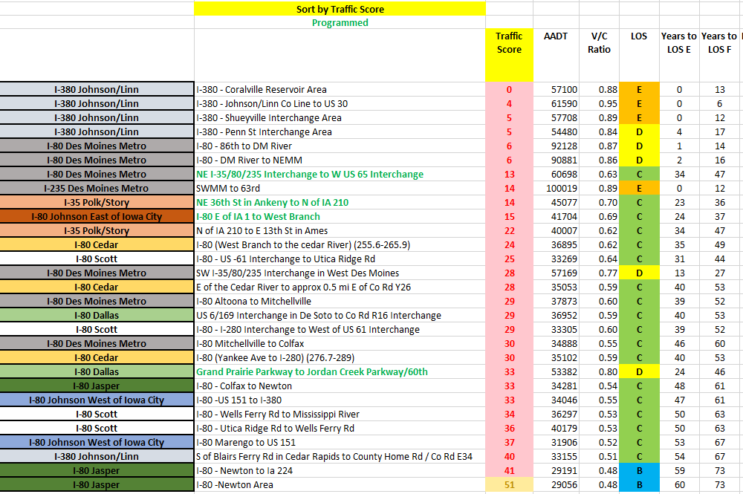
I3P Segment Scoping Tool Scores (Ranked by Traffic Score)

Slide 11
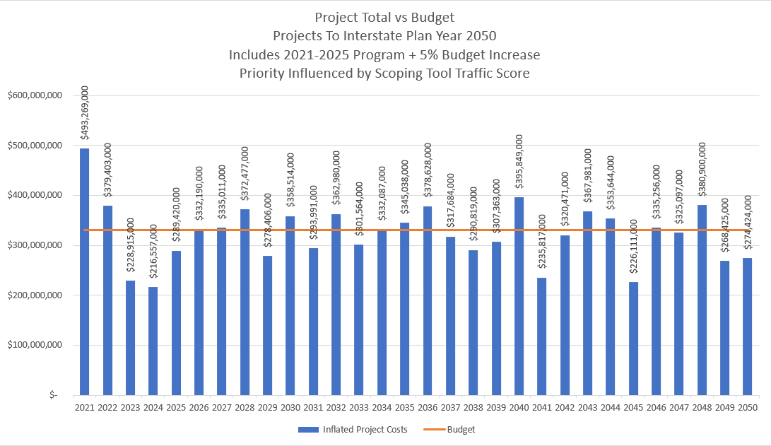
Where We Are Now

Slide 12
Next Steps
Continue Plan Update with Guidance from the Interstate Plan Advisory Team
Prioritize Projects Through a Plan Horizon of 2050
Take into account Traffic Score & LOS Information
Utilize Mobility Information
Consideration of Integrated Corridor Management Techniques in the Urban Areas
Incorporate Infrastructure Condition into the Evaluation
Choose Addition of Lanes only after all other Solutions are Exhausted
Recommendations to Commission in March of 2021
As part of 5-year program development

Slide 13
Questions?
Phil Mescher
Project Management Bureau

