Slide 1
COVID-19 Transportation Funding Impact Update
Transportation Commission Workshop
December 8, 2020

Slide 2
Update
Economic Recovery Index
Travel trends
US total rail carloads
Commercial air service passenger counts
Vehicular traffic
Vehicle sales
Funding
State Road Use Tax Fund
Federal funding update

Slide 3
Moody’s/CNN Recovery Index (Pre-Pandemic = 100)
https://www.cnn.com/business/us-economic-recovery-coronavirus

Slide 4
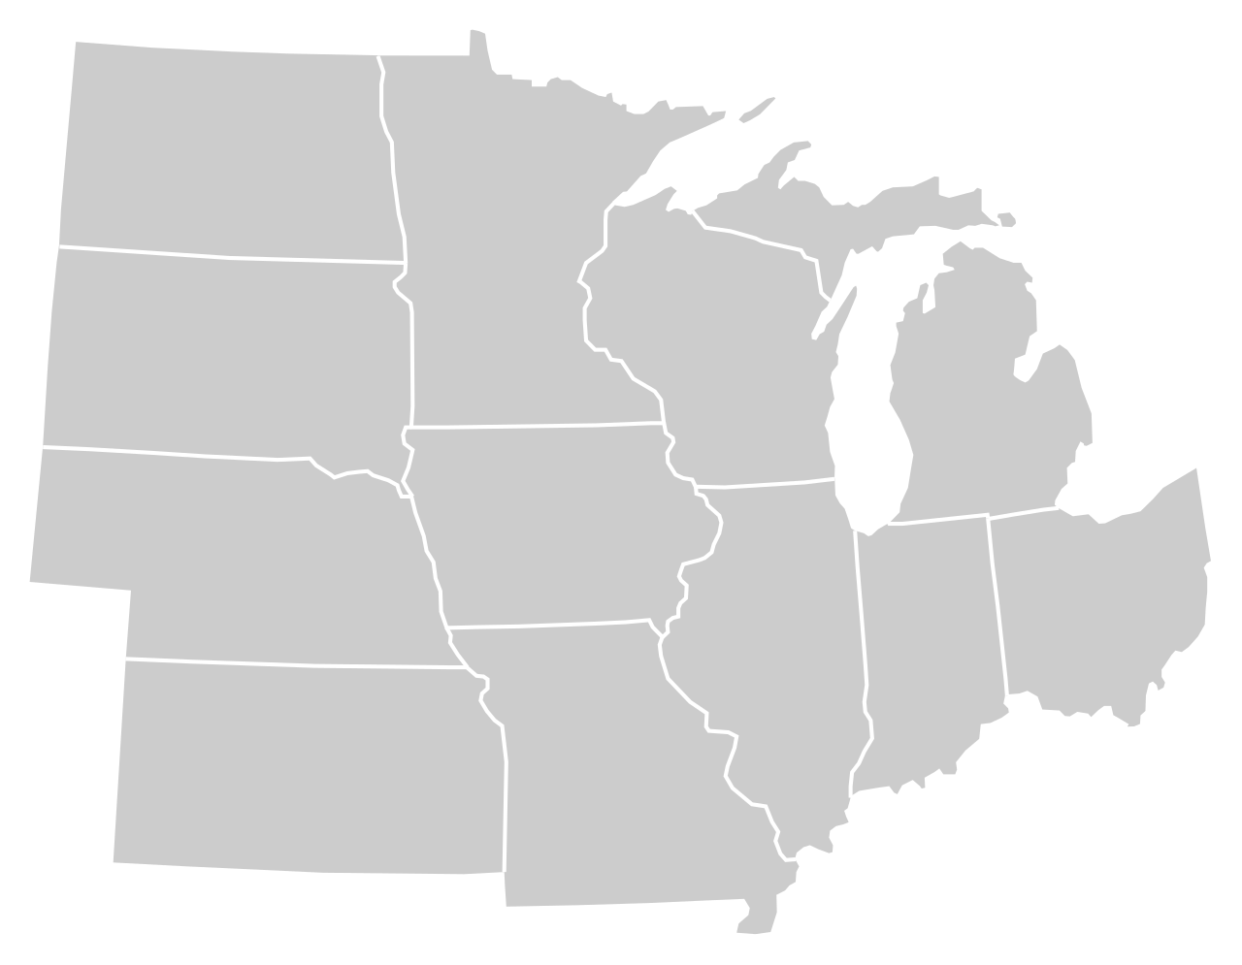
Moody’s/CNN Recovery Index - Midwest (Pre-Pandemic = 100) As of 12/2/2020
74%
69%
86%
78%
73%
81%
85%
81%
67%
80%
78%
81%
Nation is at 79%

Slide 6
Monthly Passenger Counts at Iowa’s Eight Commercial Service Airports
(through October 2020)

Slide 7
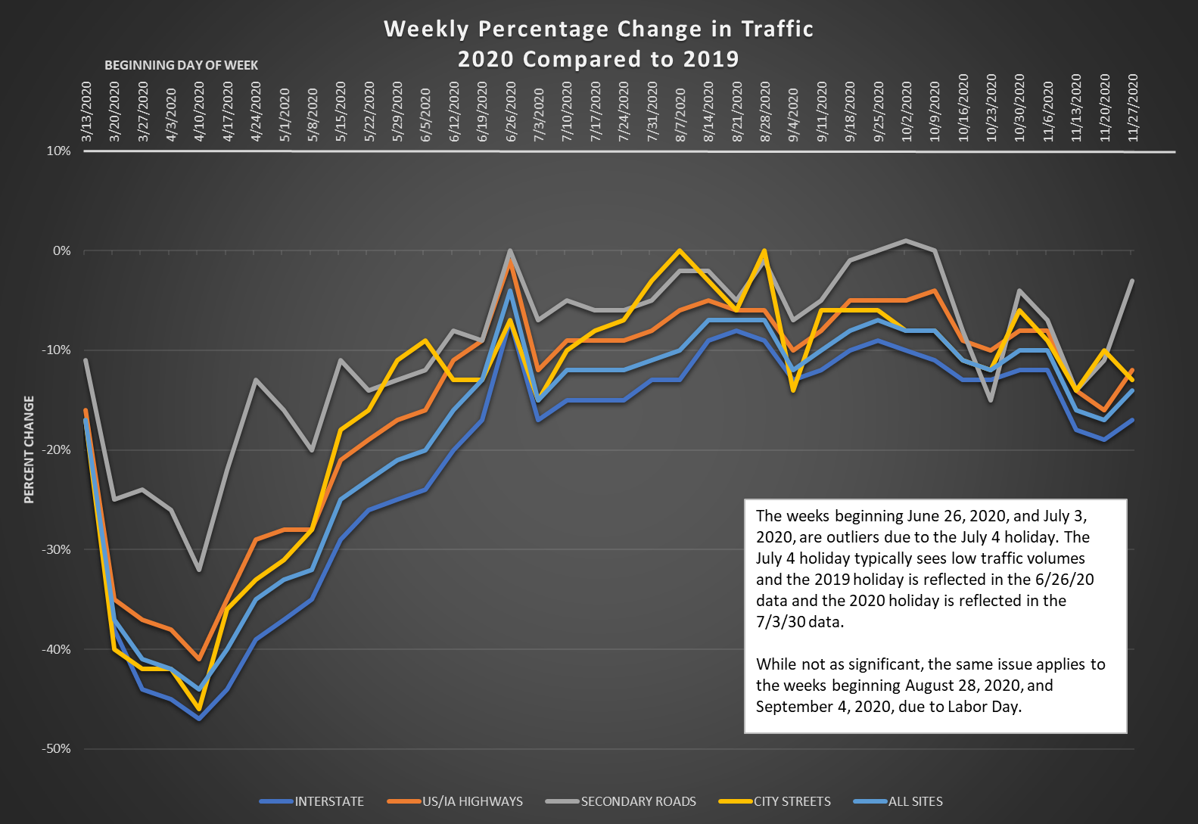

Slide 8
Road Use Tax Fund: COVID-19 Impacts
Funding sources
Fuel tax revenue
Traffic down over 40 percent in mid-April but has grown since then.
Traffic was at about 10 percent below 2019 levels for an extended period but now down around 15 percent during latest surge
Freight traffic has remained equivalent to 2019 or higher
Fee for New Registration revenue
Vehicle sales down over 50 percent in April but growing since then.
Vehicle prices have been increasing leading to generally no reduction in revenue from 2019 levels at this point.
Annual vehicle registration revenue down slightly
Was down very slightly early on – (Governor forgave late payment penalites)
Basically no COVID-19 impact at this time

Slide 9
Road Use Tax Fund: COVID-19 Impacts
Funding impacts
Overall, COVID-19 impacts have been significantly less than originally feared.
June 2020 through October 2020 (actual): -$40 million
November 2020 through June 2021 (estimated): - $10 million (this number would show a larger negative impact due to COVID-19; however, is partially offset due to a RUTF deposit timing issue in October)
Long-term – estimate revenue will be down 3.5 percent from our FY 21 forecast, primarily due to reduced travel for an extended time period

Slide 10
Federal Funding Update
Reauthorization
FAST Act extended one year through Sept. 30, 2021
$13.6 b transferred into Highway Trust Fund to ensure solvency through FFY 2021
FFY 2021 Appropriation
Continuing resolution through December 11.
Expect a one week extension through Dec. 18 and then a full year appropriation by Dec. 18
COVID-19 Relief Package
Status changes daily
Increasing chances of a bill by the end of Dec.
Could be attached to the full year appropriation
Unlikely to have dedicated state transportation funding but could include state aid that could go towards transportation.
Expect additional relief for airlines, airports, transit agencies, Amtrak, and private bus companies.

Slide 11
Questions?

