Slide 1
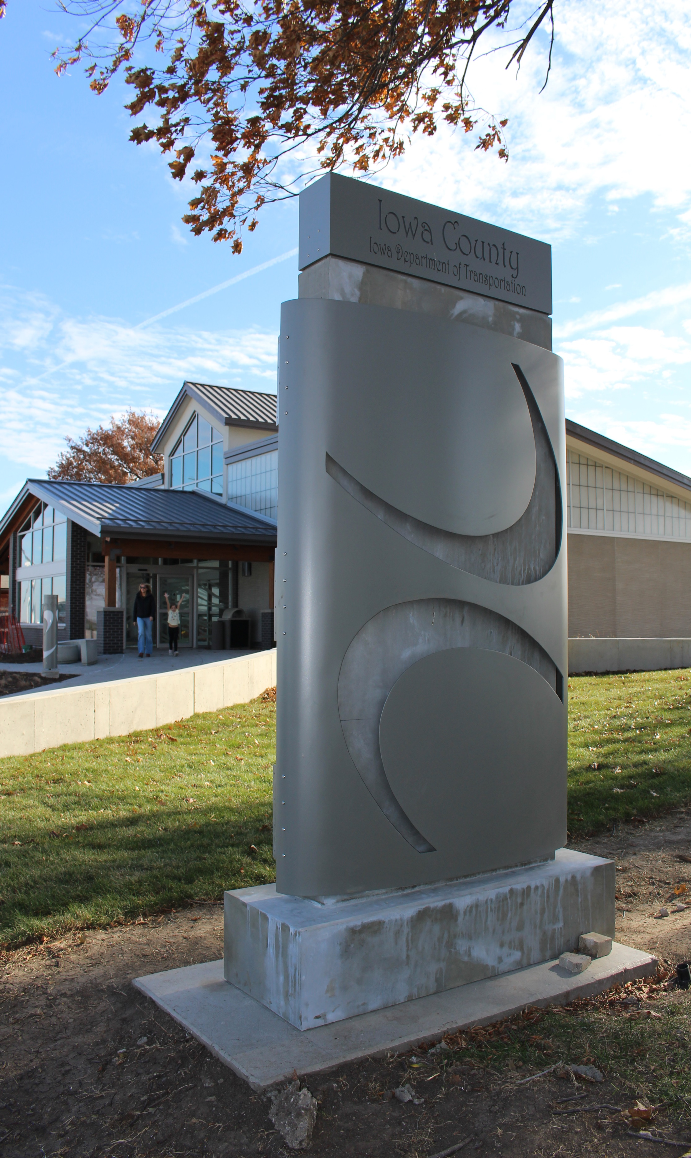
Victor Rest Area
I-80 Eastbound
Iowa County
Built 1967
Current truck parking: 22
Expanded truck parking: +13
Theme: Iowa, land between two rivers

Slide 2
Exterior Rendering of completed Rest Area

Slide 3
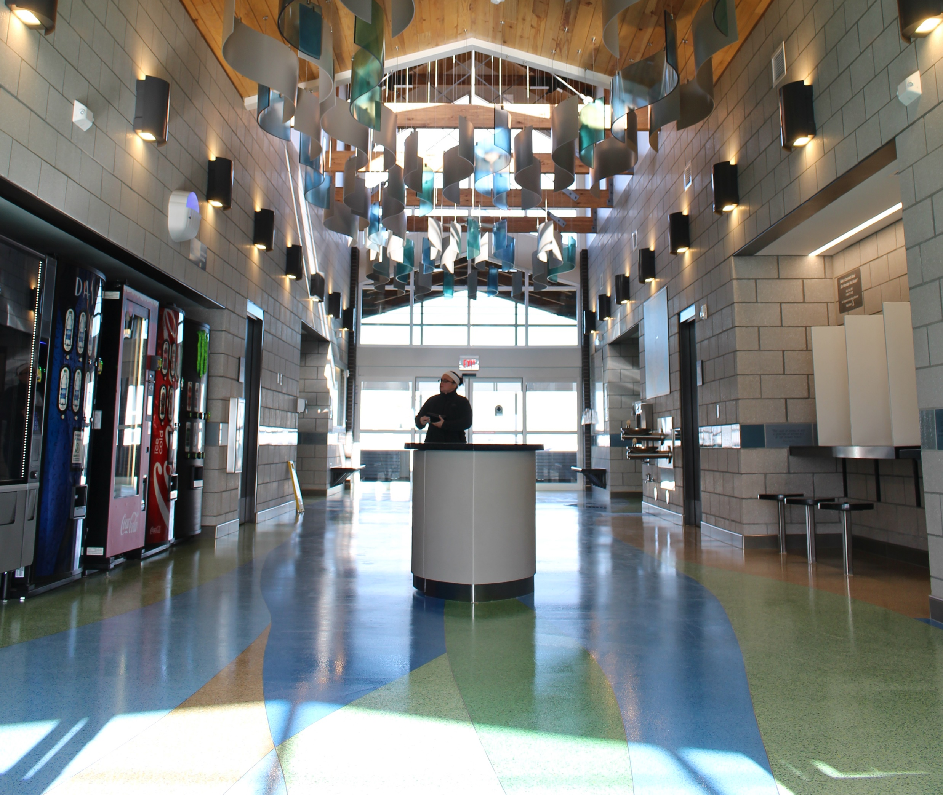
Interior of the Rest Area:
Showing the pattern on the floor and the ceiling tile that also follow the theme of the land between two rivers.

Slide 4
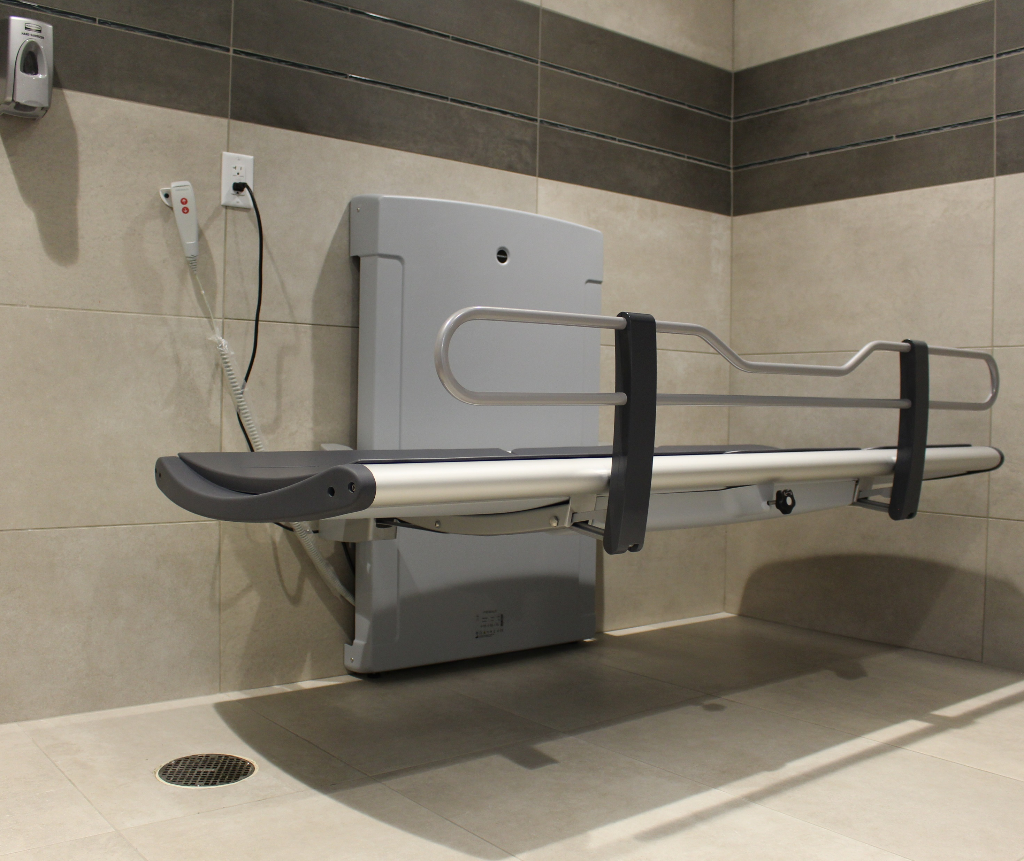
New Feature: Adult Changing Station:
We converted the Family Rest Room to accommodate and Adult Changing Station. The table is designed raise and lower to help those with limited mobility care for their personal needs when traveling

Slide 5
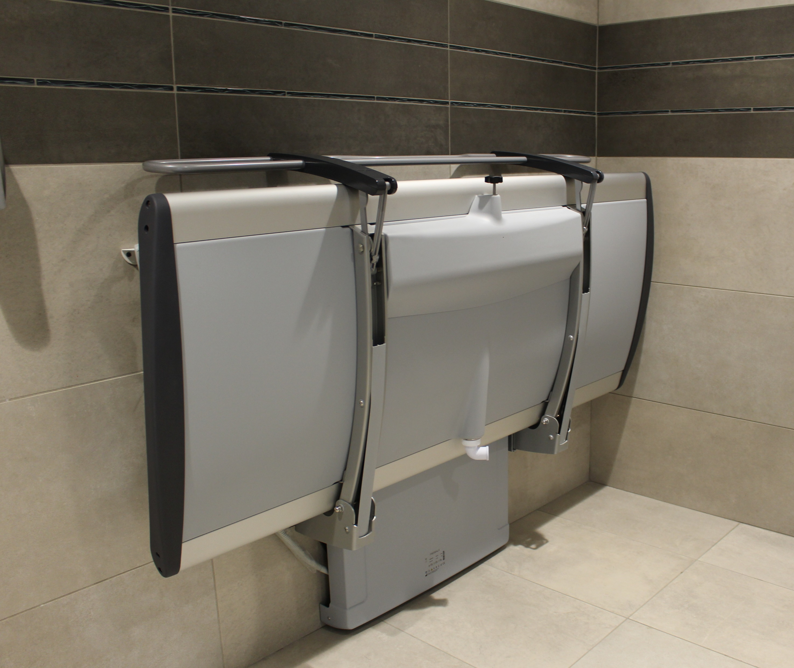
The table in its up position provides more space for other users

