Slide 1
Revitalize Iowa’s Sound Economy Program
Iowa Transportation Commission Business Meeting
December 14, 2021

Slide 2
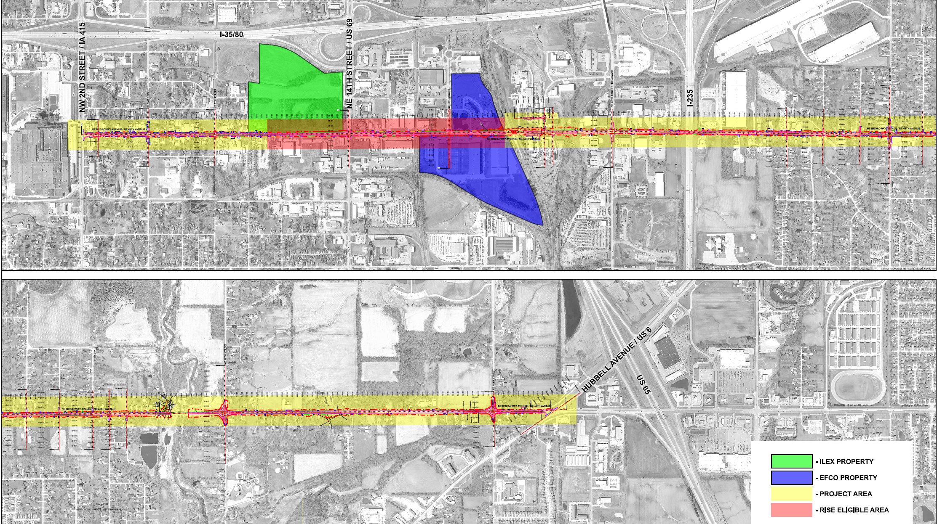
List of Local Development Applications Recommended
PROJECT NAME
SPONSOR
SCORE
TOTAL PROJECT COST
PERCENT PARTICIPATION
RECOMMENDED AMOUNT
Reconstruction of approximately 4,725 feet of NE Broadway Avenue located north of Des Moines. | Polk County | 43 | $8,216,658 | 50% | $4,108,329

Slide 3
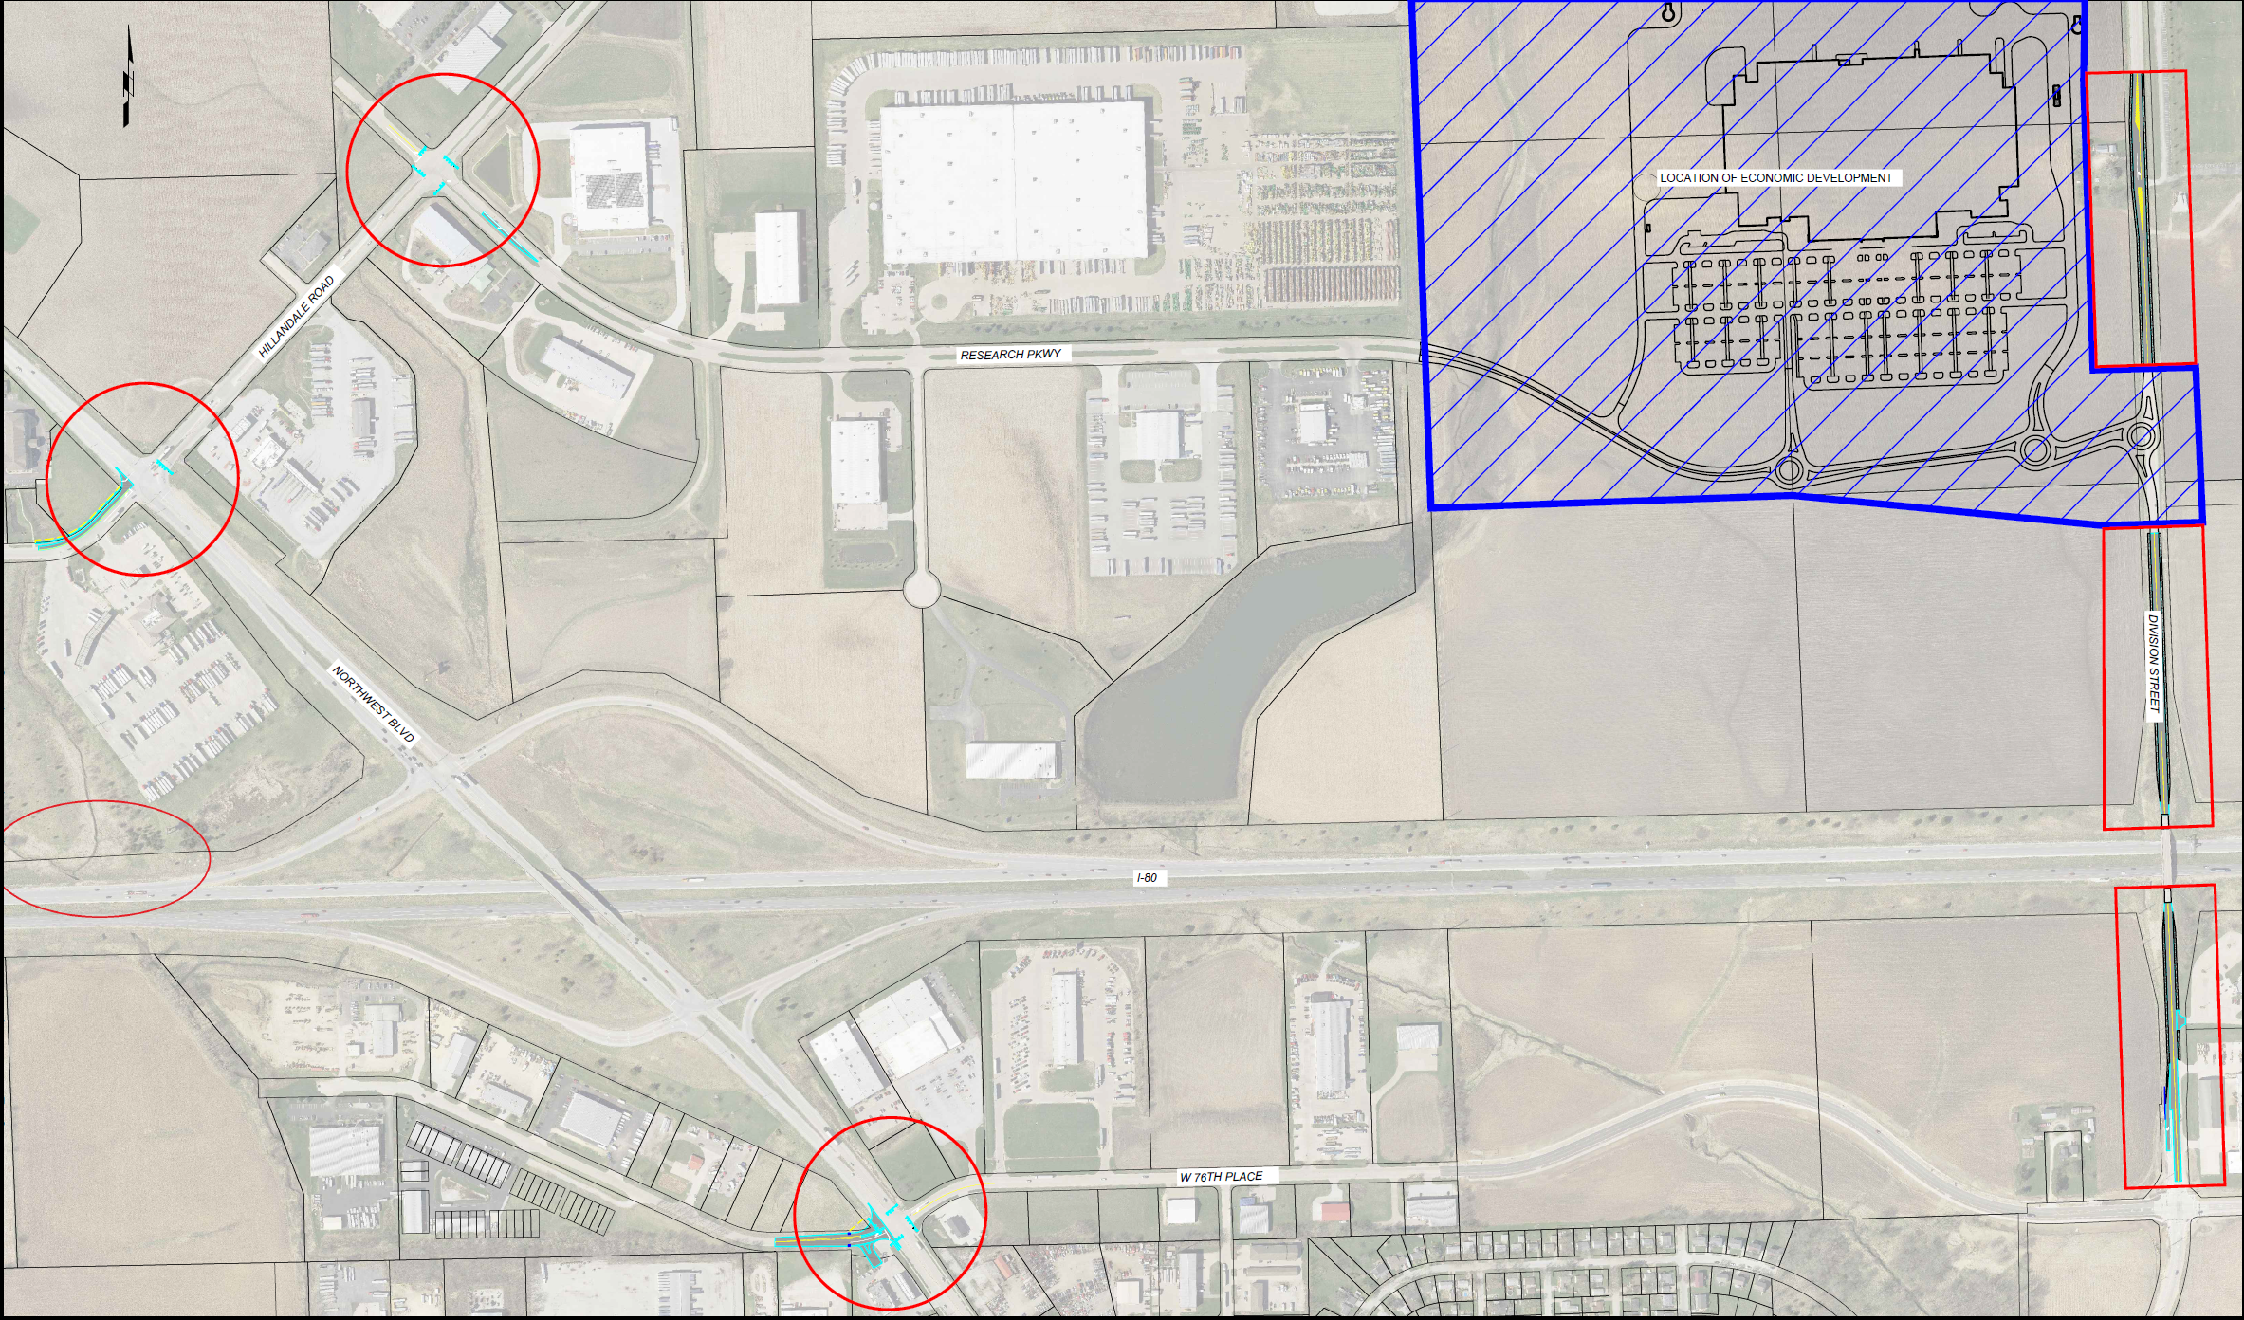
List of Local Development Applications Recommended
PROJECT NAME
SPONSOR
SCORE
TOTAL PROJECT COST
PERCENT PARTICIPATION
RECOMMENDED AMOUNT
Roadway improvements to Hillandale Road, Research Parkway, Northwest Boulevard, 76th Street, North Division Street and a 1,000-foot acceleration lane on the westbound I-80 on-ramp. | Davenport | 79 | $4,901,478 | 60% | $2,940,887

