Slide 1
COVID-19 Transportation Funding Impact
Transportation Commission Workshop
December 14, 2021

Slide 2
Update
Economic Recovery Index
Travel trends
US total rail carloads
Commercial air service passenger counts
Vehicular traffic
Infrastructure Bill Update and Overview

Slide 3
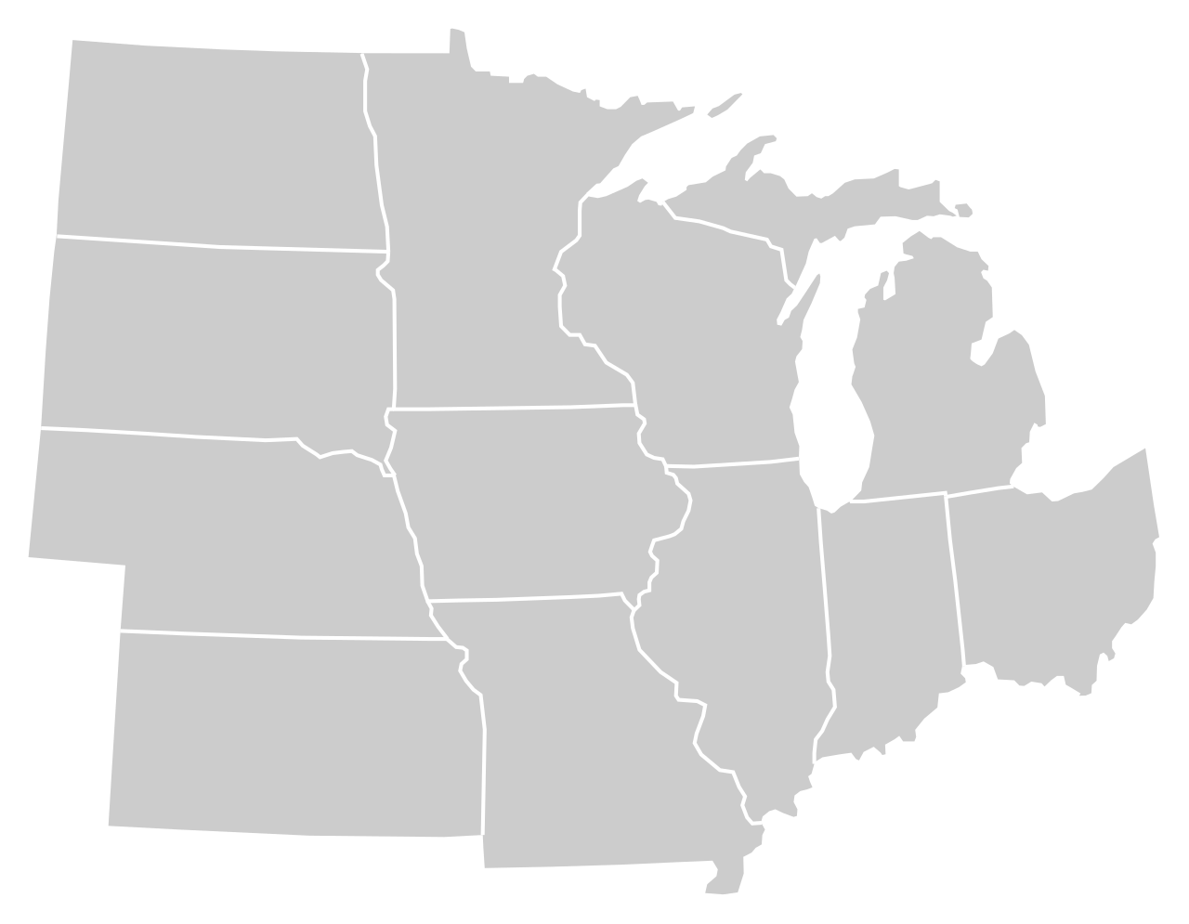
Moody’s/CNN Recovery Index - Midwest (Pre-Pandemic = 100) As of 12/3/2021
91%
90%
98%
90%
89%
93%
(99% last month)
94%
91%
84%
90%
92%
90%
Nation is at 90% (95% last month)

Slide 4
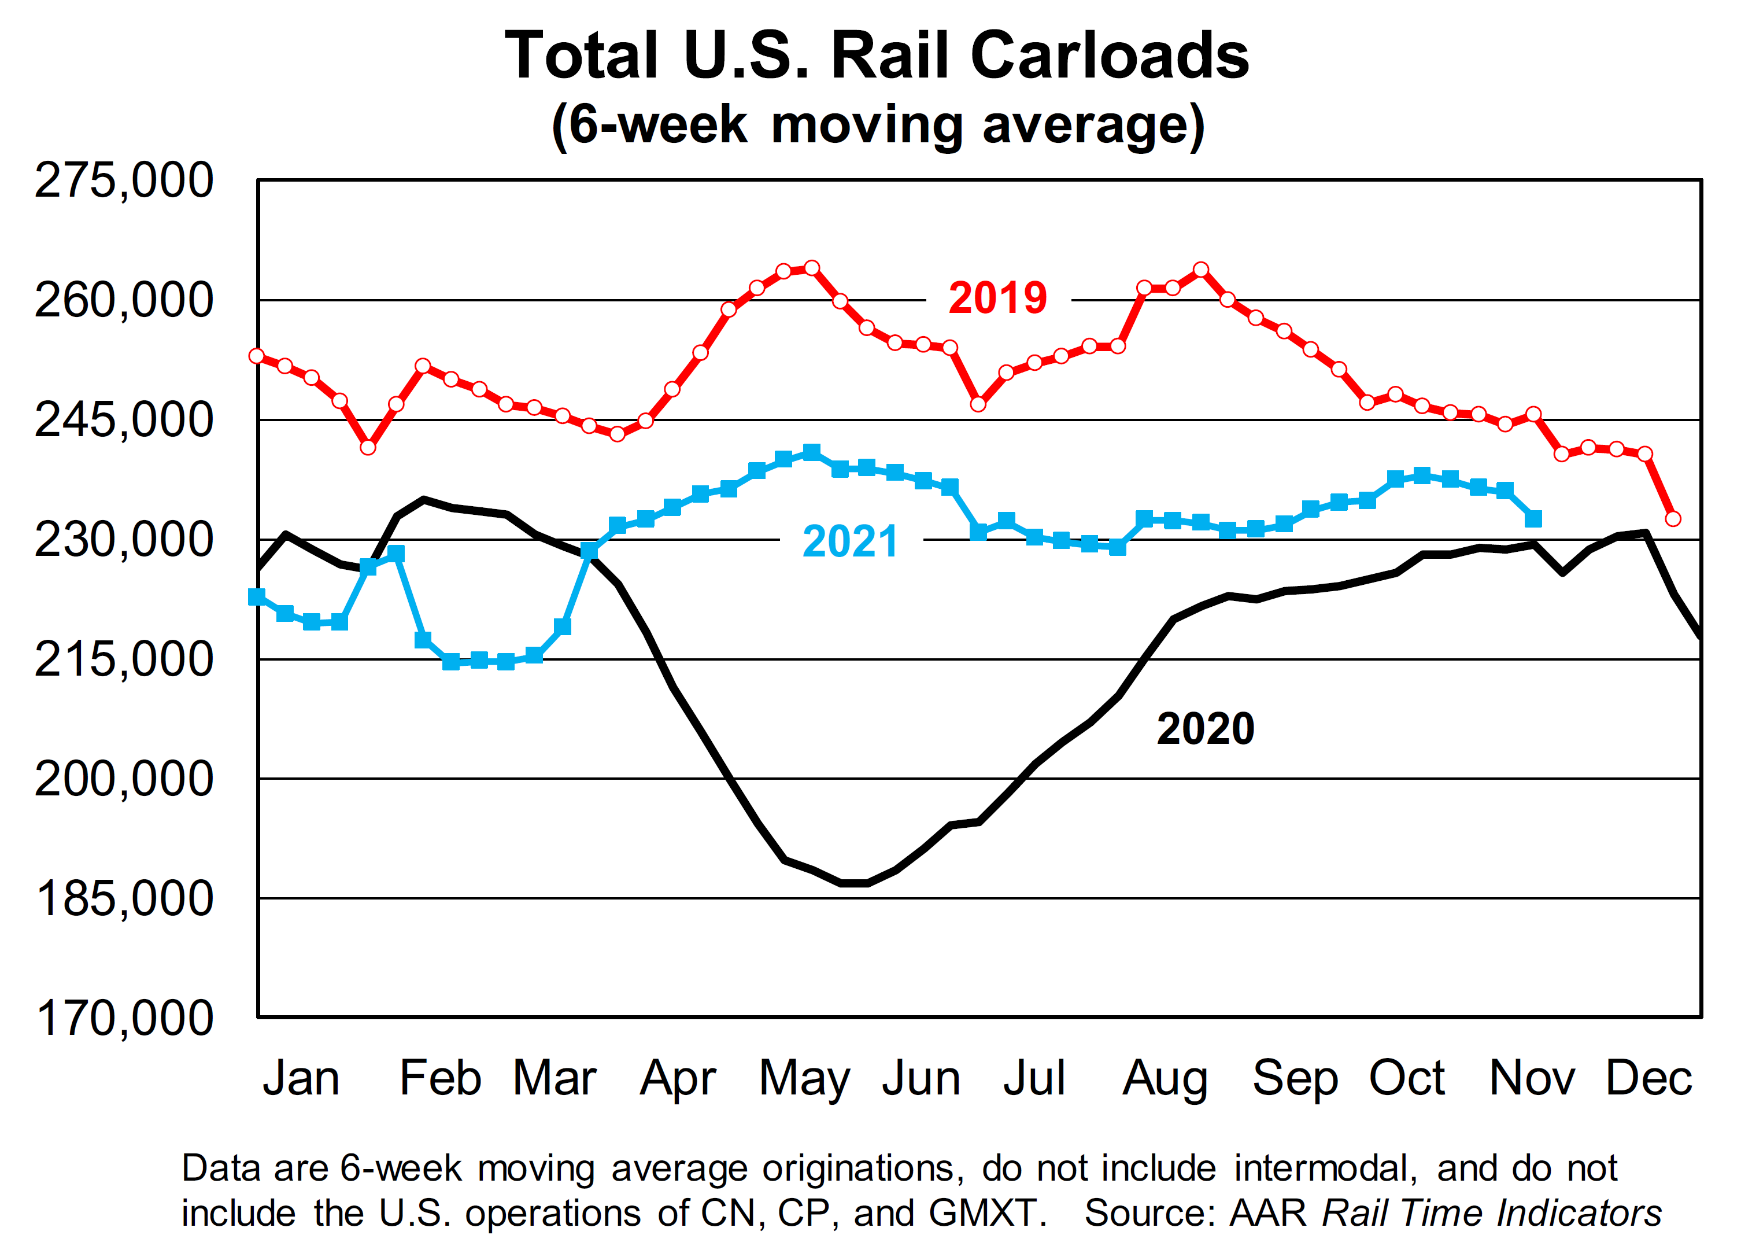

Slide 5
Monthly Passenger Counts at Iowa’s Eight Commercial Service Airports
(through October 2021)

Slide 6
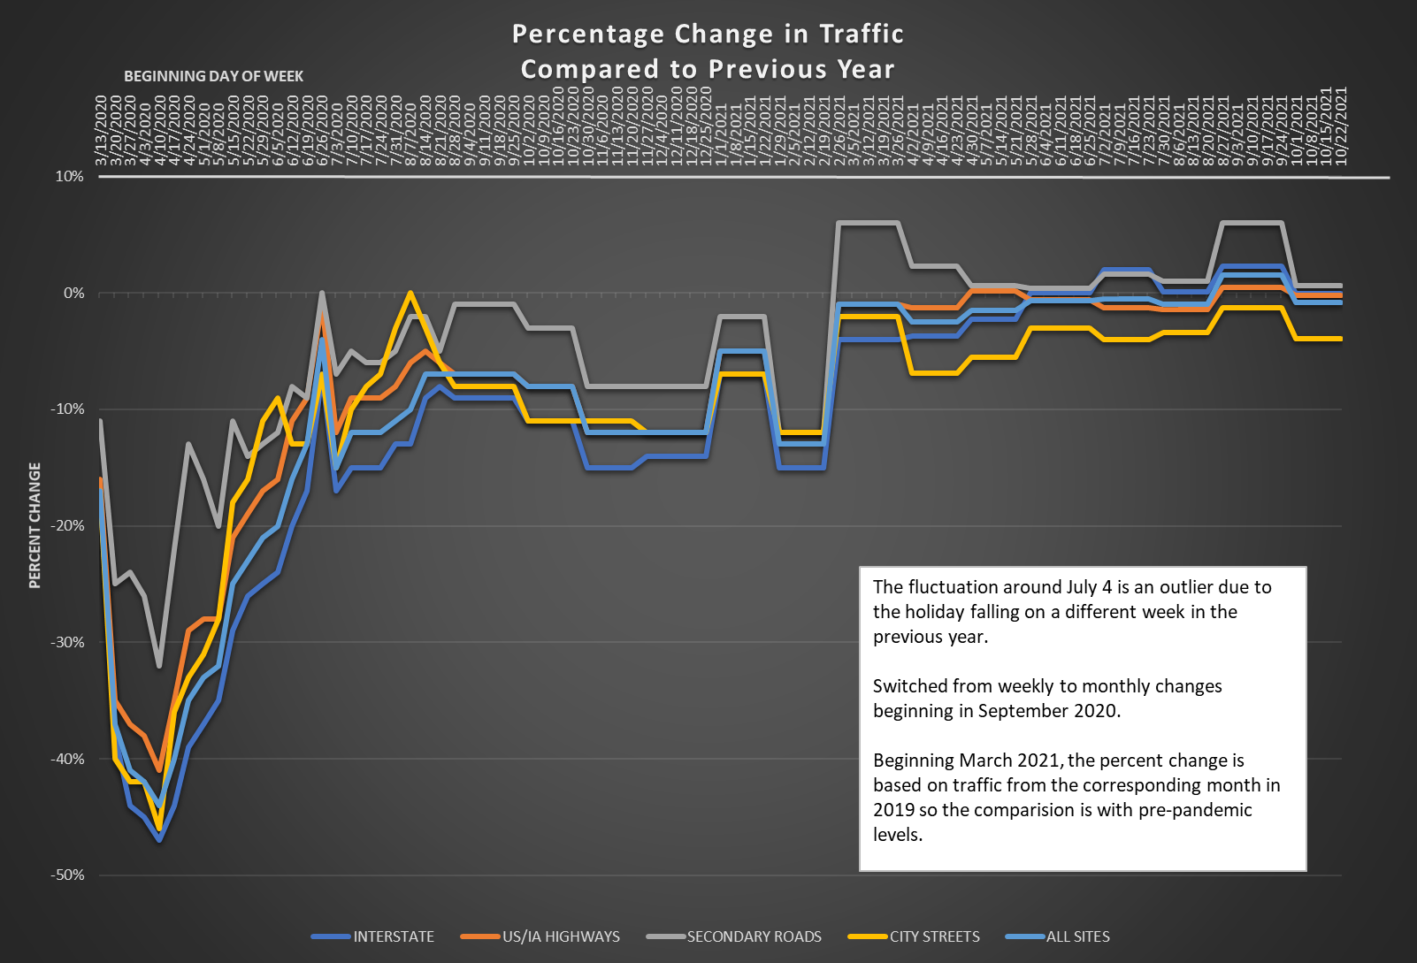

Slide 7
Questions?

