Slide 1
Revitalize Iowa’s Sound Economy Program
Iowa Transportation Commission Workshop
December 14, 2021

Slide 2
Revitalize Iowa’s Sound Economy Program
Created in 1985
Purpose: To promote economic development through roadway improvements.
Eligible development shall have value-adding activities that feed new dollars into the economy
Available to cities and counties through an application program

Slide 3
Available Funding and Application Summary
Available Funding
Funded annually with dedicated state motor fuel and special fuel tax revenues
Application Summary for SFY2022
Total number of projects awarded: 4
Total project costs: $3,684,339
Total amount awarded: $2,554,590
 | CITY | COUNTY
Average funding generated monthly | $905,101 | $452,550
SFY 2022 current Road Use Tax Revenue (as of 11/30/2021) | $5,094,762.75 | $2,547,381.37
Current Unobligated Balance (as of 11/30/2021) | $5,325,098.02 | $3,028,117.35

Slide 4
Local Development Project Evaluation Criteria
Development Potential (35 points)
Economic impact and Cost Effectiveness (20 points)
Local Commitment and Initiative (33 points)
Transportation Need and Justification (4 points)
Local Economic Need (6 points)

Slide 5
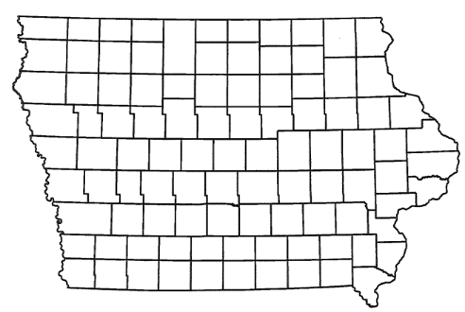
List of Local Development Applications Recommended
PROJECT NAME
SPONSOR
SCORE
TOTAL PROJECT COST
PERCENT PARTICIPATION
RECOMMENDED AMOUNT
Reconstruction of approximately 4,725 feet of NE Broadway Avenue located north of Des Moines. | Polk County | 43 | $8,216,658 | 50% | $4,108,329
Roadway improvements to Hillandale Road, Research Parkway, Northwest Boulevard, 76th Street, North Division Street and a 1,000-foot acceleration lane on the westbound I-80 on-ramp. | Davenport | 79 | $4,901,478 | 60% | $2,940,887

Slide 6
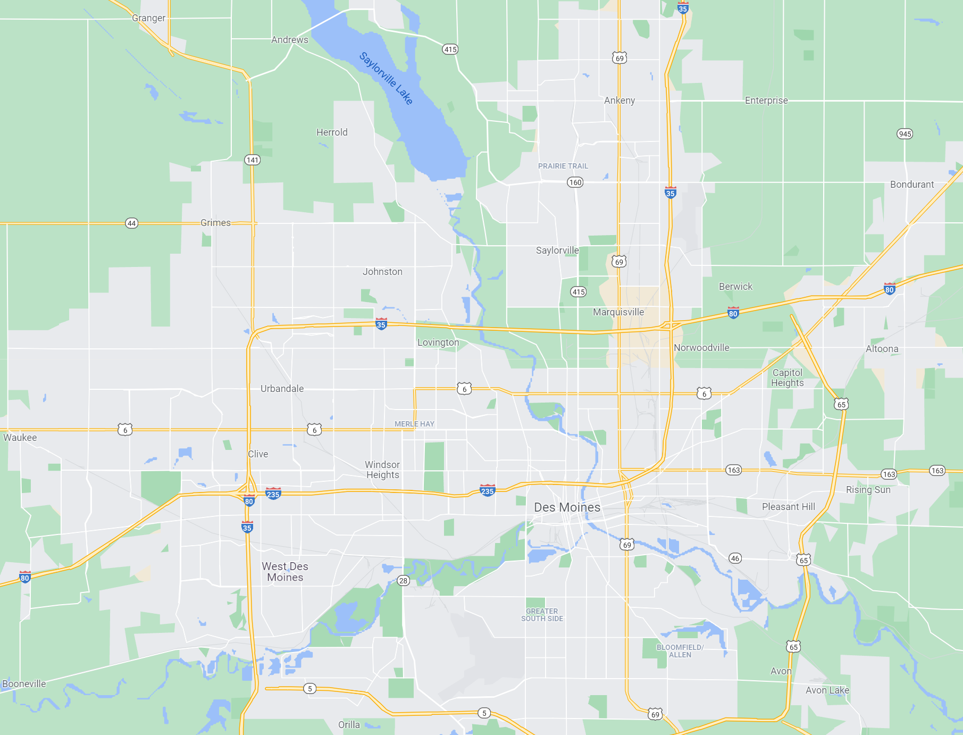
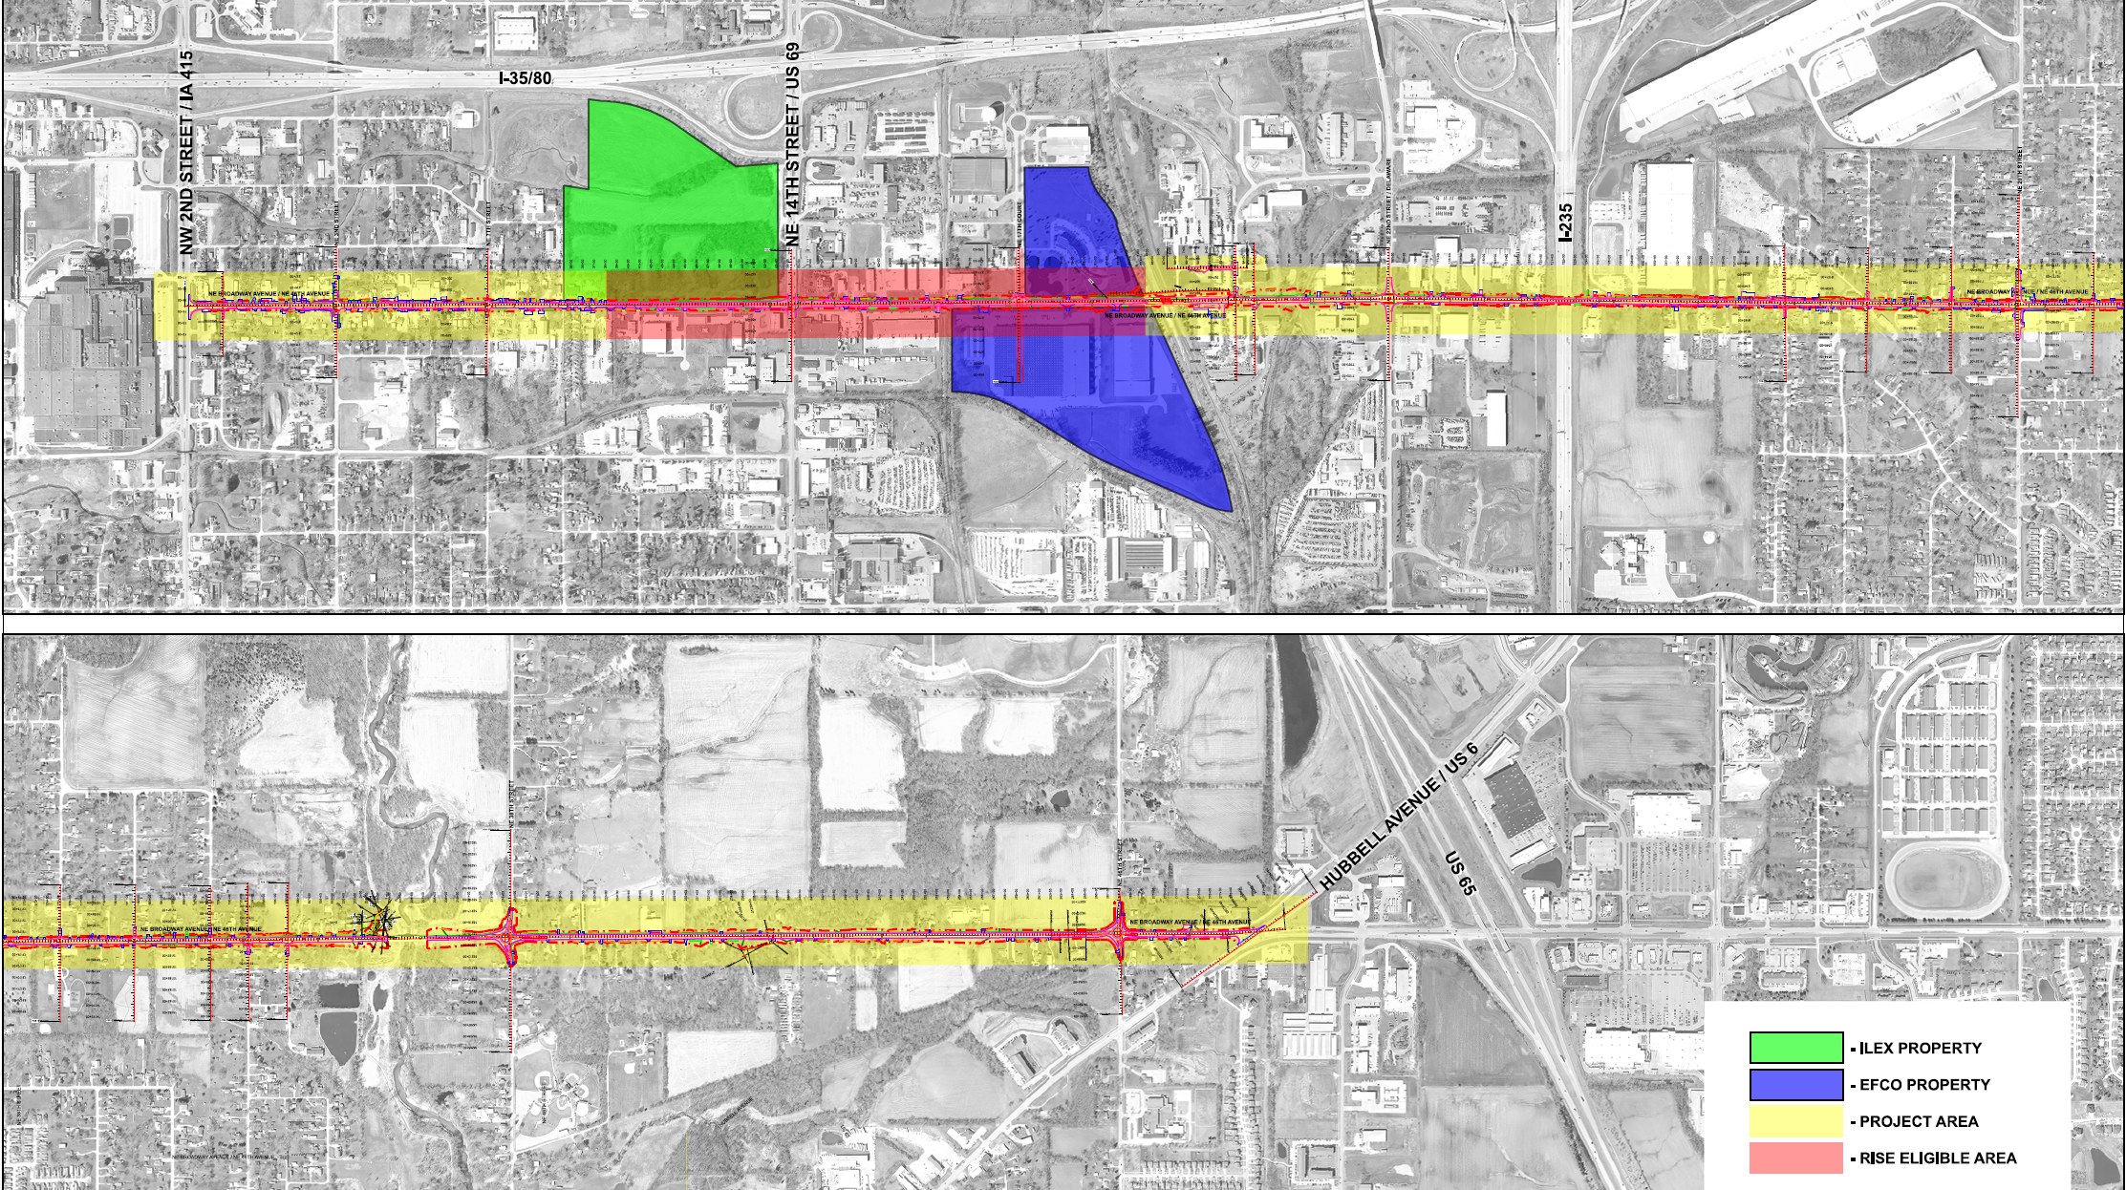
Polk County
(Local Development)
Reconstruction of approximately 4,725 feet of NE Broadway Avenue located north of Des Moines. This project is necessary to provide improved access to two lots totaling more than 71 acres for warehousing and industrial purposes.
Total Cost: $8,216,658
Requested: $4,108,329 (50%)

Slide 7
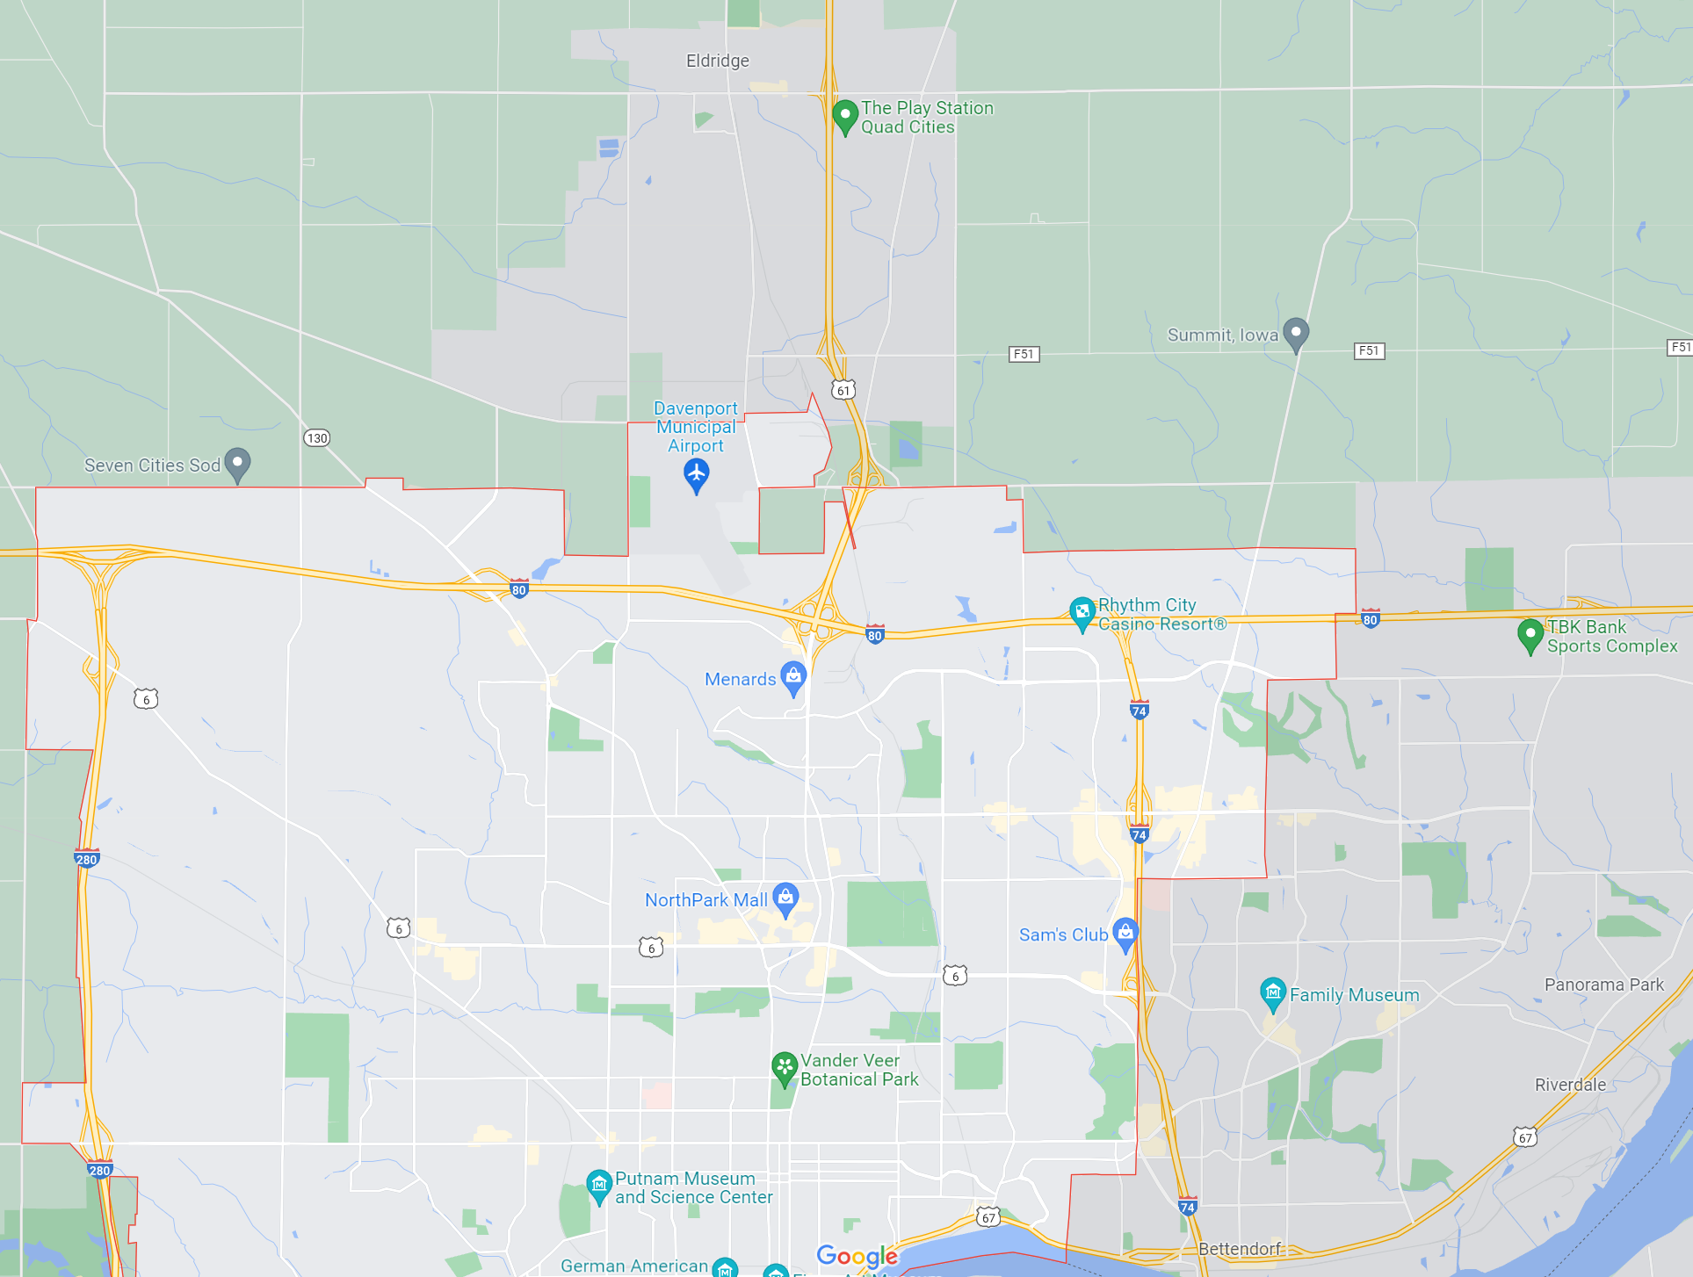
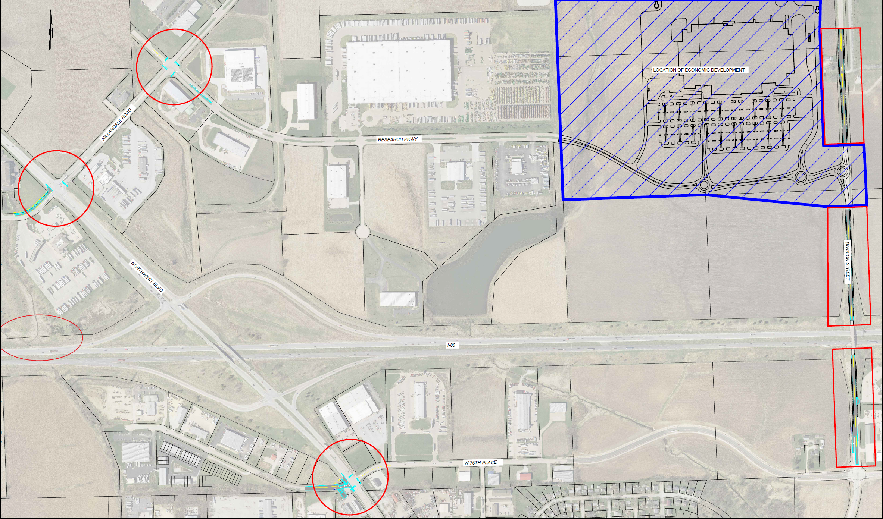
Davenport
(Local Development)
Roadway improvements to Hillandale Road, Research Parkway, Northwest Boulevard, 76th Street, North Division Street and a 1,000-foot acceleration lane on the westbound I-80 on-ramp located on the northwest side of town. This project is necessary to provide improved access to the Eastern Iowa Industrial Center, which is now a new and recertified Iowa Economic Development Authority certified site of more than 177 acres.
Total Cost: $4,901,478
Requested: $2,940,887 (60%)

Slide 8
QUESTIONS?
Craig Markley, Systems Planning Bureau
craig.markley@iowadot.us
515-239-1027

