Slide 1
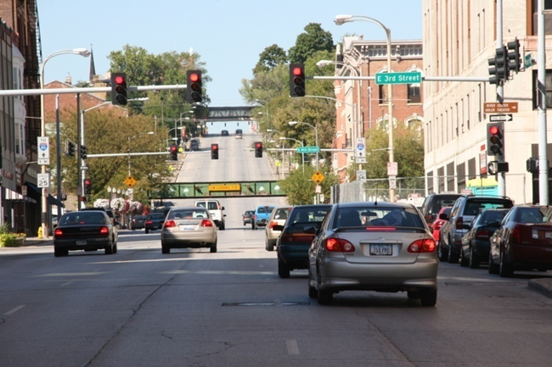

Iowa’s Clean Air Attainment Program
Funding Recommendation

Slide 2

Iowa’s Clean Air Attainment Program
Iowa’s Clean Air Attainment Program (ICAAP) was created in 1994.
Modeled after the federal Congestion Mitigation and Air Quality Improvement Program established in 1991.
Available to cities, counties, public transit agencies, MPOs, RPAs, and state agencies. Private non-profit or for-profit entities when co-sponsored by an eligible public agency through an annual application program.
Purpose is to award funds to projects with the highest potential for reducing transportation-related congestion and air pollution.

Slide 3
Project Evaluation Criteria
Vehicle traffic flow improvements (25 points)
Vehicle miles of travel (VMT) or single-occupant vehicle (SOV) reduction (25 points)
Estimated vehicle emission reduction (20 points)
Degree of transportation-related air pollution or traffic congestion (15 points)
Project cost effectiveness relative to air quality benefits (30 points)

Slide 4
Available Funding and Application Summary
Available Funding:
Iowa’s Clean Air Attainment Program funds available: $4,000,000
Application Summary:
Total number of projects: 13
Total project costs: $41,233,027
Total amount requested: $7,370,839

Slide 5
List of Applications Recommended
PROJECT NAME | SPONSOR | SCORE | TOTAL PROJECT COST | REQUESTED AMOUNT (% of Total Project Cost) | RECOMMENDED AMOUNT (% of Total Project Cost)
Traffic Signal Communication Network - Phase 3 | Ames | 77 | $1,869,100 | $1,495,280 (80%) | $1,495,280 (80%)
Traffic Signal Vehicle Detector Improvement Project | West Des Moines | 72 | $600,000 | $480,000 (80%) | $480,000 (80%)
#11 Cherry - Night | Ames Transit Agency | 69 | $39,512 | $31,609 (80%) | $31,609 (80%)
Traffic Signal System Timing Update – Phase 5 | Des Moines | 69 | $290,000 | $232,000 (80%) | $232,000 (80%)
#12 Lilac - Mid-Day | Ames Transit Agency | 68 | $37,287 | $29,830 (80%) | $29,830 (80%)
#6 Brown - Night | Ames Transit Agency | 68 | $35,323 | $28,258 (80%) | $28,258 (80%)
Jump to applications not recommended for funding

Slide 6
List of Applications Recommended
PROJECT NAME | SPONSOR | SCORE | TOTAL PROJECT COST | REQUESTED AMOUNT (% of Total Project Cost) | RECOMMENDED AMOUNT (% of Total Project Cost)
Merle Hay Road Corridor Traffic Signal Improvements | Johnston | 61 | $776,840 | $621,470 (80%) | $621,470 (80%)
Middle Road and Forest Grove Drive | Bettendorf | 59 | $9,371,160 | $500,000 (5%) | $500,000 (5%)
Route #17 Extension to Bondurant | Des Moines Regional Transit Authority (DART) | 59 | $65,490 | $52,392 (80%) | $52,392 (80%)
Iowa 160/SW Oralabor Road and Iowa 415/SW State Street Intersection Improvements | Ankeny | 58 | $1,955,000 | $1,400,000 (72%) | $529,161 (27%)
Jump to applications not recommended for funding

Slide 7
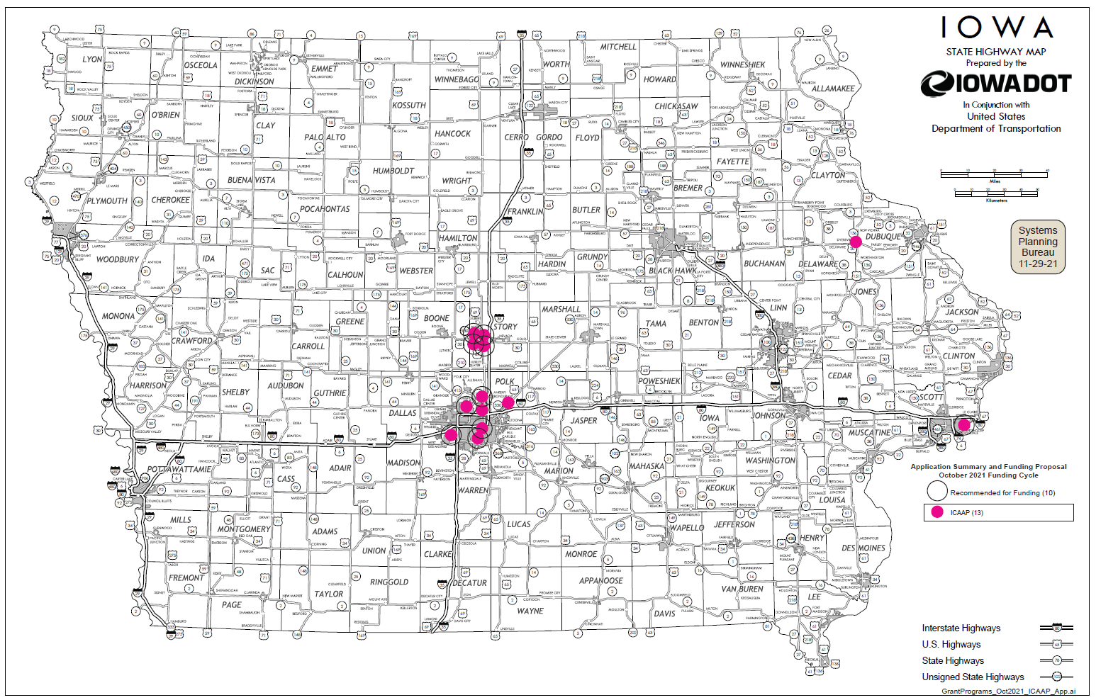
Map of Applications Received

Slide 8
Estimated Annual Benefits of Recommended Projects
Reduction of Vehicle Hours of Travel: 703,949
Reduction of Vehicle Miles of Travel: 5,531,922
Improved Air Quality
Reduced CO, VOCs, & NOx Emissions: 335,537 lbs.

Slide 9

QUESTIONS?
Jared Smith
Iowa’s Clean Air Attainment program manager
Jared.Smith@iowadot.us

Slide 10
Traffic Signal Communication Network – Phase 3
(Ames)
Install fiber optic cable and network switching equipment, traffic signal cabinets, Advanced Traffic Controllers, Advanced Traffic Management System, and software to provide communication and traffic management capabilities along a portion of South 3rd Street, Grand Avenue, Bloomington Road, Duff Avenue and connecting Homewood Golf Course to Duff Avenue at 24th Street.
Total Cost: $1,869,100
Requested: $1,495,280 (80%)
Return to List of Applications Recommended

Slide 11
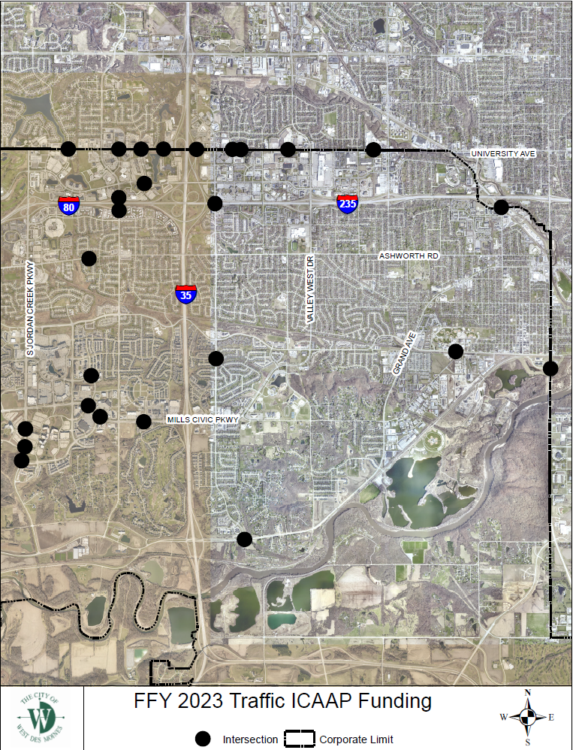
Traffic System Vehicle Detector Improvement Project
(West Des Moines)
Replace existing vehicle detection method, such as in-pavement loops, with state-of-the-art single point video detection.
Total Cost: $600,000
Requested: $480,000 (80%)
Return to List of Applications Recommended

Slide 12
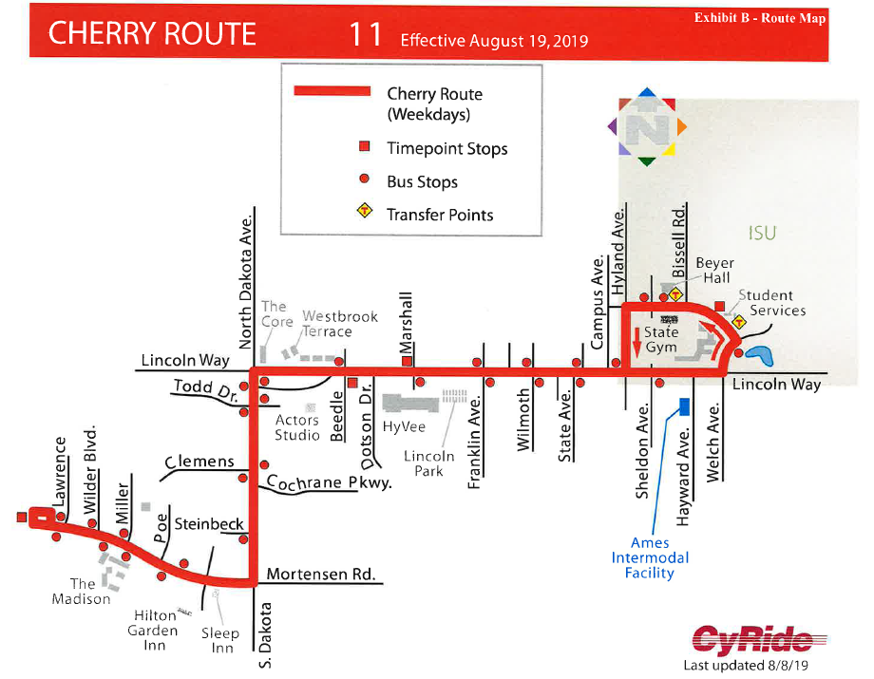
#11 Cherry - Night
(Ames Transit Agency)
Adding night service trips to the #11 Cherry route due to additional demand from residents and to improve safety.
Total Cost: $39,512
Requested: $31,609 (80%)
Return to List of Applications Recommended

Slide 13
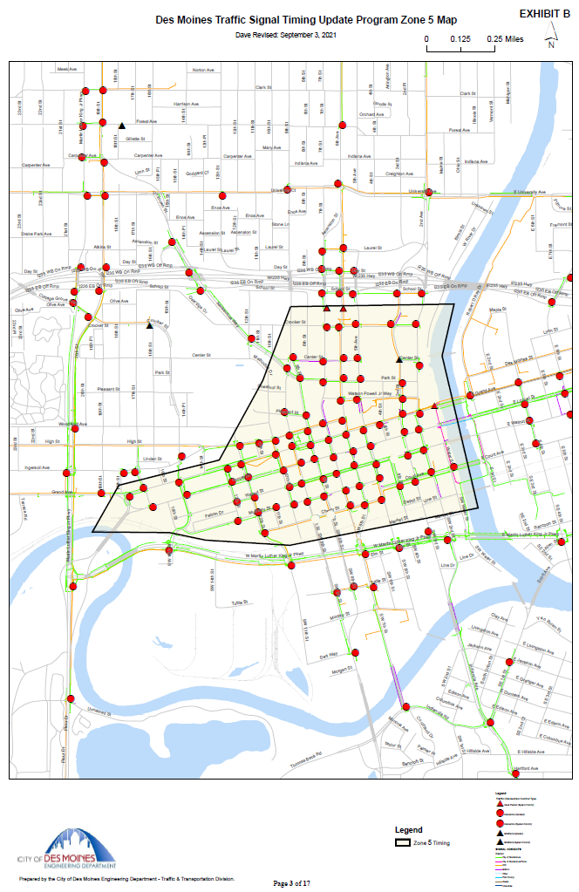
Traffic Signal Timing Update – Phase 5
(Des Moines)
Review and update signal timing and phasing plans for the traffic signal system in downtown Des Moines. This project is the fifth and final phase of a multi-phase project to update the signal operations through the entire city. Synchro traffic models will be used to help optimize signal cycle lengths, basic signal timings, split timings, offsets, and time of day periods for coordination plans.
Total Cost: $290,000
Requested: $232,000 (80%)
Return to List of Applications Recommended

Slide 14
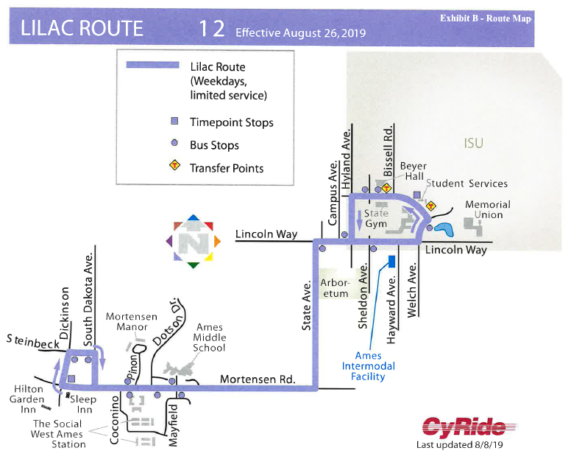
#12 Lilac – Mid-Day
(Ames Transit Agency)
In 2019 mid-day trips were added to the #12 Lilac route due to additional demand from residents. Therefore, this ICAAP request, year 3 request, is for the #12 Lilac mid-day service to support operations.
Total Cost: $37,287
Requested: $29,830 (80%)
Return to List of Applications Recommended

Slide 15
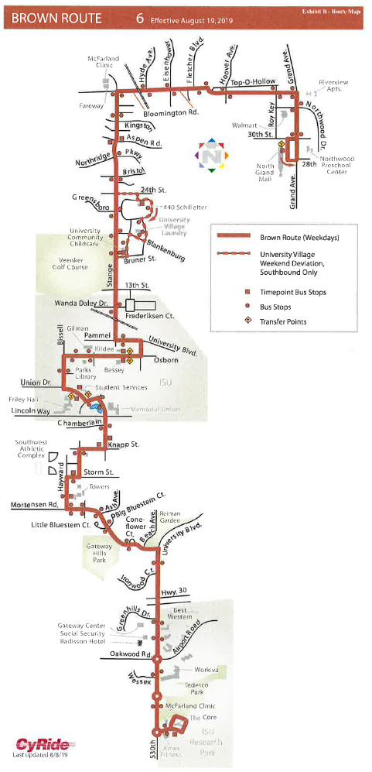
#6 Brown - Night
(Ames Transit Authority)
Adding additional night service trips due to additional demand from residents between North Grand Mall and Towers residence halls.
Total Cost: $35,323
Requested: $28,258 (80%)
Return to List of Applications Recommended

Slide 16
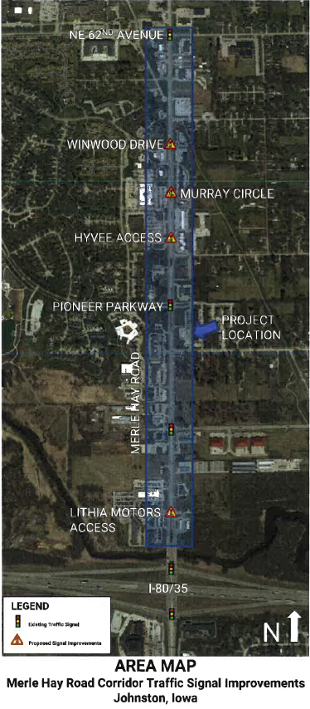
Merle Hay Road Corridor Traffic Signal Improvements
(Johnston)
Update controller cabinets at two locations to accommodate 4-section left turn signal heads, replace pedestrian signal heads with MUTCD compliant countdown heads, install pedestrian pushbuttons for ADA compliance and reconstruct pedestrian ramps. Remove two traffic signals and install one new traffic signalized intersection and install GPS time synchronization unit.
Total Cost: $776,840
Requested: $621,470 (80%)
Return to List of Applications Recommended

Slide 17
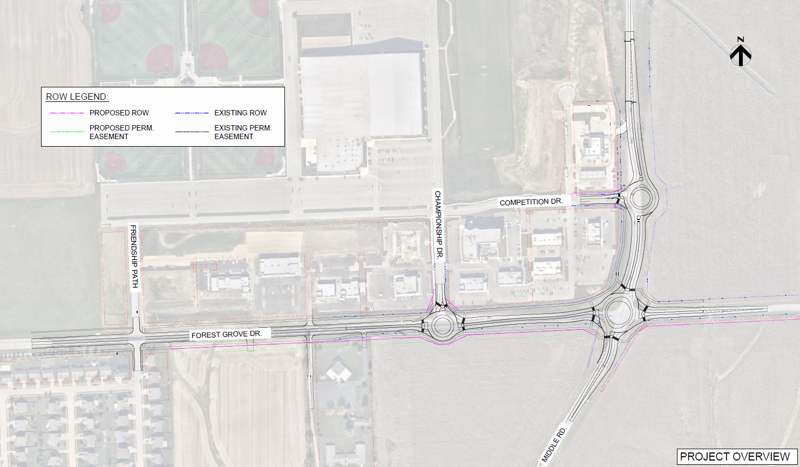
Middle Road and Forest Grove Drive
(Bettendorf)
This project would reconstruct Forest Grove Drive between Friendship Path and just east of Middle Road, and Middle Road just south of Forest Grove Drive to north of Competition Drive. It would replace the signalized intersection of Forest Grove Drive and Middle Road with a multi-lane roundabout and also construct roundabouts at the intersections of Forest Grove Drive and Championship Drive and the intersection of Middle Road and Competition Drive.
Total Cost: $9,371,160
Requested: $500,000 (5%)
Return to List of Applications Recommended

Slide 18
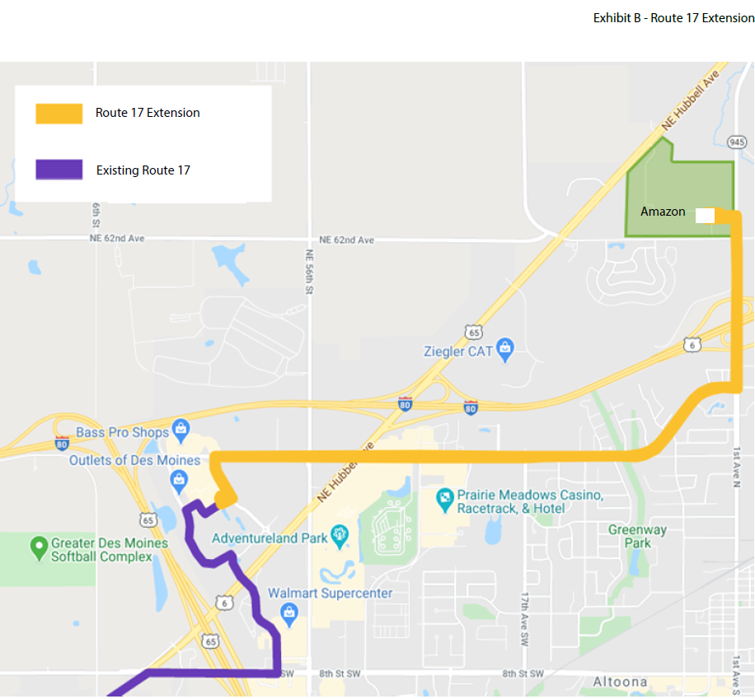
Route #17 Extension to Bondurant
(Des Moines Regional Transit Authority)
DART extended service on Route #17 between the Outlets of Des Moines and the Amazon facility in Bondurant in November 2020. The route extension provides transportation options for the employees of the Amazon facility as well as providing additional connections for the residents of Bondurant to Des Moines.
Total Cost: $65,490
Requested: $52,392 (80%)
Return to List of Applications Recommended

Slide 19
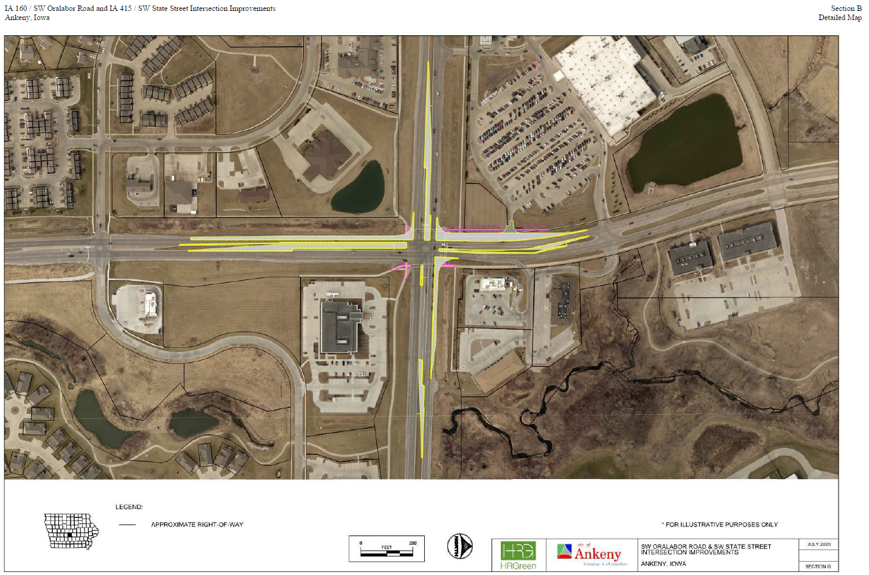
Iowa 160/SW Oralabor Road and Iowa 415/SW State Street Intersection Improvements
(Ankeny)
Intersection improvement design includes the construction of dual left-turn lanes for northbound, eastbound, and southbound approaches as well as the addition of right-turn lanes for the westbound and southbound approaches. Project also includes the replacement of existing traffic signal equipment at the intersection and upgrade of pedestrian ramps and crossings.
Total Cost: $1,955,000
Requested: $529,161 (27%)
Return to List of Applications Recommended

Slide 20
List of Applications Not Recommended for Award
PROJECT NAME | SPONSOR | SCORE | TOTAL PROJECT COST | REQUESTED AMOUNT (% of Total Project Cost) | RECOMMENDED AMOUNT (% of Total Project Cost)
NE Broadway Avenue Corridor Improvement Project – Railroad Grade Separation | Polk County Public Works | 54 | $10,443,315 | $1,000,000 (10%) | $0
Grant Street South Realignment | Bondurant | 28 | $7,750,000 | $1,000,000 (13%) | $0
12th Avenue SW to 13th Avenue SE Connector | Dyersville | 22 | $8,000,000 | $500,000 (6%) | $0
Return to List of Applications Recommended

