Slide 1
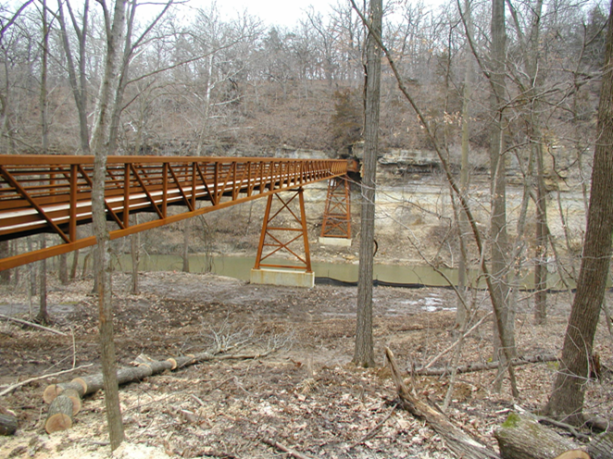

Federal Recreational Trails Program
Funding Recommendation

Slide 2

Federal Recreational Trail Program
Federal program created in 1991
Available to federal, state, and local government agencies. Private individuals and organizations may apply with a government co-sponsor.
Purpose is to develop and maintain recreational trails and trail related facilities for both motorized and non-motorized trail users.
Eligible projects include:
  Maintenance and restoration of existing trails, development of trailside and trailhead facilities, purchase of trail construction and maintenance equipment, construction of new trails, and acquisition of land for trails.

Slide 3
Project Evaluation Criteria
Degree to which motorized and non-motorized trail use are accommodated. (10 points)
Greatest number of compatible multi-purpose uses. (10 points)
Access and use for persons with disabilities, older citizens, economically challenged and other special populations or groups. (10 points)
Provides development of trail linkages. (10 points)
Opportunities for new partnerships between trail users and private interests. (10 points)
Identified in or furthers a specific goal of a state, regional, or local plan. (10 points)
Leverages greater public or private investments. (10 points)
Citizen involvement in the project’s conception and implementation (10 points)
Degree to which project ties in to other trails. (10 points)
Public/private partnerships to continue operation and maintenance. (15 points)
Trails with national designation or resulting in the cleanup of an area. (10 points)

Slide 4
Available Funding and Application Summary
Available Funding:
  Annual appropriation: $1,300,000
Application Summary:
  Total number of projects: 19
  Total project costs: $20,880,041
  Total amount requested: $8,719,435

Slide 5
List of Motorized Applications Recommended
PROJECT NAME | SPONSOR | SCORE | TOTAL PROJECT COST | REQUESTED AMOUNT (% of Total Project Cost) | RECOMMENDED AMOUNT (% of Total Project Cost)
International Snowmobile Congress 2022 Educational Sessions | Iowa State Snowmobile Association | 43.50 | $10,000 | $8,000 (80%) | $8,000 (80%)
Jump to applications not recommended for funding

Slide 6
List of Non-motorized Applications Recommended
PROJECT NAME | SPONSOR | SCORE | TOTAL PROJECT COST | REQUESTED AMOUNT (% of Total Project Cost) | RECOMMENDED AMOUNT (% of Total Project Cost)
Support for Program and Bicycle Summit | Iowa DOT | N/A | $8,750 | $7,000 (80%) | $7,000 (80%)
Tatanka Ska Trace Trail Phase IV(b): 193rd Avenue to 170th Avenue | Dickinson County | 81.67 | $1,425,230 | $395,000 (28%) | $395,000 (28%)
Clear Creek Trail: Half Moon Avenue to F.W. Kent Park | Johnson County Conservation Board | 80.00 | $2,988,000 | $388,000 (13%) | $388,000 (13%)
Nishna Bend River Access | Shelby County Conservation Board & Iowa DNR | 72.00 | $226,500 | $181,200 (80%) | $181,200 (80%)
Jump to applications not recommended for funding

Slide 7
List of Non-motorized Applications Recommended
PROJECT NAME | SPONSOR | SCORE | TOTAL PROJECT COST | REQUESTED AMOUNT (% of Total Project Cost) | RECOMMENDED AMOUNT (% of Total Project Cost)
Plywood Trail Phase IB | Le Mars | 72.00 | $1,750,893 | $300,000 (17%) | $300,000
Jump to applications not recommended for funding

Slide 8
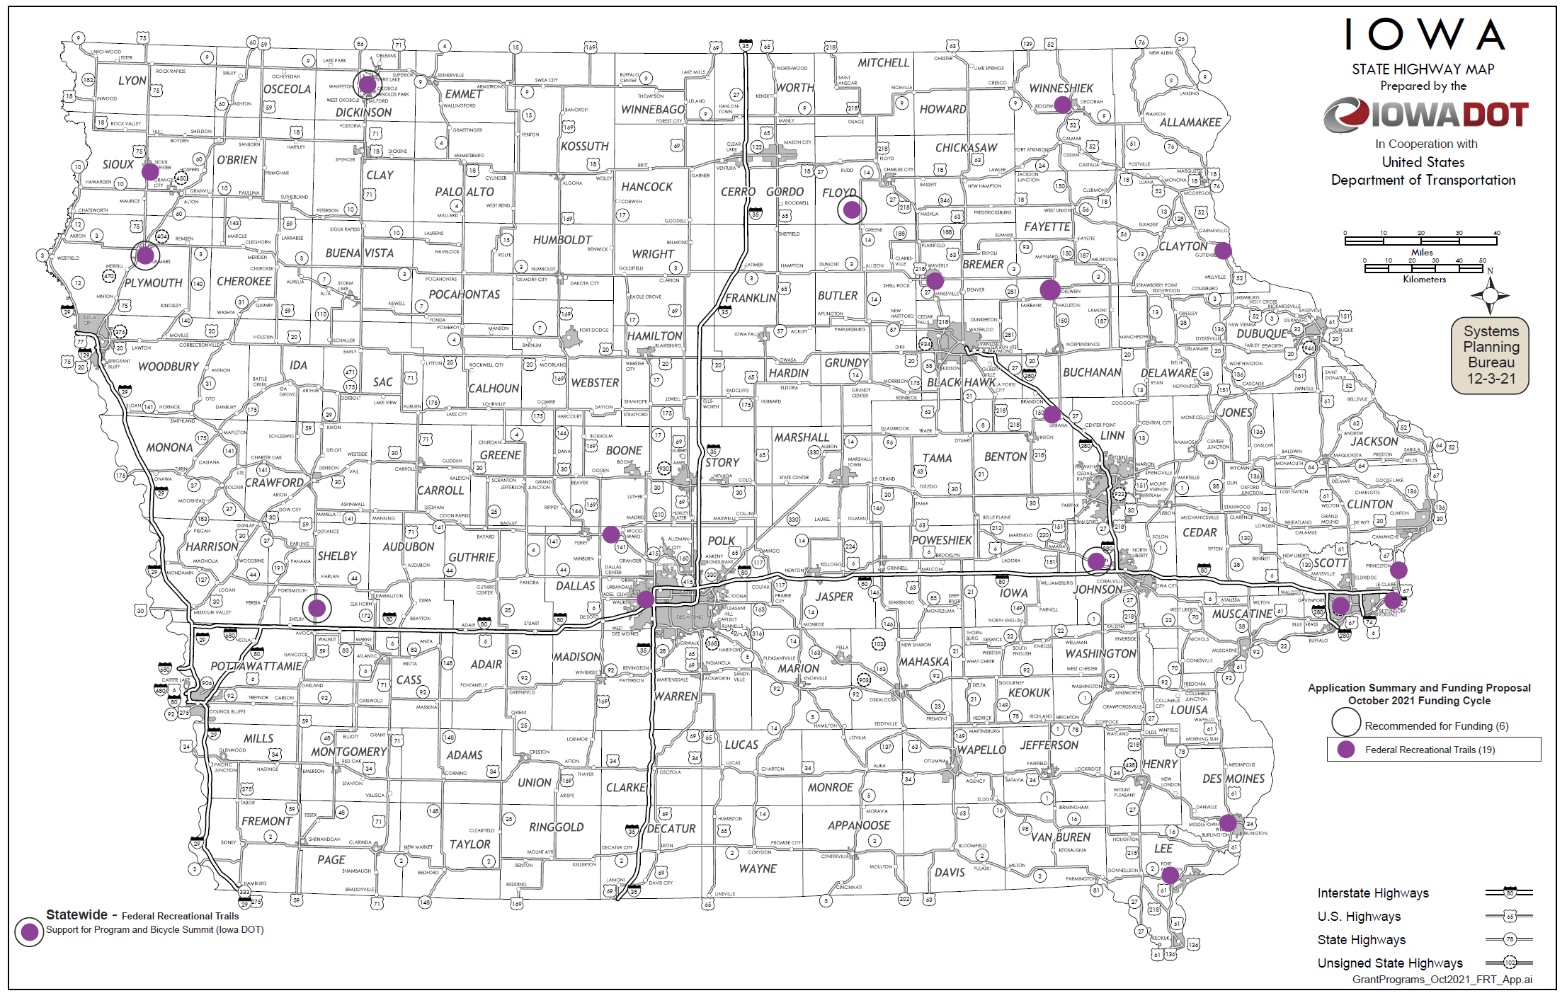
Map of Applications Received

Slide 9

QUESTIONS?
Scott Flagg
Federal/State Recreational Trail Program Manager
Scott.Flagg@iowadot.us

Slide 10
International Snowmobile Congress 2022 Educational Sessions
(Iowa State Snowmobile Association)
Provide funding to help support the educational sessions that will be held at the International Snowmobile Congress in Dubuque on June 8-11, 2022. The International Snowmobile Congress is an event dedicated to the development of collaboration of snowmobilers worldwide, and cooperation with and respect to the environment, conservation, access, education, and accountability.
Total Cost: $10,000
Requested: $8,000 (80%)
Return to List of Applications Recommended

Slide 11

Support for Program and Bicycle Summit (Iowa DOT)
This project provides funding to pay for costs related to operation of the Federal Recreational Trails Program for 2023 and for the 2023 Iowa Bicycle Summit. The Iowa Bicycle Summit is an annual conference providing education on the latest bicycle facilities, technology, and programming. It brings national speakers to Iowa to share bicycle facility successes and best practices from around the United States. Many of the lessons learned at the Summit have manifested into trail facilities and safety.
Total Cost: $8,750
Requested: $7,000 (80%)
Return to List of Applications Recommended

Slide 12
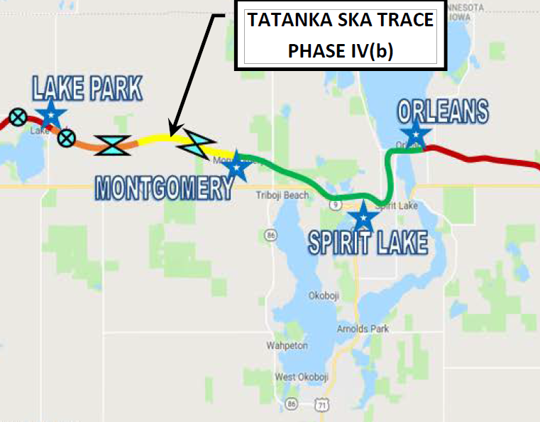
Tatanka Ska Trace Trail Phase IV(b): 193rd Avenue to 170th Avenue
(Dickinson County)
Project starts at 193rd Avenue in Montgomery and travels 2.5 miles to 170th Avenue. Project extends Tatanka Ska Trace Trail to the west and is part of the Iowa Great Lakes Connection Trail.
Total Cost: $1,425,230
Requested: $395,000 (28%)
Return to List of Applications Recommended

Slide 13
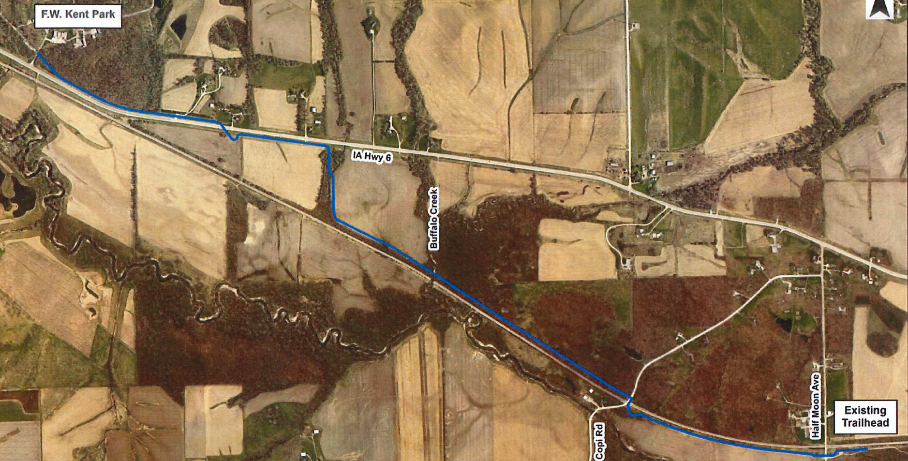
Clear Creek Trail: Half Moon Avenue to F.W. Kent Park
(Johnson County Conservation Board)
Project extends the Clear Creek Trail 2.6 miles. Starting at Half Moon Avenue and ending at F.W. Kent Park.
Total Cost: $2,988,000
Requested: $388,000 (13%)
Return to List of Applications Recommended

Slide 14
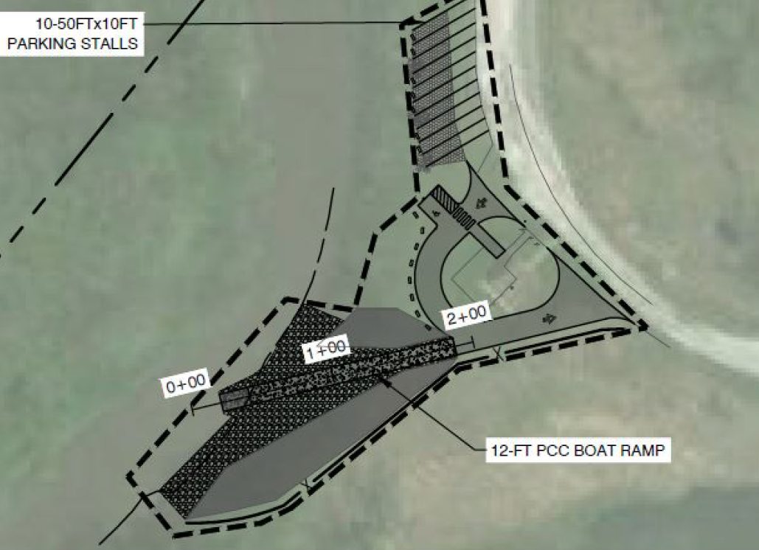
Nishna Bend River Access
(Shelby County Conservation Board & Iowa Department of Natural Resources)
Project builds a new river access and parking lot at the Nishna Bend Recreation Area in Shelby County.
Total Cost: $226,500
Requested: $181,200 (80%)
Return to List of Applications Recommended

Slide 15
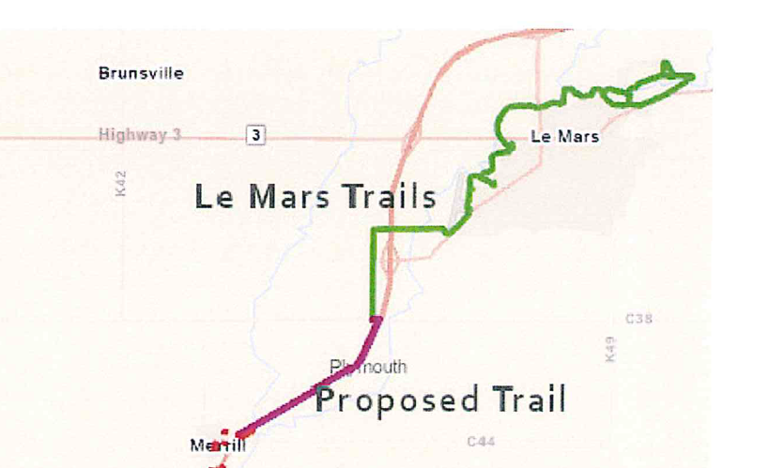
Plywood Trail Phase IB
(Le Mars)
Beginning at the intersection of County Road C38 and Key Avenue construct 2.25 miles parallel to U.S. 75 where it connects to Phase 1A.
Total Cost: $1,750,893
Requested: $300,000 (17%)
Return to List of Applications Recommended

Slide 16
List of Applications
Not Recommended for Award
PROJECT NAME | SPONSOR | SCORE | TOTAL PROJECT COST | REQUESTED AMOUNT (% of Total Project Cost) | RECOMMENDED AMOUNT (% of Total Project Cost)
Dry Run Trail Phase 3 | Winneshiek County Conservation Board | 71.83 | $958,477 | $600,000 (63%) | $0
Cedar Valley Nature Trail: 52nd Street to Benton/Buchanan County Line | Linn County Conservation Board | 71.33 | $1,244,684 | $650,000 (52%) | $0
Raccoon River Valley Trail to High Trestle Trail Phase V: M Avenue to 130th Street | Dallas County Conservation Board | 70.17 | $715,000 | $572,000 (80%) | $0
Nahant Marsh Trail Phase II | Davenport | 69.67 | $387,554 | $295,155 (76%) | $0
Return to List of Applications Recommended

Slide 17
List of Applications
Not Recommended for Award
PROJECT NAME | SPONSOR | SCORE | TOTAL PROJECT COST | REQUESTED AMOUNT (% of Total Project Cost) | RECOMMENDED AMOUNT (% of Total Project Cost)
First Bridge Pedestrian/Bicycle Bridge | River Action, Inc. | 67.67 | $2,615,716 | $500,000 (19%) | $0
Gear Avenue Trail Phase II | West Burlington | 66.50 | $890,496 | $437,040 (49%) | $0
Little Walnut Creek Trail Connector | Clive | 64.80 | $2,500,000 | $350,000 (14%) | $0
Connecting Fort Madison! Phase 4: 48th Street Trail Connector | Fort Madison | 64.17 | $625,477 | $420,000 (67%) | $0
Mississippi River Trail Phase 1 | Princeton | 61.67 | $712,000 | $569,600 (80%) | $0
Return to List of Applications Recommended

Slide 18
List of Applications
Not Recommended for Award
PROJECT NAME | SPONSOR | SCORE | TOTAL PROJECT COST | REQUESTED AMOUNT (% of Total Project Cost) | RECOMMENDED AMOUNT (% of Total Project Cost)
Sioux Center Trail Extension | Sioux Center | 58.70 | $872,146 | $687,146 (79%) | $0
Oelwein Municipal Urban Trail Segment 2 and 4 | Oelwein | 58.70 | $1,544,618 | $1,235,694 (80%) | $0
Guttenberg Community Trail: Haydn Street to Dekalb Street | Guttenberg | 55.00 | $994,000 | $795,200 (80%) | $0
Rolling Prairie Trail: Bridge Replacement | Waverly | 50.17 | $410,500 | $328,400 (80%) | $0
Return to List of Applications Recommended

