Slide 1
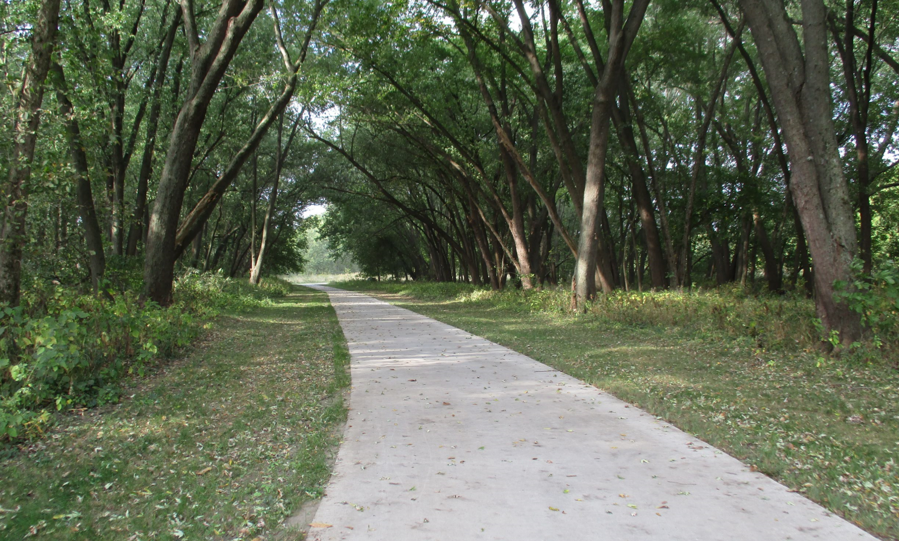

Statewide Iowa’s Transportation Alternatives Program
Funding Recommendation

Slide 2

Statewide Iowa’s Transportation Alternatives Program
Current version of former Transportation Enhancement program that has existed since 1991.
Majority of funding is distributed to Iowa’s RPAs and MPOs with $1 million reserved for statewide projects
Eligible activities include:
On-road and off-road non-motorized trail facilities, safe routes for non-drivers, conversion of abandoned rail corridors for trails, preservation/rehabilitation of historic transportation facilities among others
Federal Recreational Trails Program eligible activities
Infrastructure-related or non-infrastructure related Safe Routes to School Projects (if local TAP funds are used as well)
Scenic Byways (if local TAP funds are used as well)

Slide 3
Project Evaluation Criteria
Statewide or multi-regional impact of the project (35 points)
Degree of enhancement of the quality or utility of the state surface transportation system (20 points)
State or multi-regional tourism benefits (10 points)
Degree of statewide or multi-regional planning implemented (35 points)

Slide 4
Available Funding and Application Summary
Estimated FY 2022 Appropriation: $10,764,227
$1,374,817 set aside for Recreational Trails.
Half ($4,694,705) reserved for local projects, half stays at the state level.
The set-aside for Statewide TAP is $1,000,000
Remaining $3,694,705 of state level funding is reserved for eligible local projects:
Transportation Alternatives Program
Highway
Bridge
Transit

Slide 5
Available Funding and Application Summary
Available Funding:
Statewide Iowa’s TAP funds available: $1,000,000 plus previous years under runs
Application Summary
Total number of projects: 4
Total project costs: $2,224,387
Total amount requested: $984,213

Slide 6
List of Applications Recommended
PROJECT NAME | SPONSOR | SCORE | TOTAL PROJECT COST | REQUESTED AMOUNT (% of Total Project Cost) | RECOMMENDED AMOUNT (% of Total Project Cost)
UNI Integrated Roadside Vegetation Management | University of Northern Iowa/Tallgrass Prairie Center | 90 | $1,046,870 | $482,200 (46%) | $482,200 (46%)
Iowa Safe Routes to School Partnership | Iowa Northland Regional Council of Governments | 85 | $297,517 | $238,013 (80%) | $238,013 (80%)
Coolidge Elementary School & Taft Middle School Project | Cedar Rapids | 20 | $480,000 | $144,000 (30%) | $144,000 (30%)
Weiss Family Safe Routes to Schools Trail | Denison | 20 | $400,000 | $120,000 (30%) | $120,000 (30%)

Slide 7
Map of Applications Received

Slide 8

QUESTIONS?
Susan Hollenkamp
Transportation Alternatives program manager
Susan.hollenkamp@iowadot.us

Slide 9
UNI Integrated Roadside Vegetation Management (University of Northern Iowa/Tallgrass Prairie Center)
Native grass and wildflower seed are to be planted in tribal, county, or city rights-of-way. This allows jurisdictions that apply Integrated Roadside Vegetation Management to more cost effectively establish native roadside vegetation for habitat, biodiversity, erosion control and improved hydrology across Iowa's landscape.
Total Cost: $1,046,870
Requested: $482,200 (46%)
Return to List of Applications Received

Slide 10

Iowa Safe Routes to School Partnership (Iowa Northland Regional Council of Governments and Upper Explorerland Regional Planning Commission)
A comprehensive program that provides support to communities by implementing SRTS initiatives, including pedestrian and bicycle safety education through encouragement activities both inside and outside the classroom.
Total Cost: $297,517
Requested: $238,013 (80%)
Return to List of Applications Recommended

Slide 11
Coolidge Elementary School & Taft Middle School Sidewalk Project
(Cedar Rapids)
The project is designed to provide continual safe walking and biking paths for students and other pedestrians through and around Coolidge Elementary and Taft Middle School neighborhoods. An enhanced pedestrian crossing on F Avenue NW will also be provided with the use of a rectangular rapid-flashing beacon (RRFB).
Total Cost: $480,000
Requested: $144,000 (30%)
Coolidge Elementary School Sidewalk Path along Stoney Point Rd. SW
Taft Middle School
Sidewalk Path between Jacolyn Dr NW and F Ave NW
Return to List of Applications Recommended

Slide 12
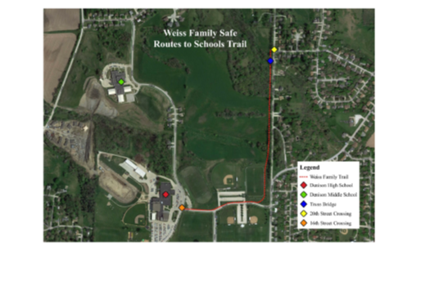
Weiss Family Safe Routes to Schools Trail (Denison)
The trail is proposed on land owned by the Weiss family on the west side of N. 20th Street. The project will grade and pave a 10-foot wide trail and set an 85-foot steel truss bridge. The north end of the route terminates across from the existing north sidewalk on Frontier Road. From there it proceeds south across the bridge and along the west side of N. 20th Street to 8th Avenue North where it will turn west along 8th Avenue North to the schools on 16th Street.
Total Cost: $400,000
Requested: $120,000 (30%)
Return to List of Applications Recommended

