Slide 1
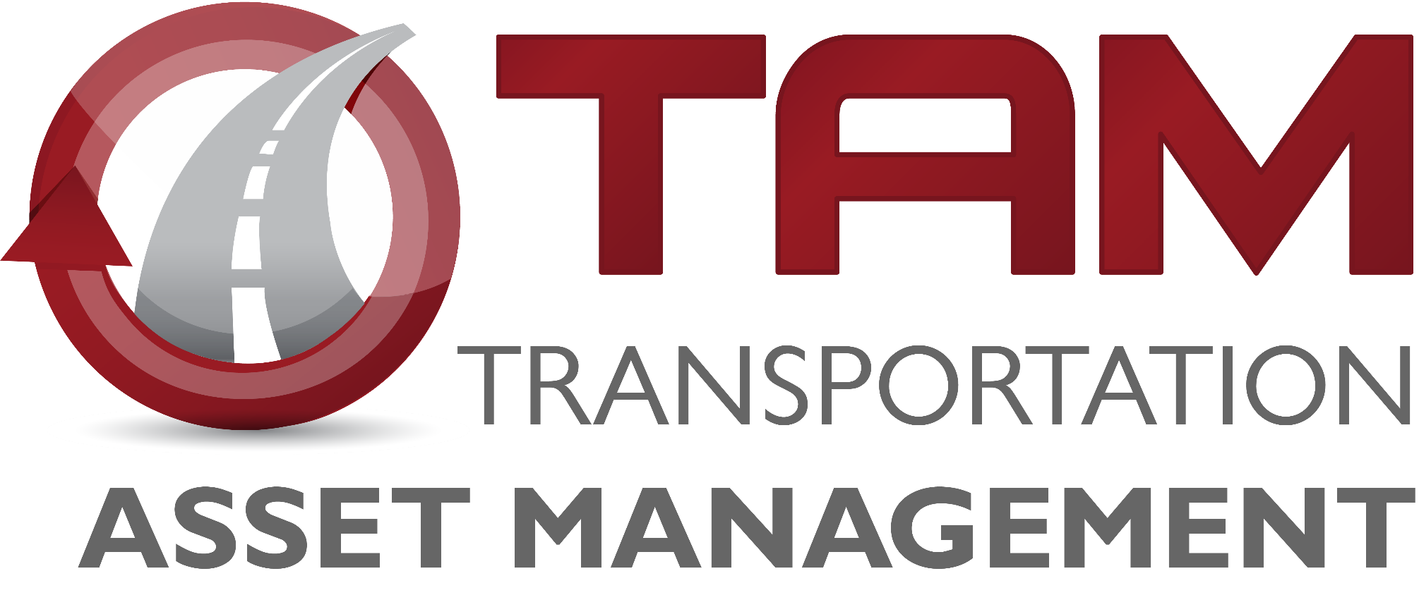

Transportation Commission Workshop
December 14, 2021

Slide 2

Pavement Management
Chris Brakke, PE
Iowa DOT Construction and Materials Bureau

Slide 3
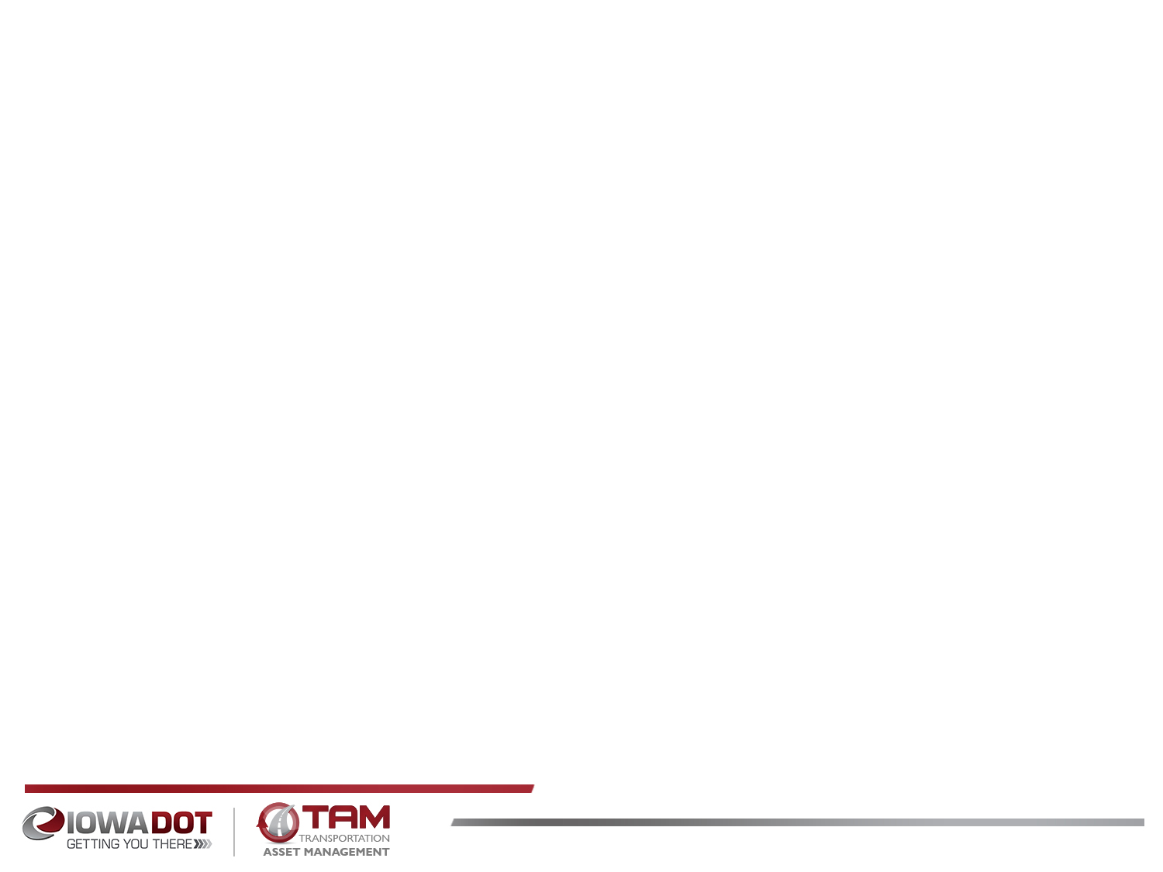



Pavement system components
Pavement
Subbase
Subgrade
Pavement
  Concrete (rigid), Asphalt (flexible), or Composite
Subbase
  Rock layer for support and drainage
Subgrade
  Improved soil layer to provide support

Slide 4
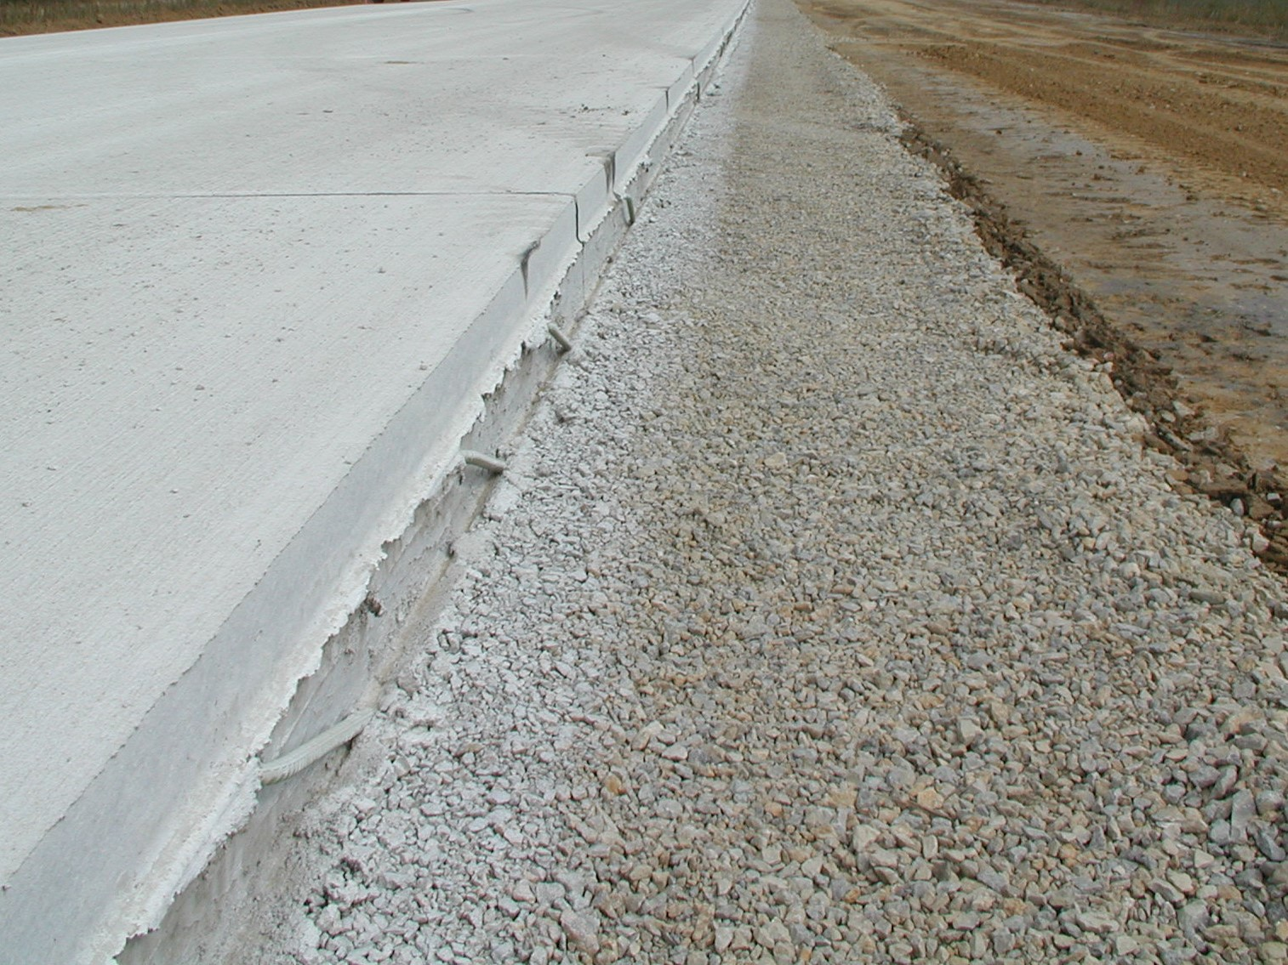
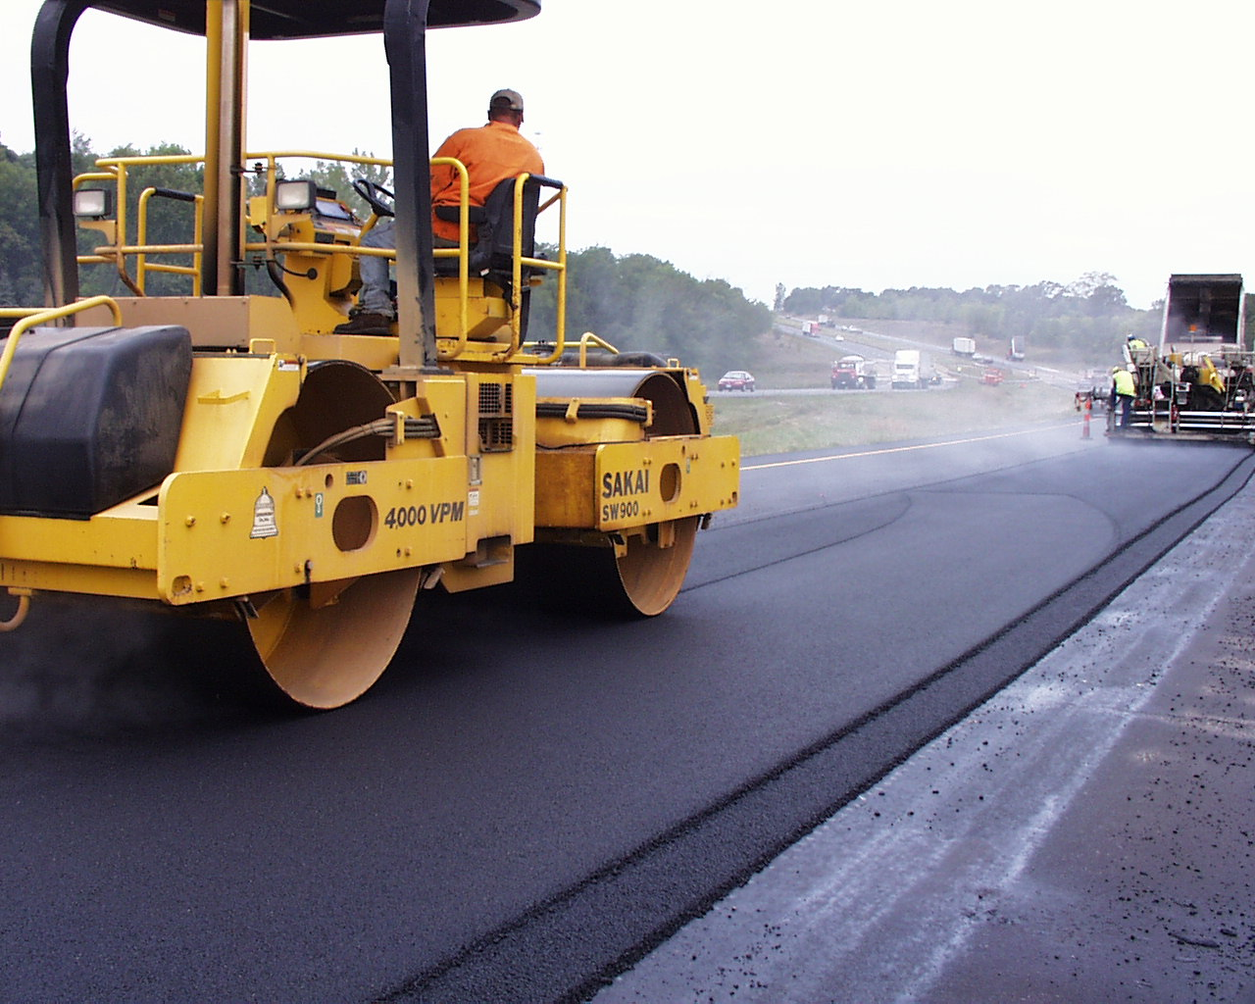
Pavement system components
Pavement design life is 40 years.
  Serviceable life can be extended with maintenance and rehabilitation, but not indefinitely.
Many factors influence the design….
  Truck traffic
  Subgrade soil
  Climate

Slide 5
Pavement Inventory
The Primary system includes 24,534 lane miles of pavement.
  3,848 or about 16% on the Interstate
  758 lane miles of ramps
  Our Investment
    If we had to replace the pavement on all of these roads today, the cost would exceed $21 billion.
Notes:
These mileages are based on the LRS data, not PMIS.

Slide 6
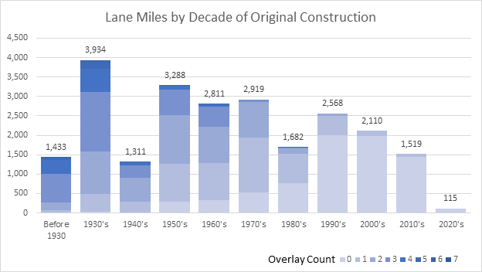
Pavement Inventory
Notes:
This chart includes 23,724 lane miles of mainline pavement on the Primary system (includes Interstates). The median pavement construction year is 1966 (50% were built prior to 1966) based on PMIS 2019. Using 2021 as our starting point, 56.8% of lane miles are at least 50 years old (CONYR = 1971 or older), and 29.9% are more than 70 years old.

Slide 7
Pavement Inventory
Half of the system’s original pavement is more than 55 years old.
30% (7,082 miles) is 70+ years old
Based on the size and age of our system we have a significant financial challenge facing us for the foreseeable future.

Slide 8
The Challenge
Over the past 30 years we have constructed or replaced 25% of the system.
If we were to make that same investment strictly into pavement replacements (not any new miles), then our pavements will need to remain serviceable for at least 120 years.
To date, we do not have any pavements that have reached that age.....Yet we have already replaced many miles that have not hit that milestone.

Slide 9
The Challenge
A recent analysis completed for the Long Range Transportation Plan led to the recommendation that we plan for a 100 year pavement life.
To achieve that replacement schedule will require $260M per year in funding for the primary system to address pavement replacement and rehabilitation.

Slide 10
Construction costs for highway projects
2-lane highway (rural)
  New construction - $6.9 million per mile
  Pavement replacement - $2.1 million per mile
  Resurfacing (3”) - $460,000 per mile

Slide 11
Managing our assets is critical to address this challenge and ease the financial burden
We need to make efficient investments when managing our pavements.
Use cost effective methods to extend pavement life.

Slide 12
Pavement Condition
Tracking the condition of pavements on the system is vital
  Pavements deteriorate at different rates and for different reasons
  Knowing the reason helps in making decisions on how to maintain pavements
We assess the condition of all pavements on a periodic basis.
  Key indicators such as roughness and cracking are evaluated at least biennially.
  Other indicators such as friction and structure are also evaluated on a 2 to 5 year cycle.
The condition information as well as details of construction and rehabilitation activities are all tracked in our Pavement Management Information System (PMIS).

Slide 13
Pavement Condition
Notes:
Note that there is a lag in the measurement of condition relative to the investment year. Typically condition lags investment by about three years (highlight how 2009 spike didn’t really show up until 2012).

Slide 14
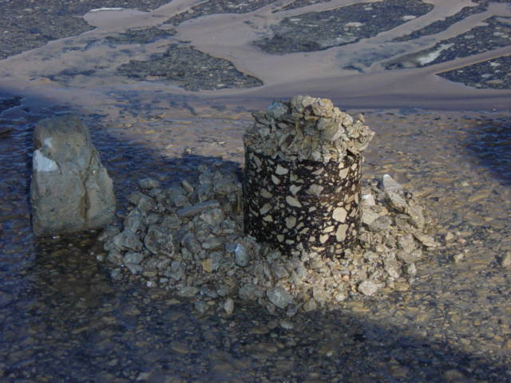
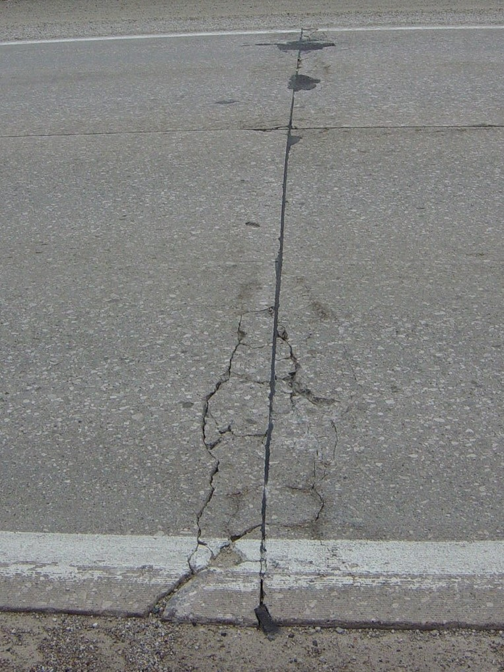
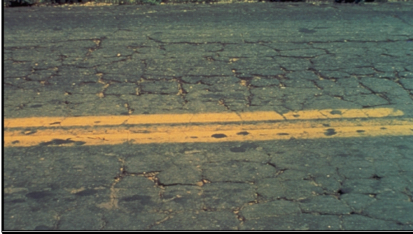
Pavement Deterioration
Pavement layers are designed for the anticipated truck loadings and for the environmental conditions
Pavements deteriorate after they are built due to many factors:
  Iowa has one of the harshest environments
    Year long moisture
    Temperature extremes
  Increased truck traffic or heavier trucks
  Subgrade inconsistency
  Drainage issues

Slide 15
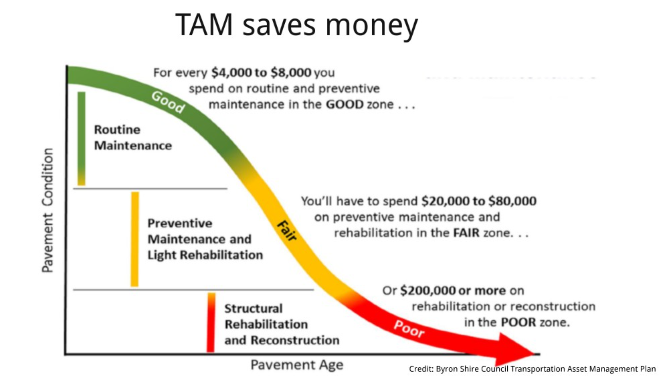
Pavement Deterioration

Slide 16
Slowing down the deterioration
Preventive Maintenance/Preservation
  Treatments applied to pavements in relatively good condition to extend pavement life and/or improve performance.
  Begin early in pavement life
  Very cost effective
  Treatments may be repeated on a schedule

Slide 17
Maintaining Good Condition Costs Less
Just like your car or home, routine and preventative maintenance can help extend the life.
  Eventually things wear out and more extensive rehabilitation or replacement is required.
Over the life of a pavement, preservation treatments are like sealing the deck on your house – it can help extend the life, but eventually it will need rehabilitation or replacement.
We use pavement management data and tools to help us determine the optimal mix of treatments to get the most life at the least cost.

Slide 18
Pavement Treatments
Increasing Annualized Cost
Maintenance/Preservation treatments
  Crack & joint sealing/filling
  Diamond grinding
  Thin surface treatments
    Chip seals
    Slurry seals
    Microsurfacing
    Thin lift asphalt overlays
Rehabilitations (20 year life)
  Functional overlays (to address ride)
  Cold-in-Place recycling
  Structural overlays (asphalt and concrete)
  Rubblization/crack & seat
Reconstruction (40 year life)
  Completely replacing the pavement and sometimes the subgrade
$3,000/mile/year of life
$9,000/mile/year
$10,000/mile/year
$35,000/mile/year
$50,000/mile/year
Notes:
Costs (from TAMP): Maint/Pres Tx $20k - $50k per lane mile; Rehab Tx $220k - $500k per LM; Recon Tx $600k - $750k per LM

Slide 19
Pavement Management
Which treatment to use depends on the condition of the pavement and the life that is needed.
The right treatment is cost effective because it has the lowest cost and will perform for the desired timeframe.
Some pavements require a higher cost treatment, but it can still be cost effective because it will provide a longer life or a higher level of performance.
The treatment cost and the effectiveness are incorporated into the models used to predict pavement needs into the future.

Slide 20
Condition Forecast Process
Modeling software predicts the system-wide pavement condition under any given funding scenario.
  Models are developed based on past pavement performance to predict future performance.
  The tool evaluates all viable treatment alternatives for each pavement.
  Optimization is used to select the mix of candidates that maximizes network condition.

Slide 21
Target Condition Index
Notes:
This chart shows past expenditures in the 3R program (Non-Interstate Pavement Modernization) and pavement condition. It is important to note there is about a 3-year lag in the condition measurement – projects in FY19 might not be complete until the fall of 2019, and often those won’t be evaluated again for another year or two so we might not see their condition reflected until the 2021 data. This lag is why we see the unexpected relationship between expenditures and condition.

Slide 22
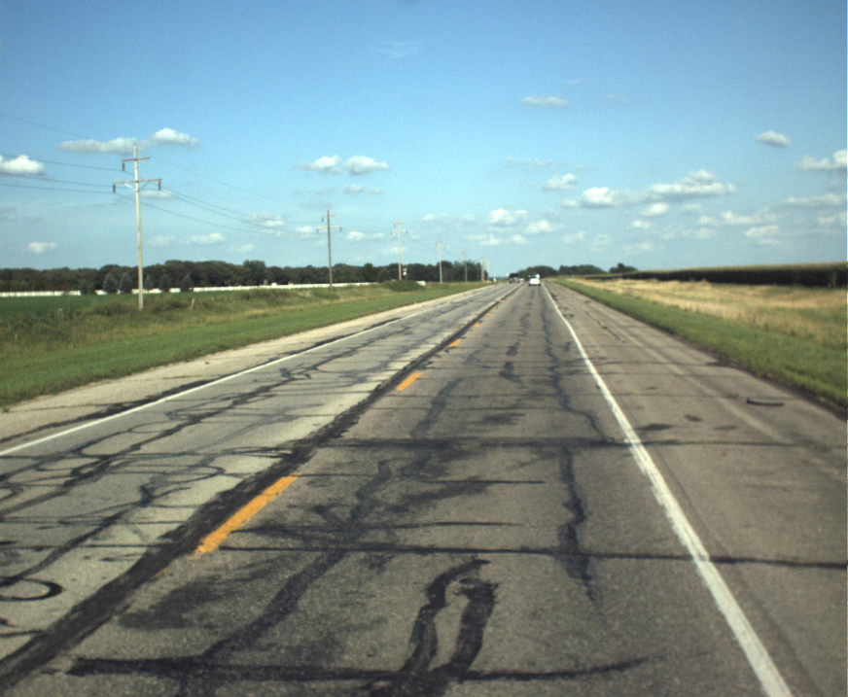
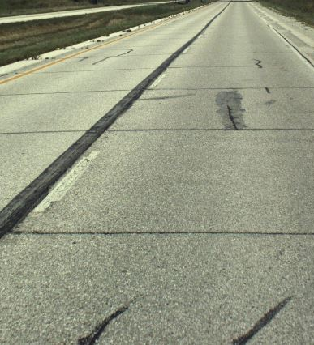
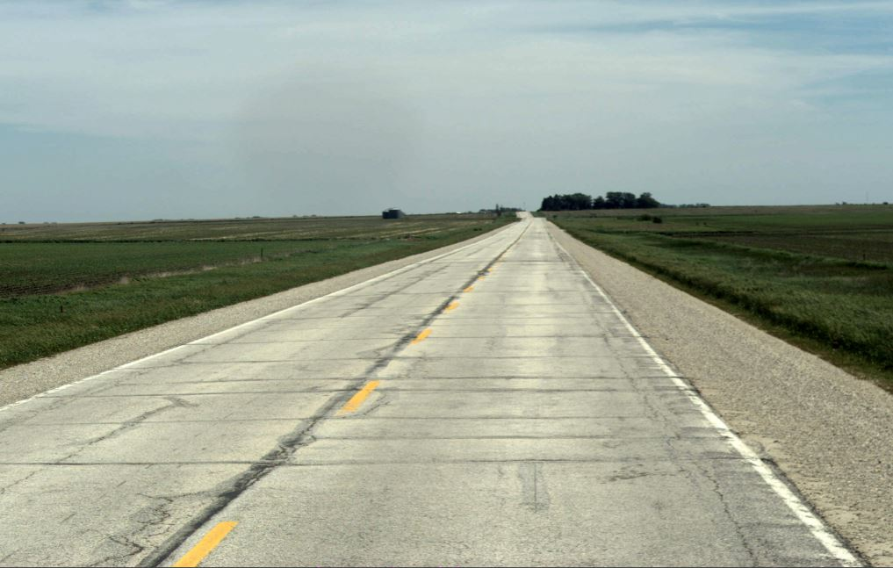
PCI = 33
PCI = 75
PCI = 50

Slide 25
Key Take-aways
Recent funding increases have helped slow the decline in condition of the system.
While short term funding can meet our target condition, the long-term needs are out-pacing our level of investment in pavement reconstruction………
  The reason is that Iowa’s highway system has been built over the past 100 years to the size it is today. At this point, the current projected funding is not adequate to sustain a system of this size in a state of good repair.
To address the need for replacing our aged system will require $260M per year in investment to the Primary system to achieve a 100 year replacement cycle.

