Slide 1
Transportation Trends Update
Transportation Commission Workshop
December 13, 2022

Slide 2
Overview
US total rail carloads
Commercial air service passenger counts
Vehicular traffic
Mississippi River

Slide 4
Railroad/Labor Issue
Legislation signed on Dec. 2, 2022, to impose labor agreement
Language based on tentative agreement negotiated in September

Slide 5
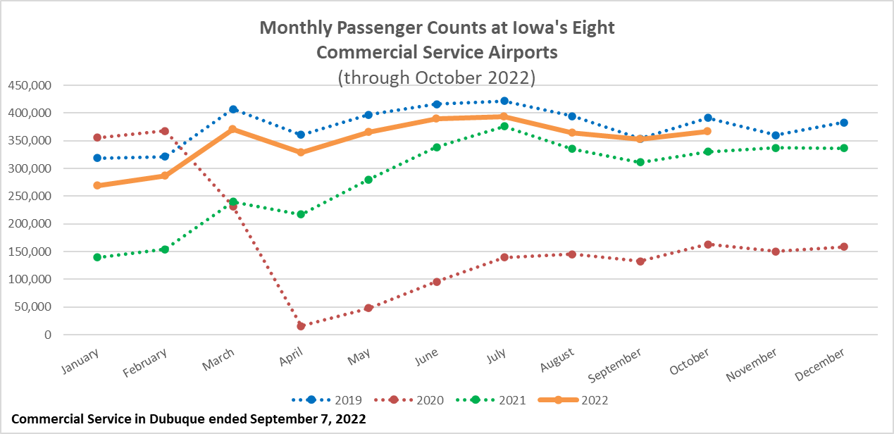

Slide 7
Mississippi River - Drought
Drought causing lower Mississippi River water levels to approach record lows
Fewer barges per tow
Barges filled with less grain
One-way traffic - bottlenecks
About 60 percent of all corn and grain exports traverse the Mississippi River
Increasing transportation costs
Nearly tripling of rates
Less competitive on export market
Lower prices given increased supplies
Potential impact on fertilizer transport in spring

Slide 8
Mississippi River - Status
Recent rains over the last month have provided some relief in the south
Continuous dredging is maintaining workable riverbed depths
Above-normal precipitation forecasts for parts of the watershed could help to improve conditions
Source: Mississippi River Basin Ag & Water Desk

Slide 9
Questions?

