Slide 1
Railroad Revolving Loan and Grant Program Policy Adjustment and Planning Study recommendation
December 13, 2022
Commission Workshop

Slide 2
Railroad Revolving Loan and Grant Program
Created by legislation in 2005
Purpose: To provide loans and grants for railroad related improvement projects to benefit Iowa.
Funded by loan repayments and appropriations by the Iowa Legislature. Funding is available to cities, counties, economic development organizations, businesses, rail companies and alliances of such organizations.

Slide 3
Current Program Timeline
Applications are evaluated annually (one funding cycle per year)
All 3 eligible projects types are reviewed
Targeted Job Creation
Rail Network Improvements
Rail Port Planning and Development

Slide 4
Proposed Adjustment
Rail Port Planning and Development Studies be evaluated as they are received
Why do this?
Helps serve customer needs more timely.
Allows planning projects to be funded at any time.
Facilitates projects with economic development opportunities to be advanced without delays due to the annual funding cycle.
How will changes be made?
Accept planning study applications at any time and be considered for funding, based on funding availability.
RRLG Program Guidance will be updated and posted on website.

Slide 5
This change is allowable with current Administrative Rules
(1)Submission. Applications may be submitted at any time and will be held until the next evaluation cycle.
a. A notice of funding availability will be published on the department's website when funding is available. The notice will include the approximate amount of funding available and a deadline for consideration of applications.
Iowa Admin. Code r. 761-822.10

Slide 6
FY 23 Program Modification Recommendation
TOTAL RAIL PROJECT COST
REQUESTED AMOUNT
(% of Total Project Cost)
RECOMMENDED AMOUNT
(% of Total Project Cost)
PROJECT NAME
SPONSOR
SCORE
Iowa Crossroads of Global Innovation Dual Rail and Transload Study | Webster County | Not Applicable | $200,000 | Grant: $100,000 (50%) | Grant: $100,000 (50%)
Notes:
The Commission approved the FY 23 RRLG projects on October 11, 2022. Webster County submitted a planning study application in September, after project recommendations for FY 23 had been considered. With the change in accepting and funding planning studies at anytime during the year, we are recommending funding this planning study.
Total study cost $200,000
Grant Requested: $100,000 (50%)
Staff recommends a full grant award of $100,000(50%)

Slide 7
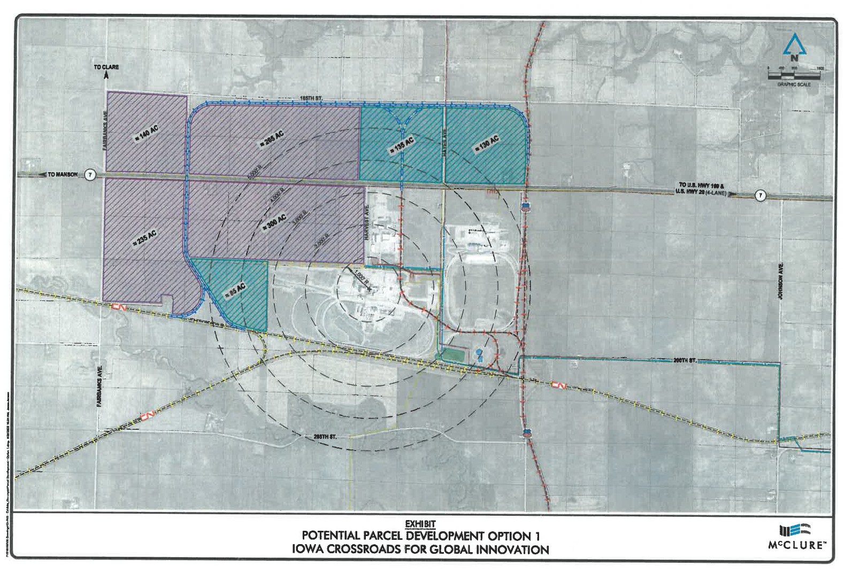
Iowa Crossroads of Global Innovation Dual Rail and Transload Study
The purpose of the study is to determine the feasibility of a transload facility to serve Webster County. The study will determine the current and future needs of the area and prepare a plan for an efficient rail transportation to meet those needs.
Total Cost: $200,000
Requested: $100,000 Recommended: $100,000
Return to Recommendation Summary
Notes:
The project area includes two Class 1 RR’s, UPRR and CN. The area is primed with industrial agricultural companies and existing rail facilities. The study will review the potential for expanding the rail capabilities of the area and add benefit by constructing a rail port transload facility to transfer products between truck and train freight movement systems and provide dual rail service to companies served.

Slide 8
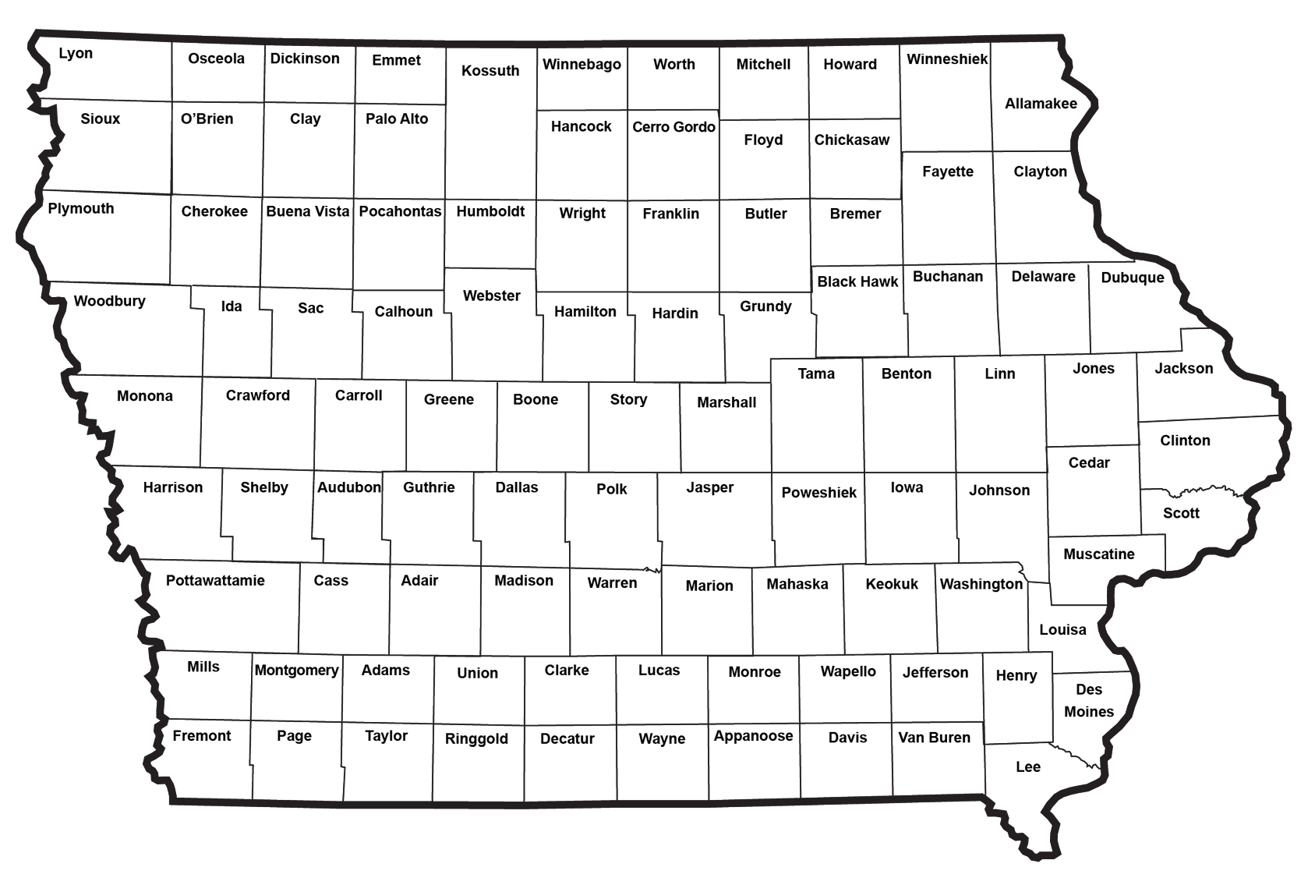
Iowa Crossroads of Global Innovation Dual Rail and Transload Study
Return to Recommendation Summary

Slide 9
QUESTIONS?
Tammy Nicholson,
Modal Transportation Bureau
Tamara.nicholson@iowadot.us
515-239-1052

