Slide 1
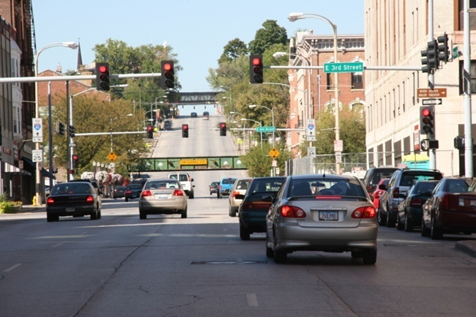

Iowa’s Clean Air Attainment Program
Funding Recommendation

Slide 2

Iowa’s Clean Air Attainment Program
Iowa’s Clean Air Attainment Program (ICAAP) was created in 1994.
Modeled after the federal Congestion Mitigation and Air Quality Improvement Program established in 1991.
Available to cities, counties, public transit agencies, MPOs, RPAs, and state agencies. Private non-profit or for-profit entities when co-sponsored by an eligible public agency through an annual application program.
Purpose is to award funds to projects with the highest potential for reducing transportation-related congestion and air pollution.

Slide 3
Project Evaluation Criteria
Vehicle traffic flow improvements (25 points)
Vehicle miles of travel (VMT) or single-occupant vehicle (SOV) reduction (25 points)
Estimated vehicle emission reduction (20 points)
Degree of transportation-related air pollution or traffic congestion (15 points)
Project cost effectiveness relative to air quality benefits (30 points)

Slide 4
Available Funding and Application Summary
Available Funding:
Iowa’s Clean Air Attainment Program funds available: $4,000,000
Application Summary:
Total number of projects: 8
Total project costs: $4,841,950
Total amount requested: $3,873,560

Slide 5
List of Applications Recommended
PROJECT NAME | SPONSOR | SCORE | TOTAL PROJECT COST | REQUESTED AMOUNT (% of Total Project Cost) | RECOMMENDED AMOUNT (% of Total Project Cost)
Traffic System Vehicle Detection Improvement Project – Phase 2 | West Des Moines | 86 | $540,000 | $432,000 (80%) | $432,000 (80%)
Marketing Campaign | Des Moines Area Regional Transit Authority | 76 | $50,000 | $40,000 (80%) | $40,000 (80%)
Altoona ITS Master Plan | Altoona | 72 | $94,860 | $75,888 (80%) | $75,888 (80%)
100th Street Adaptive Signal Coordination | Urbandale | 53 | $180,000 | $144,000 (80%) | $144,000 (80%)
Deployment of Ames Traffic Signal Master Plan – Phase 4 | Ames | 52 | $1,901,600 | $1,521,280 (80%) | $1,521,280 (80%)

Slide 6
List of Applications Recommended
PROJECT NAME | SPONSOR | SCORE | TOTAL PROJECT COST | REQUESTED AMOUNT (% of Total Project Cost) | RECOMMENDED AMOUNT (% of Total Project Cost)
Ansborough Avenue Adaptive Signal Control Technology | Waterloo | 44 | $910,000 | $728,000 (80%) | $728,000 (80%)
Broadway Street Adaptive Signal Control Technology | Waterloo | 41 | $1,100,000 | $880,000 (80%) | $880,000 (80%)
Route #17 Extension to Bondurant – Year 3 | Des Moines Regional Transit Authority | 29 | $65,490 | $52,392 (80%) | $52,392 (80%)

Slide 7
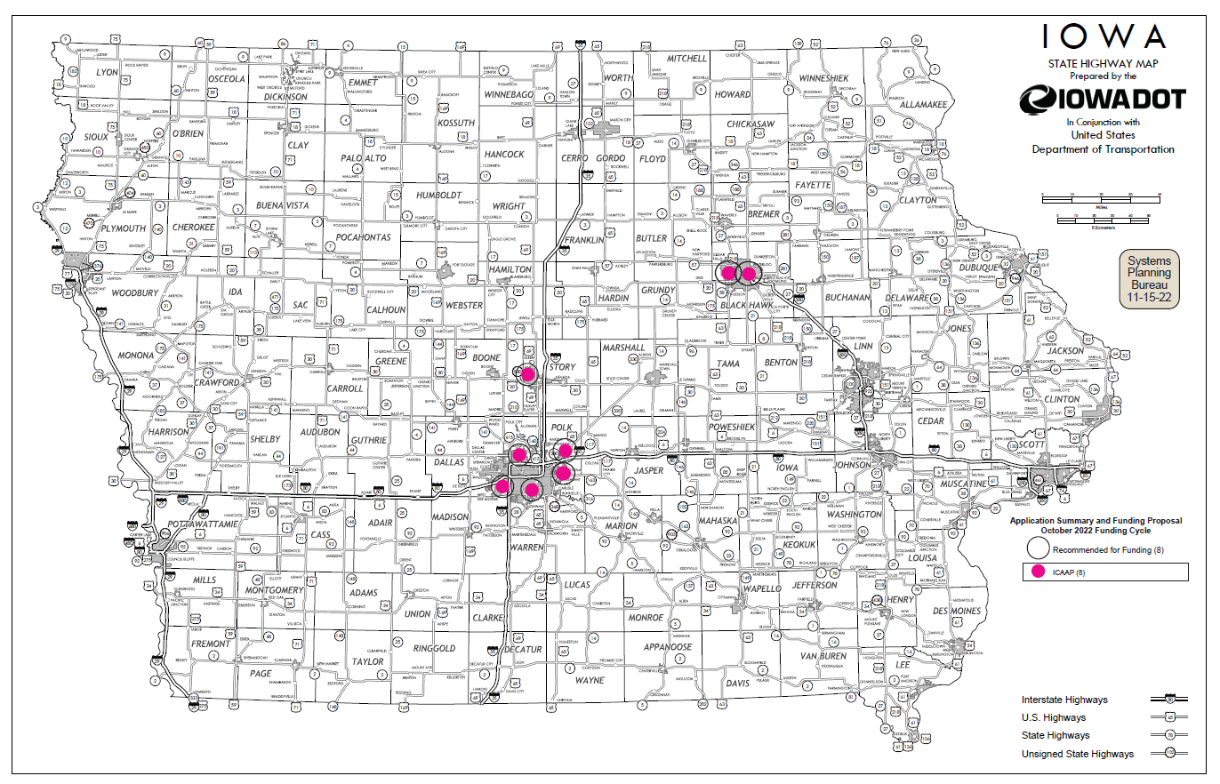
Map of Applications Received

Slide 8
Estimated Annual Benefits of Recommended Projects
Reduction of Vehicle Hours of Travel: 721,548
Reduction of Vehicle Miles of Travel: 5,559,581
Improved Air Quality
Reduced CO, VOCs, & NOx Emissions: 343,925 lbs.

Slide 9

QUESTIONS?
Jared Smith
Iowa’s Clean Air Attainment program manager
Jared.Smith@iowadot.us

Slide 10
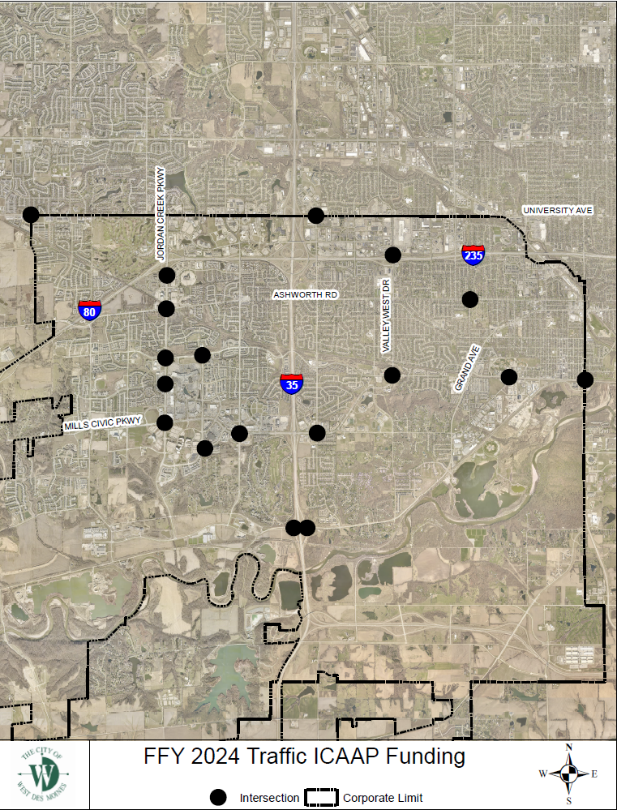
Traffic System Vehicle Detector Improvement Project – Phase 2
(West Des Moines)
Replace existing vehicle detection method, such as in-pavement loops, with state-of-the-art single point video detection.
Total Cost: $540,000
Requested: $432,000 (80%)
Return to List of Applications Recommended

Slide 11
Marketing Campaign
(Des Moines Area Regional Transit Authority)
The project is a marketing campaign aiming to increase awareness and ridership on DART’s Fixed Route service and Ride Share service.
Total Cost: $50,000
Requested: $40,000 (80%)
Return to List of Applications Recommended

Slide 12
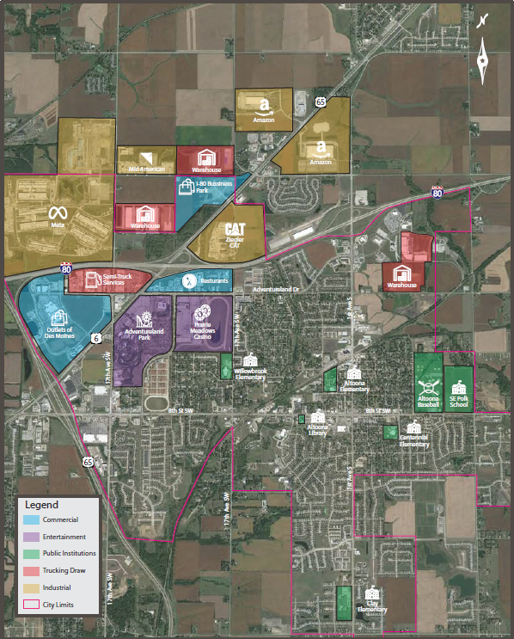
ITS Master Plan
(Altoona)
Development of a city-wide Intelligent Transportation System (ITS) Master Plan which will allow the city to leverage their investment in their city-wide fiber communication system to monitor and improve traffic flows on major corridors and around key event centers, like Adventureland and Prairie Meadows.
Total Cost: $94,860
Requested: $75,888 (80%)
Return to List of Applications Recommended

Slide 13
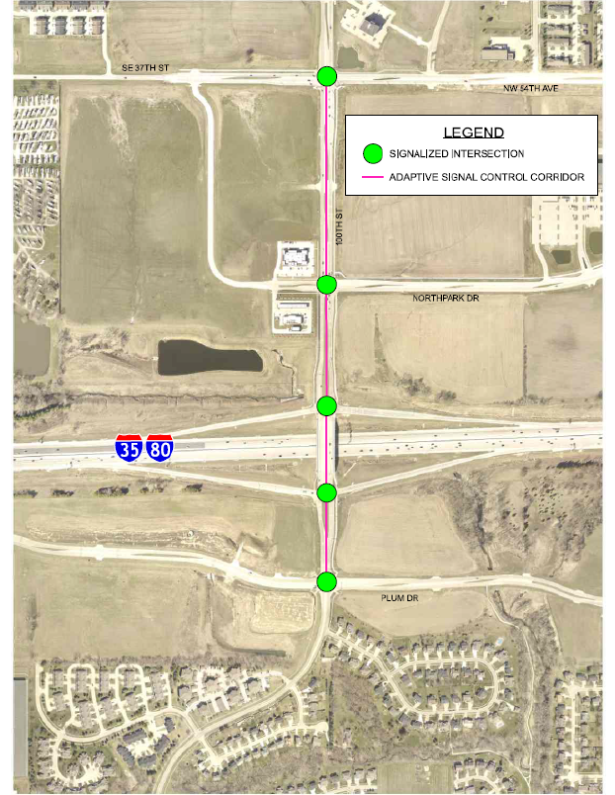
100th Street Adaptive Signal Coordination
(Urbandale)
Adaptive signal control technology and detection modifications to improve adaptive operation at five existing signalized intersections along 100th Street between Plum Drive and NW 54th Avenue. Adaptive signal control would be beneficial on 100th Street to improve traffic flow during peak travel times and for incident management along I-35/80.
Total Cost: $180,000
Requested: $144,000 (80%)
Return to List of Applications Recommended

Slide 14
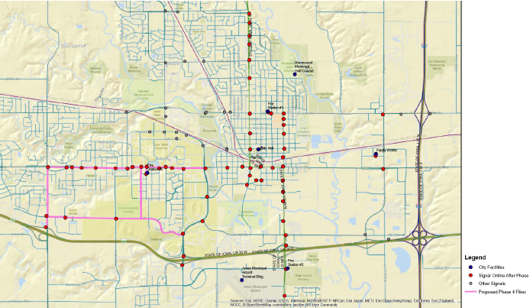
Deployment of Ames Traffic Signal Master Plan – Phase 4
(Ames)
Fourth phase will provide a fiber optic connection from Lincoln Way, University Boulevard, South Dakota Avenue, and Mortensen Road. This phase will also add a redundant link for signals along University Avenue and include a spur along Dakota Avenue, from Mortensen Road to U.S. 30 westbound ramp. This spur will also connect Fire Station #2.
Total Cost: $1,901,600
Requested: $1,521,280 (80%)
Return to List of Applications Recommended

Slide 15
Ansborough Avenue Adaptive Signal control Technology
(Waterloo)
Install adaptive signal control technology on Ansborough Avenue in Waterloo. This project includes 2.7 miles of fiber optic interconnection and connection to the city of Waterloo traffic fiber optic network at the Downing Street intersection with Ansborough Avenue.
Total Cost: $910,000
Requested: $728,000 (80%)
Return to List of Applications Recommended

Slide 16
Broadway Street Adaptive Signal Control Technology
(Waterloo)
Install adaptive signal control technology on Broadway Avenue in Waterloo. This project includes 3.7 miles of fiber optic interconnection and connection to the city of Waterloo traffic fiber optic network at the Franklin Street intersection with U.S. 63.
Total Cost: $1,100,000
Requested: $880,000 (80%)
Return to List of Applications Recommended

Slide 17
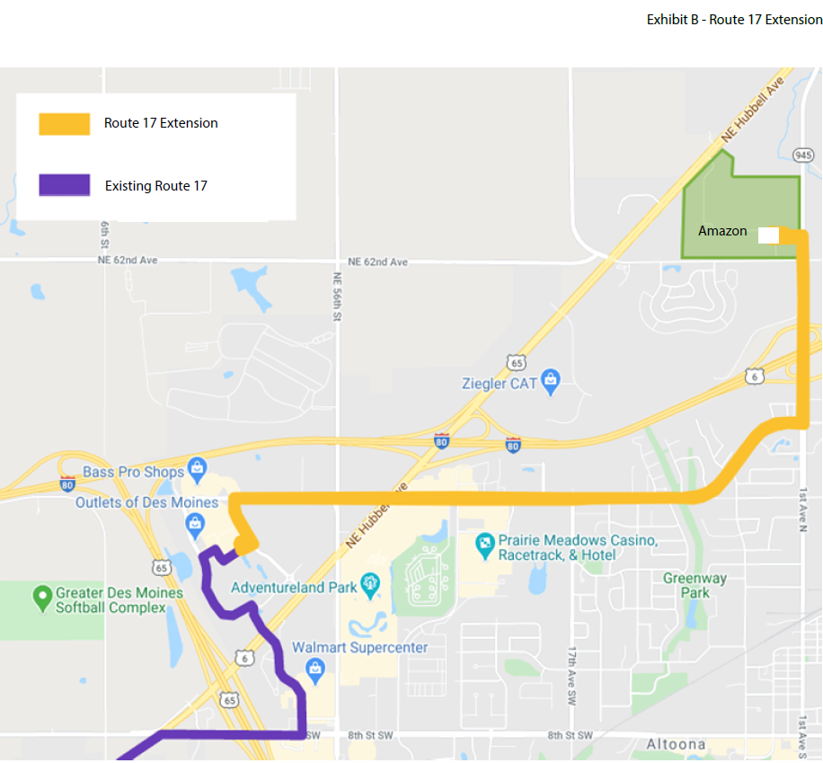
Route #17 Extension to Bondurant – Year 3
(Des Moines Regional Transit Authority)
DART extended service on Route #17 between the Outlets of Des Moines and the Amazon facility in Bondurant in November 2020. The route extension provides transportation options for the employees of the Amazon facility as well as providing additional connections for the residents of Bondurant to Des Moines.
Total Cost: $65,490
Requested: $52,392 (80%)
Return to List of Applications Recommended

