Slide 1
Federal Recreational Trails Program
Funding Recommendation

Slide 2
Federal Recreational Trail Program
Federal program created in 1991
Available to federal, state, and local government agencies. Private individuals and organizations may apply with a government co-sponsor.
Purpose is to develop and maintain recreational trails and trail related facilities for both motorized and non-motorized trail users.
Eligible projects include:
Maintenance and restoration of existing trails, development of trailside and trailhead facilities, purchase of trail construction and maintenance equipment, construction of new trails, and acquisition of land for trails.

Slide 3
Project Evaluation Criteria
Degree to which motorized and non-motorized trail use are accommodated. (10 points)
Greatest number of compatible multi-purpose uses. (10 points)
Access and use for persons with disabilities, older citizens, economically challenged and other special populations or groups. (10 points)
Provides development of trail linkages. (10 points)
Opportunities for new partnerships between trail users and private interests. (10 points)
Identified in or furthers a specific goal of a state, regional, or local plan. (10 points)
Leverages greater public or private investments. (10 points)
Citizen involvement in the project’s conception and implementation (10 points)
Degree to which project ties in to other trails. (10 points)
Public/private partnerships to continue operation and maintenance. (15 points)
Trails with national designation or resulting in the cleanup of an area. (10 points)

Slide 4
Available Funding and Application Summary
Available Funding:
Annual appropriation: $1,300,000
Underruns from closed projects: $ 61,167
Application Summary:
Total number of projects: 18
Total project costs: $19,760,150
Total amount requested: $7,653,328

Slide 5
List of Motorized Applications Recommended
PROJECT NAME | SPONSOR | SCORE | TOTAL PROJECT COST | REQUESTED AMOUNT (% of Total Project Cost) | RECOMMENDED AMOUNT (% of Total Project Cost)
Nicholson-Ford OHV Park Tree Clean Up | Iowa Department of Natural Resources | 57.57 | $164,500 | $131,600 (80%) | $131,600 (80%)
Snowmobile Trail Maintenance | Iowa State Snowmobile Association | 56.43 | $307,500 | $246,000 (80%) | $246,000 (80%)
Jump to applications not recommended for funding

Slide 6
List of Non-motorized Applications Recommended
PROJECT NAME | SPONSOR | SCORE | TOTAL PROJECT COST | REQUESTED AMOUNT (% of Total Project Cost) | RECOMMENDED AMOUNT (% of Total Project Cost)
Bicycle Summit | Iowa DOT | N/A | $7,500 | $6,000 (80%) | $6,000 (80%)
Cedar River Water Trails Access Improvements | Mitchell County Conservation Board | 79.57 | $1,289,210 | $665,050 (52%) | $665,050 (52%)
Central Place Levee Trail Phase 2 | Des Moines | 76.57 | $2,500,000 | $300,000 (12%) | $300,000 (12%)
Jump to applications not recommended for funding

Slide 7
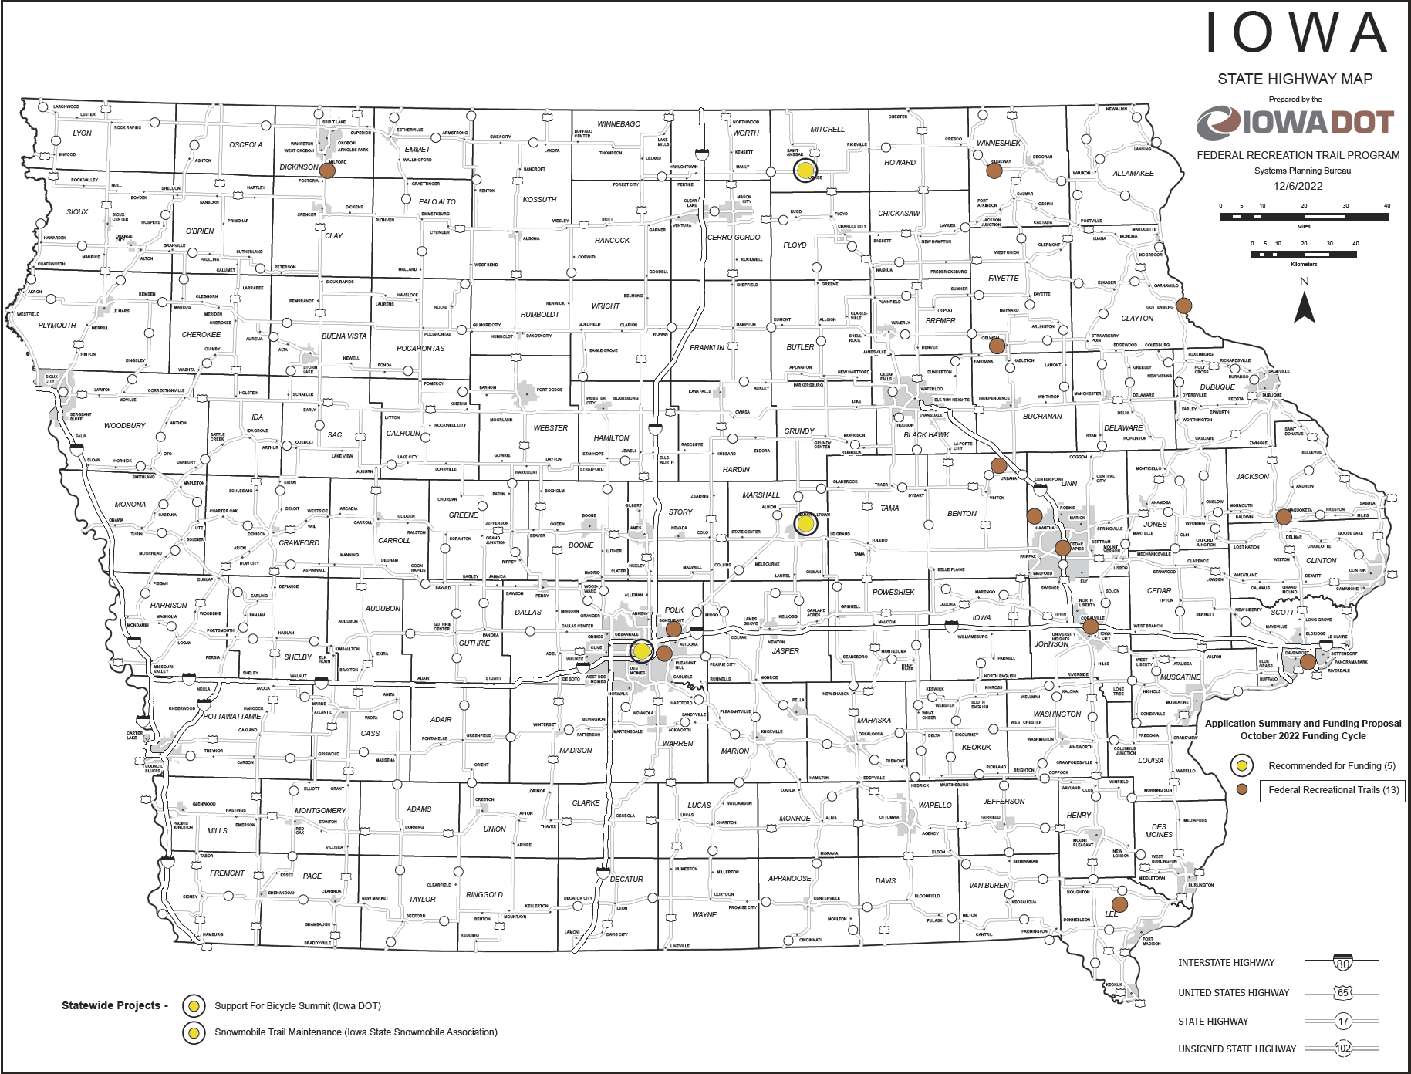
Map of Applications Received

Slide 8
QUESTIONS?
Scott Flagg, Federal Recreational Trails Program Manager
scott.flagg@iowadot.us
515-239-1252

Slide 9
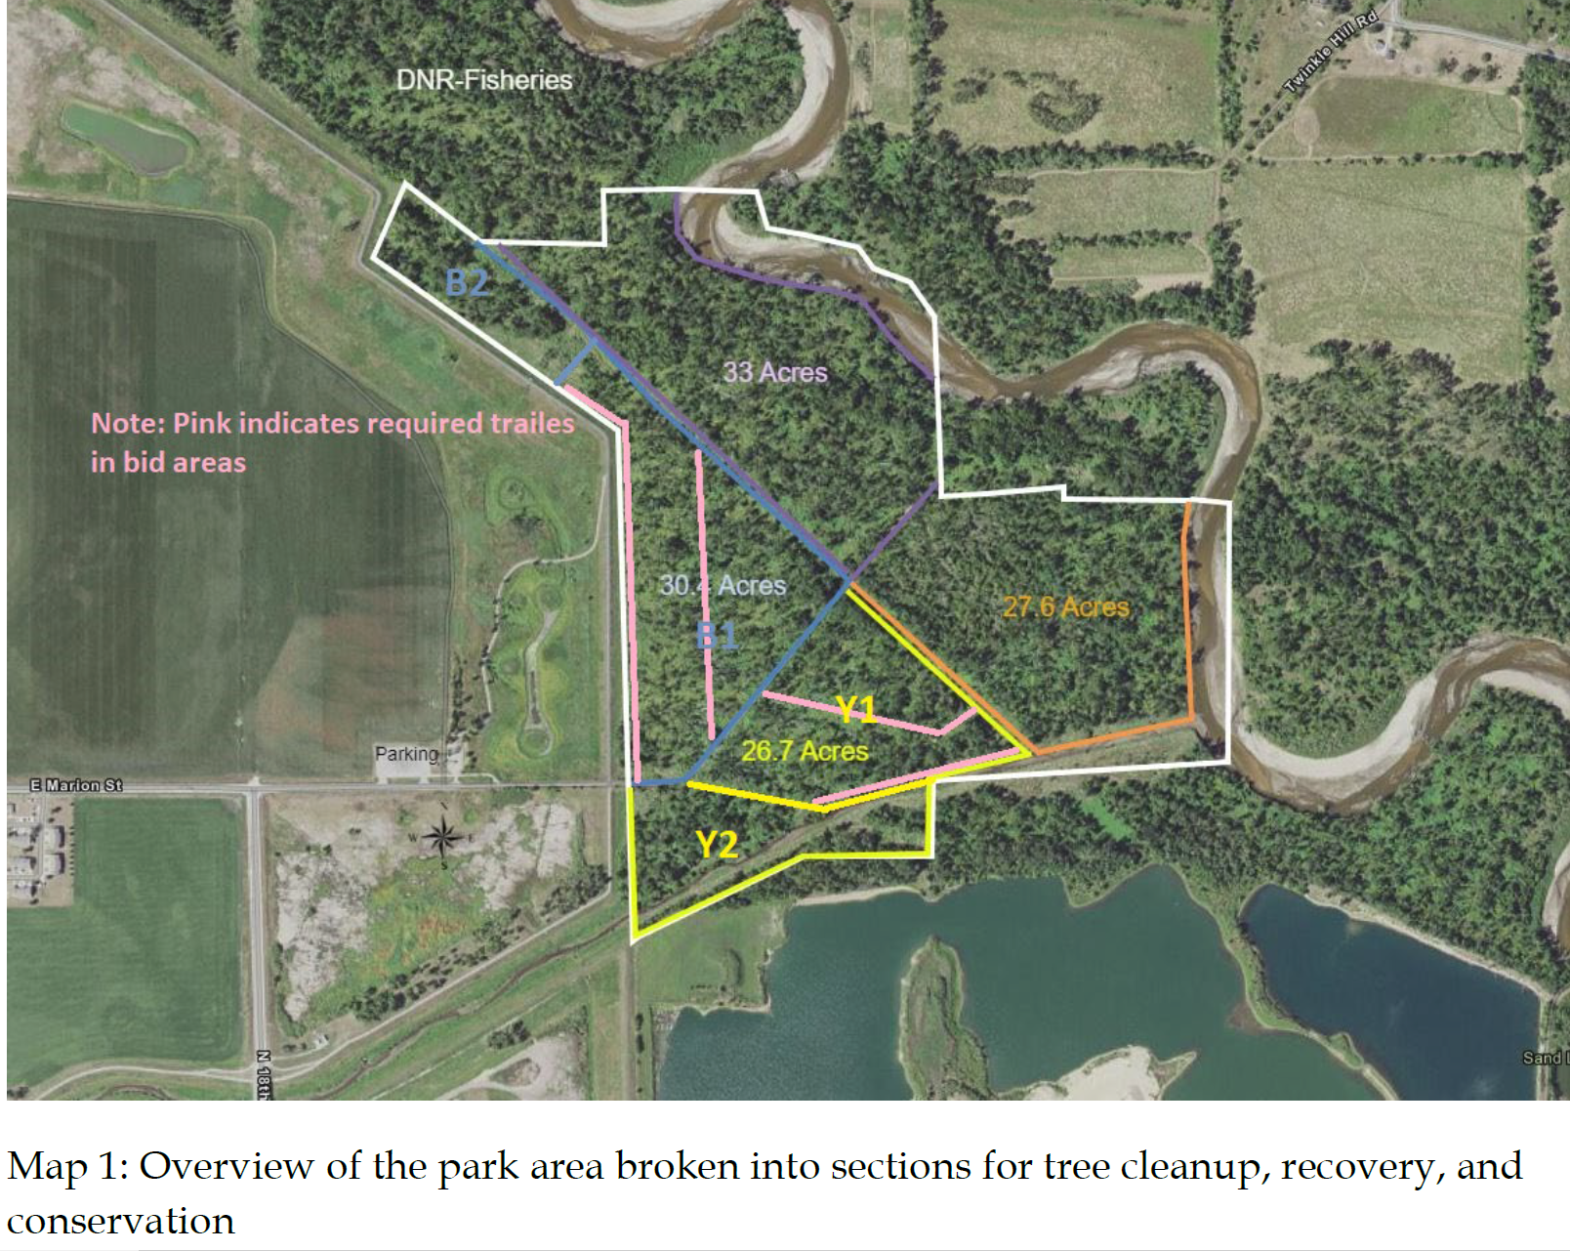
Nicholson-Ford OHV Park Tree Clean Up
(Iowa Department of Natural Resources)
Remove damaged and downed trees and reopen trails within park that was damaged by 2020 derecho.
Total Cost: $164,500
Requested: $131,600 (80%)
Return to List of Applications Recommended

Slide 10
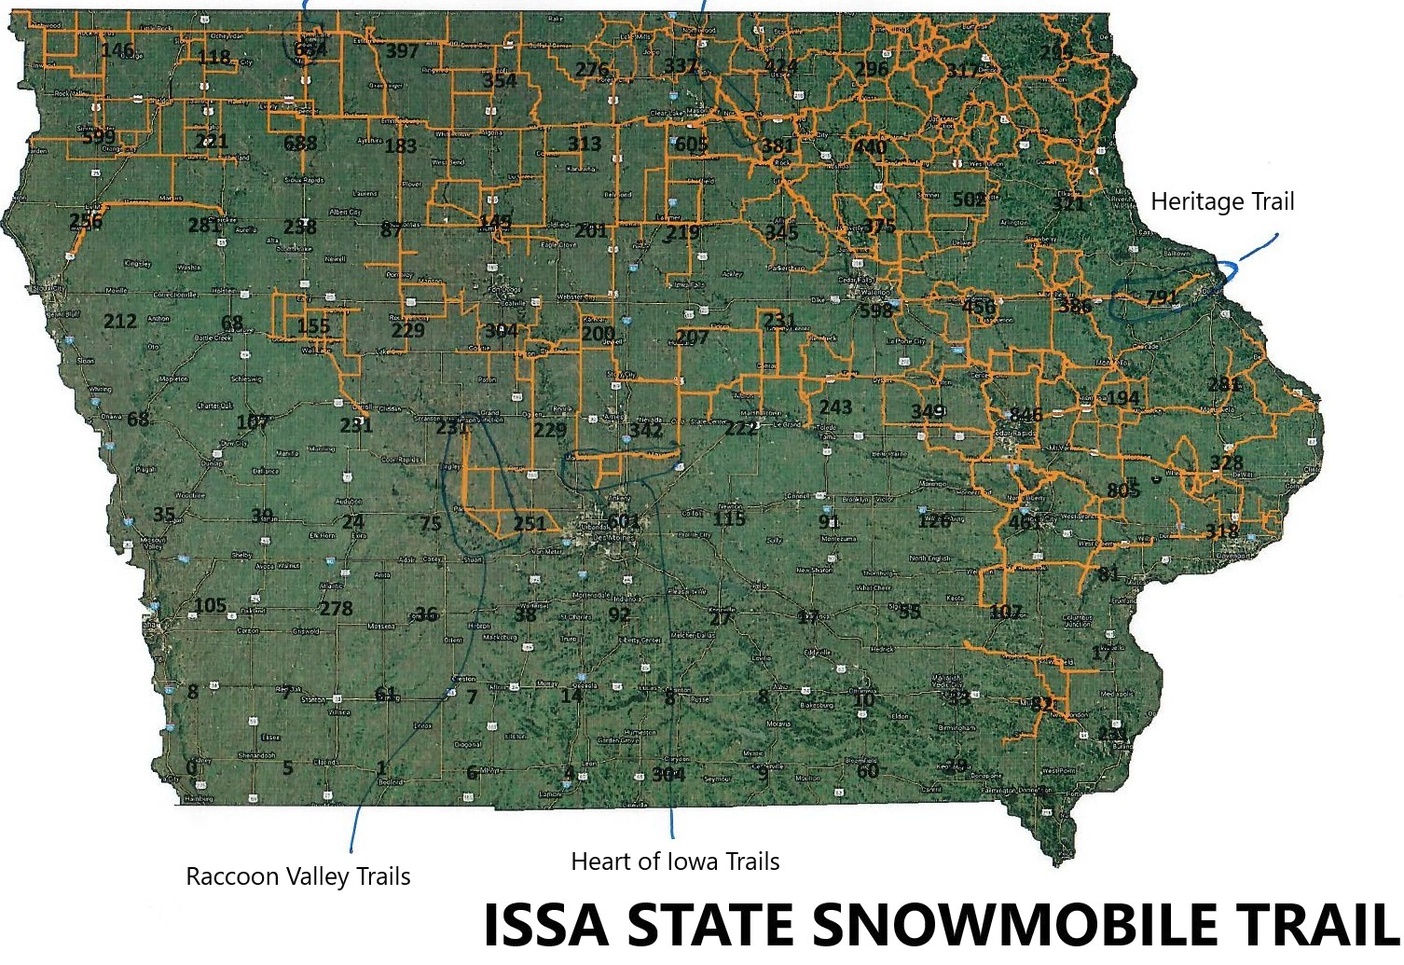
Snowmobile Trail Maintenance
(Iowa State Snowmobile Association)
Project will create and maintain snowmobile trails in 63 counties across Iowa for the winter of 2023-2024.
Total Cost: $307,500
Requested: $246,000 (80%)
Return to List of Applications Recommended

Slide 11
Bicycle Summit (Iowa DOT)
This project provides funding to pay for costs related to the 2024 Iowa Bicycle Summit. The Iowa Bicycle Summit is an annual conference providing education on the latest bicycle facilities, technology, and programming. It brings national speakers to Iowa to share bicycle facility successes and best practices from around the United States. Many of the lessons learned at the Summit have manifested into trail facilities and safety.
Total Cost: $7,500
Requested: $6,000 (80%)
Return to List of Applications Recommended

Slide 12
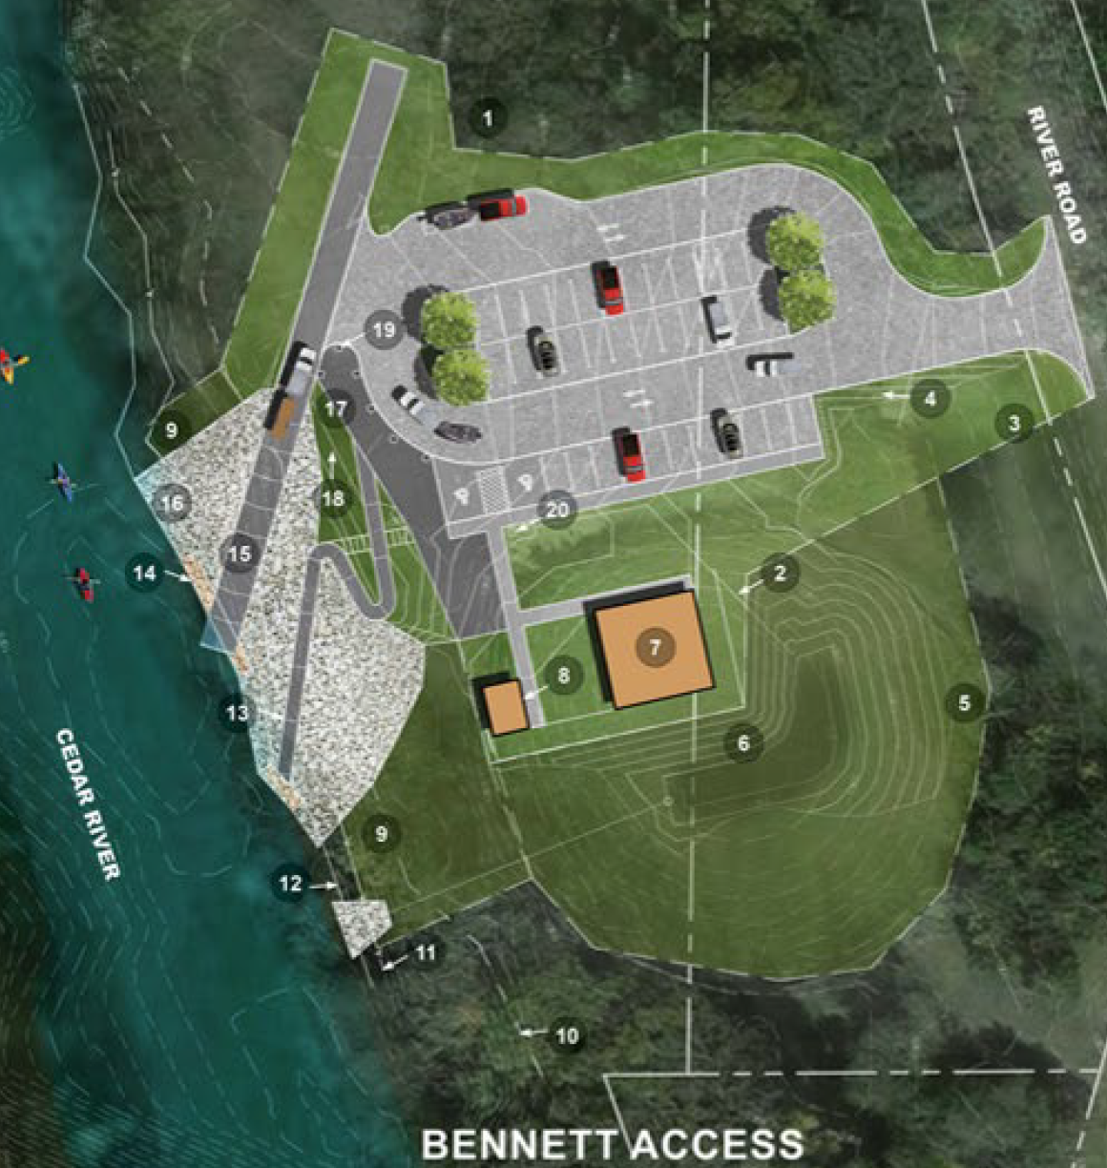
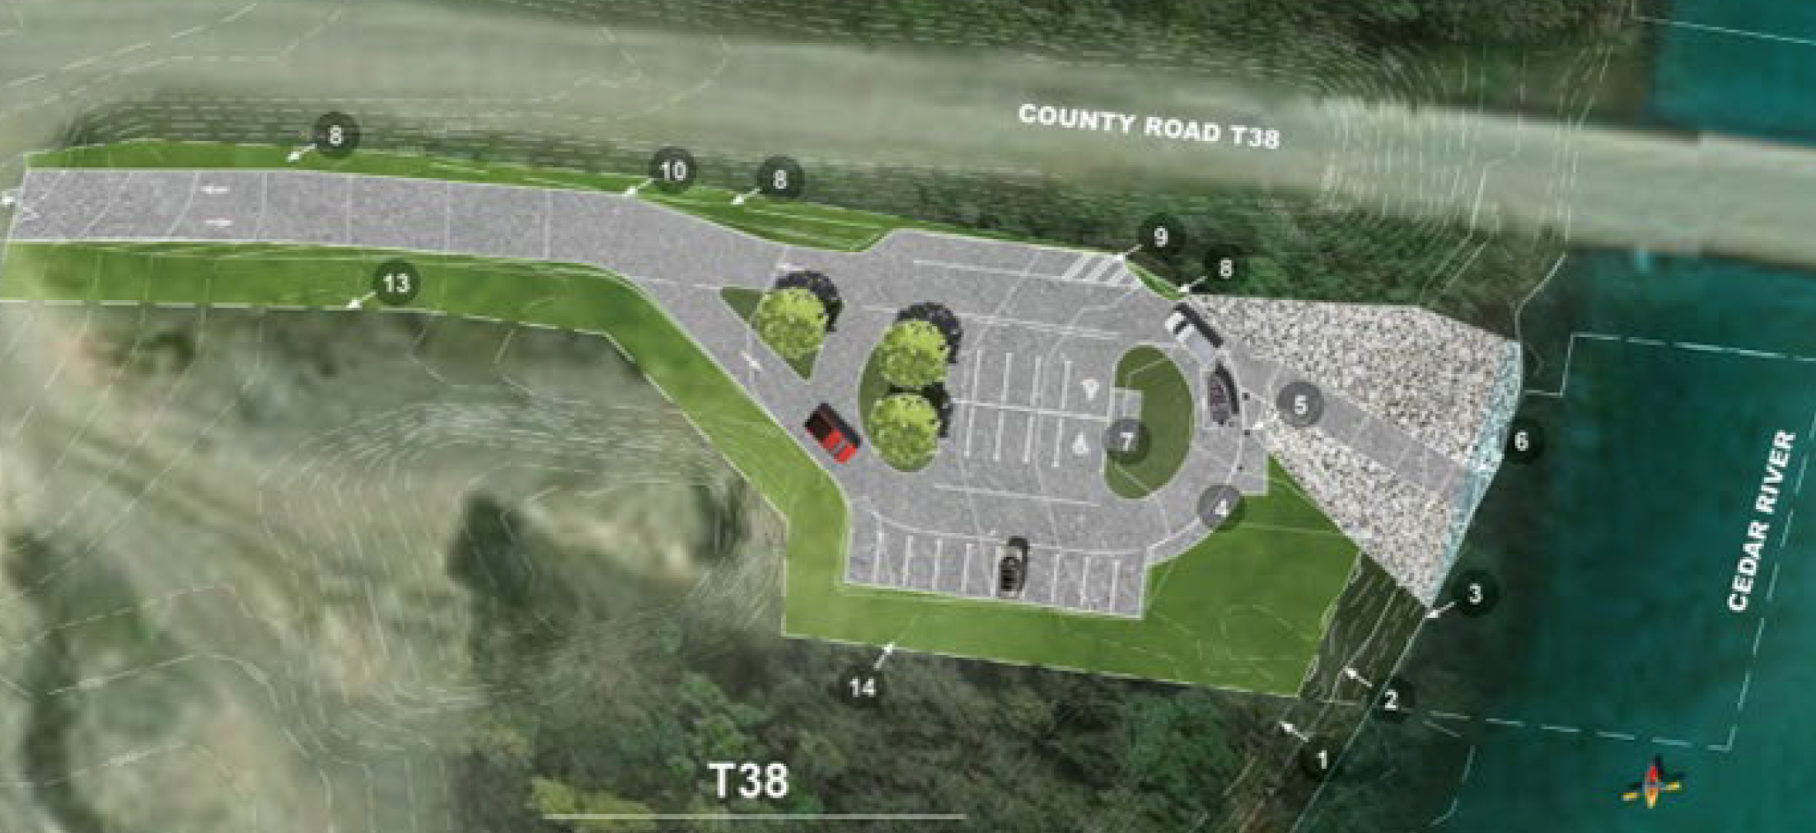
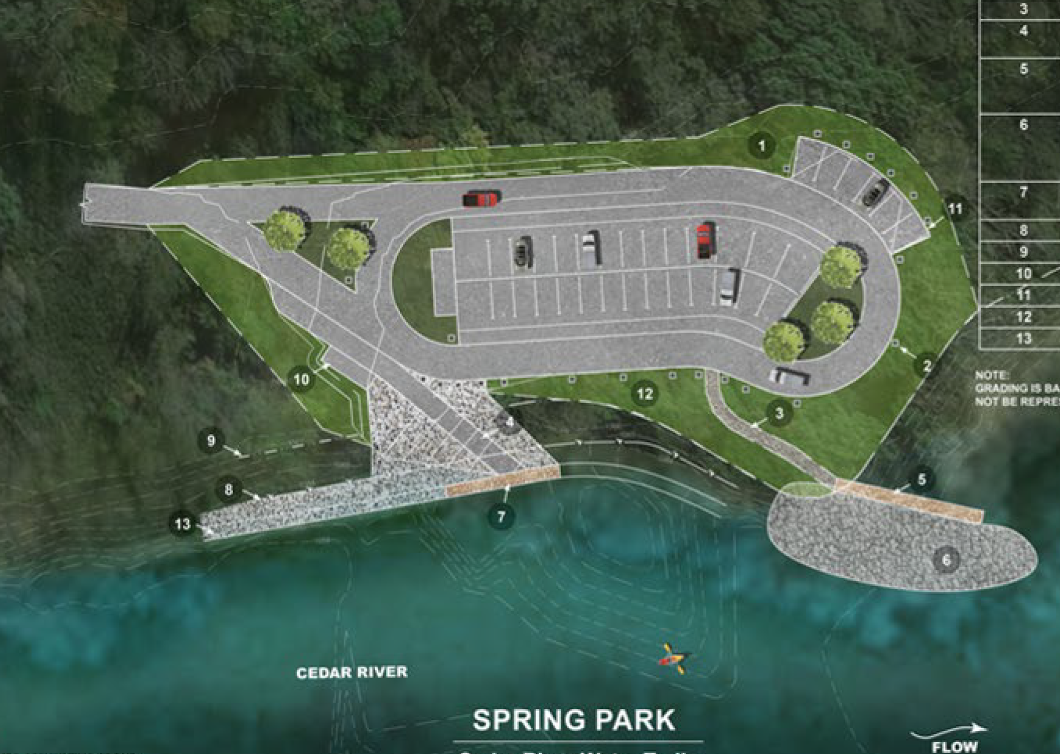
Cedar River Water Trails Access Improvements
(Mitchell County Conservation Board)
Project adds paved parking, boat ramps and other enhancements at three Cedar River access points.
Total Cost: $1,289,210
Requested: $665,050 (52%)
Return to List of Applications Recommended

Slide 13
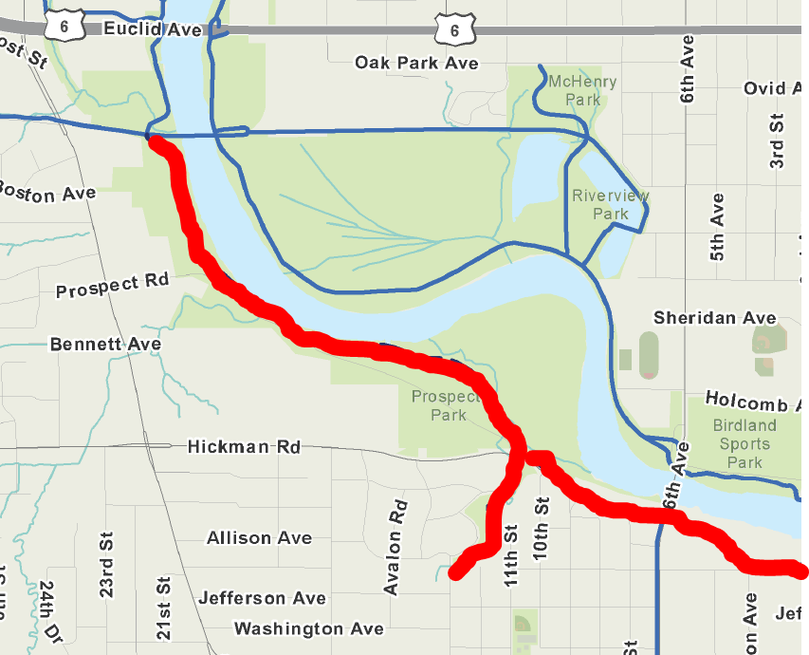
Central Place Levee Trail Phase 2
(Des Moines)
Project constructs 2.1-miles of multi-use trail along the west bank of the Des Moines River between the intersection of 2nd Avenue and Franklin Avenue and the intersection of the Inter-Urban and Trestle to Trestle trails. A 0.8 mile spur into local neighborhoods without trail access is also included.
Total Cost: $2,500,000
Requested: $300,000 (12%)
Return to List of Applications Recommended

Slide 14
List of Applications Not Recommended for Award
PROJECT NAME | SPONSOR | SCORE | TOTAL PROJECT COST | REQUESTED AMOUNT (% of Total Project Cost) | RECOMMENDED AMOUNT (% of Total Project Cost)
Trailhead at Clear Creek Point | Coralville | 69.71 | $155,400 | $124,320 (80%) | $0
Cedar Valley Nature Trail: Iowa 150 to Benton/Buchanan County Line | Linn County Conservation Board | 69.57 | $2,474,080 | $750,000 (30%) | $0
Clay County Connection Phase II | Dickinson County | 68.29 | $972,850 | $340,500 (35%) | $0
First Bridge Pedestrian/Bicycle Bridge | River Action Inc | 67.71 | $2,906,748 | $700,000 (24%) | $0
Copper Creek Mountain Bike Park | Polk County Conservation Board | 61.29 | $1,600,000 | $400,000 (25%) | $0
Return to List of Applications Recommended

Slide 15
List of Applications Not Recommended for Award
PROJECT NAME | SPONSOR | SCORE | TOTAL PROJECT COST | REQUESTED AMOUNT (% of Total Project Cost) | RECOMMENDED AMOUNT (% of Total Project Cost)
Pollmiller Park Trail Rehabilitation | Lee County Conservation Board | 57.57 | $420,000 | $150,000 (36%) | $0
Oelwein Municipal Urban Trail - Segment 2 | Oelwein | 57.43 | $781,318 | $625,054 (80%) | $0
Chichaqua Valley Trail Connection | Bondurant | 57.14 | $1,579,289 | $100,000 (6%) | $0
Guttenberg Recreational Trail Connection | Guttenberg | 56.86 | $819,000 | $215,200 (26%) | $0
Iowa 64 and Prairie Creek Trails Connection | Maquoketa | 54.71 | $561,755 | $449,404 (80%) | $0
Return to List of Applications Recommended

Slide 16
List of Applications Not Recommended for Award
PROJECT NAME | SPONSOR | SCORE | TOTAL PROJECT COST | REQUESTED AMOUNT (% of Total Project Cost) | RECOMMENDED AMOUNT (% of Total Project Cost)
4th Street Trail : 7th Avenue to 9th Avenue SE | Cedar Rapids | 54.43 | $502,000 | $401,000 (80%) | $0
Palo Connector Trail | Palo | 47.17 | $2,464,000 | $1,971,200 (80%) | $0
Prairie Farmer Trail Paving Project | Winneshiek County Secondary Roads | 42.50 | $255,000 | $78,000 (31%) | $0
Return to List of Applications Recommended

