Slide 1
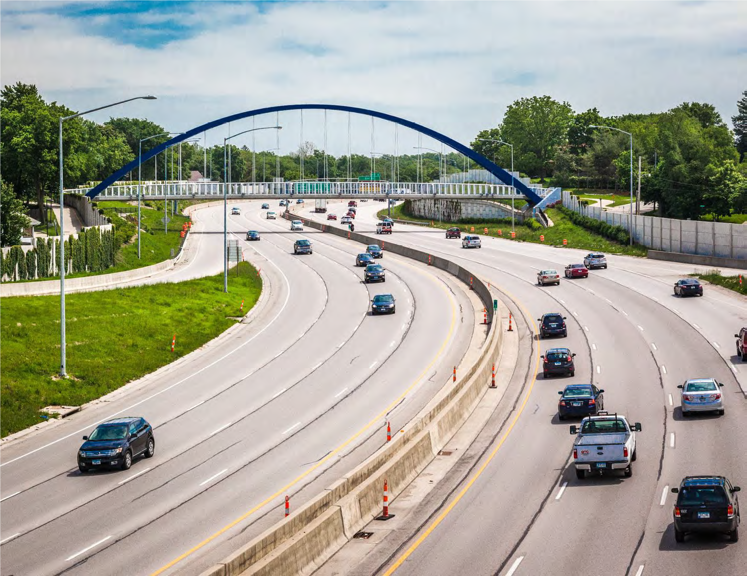

Iowa Interstate Investment Plan
Transportation Commission
December 13, 2022

Slide 2

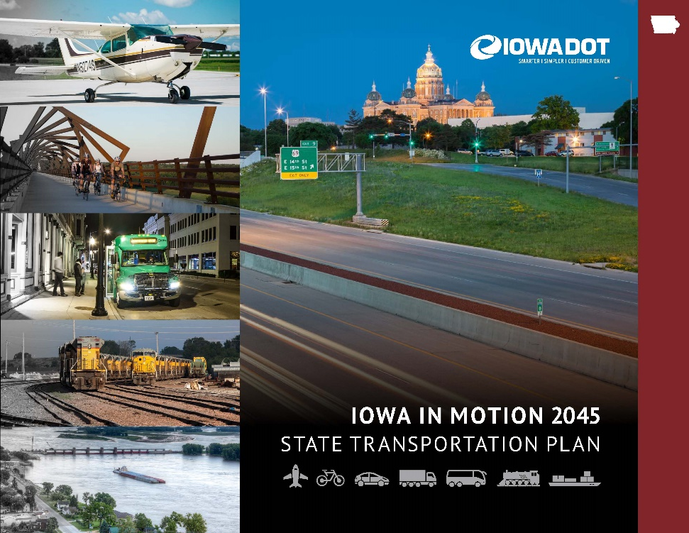
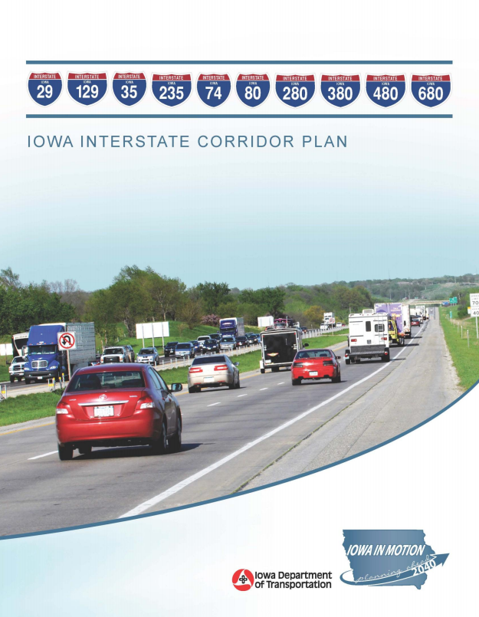
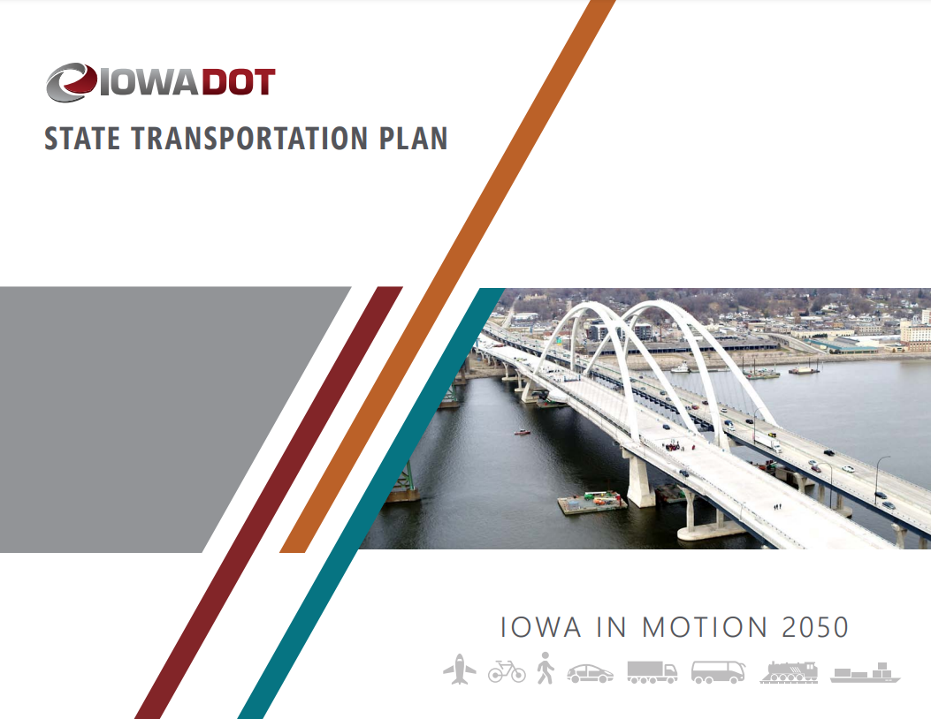
Planning Efforts Continue to Highlight Iowa’s Transportation Needs Exceed Available Funding

Slide 3
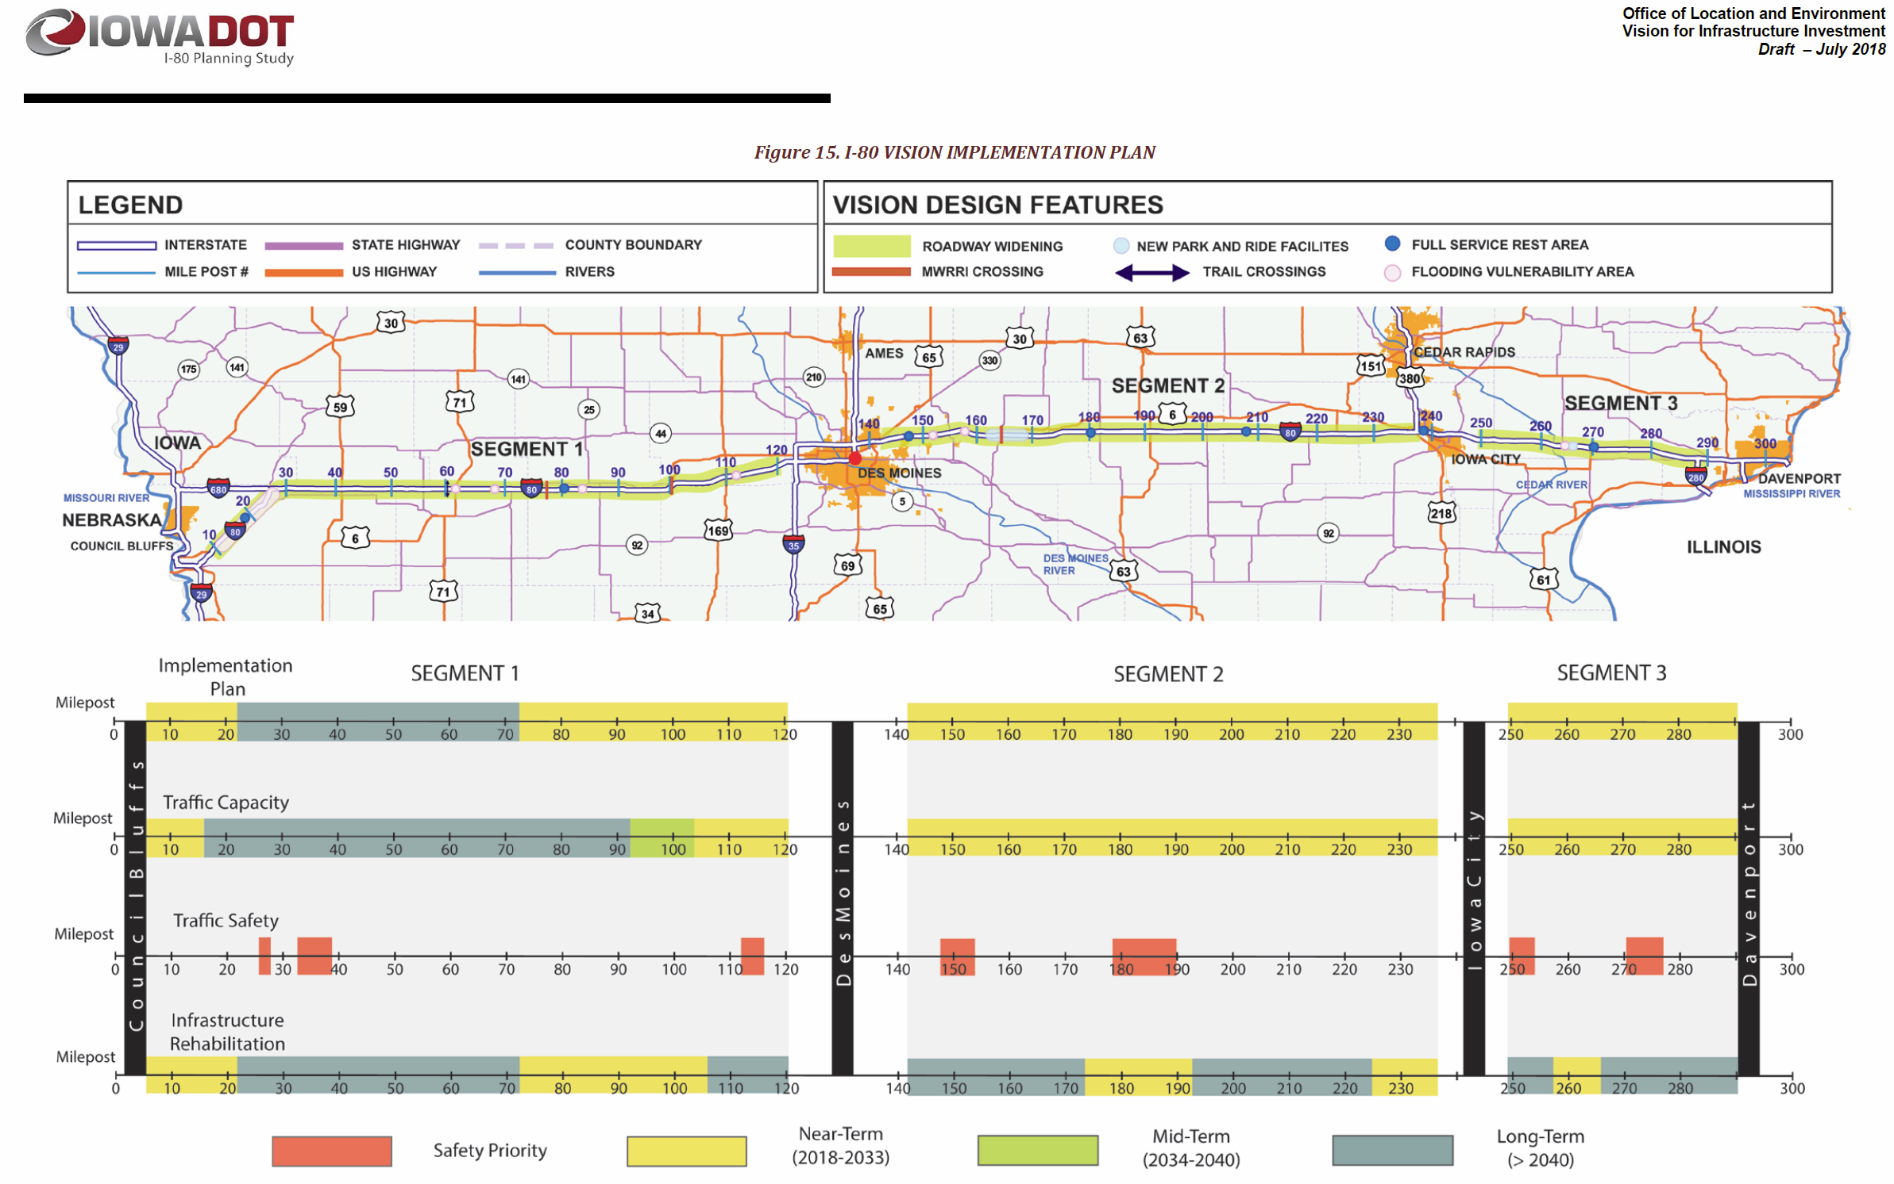
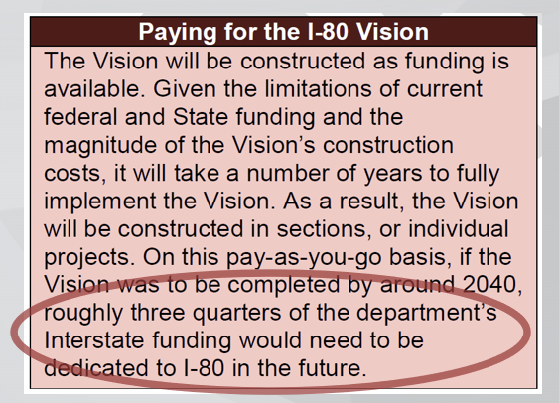
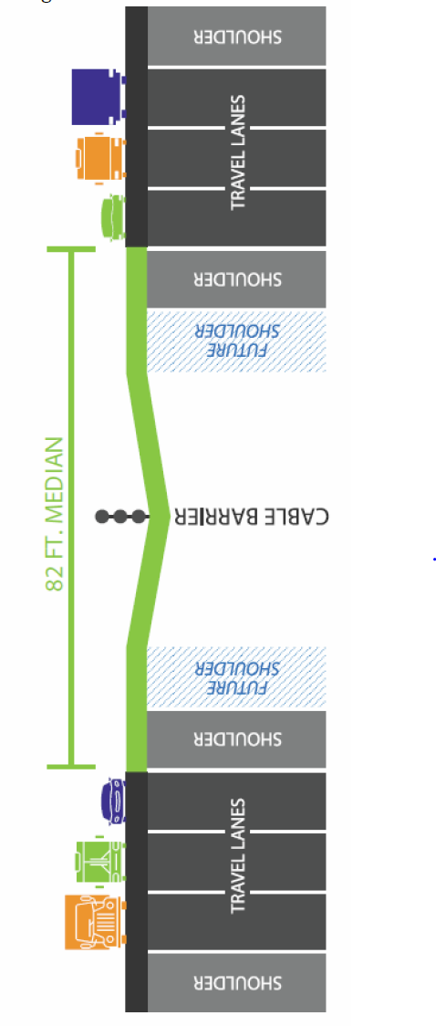
Interstate 80 - Planning and Environmental Linkage Study (PEL) 2018
Based on current funding availability, the Vision is likely untenable, even by year 2050

Slide 4

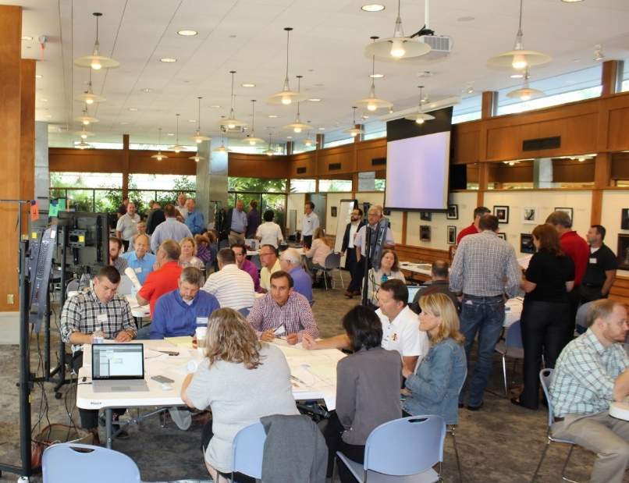

Interstate Plan Proposed
Workshop Summer 2018
2 Days - 70 Participants
Balancing Design and $$
Emphasis on “Rightsizing Projects”
Notes:
The I3P is primarily a planning tool that helps us identify realistic candidates for future programming based on a constrained interstate budget.

Slide 5
Workshop Recommendations
Stewardship - All participants recommended that the focus should be on preservation treatments to keep the system in its current state of good repair.
Consider Technology Options First - Expansion projects in urban corridors will be limited and focus on technology solutions and other management strategies before adding lanes.
Transportation Systems Management & Operations (TSMO)
Integrated Corridor Management (ICM)
Widening Options - Many segments of Interstate have significant pavement life remaining, so adding capacity in those areas will first consider widening the existing pavement rather than a complete rebuild.

Slide 6
Coordination of Department Goals
Performance Based Design or “Right Sizing”
System thinking rather than project thinking
Don’t over-solve the problem
Reducing low impact upgrades on one project will allow us to get more miles addressed to achieve the high value upgrades
Better Timing of Projects to Minimize Potential Waste
Resiliency and Sustainability
A transportation system:
able to withstand or recover quickly from man-made or environmental disruptions.
maintain a state of good repair while managing our resources in a way that promotes environmental stewardship and is fiscally responsible
Asset Management
Maintenance strategies that optimize the performance and cost-effectiveness of the Interstate System

Slide 7
Infrastructure Investment and Jobs Act of 2021
As we continually monitor needs on the Interstate System and assess the positive funding impact of the Infrastructure Bill, we recognize some projects may need to be accelerated or delayed in the Interstate Plan.

Slide 8
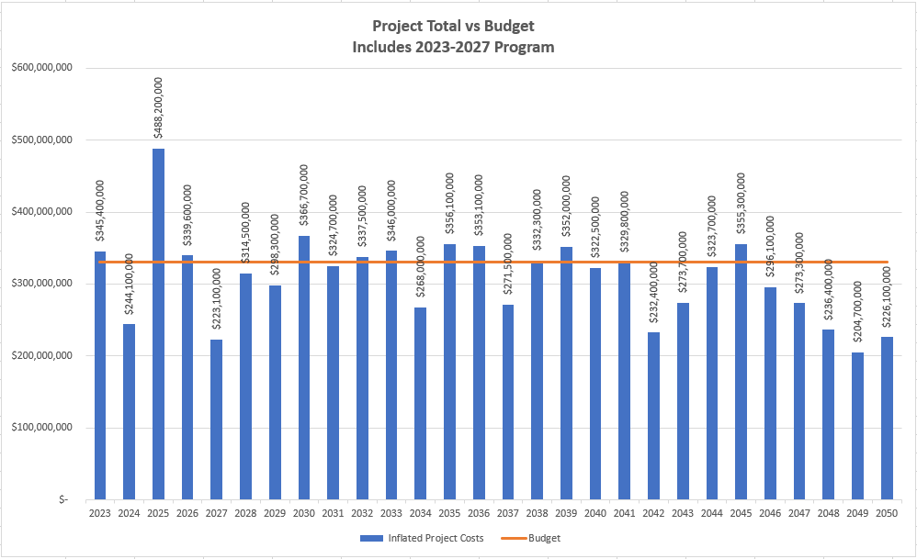
Project Totals and Annual Budget
$330 Million Annual Budget
Program Years
Project Budgets Set Very Tight to Promote Right Sizing

Slide 9
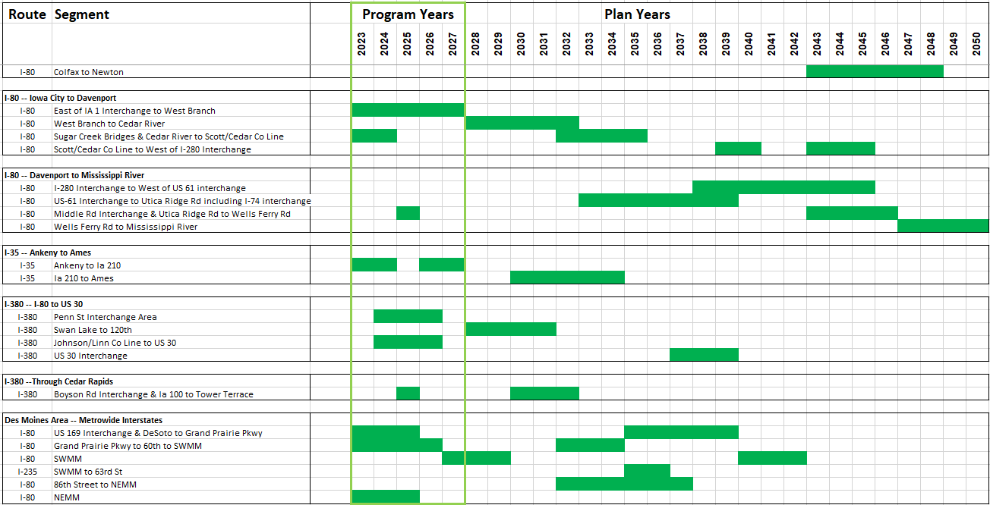
Project Timing

Slide 10
Other Projects
Other Interstate Work
Madison Ave Interchange – Programmed (2023-2024)
SWMM Interchange (Phase 1) – Programmed Beginning in 2027
NEMM Interchange – Programmed (2023-2025)
Middle Road Interchange – Programmed 2025
Hickman Road Interchange – Programmed (2024-2027)

Slide 11
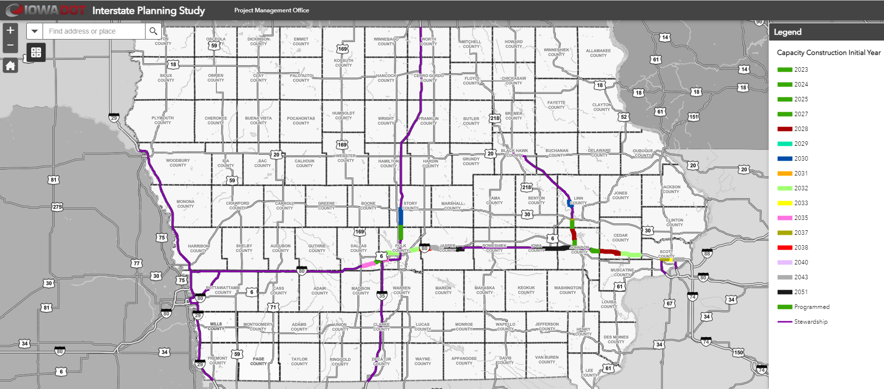
Statewide Interstate Plan Map

Slide 12
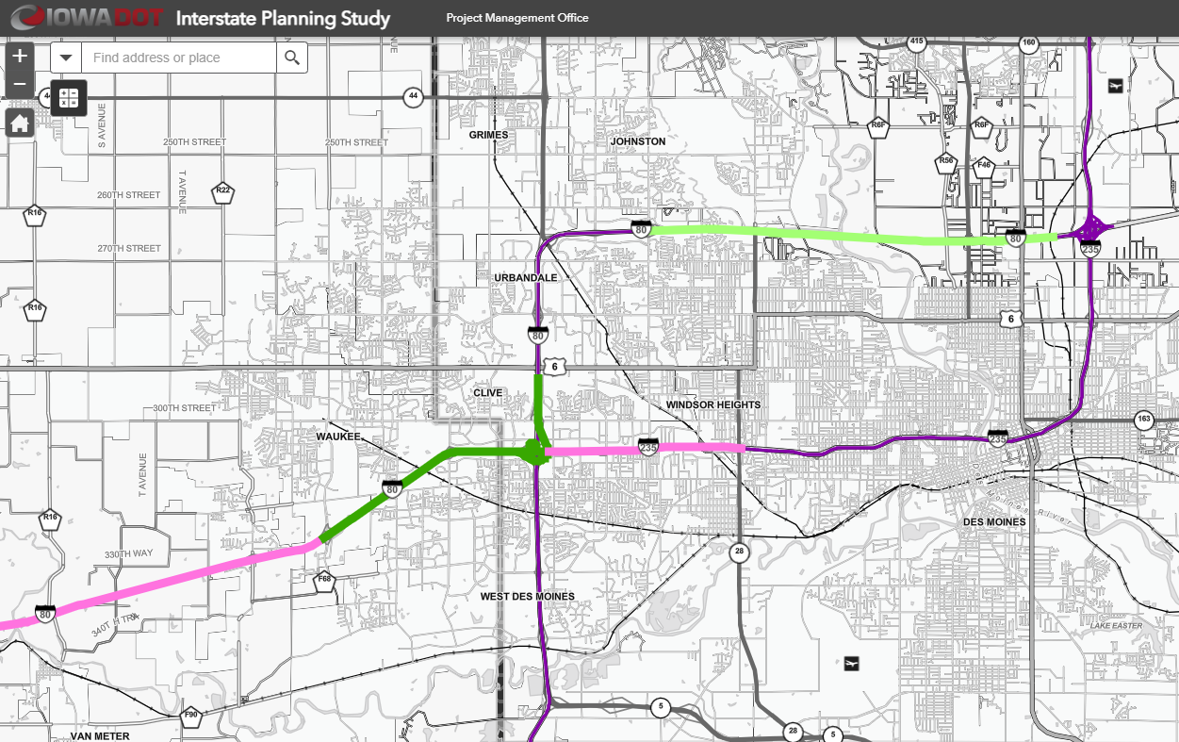
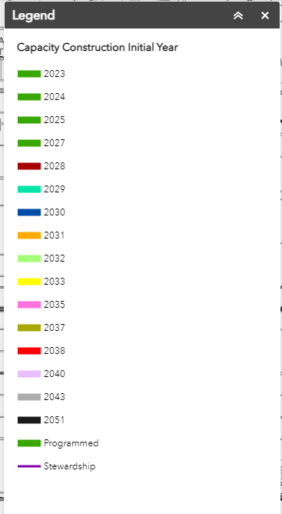
Des Moines Area Metro Wide Interstates
2032
2027
2023
2035
2035

Slide 13
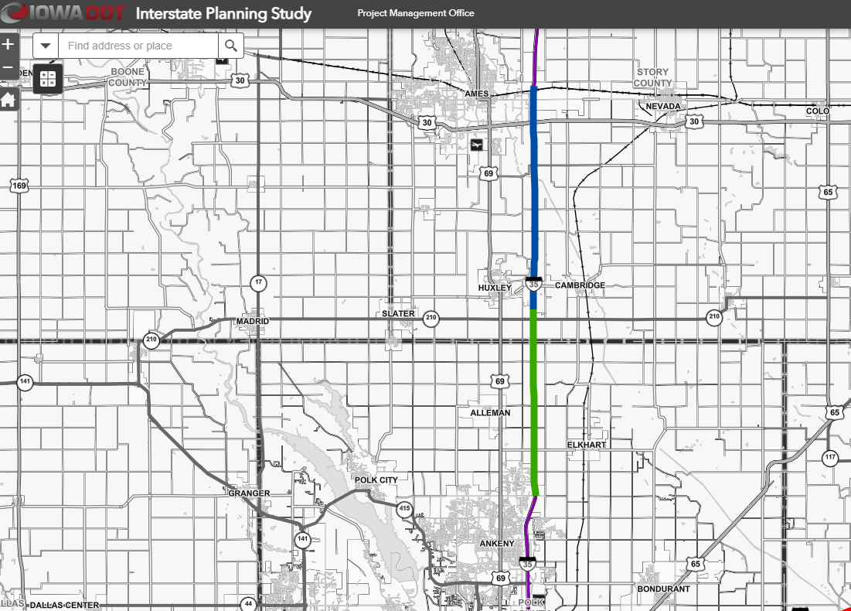
Interstate 35 Ankeny to Ames
2030
2023

Slide 14
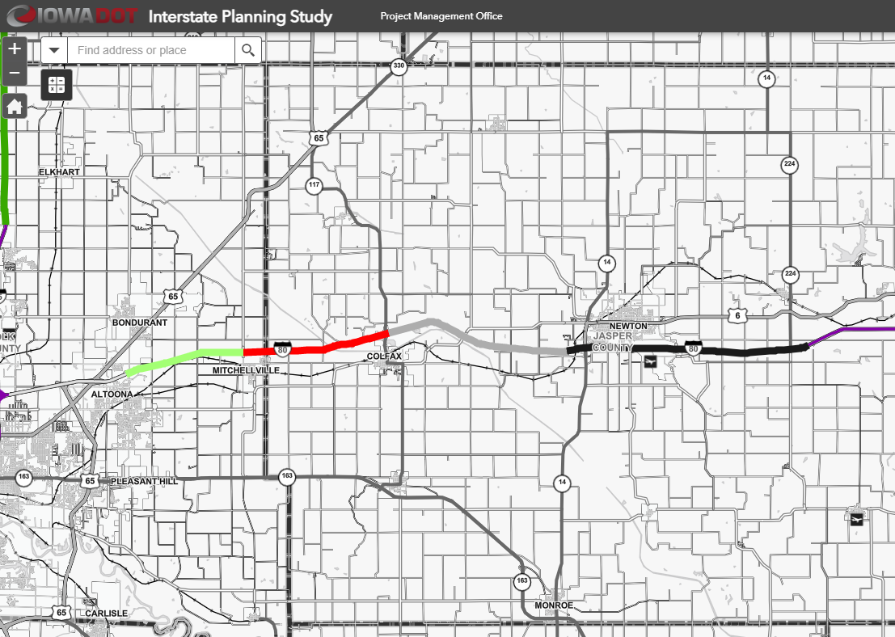
Altoona through Newton Interstates
2032
2038
2043
2051

Slide 15
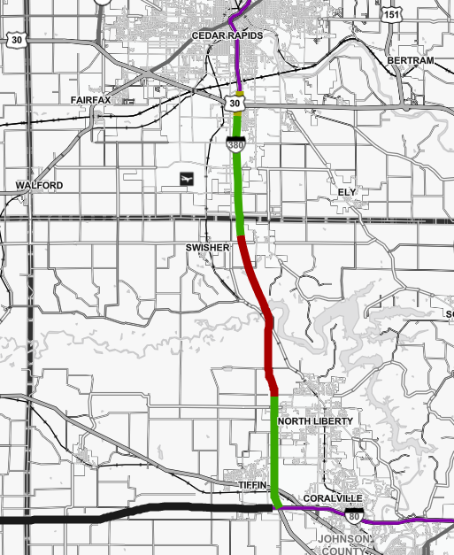
I-380 Iowa City to Cedar Rapids
2037
2024
2028
2024

Slide 16
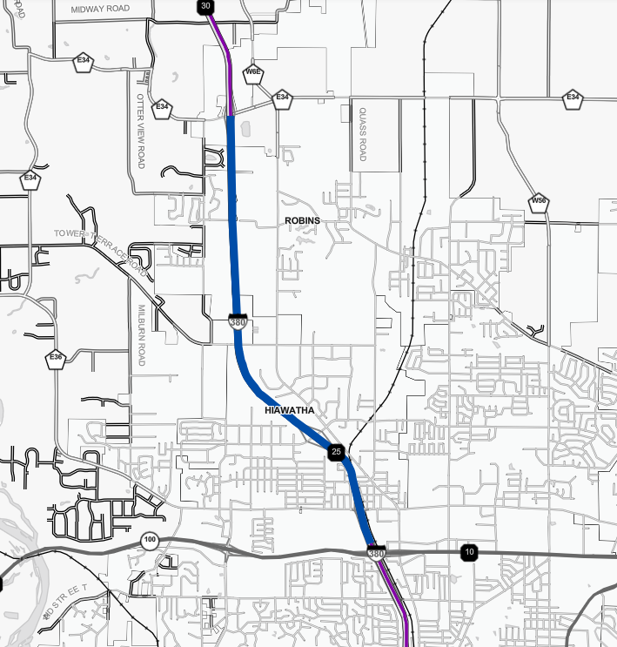
I-380 North of Cedar Rapids
2030

Slide 17
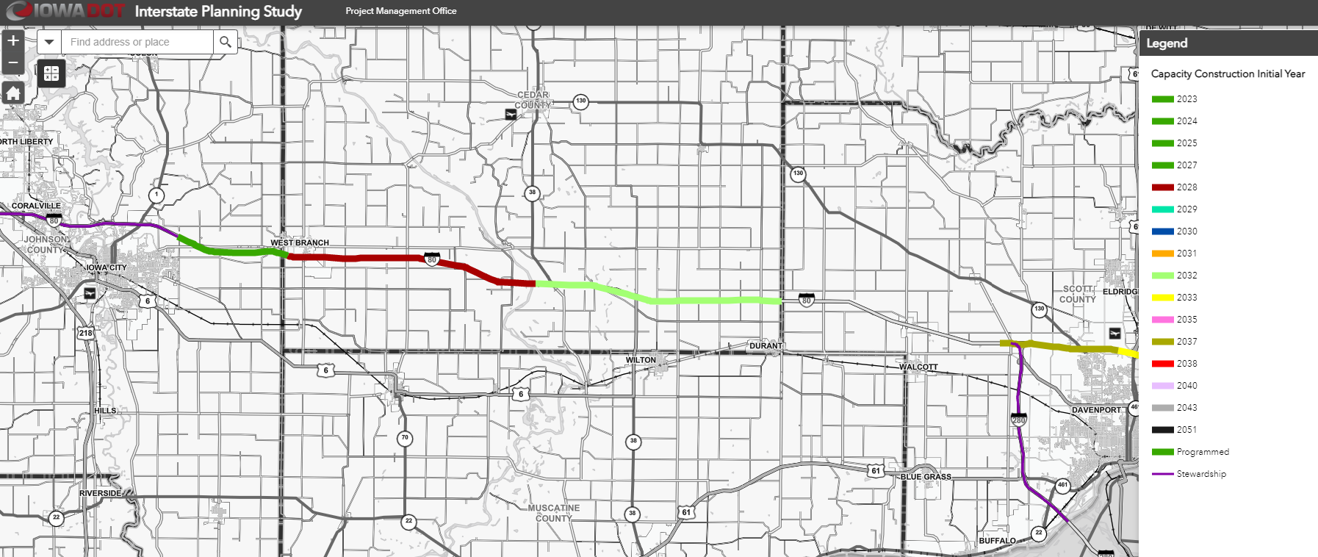
Interstate 80 Iowa City to Davenport
2023
2028
2032

Slide 18
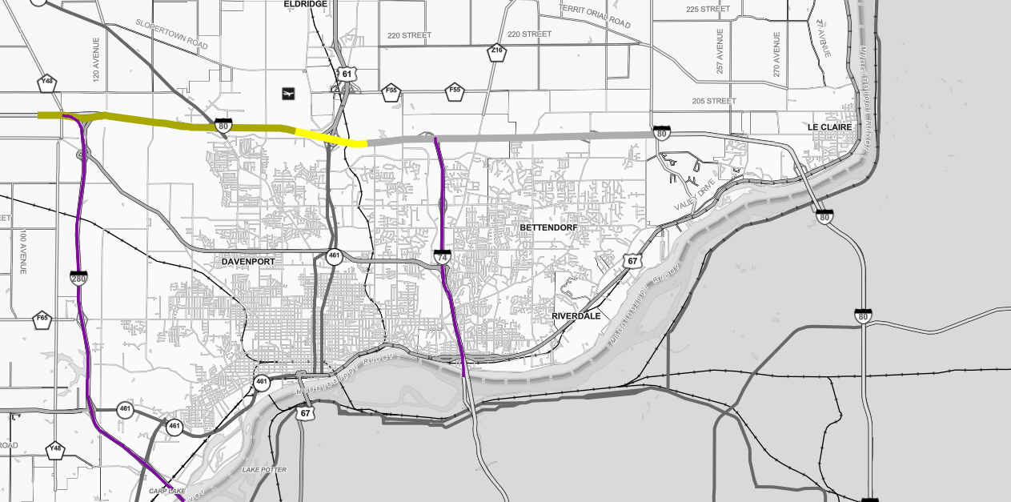
Interstate 80 Davenport/Bettendorf
2028
2043
2047
2037
2033
I-80 Bridge
2026-2028

Slide 19
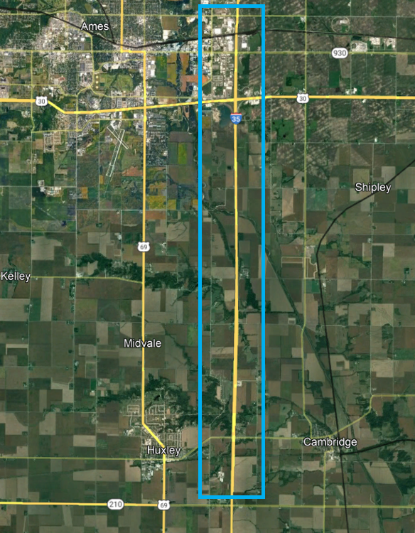
Interstate 35 - Story County
Iowa 210 to 13th St Ames
Reconstruction to 6-lanes
2030 - $4.9 million
2031 - $30.7 million
2032 - $39.3 million
2033 - $67.6 million
2034 - $1.2 million

Slide 20
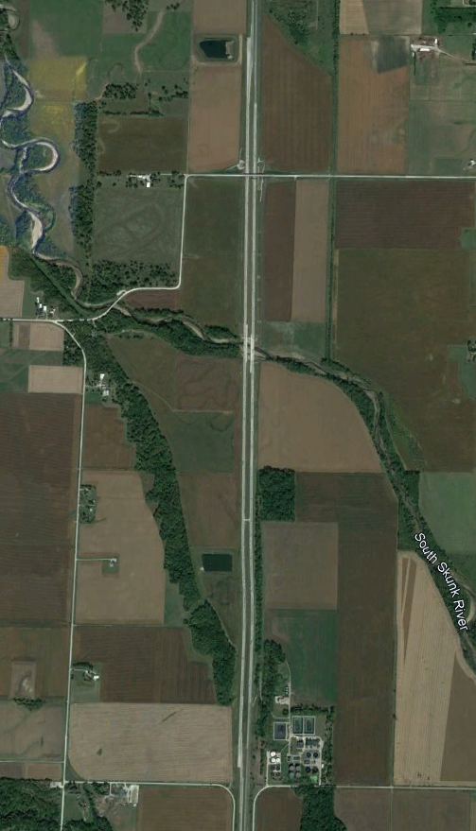
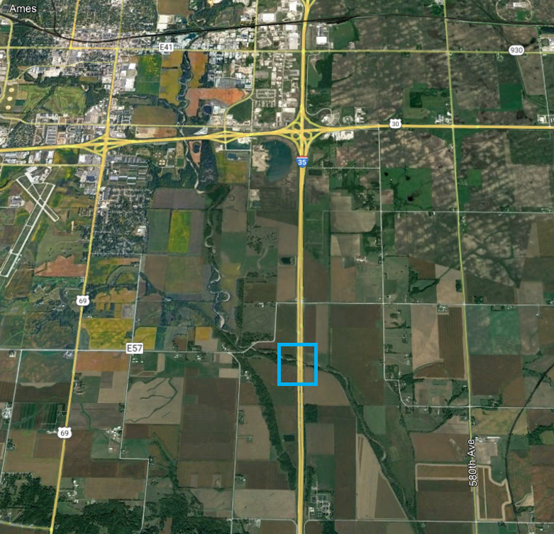
Interstate 35 Story County
South Skunk River Bridges
I-35 Mainline Bridges Over Skunk River Completed
I-35 Alignment Shift:
Construction
Traffic Management
I-35
Notes:
Explain Skunk River bridge work already complete in this corridor.

Slide 21
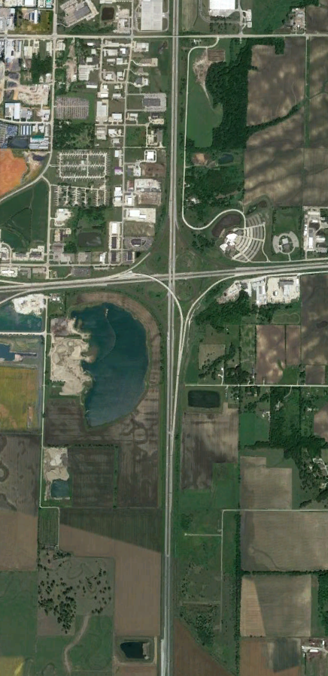
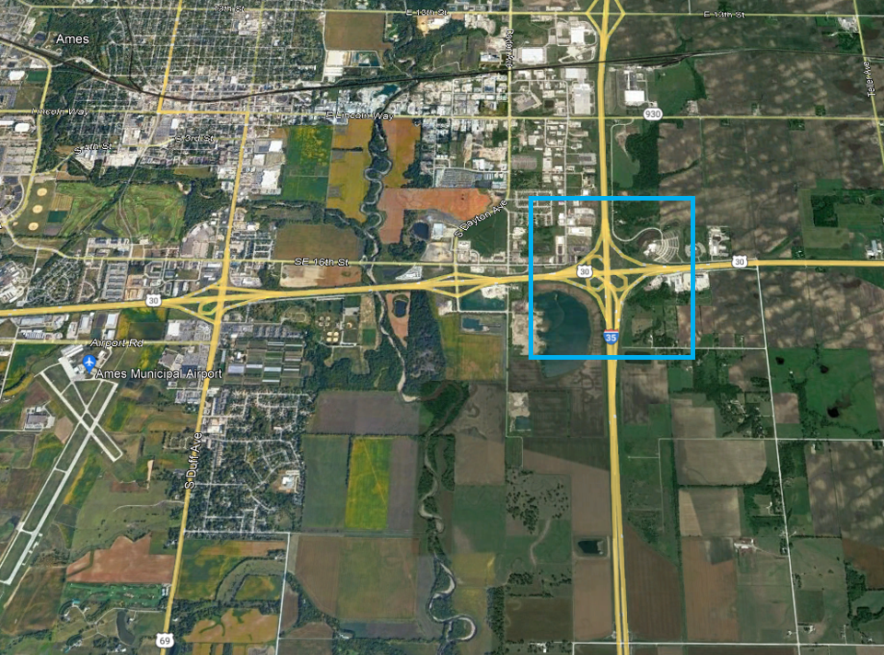
Interstate 35 Ames
I-35 Mainline Bridges over US 30
E Lincoln Way
Replacement of I-35 Mainline Bridges Over US 30
Initial Programming 2027
US 30
I-35

Slide 22
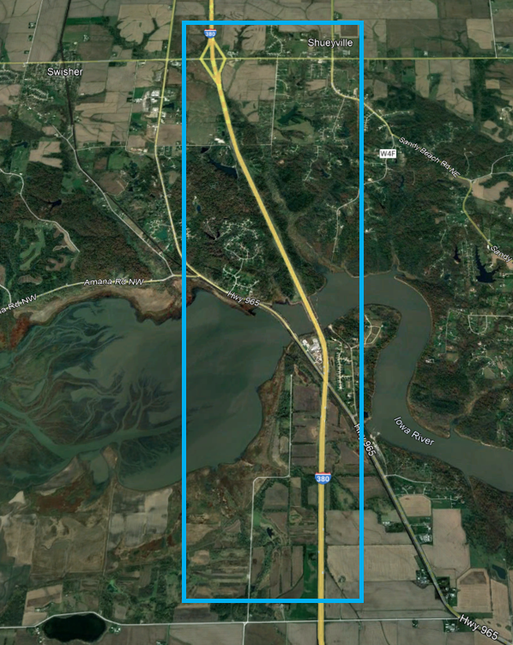
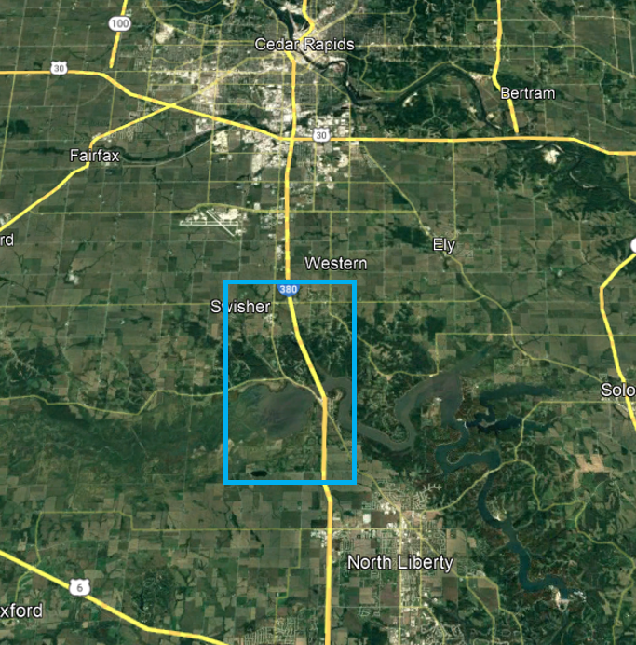
Interstate 380 Johnson/Linn
North of Swan Lake Rd to North of 120th St
Reconstruction to 6-lanes
120th St
2028 - $17.8 million
2029 - $50.2 million
2030 - $46.1 million
2031 - $27.0 million
Swan Lake Rd

Slide 23
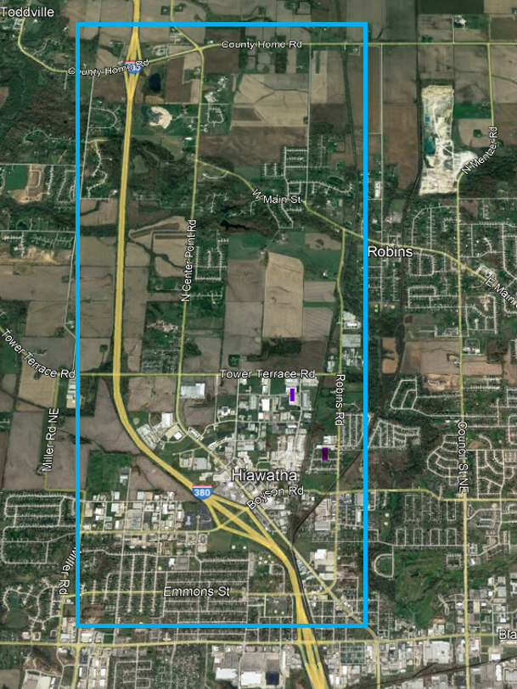
Interstate 380 Linn County
Blairs Ferry Rd to County Home Rd
Reconstruction to 6-lanes
2030 - $15.4 million
2031 - $16.0 million
2032 - $16.5 million
Tower Terrace Interchange
2022 - $15.8 million
Boyson Rd Interchange Programmed for 2025
$19.9 million

Slide 24
Interstate 80 Scott County
Mississippi River Bridge
PEL Study Completed
Phase 1 Engineering
3 Public Meetings to Date
Down to 4 Alternatives
Originally Programmed 2026-2028
Recommend Moving to 2028-2030 at Illinois DOT Request
Illinois DOT - lead Agency

Slide 25

THANK YOU
Phil Mescher, AICP, CPM
PROJECT MANAGEMENT BUREAU
IOWA DEPARTMENT OF TRANSPORTATION
Phil.Mescher@iowadot.us
Office Phone: 515-233-7969

