Slide 1
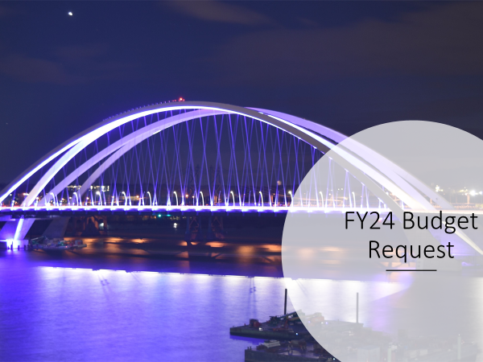

Slide 2
Total: $415,912,000
John Doe
manager
manager
manager

Slide 3
Total: $415,912,000
John Doe
manager
manager
manager

Slide 4
BUDGET SUMMARY
ITEM | FY2023 BUDGET | ADJUSTMENTS | FY2024 REQUEST
Operations | $373,173 |  | $373,173
Special Purpose | $27,971 | $68 | $28,039
Capital | $14,700 |  | $14,700
TOTAL | $415,844 | $68 | $415,912
FTEs | 2,757 | 0 | 2,757
John Doe
manager
manager
manager

Slide 5
BUDGET OPERATIONS
BUDGET UNIT/DIVISION | FY2023 BUDGET |  | ADJUSTMENTS |  | FY2024 REQUEST
 | FTEs | $ | FTEs | $ | FTEs | $
Transportation Operations | 2,468 | $344,251 | (5) |  | 2,468 | $344,251
Motor Vehicle | 289 | $28,922 | 5 | - | 289 | $28,922
TOTAL OPERATIONS | 2,757 | $373,173 | 0 | $0 | 2,757 | $373,173
John Doe
manager
manager
manager

Slide 6
BUDGET SPECIAL PURPOSE
ITEM | FY2023 BUDGET | ADJUSTMENTS | FY2024 REQUEST
Replacement equipment | $12,700 | - | $12,700
Workers’ compensation | $3,642 | ($165) | $3,477
Unemployment compensation | $145 | - | $145
DAS/OCIO utility services | $2,898 | $428 | $3,326
Waste management | $1,000 | - | $1,000
Drivers’ licenses | $3,876 | - | $3,876
TraCS/MACH | $300 | - | $300
County treasurer support | $1,406 | - | $1,406
Mississippi River Parkway Commission | $40 | - | $40
Transportation maps | $195 | ($195) | -
Indirect cost allocation | $750 | - | $750
Statewide interoperable communication system | $437 | - | $437
State auditor reimbursement | $678 | - | $678
Total special purpose | $27,971 | $68 | $28,039
John Doe
manager
manager
manager

Slide 7
BUDGET CAPITAL
ITEM | FY2023 REQUEST | ADJUSTMENTS | FY2024 REQUEST
Facility Major Maintenance & Enhancements | $5,300 | - | $5,300
Facility Routine Maintenance & Preservation | $4,700 | - | $4,700
Rest Area Facility Maintenance | $400 | - | $400
MVD Field Facilities Maintenance | $400 | - | $400
MVE Field Facilities Maintenance | $400 | - | $400
Electronic Records Management System | $3,500 | - | $3,500
TOTAL CAPITAL | $14,700 | - | $14,700
John Doe
manager
manager
manager

Slide 8
SUMMARY OF BUDGET REQUEST
ITEM
OPERATIONS BUDGET
Fuel Operational Costs
Equipment Deprecation
Safety Items
SPECIAL PURPOSE BUDGET
Equipment Purchasing Price Increase
CAPITAL BUDGET
Davenport Highway Operations Complex
Electronic Records Management System *
John Doe
manager
manager
manager
* Capital Project approved for spend in FY23-25

Slide 9
MODAL PROGRAM APPROPRIATIONS
ITEM | FY 2023 DOT BUDGET* | ADJUSTMENTS | FY 2024 DOT REQUEST*
Commercial Service Vertical Infrastructure | $1,900 | - | $1,900
General Aviation Vertical infrastructure | $1,000 | - | $1,000
State Recreational Trails | $2,500 | - | $2,500
Public Transit Infrastructure | $1,500 | - | $1,500
Railroad Revolving Loan and Grant Program | $2,000 | - | $2,000
TOTAL | $8,900 | - | $8,900
John Doe
manager
manager
manager
*Appropriations requested from Rebuild Iowa’s Infrastructure Fund (RIIF)

Slide 10
QUESTIONS

