Slide 1
Iowa’s Clean Air Attainment Program
Funding Recommendation

Slide 2
Iowa’s Clean Air Attainment Program
Iowa’s Clean Air Attainment Program (ICAAP) was created in 1994.
Modeled after the federal Congestion Mitigation and Air Quality Improvement Program established in 1991.
Available to cities, counties, public transit agencies, MPOs, RPAs, and state agencies. Private non-profit or for-profit entities when co-sponsored by an eligible public agency through an annual application program.
Purpose is to award funds to projects with the highest potential for reducing transportation-related congestion and air pollution.

Slide 3
Project Evaluation Criteria
Vehicle traffic flow improvements (25 points)
Vehicle miles of travel (VMT) or single-occupant vehicle (SOV) reduction (25 points)
Estimated vehicle emission reduction (20 points)
Degree of transportation-related air pollution or traffic congestion (15 points)
Project cost effectiveness relative to air quality benefits (30 points)

Slide 4
Available Funding and Application Summary
Available Funding:
Iowa’s Clean Air Attainment Program funds available: $4,000,000
Application Summary:
Total number of projects: 6
Total project costs: $20,130,600
Total amount requested: $6,617,560

Slide 5
List of Applications Recommended
PROJECT NAME | SPONSOR | SCORE | TOTAL PROJECT COST | REQUESTED AMOUNT (% of Total Project Cost) | RECOMMENDED AMOUNT (% of Total Project Cost)
Traffic System Vehicle Detection Improvement Project Phase 3 | West Des Moines | 85 | $915,000 | $732,000 (80%) | $732,000 (80%)
Traffic Signal System Improvements | Polk County | 71 | $632,500 | $506,000 (80%) | $506,000 (80%)
Smart Traffic Routing with Efficient and Effective Traffic Signals (STREETS) Phase 2 | Dubuque | 61 | $2,323,500 | $1,100,000 (47%) | $1,100,000 (47%)
North Ankeny Boulevard/U.S. 69 Improvements from 1st Street to 11th Street | Ankeny | 49 | $6,186,150 | $1,900,000 (31%) | $1,662,000 (27%)
Jump to applications not recommended for funding

Slide 6
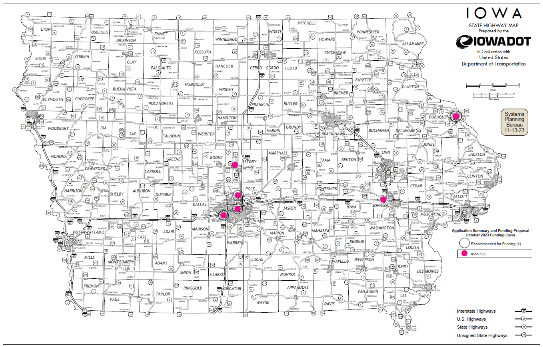
Map of Applications Received

Slide 7
Estimated Annual Benefits of Recommended Projects
Reduction of Vehicle Hours of Travel: 734,442
Reduction of Vehicle Miles of Travel: 5,488,098
Improved Air Quality
Reduced CO, VOCs, & NOx Emissions: 351,877 lbs.

Slide 8
QUESTIONS?
Jared Smith
Iowa’s Clean Air Attainment Program Manager
Jared.Smith@iowadot.us

Slide 9
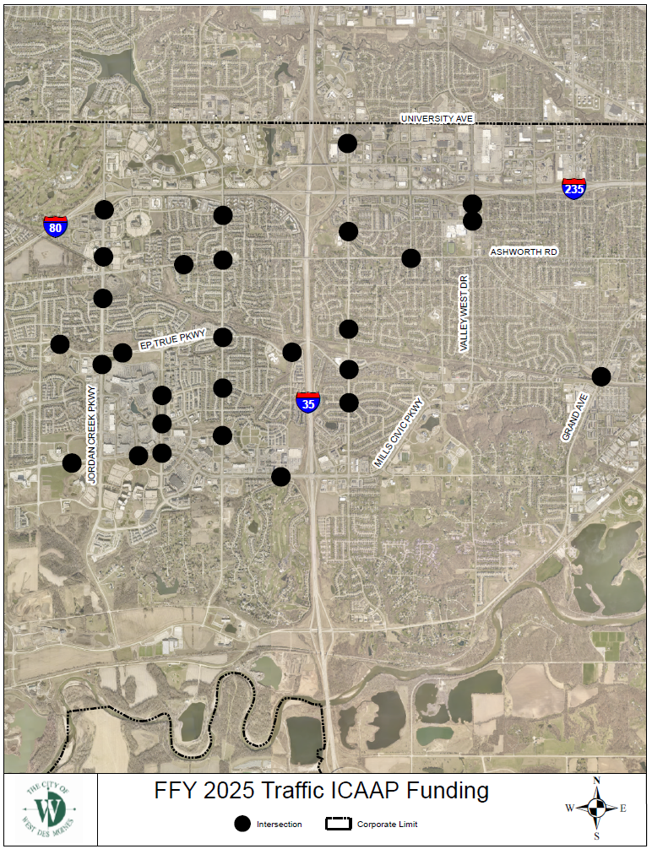
Traffic System Vehicle Detector Improvement Project Phase 3
(West Des Moines)
This project will replace existing vehicle detection methods, such as in-pavement loops, with state-of-the-art single point video detection at 30 intersections.
Total Cost: $915,000
Requested: $732,000 (80%)
Return to List of Applications Recommended

Slide 10
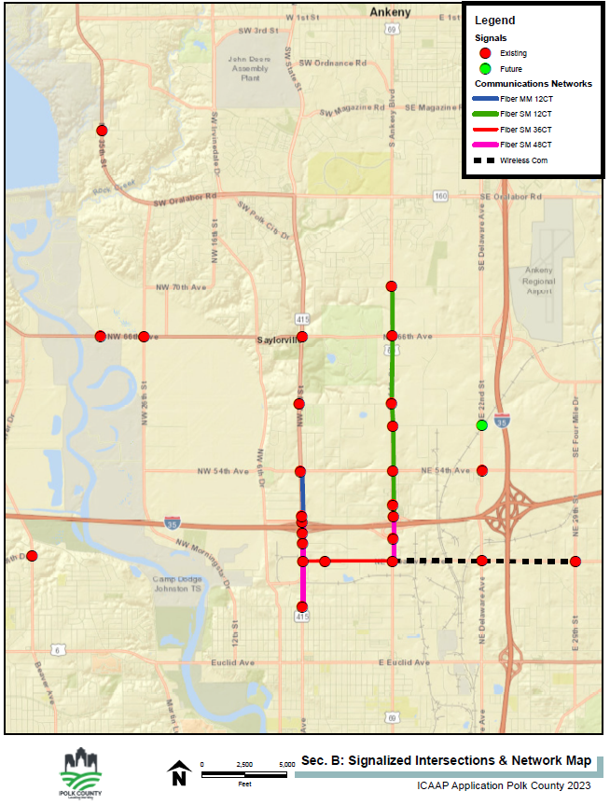
Traffic Signal System Improvements
(Polk County)
Signal system improvements will include ATMS management and control software, fiber optic connection to the Public Works facility, wireless communications, controller upgrades, flashing yellow arrow signal head upgrades, battery back-up systems, and traffic monitoring cameras.
Total Cost: $632,500
Requested: $506,000 (80%)
Return to List of Applications Recommended

Slide 11
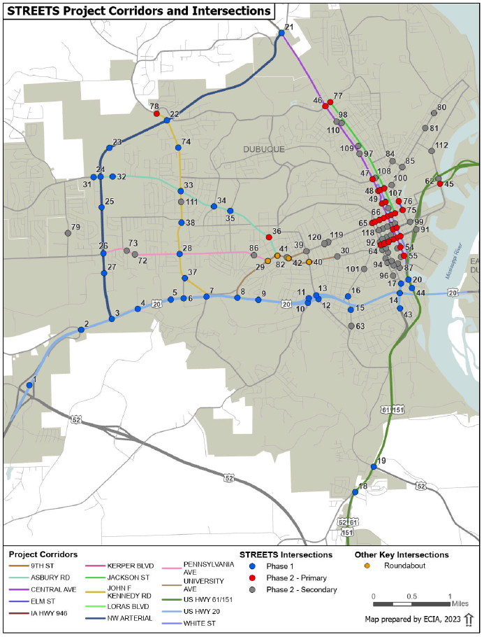
Smart Traffic Routing with Efficient and Effective Traffic Signals (STREETS) Phase 2
(Dubuque)
Utilize advanced traffic control strategies to create an adaptive traffic control system. Project will procure and install adaptive traffic signal equipment and ITS infrastructure at 78 intersections.
Total Cost: $2,323,500
Requested: $1,100,000 (47%)
Return to List of Applications Recommended

Slide 12
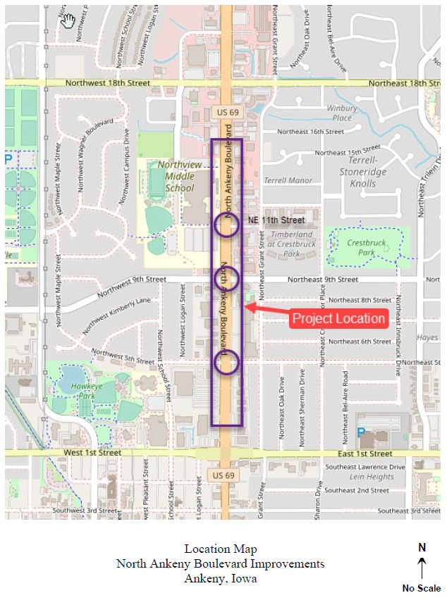
North Ankeny Boulevard/U.S. 69 Improvements from 1st Street to 11th Street
(Ankeny)
This project will construct new right-turn lanes at 5th Street, 9th Street, and 11th Street, replace traffic signals and pushbuttons, pedestrian upgrades, median modifications and other improvements.
Total Cost: $6,186,150
Requested: $1,900,000 (31%)
Recommended: $1,662,000 (27%)
Return to List of Applications Recommended

Slide 13
List of Applications Not Recommended for Award
PROJECT NAME | SPONSOR | SCORE | TOTAL PROJECT COST | REQUESTED AMOUNT (% of Total Project Cost) | RECOMMENDED AMOUNT (% of Total Project Cost)
Traffic Signal Master Plan Deployment Phase 5 | Ames | 47 | $2,349,450 | $1,879,560 (80%) | $0
North Park Road Improvements | Tiffin | 29 | $7,724,000 | $500,000 (6%) | $0
Return to List of Applications Recommended

