Slide 1
Federal Recreational Trails Program
Funding Recommendation

Slide 2
Federal Recreational Trail Program
Federal program created in 1991
Available to federal, state, and local government agencies. Private individuals and organizations may apply with a government co-sponsor.
Purpose is to develop and maintain recreational trails and trail related facilities for both motorized and non-motorized trail users.
Eligible projects include:
Maintenance and restoration of existing trails, development of trailside and trailhead facilities, purchase of trail construction and maintenance equipment, construction of new trails, and acquisition of land for trails.

Slide 3
Project Evaluation Criteria
Degree to which motorized and non-motorized trail use are accommodated (10 points)
Greatest number of compatible multi-purpose uses (10 points)
Access and use for persons with disabilities, older citizens, economically challenged and other special populations or groups (10 points)
Provides development of trail linkages (10 points)
Opportunities for new partnerships between trail users and private interests (10 points)
Identified in or furthers a specific goal of a state, regional, or local plan (10 points)
Leverages greater public or private investments (10 points)
Citizen involvement in the project’s conception and implementation (10 points)
Degree to which project ties into other trails (10 points)
Public/private partnerships to continue operation and maintenance (15 points)
Trails with national designation or resulting in the cleanup of an area (10 points)

Slide 4
Available Funding and Application Summary
Available Funding:
Annual appropriation: $1,300,000
Underruns from closed projects: $20,433
Application Summary:
Total number of projects: 15
Total project costs: $17,218,789
Total amount requested: $8,777,063

Slide 5
List of Motorized Applications Recommended
PROJECT NAME | SPONSOR | SCORE | TOTAL PROJECT COST | REQUESTED AMOUNT (% of Total Project Cost) | RECOMMENDED AMOUNT (% of Total Project Cost)
Snowmobile Trail Maintenance | Iowa State Snowmobile Association | 59.57 | $432,999 | $346,399 (80%) | $346,399 (80%)
Off-Highway Vehicle Park Equipment | Iowa Department of Natural Resources | 55.17 | $425,000 | $340,000 (80%) | $340,000 (80%)
Jump to applications not recommended for funding

Slide 6
List of Non-motorized Applications Recommended
PROJECT NAME | SPONSOR | SCORE | TOTAL PROJECT COST | REQUESTED AMOUNT (% of Total Project Cost) | RECOMMENDED AMOUNT (% of Total Project Cost)
Support for Bicycle Summit | Iowa DOT | N/A | $7,500 | $6,000 (80%) | $6,000 (80%)
Central Place Levee Trail Phase 1 | Des Moines | 69.71 | $1,508,000 | $500,000 (33%) | $500,000 (33%)
Connecting Fort Madison! Phase IV 48th Street Trail Connector | Fort Madison | 67.29 | $631,388 | $125,000 (20%) | $125,000 (20%)
Jump to applications not recommended for funding

Slide 7
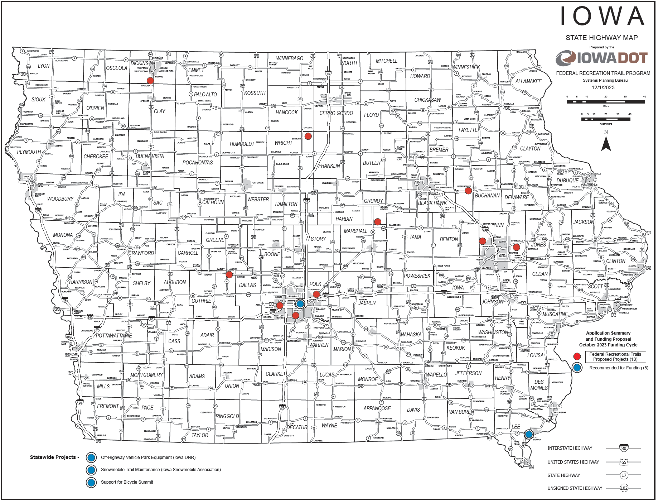
Map of Applications Received

Slide 8
QUESTIONS?
Scott Flagg, Federal Recreational Trails Program Manager
scott.flagg@iowadot.us
515-239-1252

Slide 9
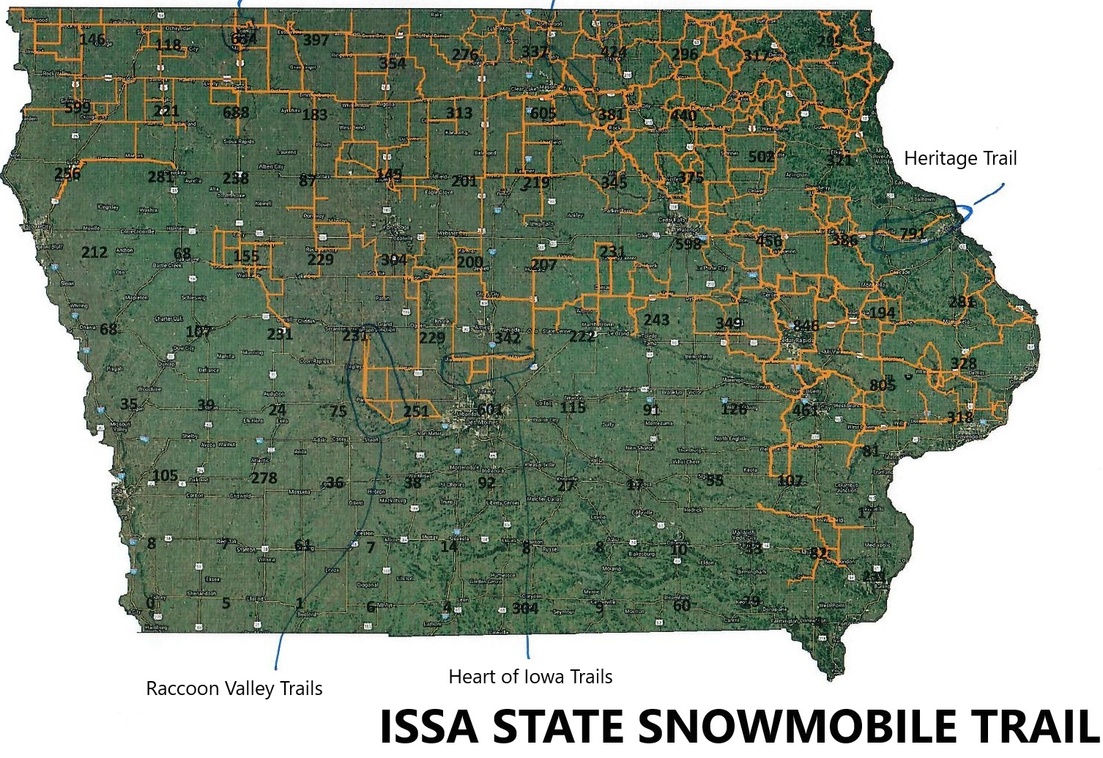
Snowmobile Trail Maintenance
(Iowa State
Snowmobile Association)
This project will create and maintain snowmobile trails in 63 counties across Iowa for the winter of 2024-2025.
Total Cost: $432,999
Requested: $346,399 (80%)
Return to List of Applications Recommended

Slide 10
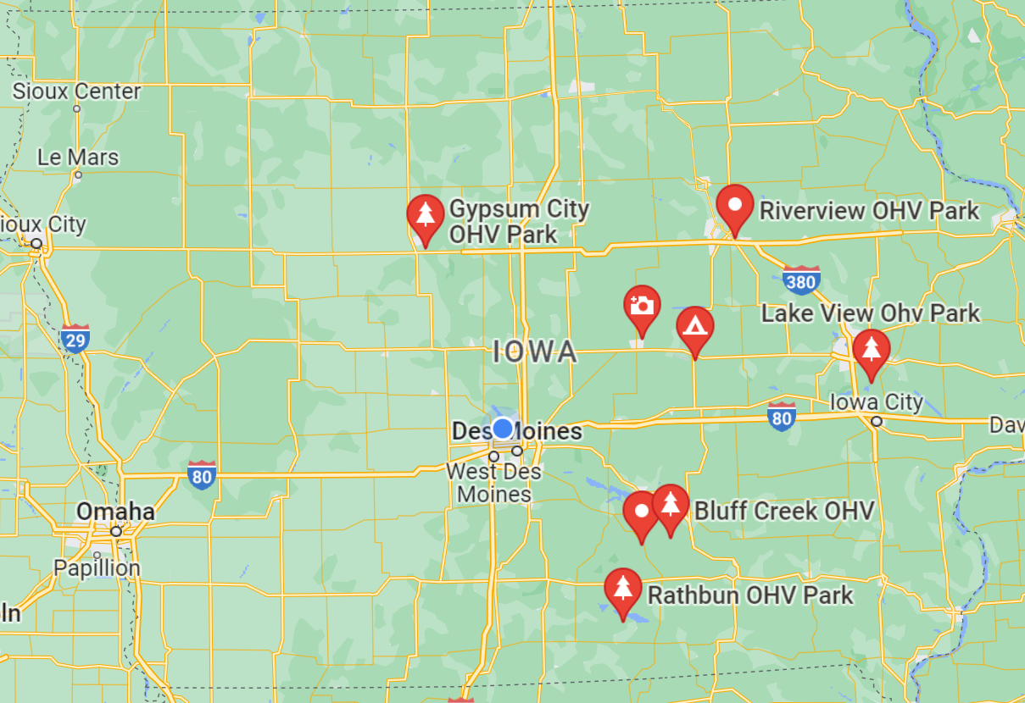
Off-Highway Vehicle
Park Equipment
(Iowa Department of
Natural Resources)
This project will purchase 10 pieces of trail maintenance equipment (tractors, bobcats and brushcats) for use at designated OHV parks.
Total Cost: $425,000
Requested: $340,000 (80%)
Return to List of Applications Recommended

Slide 11
Support for Bicycle Summit
(Iowa DOT)
This project provides funding to pay for costs related to the 2025 Iowa Bicycle Summit. The Iowa Bicycle Summit is an annual conference providing education on the latest bicycle facilities, technology, and programming. It brings national speakers to Iowa to share bicycle facility successes and best practices from around the United States. Many of the lessons learned at the summit have manifested into trail facilities and safety.
Total Cost: $7,500
Requested: $6,000 (80%)
Return to List of Applications Recommended

Slide 12
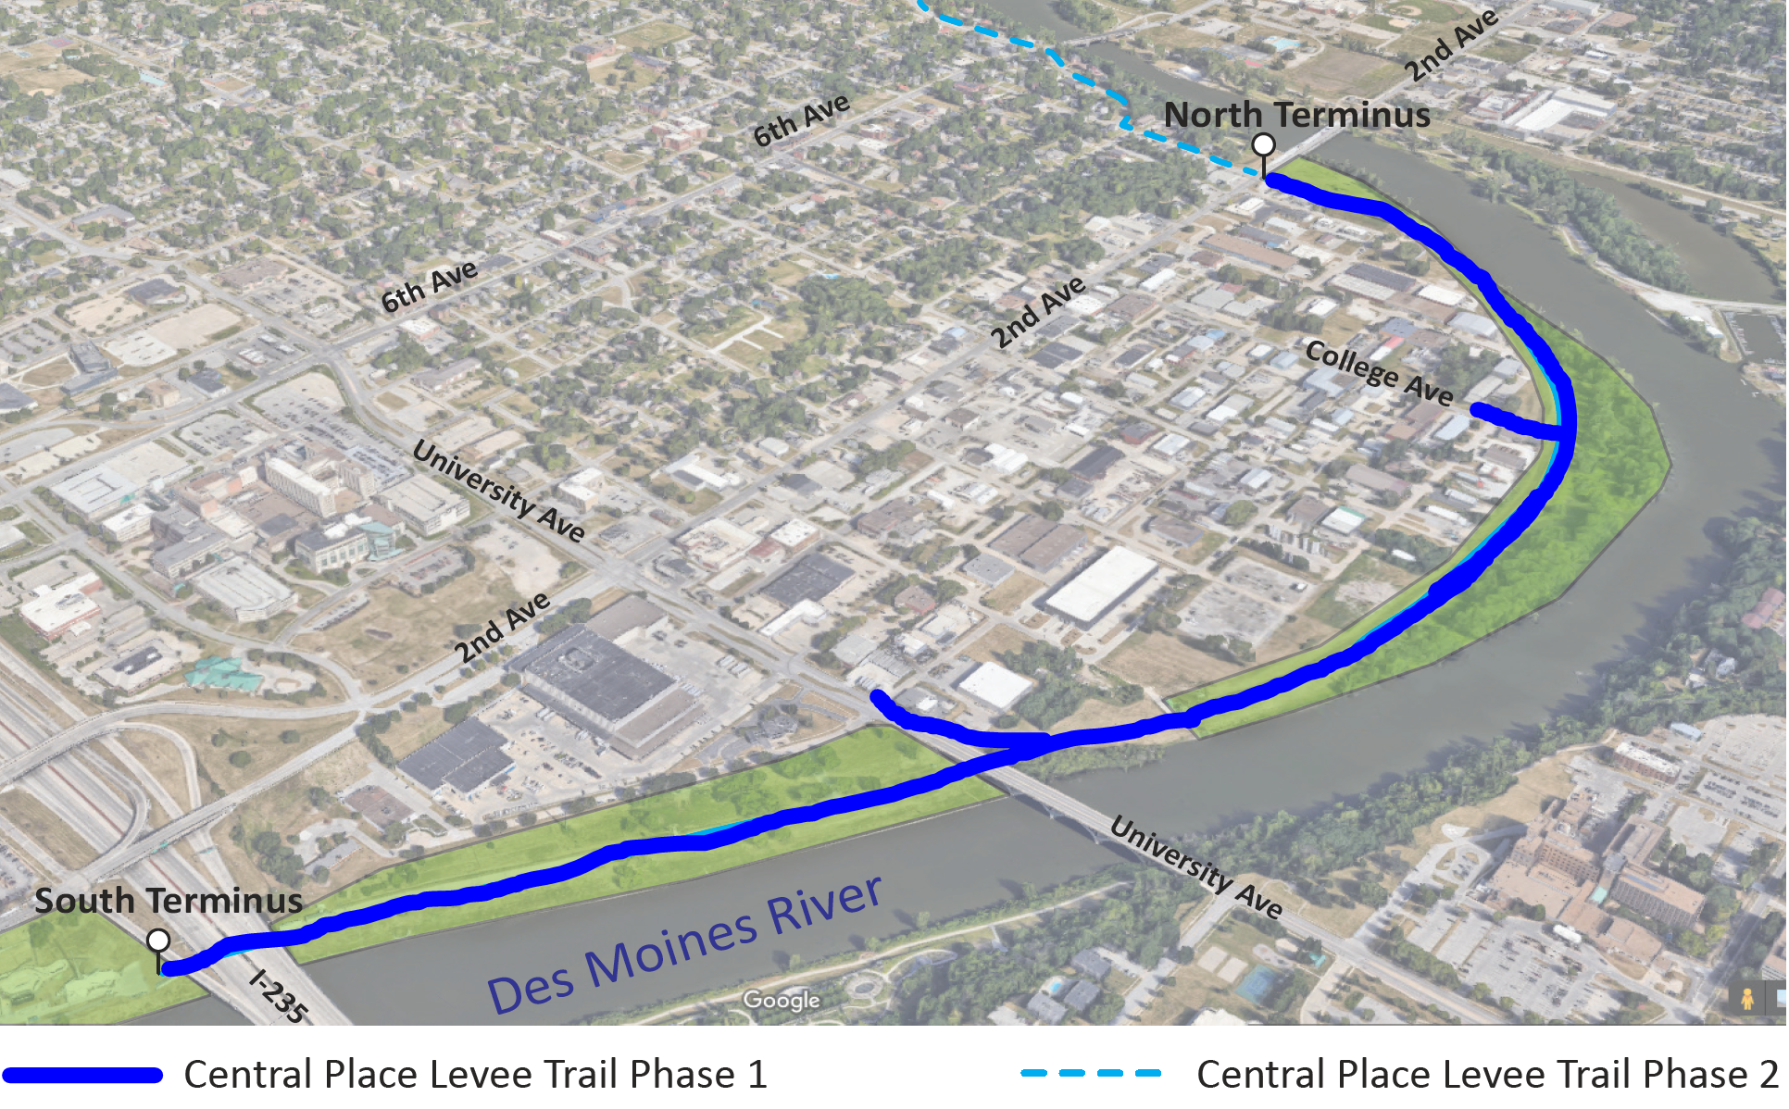
Central Place Levee Trail Phase 1
(Des Moines)
This project includes a 1.5-mile trail along the Des Moines River connecting Lauridsen Skatepark and the intersection of Franklin Avenue and 2nd Avenue as well as sidewalk connections to the adjacent neighborhood and wayfinding.
Total Cost: $1,508,000
Requested: $500,000 (33%)
Return to List of Applications Recommended

Slide 13
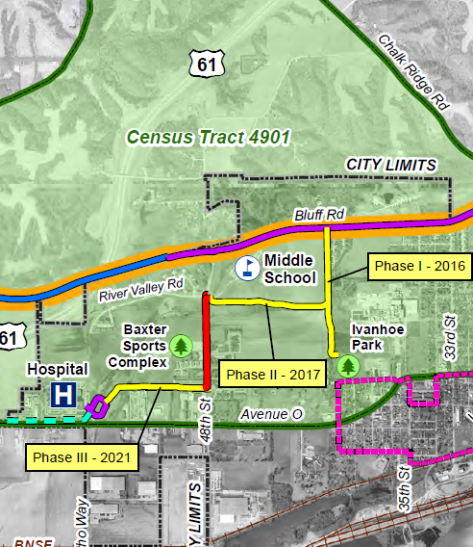
Connecting Fort Madison! Ph IV
48th Street Trail Connector
(Fort Madison)
This trail will run alongside 48th Street between Avenue L and River Valley Road and connect to the Baxter Sports Complex and existing trail linkages.
Total Cost: $631,388
Requested: $125,000 (20%)
Return to List of Applications Recommended

Slide 14
List of Applications Not Recommended for Award
PROJECT NAME | SPONSOR | SCORE | TOTAL PROJECT COST | REQUESTED AMOUNT (% of Total Project Cost) | RECOMMENDED AMOUNT (% of Total Project Cost)
Clay County Connection Phase II | Dickinson County | 67.00 | $1,407,545 | $490,000 (35%) | $0
Grant Street South Trail and Underpass | Bondurant | 60.71 | $2,968,265 | $250,000 (8%) | $0
Prairie Lands Trail Extension | Wright County Conservation Board | 59.71 | $1,283,100 | $1,026,480 (80%) | $0
Grant Wood Trail: Paralta Road to Springville Road | Linn County Conservation Board | 59.43 | $900,000 | $400,000 (44%) | $0
Clive Greenbelt to Raccoon River Valley Trail Connection | Clive | 57.57 | $1,400,000 | $470,000 (34%) | $0
Return to List of Applications Recommended

Slide 15
List of Applications Not Recommended for Award
PROJECT NAME | SPONSOR | SCORE | TOTAL PROJECT COST | REQUESTED AMOUNT (% of Total Project Cost) | RECOMMENDED AMOUNT (% of Total Project Cost)
Comet Trail Extension and Trailhead | Conrad | 55.86 | $153,550 | $122,840 (80%) | $0
Palo Connector Trail System | Palo | 50.00 | $2,650,000 | $2,120,000 (80%) | $0
Enterprise Drive Trail Extension - Phase 2 | Independence | 47.00 | $631,692 | $401,544 (64%) | $0
Raccoon River Valley Trail Resurfacing Project | Guthrie County Conservation Board | 45.57 | $2,216,000 | $1,772,800 (80%) | $0
Great Western Trail Improvements Project | Polk County Conservation Board | 40.86 | $596,000 | $400,000 (67%) | $0
Return to List of Applications Recommended

