Slide 1
FFY 23 Public Transit Program (Vehicle Replacements)
FFY 2022 and FFY 2023 Discretionary Grants
December 12, 2023

Slide 2
Public Transit Program Recommendations
Formula Allocations + CMAQ:
Federal Fiscal Year (FFY) 2023 Transit Program (Vehicle Replacements)
Discretionary Grants:
FFY 2022 Bus Replacement Discretionary Award
FFY 2022 Grants for Buses and Bus Facilities Discretionary Award
FFY 2023 Grants for Buses and Bus Facilities Discretionary Award

Slide 3
Section 5339 Grants for Bus and Bus Facilities Formula Program
Purpose: Federal Transit Administration (FTA) program that provides funding to states and transit agencies through a statutory formula to replace, rehabilitate and purchase buses and related equipment and to construct bus-related facilities

Slide 4
FFY 2023 - Section 5339 Grants for Bus and Bus Facilities
5339 Direct Apportionments:
Urban (50-200K population) – $1,110,176
Statewide – $4,000,000
Council Bluffs – $985,645
Davenport (IA/IL) - $502,218
Des Moines – $779,800

Slide 5
FFY 2023- Section 5339 Grants for Bus and Bus Facilities
State Apportionments:
Urban (50-200K population) – $1,110,176
One transit systems, two vehicles
Statewide – $4,000,000
Ten transit systems, thirty-six vehicles

Slide 6
Congestion Mitigation Air Quality Program (CMAQ)
Purpose: To fund transportation projects in non-attainment or maintenance areas of Clean Air Act Standards. States that have no nonattainment or maintenance areas receive a minimum apportionment of CMAQ funding for either air quality projects or other elements of flexible spending. Funds may be used for any transit capital expenditures otherwise eligible for FTA funding as long as they have an air quality benefit
FY 2023 allocation: $3,000,000
Nine transit systems, fifteen vehicles

Slide 7
Project Distribution Criteria
Funds are distributed for bus replacement based on the Public Transit Management System (PTMS) process and the availability of local match
Prioritizes vehicle replacements based on the degree to which each vehicle exceeds the useful life for that particular vehicle type in terms of both age and accumulated mileage
The age, vehicle type, and mileage are maintained for all vehicles within the PTMS database

Slide 8
Summary
Total capital funds available: $8,110,176
Sixteen transit systems will be able to purchase fifty-two vehicles
A detailed list of vehicles is included in the Federal Fiscal Year (FFY) 2023 Transit Program (Vehicle Replacements) handout

Slide 9
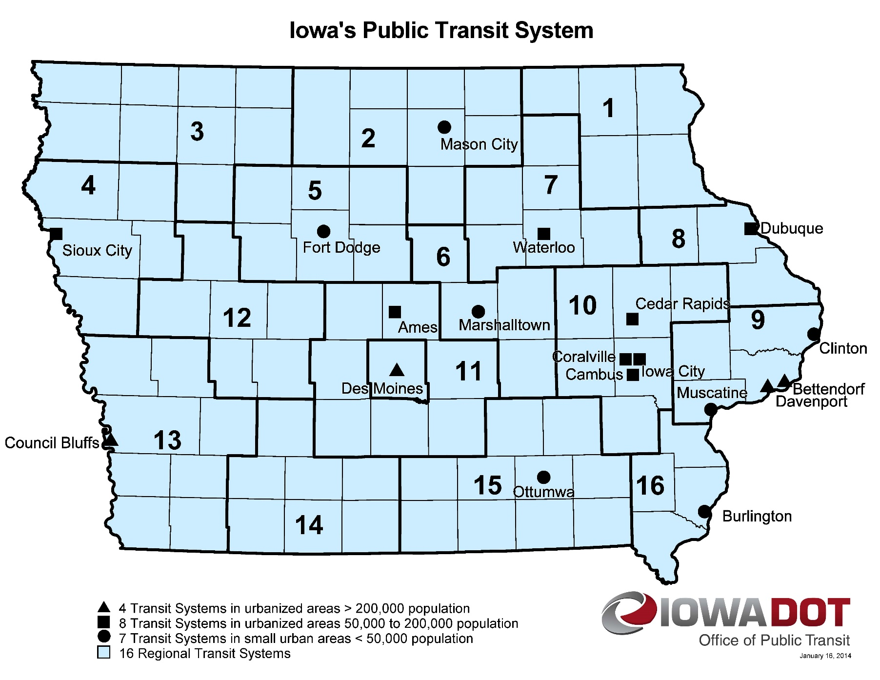
Transit System Vehicle Replacements
Notes:
18 Transit Systems

Slide 10
FTA Bus/Bus Facilities and Low and No Emission Discretionary Grants
Purpose: The Grants for Buses and Bus Facilities Competitive Program (49 U.S.C. 5339(b)) and the Low or No Emission Vehicle Program (49 U.S.C. 5339(c)) makes federal resources available to states and direct recipients to replace, rehabilitate and purchase buses and related equipment and to construct bus-related facilities, including technological changes or innovations to modify low or no emission vehicles or facilities.

Slide 11
FTA Bus/Bus Facilities and Low and No Emission Discretionary Grants
Eligible Applicants: Designated recipients that allocate funds to fixed route bus operators, states, local governmental authorities that operate fixed route bus service, Native American tribes.
Funding is provided through competitive grants.
Fleet transition plans required for projects related to zero-emission buses.
Iowa DOT successfully applied for statewide projects for the FFY 2022 and FFY 2023 funding.

Slide 12
Project Evaluation Criteria
Demonstration of need for capital investment in bus vehicles and/or supporting facilities
Demonstration of benefit for how the project will improve transit system condition, service reliability, and enhance access and mobility
Demonstration of how the project is consistent with transit priorities identified in the long range plan
Local financial commitment
Project implementation strategy
Demonstration of technical, legal and financial capacity to undertake the project

Slide 13
FTA Available Discretionary Funding
Federal Fiscal Year | 2022 | 2023
Grants for Buses and Bus Facilities (Competitive) | $376 million | $384 million
Low or No Emissions Grants (Competitive) | $1.122 billion | $1.123 billion

Slide 14
Discretionary Awards to Iowa
FFY 2022 Bus Replacement Discretionary Award
$12,000,000 for bus replacements
Funding recommendation
Replace 70 of the oldest vehicles operating beyond their federal useful life at 20 public transit agencies
Utilized Public Transit Management System process
Points awarded based on age and mileage
Prioritize highest points down
A detailed list of vehicles is included in the Federal Fiscal Year (FFY) 2022 FTA 5339(b) Bus Replacement Discretionary Grant Award handout.

Slide 15
Discretionary Awards to Iowa
FFY 2022 Grants for Buses and Bus Facilities Discretionary Award
$15,844,561
Funding recommendation
Provide ten zero-emission buses and charging equipment to three public transit agencies (Sioux City Transit, Region 11-HIRTA, Region 13-SWITA)
Support construction of a new facility for Region 11 (HIRTA)
Support construction of new facility for Region 14 (Southern Iowa Trolley)
A detailed list of vehicles is included in the Federal Fiscal Year (FFY) 2022 FTA 5339(b) Bus and Bus Facilities Discretionary Grant Award handout.

Slide 16
Discretionary Awards to Iowa
FFY 2023 Grants for Buses and Bus Facilities Discretionary Award
$17,853,710
Funding recommendation
Provide 13 zero-emission buses or vehicles and charging equipment to four public transit agencies (Clinton MTA, Region 11-HIRTA, Region 13-SWITA, Coralville)
Support construction of a new facility for Riverbend Transit
Support construction of new facility for Region 11 (HIRTA)
A detailed list of vehicles is included in the Federal Fiscal Year (FFY) 2023 FTA 5339(b) Bus and Bus Facilities Discretionary Grant Award handout.

Slide 17
Discretionary Awards to Iowa
Notes:
18 Transit Systems

Slide 18
QUESTIONS?
For more information on Iowa’s public transit and intercity bus programs, visit
www.iowadot.gov/transit
Notes:
Any questions?

