Slide 1
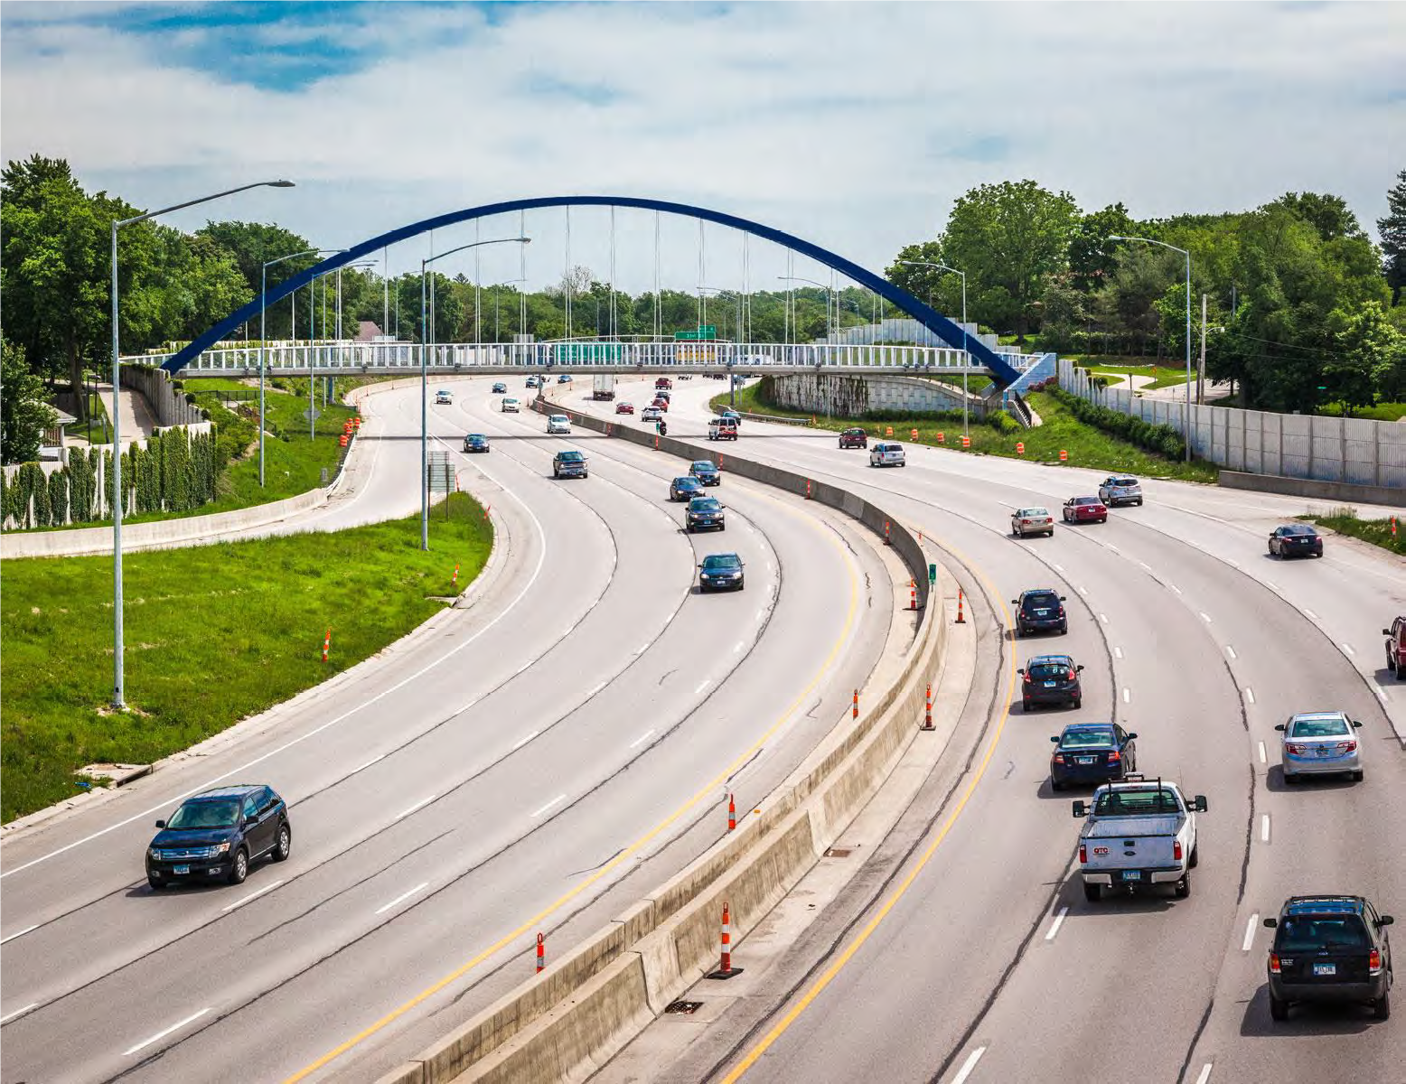

Iowa Interstate Investment Plan
Transportation Commission
December 12, 2023

Slide 2

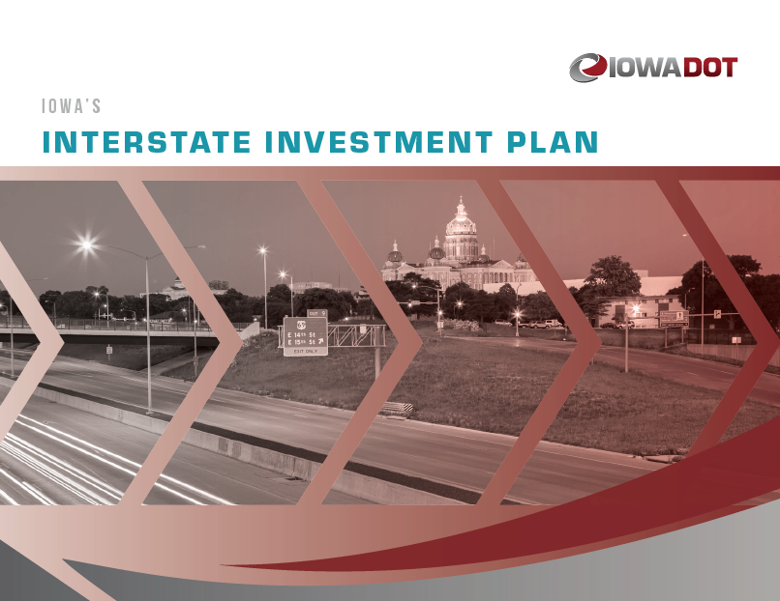
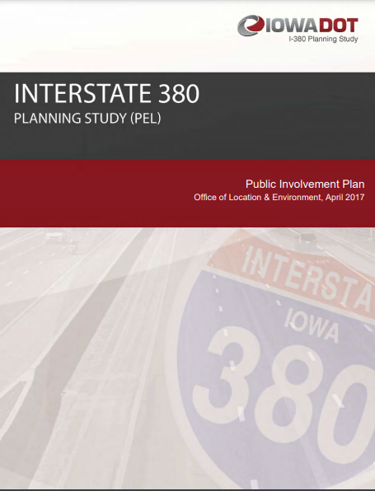

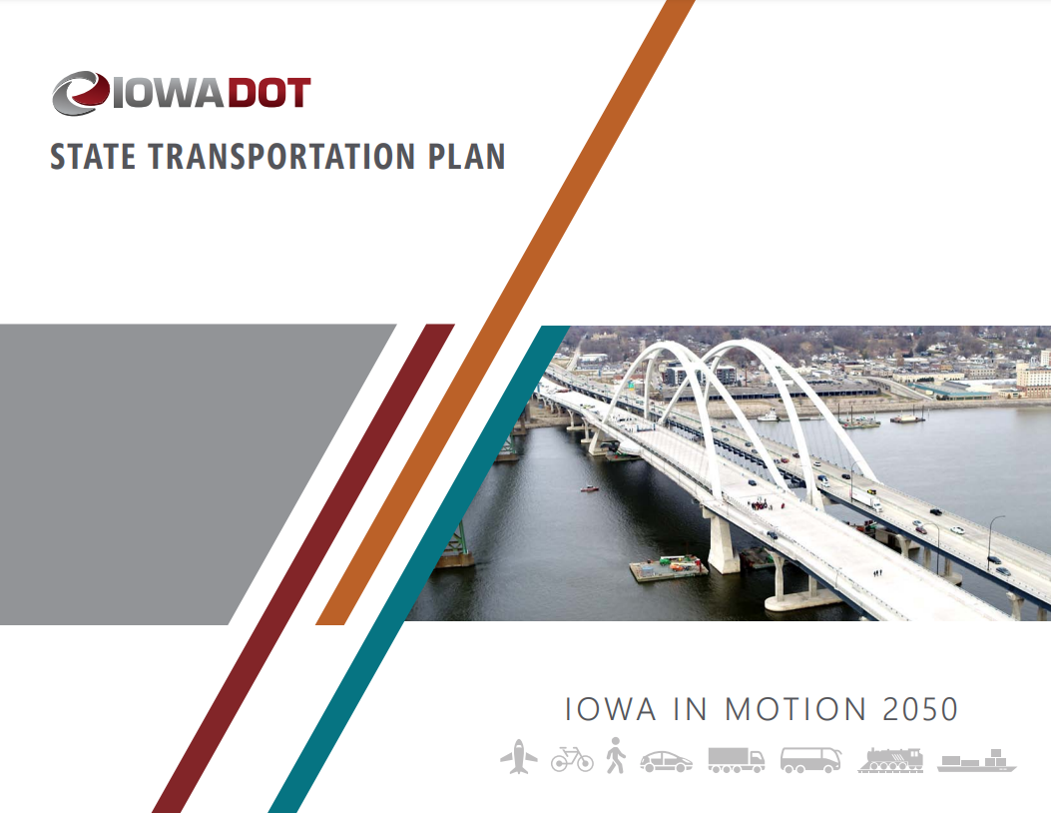

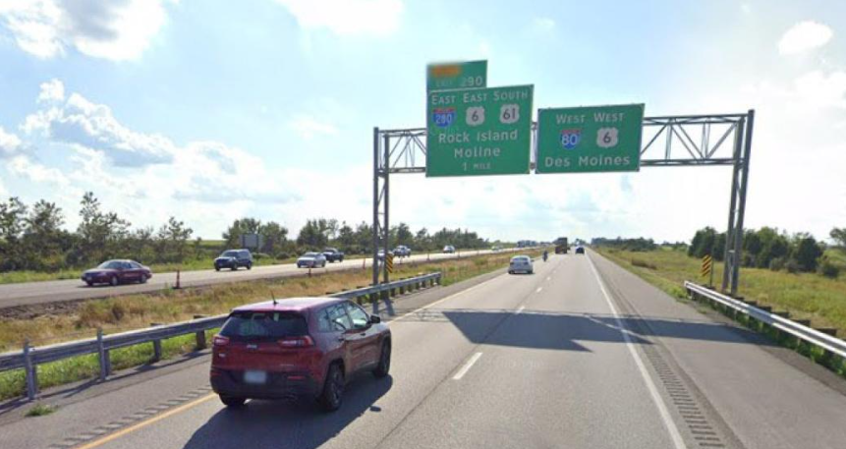
Background: Why an Interstate Plan?
Planning Efforts & Project Development Activities Highlight Iowa’s Transportation Needs Exceed Available Funding
Desired a tool that helps us identify realistic candidates for future programming based on a constrained interstate budget
Notes:
Reminder of why we have developed the interstate plan.
Planning Shows the Need but we do not have the funds
5 years now with Interstate Plan
Inflation Impacts
Higher Materials Costs
Concrete
Asphalt
Steel
Higher Labor Costs
Grading
Excavation

Slide 3

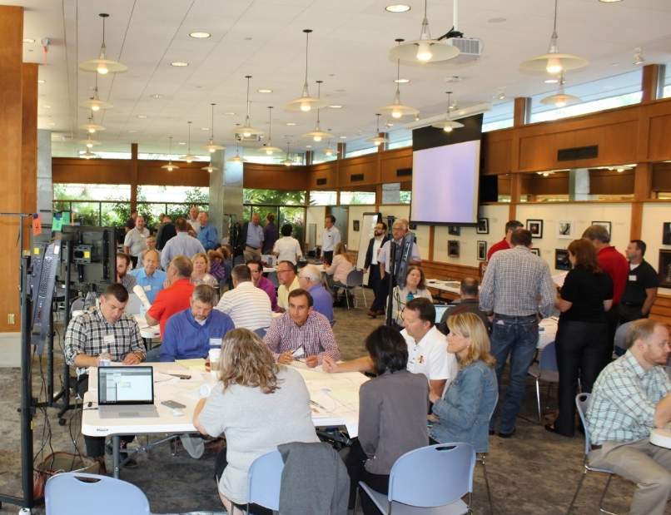
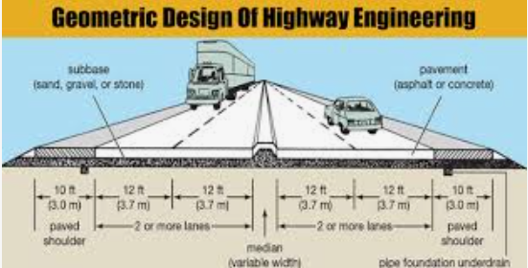
Concept of a “fiscally constrained” Plan for Iowa’s Interstate System
Initiated by a 2-day Workshop including 70 Participants in Summer of 2018
Identified Statewide Interstate Needs and Budget Estimates
Rehabilitation Needs vs. Capacity Expansion Needs
Goal: Contrast the timing between both by corridor
Workshop Summer 2018
Balancing Design and $$
2 Days - 70 Participants
Notes:
Quick Reminder of the Workshop that led to the I3P

Slide 4
Workshop Recommendations
Stewardship - All participants recommended that the focus should be on preservation treatments to keep the system in its current state of good repair.
Consider Technology Options First - Expansion projects in urban corridors will be limited and focus on technology solutions and other management strategies before adding lanes.
Transportation Systems Management & Operations (TSMO)
Integrated Corridor Management (ICM)
Widening Options - Many segments of Interstate have significant pavement life remaining, so adding capacity in those areas will first consider widening the existing pavement rather than a complete rebuild.
Notes:
Recommendations

Slide 5
Coordination of Department Goals
Performance Based Design or “Right Sizing”
System thinking rather than project thinking
Don’t over-solve the problem
Reducing low impact upgrades on one project will allow us to get more miles addressed to achieve the high value upgrades
Better Timing of Projects to Minimize Potential Waste
Resiliency and Sustainability
A transportation system:
able to withstand or recover quickly from man-made or environmental disruptions.
maintain a state of good repair while managing our resources in a way that promotes environmental stewardship and is fiscally responsible
Asset Management
Maintenance strategies that optimize the performance and cost-effectiveness of the Interstate System
Notes:
Right Sizing at the Right Time

Slide 6
Initial Plan Result
$330 Million Annual Budget
$330 Million Annual Budget
Project Budgets Set Very Tight to Promote Right Sizing
Notes:
Horizon to year 2040
Priority Projects Near Term
Large Number of Projects in out years

Slide 7
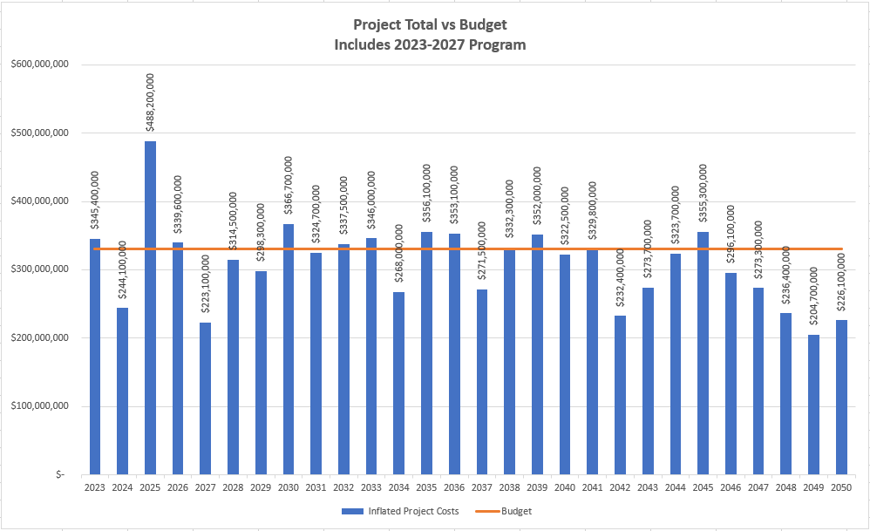
Last Year’s (2022) Project Totals
$330 Million Annual Budget
Program Years
Project Budgets Set Very Tight to Promote Right Sizing
Notes:
Includes 5% increase in budget – implemented after 2nd year
Capacity Project Priority driven by Traffic Needs

Slide 8
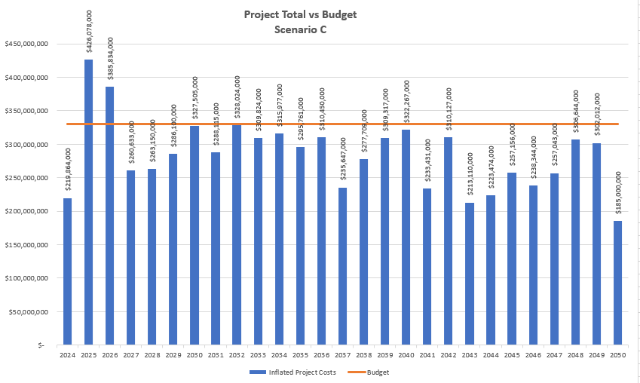
2023 Project Totals and Annual Budget
$330 Million Annual Budget
Program Years
Project Budgets Set Very Tight to Promote Right Sizing
Notes:
Many projects pushed past year 2050 to give most realistic expectation of what we can accomplish in the next 25+ years.

Slide 9
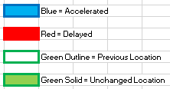
Project Timing
Notes:
Explain How Graph Works
Moved up expansion I-80 - DSM to Mitchellville
Mitchellville to Iowa City pushed past 2050
Iowa City to Cedar River remains priority
Sugar Creek Bridges over Cedar River priority

Slide 10
Project Timing
Notes:
Scott County expansion not yet warranted by traffic
Spot Improvements will be needed
I-380 Iowa City to Cedar Rapids priority to finish – Middle Section over Iowa River
Wright Bros Interchange Priority
Boyson Rd north of Cedar Rapids programmed

Slide 11
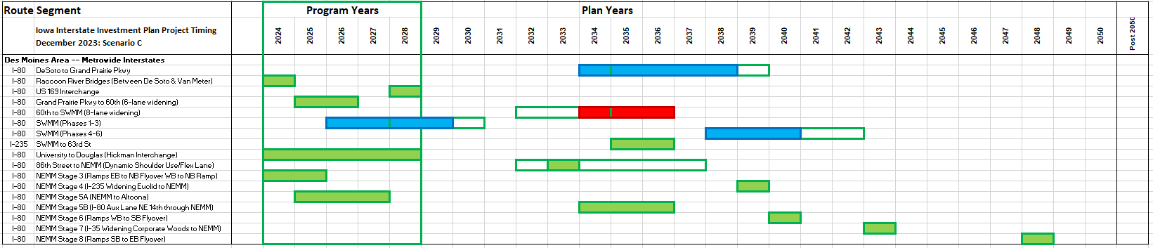
Project Timing
Notes:
I-80 widening West of DSM – GPP to 60th under construction
I-80/US 169 interchange at DeSoto programmed
Focus on SW and NE Systems Interchanges in DSM

Slide 12
Other Projects
Other Interstate Work
Madison Ave Interchange – Programmed (2024-2025)
Middle Road Interchange – Programmed 2026
Hickman Road Interchange – Programmed (2025-2028)

Slide 13
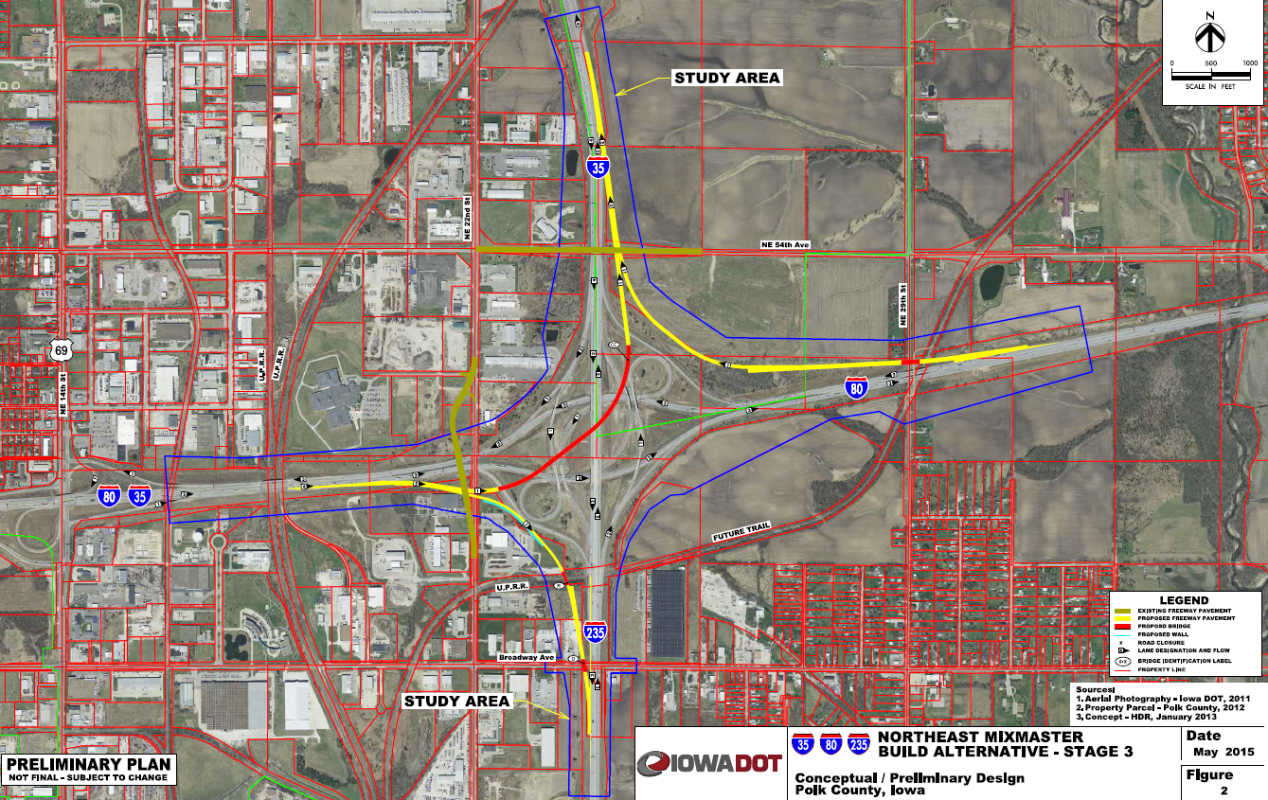
Des Moines NE Mixmaster Phases
Stage Timing
Stage 1/2 - Complete
Stage 3 – Currently under Construction
EB to NB Flyover
WB to NB Ramp
Stage 4 – 2039
South I-235 Widening
Stage 5 – 2034
West I-80 through Interchange
Widening and Aux Lanes
Stage 6 – 2040
I-80 WB to SB Flyover
Stage 7 – 2043
North I-35 Widening
Stage 8 – 2048
North I-35 SB to EB Flyover
Example Plan Graphic

Slide 14
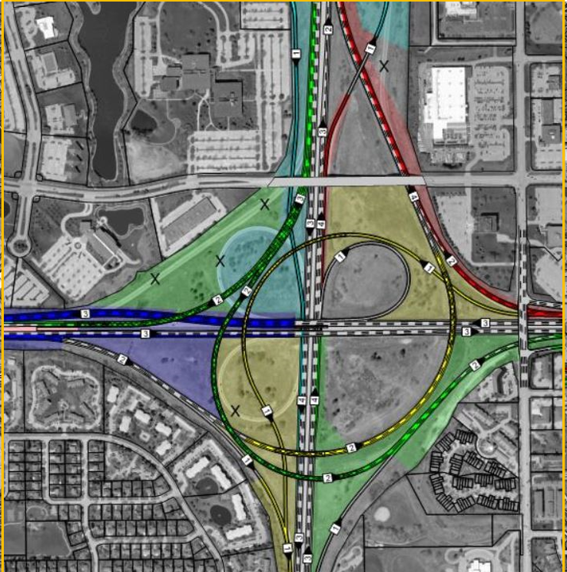
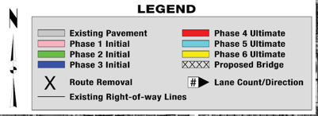
Des Moines SW Mixmaster Stages
Phase Timing
Phases 1,2,3 – 2027 & 2028
ROW in 2026
Erosion Control in 2029
Phase 4 - 2038
Phase 5 - 2039
Phase 6 - 2040

Slide 15
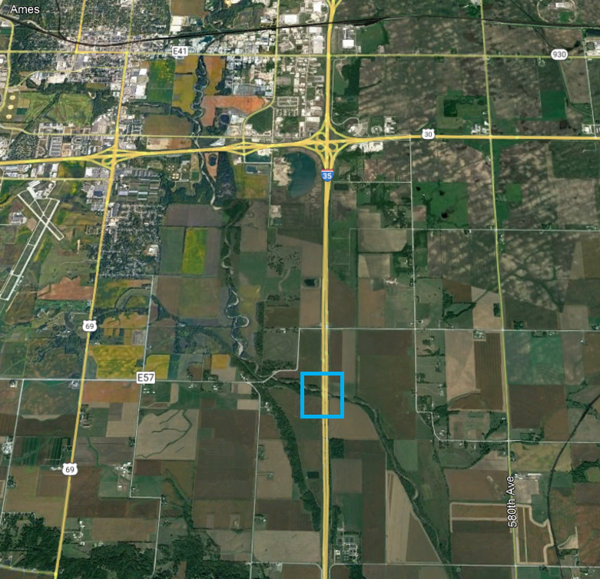
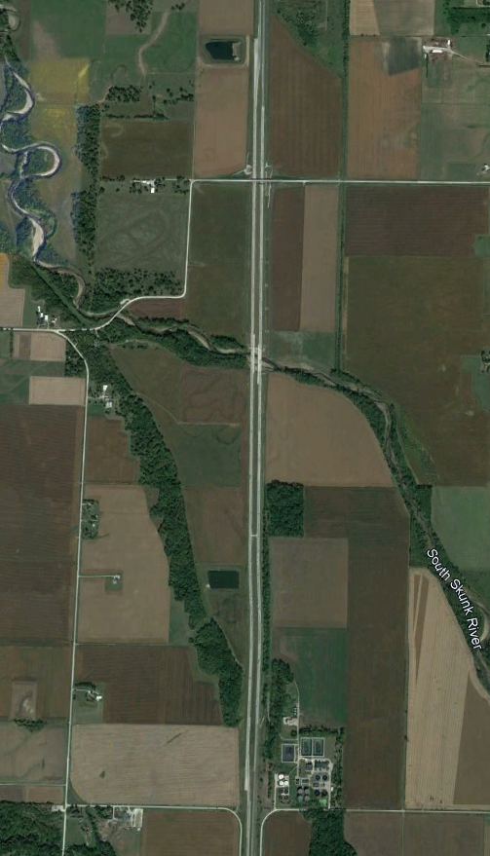
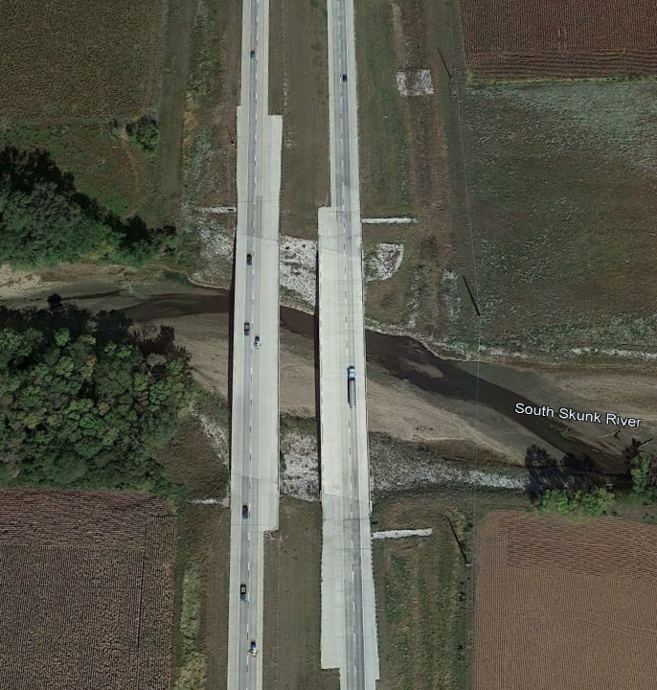
Interstate 35 Story County
South Skunk River Bridges
I-35 Mainline Bridges Over Skunk River Completed
I-35 Alignment Shift:
Construction
Traffic Management
I-35
Notes:
Explain Skunk River bridge work already complete in this corridor.

Slide 16
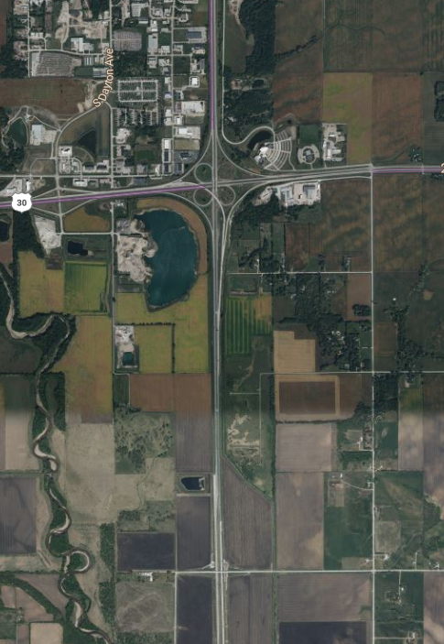
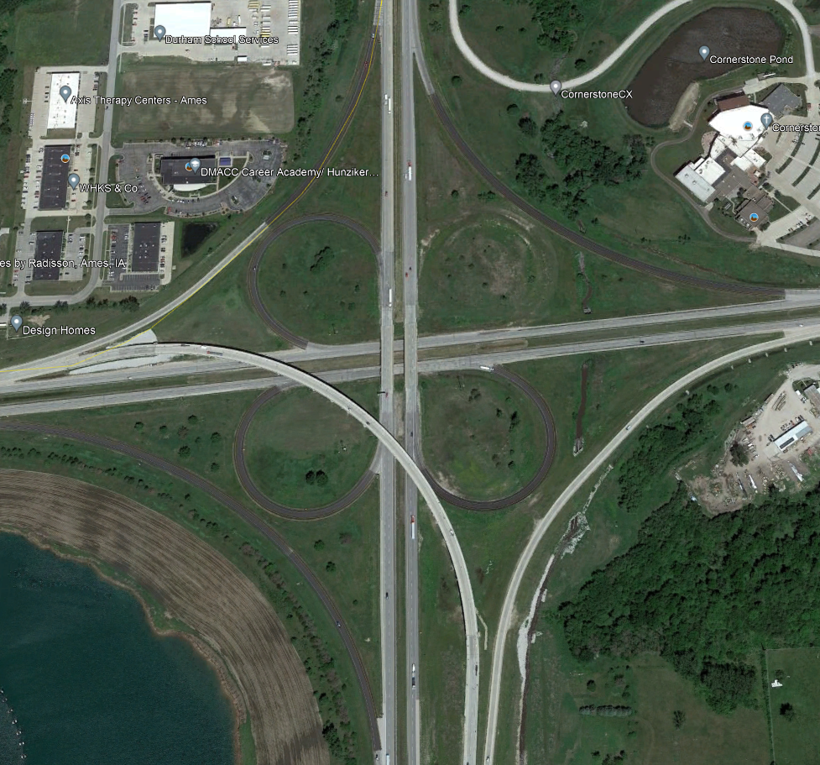
Interstate 35 Ames
I-35 Mainline Bridges over US 30
N of Co Rd E57/260th St to 0.6 mi N of US 30
2027 - $11.8 million
2028 - $11.5 million
2029 - $30.9 million
2030 - $26.6 million
2031 - $1.2 million
260th St
Notes:
Explain all the work that goes into MOT etc.

Slide 17
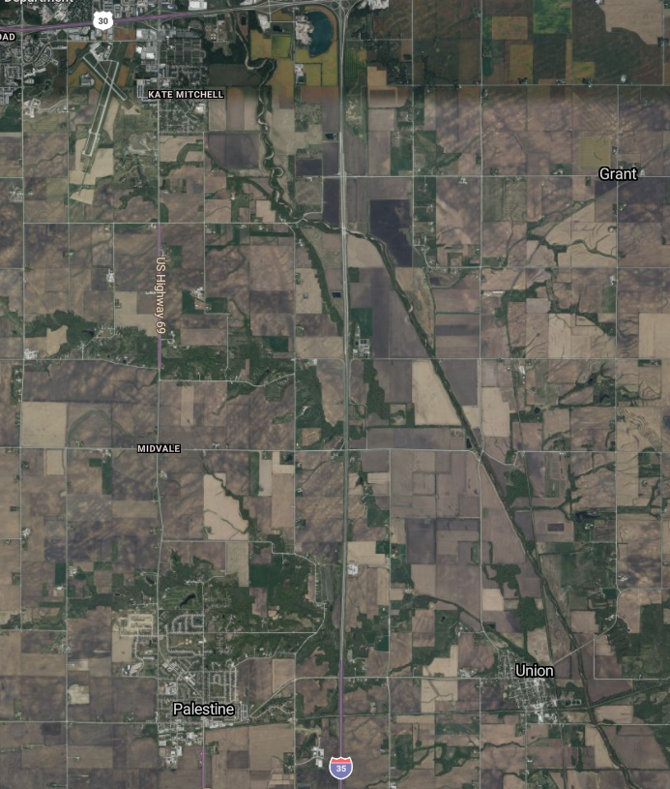
Interstate 35 - Story County
North of 315th St to
E57/260th St
Reconstruction to 6-lanes
Ames
260th St
2029 - $2.0 million
2030 - $6.0 million
2031 - $38.3 million
2032 - $37.0 million
I-35
Huxley
315th St

Slide 18
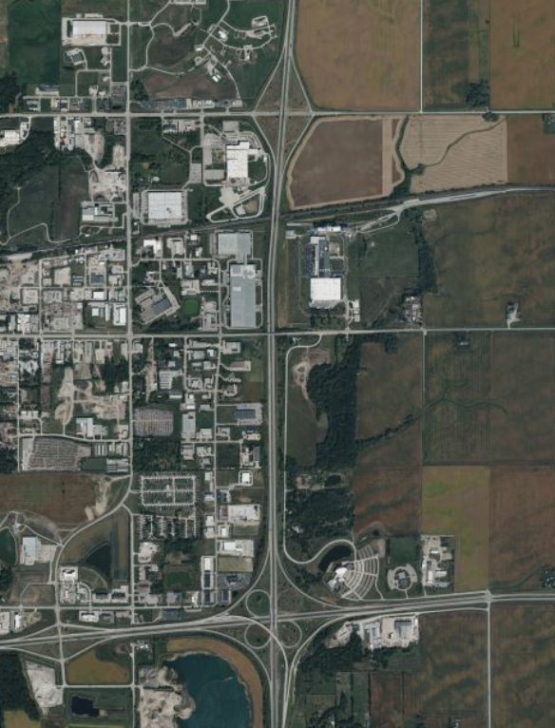
Interstate 35 - Story County
North of US 30 to 13th St Ames
Reconstruction to 6-lanes
13th St
2035 - $30.2 million
2036 - $30.2 million
I-35
US-30

Slide 19
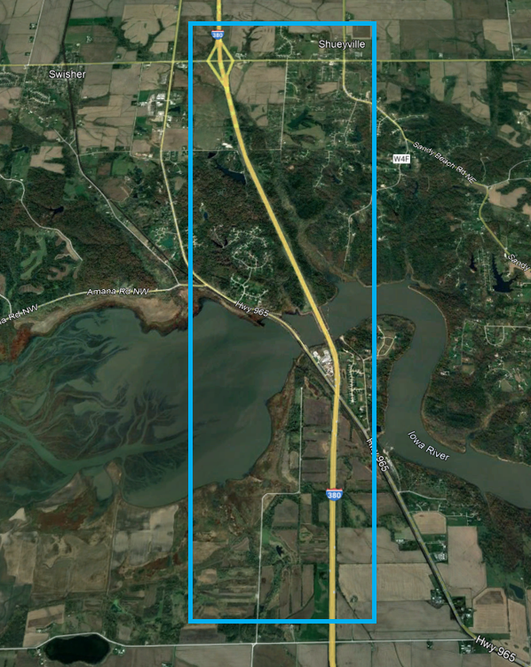
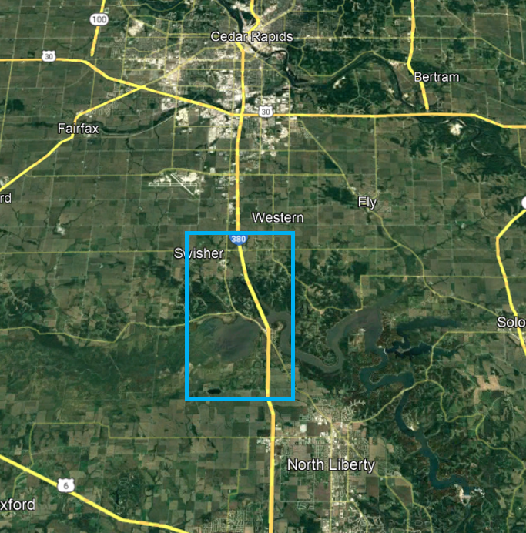
Interstate 380 Johnson/Linn
North of Swan Lake Rd to North of 120th St
Reconstruction to 6-lanes
Delayed One Year
120th St
2029 - $50.2 million
2030 - $55.4 million
2031 - $60.2 million
Swan Lake Rd
Notes:
Iowa River Crossing

Slide 20
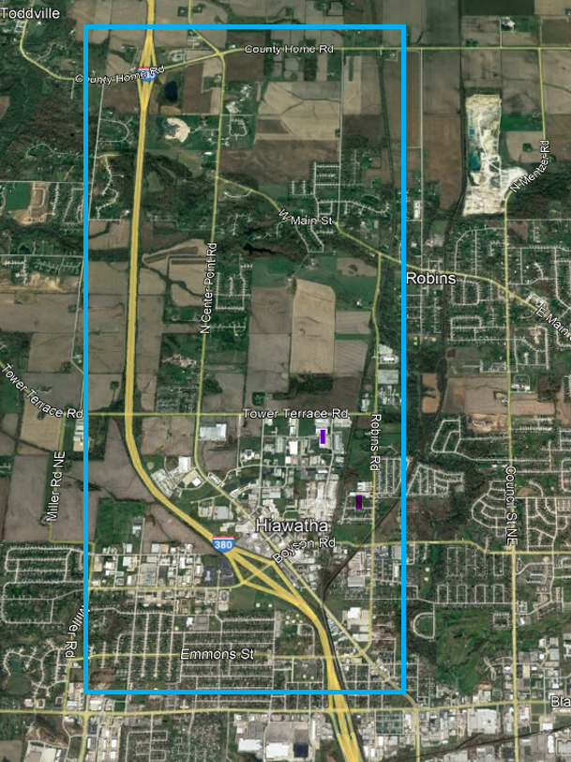
Interstate 380 Linn County
Blairs Ferry Rd to County Home Rd
Reconstruction to 6-lanes
2030 - $15.4 million
2031 - $32.5 million
Boyson Rd Interchange Programmed for 2025
$24.1 million
I-380
Boyson Rd

Slide 21
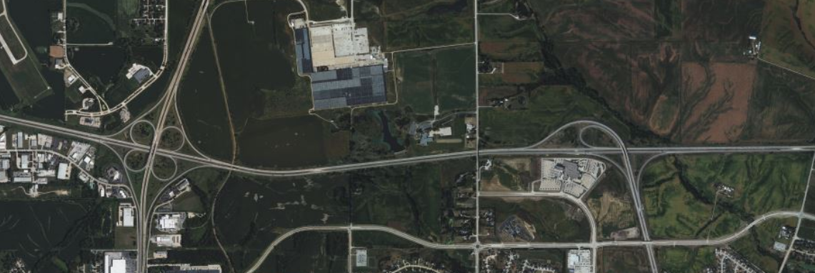
Interstate 80 Scott County
Based on Timing of Capacity Need due to Traffic Volumes – I-80 Scott County corridor widening to 6-lanes moved to post 2050.
However, there are spot locations that will need addressed sooner than 2050.
US 61
I-80
I-74
Notes:
Spot Treatments
US 61 Interchange
Mainline between US 61 and I-74

Slide 22
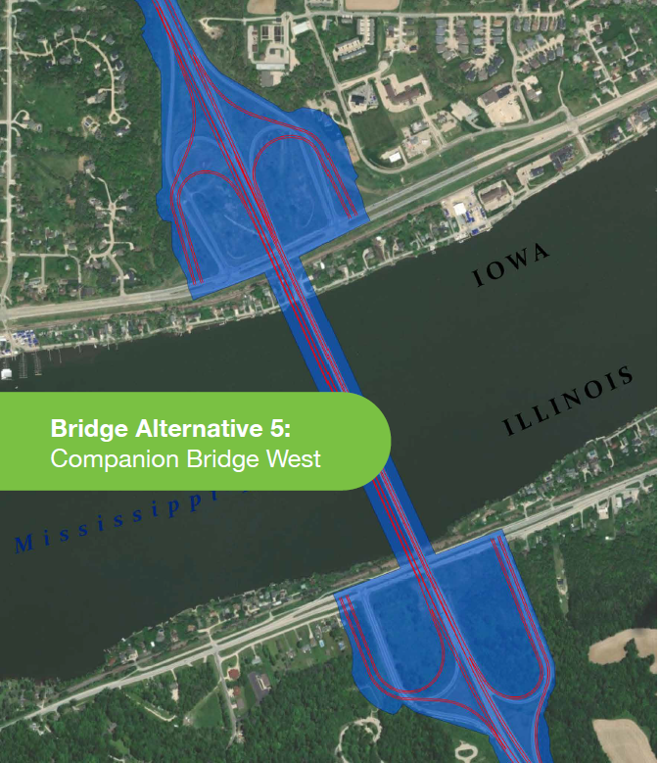
Interstate 80 Scott County
Mississippi River Bridge
PEL Study Completed
Phase 1 Engineering
4 Public Meetings to Date
Preferred Alternative Chosen
Alt 5 – Companion Bridge West
One Year Programmed 2028
Total Iowa Share $150 M
Illinois DOT - lead Agency

Slide 23

THANK YOU
Phil Mescher, AICP, CPM
PROJECT MANAGEMENT BUREAU
IOWA DEPARTMENT OF TRANSPORTATION
Phil.Mescher@iowadot.us
Office Phone: 515-233-7969

