Slide 1
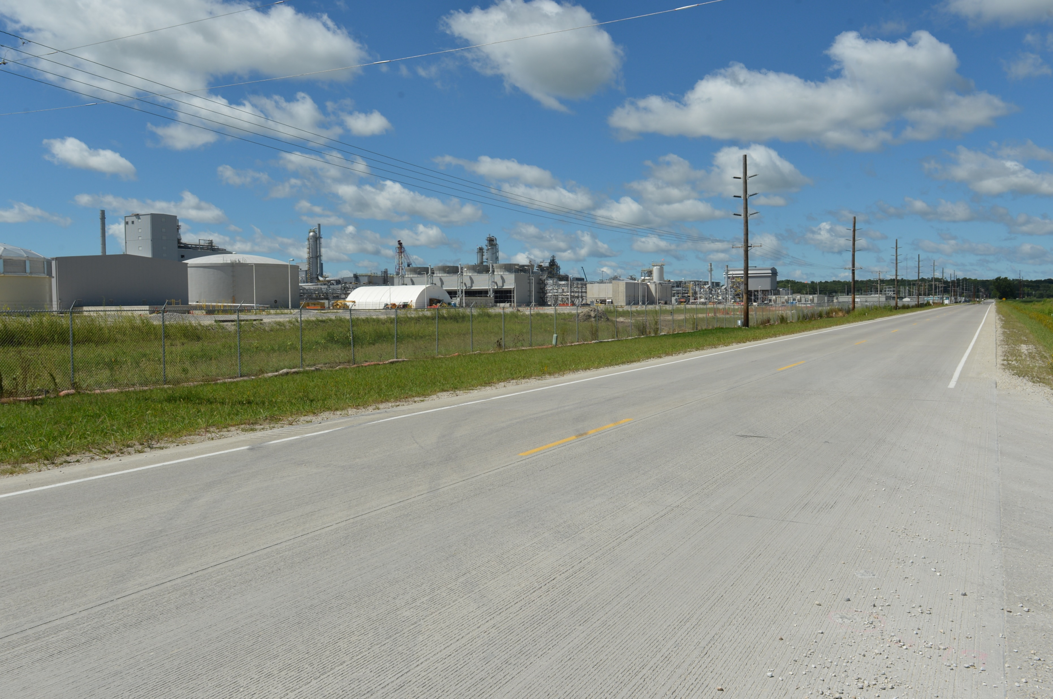

Revitalize Iowa’s Sound Economy Program
Funding Recommendation
Debra Arp
Local Systems Bureau, Grant Team Leader
12/10/2024

Slide 2
Revitalize Iowa’s Sound Economy Program
Created in 1985
Purpose: To promote economic development through roadway improvements
Eligible development shall have value-adding activities that feed new dollars into the economy
Available to cities and counties through an application program
2
2

Slide 3
Monthly Program Financial Report
Funded annually with dedicated state motor fuel and special fuel tax revenues
 | City RISE Fund | County RISE Fund
FY2025 Projected Total RISE Road Use Tax Fund (RUTF) Revenue ¹ | $11,611,933 | $5,805,967
Actual RISE Revenue Received as of 10/31/2024 ² (% of FY2025 Projected Revenue) | $4,128,568 (35.6%) | $2,036,253 (35.1%)
FY2025 RISE Funds Awarded as of 10/31/2024 (% of Projected Total RUTF committed) | $8,896,357 (76.6%) | $0 (0%)
Fund Balance as of 10/31/2024 | $54,239,782 | $19,035,926
Outstanding Commitments as of 10/31/2024³ | ($45,474,963) | ($16,155,923)
Uncommitted Balance as of 10/31/2024 | $8,764,819 | $2,880,003
¹ Calculation based on FY2024 average monthly RISE RUTF revenue of $967,661 to the city RISE fund and $483,831 to the county RISE fund. As of 10/31/2024, FY2025 is 33.3% complete.
² Actual RISE revenue includes RUTF revenue, loan repayments, and project settlements. These revenue sources are variable and are not included in projections.
³ Award of $285,212 to Jasper County in November 2024 is not reflected in the outstanding commitments of 10/31/2024.
3
3

Slide 4
Local Development Project Evaluation Criteria
Criteria | Points
Development Potential | 35
Economic Impact and Cost Effectiveness | 20
Local Commitment and Initiative | 33
Transportation Need and Justification | 4
Local Economic Need | 6
4
4

Slide 5
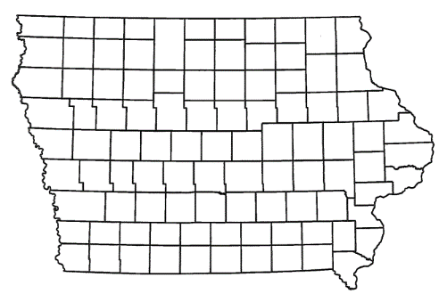
Local Development Recommendations
PROJECT NAME | SPONSOR | SCORE | TOTAL PROJECT COST | PERCENT PARTICIPATION | RECOMMENDED AMOUNT
Construction of approximately 2,600 feet of Dakota Drive; 470 feet of Wolfe Avenue; turn lanes on Dakota Drive and a left turn lane on Ansborough Avenue located on the southwest side of town (Certified Site) | Waterloo | 62 | $3,788,225 | 60% | $2,272,935
5
5

Slide 6
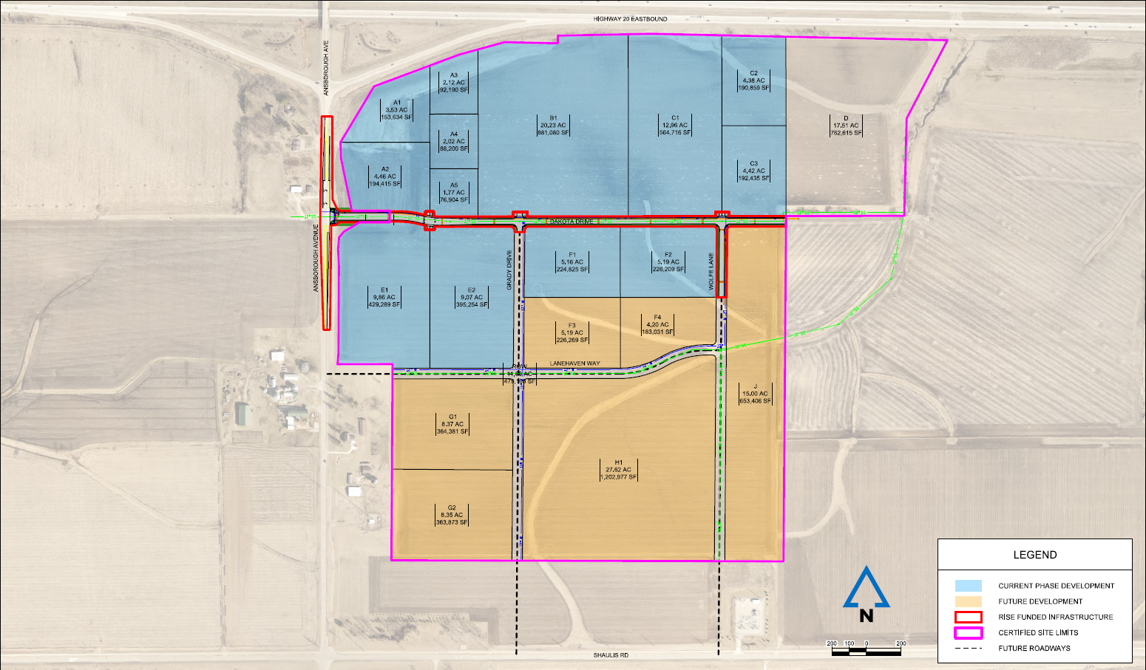
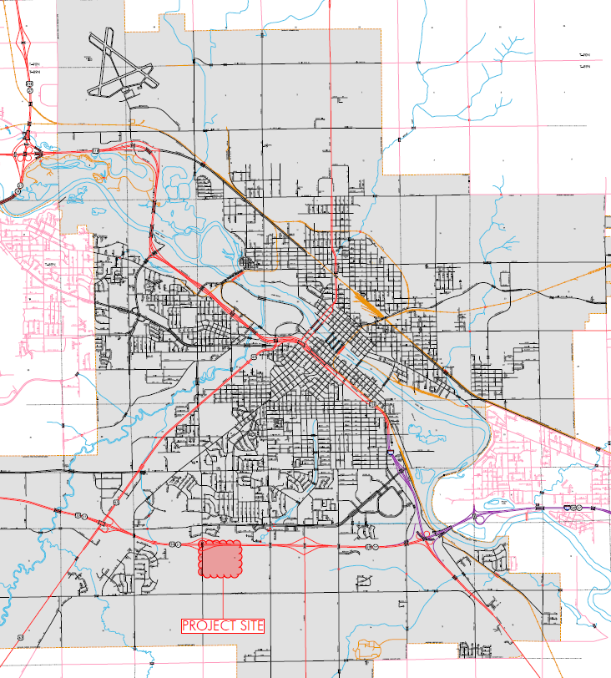
Waterloo
Local Development (Certified Site)
Construction of approximately 2,600 feet of Dakota Drive; 470 feet of Wolfe Avenue; turn lanes on Dakota Drive and a left turn lane on Ansborough Avenue located on the southwest side of town.
Total Cost: $3,788,225
Requested: $2,272,935 (60%)
6

Slide 7



Questions?
jennifer.kolacia@iowadot.us
515-239-1738

