Slide 1
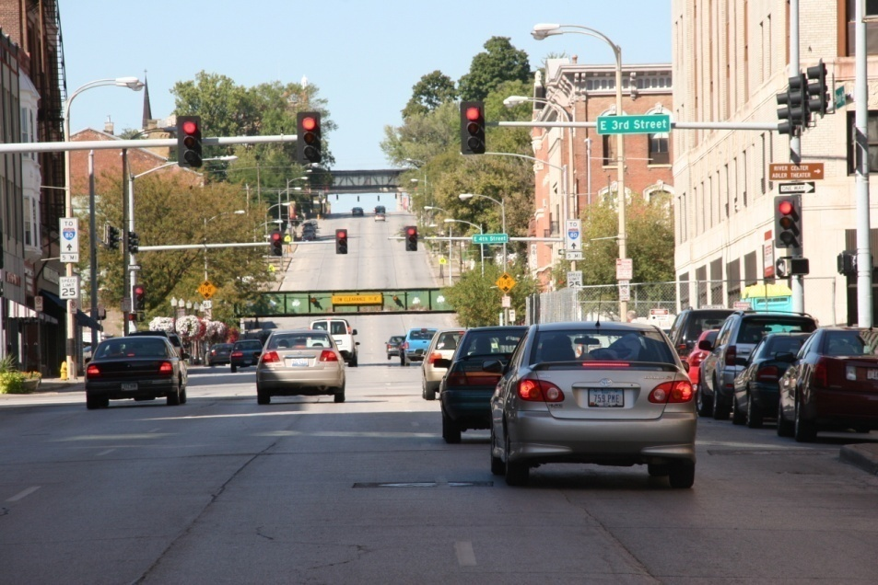
Iowa’s Clean Air Attainment Program
Funding Recommendation
Debra Arp
Local Systems Bureau, Grant Team Leader
12/10/2024

Slide 2
Iowa’s Clean Air Attainment Program
Created in 1994
Available to federal, state, and local government agencies; transit agencies; and planning organizations. Private individuals and organizations may apply with a government co-sponsor.
Purpose is to support projects with the highest potential for reducing transportation-related congestion and air pollution
2
2

Slide 3
Iowa’s Clean Air Attainment Program (con’t)
Funded with $4 million in federal Congestion Mitigation and Air Quality Improvement (CMAQ) program.
Iowa is an air quality attainment state and funds may be used for any eligible Surface Transportation Block Grant or CMAQ project.
Eligible projects include:
Improvements to motor vehicle traffic flow, public transit service and intermodal freight movement; reduction in traffic congestion and single-occupant vehicle travel; purchase of publicly owned alternative fuel vehicles; and bicycle and pedestrian facilities and programs.
3
3

Slide 4
Project Evaluation Criteria
Criteria | Points
Project cost effectiveness relative to air quality benefits | 30
Vehicle traffic flow improvement | 25
Vehicle miles of travel (VMT) or single occupancy vehicle (SOV) reduction | 25
Estimated vehicle emission reduction | 20
Degree of transportation related air pollution or traffic congestion | 15
4
4

Slide 5
Available Funding and Application Summary
Available Funding: | Column 2
CMAQ funds | $4,000,000
Application Summary:
Total number of projects | 7
Total project costs | $21,266,208
Total amount requested | $7,754,728
5
5

Slide 6
List of Applications Recommended
PROJECT NAME | SPONSOR | SCORE | TOTAL PROJECT COST | REQUESTED AMOUNT (% of Total Project Cost) | RECOMMENDED AMOUNT (% of Total Project Cost)
SE 14th Street (U.S. 69) Corridor Adaptive Signal Control | City of Des Moines | 79 | $2,594,000 | $2,075,000 (80%) | $2,075,000 (80%)
Enterprise Commute Vanpool | Region 6 Planning Commission | 69 | $144,000 | $115,200 (80%) | $115,200 (80%)
Hammond Avenue and Ridgeway Avenue Roundabout | Waterloo | 63 | $1,200,000 | $700,000 (58%) | $700,000 (58%)
U.S. 6 & NW 111th Street Improvements Related to I-35/80 Interchange Reconstruction | Urbandale & Clive | 62 | $13,210,680 | $2,500,000 (19%) | $1,109,800 (8%)
6
Jump to Applications Not Recommended for Funding
6

Slide 7
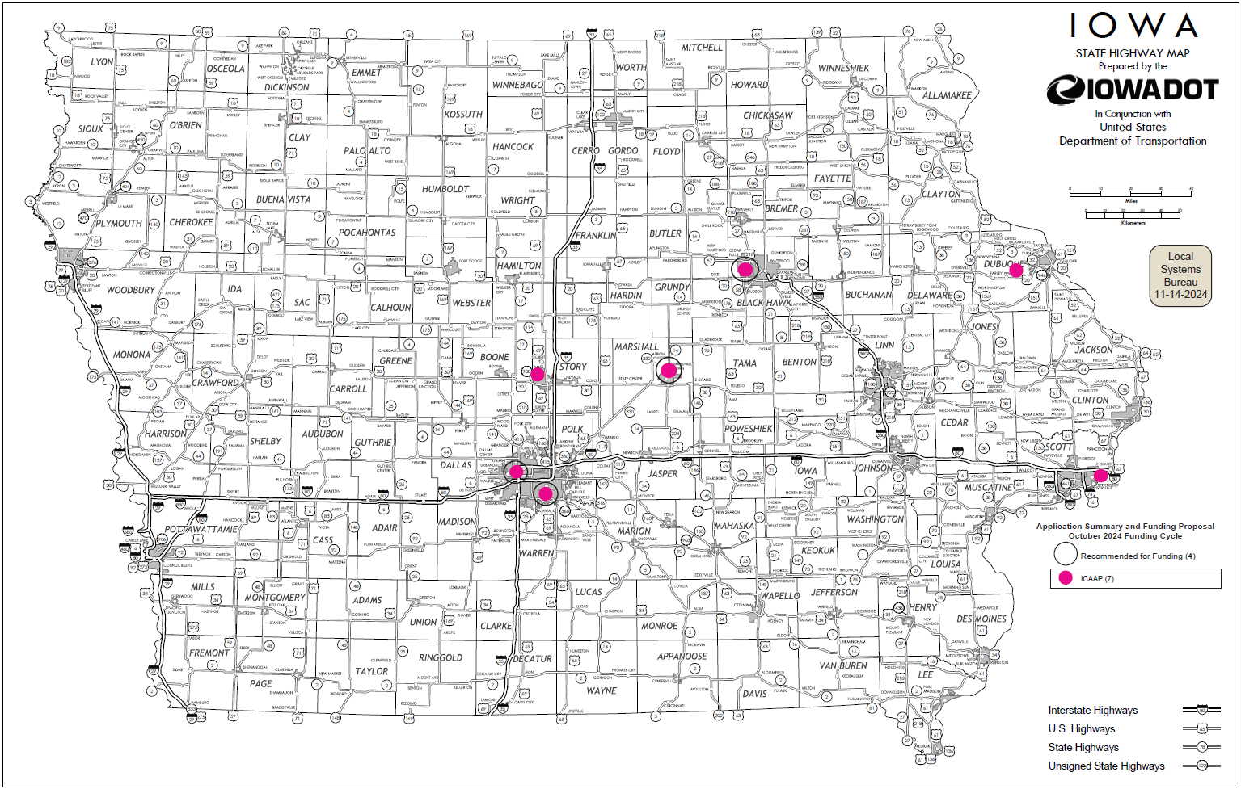
Map of Applications Received
7

Slide 8
Estimated Annual Benefits of
Recommended Projects
Reduction of Vehicle Hours of Travel: 744,663 hrs
Reduction of Vehicle Miles of Travel: 5,543,242 mi
Reduced CO, VOCs, & NOx Emissions: 361,553 lbs
8
8

Slide 9
Questions?
jared.smith@iowadot.us
515-239-1713

Slide 10
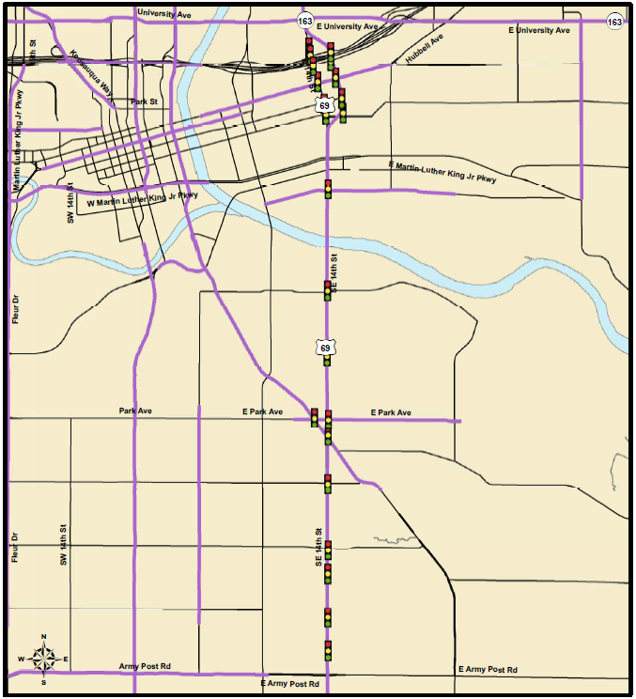
SE 14th St (U.S. 69) Corridor Adaptive Signal Control
(Des Moines)
The project will install adaptive traffic signal control for 25 intersections along SE 14th Street from Walker Street to Cummins Road and also upgrade detection, install pedestrian pushbuttons and update signal heads to comply with PROWAG.
Total Cost: $2,594,000
Requested: $2,075,000 (80%)
Return to List of Applications Recommended
10

Slide 11
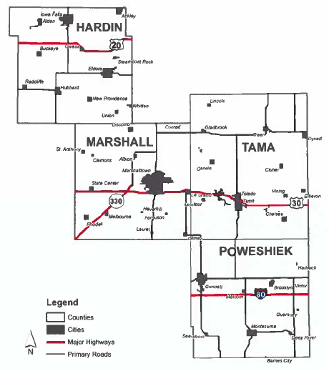
Enterprise Commute Vanpool (Region 6 Planning Commission)
This project will support Peoplerides public transit (Region 6 Planning Commission) Enterprise vanpool services. Up to 20 vans will operate in the region providing transportation to area employers. All vehicles are open to public transportation.
Total Cost: $144,000
Requested: $115,200 (80%)
Return to List of Applications Recommended
11

Slide 12
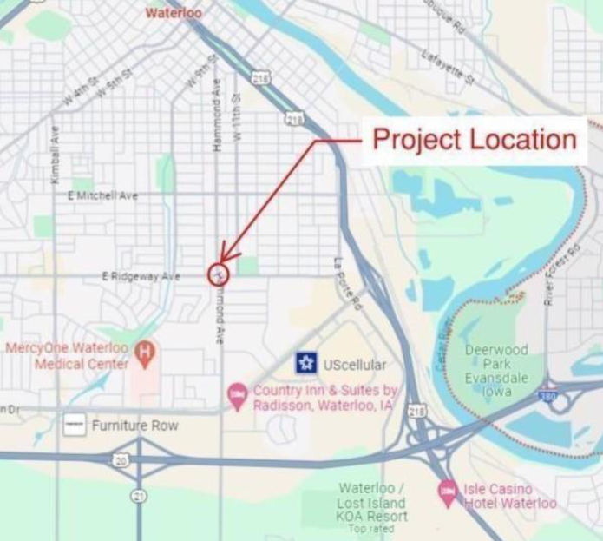
Hammond Avenue and Ridgeway Avenue Roundabout
(Waterloo)
This project will construct a single-lane roundabout at the intersection of Hammond Avenue & Ridgeway Avenue improving emissions and the geometry of a skewed intersection.
Total Cost: $1,200,000
Requested: $700,000 (58%)
Return to List of Applications Recommended
12

Slide 13
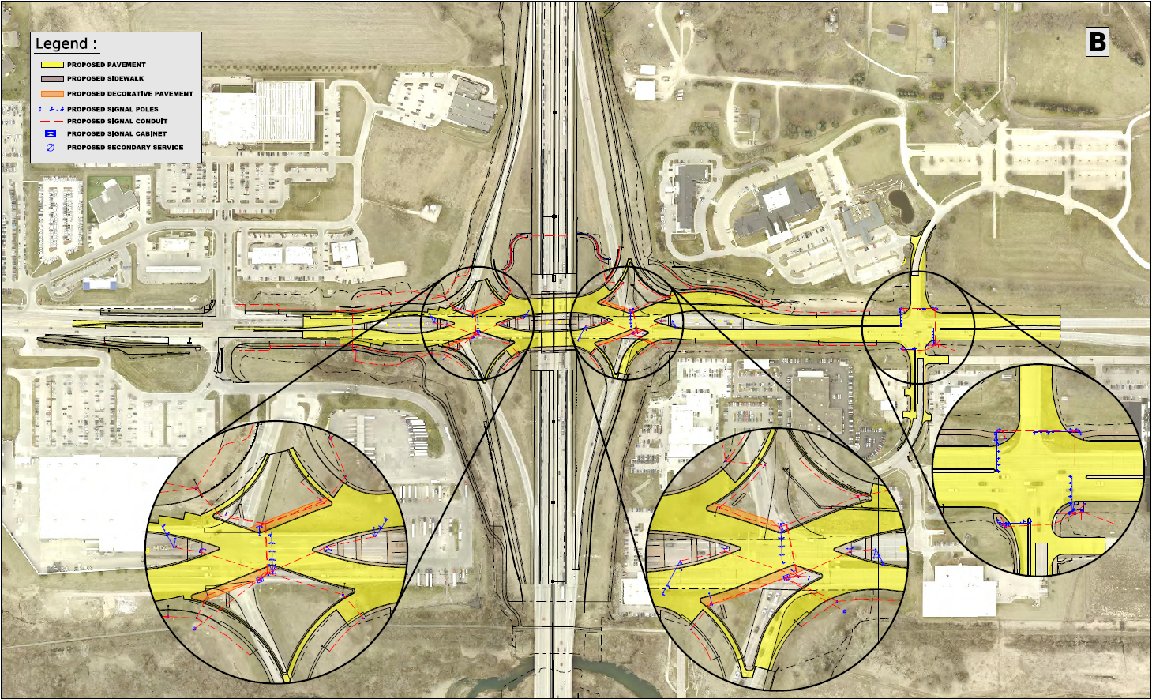
U.S. 6 & NW 111th St. Improvements Related to I-35/80 Interchange Reconstruction
(Urbandale/Clive)
This project will construct roadway improvements on U.S. 6 from west of the reconstructed I-35/80 interchange to NW 111th St and other improvements to NW 111th St.
Total Cost: $13,210,680
Requested: $2,500,000 (19%)
Recommended: $1,109,800 (8%)
Return to List of Applications Recommended
13

Slide 14
List of Applications Not Recommended for Award
PROJECT NAME | SPONSOR | SCORE | TOTAL PROJECT COST | REQUESTED AMOUNT (% of Total Project Cost) | RECOMMENDED AMOUNT (% of Total Project Cost)
Deployment of Ames Traffic Signal Master Plan Ph 5 | Ames | 57 | $2,515,000 | $1,312,000 (52%) | $0
Center Avenue/ Jacoby Drive Roundabout | Epworth | 29 | $1,352,528 | $852,528 (63%) | $0
Scott County Urban Transit Study | Davenport | 28 | $250,000 | $200,000 (80%) | $0
14
Return to List of Applications Recommended
14

