Slide 1
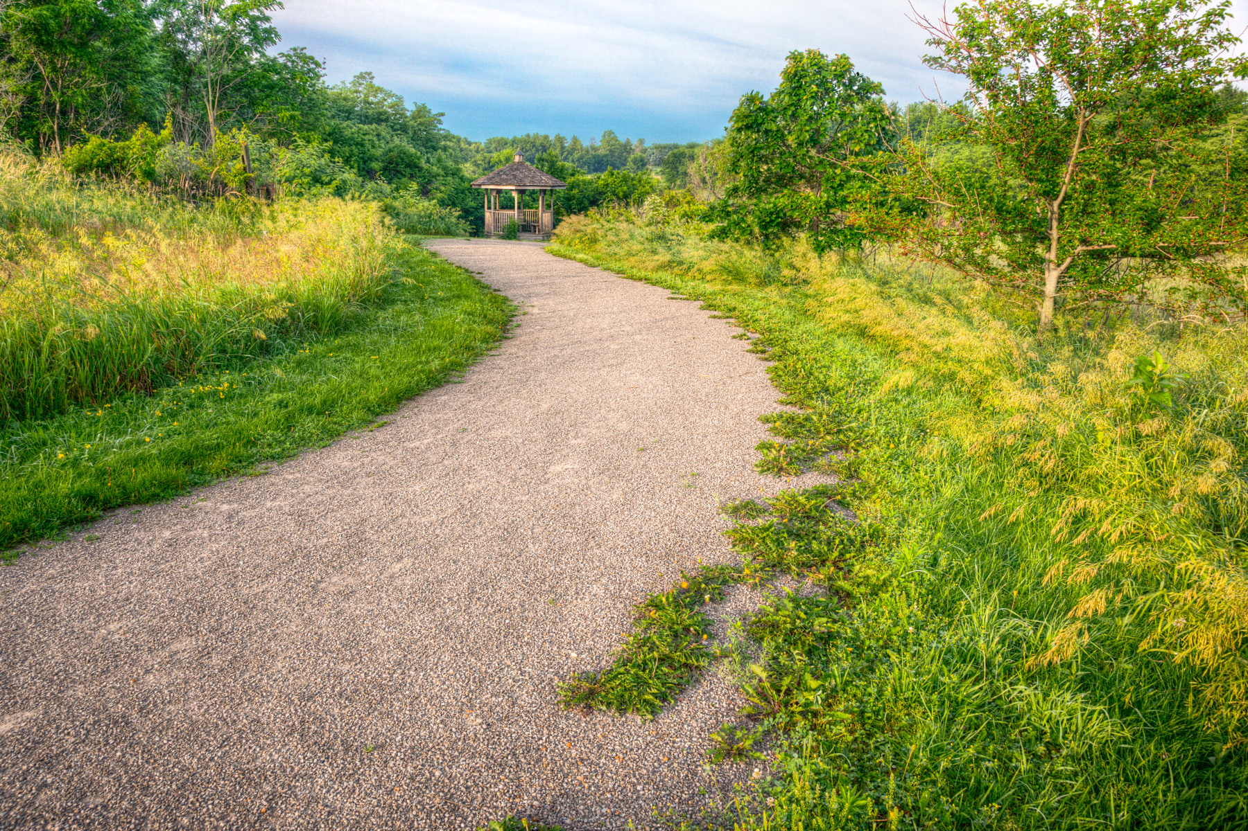
Federal Recreational Trails Program
Funding Recommendation
Debra Arp
Local Systems Bureau, Grant Team Leader
12/10/2024

Slide 2
Federal Recreational Trail Program
Created in 1991
Available to federal, state, and local government agencies. Private individuals and organizations may apply with a government co-sponsor.
Purpose is to develop and maintain recreational trails and trail related facilities for both motorized and non-motorized trail users.
Eligible projects include:
Maintenance and restoration of existing trails, development of trailside and trailhead facilities, purchase of trail construction and maintenance equipment, construction of new trails and acquisition of land for trails.
2
2

Slide 3
Project Evaluation Criteria
Criteria | Points
Degree to which motorized and non-motorized trail use are accommodated. | 10
Greatest number of compatible multi-purpose uses | 10
Access and use for persons with disabilities, older citizens, economically challenged and other special populations or groups. | 10
Provides development of trail linkages | 10
Opportunities for new partnerships between trail users and private interests. | 10
Identified in or furthers a specific goal of a state, regional, or local plan | 10
Leverages greater public or private investments | 10
Citizen involvement in the project’s conception and implementation. | 10
Degree to which project ties into other trails. | 10
Public/private partnerships to continue operation and maintenance. | 15
Trails with national designation or resulting in the cleanup of an area | 10
MAXIMUM POINTS | 115
3
3

Slide 4
Available Funding and Application Summary
Available Funding: | Column 2
Annual appropriation | $1,300,000
Underruns from closed projects | $492,000
Total available funding | $1,792,000
Application Summary:
Total number of projects | 9
Total project costs | $25,152,638
Total amount requested | $5,577,042
4
4

Slide 5
List of Motorized Applications Recommended
PROJECT NAME | SPONSOR | SCORE | TOTAL PROJECT COST | REQUESTED AMOUNT (% of Total Project Cost) | RECOMMENDED AMOUNT (% of Total Project Cost)
Snow Trail Maintenance Equipment | Iowa State Snowmobile Association | 61 | $325,000 | $260,000 (80%) | $260,000 (80%)
Off-Highway Vehicle Park Equipment | Iowa Department of Natural Resources | 48 | $340,000 | $272,000 (80%) | $272,000 (80%)
5
Jump to Applications Not Recommended for Funding
5

Slide 6
List of Non-motorized Applications Recommended
PROJECT NAME | SPONSOR | SCORE | TOTAL PROJECT COST | REQUESTED AMOUNT (% of Total Project Cost) | RECOMMENDED AMOUNT (% of Total Project Cost)
Estherville River Recreation Enhancement Project | Estherville | 70 | $1,300,000 | $650,000 (50%) | $650,000 (50%)
Iowa River’s Edge Trail: Bridge Improvements | Hardin County | 68 | $548,071 | $438,475 (80%) | $438,475 (80%)
6
Jump to Applications Not Recommended for Funding
6

Slide 7
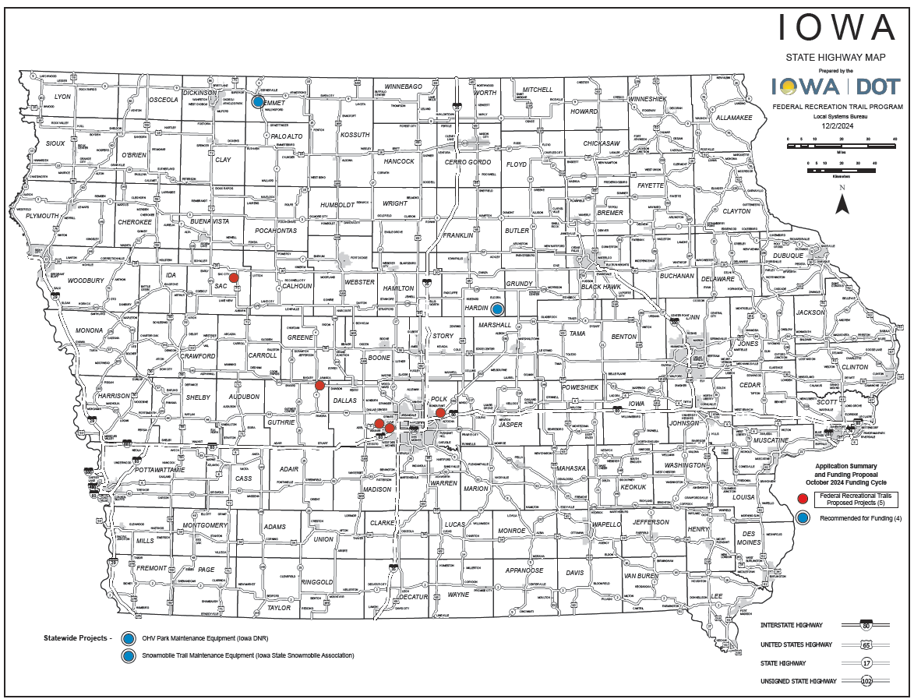
Map of Applications Received
7

Slide 8
Questions?
scott.flagg@iowadot.us
515-239-1252

Slide 9
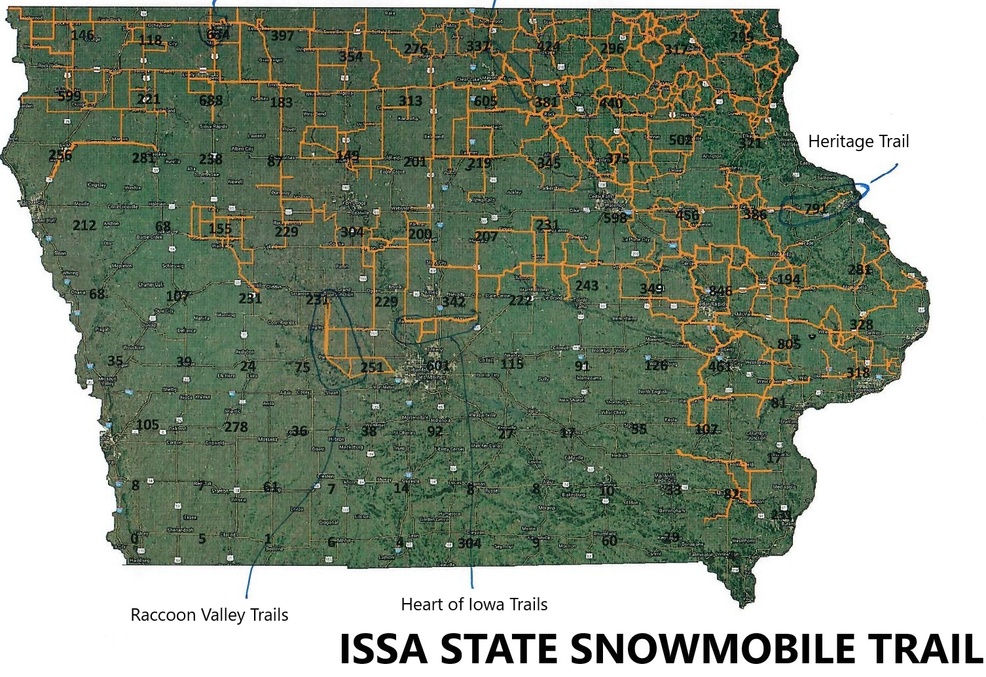
Snow Trail Maintenance Equipment
(Iowa State Snowmobile Association)
This project purchases new snow cat power units and drags to maintain snow trails across Iowa.
Total Cost: $325,000
Requested: $260,000 (80%)
Return to List of Applications Recommended
9

Slide 10
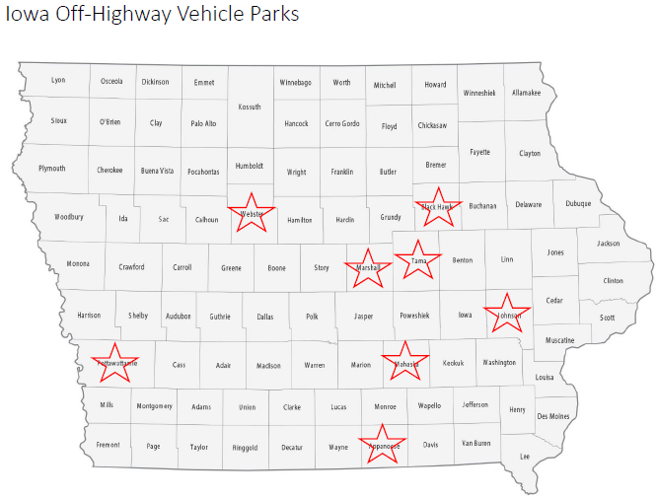
Off-Highway Vehicle Park Equipment
(Iowa Department of Natural Resources)
This project will purchase six pieces of trail maintenance equipment (bobcats and excavators) for use at designated OHV parks.
Total Cost: $340,000
Requested: $272,000 (80%)
Return to List of Applications Recommended
10

Slide 11
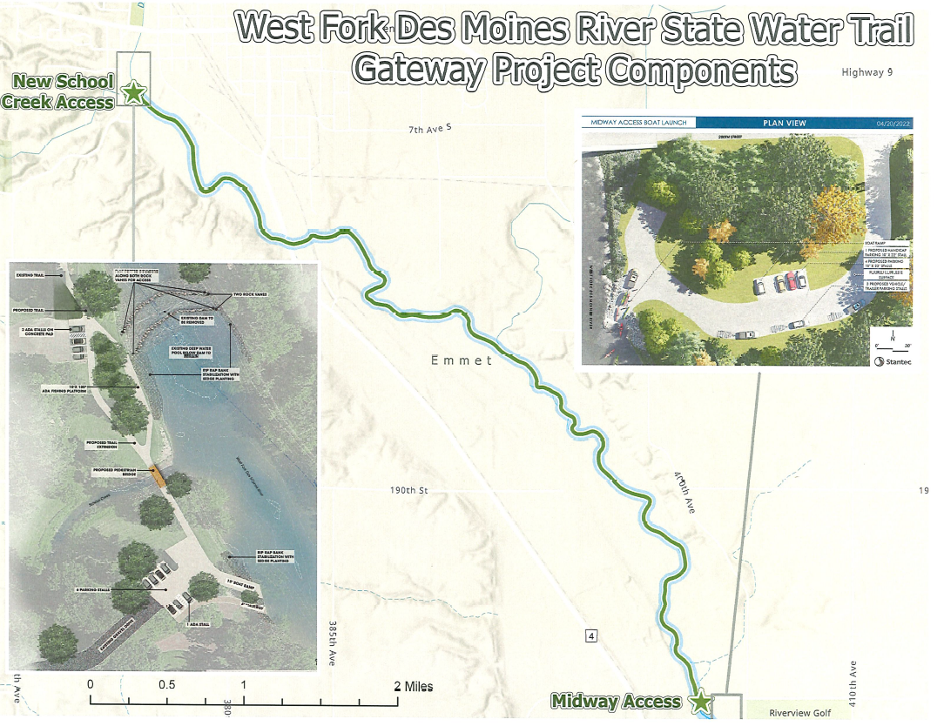
Estherville River Recreation Enhancement Project
(Estherville)
This project includes several water trail improvements along the West Fork of the Des Moines River including reconstruction of the School Creek access and a new Midway Access resulting in 2 ADA-accessible launches and landings, enhanced fishing access, and additional pedestrian improvements.
Total Cost: $1,300,000
Requested: $650,000 (50%)
Return to List of Applications Recommended
11

Slide 12
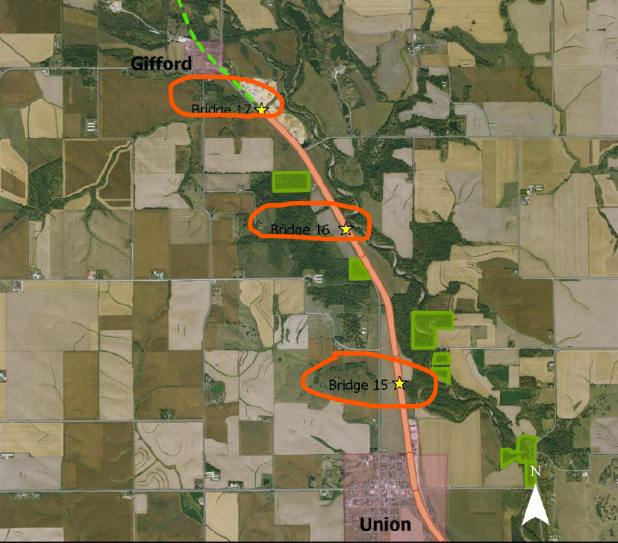
Iowa River’s Edge Trail: Bridge Improvements
(Hardin County)
This project will rehabilitate three bridges along the Iowa River’s Edge Trail between Gifford and Union.
Total Cost: $548,071
Requested: $438,475 (80%)
Return to List of Applications Recommended
12

Slide 13
List of Applications Not Recommended for Award
PROJECT NAME | SPONSOR | SCORE | TOTAL PROJECT COST | REQUESTED AMOUNT (% of Total Project Cost) | RECOMMENDED AMOUNT (% of Total Project Cost)
Waukee Regional Trail Connection and Safety Improvements | Waukee | 62 | $7,170,000 | $300,000 (4%) | $0
Sac City Trail Connector | Sac City | 60 | $1,625,000 | $1,300,000 (80%) | $0
Grant Street Trail | Bondurant | 59 | $5,350,000 | $300,000 (6%) | $0
Little Walnut Creek Trail | Clive | 54 | $3,606,000 | $300,000 (8%) | $0
Raccoon River Valley Trail Project | Guthrie County Conservation Board | 43 | $4,888,567 | $1,756,757 (36%) | $0
13
Return to List of Applications Recommended
13

