Slide 1
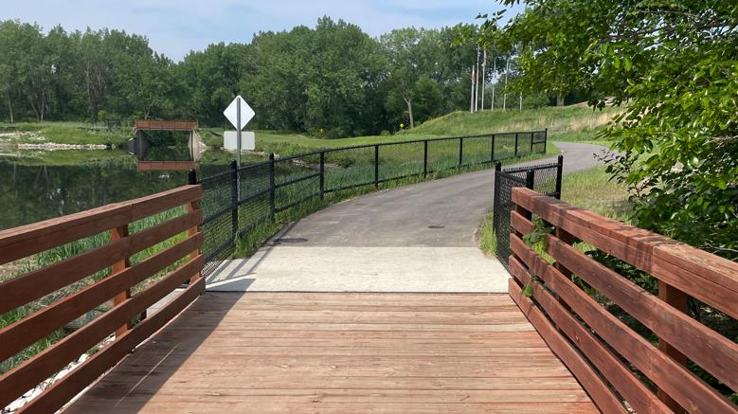

Statewide Transportation Alternatives
Set-aside Program
Funding Recommendation
Debra Arp
Local Systems Bureau, Grant Team Leader
12/10/2024

Slide 2
Statewide Transportation Alternatives Set-Aside Program
Current version of program in existence since 1991
Majority of funding is distributed to Iowa’s MPOs and RPAs, but $5 million reserved for statewide projects annually with 20% target for Safe Routes to School projects
Available to a variety of project sponsors but most applicants are cities and counties
2
2

Slide 3
Eligible Activities
On-road and off-road non-motorized trail facilities, safe routes for non-drivers, conversion of abandoned rail corridors for trails, preservation/rehabilitation of historic transportation facilities among others
Federal Recreational Trails Program eligible activities
Infrastructure-related or non-infrastructure related Safe Routes to School Projects
Scenic Byways
3
3

Slide 4
Project Evaluation Criteria
Criteria | Points
Statewide or multi-regional impact of the project | 25
Connectivity and Completion of Trail Linkages | 15
Alignment with Local, Regional, or Statewide Planning Documents | 15
Federal-aid Project Development Process, Understanding & Capacity | 10
Contribution Toward Safety for All Transportation Modes | 10
Enhancement of Statewide Tourism Benefits | 10
Leverage of other funding sources | 10
Need for the proposed project | 10
Addresses high-need areas | 10
Improve accessibility | 5
Long-term maintenance plan | 5
Project readiness | 5
MAXIMUM POINTS | 130
4
4

Slide 5
Available Funding and Application Summary
Available Funding: | Column 2
Total Funding Available | $9,000,000 | $9,000,000
Target to Safe Routes to School | $1,800,000 (20%) | $1,800,000 (20%)
Target for non-Safe Routes to School | $8,000,000 | $7,200,000
Application Summary:
Total number of projects: | 11
Total project costs | $6,250,826
Total amount requested | $4,704,266
5
5

Slide 6
Safe Routes to School Applications Recommended
PROJECT NAME | SPONSOR | SCORE | TOTAL PROJECT COST | REQUESTED AMOUNT (% of Total Project Cost) | RECOMMENDED AMOUNT (% of Total Project Cost)
Vine Street Safe Routes to School Project | Hartford | 87 | $916,533 | $733,226 (80%) | $733,226 (80%)
Tama-Toledo Safe Routes to School Improvements | Tama | 85 | $752,856 | $602,284 (80%) | $602,284 (80%)
Iowa Safe Routes Partnership | Iowa Northland Regional Council of Governments | 80 | $354,344 | $283,482 (80%) | $283,482 (80%)
15th Street Safe Routes to School Sidewalk | Marion | 79 | $680,000 | $544,000 (80%) | $544,000 (80%)
Plum Street Safe Routes to School Project | Tipton | 78 | $289,675 | $231,740 (80%) | $231,740 (80%)
6
6

Slide 7
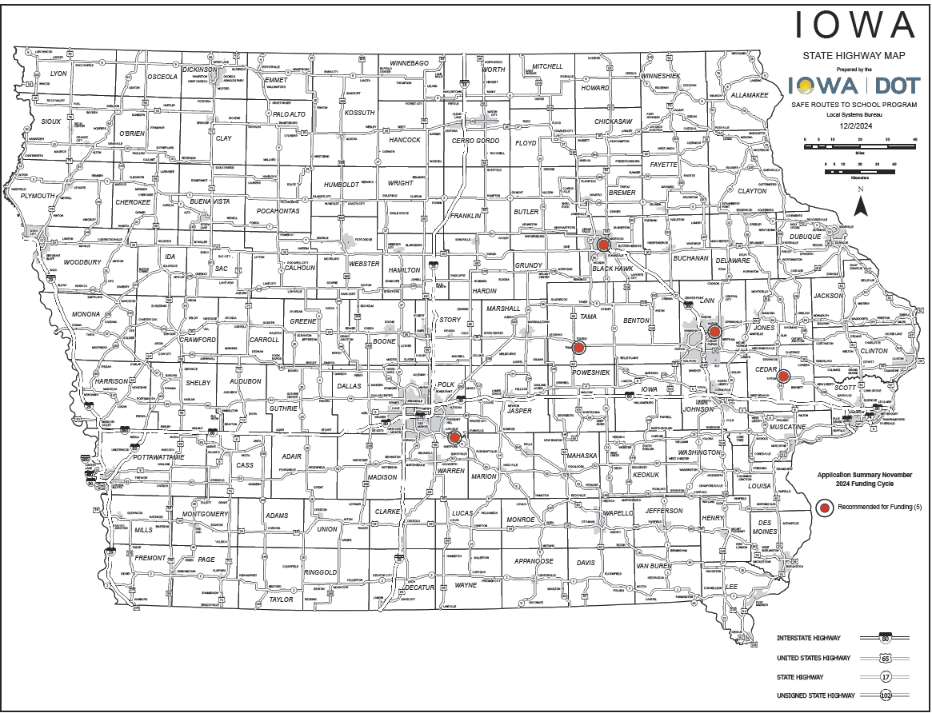
Safe Routes to School Applications Received
7

Slide 8
All Other Applications Recommended
PROJECT NAME | SPONSOR | SCORE | TOTAL PROJECT COST | REQUESTED AMOUNT (% of Total Project Cost) | RECOMMENDED AMOUNT (% of Total Project Cost)
West Clay Street Trail Extension over I-35 | Osceola | 116 | $930,000 | $740,000 (80%) | $740,000 (80%)
U.S. 6, Iowa 1, and Riverside Drive Bicycle and Pedestrian Facilities | Iowa City | 114 | $675,000 | $540,000 (80%) | $540,000 (80%)
UNI Integrated Roadside Vegetation Management | University of Northern Iowa Tallgrass Prairie Center | 72 | $436,418 | $349,134 (80%) | $349,134 (80%)
Little River Scenic Pathway Extension Ph 2 | Decatur County Conservation Board | 66 | $453,000 | $70,000 (15%) | $70,000 (15%)
8
8

Slide 9
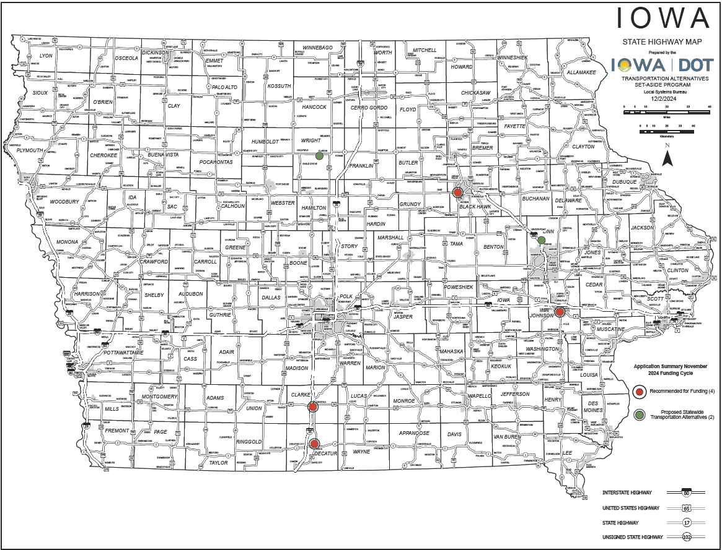
All Other Applications Received
9

Slide 10



Questions?
susan.hollenkamp@iowadot.us
515-239-1810

Slide 11
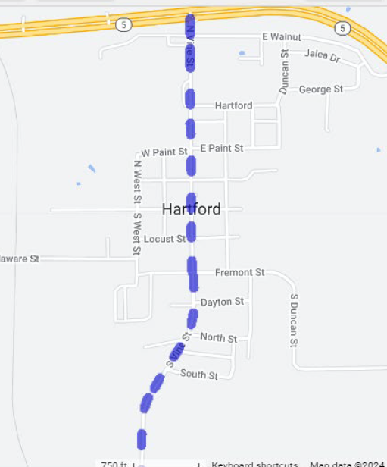
Vine Street Safe Routes to School Project
(Hartford)
This project will repair and replace 1.3 miles of sidewalk along both sides of North and South Vine Street in Hartford.
Total Cost: $916,533
Requested: $733,226 (80%)
Return to List of Applications Recommended
11

Slide 12
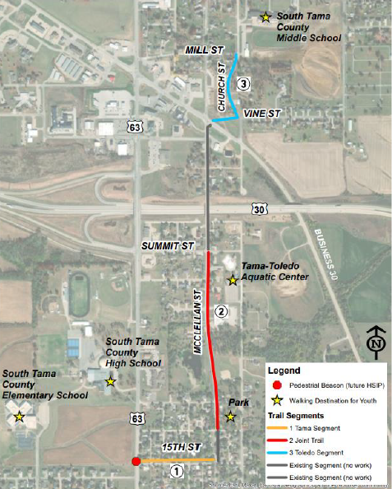
Tama-Toledo Safe Routes to School Improvements
(Tama)
This project will develop a coordinated safe routes to school network for the cities of Tama and Toledo by developing 0.44 miles of trail and 0.46 miles of sidewalk to provide safe routes to school in the two south Tama County school district campuses.
Total Cost: $752,856
Requested: $602,284 (80%)
Return to List of Applications Recommended
12

Slide 13
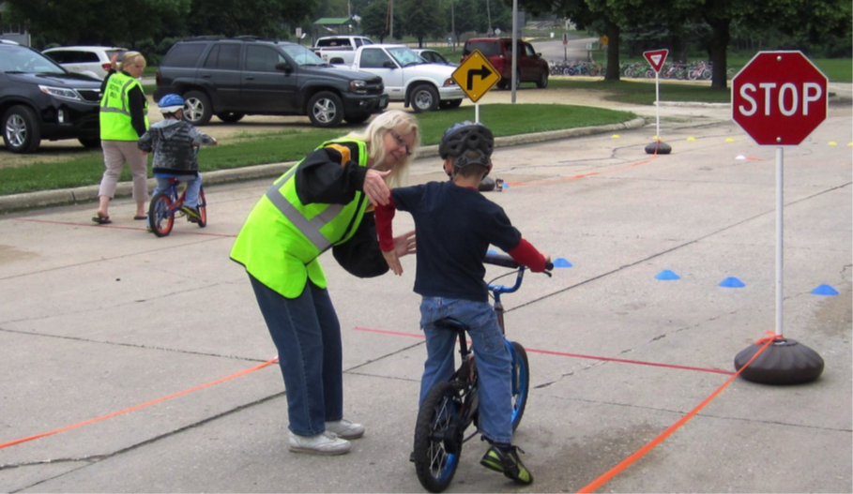
Iowa Safe Routes Partnership
(Iowa Northland Regional Council of Governments)
A comprehensive program that provides support to communities by implementing SRTS initiatives, including pedestrian and bicycle safety education through encouragement activities both inside and outside the classroom.
Total Cost: $354,344
Requested: $283,482 (80%)
Return to List of Applications Recommended
13

Slide 14
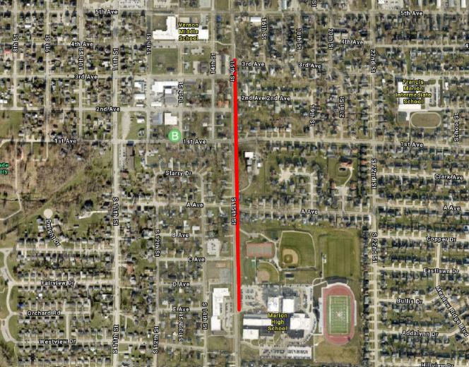
15th Street Safe Routes to School Sidewalk Project
(Marion)
The project will widen an existing sidewalk to a 10-foot trail along 15th Street from Marion High School to Vernon Middle School.
Total Cost: $680,000
Requested: $544,000 (80%)
Return to List of Applications Recommended
14

Slide 15
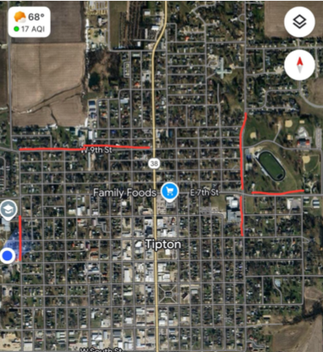
Plum Street Safe Routes to School Project
(Tipton)
This project includes 6-foot wide sidewalk on Plum Street from Iowa 130 to E. 10th Street and includes the removal a bottleneck.
Total Cost: $289,675
Requested: $231,740 (80%)
Return to List of Applications Recommended
15

Slide 16
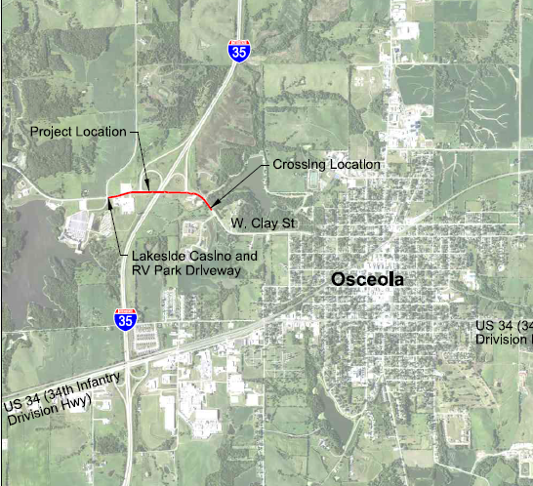
West Clay Street Trail Extension Over I-35
(Osceola)
This project includes a 0.64 mile trail along on the south side of West Clay Street and the existing interstate bridge.
Total Cost: $930,000
Requested: $740,000 (80%)
Return to List of Applications Recommended
16

Slide 17
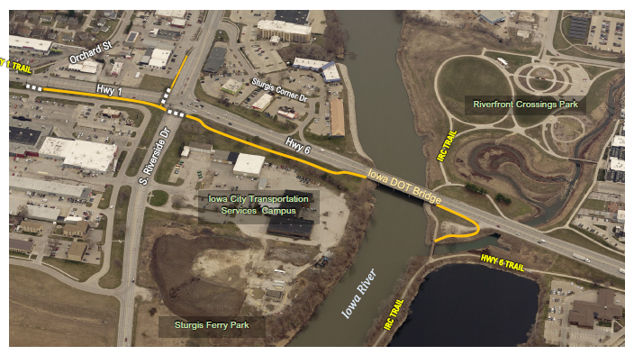
U.S. 6, Iowa 1, and Riverside Drive Bicycle and Pedestrian Facilities
(Iowa City)
This project will establish pedestrian and bicycle facilities along the U.S. 6/Iowa 1 corridor from Gilbert Street to Orchard Street and a trail connection to the bridge over the Iowa River.
Total Cost: $675,000
Requested: $540,000 (80%)
Return to List of Applications Recommended
17

Slide 18
Native Grass & Wildflower Seed for County & City Rights-of-way
(UNI Tallgrass Prairie Center)
This project result in native grass & wildflower seed being planted in road rights-of-way across the state consistent with Integrated Roadside Vegetation Management principles.
Total Cost: $436,418
Requested: $349,134 (80%)
Return to List of Applications Recommended
18

Slide 19
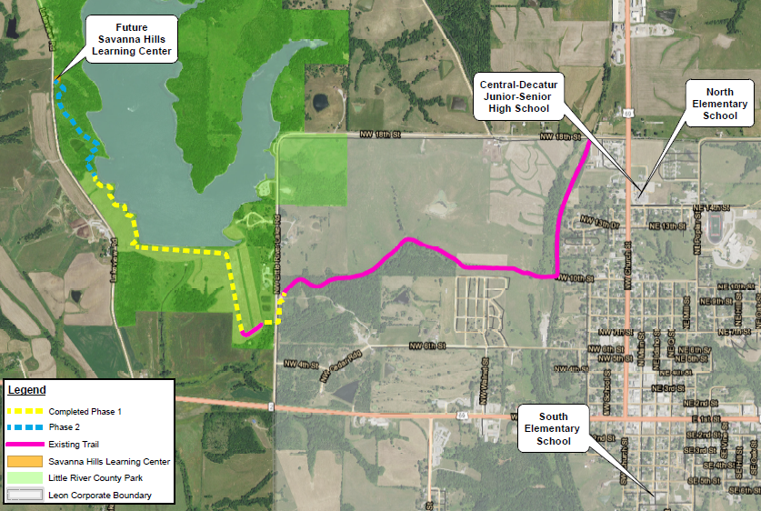
Little River Scenic Pathway Extension Phase 2
(Decatur County Conservation)
This project will extend the existing Little River Scenic Pathway from the west side of Little River Lake 0.4 miles to the Savanna Hills Learning Center building site.
Total Cost: $453,000
Requested: $70,000 (15%)
Return to List of Applications Recommended
19

Slide 20
List of Applications Not Recommended for Award
PROJECT NAME | SPONSOR | SCORE | TOTAL PROJECT COST | REQUESTED AMOUNT (% of Total Project Cost) | RECOMMENDED AMOUNT (% of Total Project Cost)
Morgan Creek Trail, Cedar River Bridge Plans | Linn County Conservation Board | 58 | $550,000 | $440,000 (80%) | $0
Highway 3 and 4th Street HAWK Signal Replacement | Clarion | 44 | $213,000 | $170,400 (80%) | $0
20
20

