Slide 1
Iowa Interstate Investment Plan
Transportation Commission Update December 2024
3/2/2023
December 10, 2024

Slide 2
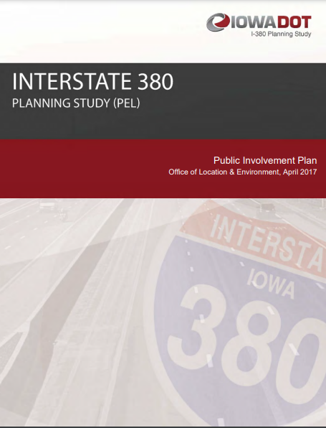
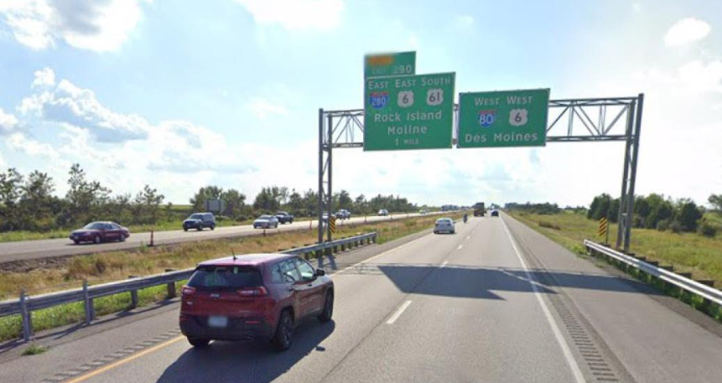
Background: Why an Interstate Plan?
Planning Efforts & Project Development Activities Highlight Iowa’s Transportation Needs Exceed Available Funding
Desired a tool that helps us identify realistic candidates for future programming based on a constrained interstate budget

Slide 3
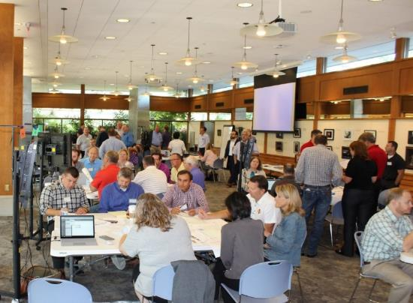
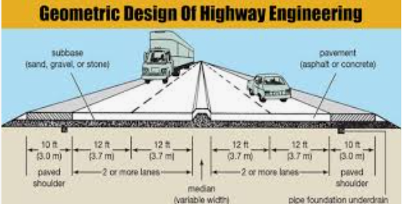
Concept of a “fiscally constrained” Plan for Iowa’s Interstate System
Initiated by a 2-day Workshop including 70 Participants in Summer of 2018
Identified Statewide Interstate Needs and Budget Estimates
Rehabilitation Needs vs. Capacity Expansion Needs
Goal: Contrast the timing between both by corridor
Workshop Summer 2018
Balancing Design and $$
2 Days - 70 Participants

Slide 4
Workshop Recommendations
Stewardship - All participants recommended the focus should be on preservation treatments to keep the system in its current state of good repair.
Consider Technology Options First - Expansion projects in urban corridors will be limited and focus on technology solutions and other management strategies before adding lanes.
Transportation Systems Management & Operations (TSMO)
Integrated Corridor Management (ICM)
Widening Options - Many segments of Interstate have significant pavement life remaining, so adding capacity in those areas will first consider widening the existing pavement rather than a complete rebuild.

Slide 5
Initial Plan Result
$330 Million Annual Budget
Project Budgets Set Very Tight to Promote Right Sizing

Slide 6
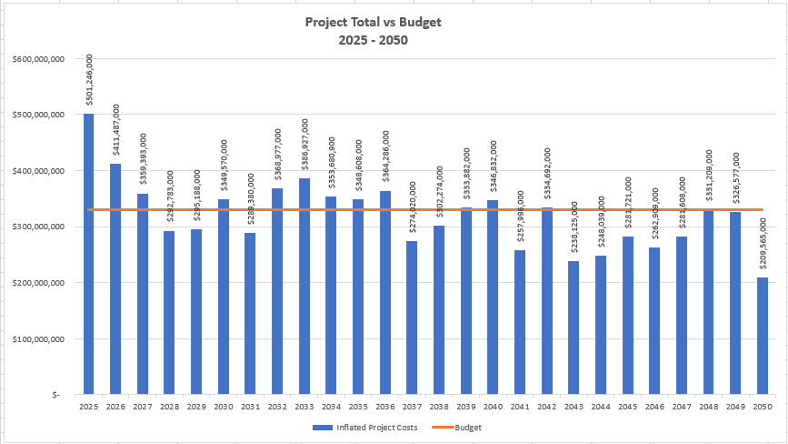
2024 Project Totals and Annual Budget
$330 Million Annual Budget
Program Years
Project Budgets Set Very Tight to Promote Right Sizing

Slide 7
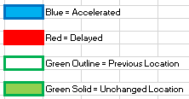
Proposed Project Timing

Slide 8
Proposed Project Timing

Slide 9
Proposed Project Timing

Slide 10
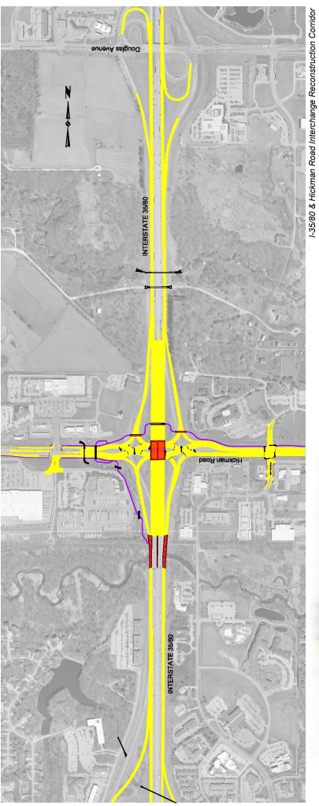
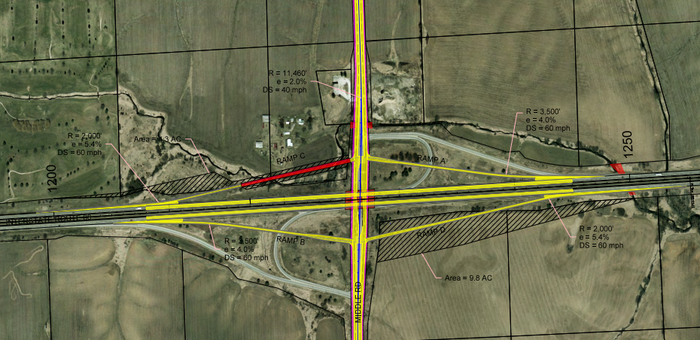
Other Notable Interstate Work
I-80 Hickman Interchange
I-29 Madison Ave Interchange – Programmed (2025-2026)
I-80 Middle Road Interchange – Programmed 2026
I-80 Hickman Road Interchange – Programmed (2025-2026)
I-80 and Middle Road

Slide 11
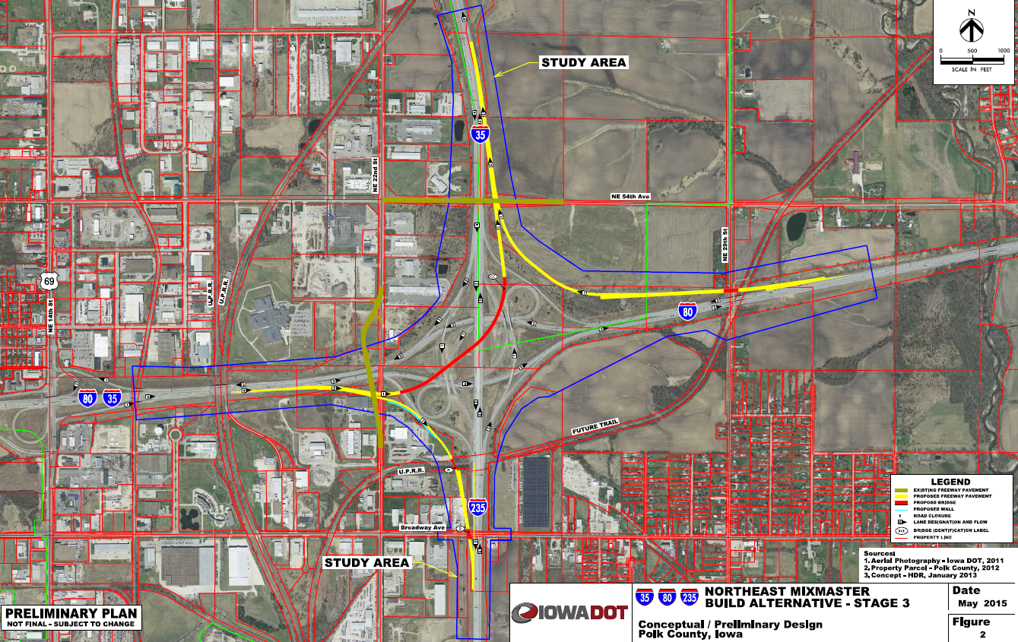
Des Moines NE Mixmaster Phases
Stage Timing
Stage 1/2 - Complete
Stage 3 – Currently under Construction
EB to NB Flyover
WB to NB Ramp
Stage 4 – 2039
South I-235 Widening
Stage 5 – 2034
West I-80 through Interchange
Widening and Aux Lanes
Stage 6 – 2040
I-80 WB to SB Flyover
Stage 7 – 2043
North I-35 Widening
Stage 8 – 2048
North I-35 SB to EB Flyover

Slide 12
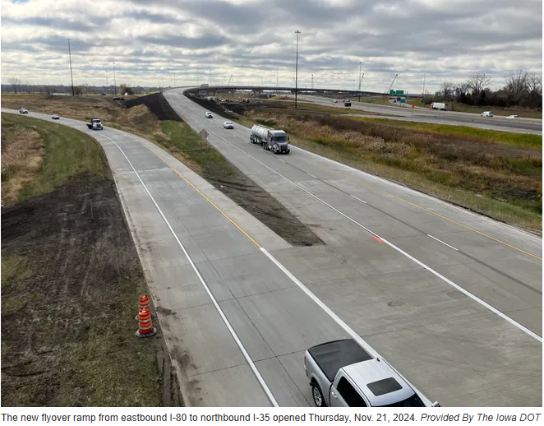
Des Moines NE Mixmaster Flyover Now Open

Slide 13
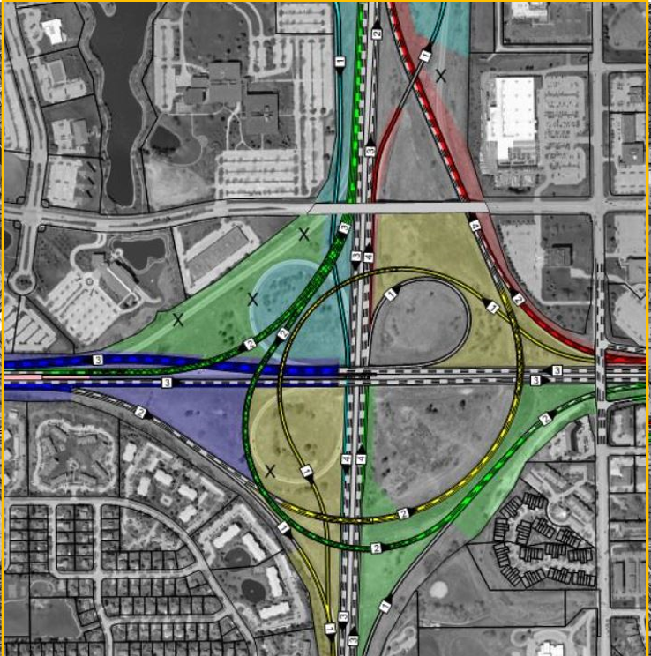
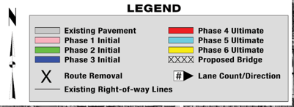
Des Moines SW Mixmaster Phases
Phase Timing
Phases 1,2,3 – 2027 & 2028
ROW in 2026
Erosion Control in 2029
Phase 4 - 2038
Phase 5 - 2039
Phase 6 - 2040

Slide 14
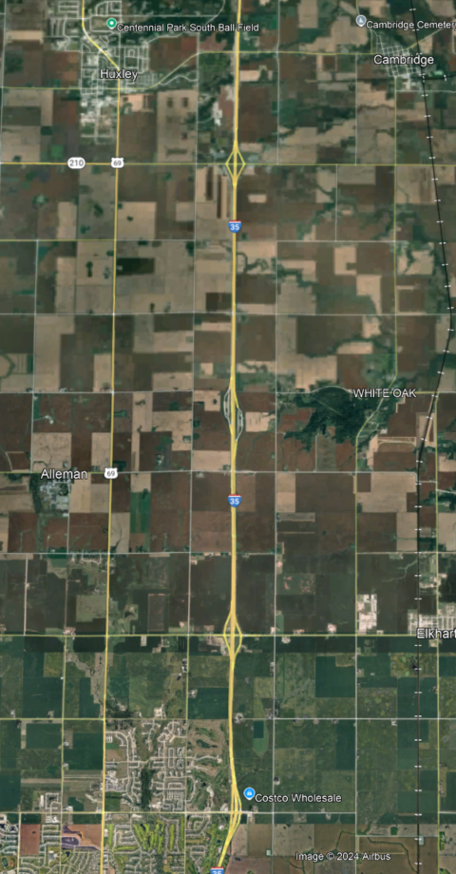
Interstate 35 – Polk/Story County
Reconstruction to 6-lanes
315th St
Huxley
North of NE 36th St Ankeny to North of 315th St
2026 - $53.5 million
2027 - $1.2 million
Ankeny
NE 36th St

Slide 15
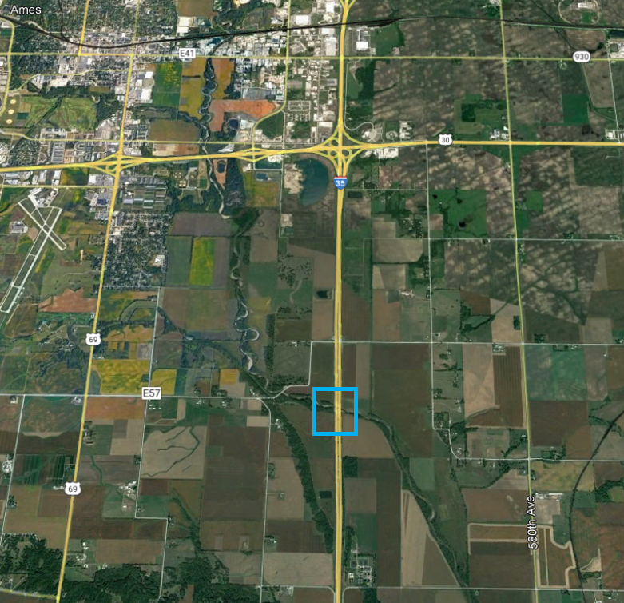
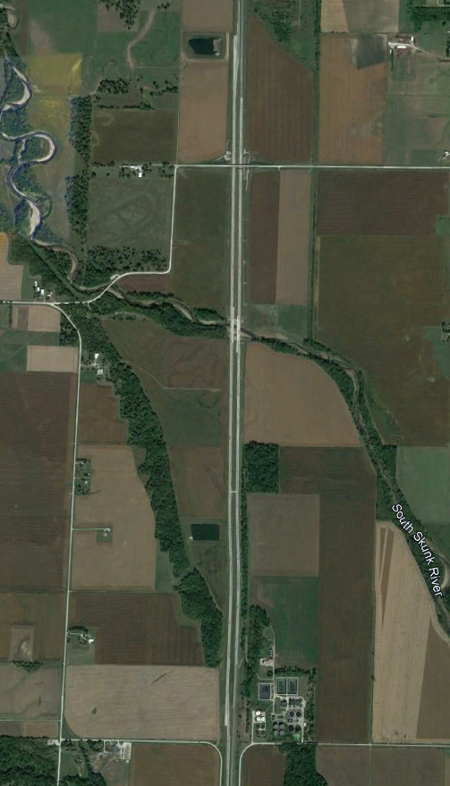
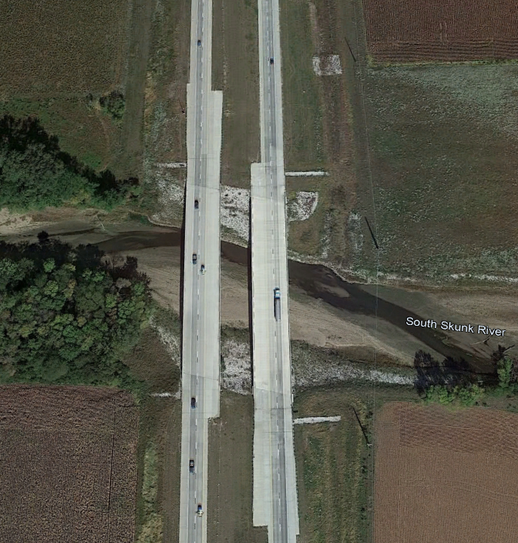
Interstate 35 Story County
South Skunk River Bridges
I-35 Mainline Bridges Over Skunk River Completed
I-35 Alignment Shift:
Construction
Traffic Management
I-35

Slide 16
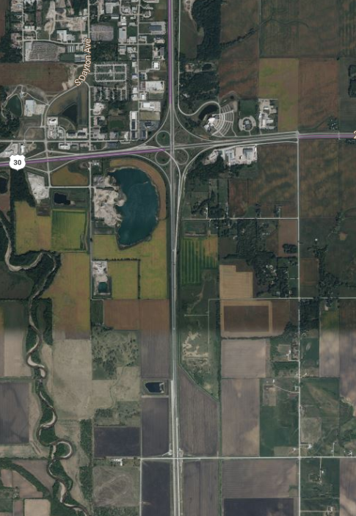
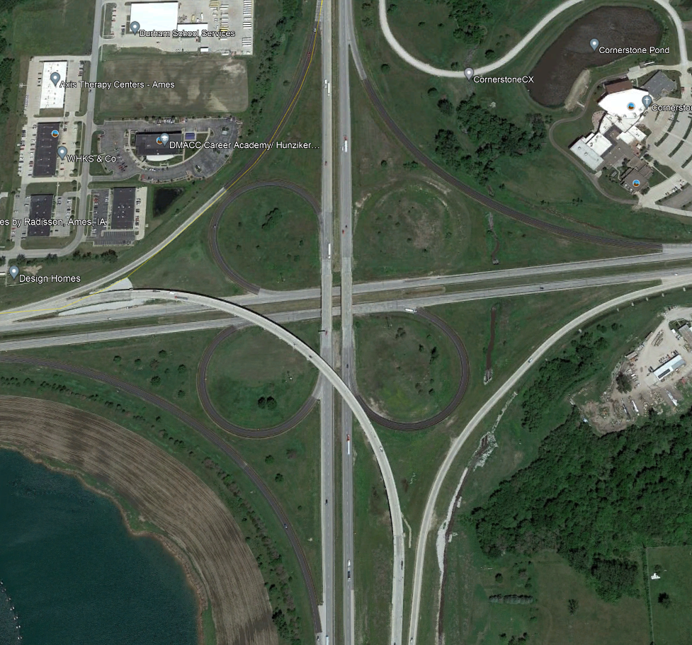
Interstate 35 Ames
I-35 Mainline Bridges over US 30
N of Co Rd E57/260th St to 0.6 mi N of US 30
2027 - $6.9 million (ROW)
2028 - $11.6 million
2029 - $31.9 million
2030 - $26.6 million
2031 - $1.2 million
I-35

Slide 17
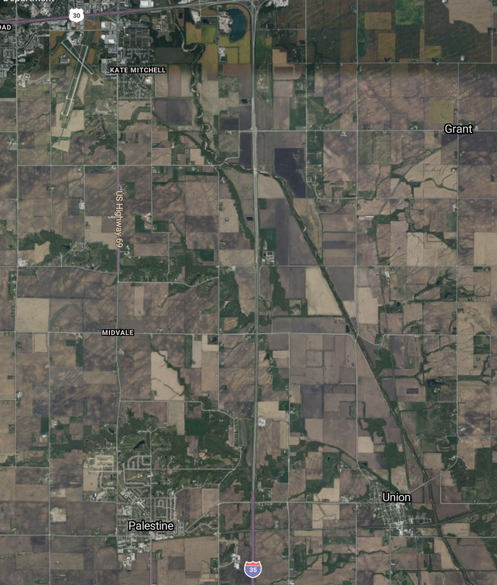
Interstate 35 – Story County
Reconstruction to 6-lanes
North of 315th St to 260th St
Ames
2030 - $2.0 million
2031 - $6.0 million
2032 - $38.3 million
2033 - $37.0 million
260th St
I-35
Huxley
315th St

Slide 18
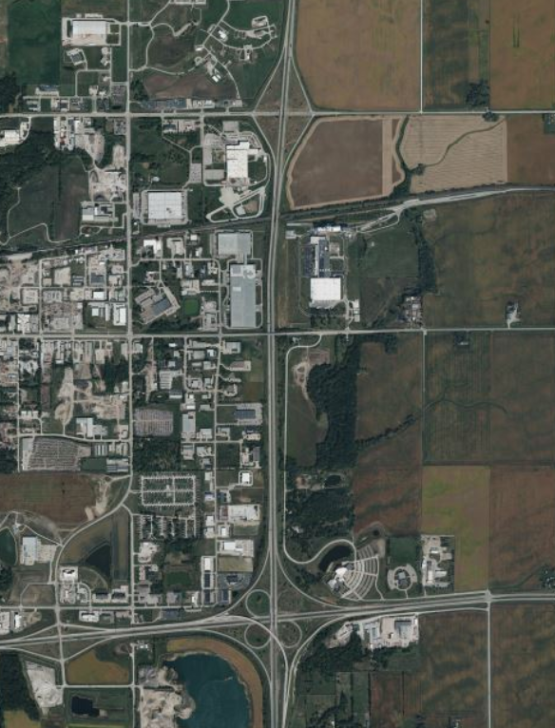
Interstate 35 – Story County
Reconstruction to 6-lanes
North of US 30 to 13th St Ames
13th St
2035 - $30.2 million
2036 - $30.2 million
I-35
US-30

Slide 19
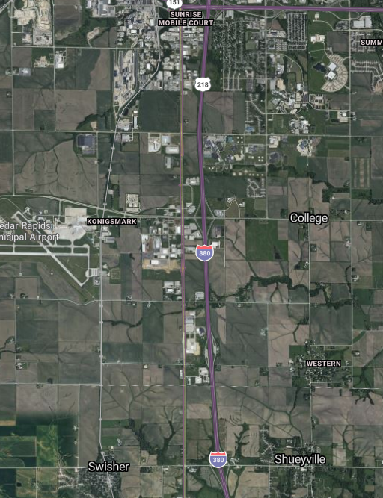
Interstate 380 – Linn County
Reconstruction to 6-lanes
North of 120th St to South of US 30
(including Wright Bros Blvd interchange reconstruction)
US 30
2025 - $112.3 million
2026 - $1.6 million
120th ST

Slide 20
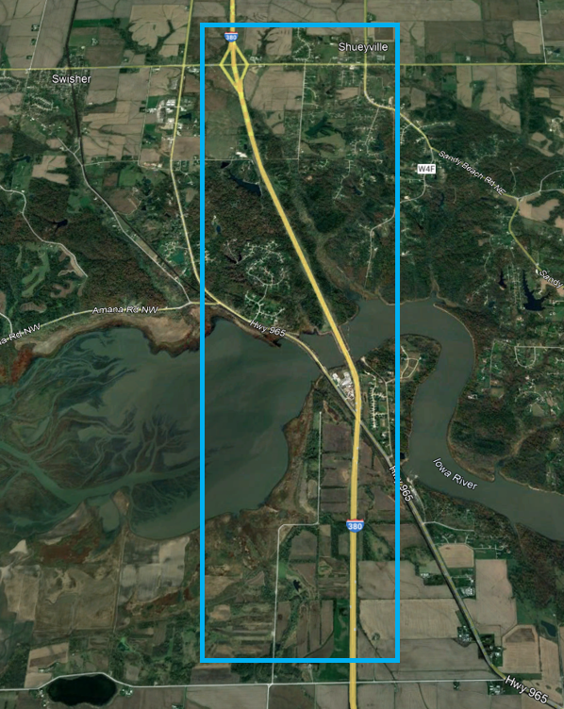
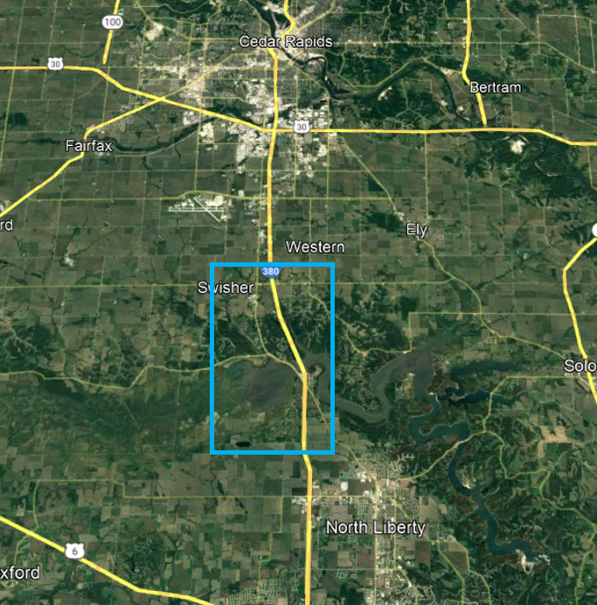
Interstate 380 – Johnson/Linn County
Reconstruction to 6-lanes
North of Swan Lake Rd to North of 120th St
120th St
2029 - $7.9 million
2030 - $57.8 million
2031 - $56.3 million
2032 - $27.0 million
Swan Lake Rd

Slide 21
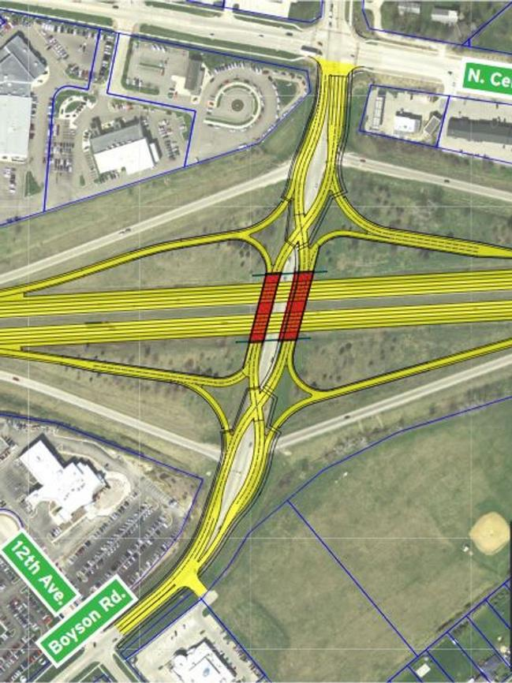
Interstate 380 – Linn County
Boyson Road Interchange Reconstruction
Programmed for 2025
$24.1 million

Slide 22
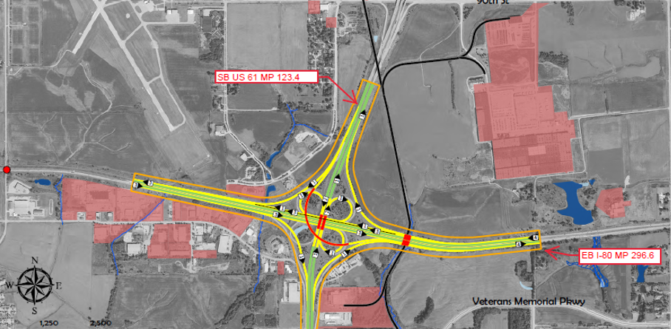
Interstate 80 – Scott County
Based on Timing of Capacity Need due to Traffic Volumes – I-80 Scott County corridor widening to 6-lanes moved to post 2050.
However, there are spot locations that may need to be addressed sooner than 2050.
Below is an example of potential interchange improvements at I-80 and US 61 (southbound US 61 to eastbound I-80 flyover)
US 61
I-80

Slide 23
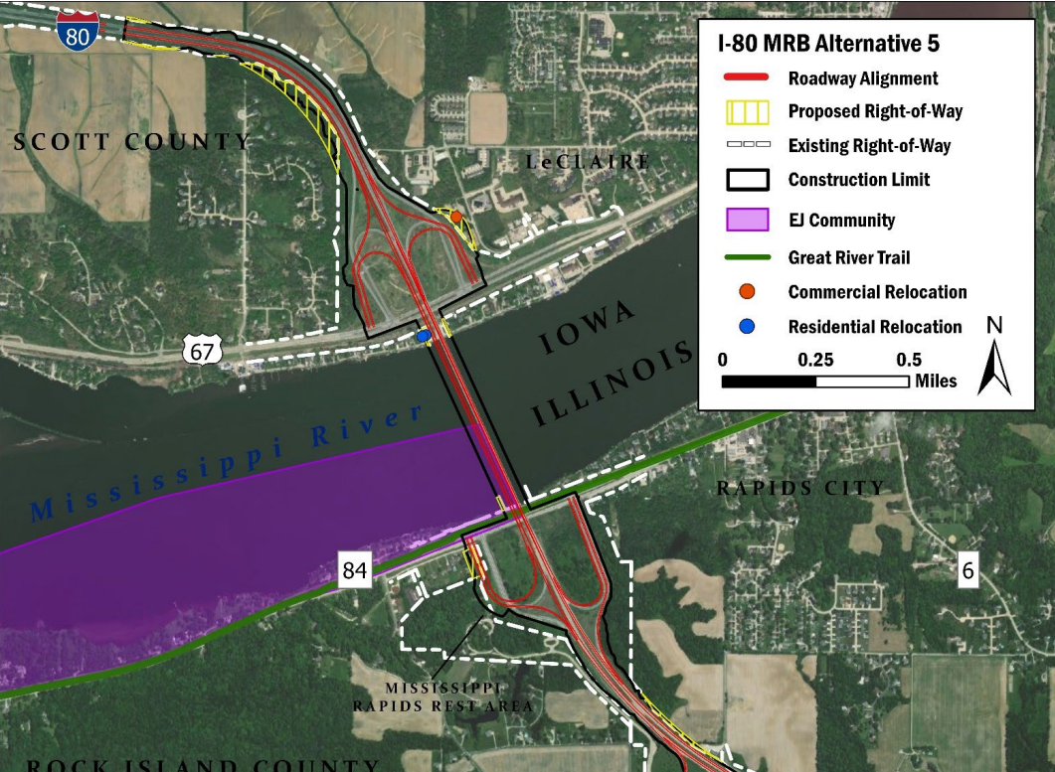
Interstate 80 – Scott County
Mississippi River Bridge
PEL Study Completed
Phase 1 Engineering
5 Public Meetings to Date
Preferred Alternative Chosen
Alt 5 – Companion Bridge West
Bike/Ped Facility Added
Two Years Programmed 2028-2029
Total Iowa Share $210 M
Reflected in New Program
Illinois DOT - lead Agency
US 61
I-80

Slide 24
Questions?
Phil Mescher, AICP, CPM
515-233-7969
Phil.Mescher@iowadot.us​
iowadot.gov

