Slide 1

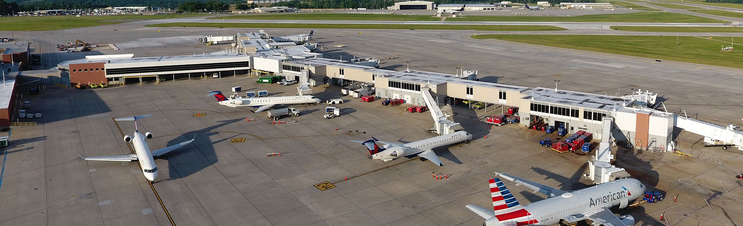
Iowa Commercial Aviation Infrastructure Fund (ICAIF)
PROGRAM TIMELINE
Funds awarded: June 2, 2022 ($100M) COMPLETE
Administration: Reimbursable grants through Iowa DOT COMPLETE
Funds obligated: No later than December 15, 2023 COMPLETE
Reimbursement claims submitted: No later than June 30, 2026
Notes:
In March, 2022 Gov Reynolds announced a $100M investment in Iowa commercial service airports.
One-time funds through the American Rescue Plan State and Local Fiscal Recovery Funds
Iowa DOT would administer
Iowa’s eight commercial airports were eligible for funding to support modernization and expansion projects. Ninety percent of the funds would be granted based upon passenger numbers from 2019 and the remaining 10% will be split equally among the eight commercial airports.
All airports applied for their fully allocated amounts.
Reimbursement claims no later than June 30, 2026, however all airports are well ahead of that deadline.

Slide 2
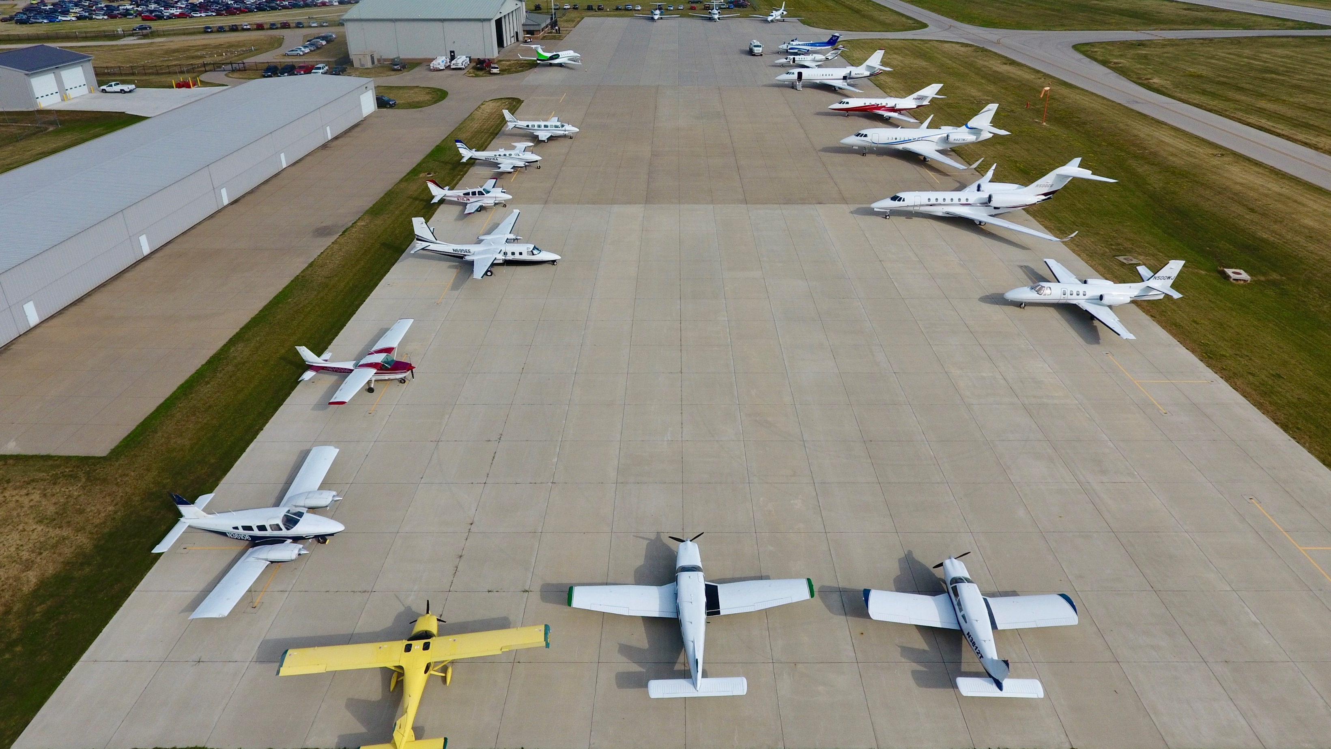
ICAIF Project Update Summary
Airport | Project | Status | Grant Amount | Reimbursed
Des Moines International Airport | Parking structure & terminal design | Under construction- 70% complete | $58,783,949 | $34,651,193
The Eastern Iowa Airport (Cedar Rapids) | Terminal addition | Under construction- 70% complete | $28,350,890 | $14,770,092
Sioux Gateway Airport | Hangar development | Construction Complete- 90% complete | $3,149,582 | $1,827,551
Dubuque Regional Airport | Hangar development | Construction Complete- 90% complete | $2,783,502 | $2,602,177
Waterloo Regional Airport | Parking structure | Under Construction- 50% complete | $2,197,573 | $998,933
Fort Dodge Regional Airport | Hangar development | Closeout | $1,585,761 | $1,585,761
Mason City Municipal Airport | Hangar development | Construction Complete- 90% complete | $1,574,795 | $1,482,752
Southeast Iowa Regional Airport (Burlington) | Hangar development | Under construction- 70% complete | $1,573,948 | $1,325,157
 |  |  | $100,000,000 | $59,243,616
Notes:
Eligible projects under this program include terminal construction and renovations, parking structure construction and hangar construction.
See grant amounts and reimbursement status to date.
We will provide and overview of projects in next slides.

Slide 3
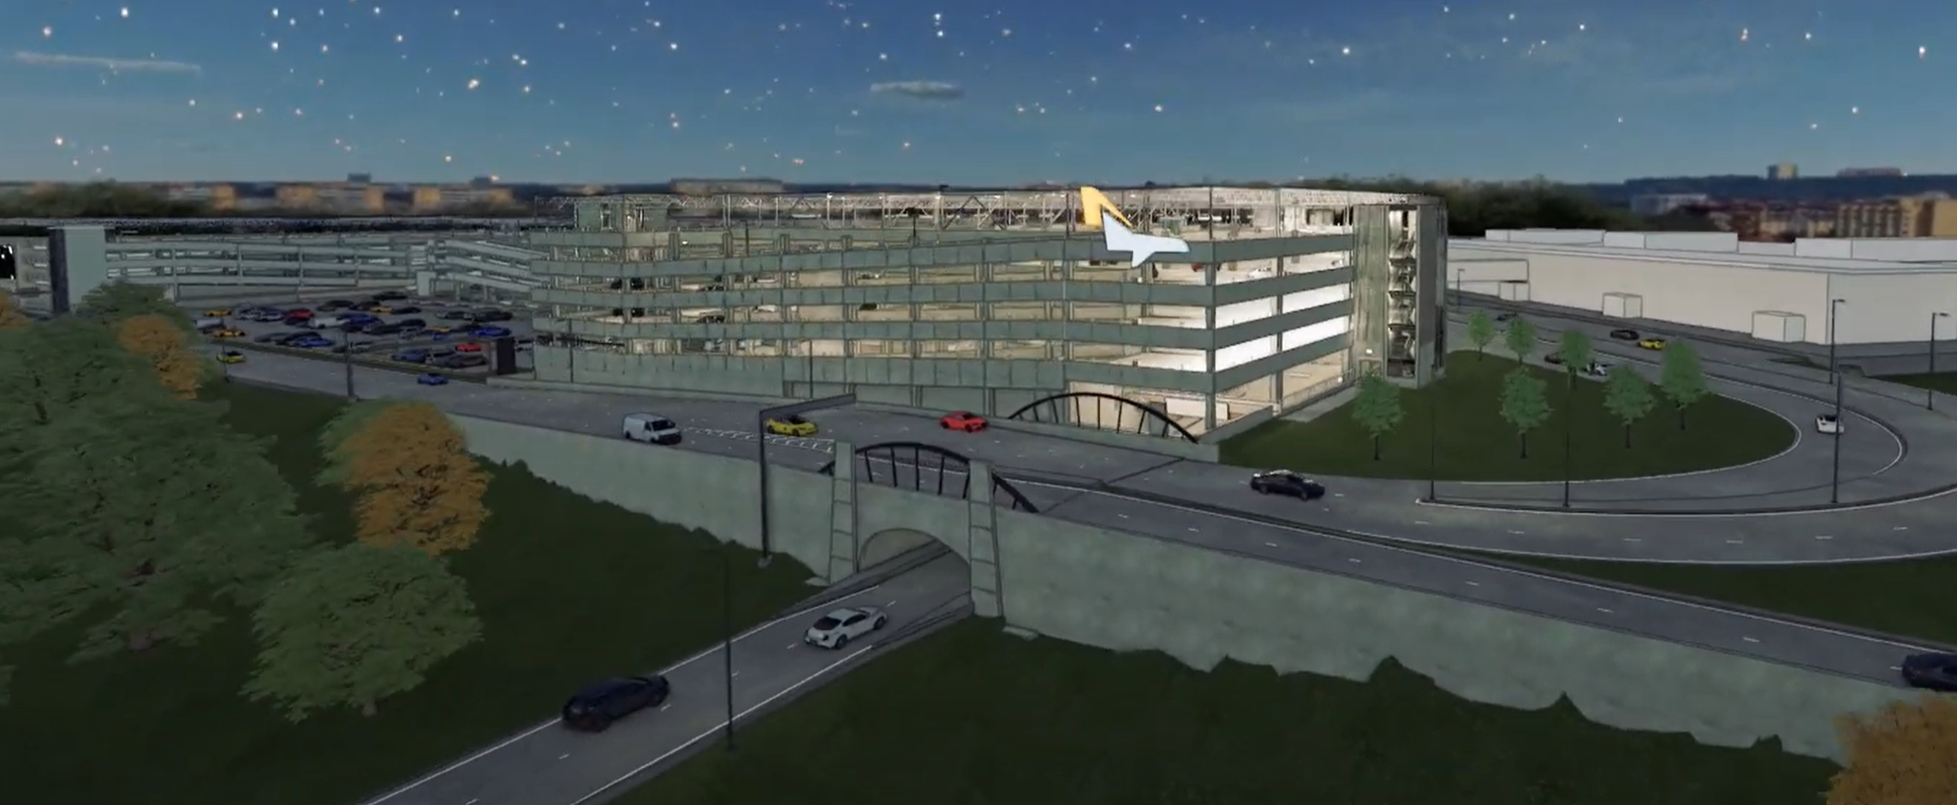
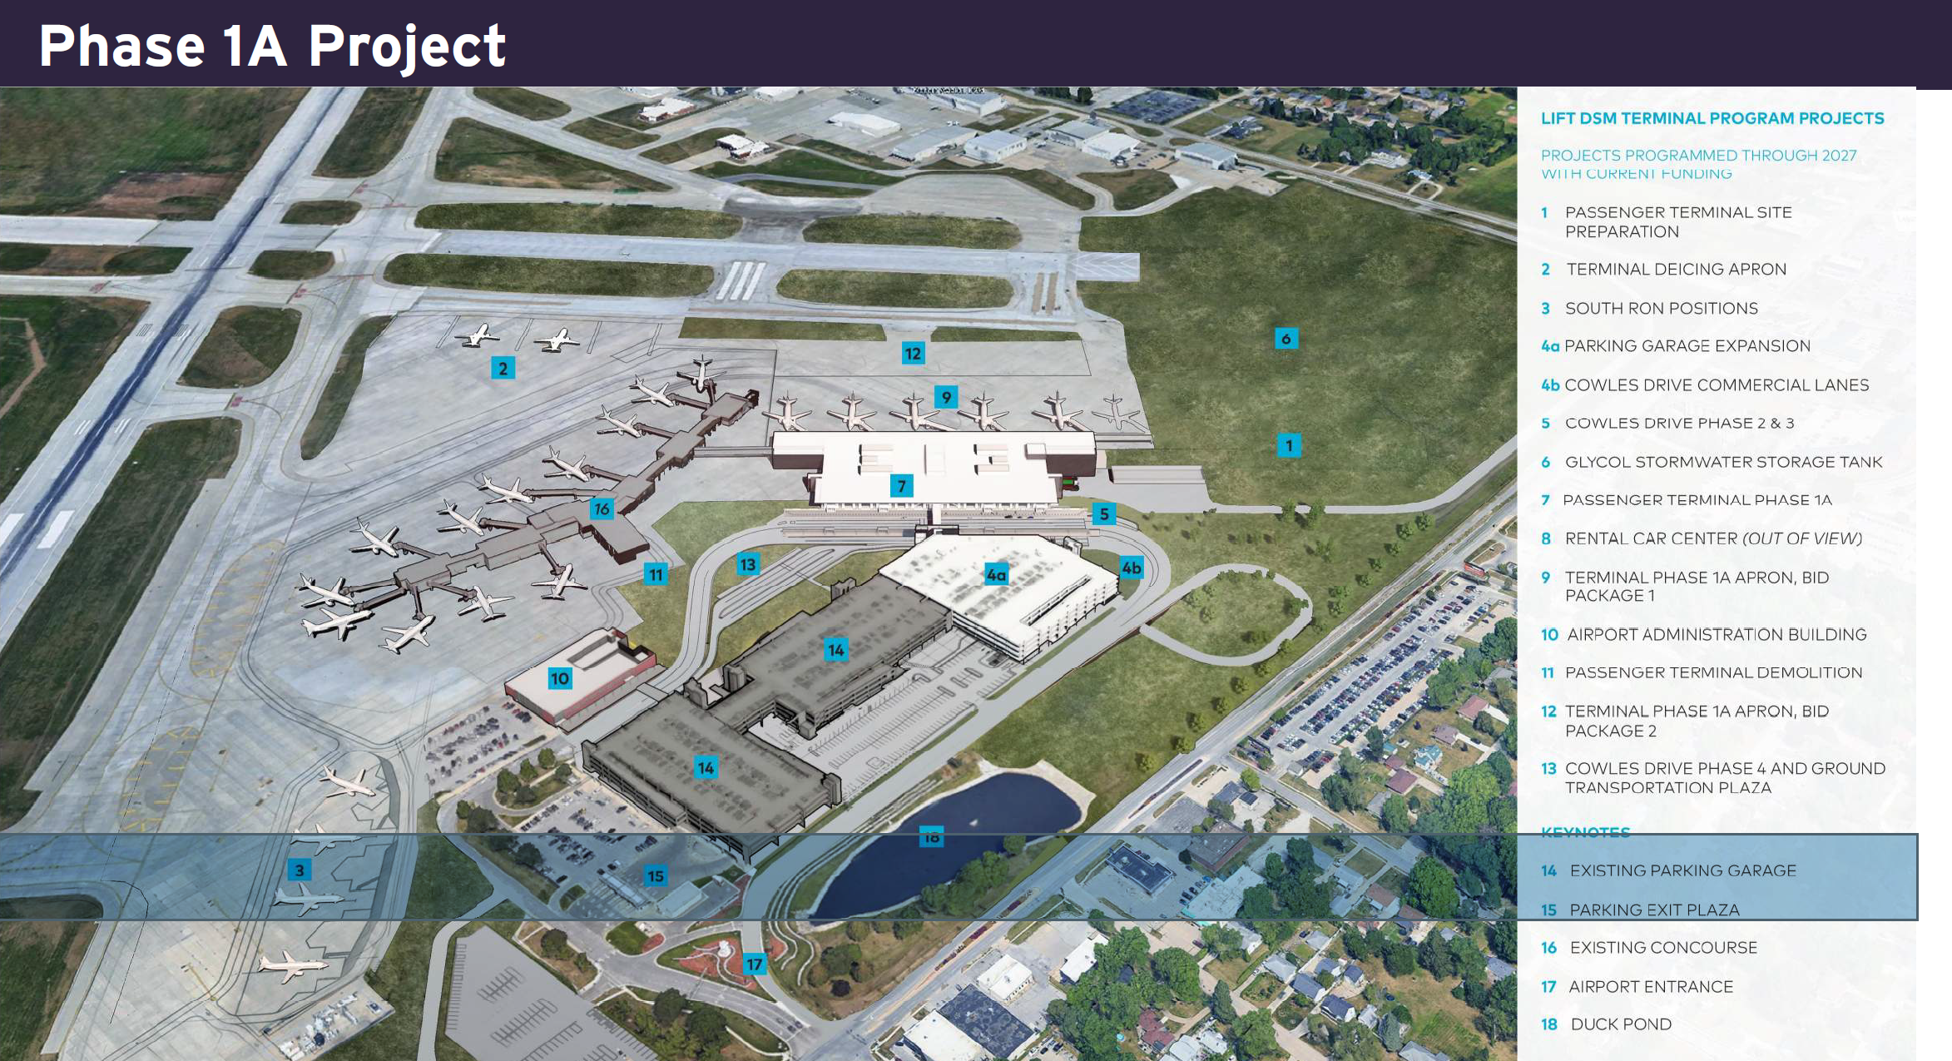
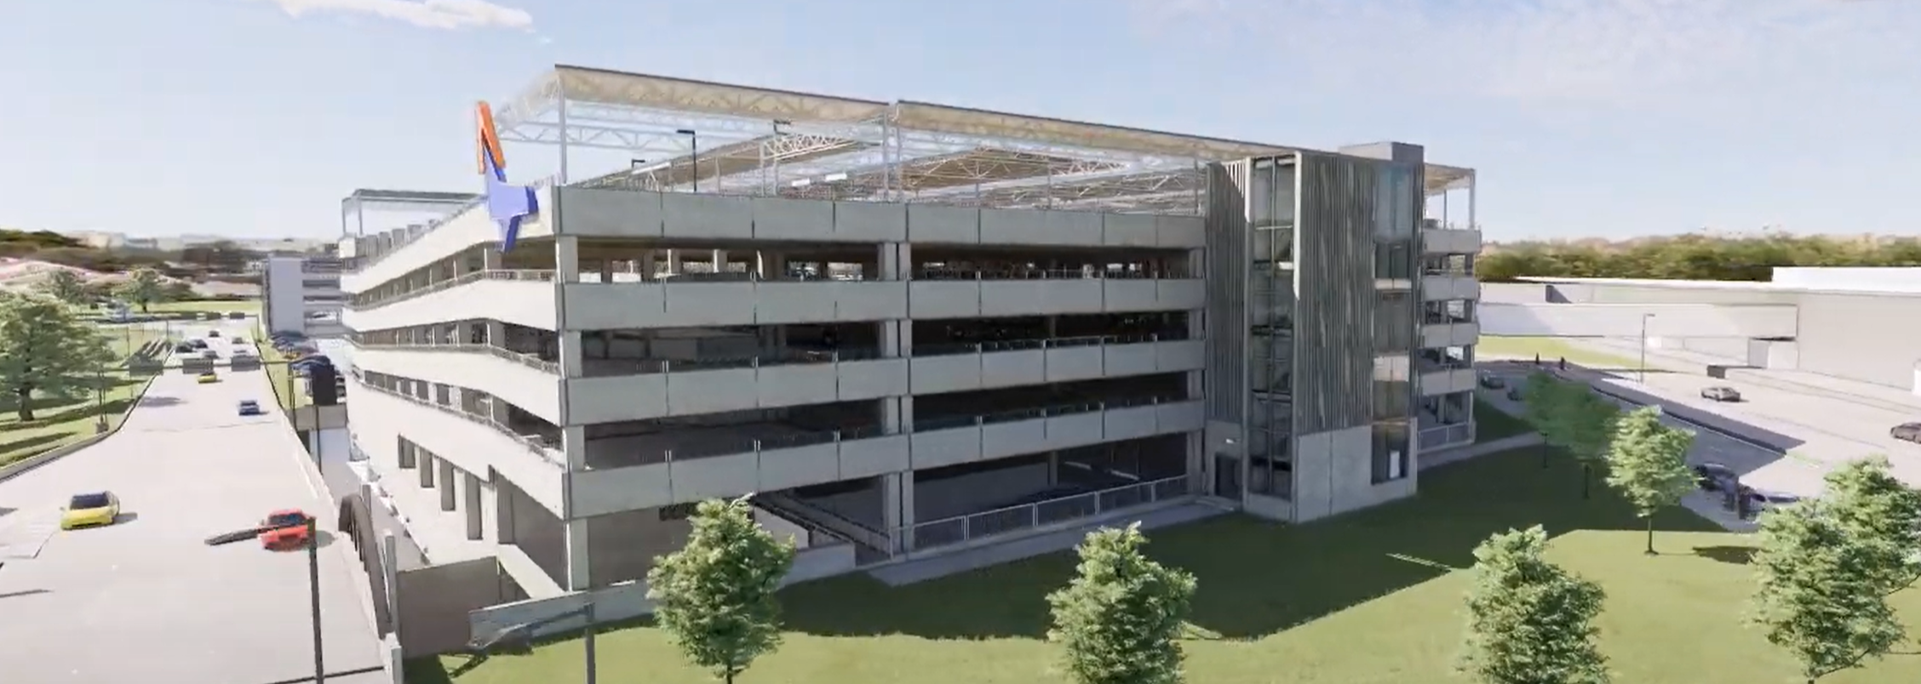
Des Moines International Airport
$58,783,949
Complete the 30% design phase for the new airport terminal project and construct a 5-story parking garage providing 1,150 new parking spaces.

Slide 4
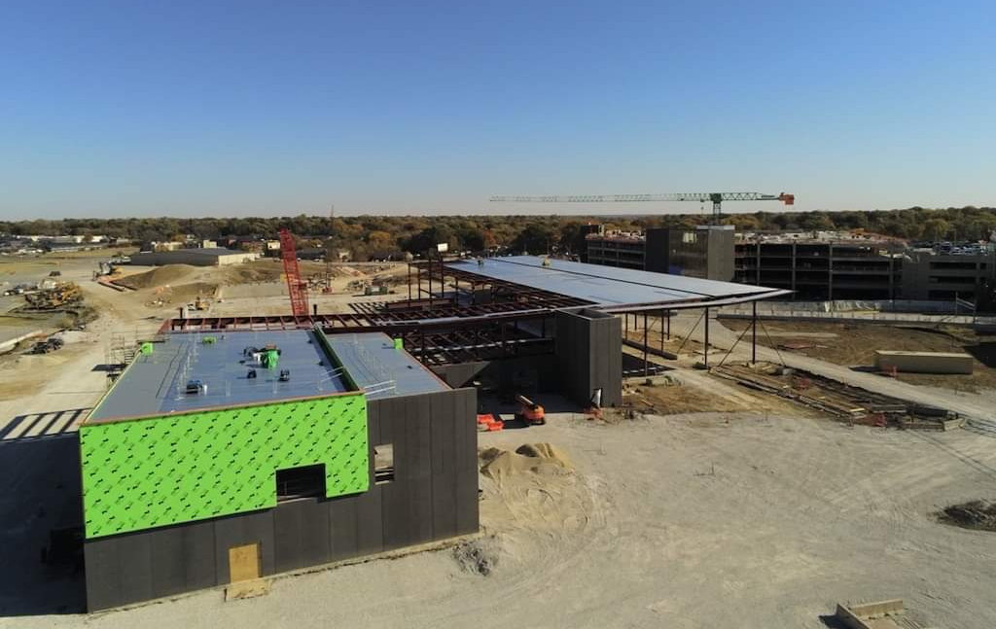
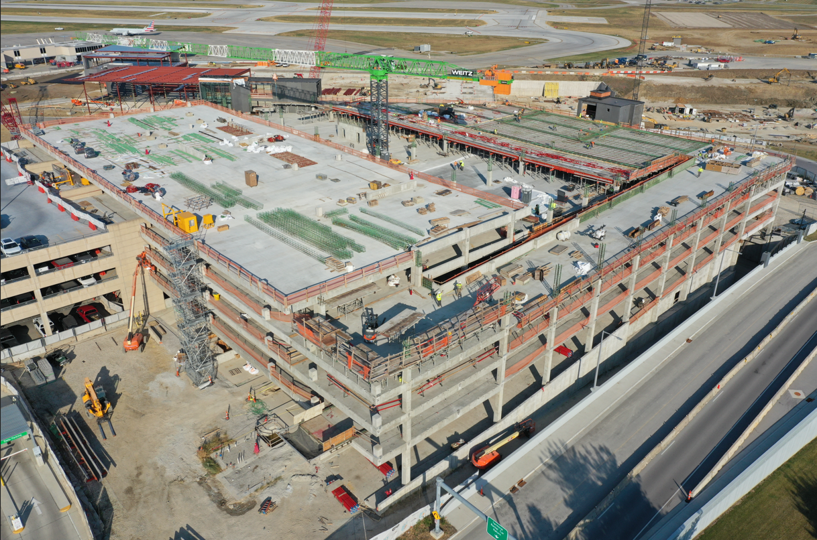
Des Moines International Airport
Update – December 2024
Terminal construction is underway and expected to be completed in the second half of 2026. The new parking structure is standing, and the airport is targeting spring break 2025 to start using part of the structure.
Notes:
Transition to the new terminal is expected early 2027.
The parking structure should be fully operational summer 2025.
Phase 1A and 1B approved for $480M (plus garage, plus enabling, plus 1C, plus airside)
Sources of funds
FAA, Iowa DOT, airport cash, local community contributions, $350M bond referendum
Growth continues. Gates will be larger and increase from 12 to 21. RON

Slide 5
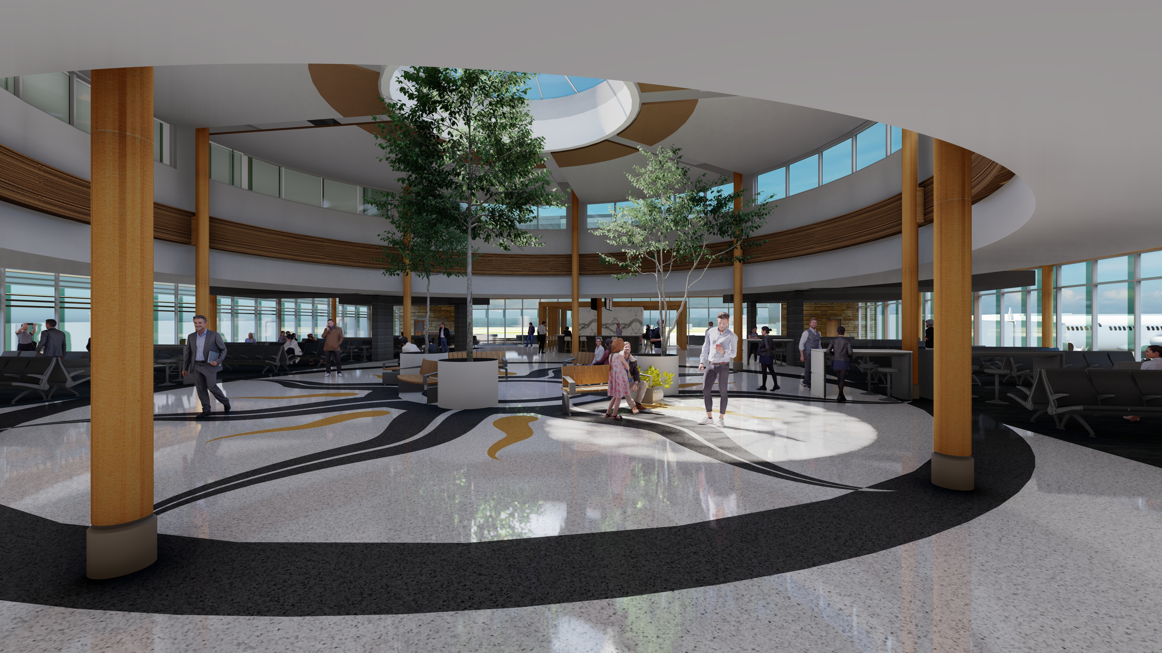
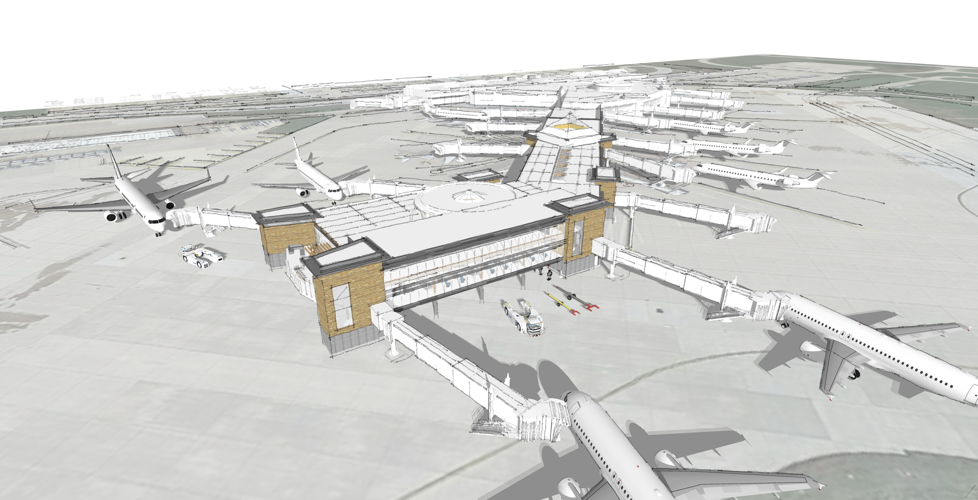
The Eastern Iowa Airport (Cedar Rapids)
$28,350,890
Complete the final phase (Phase 4) of the Terminal Modernization that began in 2014. The project adds capacity with four new boarding bridges and includes new administrative offices.

Slide 6
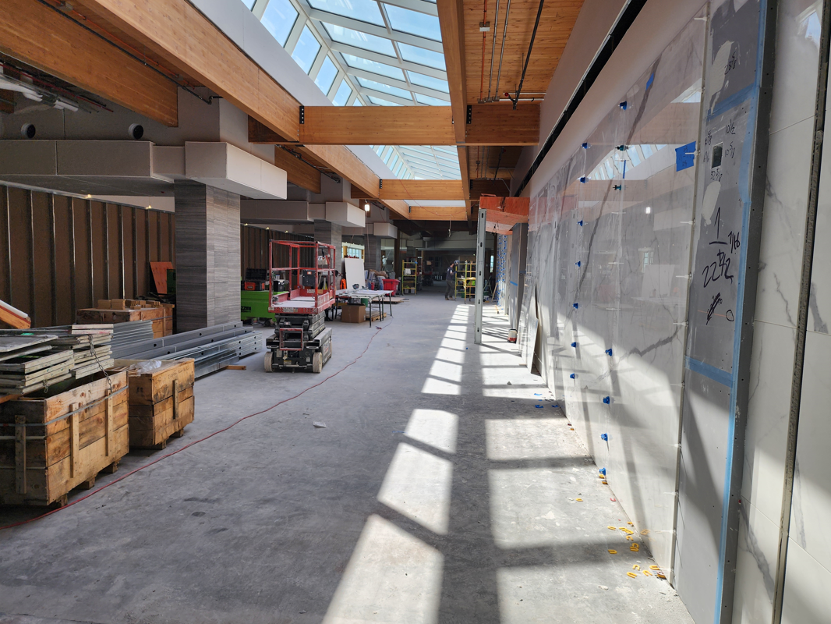
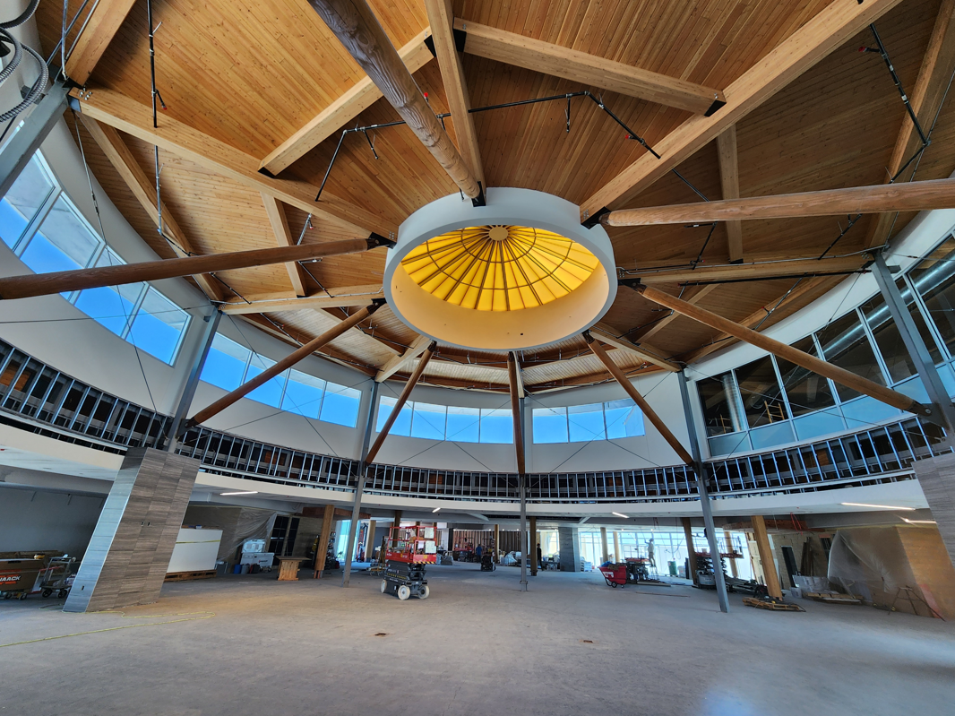
The Eastern Iowa Airport
Update – December 2024
Loading bridges have been attached to the expanded terminal, and inside construction work is underway. Completion is estimated for June of 2025.

Slide 7
Sioux Gateway Airport (Sioux City)
$3,149,582
Begin Phase 1 of the North T-hangar Development project. Construct two, 10-unit T-hangar buildings with associated site prep, paving, and utilities. A wait list exist for these hangars.

Slide 8
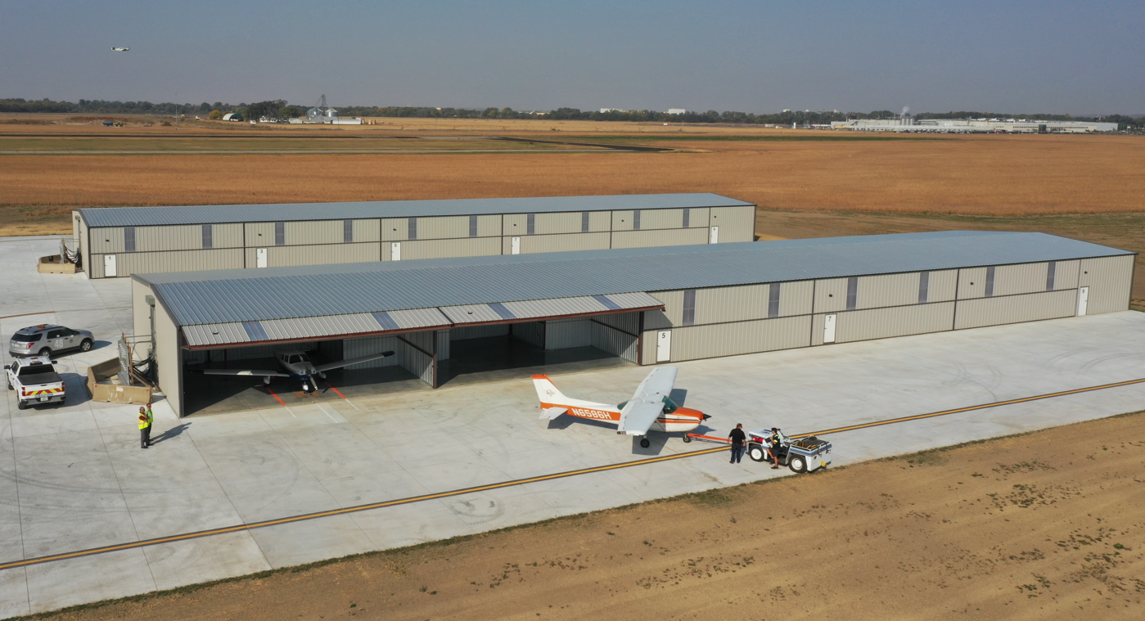
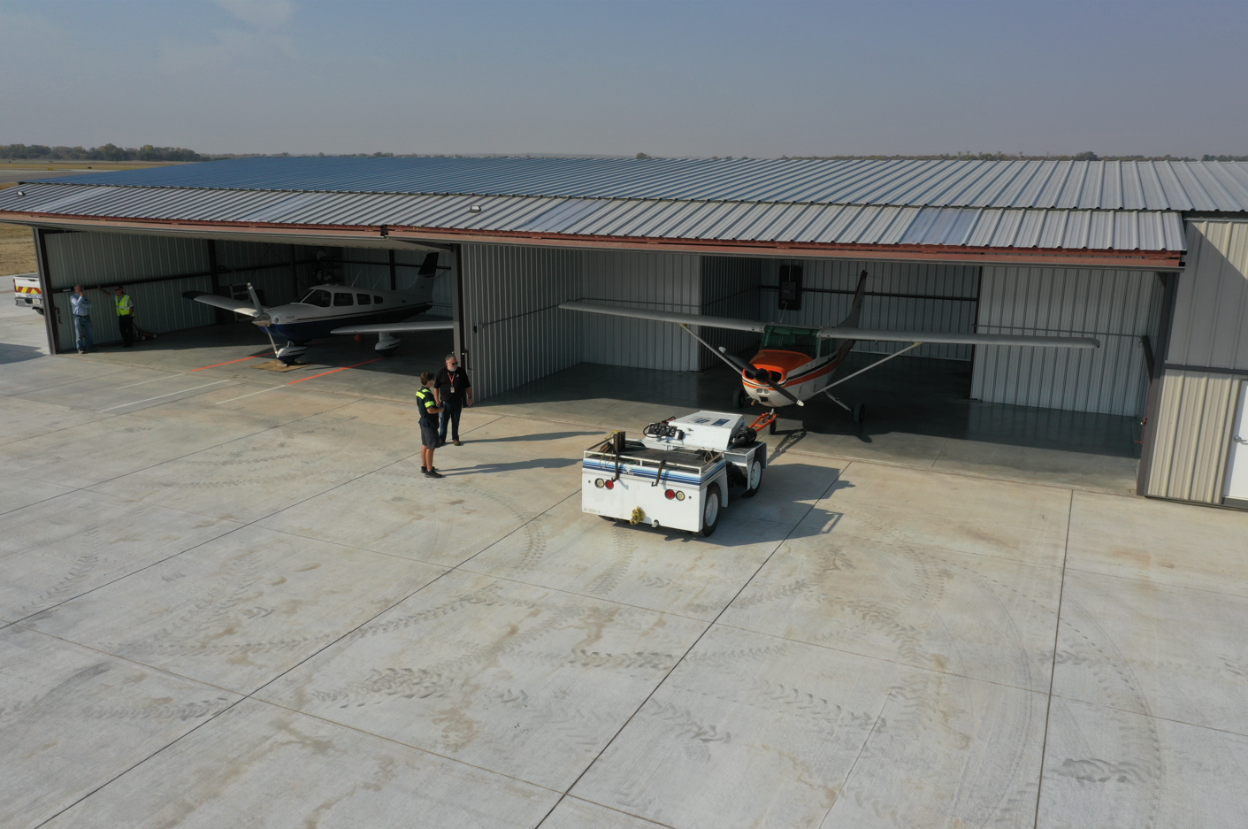
Sioux Gateway Airport
Update – December 2024
Construction of the twenty T-hangars is complete. All the hangars have been leased except for two. Those two hangars have several interested parties. The grant will be closed out soon.

Slide 9
Dubuque Regional Airport
$2,783,502
Construct a box hangar for tenants needing larger hangar space. The hangar is being built adjacent to an existing aircraft apron and parking lot next to the University of Dubuque Aviation Program.

Slide 10
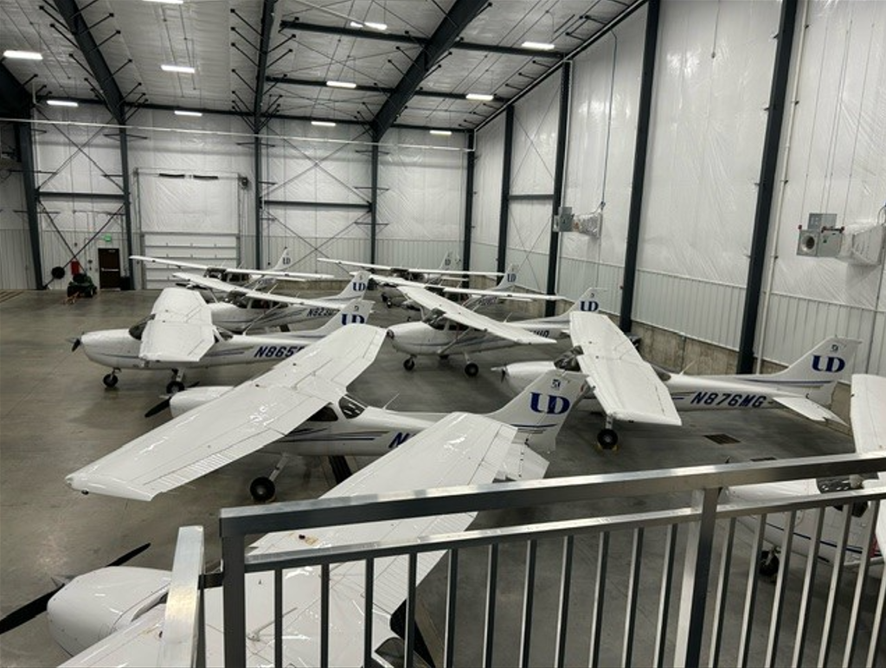
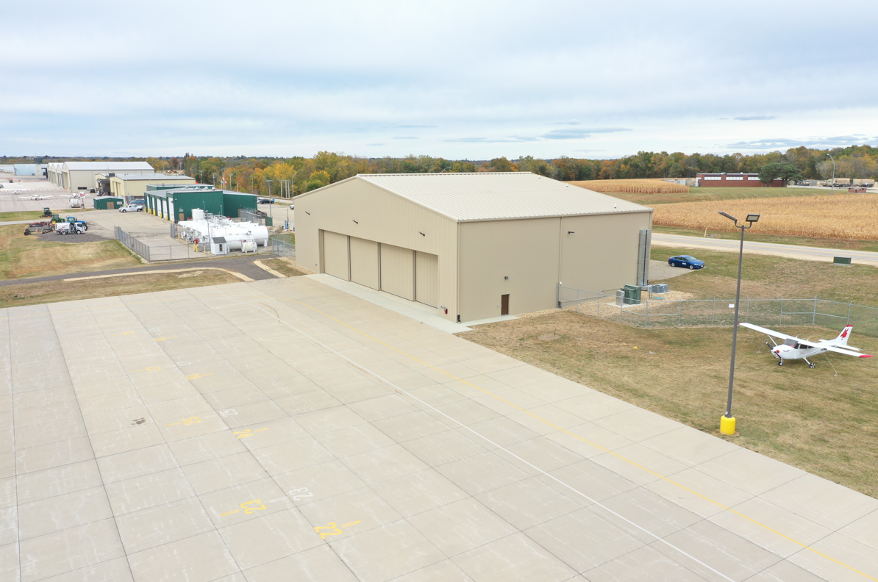
Dubuque Regional Airport
Update – December 2024
Construction of the box hangar is complete and has been occupied by the University of Dubuque to house up to fourteen flight training aircraft. The project has been closed out with the contractor and the ICAIF grant will be closed out soon.

Slide 11
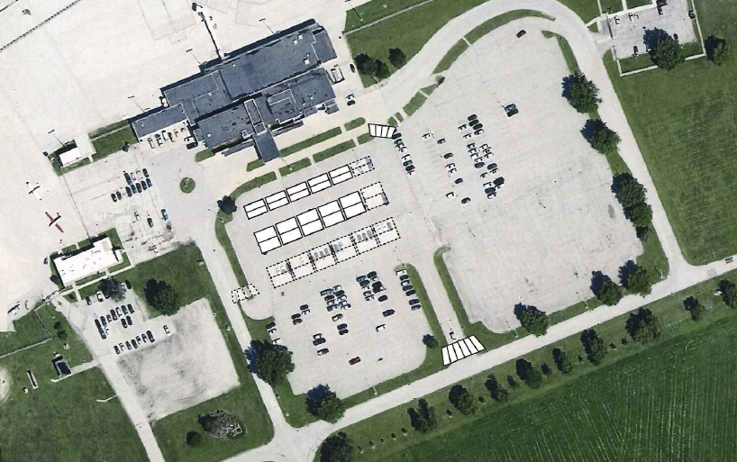
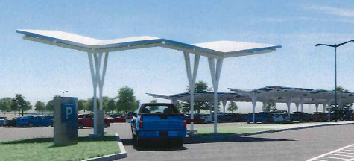
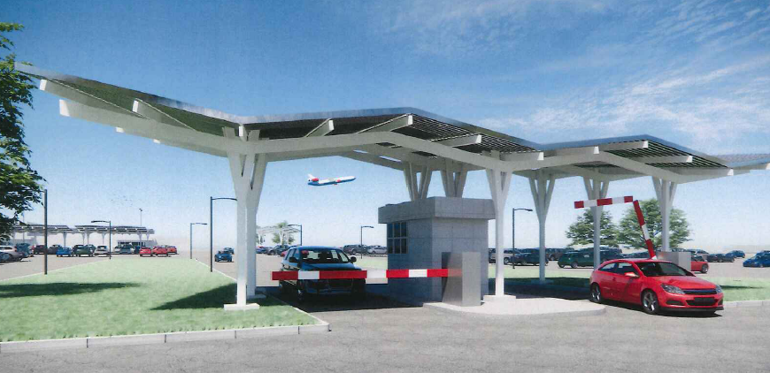
Waterloo Regional Airport
$2,197,573
Construct parking lot canopy system with LED lighting to provide cover for parking lot ticketing lane, pay station lanes, as well as parking structure for disabled and high-use parking spaces. Canopies will be one component of an airport terminal landside modernization program that include the city's rehabilitation of the airport entry road, new wayfinding signs, and resurfacing of the front part of the parking lot.

Slide 12
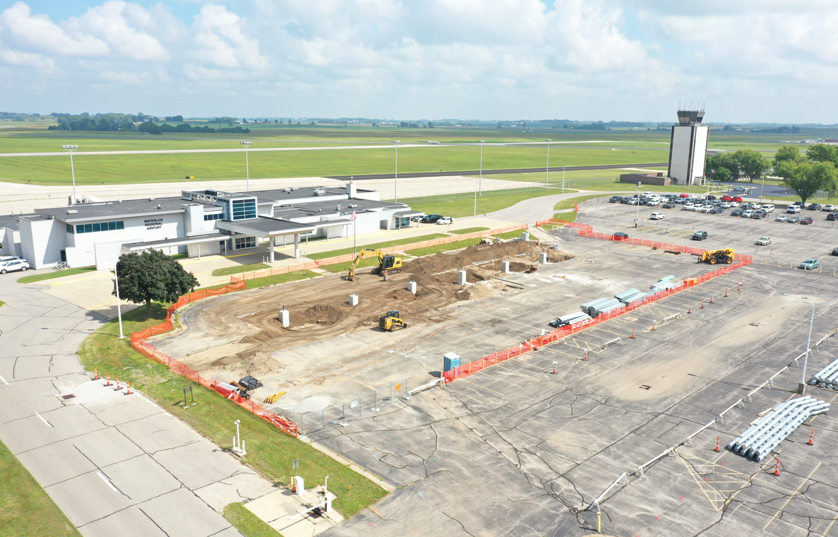
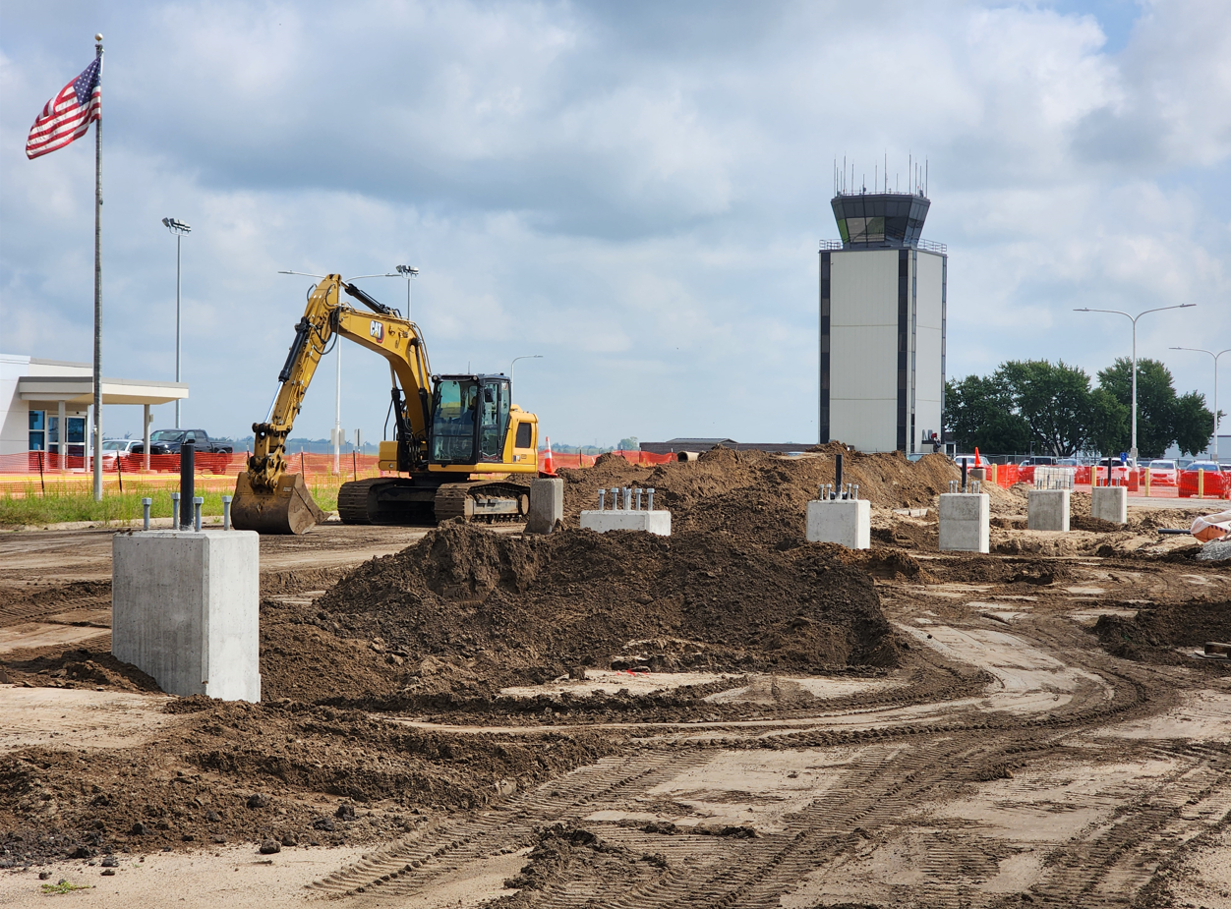
Waterloo Regional Airport
Update – December 2024
The project is starting construction and is expected to be completed well ahead of deadline.

Slide 13
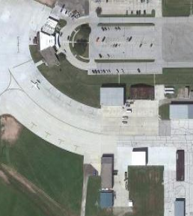
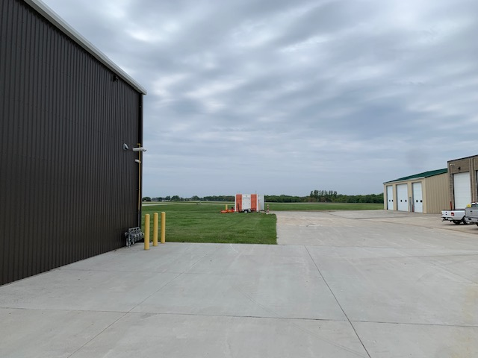
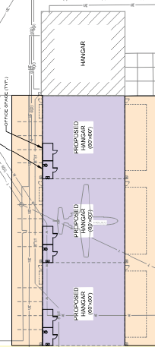
Fort Dodge Regional Airport
$1,585,761
Construct three modern box hangars with associated site prep, paving, and utilities. A waiting list exist for hangars.

Slide 14
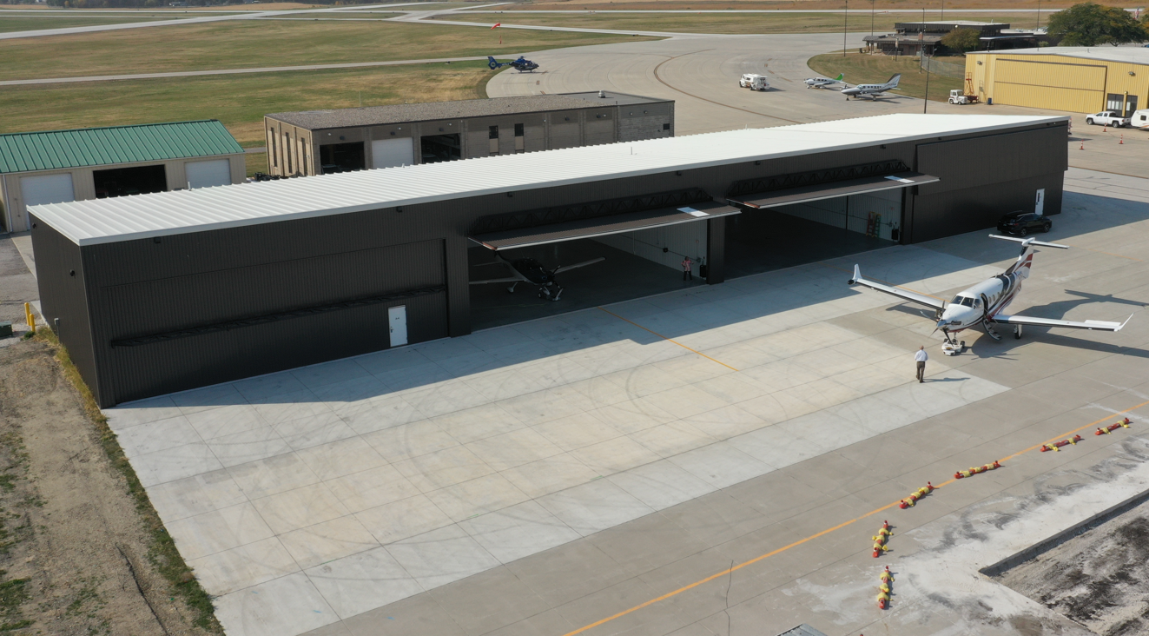
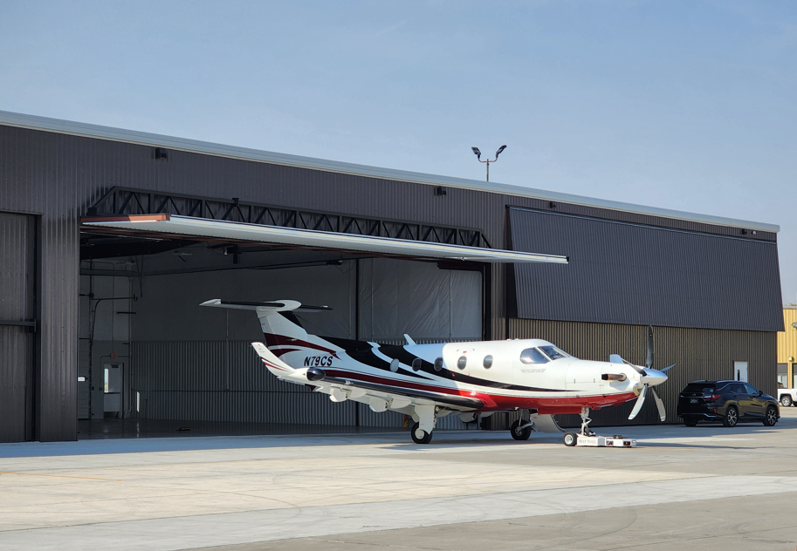
Fort Dodge Regional Airport
Update – December 2024
Construction is complete and the hangars are occupied, one of them with LifeFlight-2, which is now able to provide faster response times.

Slide 15
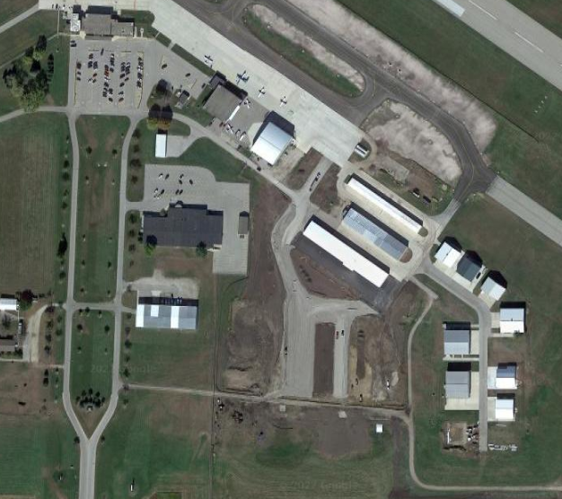
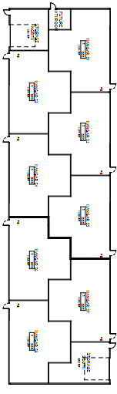
Mason City Municipal Airport
$1,574,795
Construct a hangar building with 8 T-hangar units and a larger end unit. All taxi lanes and utility work to support the project were already complete and the project was shovel ready.

Slide 16
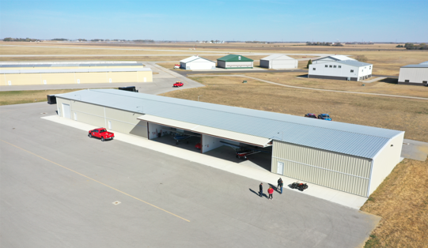
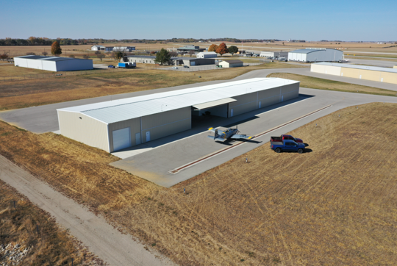
Mason City Municipal Airport
Update – December 2024
Construction of the T-hangar building is complete, and the building is fully occupied. The airport still has an active waiting list of 16 interested parties for additional hangars.

Slide 17
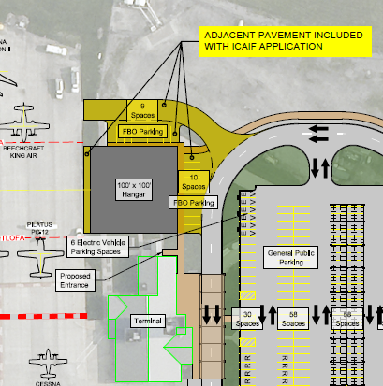
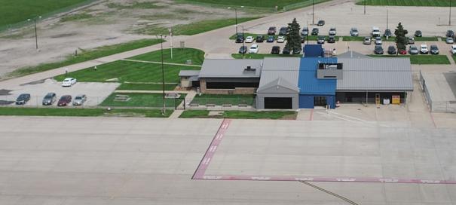
Southeast Iowa Regional Airport (Burlington)
$1,573,948
Construct a large box hangar for storing larger business aircraft, general aviation aircraft, and the aircraft providing commercial air service at the airport.

Slide 18
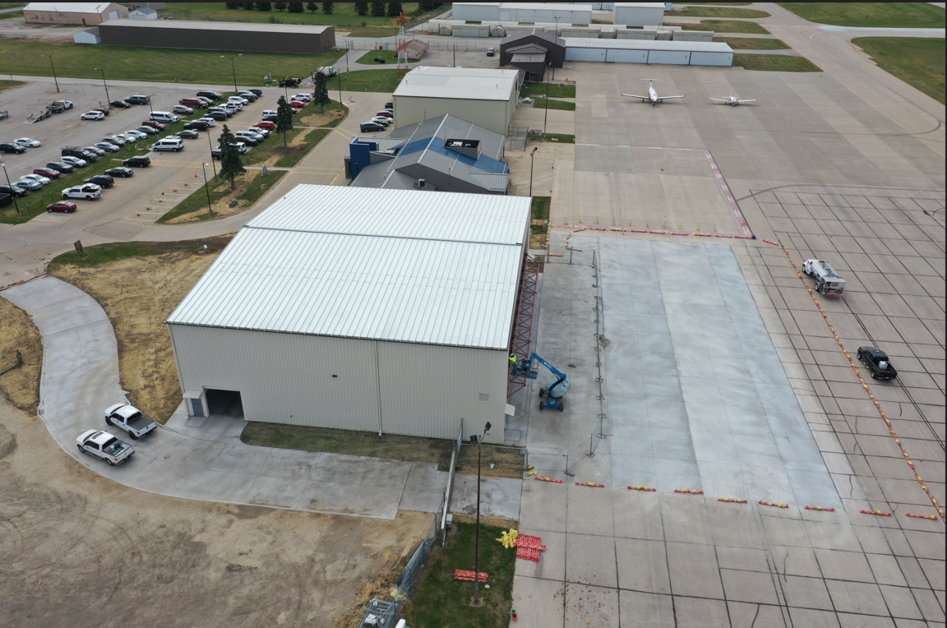
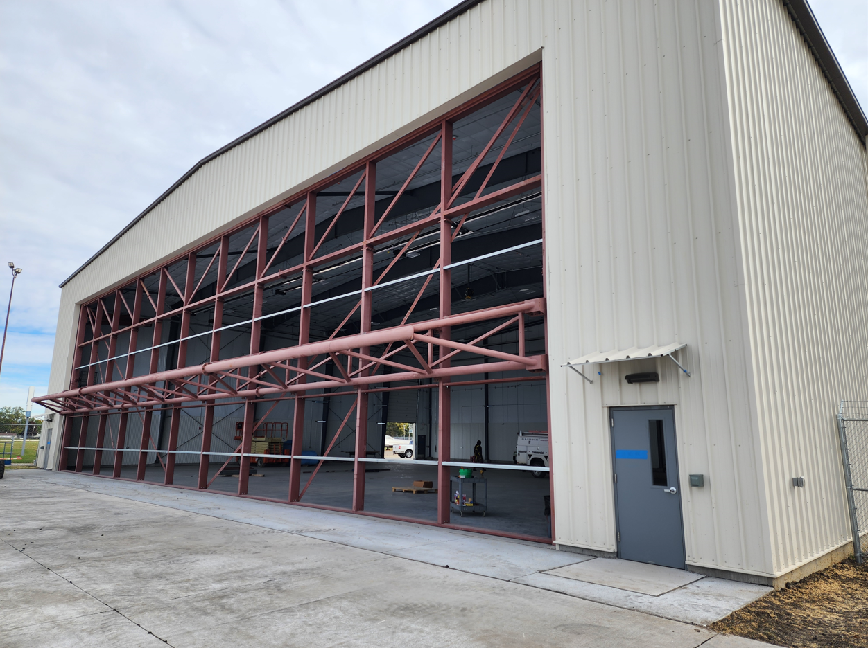
Southeast Iowa Regional Airport
Update – December 2024
Construction on the box hangar is mostly complete and is will start being occupied in the coming weeks.

Slide 19
Thank you!
Questions?

