Slide 1
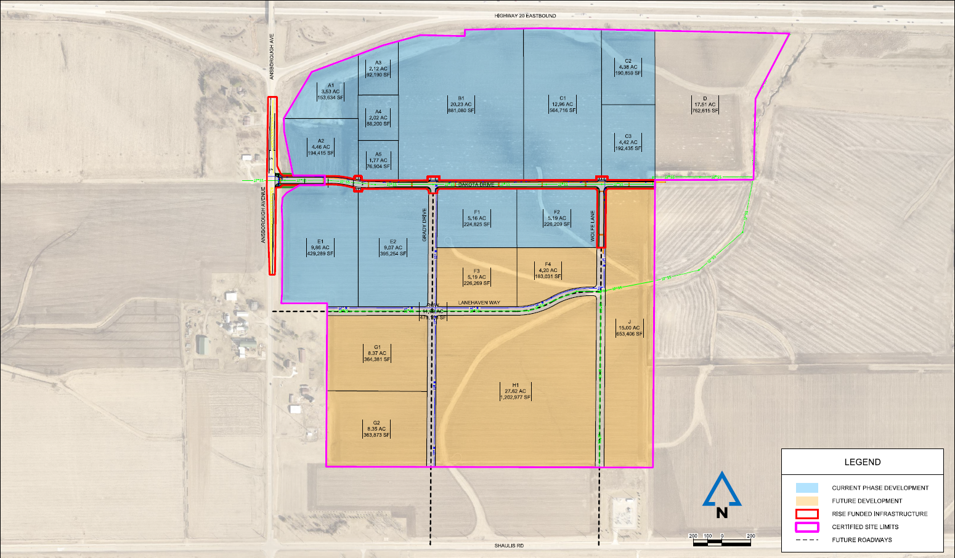
Local Development Recommendation
PROJECT NAME | SPONSOR | SCORE | TOTAL PROJECT COST | PERCENT PARTICIPATION | RECOMMENDED AMOUNT
Construction of approximately 2,600 feet of Dakota Drive; 470 feet of Wolfe Avenue; turn lanes on Dakota Drive and a left turn lane on Ansborough Avenue located on the southwest side of town (Certified Site) | Waterloo | 62 | $3,788,225 | 60% | $2,272,935
1
1

