Slide 1
IOWA INTERSTATE INVESTMENT PLAN 2040 WORKSHOP
Matt Haubrich
Deanna Maifield

Slide 2
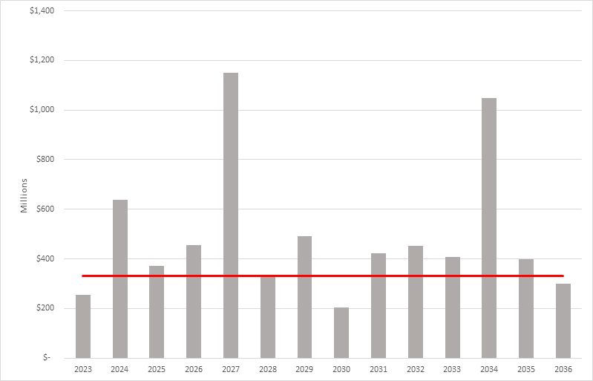
Interstate Needs – as calculated during the workshop
Interstate Needs by Year
$330m
or
50% of
current
program
Notes:
At the end of the workshop, it was evident that the there was ideal solution

Slide 3
Since the Workshop
Quality review of the concepts
Refine cost estimates
Additional reductions in the scope of work for projects
Delayed potential projects to fit within available funding levels

Slide 4
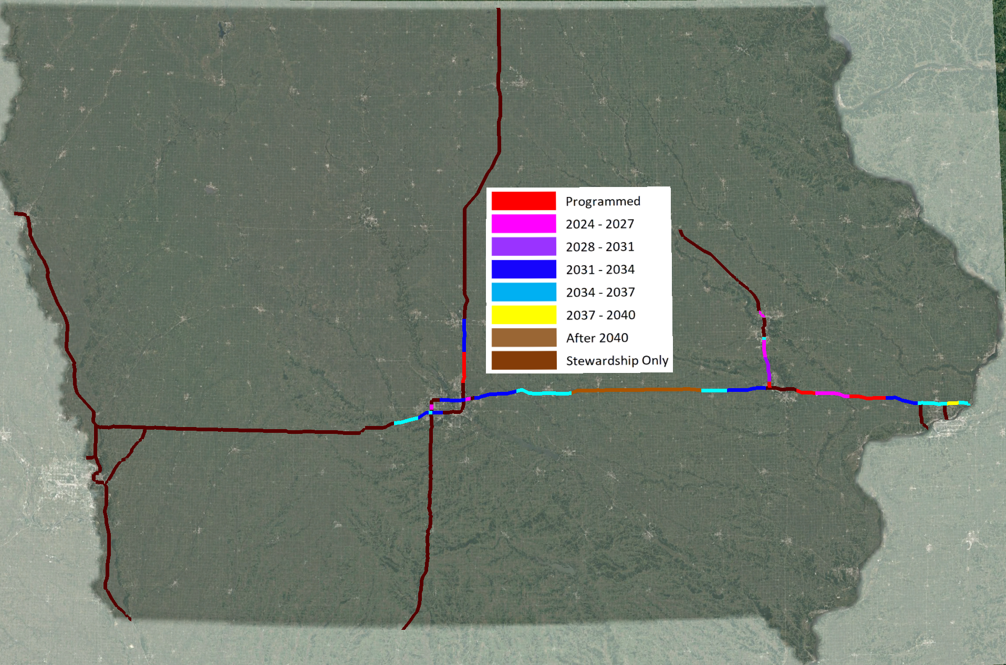
System Goals
Maintain pavement and bridge conditions
as they are today
Provide capacity expansion according to the mapped priorities
Look to innovative solutions to maximize the life of our system
Limit spending to 50% of our current funding
Minimize project costs today by focusing on the immediate issues and keeping a narrow scope of work
Notes:
Most important slide

Slide 5
Where We Are Today- a baseline

Slide 6
Purpose of Today’s Conversation
Not the map, but the process
Goals are defined
Project teams develop projects that align with the goals
Goals will be adjusted and communicated as things change
Notes:
Before we jump into the maps I’d like to talk about the purpose of today’s conversation
The maps represent the amount of capacity expansion we can complete in a year, and a reasonable start for prioritizing based upon traffic volumes and condition

Slide 7
Define / Monitor / Adjust Cycle
Prioritize capacity improvement projects and schedule corridors
Manage and deliver individual projects to meet the defined goals
Develop dashboards to monitor progress and key assumptions
Refresh cost, schedule and condition data and provide updates
Notes:
Key Message

Slide 8
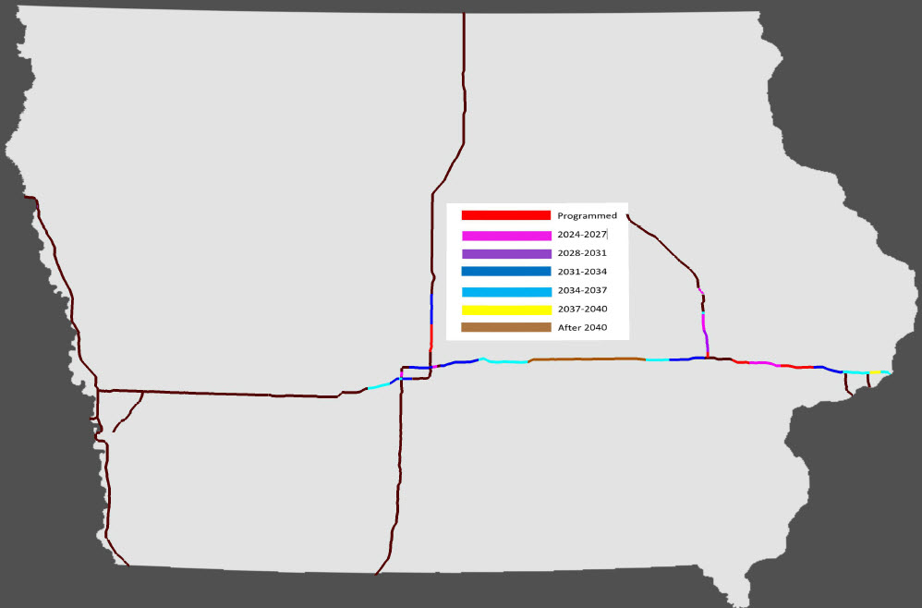
Proposed Capacity Expansion Priorities

Slide 9
Proposed Capacity Expansion Priorities
Ames
US 30
Marengo
Kellogg
Colfax
Durant
DeSoto

Slide 10
Results
Budget was only balanced to 2031
Many segments were delayed beyond 2031 and do not fit within the budget
Currently recommend holding to the $330m budget for interstate funding
Notes:
Key Message

Slide 11
The Budget – flat funding and 50% to Interstate

Slide 12
Results
Budget was only balanced to 2031
Many segments were delayed beyond 2031 and do not fit within the budget
Currently recommend holding to the $330m budget for interstate funding
Establish budgets for each segment
Notes:
Key Message

Slide 13
Budgets
Stewardship projects were funded to maintain current condition
Budgets do not allow projects to include all of the approaches or features that most include today.
Notes:
Budgets were set relatively tight
We will expect the project teams to find the best value solutions for each location
But here are some examples of the Cadillac vs Chevy adage

Slide 14
Ideal Interstate Design
Existing Roadway
Future

Slide 15
Ideal Interstate Construction Sequence (animated in next 7 slides)

Slide 22
Cost Saving Examples
Preserve Existing Pavement
Notes:
Examples- not prescriptive or all inclusive

Slide 23
Cost Saving Examples
Narrow Median through Existing Bridges
- Also reduces sideroad and interchange work

Slide 24
Cost Saving Examples
Add future lanes by repainting
Don’t flatten existing foreslopes

Slide 25
What are we committing to
Not the map, but the process
Goals are defined
Project teams develop projects that align with the goals
Goals will be adjusted and communicated as things change
Notes:
Key Message

Slide 26
Thank You

