Slide 1
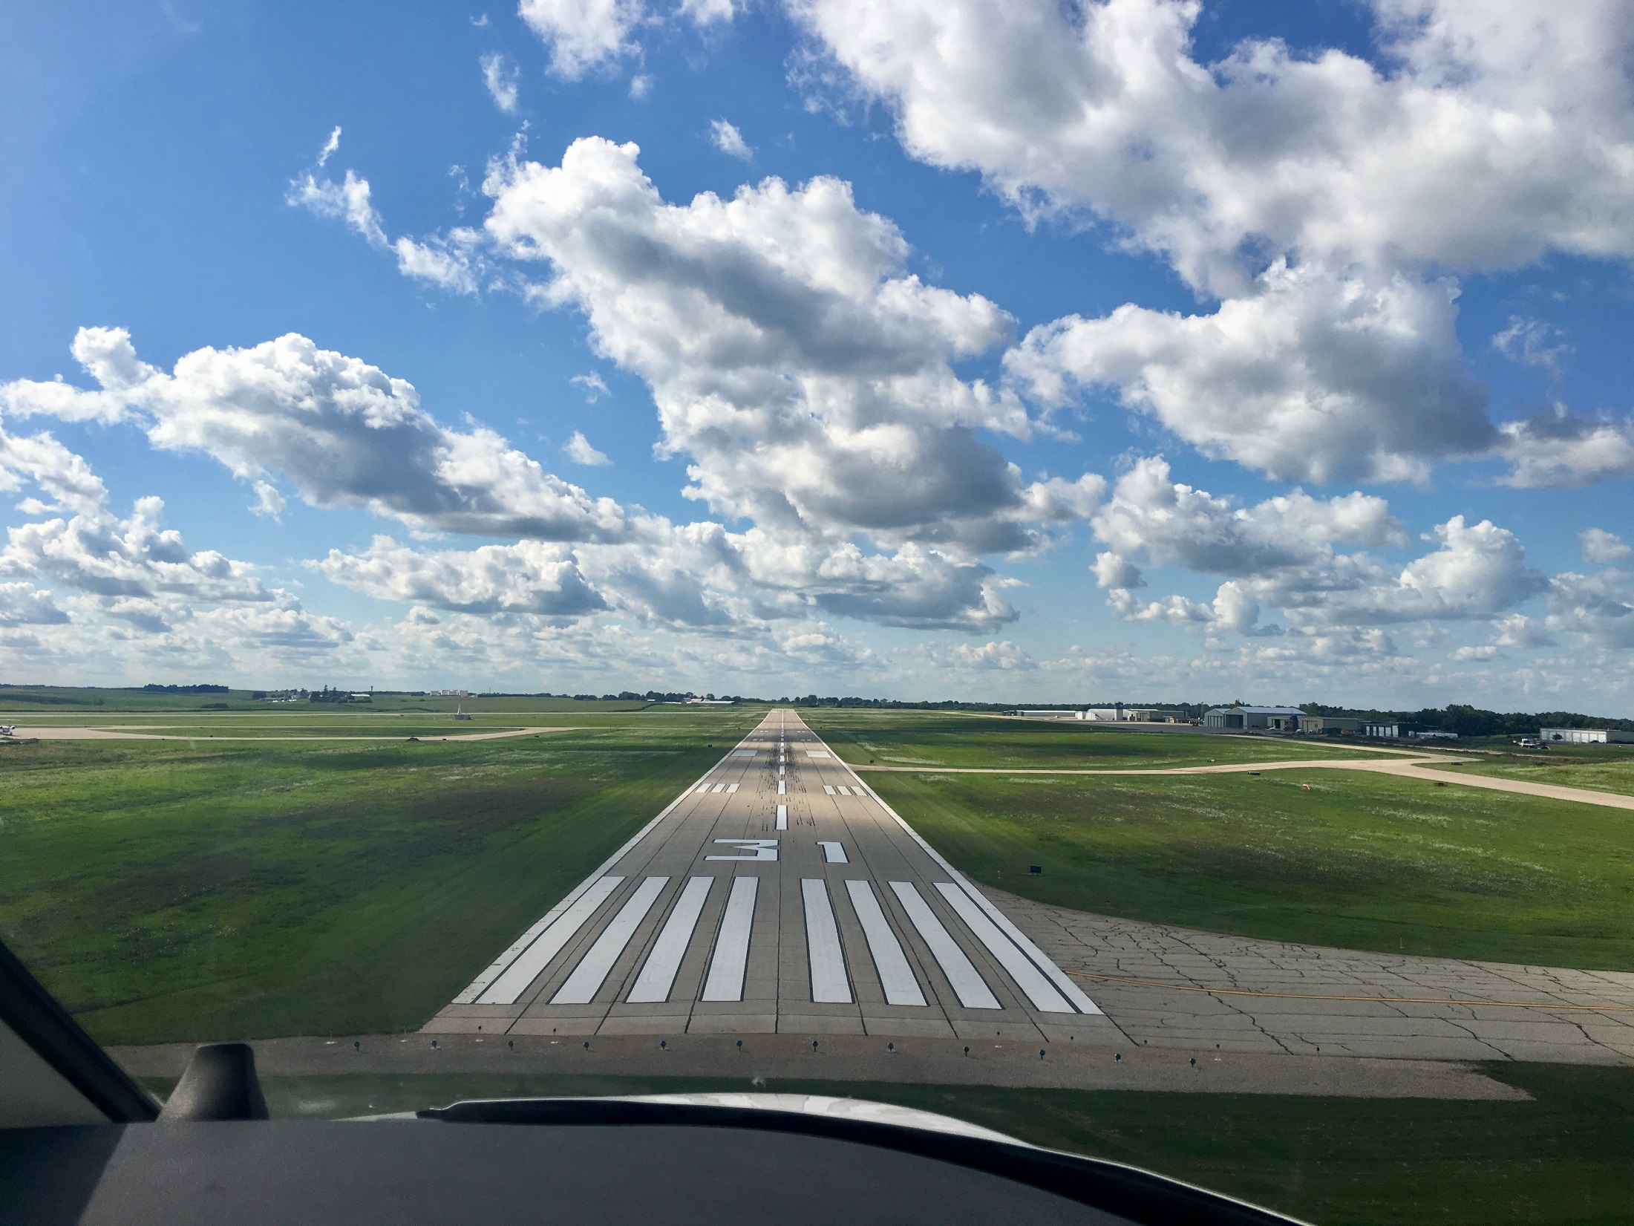

FFY 2020
Federal Aviation Administration
Funding Preapplications
Shane Wright
Office of Aviation
February 11, 2019

Slide 2
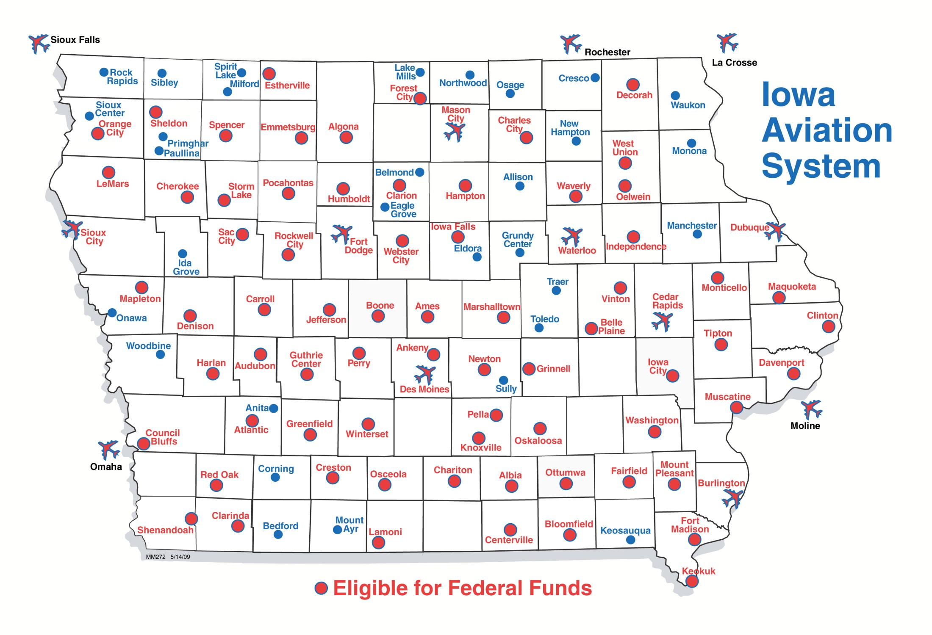
Airports in Iowa Eligible for Federal Funding
Notes:
70 general aviation airports and 3 non-primary commercial service airports – Burlington, Fort Dodge and Mason City
DSM, CID, DBQ, SUX, ALO primary airports (more than 10,000 enplanements) go directly to FAA
30 general aviation airports not eligible for federal funds

Slide 3
Federal Aviation Funding
Channeling Act of 1993 - Applies to all general aviation (GA) airports and commercial service airports that do not receive primary entitlement funds – Iowa Code Section 330.13
  Must submit federal preapplication to the Iowa DOT prior to submittal to FAA
Transportation Commission approves submittal of applications to FAA
Final approval and programming of projects responsibility of the FAA

Slide 4
Federal Aviation Funding
FAA Reauthorization Act of 2018
  $3.35 billion for five years
  90% federal share
Total available dollars remain subject to annual appropriations
Federal Airport Improvement Program (AIP)
  Nonprimary entitlement – Airports receive up to $150,000 each year, based on 5-year capital improvement plan included in the NPIAS (can accumulate 4 years)
  State apportionment – Based on population and land area
  Discretionary – Airport projects compete for funds based on FAA priority of project.
  Entitlement funds are available to airports for any qualifying project. If a grant request exceeds the entitlement available, the FAA may apply apportionment or discretionary to fund the difference.
Notes:
Passed February 2012 after 24 continuing resolutions
FY 2013 funding approp thru March 27

Slide 5
Summary of Federal Funding to Nonprimary Airports in Iowa
 | 2015 | 2016 | 2017 | 2018 | 2019*
Entitlement | $9,463,822 | $14,072,482 | $8,583,899 | $9,842,418 | $13,769,454
Apportionment | $3,113,351 | $3,142,459 | $3,086,621 | $3,038,967 | $3,084,797
Discretionary | $7,770,209 | $2,808,745 | $7,130,406 | $13,921,868 | $18,026,899
 | $20,347,382 | $20,023,686 | $18,806,926 | $26,803,253 | $34,971,150
*Preliminary
Notes:
2013 – Land purchases (Iowa City, Sioux County))
Washington rwy reconstructon
2014 – fewer projects requested that needed discretionary funding

Slide 6
FFY 2020 Federal Funding
Project Categories
Safety and Planning
  Projects that are safety or planning related
  These projects are a high priority as they help to ensure the immediate safety and long term viability of the Iowa air transportation system
Maintenance and Development Projects
  Projects that are to replace, repair, or expand airport infrastructure.
  Also include acquisition of snow removal equipment, fueling facilities, and buildings
Land acquisition
  All conditions must be satisfied for FAA to program a project that must compete for discretionary funding
  Justified, eligible project and shown on an airport layout plan
  Environmental process complete
  Must have purchased the land or have a formal negotiated agreement

Slide 7
FFY 2020 Federal Funding
Safety and Planning Projects
Safety projects
Airport | Project description | 90 percent federal level | Total amount
Bloomfield Municipal | Eliminate West Pond | $194,400 | $216,000
Iowa City Municipal | Runway 12/30 Approach Surface Obstruction Mitigation | $234,000 | $260,000
 | Total safety projects | $428,400 | $476,000
Planning projects
Airport | Project description | 90 percent federal level | Total amount
Algona Municipal | Design and Approach Survey for Runway 12/30 Displacement and Safety Area | $153,000 | $170,000
Cherokee Regional | Partial Parallel Taxiway, Apron to Runway 36 (Design Only) | $162,000 | $180,000
Iowa Falls Municipal | Rehabilitate Runway 13/31 (Design) | $193,500 | $215,000
Maquoketa Municipal | Extend Runway 15 (Design) | $178,650 | $198,500
Mount Pleasant Municipal | Environmental Assessment for Runway 33 Extension | $135,000 | $150,000
Perry Municipal | Runway 14/32 Paving Design | $202,500 | $225,000
Rockwell City Municipal | Environmental Assessment for South End Improvements | $81,000 | $90,000
Sioux County Regional | Terminal Area Study & Plan Update | $67,500 | $75,000
Iowa DOT | Pavement Condition Study | $311,788 | $346,432
Iowa DOT | Economic Impact Study | $297,000 | $330,000
 | Total planning projects | $1,781,938 | $1,979,932
Notes:
The Iowa Aviation System Plan provides a detailed overview of the Iowa Aviation System. It evaluates existing conditions and makes recommendations for future development of the air transportation system.
Last Aviation System Plan was published in 2010.
Originally scheduled to receive FAA funding in FY2018, but FY2017 funds became available and offered to us to begin this effort early.
Estimated cost of $350,000 requiring a $35,000 state share.
Because this is a FAA FY2017 project, it does not appear on the list of projects, but we are requesting commission approval to move ahead with the project.

Slide 8
FFY 2020 Federal Funding
Maintenance and Development Projects
Maintenance and development projects
Airport | Project description | 90 percent federal level | Total amount
Ames Municipal | Electrical Vault & Terminal Demolition | $360,000 | $400,000
Ankeny Regional | Taxiway D Apron Grading and Paving | $524,745 | $583,050
Carroll Municipal | Pavement Maintenance Runway 3/21 & Connecting Taxiway & Terminal Apron | $288,000 | $320,000
Centerville Municipal | Runway 16/34 Electrical Rehabilitation | $429,300 | $477,000
Chariton Municipal | Airfield Pavement Rehabilitation | $249,787 | $277,541
Chariton Municipal | Jet-A Fueling Facility | $238,500 | $265,000
Charles City Municipal | Reconstruct Partial Parallel Taxiway | $1,890,000 | $2,100,000
Clarinda Municipal | Acquire Snow Removal Equipment | $225,000 | $250,000
Clarion Municipal | Runway & Taxiway Lighting Improvements | $321,300 | $357,000
Creston Municipal | Runway 16/34 Pavement Rehabilitation | $3,060,000 | $3,400,000
Decorah Municipal | Entrance Road Reconstruction | $286,200 | $318,000
Estherville Municipal | Partial Parallel Taxiway (Runway 34 to Existing Connector Taxiway) | $660,960 | $734,400
Fairfield Municipal | Airfield Pavement Rehabilitation | $531,000 | $590,000
Fort Dodge Regional | Runway 6/24 & Runway 12/30 Rehabilitation | $648,000 | $720,000
Fort Dodge Regional | Taxiways B, D, and E Surface Seat Coat | $291,510 | $323,900
Fort Dodge Regional | Reconstruct Taxiway B West | $1,019,160 | $1,132,400
Harlan Municipal | Apron Rehabilitation | $383,976 | $426,640
Iowa City Municipal | Runway 25 Threshold Relocation | $279,000 | $310,000
Knoxville Municipal | Expand Apron | $753,300 | $837,000
Knoxville Municipal | Construct Connector Taxiway | $494,460 | $549,400
Le Mars Municipal | Rehabilitate Runway 18/36 | $285,300 | $317,000
Marshalltown Municipal | Storage Hangar Construction | $550,000 | $1,105,000
Mason City Municipal | Reconstruct Taxiway Lighting | $360,000 | $400,000

Slide 9
FFY 2020 Federal Funding
Maintenance and Development Projects continued
Muscatine Municipal | Taxiway Reconstruction Phase One | $990,720 | $1,100,800
Osceola Municipal | Construct Parallel Taxiway to End 36 | $1,109,835 | $1,233,150
Ottumwa Regional | Runway 4/22 and Taxiway Crack Cleaning and Slurry Sealing | $442,746 | $491,940
Red Oak Municipal | Pavement Maintenance on Connecting Taxiways and Apron | $108,000 | $120,000
Shenandoah Regional | Runway 4/22 and 12/30 Pavement Maintenance | $262,800 | $292,000
Sioux County Regional | Acquire Snow Removal Equipment | $270,000 | $300,000
Storm Lake Municipal | Lighting Replacement - Runway 13/31 and Taxiway | $510,570 | $567,300
Vinton Municipal | Runway 9/27 Rehabilitation | $414,000 | $460,000
Webster City Municipal | Reconstruct Partial Parallel Taxiway | $761,170 | $845,745
 | Total maintenance and development projects | $18,999,339 | $21,604,266

Slide 10
FFY 2020 Federal Funding
Land acquisition
Land acquisition projects
Airport | Project description | 90 percent federal level | Total amount
Bloomfield Municipal | Land Acquisition | $261,900 | $291,000
Lamoni Municipal | Land Acquisition | $216,000 | $240,000
Manchester Municipal | Land Acquisition for Airport Runway Protection Zone and Safety Areas | $434,016 | $482,240
Pocahontas Municipal | Land Acquisition for Runway 12/30 Clearances | $495,225 | $550,250
South Central Regional | Land Acquisition | $773,199 | $854,665
South Central Regional | Land Acquisition | $255,659 | $284,065
South Central Regional | Land Acquisition | $441,959 | $491,065
South Central Regional | Land Acquisition | $922,088 | $1,024,611
South Central Regional | Land Acquisition | $396,944 | $441,049
Tipton Municipal | Land Acquisition | $255,285 | $309,150
West Union Municipal | Land Acquisition | $108,000 | $120,000
 | Total land acquisition projects | $4,560,275 | $5,088,095
Notes:
Charles City finishing environmental – 13 parcels – not all likely to be ready for 2015
Only eligible for discretionary if agreement in place by April 2014

Slide 12
FFY 2020 Federal Funding
Preapplications Summary
 | Projects | Airports | Federal Share | Total Applications
Safety and Planning | 12 | 11 | $2,210,338 | $2,455,932
Maintenance and Development | 32 | 29 | $18,999,339 | $21,604,266
Land Acquisition | 11 | 7 | $4,560,275 | $5,088,095
Total Preapplications | 55 | 47 | $25,769,952 | $29,148,293
Notes:
Total eligible airports: 73 plus 2 new/replacement
No projects: 21 airports

Slide 13
FFY 2020 Federal Aviation Administration
Funding Preapplications
Questions??

