Slide 1
2020-2024 Highway Program Development
February 11, 2019

Slide 2
February 11, 2019
Overview
Discuss Highway Program Development Process
Discuss 2020-2024 Highway Program Development Schedule
Discuss Extended Highway Program Analysis
Discuss Statewide Line Items
At what levels should the line item targets be programmed?
Discuss Federal Funding
Discuss Program Objectives/Priorities/Considerations
Action Item: Project Prioritization Weighting

Slide 3
Highway Program Development Process
February 11, 2019
Public Policy and Input
What direction do we have?
Transportation Plans
What type of system do we need?
Performance Monitoring
Are we successful?
Five-Year Program
What projects will be done and when?

Slide 4
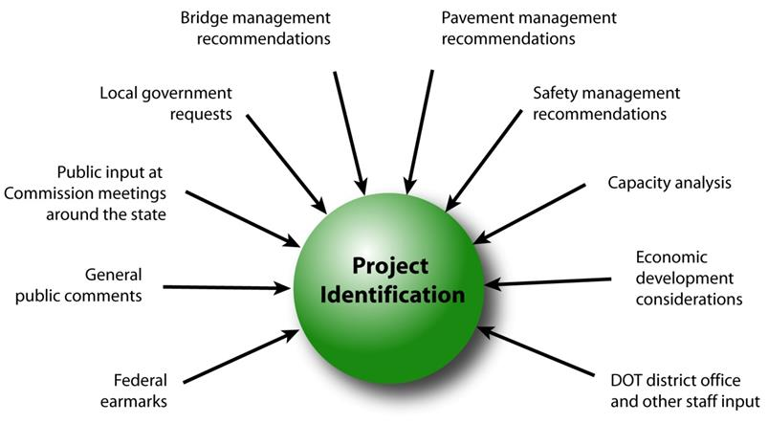
February 11, 2019
Step 1: Project identification

Slide 5
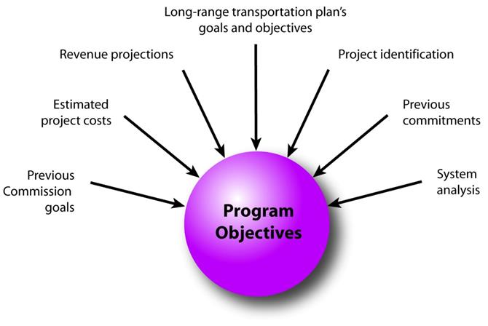
February 11, 2019
Step 2: Establishing the Transportation Commission’s annual programming objectives

Slide 6
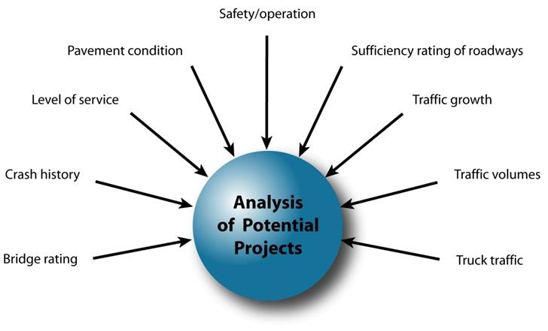
February 11, 2019
Step 3: Evaluating potential project candidates

Slide 7
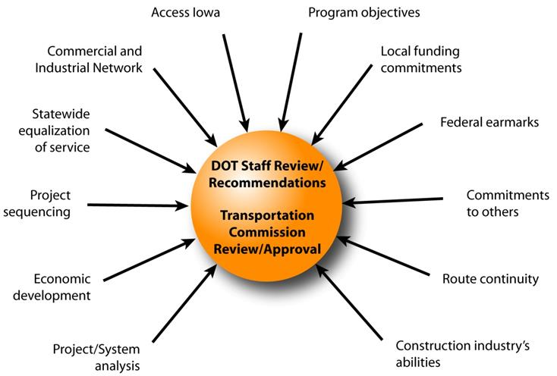
February 11, 2019
Step 4: Developing the final program

Slide 8
February 11, 2019
Commission Program Development Schedule (2020-2024)
February 2019
Discuss Highway Program Development Process
Discuss 2020-2024 Highway Program Development Schedule
Discuss Extended Highway Program Analysis
Discuss Statewide Line Items
At what levels should the line item targets be programmed?
Discuss Federal Funding
Discuss Program Objectives/Priorities/Considerations
Action Item: Project Prioritization Weighting
March 2019
Discuss 2020-2024 available Highway Program funding
Discuss 2020-2024 Highway Program Options
Determine 2020-2024 Highway Program Objectives
Action Item: Line Item Targets for Programming
April 2019
Develop the Draft 2020-2024 Highway Program
Action Item: 2020-2024 Highway Program Objectives
May 2019
Present the Draft 2020-2024 Iowa Transportation Improvement Program to the public
(including all previous program approvals and draft 2020–2024 Highway Program)
June 2019
Action Item: Approve the 2020–2024 Iowa Transportation Improvement Program

Slide 9
2019-2028 Highway Program Analysis
For Highway Planning Purposes Only (x $1,000,000)
February 11, 2019
(as shown May 8, 2018)
Approved Highway Program Extended Highway Program
2019 2020 2021 2022 2023 2024 2025 2026 2027 2028
Projected Funds 722.6 649.3 643.2 633.7 657.7 657.7 657.7 657.7 657.7 657.7
Highway Program Components
Interstate Stewardship 202.6 148.2 173.1 175.8 162.5 165.0 165.0 170.0 175.0 180.0
Non-Interstate Pavement Modernization 95.4 100.0 105.0 115.0 125.0 130.0 135.0 140.0 150.0 160.0
Non-Interstate Bridge Modernization 54.4 54.7 57.1 64.6 100.2 110.0 125.0 140.0 155.0 170.0
Safety Specific 19.7 25.0 25.0 25.0 25.0 25.0 25.0 25.0 25.0 25.0
Non-Interstate Capacity/System Enhancement 150.0 155.6 110.4 106.5 166.7
IA 9 Allamakee Mississippi River Bridge 40.0
IA 17 Boone N of US 30 and E 3 mi 6.0 0.1
US 30 Story E of I-35 to E of 600th Ave 0.3
US 30 Benton from IA 21 to US 218 0.2
US 61 Des Moines from 210th St to N of Mediapolis 14.6 0.1
US 61 Des Moines N of Mediapolis to N of IA 78 3.7 23.5 0.1
IA 92 Washington/Louisa from US 218 to IA 70 0.2
Major Interstate Capacity/System Enhancement 219.8 191.4 209.3 150.3 95.6
I-35 Polk/Story 30.5 52.5 1.0
I-80 Cedar 33.0 34.0
I-80 Scott Mississippi River Bridge 100.0
Highway Program Balance (19.3) (25.6) (36.7) (3.5) (17.3) (0.8) 97.5 181.6 152.7 122.7
Black: Approved by the Commission as of June 12, 2018, or implied commitment by the Commission by an established target amount or multi-year project
( ): Indicates Highway Program is over-programmed

Slide 10
2020-2029 Highway Program Analysis
For Highway Planning Purposes Only (x $1,000,000)
February 11, 2019
Proposed Highway Program Extended Highway Program
2020 2021 2022 2023 2024 2025 2026 2027 2028 2029
Projected Funds 649.3 643.2 633.7 657.7 657.7 657.7 657.7 657.7 657.7 657.7
Highway Program Components
Interstate Stewardship 148.2 173.1 175.8 162.5 165.0 165.0 170.0 175.0 180.0 185.0
Non-Interstate Pavement Modernization 100.0 105.0 115.0 125.0 130.0 135.0 140.0 150.0 160.0 170.0
Non-Interstate Bridge Modernization 54.7 57.1 64.6 100.2 110.0 125.0 140.0 155.0 170.0 185.0
Safety Specific 25.0 25.0 25.0 25.0 25.0 25.0 25.0 25.0 25.0 25.0
Non-Interstate Capacity/System Enhancement 155.6 110.4 106.5 166.7
IA 9 Allamakee Mississippi River Bridge 40.0
IA 17 Boone N of US 30 and E 3 mi 6.0 0.1
US 30 Story E of I-35 to E of 600th Ave 0.3
US 30 Benton from IA 21 to US 218 0.2
US 61 Des Moines from 210th St to N of Mediapolis 14.6 0.1
US 61 Des Moines N of Mediapolis to N of IA 78 3.7 23.5 0.1
IA 92 Washington/Louisa from US 218 to IA 70 0.2
Major Interstate Capacity/System Enhancement 191.4 209.3 150.3 95.6
I-35 Polk/Story 30.5 52.5 1.0
I-80 Cedar 33.0 34.0
I-80 Scott Mississippi River Bridge 150.0
Highway Program Balance (25.6) (36.7) (3.5) (17.3) 99.2 (52.5) 181.6 152.7 122.7 92.7
Black: Approved by the Commission as of June 12, 2018, or implied commitment by the Commission by an established target amount or multi-year project
Green: Changes since previous discussion
( ): Indicates Highway Program is over-programmed

Slide 11
 | DRAFT 2020 - 2024 IOWA HIGHWAY PROGRAM
 |  |  |  | PROJECT ESTIMATED COSTS X $1000
 | LOCATION | FUNDING | TYPE OF WORK | 2020 | 2021 | 2022 | 2023 | 2024
 | (00) STATEWIDE
 | STATEWIDE INTERSTATE PAVEMENT MAINTENANCE | 4R | PAVEMENT REHAB | 9500 | 9500 | 9500 | 9500 | 9500
 | STATEWIDE INTERSTATE GUARDRAIL REPAIR | 4R | GUARDRAIL REPAIR | 650 | 650 | 650 | 650 | 650
 | STATEWIDE INTERSTATE LIGHTING | 4R | LIGHTING | 500 | 500 | 500 | 500 | 500
 | STATEWIDE INTERSTATE REST AREA MAINTENANCE | 4R | REST AREA IMPROVE | 3700 | 3700 | 3700 | 3700 | 3700
 | STATEWIDE INTERSTATE SIGNING | 4R | TRAFFIC SIGNS | 1000 | 1000 | 1000 | 1000 | 1000
 | NON-INTERSTATE PAVEMENT PRESERVATION | 3R | PAVEMENT REHAB |  | 105000 | 115000 | 125000 | 130000
 | STATEWIDE SAFETY SPECIFIC | SR | MISCELLANEOUS |  | 25000 | 25000 | 25000 | 25000
 | AMERICANS WITH DISABILITIES ACT |  | MISCELLANEOUS | 3000 | 3000 | 3000 | 3000 | 3000
 | CONSTRUCTION INDUSTRY TRAINING PROGRAM |  | MISCELLANEOUS | 500 | 500 | 500 | 500 | 500
 | COOPERATIVE CITY/COUNTY/STATE HIGHWAY RESEARCH |  | MISCELLANEOUS | 1500 | 1500 | 1500 | 1500 | 1500
 | EMERGENCY & CONTINGENCY - U-STEP/C-STEP |  | MISCELLANEOUS | 6000 | 6000 | 6000 | 6000 | 6000
 | POST LETTING PROJECT COST |  | MISCELLANEOUS | 10000 | 10000 | 10000 | 10000 | 10000
 | PREVOCATIONAL TRAINING AND DBE SUPPORT SERVICES |  | MISCELLANEOUS | 300 | 300 | 300 | 300 | 300
 | SCENIC BYWAY PROGRAM |  | MISCELLANEOUS | 500 | 500 | 500 | 500 | 500
 | STATEWIDE CONSULTANT SERVICES |  | OUTSIDE SERV. ENGINEER | 80000 | 80000 | 80000 | 80000 | 80000
 | STATEWIDE CONSULTANT SERVICES |  | OUTSIDE SERV. ENGINEER | 2500 | 2500 | 2500 | 2500 | 2500
 | STATEWIDE CONTRACT MAINTENANCE |  | MISCELLANEOUS | 31350 | 31350 | 31350 | 31350 | 31350
 | STATEWIDE RAILROAD CROSSINGS |  | MISCELLANEOUS | 500 | 500 | 500 | 500 | 500
 | STATEWIDE ROADSIDE IMPROVEMENT |  | LANDSCAPING | 2500 | 2500 | 2500 | 2500 | 2500
 | STATEWIDE TRAFFIC CONTROL DEVICES |  | TRAFFIC SIGNS | 10000 | 10000 | 10000 | 10000 | 10000
 | ABBREVIATIONS
 | 4R - INTERSTATE STEWARDSHIP
 | 3R - NON-INTERSTATE PAVEMENT MODERNIZATION
 | SR - SAFETY SPECIFIC
At what levels should the line item targets in the blue box be programmed?

Slide 12
Federal Funding Status
The FAST Act authorizes federal funding through September 30, 2020.
Core programs remain in place with some growth in funding.
FAST Act funding allocations were determined by Commission in 2016.
The next Highway Trust Fund cliff is in 2021, leaving uncertainty in the last four years of this next five-year program.
Contingency plan has been developed should significant reduction in federal funding occur. Consider identifying specific project impacts with this Program.
Currently operating under a continuing resolution through Feb. 15. There were no immediate impacts on federal highway funding due to the shutdown.

Slide 13
Current Highway Program Objectives
February 11, 2019
Stewardship Investments
Interstate (Pavement Reconstruction/Modernization, Bridges, Pavement Patching/Maint., Rest Areas/Misc.)
- Maintain scheduled completion of I-35 in Polk County from Oralabor Road to NE 36th St. in Ankeny
- Maintain scheduled completion of I-35/80 Interchange NE of Des Moines in Polk County
- Maintain scheduled completion of I-80 in Polk County at Iowa 141 interchange in Urbandale
- Maintain scheduled completion of I-80/380 interchange reconstruction in Johnson County
Non-Interstate Pavement Modernization
Non-Interstate Bridge Modernization
Safety
Major Interstate Capacity/System Enhancement Projects
Maintain scheduled completion of I-29/I-80/I-480 in Council Bluffs (CBIS)
Maintain scheduled completion of I-74 in Davenport/Bettendorf (Central Section)
Maintain scheduled completion of I-80 in Johnson/Cedar Counties
Maintain scheduled completion of I-380 in Linn County for Tower Terrace
Non-Interstate Capacity/System Enhancement Projects
Maintain scheduled completion of Iowa 1 in Jefferson County in Fairfield
Maintain scheduled completion of Iowa 3 in Dubuque County from Luxemburg to Sageville
Maintain scheduled completion of Iowa 13 in Linn County from N of County Home Rd to S of Central City
Maintain scheduled completion of Iowa 14 in Marshall and Grundy Counties from Co Rd E18 to Iowa 175
Maintain scheduled completion of Iowa 17 in Boone County north of U.S. 30
Maintain scheduled completion of U.S. 18 in Floyd County at the U.S. 218 intersection in Floyd
Maintain scheduled completion of U.S. 20 in Webster County from E of Co Rd P73 to Iowa 17
Maintain scheduled completion of U.S. 20 in Black Hawk County from Iowa 21 to I-380 in Waterloo
Maintain scheduled completion of U.S. 20 in Dubuque County at Swiss Valley Road intersection
Maintain scheduled completion of U.S. 30 in Story County from 0.5 miles east of I-35 to east of 590th Ave
Maintain scheduled completion of U.S. 30 in Tama and Benton Counties
Maintain scheduled completion of U.S. 52 in Jackson County from the Mississippi River to Sabula
Maintain scheduled completion of U.S. 61 in Des Moines County from Burlington to N of Mediapolis
Maintain scheduled completion of U.S. 69 in Polk County from I-80 to SE 33rd St in Ankeny
Maintain scheduled completion of U.S. 69 in Wright County from N of UP RR to Co Rd C20
Maintain scheduled completion of U.S. 75 in Plymouth County from Hinton to Merrill
Maintain scheduled completion of Iowa 92 in Washington and Louisa Counties

Slide 14
February 11, 2019
Program Development Considerations
Continue to increase stewardship investments on existing highway system (i.e., bridges, pavements, safety)
Balance capacity improvements with stewardship needs
Address increasing safety/operational needs on the Interstate
I-35 in central Iowa
I-80 in eastern Iowa
I-380 from Iowa City to Cedar Rapids
Address major river crossing needs
Continue to complete existing priority corridors

Slide 15
February 11, 2019
Program Development Considerations
Review existing priority corridors and determine if changes are necessary
U.S. 30 in Harrison County for Missouri Valley bypass
U.S. 30 in Greene/Boone Counties from Jefferson to Ogden
U.S. 30 in Cedar County from Lisbon to Stanwood
U.S. 30 in Clinton County from Calamus to U.S. 61
U.S. 61 in Des Moines/Louisa Counties from 0.5 miles north of Iowa 78 to 2.0
miles south of Iowa 92
U.S. 63 in Davis/Wapello Counties from North of Bloomfield to Ottumwa

Slide 16
Options of Projects to add to the Highway Program
For Highway Planning Purposes Only (x $1,000,000)
 | 2020 | 2021 | 2022 | 2023 | 2024 | 2025 | 2026 | 2027 | 2028 | Beyond | Total
Non-Interstate Capacity/System Enhancement (NR funds)
Stewardship
IA 1 Johnson: SB in Iowa City from Burlington to N Dodge St |  |  |  | 3.1 |  |  |  |  |  |  | 3.1
IA 9 Allamakee: Mississippi River Bridge (state share) |  |  |  |  | 40.0 |  |  |  |  |  | 40.0
IA 12 Woodbury: Gordon Drive bridge in Sioux City |  |  |  |  |  |  |  | TBD |  |  | TBD
IA 13 Delaware: N of Co Rd D13 to S Jct IA 3 |  |  |  |  | 10.0 |  |  |  |  |  | 10.0
IA 21 Iowa: South of Belle Plaine |  |  |  |  | TBD |  |  |  |  |  | TBD
US 20 Woodbury: US 75 in Sioux City to Little Whiskey Creek (EB/WB) |  |  |  | 11.0 |  |  |  |  |  |  | 11.0
US 20 Black Hawk: Hudson Rd to US 63 (EB/WB) |  |  |  | 14.1 |  |  |  |  |  |  | 14.1
US 30 Story: Co Rd S-14 in Nevada |  |  |  |  | 4.0 |  |  |  |  |  | 4.0
US 34 Montgomery: W of IA 48 to Co Rd H34 |  |  |  | 12.0 |  |  |  |  |  |  | 12.0
IA 38 Cedar: SCL to NCL in Tipton (state share) |  | 2.1 |  |  |  |  |  |  |  |  | 2.1
IA 44 Dallas: At Co Rd R30 2 mi W of Grimes (state share) | 0.3 |  |  |  |  |  |  |  |  |  | 0.3
US 63 Poweshiek: W Jct US 6 to SCL of Tama |  |  |  |  | 10.0 |  |  |  |  |  | 10.0
IA 64 Jackson: US 61 to IA 62 in Maquoketa (state share) |  | 3.6 |  |  |  |  |  |  |  |  | 3.6
US 65 Cerro Gordo: 0.1 mi S of 27th St SW to 6th St S in Mason City |  |  |  |  | 11.1 |  |  |  |  |  | 11.1
US 67 Scott: Mississippi River Bridge |  |  |  |  |  |  |  |  |  | 110.0 | 110.0
US 71 Dickinson: Okoboji Grove Rd in Arnolds Park to East View Ave |  |  |  | 11.7 |  |  |  |  |  |  | 11.7
US 75 Plymouth: Woodbury Co to S of W Grover St in Hinton (SB) | 12.9 |  |  |  |  |  |  |  |  |  | 11.9
US 75 Sioux: In Sioux Center pavement replacement (state share) |  |  | 0.3 | 13.0 | 7.0 |  |  |  |  |  | 20.3
US 75 Sioux: N of Sioux Center to US 18 |  |  |  |  |  | 10.0 |  |  |  |  | 10.0
IA 150 Buchanan: In Independence from 8th St to CN RR |  |  | 3.8 |  |  |  |  |  |  |  | 3.8
US 151 Linn: Co Rd X20 in Springville |  |  | 8.3 | 14.4 | 0.3 |  |  |  |  |  | 23.0
IA 141 Polk: NW 121st St intersection including local road connections |  |  |  |  | 7.8 |  |  |  |  |  | 7.8
IA 160 Polk: DMACC Blvd in Ankeny (state share) | 0.5 |  |  |  |  |  |  |  |  |  | 0.5
IA 415 Polk: Co Rd R6F/NW Beaver Dr 1.5 mi NE of IA 141 (state share) |  | 0.4 |  |  |  |  |  |  |  |  | 0.4
IA 922 Linn: 29th to 31st St NE in Cedar Rapids (state share) | 0.5 |  |  |  |  |  |  |  |  |  | 0.5
ITS (multiple locations statewide) | 0.8 |  |  | 0.8 |  |  |  |  |  |  | 1.6
Culverts (multiple locations statewide) | 1.8 | 1.0 | 0.8 | 0.8 |  |  |  |  |  |  | 4.4
Slide Repairs (multiple locations statewide) | 0.9 | 1.0 |  |  |  |  |  |  |  |  | 1.9
Jasper: Traffic Incident Management (TIM) Training Center | TBD | TBD |  |  |  |  |  |  |  |  | 11.8
Subject to change as additional information becomes available

Slide 17
Options of Projects to add to the Highway Program
For Highway Planning Purposes Only (x $1,000,000)
 | 2020 | 2021 | 2022 | 2023 | 2024 | 2025 | 2026 | 2027 | 2028 | Beyond | Total
Non-Interstate Capacity/System Enhancement (NR funds)
Capacity
US 30 Harrison: Missouri Valley bypass |  |  |  |  | 10.5 | 43.5 | 18.5 | 17.9 | 0.5 |  | 90.9
US 30 Tama: Meskwaki interchange |  |  |  |  |  |  |  |  |  |  | TBD
US 61 Louisa: 1 mi N of IA 78 to 2 mi S of IA 92 |  |  |  |  | 5.8 | 37.1 |  | 16.2 | 29.6 | 19.3 | 108.0
US 63 Mahaska: Bypass NW of Oskaloosa |  |  |  |  | 6.1 | 14.7 | 18.7 | 0.3 |  |  | 39.8
US 218 Bremer: Cedar River in Janesville to IA 116 in Waverly |  |  |  |  | 18.8 | 12.9 |  |  |  |  | 31.7
Potential Transfer of Jurisdictions (NR funds)
US 6 Pottawattamie: 6th St in Council Bluffs east to I-80 |  |  |  | TBD |  |  |  |  |  |  | TBD
IA 78 Henry: Olds to Louisa County | 13.7 |  |  |  |  |  |  |  |  |  | 13.7
IA 78 Louisa: Henry County to US 61 | 8.4 |  |  |  |  |  |  |  |  |  | 8.4
Subject to change as additional information becomes available

Slide 18
Options of Projects to add to the Highway Program
For Highway Planning Purposes Only (x $1,000,000)
 | 2020 | 2021 | 2022 | 2023 | 2024 | 2025 | 2026 | 2027 | 2028 | Beyond | Total
Major Interstate Capacity/System Enhancement (MI funds)
I-35 Story: N of IA 210 to E 13th St in Ames |  |  |  |  |  |  | 45.0 | 50.0 | 25.0 |  | 120.0
I-74 Scott: In Bettendorf from N of Lincoln Rd to S of US 6 |  |  |  |  |  | 59.5 |  |  |  |  | 59.5
I-74 Scott: US 6 Interchange in Davenport (reconstruction) |  |  |  |  |  |  | 24.9 |  |  |  | 24.9
I-74 Scott: In Davenport from S of US 6 to 67th St |  |  |  |  |  |  |  | 63.7 |  |  | 63.7
I-80 Polk: I-35/235 to US 65 near Altoona |  |  |  |  |  |  | 27.9 | 28.9 |  |  | 56.8
I-80 Polk/Jasper: Altoona to Colfax |  |  |  |  |  |  |  |  |  | TBD | TBD
I-80 Iowa/Johnson: US 151 to I-380 |  |  |  |  |  |  |  |  |  | TBD | TBD
I-80 Cedar: 0.5 mi E of Co Rd X30 to E of the Cedar River |  |  |  |  |  |  |  | 40.0 | 45.0 | 45.0 | 130.0
I-80 Cedar/Scott: 0.5 mi W of Co Rd Y26 to I-280 |  |  |  |  |  |  |  | TBD | TBD | TBD | TBD
I-80 Scott: I-280 to US 61 |  |  |  |  |  |  |  | TBD | TBD | TBD | TBD
I-80 Scott: US 61 to W of Middle Road in Bettendorf |  |  |  |  |  |  |  | TBD | TBD | TBD | TBD
I-80 Scott: W of Middle Road in Bettendorf to Mississippi River |  |  |  |  | TBD | TBD |  |  |  |  | TBD
I-80 Scott: Mississippi River Bridge |  |  |  |  |  | 150.0 |  |  |  |  | 150.0
I-380 Johnson: Forevergreen Rd to S of Co Rd F12 |  |  |  |  |  |  |  | TBD | TBD | TBD | TBD
I-380 Johnson/Linn: S of Co Rd F12 to US 30 |  |  |  |  |  | TBD | TBD | TBD | TBD | TBD | TBD
I-380 Linn: Blairs Ferry Road to County Home Road (add lanes) |  |  |  |  |  |  | TBD | TBD |  |  | TBD
Stewardship (Shelf-Ready) Projects |  | 100.0 | 100.0 | 100.0 | 100.0 | 100.0 |  |  |  |  | 500.0
Subject to change as additional information becomes available

Slide 19
Next Steps
February 11, 2019
Discuss 2020-2024 available Highway Program funding
Discuss 2020-2024 Highway Program Options
Determine 2020-2024 Highway Program Objectives
Action Item: Line Item Targets for Programming

