Slide 1
Representing the interests of all public use airports in Iowa
Rhonda Chambers
Airport Director of the Fort Dodge Regional Airport
William Kyle
Airport Manager of the Northeast Iowa Regional Airport
& President of Charles City Aeronautics Inc.

Slide 2
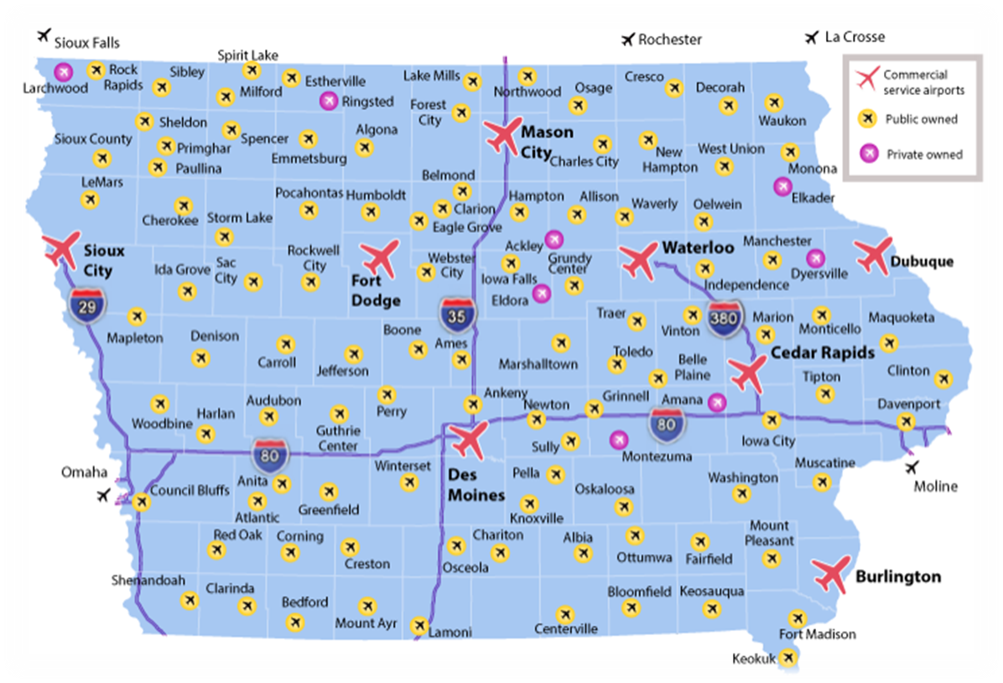
Representing the interests of all public use airports in Iowa
WHY ARE AIRPORTS IMPORTANT TO IOWA?

Slide 3
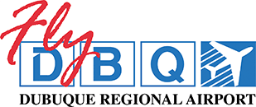
Representing the interests of all public use airports in Iowa
Representing the interests of all public use airports in Iowa
1,964,027 Passengers (163,688 per Month)

Slide 4
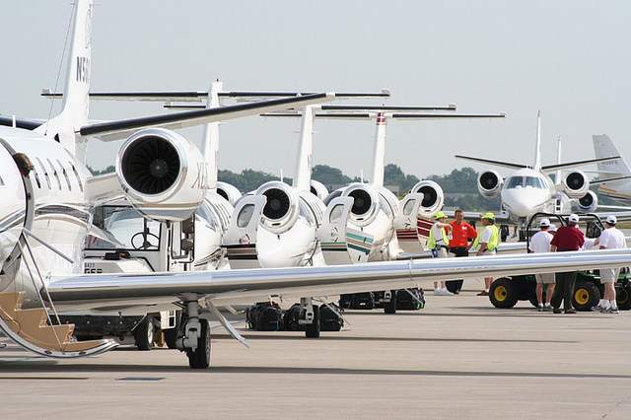
Business/Corporate Aviation

Slide 5
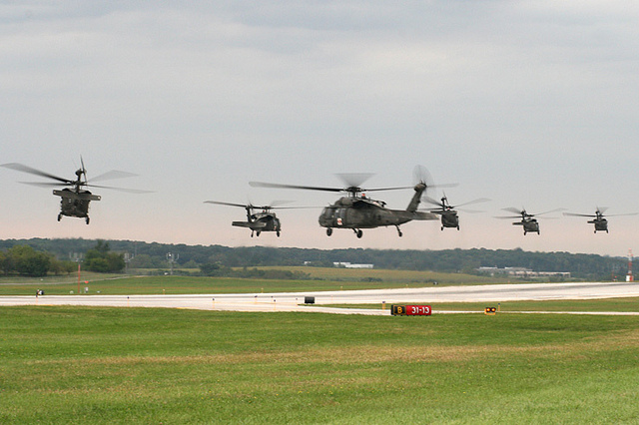
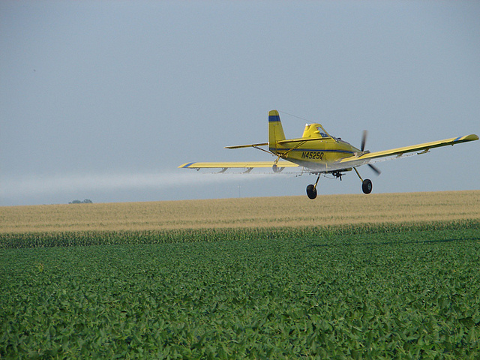
Representing the interests of all public use airports in Iowa
Military
Agriculture Sprayers

Slide 6
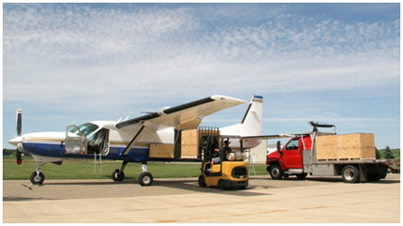
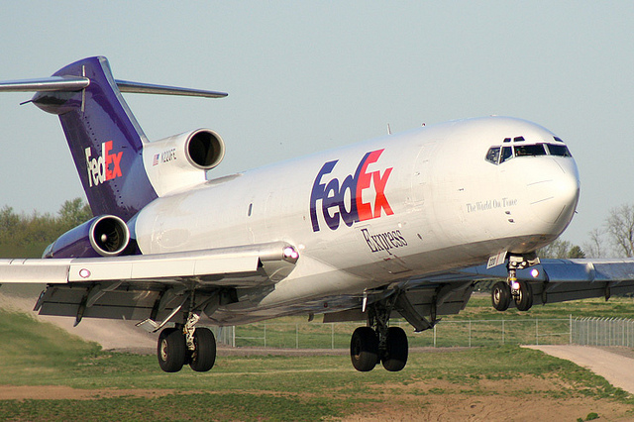
Representing the interests of all public use airports in Iowa
Cargo Industry

Slide 7
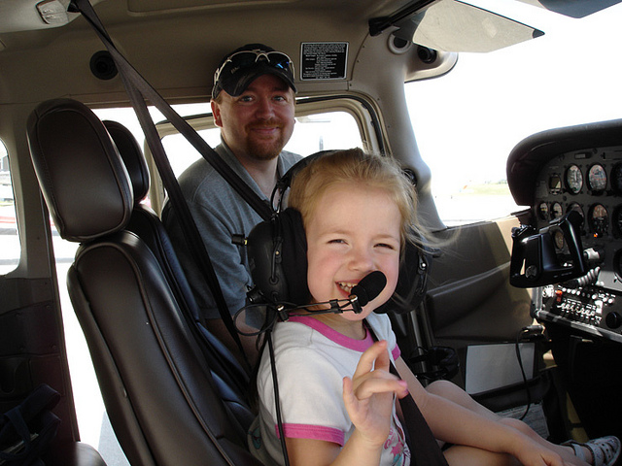
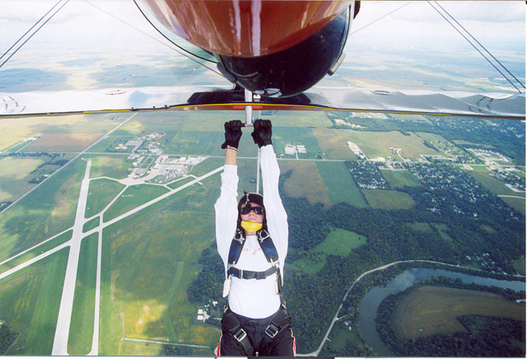
Representing the interests of all public use airports in Iowa
Recreation

Slide 8
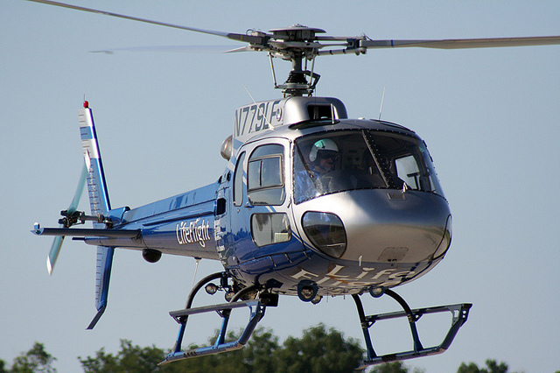
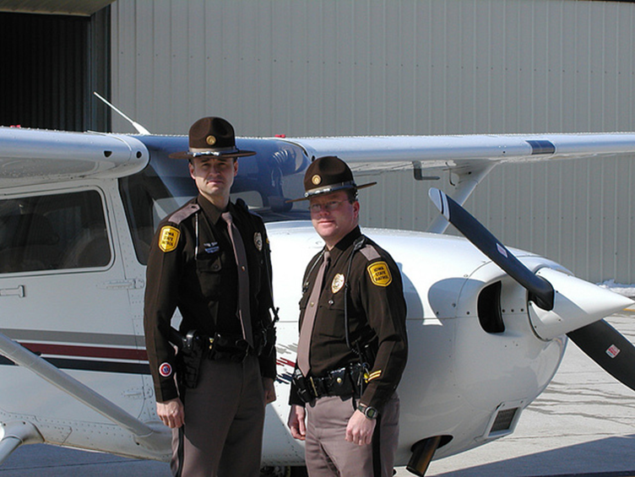
Representing the interests of all public use airports in Iowa
Iowa’s EMS Helicopters
Iowa State Patrol’s
Air Wing Division

Slide 9
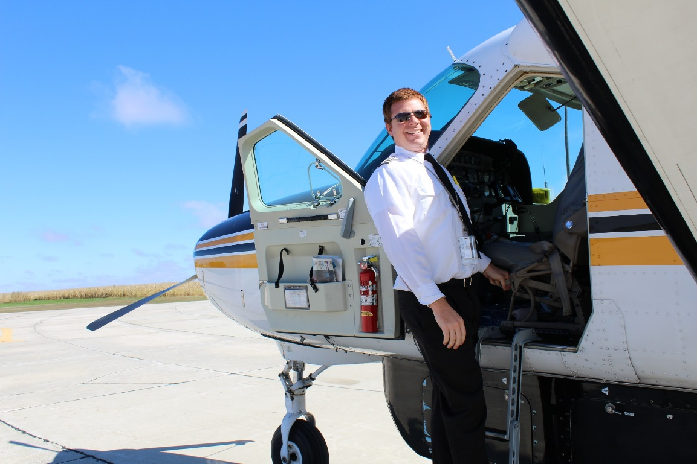
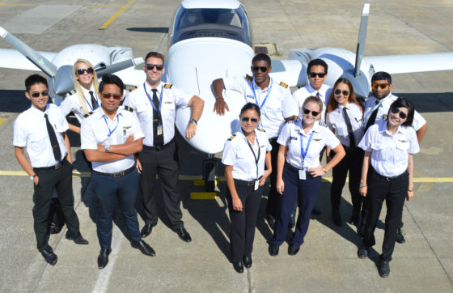
Representing the interests of all public use airports in Iowa
Pilots
Aviation Schools

Slide 10
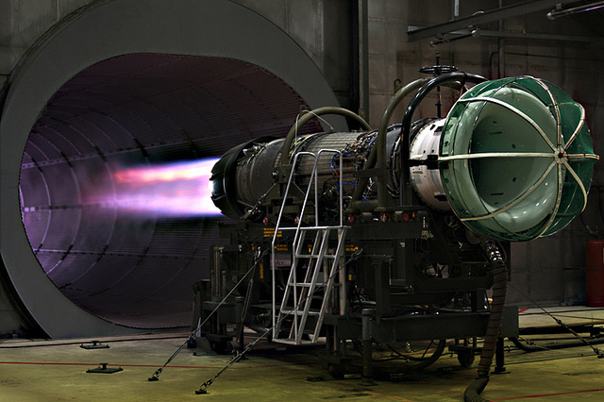
Representing the interests of all public use airports in Iowa
Aerospace Information Technology

Slide 11
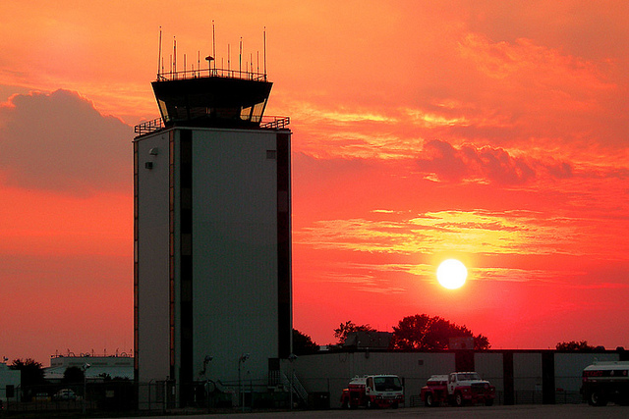
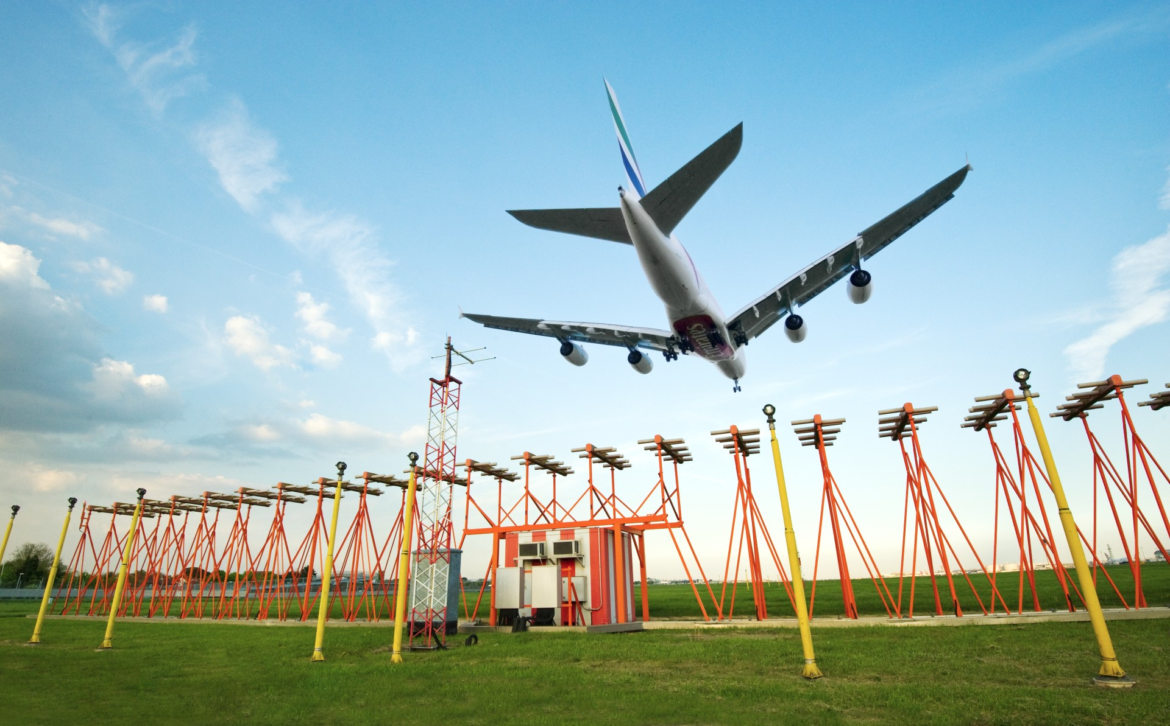
Representing the interests of all public use airports in Iowa
Air Traffic Controllers
Navigation Technicians

Slide 12
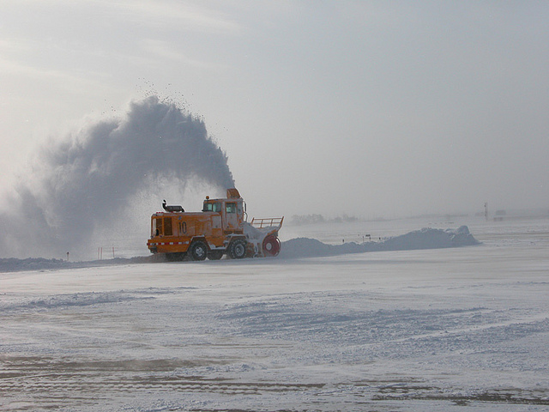
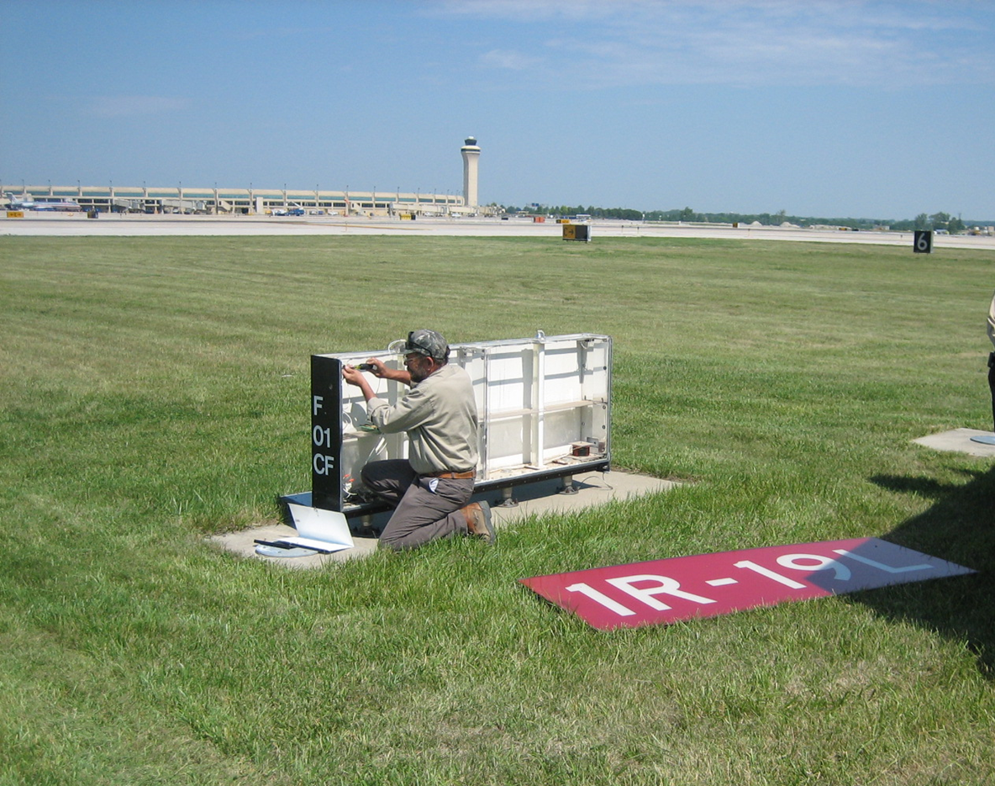
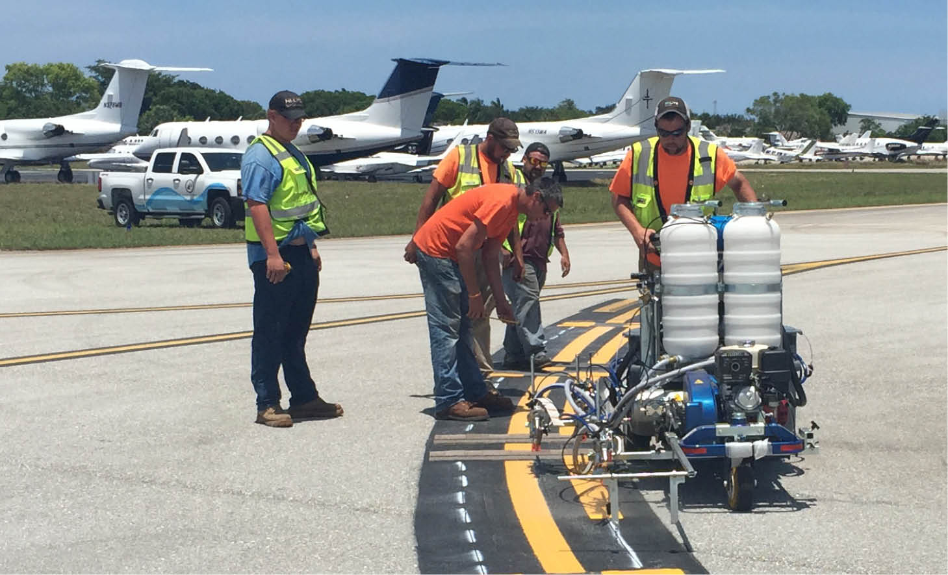
Representing the interests of all public use airports in Iowa
Airport Management, Airfield Operations & Maintenance

Slide 13
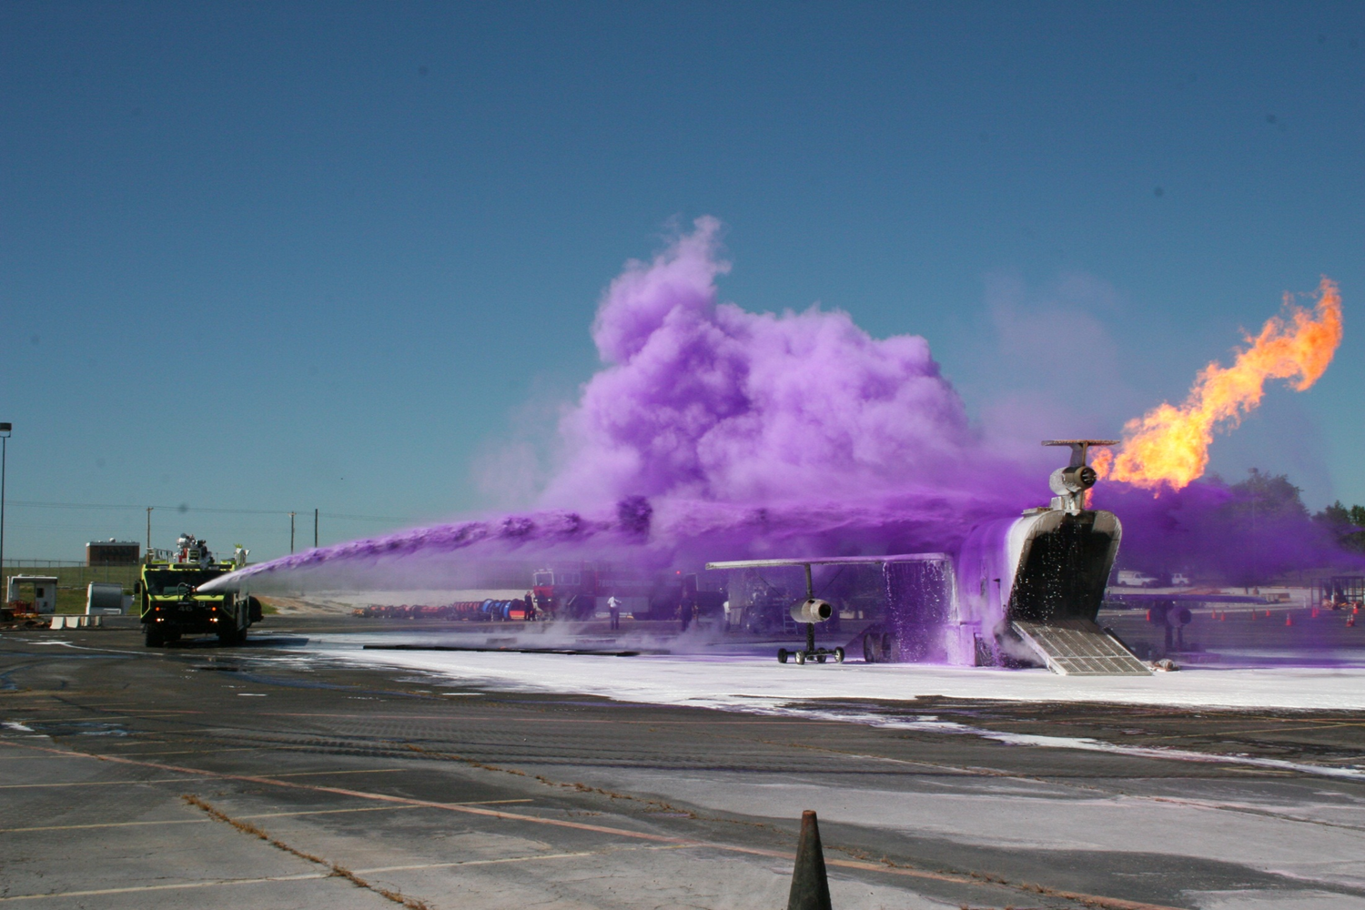
Representing the interests of all public use airports in Iowa
Aircraft Rescue & Firefighting-Emergency Responders

Slide 14
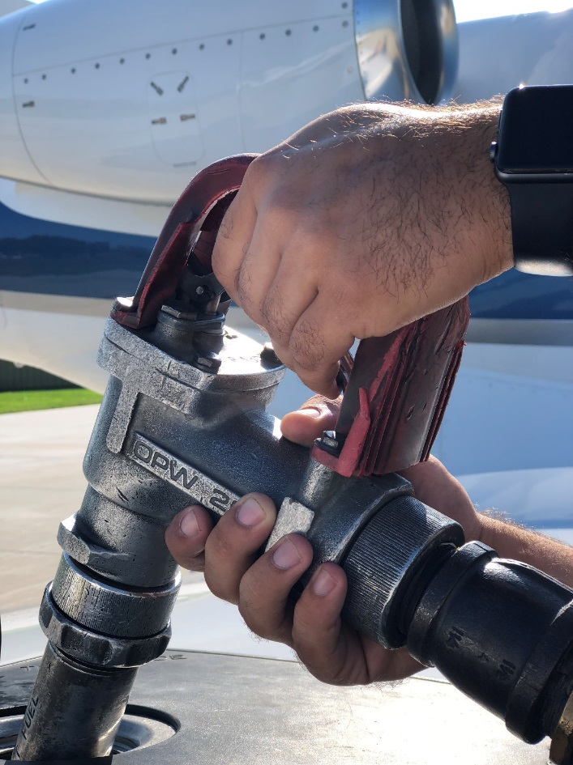
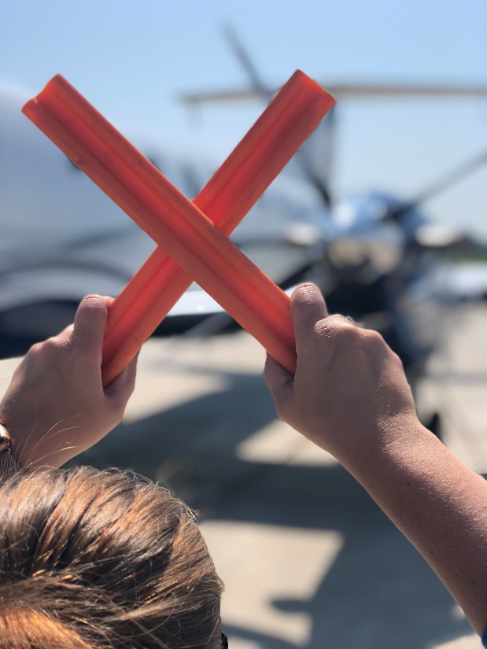
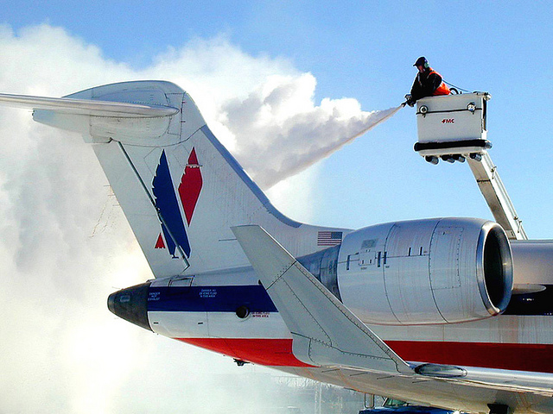
Representing the interests of all public use airports in Iowa
Fueling Services
Ground Handling
De-Icing

Slide 15
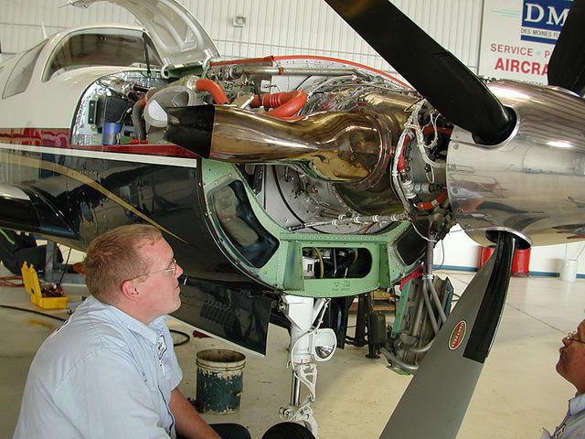
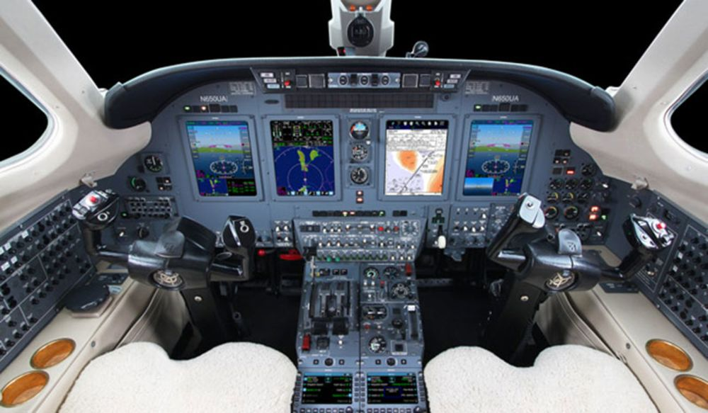
Representing the interests of all public use airports in Iowa
Aircraft Maintenance & Avionics

Slide 16
Office of Aviation
2019 Airport Programs
Airport Improvement Program - $4,616,091
Funded through the State Aviation Fund
Vertical Infrastructure Programs - $2,231,990
Commercial Service - $1,500,000
General Aviation - $731,990

Slide 17
Representing the interests of all public use airports in Iowa
FY 19-20 Airport Vertical Infrastructure Needs: $80 Million
Current Funding: $2.2 Million per year
Airport Infrastructure Reinvestment for Iowa
(AIR-Iowa)
10-Year Program – $16.5 Million per year

Slide 18
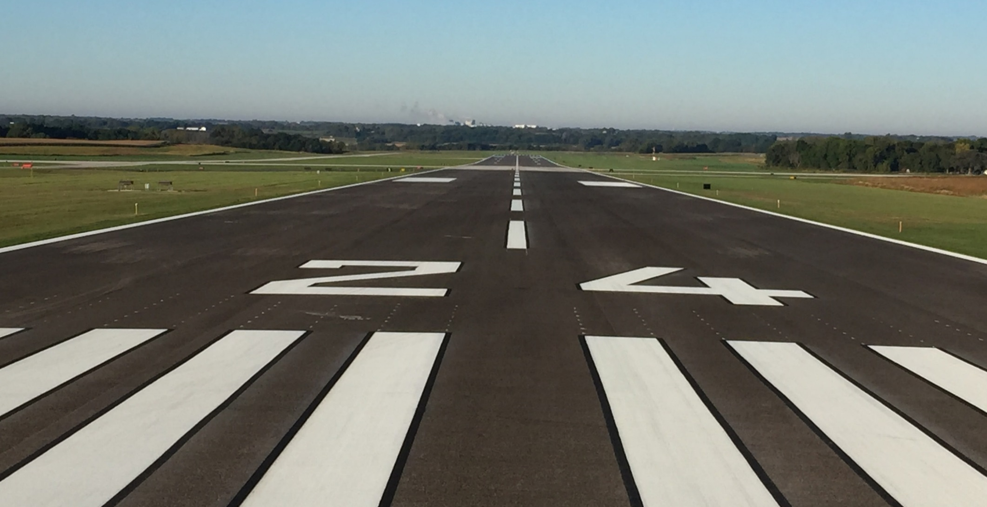
Representing the interests of all public use airports in Iowa
MOST IMPORTANT MAIN STREET
In conclusion…

Slide 19
Representing the interests of all public use airports in Iowa
Thank you!!

