Slide 1

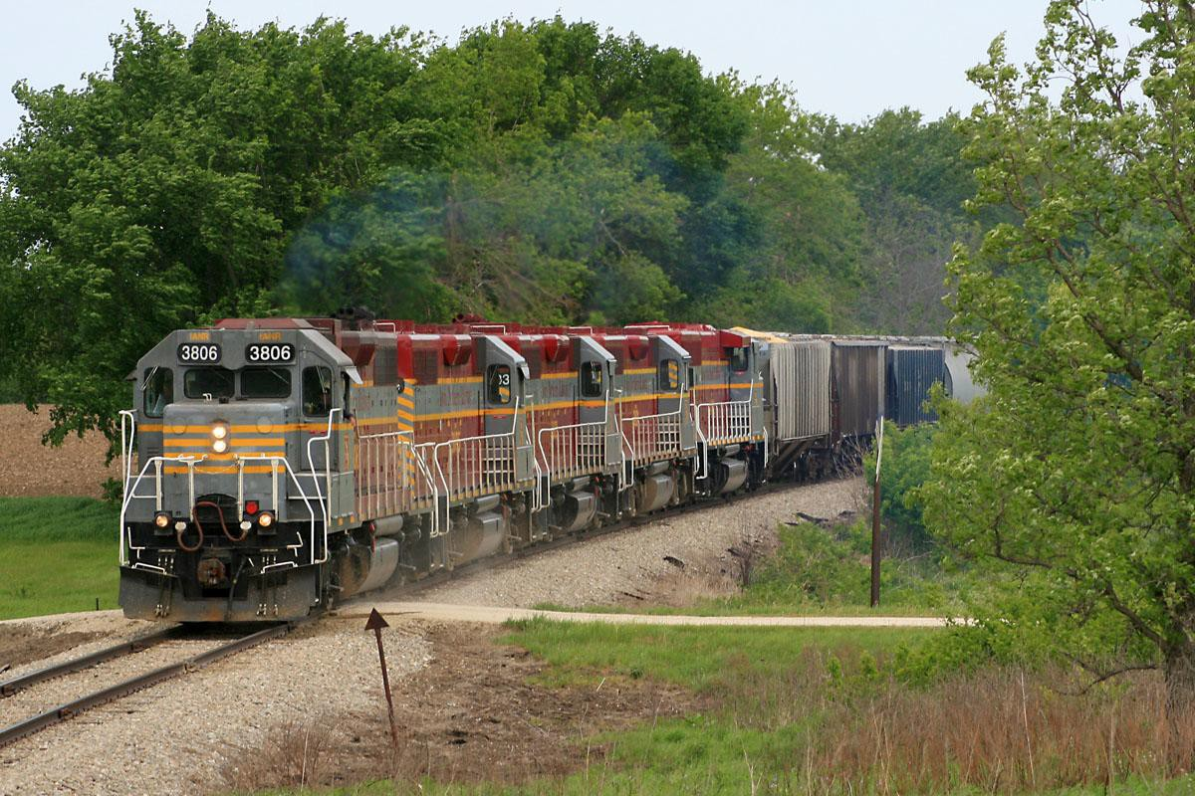
IOWA’S SHORT LINE RAILROADS -
THE NOT SO LITTLE ENGINES THAT CAN

Slide 2
IOWA HAS 3,905 MILES OF RAILWAY TRACK
SERVED BY FIVE CLASS I RAILROADS
BNSF Railway
Canadian National
Canadian Pacific Railway
Norfolk & Southern Railway
Union Pacific Railroad

Slide 3
IOWA HAS 12 CLASS II AND CLASS III RAILROADS
Iowa Interstate Railroad (368 miles)
Iowa Northern Railway (254 miles)
Cedar Rapids and Iowa City Railway (CRANDIC) (60 miles)
Appanoose County Community Railroad (35 miles)
D & I Railroad (39 miles)
Boone & Scenic Valley Railroad (12 miles)
Burlington Junction Railway (12 miles)
CBEC Railway (5 miles)
Iowa Traction Railroad (10 miles)
Iowa River Railroad (9 miles)
Keokuk Junction Railway (8 miles)

Slide 5
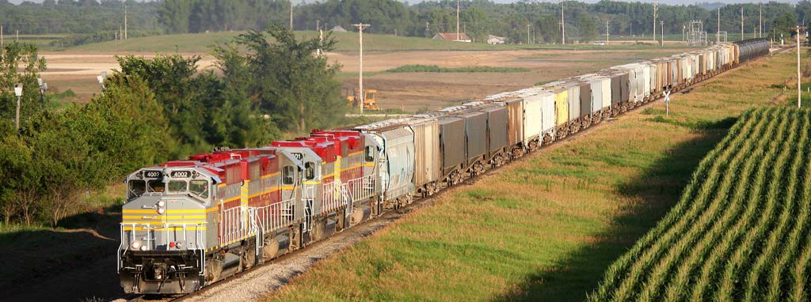

Slide 6
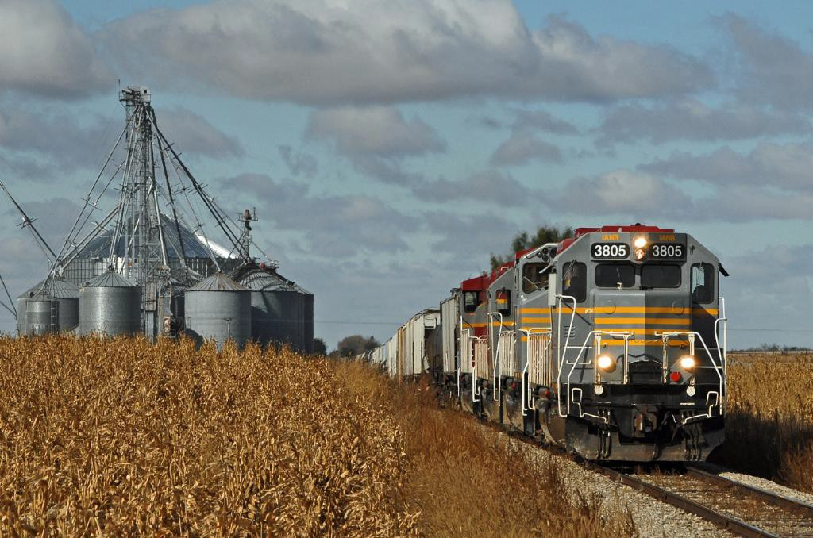
THREE MAJOR SOURCES OF U.S. JOBS ARE RELIANT ON SHORT LINES – AGRICULTURE, MANUFACTURING AND MINING

Slide 7
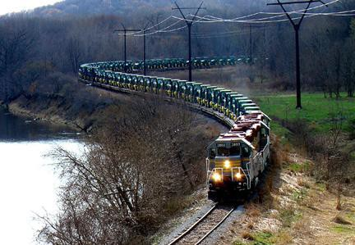
AMERICAN SHORT LINE RAILROAD CUSTOMERS PROVIDE *478,820 JOBS
* $26.1 BILLION IN LABOR INCOME
*$56.2 BILLION IN ADDED VALUE TO THE U.S. ECONOMY

Slide 8
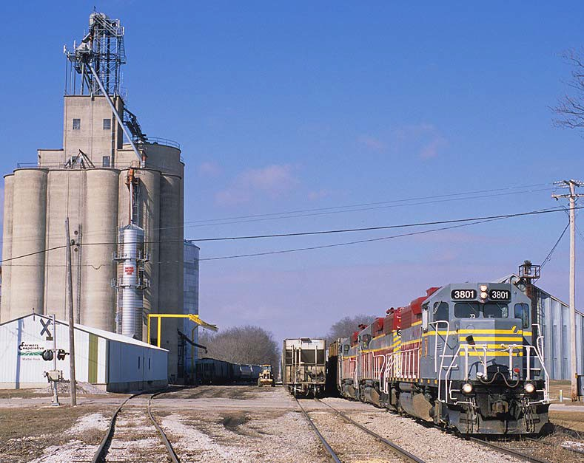
SHORT LINES OPERATE ACROSS THE ENTIRE COUNTRY, MAINLY IN RURAL AREAS, AND DIRECTLY EMPLOY OVER 17,100 PEOPLE

Slide 9
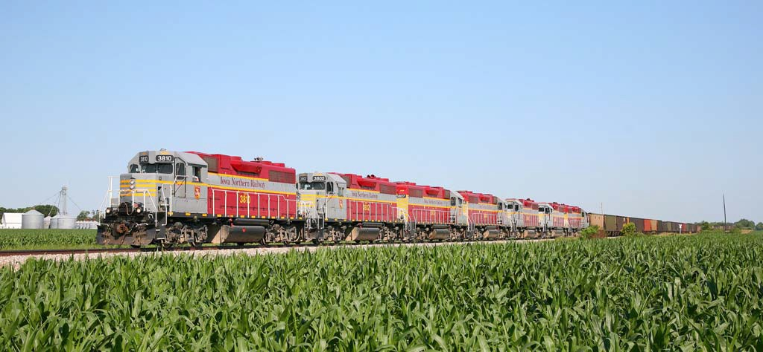
IOWA SHORT LINES EMPLOY OVER 450 F/T EMPLOYEES

Slide 10
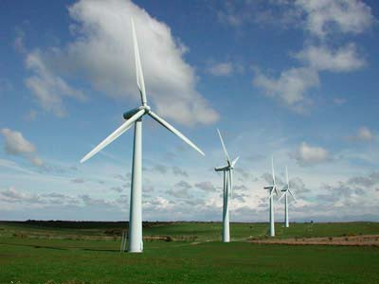
IOWA SHORT LINES –
HOMETOWN INDUSTRIAL DEVELOPERS

Slide 11
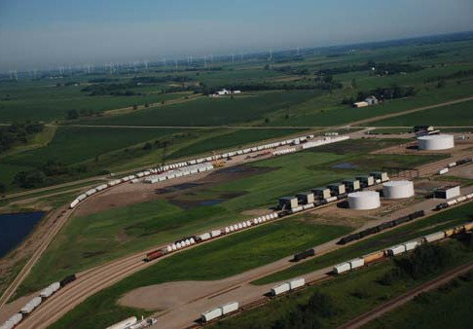
MANLY TERMINAL – MANLY LOGISTICS PARK

Slide 12
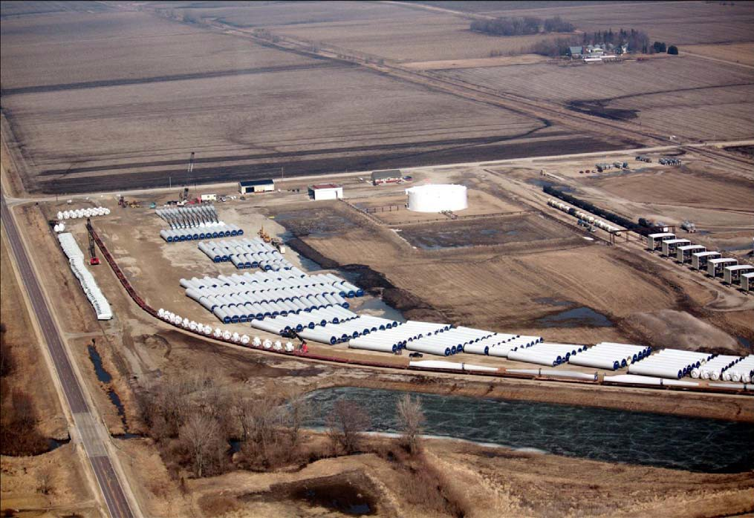

Slide 13
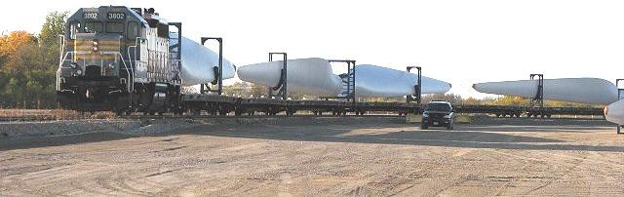
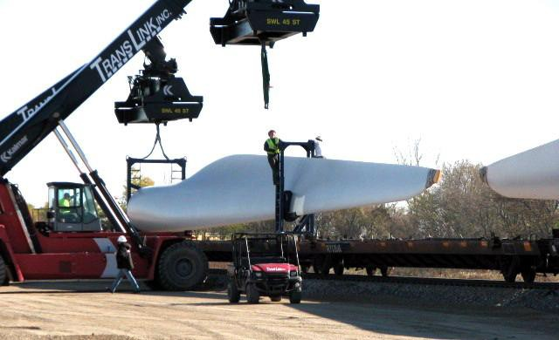

Slide 14
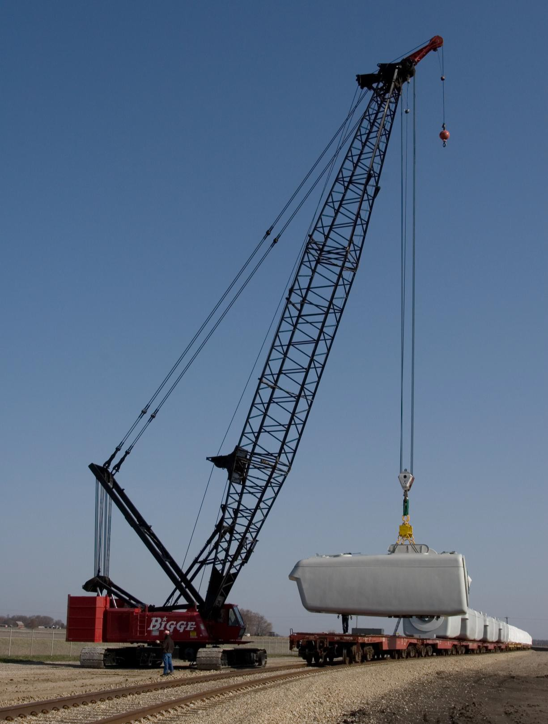
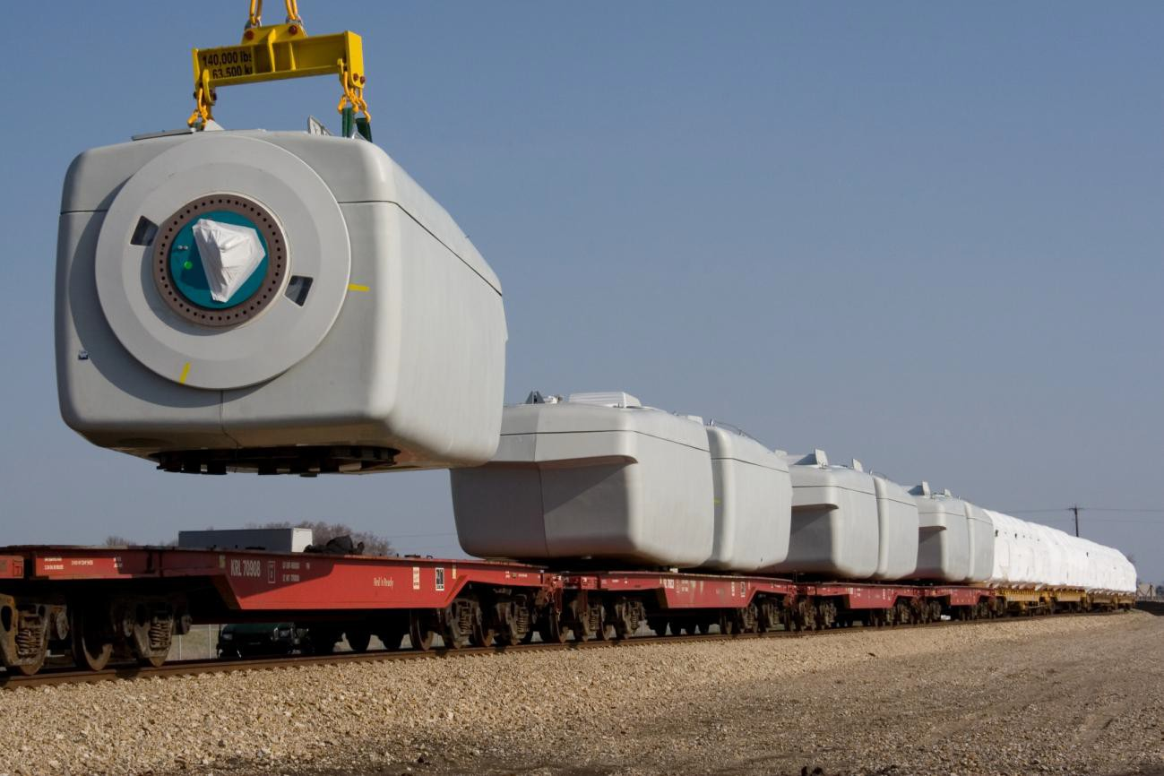

Slide 15
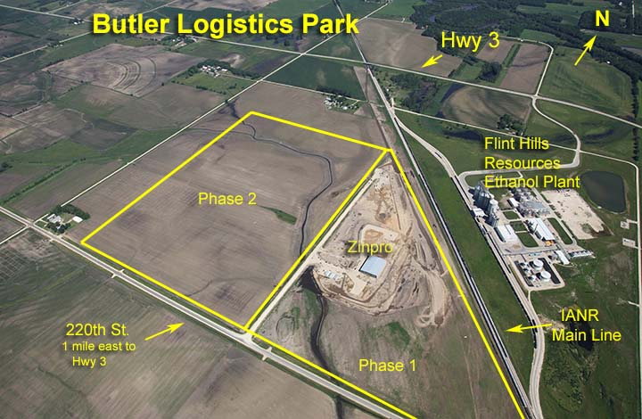
SHELL ROCK - BUTLER LOGISTICS PARK
(IOWA NORTHERN)

Slide 17
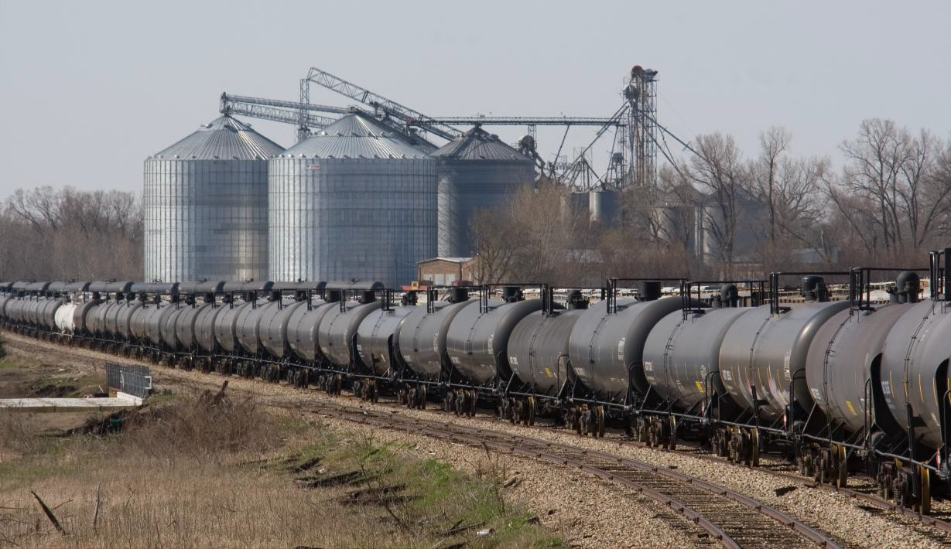
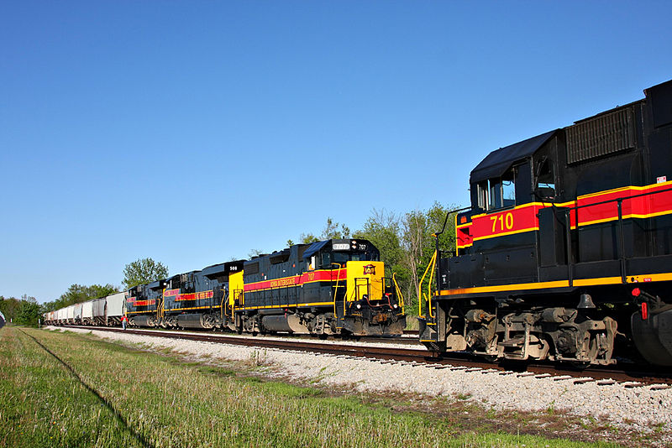
CORN (& ETHANOL) ARE STILL KING

Slide 18
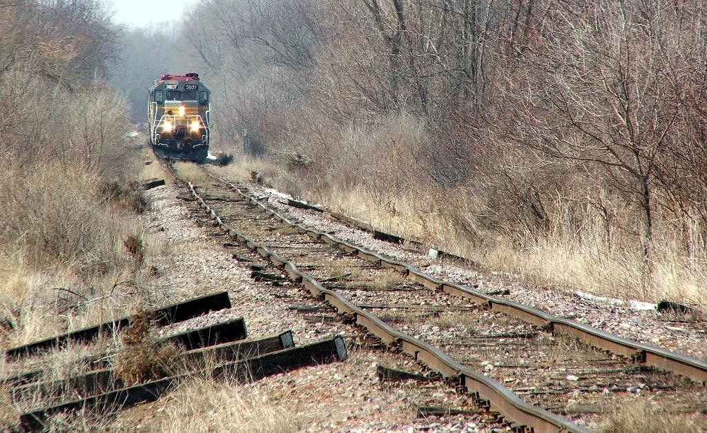
CONTINUAL REINVESTMENT
CONTINUAL IMPROVEMENT
FROM THIS:

Slide 19
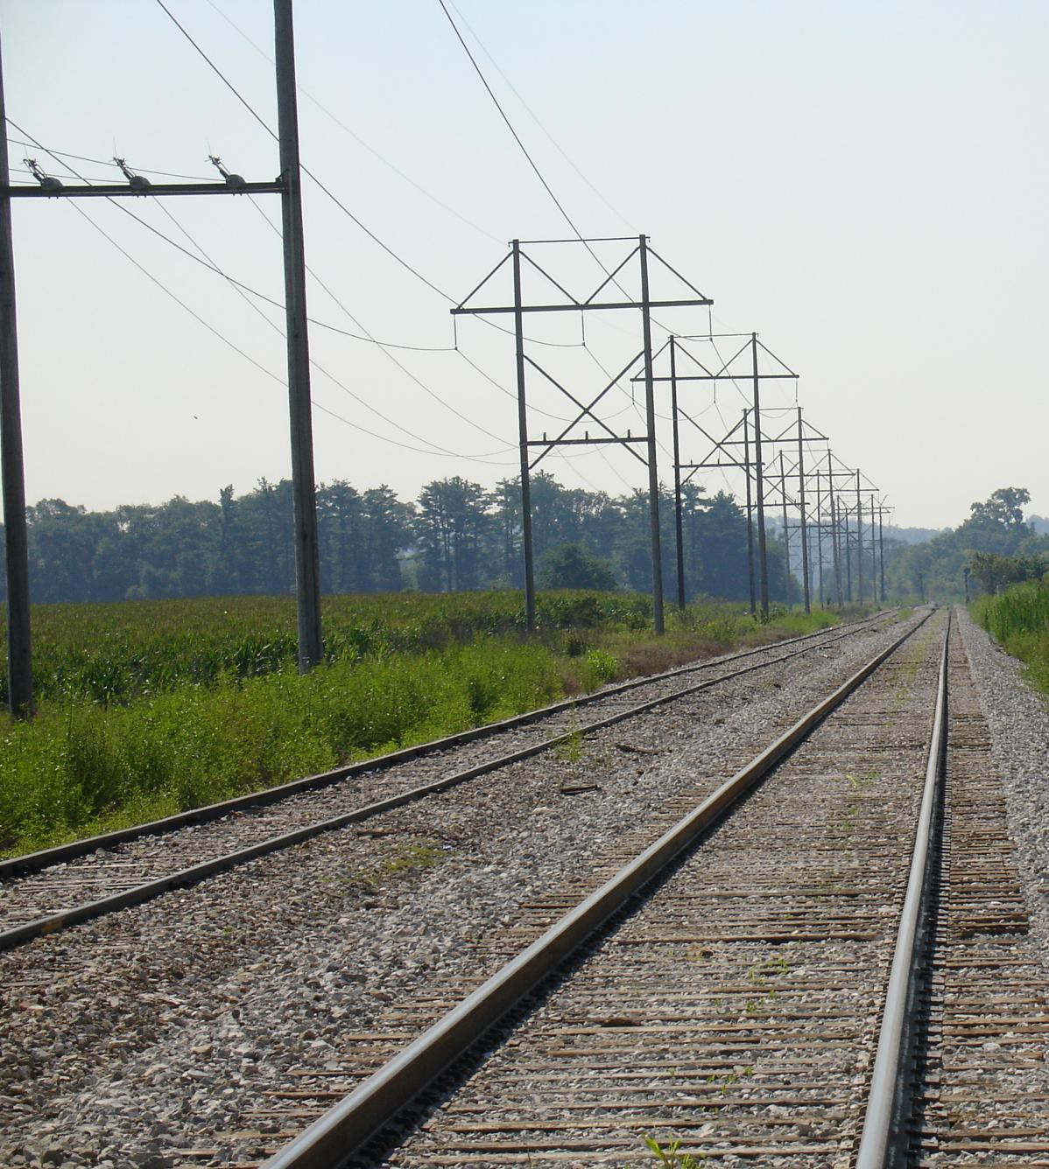
TO THIS:

Slide 20
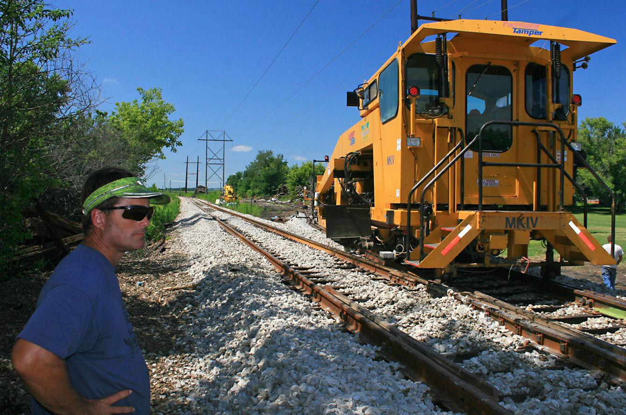
IOWA SHORT LINE RAILROADS TYPICALLY INVEST 25 TO 30 PERCENT OF REVENUES IN MAINTAINING & IMPROVING TRACK INFRASTRUCTURE

Slide 21
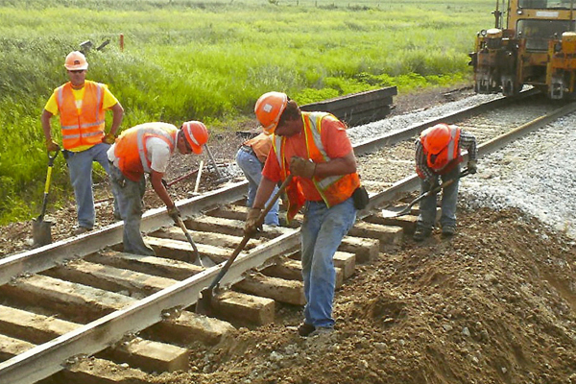
SINCE THE 2004 ENACTMENT OF THE U.S SHORT LINE TAX CREDIT, TRAIN DERAILMENTS ON SHORT LINES HAVE DECLINED BY 50 PERCENT (FRA)

Slide 22
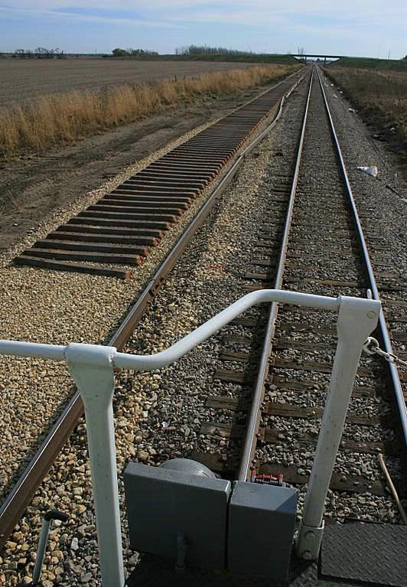
ALL IOWA RAILROADS SPEND OVER $265 MILLION ANNUALLY IN CAP EX -
AN AVERAGE OF OVER $62,000 PER MILE

Slide 23
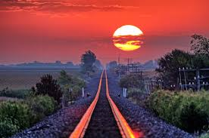
WITHOUT STATE SUPPORT MANY IOWA SHORT LINES WOULD NOT EXIST
Between 1983 and 2009 the Iowa DOT and Iowa Railway Finance Authority loaned over $25 million to help new Short Lines purchase over 650 miles of abandoned rail lines from Class 1 carriers.
Every dollar was repaid.

Slide 24
NEW STATE PROGRAMS HAVE HELPED TO REBUILD IOWA RAIL LINES
The Iowa Rail Revolving Loan/Grant Program since 2006 has awarded over $43 million to spur rail-related economic expansion. Matched over $111 million of private investment by Short Lines and industries.
Led to over 2,000 new/retained jobs.
More recently the Linking Iowa’s Freight Transportation System (LIFTS) is helping to spur improvements in new freight intermodal projects.

Slide 25
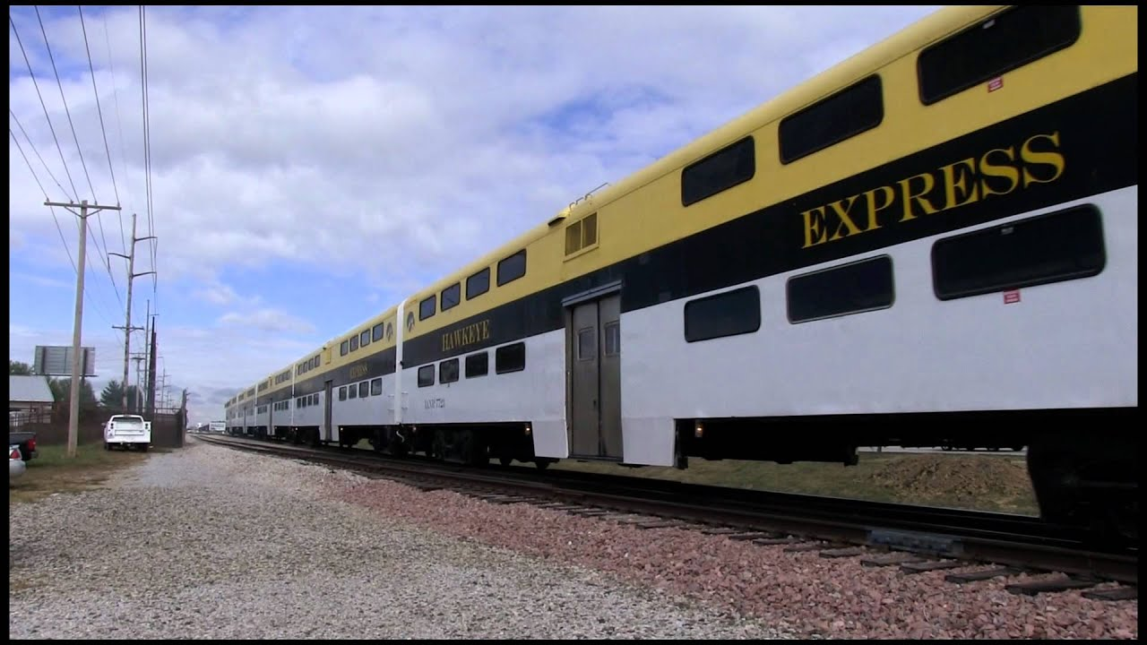
IOWA’S SHORT LINES DO SOME FUN RAILROADING TOO!

Slide 26
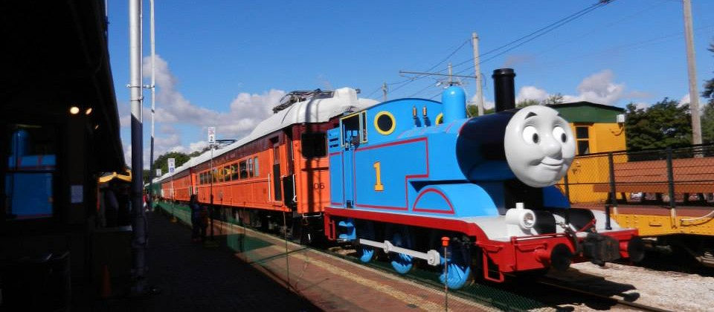
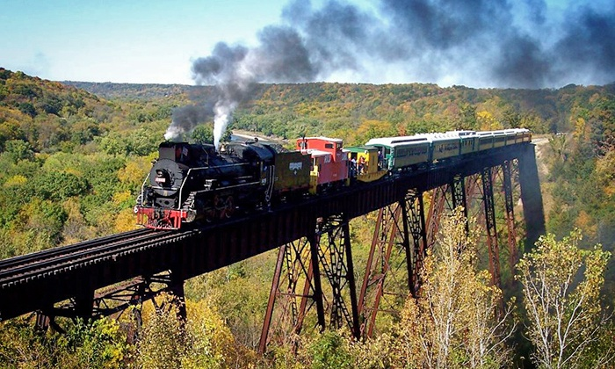
BOONE & SCENIC VALLEY

Slide 27
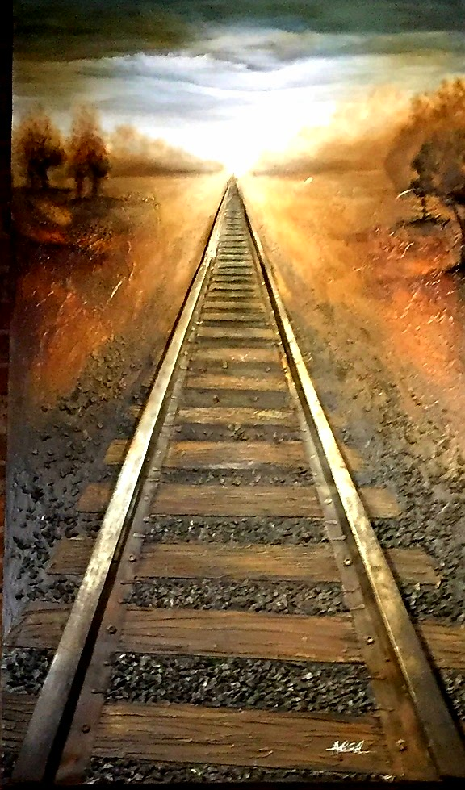
THANKS FOR LISTENING!

