Slide 1
Iowa’s Scenic Byways
Created by the Byways of Iowa Coalition
for the Iowa Transportation Commission
February 12, 2019
Notes:
Thank You for allowing us to share a little about the Iowa’s Scenic Byways and their importance to their region and communities they showcase to fellow Iowans and visitors alike.

Slide 2
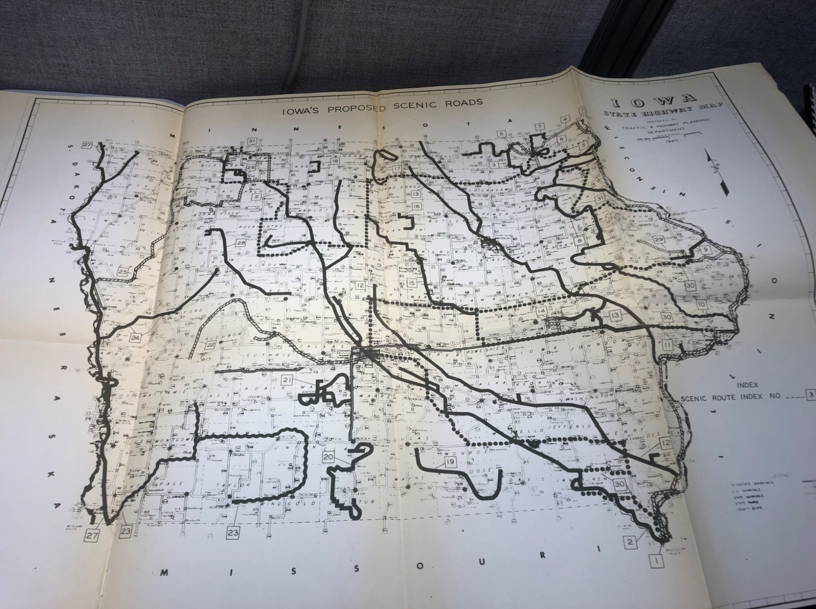
1965
Notes:
The idea for a Byway program began in 1965 when a report on Scenic Highways was prepared by the Iowa Highway Commission in cooperation with the Bureau of Public Roads. From the report, “The Highway Commission solicited information from 284 governmental organizations for the study. The group included 99 County Engineers, 99 County Board of Supervisors, and the 83 Boards of County Conservation. The Governor’s Committee on outdoor recreation and the Iowa Development Commission also cooperated in this report. The question of what is scenic varied across the State. But a general agreement was that a scenic highway should provide a change of pace from what a person normally encounters, yet the route should have a change in pace within itself.” This report is located at the DOT headquarters in Ames.

Slide 3
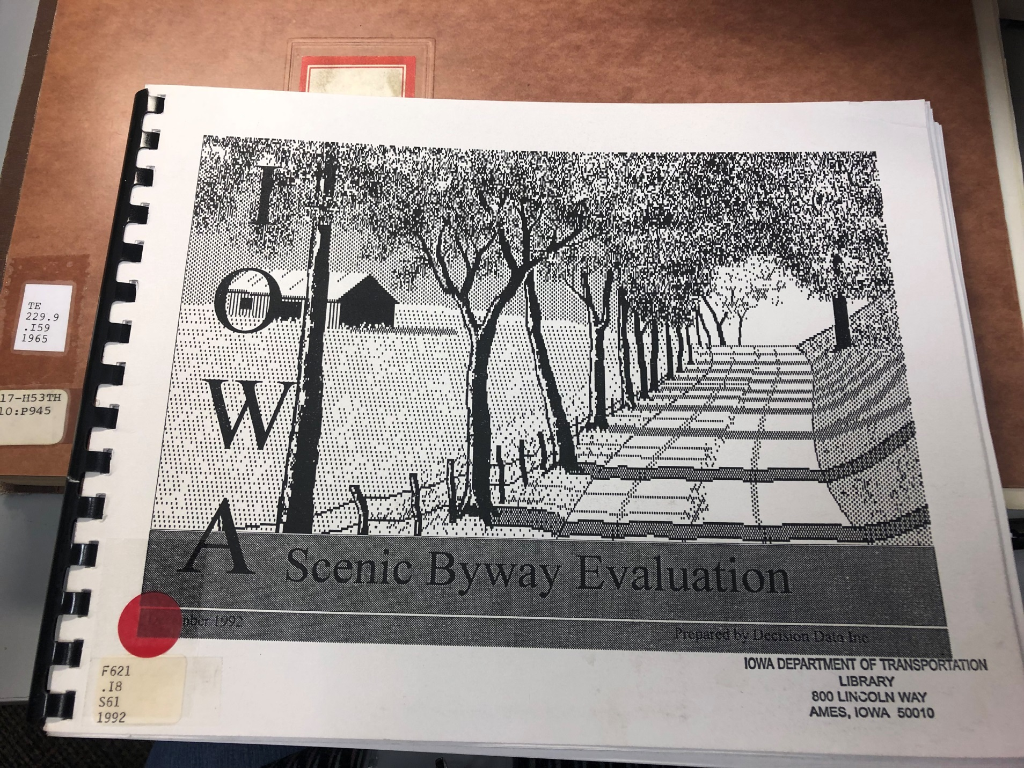
1992
Notes:
Then the idea of Scenic Byways in Iowa was revisited in 1992. The Iowa Highway Commission had been renamed the Iowa Department of Transportation and they “entered into a contract with Decision Data from Topeka, KS to inventory and evaluate some 1,650 miles of locally nominated roads and highways (state, local, paved and unpaved) for inclusion in Iowa’s pilot scenic highways (byways) project. The Scenic Byway Evaluation project and the contract were in response to the 1987 Iowa legislation concerning pilot scenic highway routes and the Department of Transportation Duties.” “The Iowa DOT program objective was ‘to identify four pilot scenic highway routes across two or more counties each for trial promotion in the state’s tourism marketing program.”

Slide 4
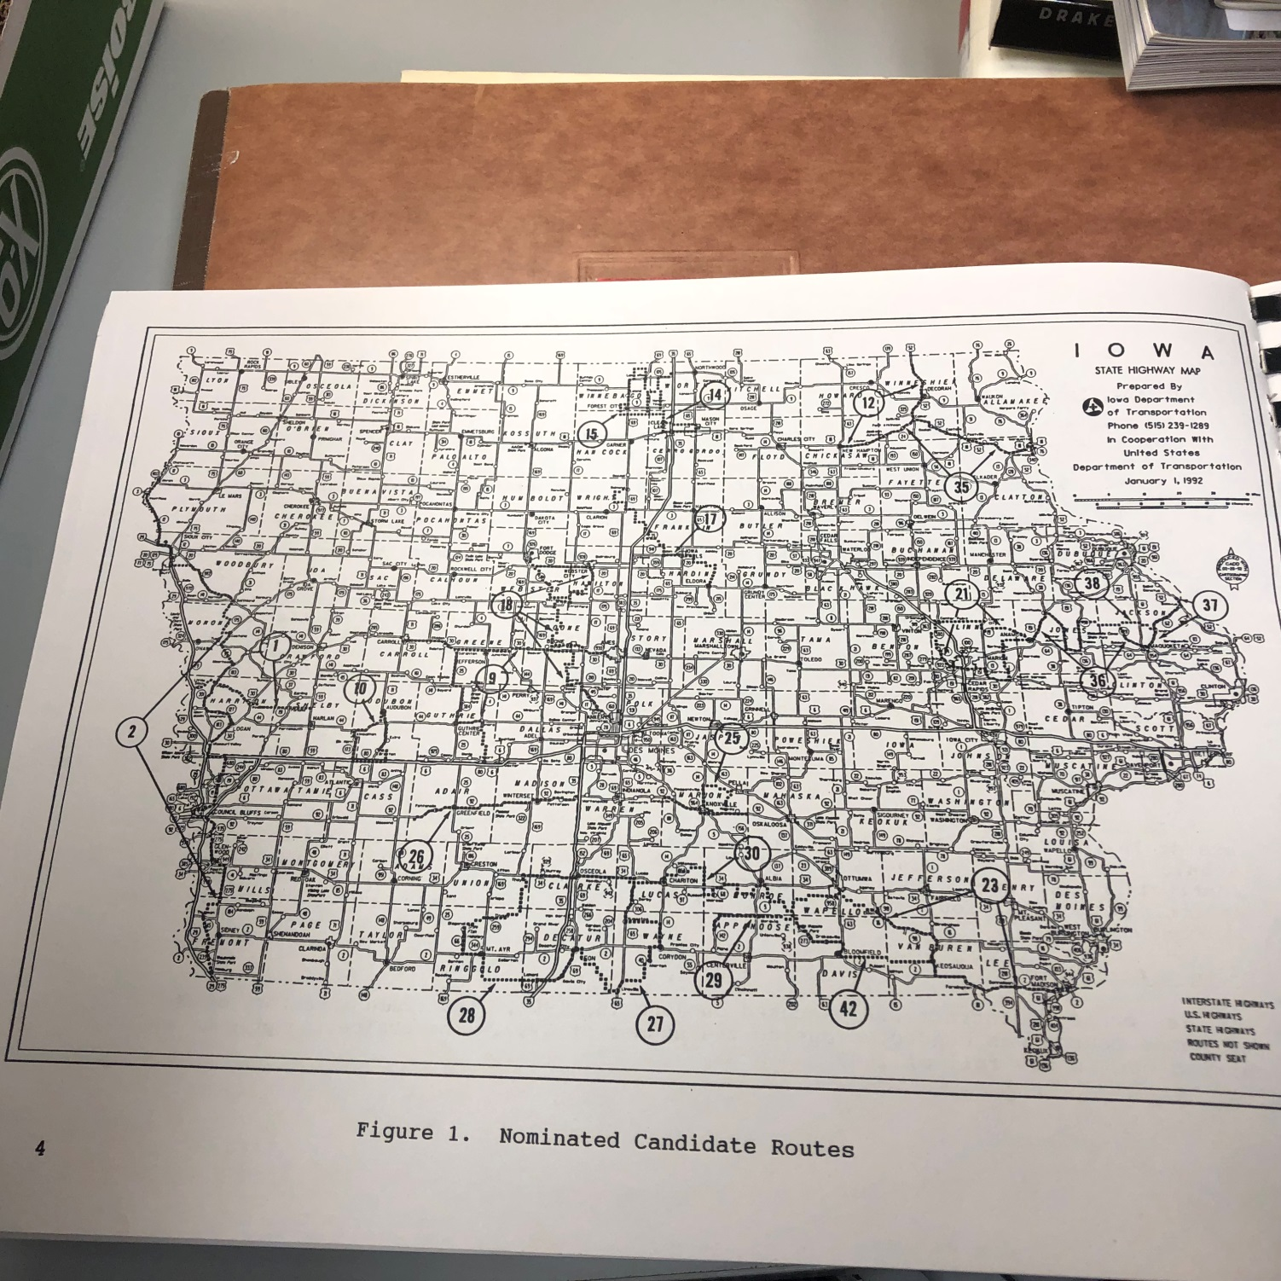
Selecting 4 Scenic Byways
Notes:
“In January of 1992, the Iowa DOT sent a letter to public road agencies requesting that they assist in identifying (nominating) candidate routes for possible designation as a pilot scenic highway route. The two-page letter included nomination instructions and sample criteria to be used in evaluating candidate routes and selecting the final four pilot routes.

Slide 5
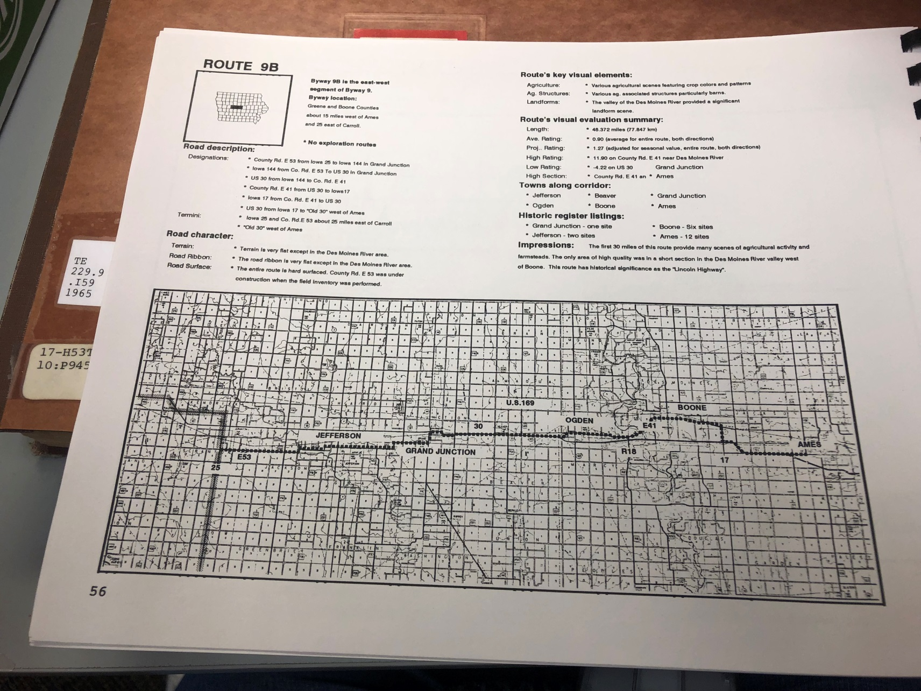
How to Evaluate?
Notes:
“The inventory and evaluation process was to be based on the Scenic Byways Research conducted in 1990-91 by Dr. Bob L. Smith, P.E. Professor of Civil Engineering, Kansas State University. The physical system used in both the research and project was an adaptation of the Route Inventory Management System developed by Decision Data. The research covered four principal issues necessary for a successful scenic byways program in a state or region. 1. SCENIC QUALITY, 2. ROAD SAFETY, 3. SCENIC BYWAY DESIGNATION, and 4. SCENIC BYWAY INFORMATION. A Scenic Byway was defined as “A scenic road or byway that has roadside or aesthetic, cultural, or historic value. An essential part of this road is its scenic corridor. The corridor may contain outstanding scenic vistas, unusual geological formations, dramatic urban scenes, scientific features or other elements all providing enjoyment for the highway traveler.”

Slide 6
The Original 4 Pilot Byways
Selected in 1992
Implemented in 1998
Notes:
These are the original 4 Scenic Byways- Grant Wood, Historic Hills, River Bluffs, and Western Skies.

Slide 7
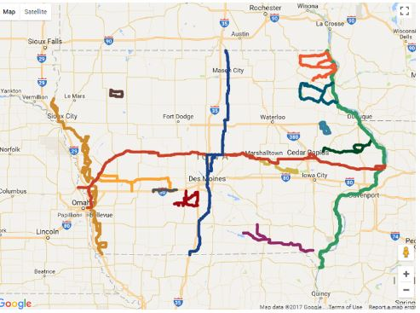
Today- Iowa’s 14 Byways
Notes:
Fast forward to 2019. Iowa now has 14 Byways. 2 are National Scenic Byways- Loess Hills along the Missouri River (tan) and the Great River Road along the Mississippi (green). 2 are Heritage Byways – the Lincoln and the Jefferson Highway that crisscross in the middle of Iowa (LH red, Jeff blue), the original 4- Western Skies (gold), Historic Hills SE Iowa (purple), River Bluff (turquoise), Grant Wood (deep green). The Driftless Area in the NE Corner(orange), Iowa Valley in Central Iowa (light tan), Glacial Trail in NW Iowa (brown), and Delaware Crossing (light blue circle off Highway 20) are joined by new Byways in 2018- White Pole Road (Brown line west of Des Moines) and Bridges of Madison County (burgundy). The Jefferson Highway already pointed out became a Byway in 2018 as well.

Slide 8
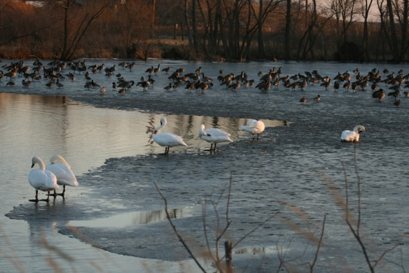
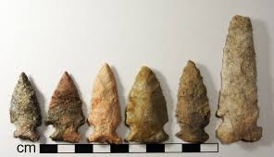
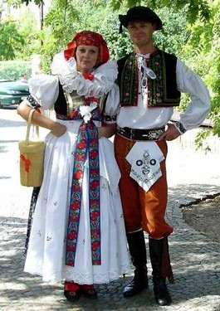
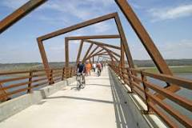
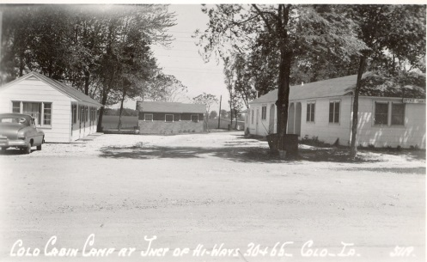
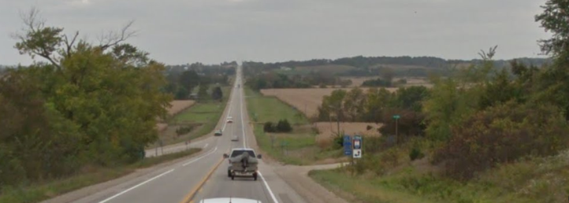
Six Intrinsic Qualities
Archaeological
Natural
Cultural
Recreational
Historical
Scenic
Notes:
Today, scenic byways are evaluated using 6 intrinsic qualities. The 6 qualities are Archaeological, Cultural, Historical, Natural, Recreational, and Scenic. All of Iowa’s Byways are considered “scenic”, but the Jefferson and Lincoln are labeled as “heritage” because of their high historical and cultural qualities.

Slide 9
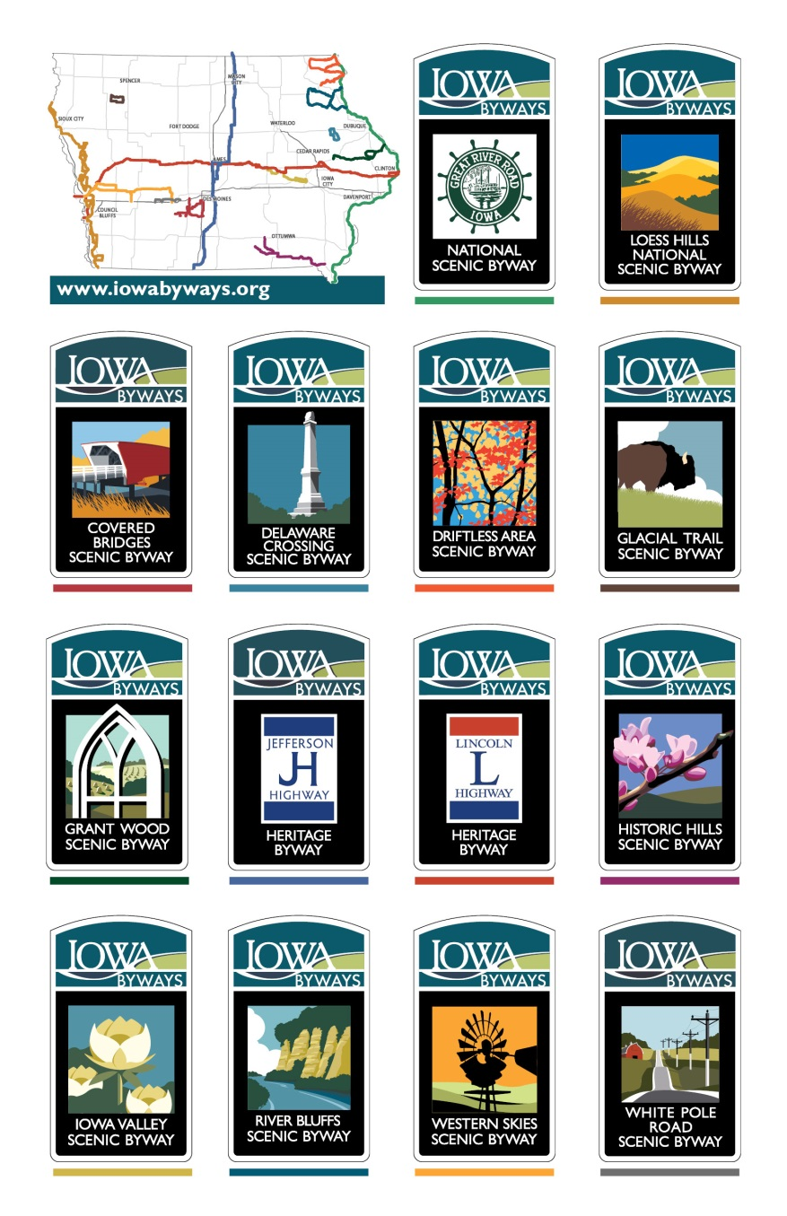
Iowa Byway Signage-
the GOLD Standard!
Notes:
All of the 14 Byways have had road signs developed to mark the routes. All of them have been installed except the Jefferson which will be done in 2019. The design has a uniform “Iowa Byway” logo at the top and the center graphic is unique for each. The name of the Byway is at the bottom. Byways in other states are very jealous of the Iowa signs and many are asking their DOTs to follow suit. In some states, their signs only have a graphic with no name, which leaves a visitor wondering what the sign should mean to them. Iowa can be VERY proud of signage.

Slide 10
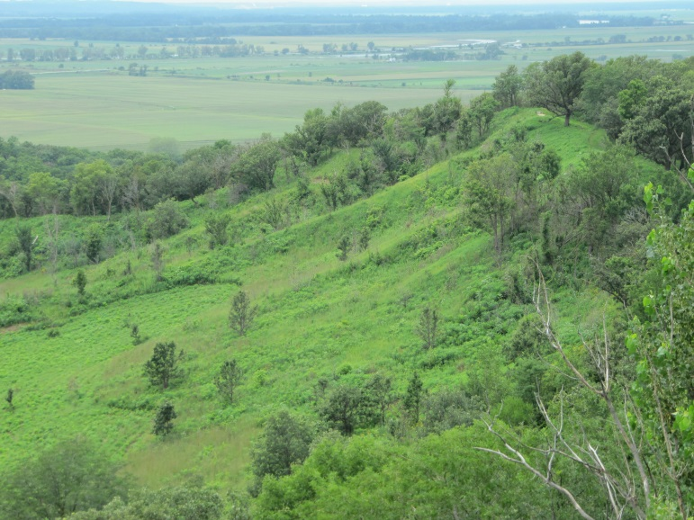
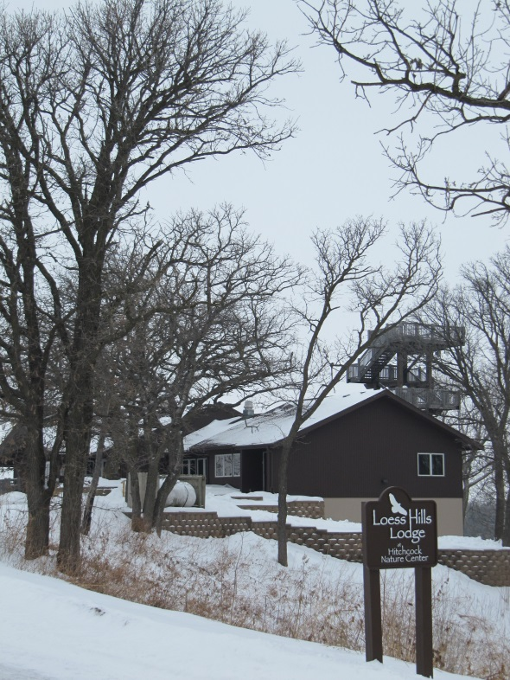
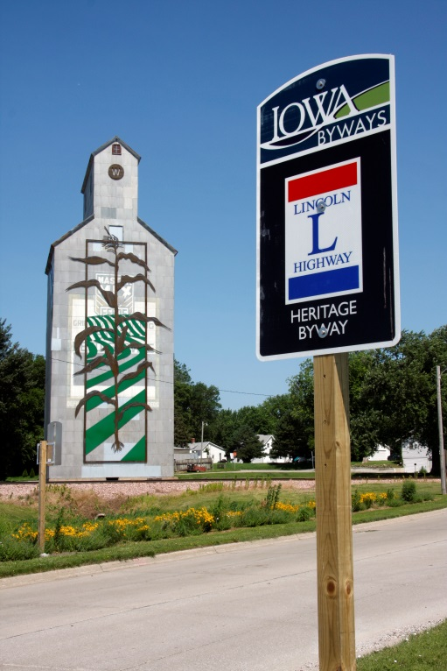
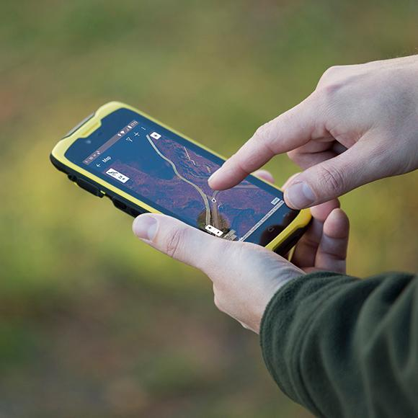
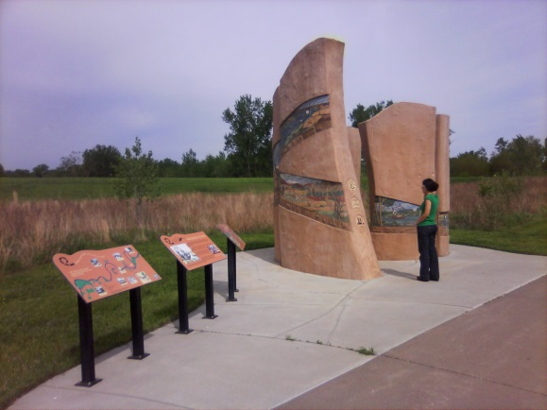
Resources Identified
and Points Collected
Photo Project
Photo by Mike Whye
Notes:
The first projects undertaken by the Byways were to identify their intrinsic quality resources and catalog them using GPS. Another project was having professional photographers document the resources visually. These photos have been used on websites, Facebook posts, and printed materials.

Slide 11
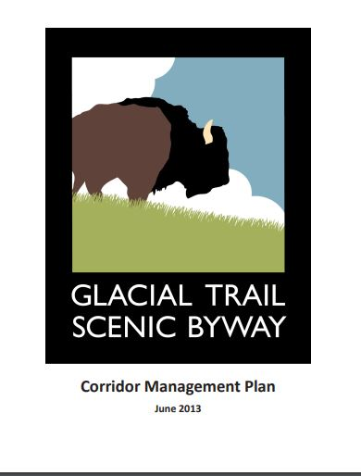
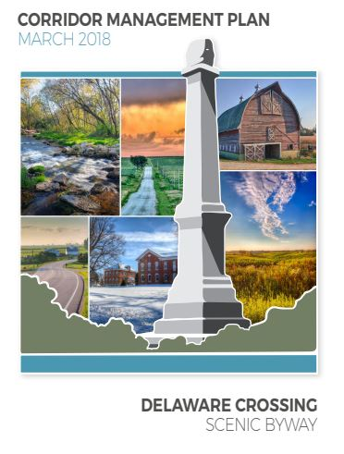
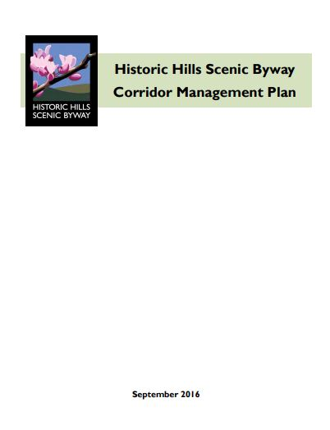
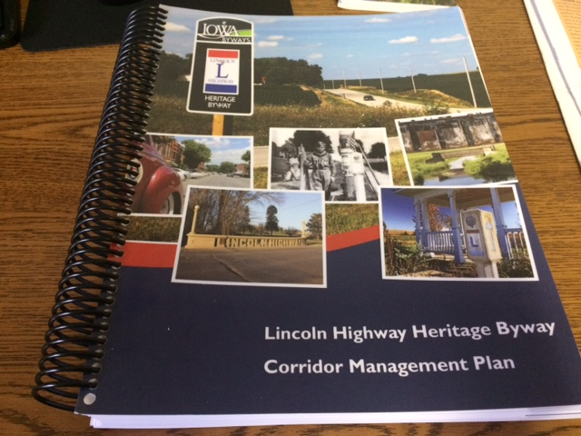
Corridor Management Plans
Notes:
Each Byway is required to create a Corridor Management Plan to showcase what is important to their Byway and identifies projects in each community that the Byway can either lead or partner with other organizations. Community input meetings were a large part of this process. The first 11 Byways have completed their plans and they are on file with the DOT (available on the DOT website.) The three new Byways- Covered Bridges, White Pole, and Jefferson do not have plans yet.

Slide 12
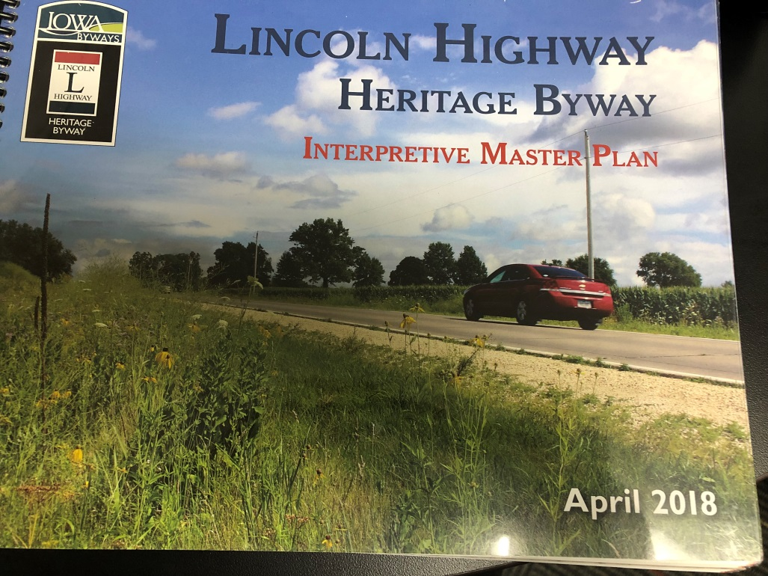
Interpretive Master Plan
Notes:
By 2018, the 11 Byways also had Master Interpretive Plans created through funding from the National Scenic Byway program. The 3 new byways do not have these documents yet.

Slide 13
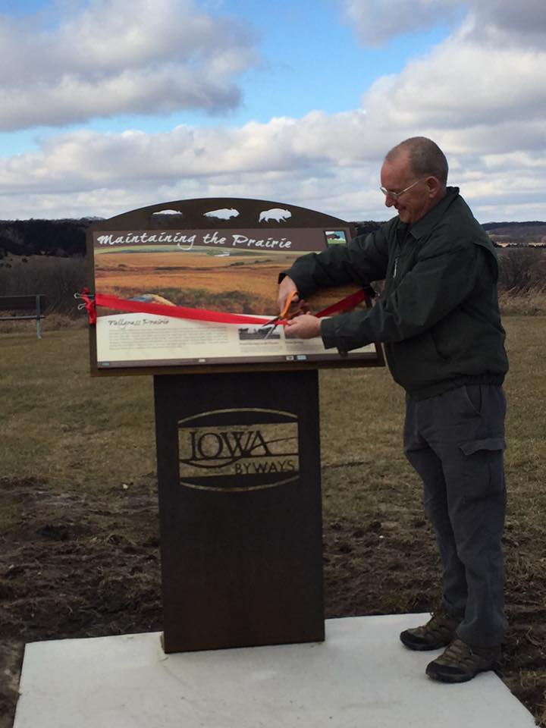
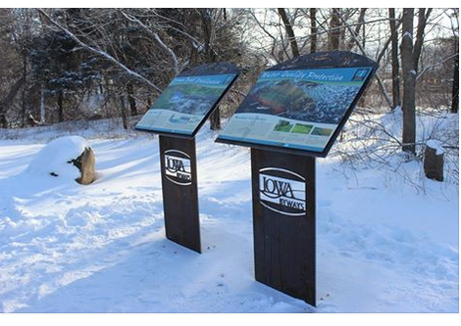
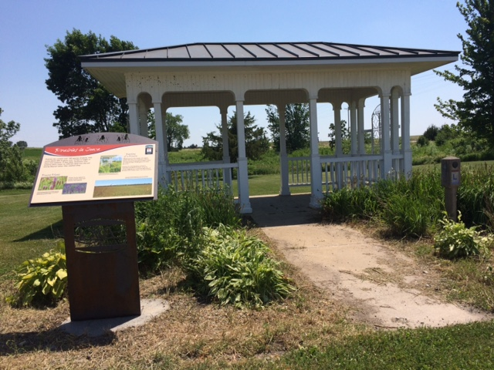
Collaboration
Interpretation
Notes:
Even before all the Byways had an interpretive plan, the 11 Byways completed a collaborative project for conservation-related interpretation. Each Byway created two panels. A uniform base design was created with the Iowa Byways logo at the bottom and each arched top has a unique series of 3 cutout designs. Through this project, the Byways saw the power of interpretation and what it can do for visitors, locations, and communities There is a great need for interpretation in Iowa.

Slide 14
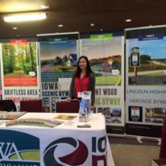
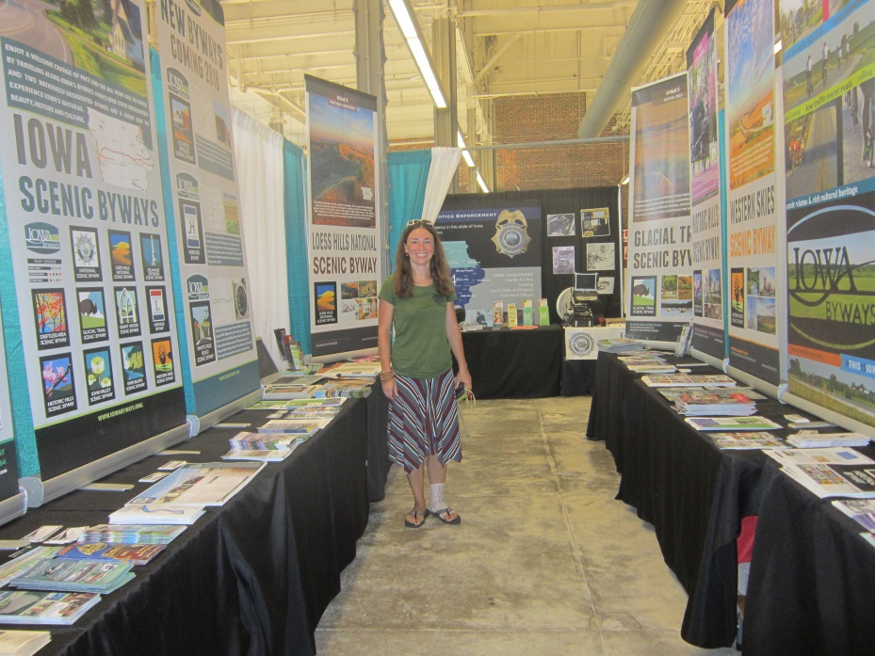
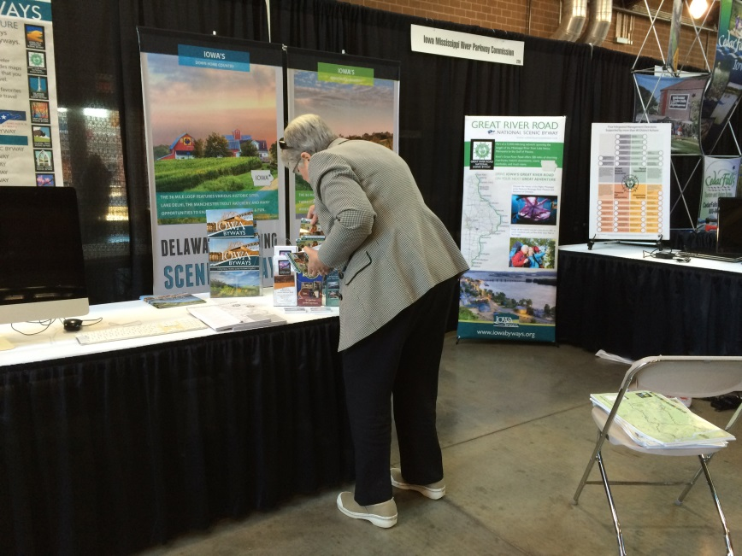
Collaboration
Motorcycle Forum
Events
State Fair
Legislative Day
Notes:
The Byways have also collaborated on events. We have participated in the Motorcycle Forum, Legislative Day, and manned a booth for 11 days at the Iowa State Fair. We also attend events in our own areas of the state.

Slide 15
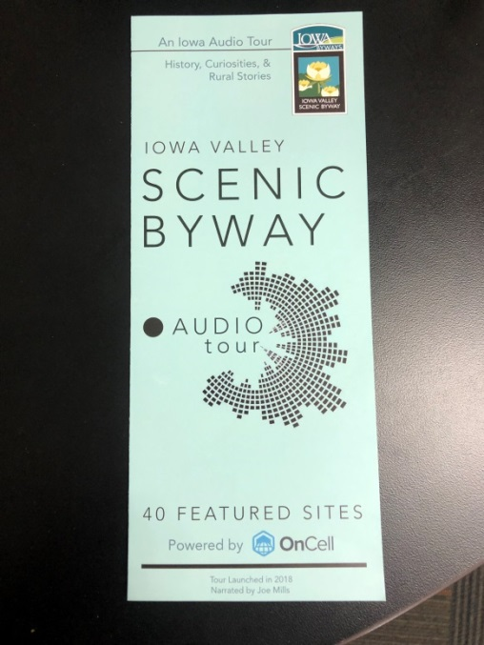
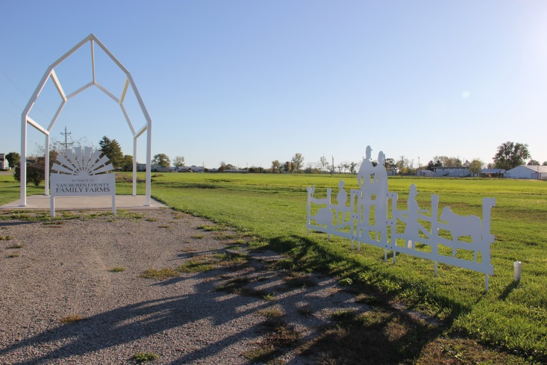
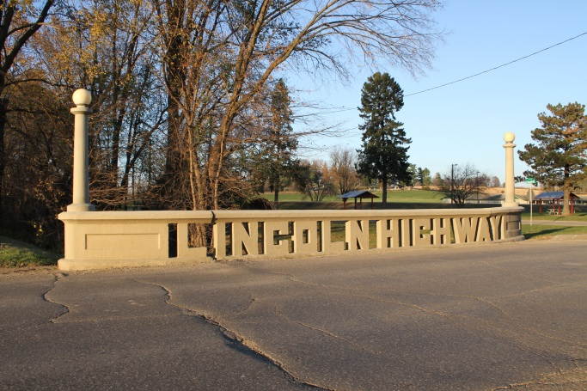
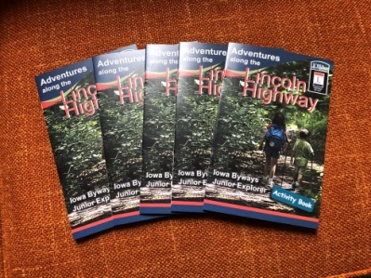
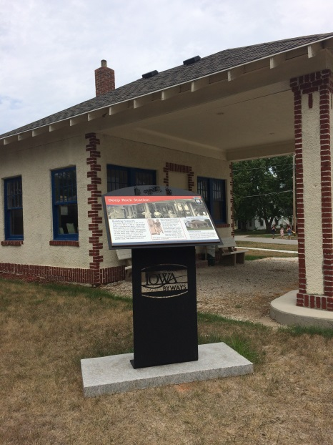
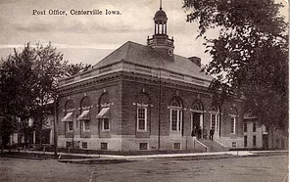
Unique Projects
Notes:
We also have developed unique projects for each Byway through our Corridor Management Plans and our varying levels of each intrinsic quality. Some of these are audio tours, art projects, restoring a historic bridge, further interpretation, community visioning, museum crawls, and themed publications.

Slide 16
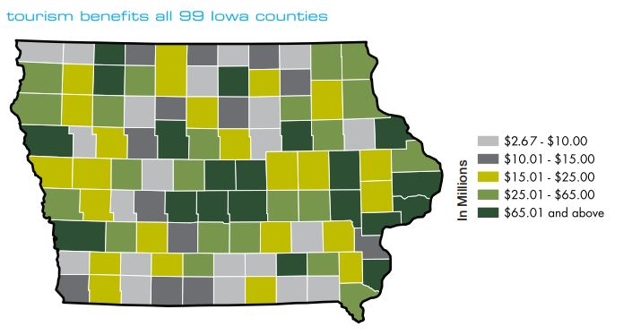
Tourism in Iowa
Notes:
From Travel Iowa’s 2017 Economic Impact Study, tourism benefits ALL 99 counties. The Byways work as a conduit in our areas to attract travelers to our communities.

Slide 17
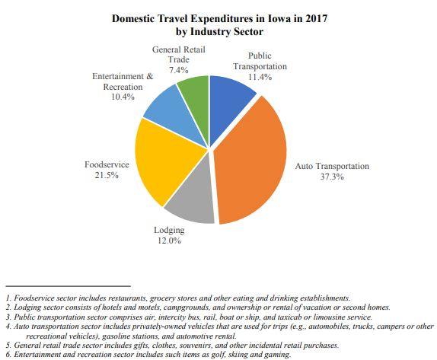
Top Sectors
Food
Lodging
Auto
Notes:
From U.S. Travel Association’s report created for Iowa Economic Development Authority and the Iowa Tourism Office, the three largest expenditures for travelers in Iowa are Food, Lodging, and Auto Expenses. Figures are from 2017. 2018 figures are not available yet.

Slide 18
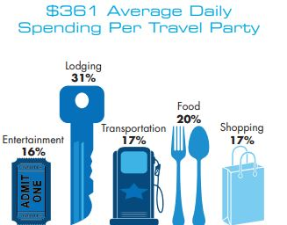
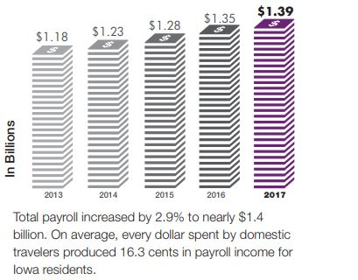
Spending
Translates Into
Payroll
Notes:
From information collected at Iowa Welcome Centers, the average spending by travel parties is $361 per day. The average traveling party is reported to be 2.5 people. From Iowa Tourism’s Economic Impact report, this spending on tourism created 1.39 billion in related payroll

Slide 19
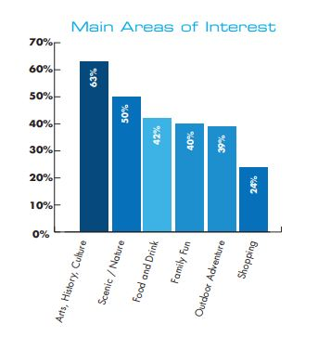
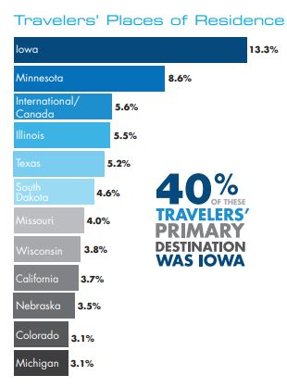
Where Are Travelers Coming From?
Why Are They Traveling?
Notes:
Travelers in Iowa are mostly fellow Iowans and surrounding states, Canada, and international visitors round out place of residence. The main areas of interest are Art, History, culture (63%) followed by Scenic and Nature (50%). Outdoor recreation is close behind at 39 %. Remember those intrinsic qualities that comprise a Byway? Byways have what visitors are looking for. Our goal is to continue to improve the visitor experience through printed materials, interpretive signs, events, restored structures, and art pieces to give Iowa’s guests a unique and memorable experience.

Slide 20
Glacial Trail Scenic Byway
Loess Hills Scenic Byway
Western Skies Scenic Byway
Rebecca Castle, Golden Hills RC& D
Delaware Crossing Scenic Byway
Driftless Area Scenic Byway
Grant Wood Scenic Byway
River Bluffs Scenic Byway
Jared Nielsen and Mallory Hanson, Northeast Iowa RC& D
Covered Bridges Scenic Byway
Teddi Yaeger, Madison County Chamber of Commerce
Great River Road
Jenna Pollock, Mississippi River Parkway Commission
Historic Hills Scenic Byway
Diana Hughell, Pathfinders RC&D
Iowa Valley Scenic Byway
Jessica Rilling, Iowa Valley RC&D
Jefferson Highway Heritage Byway
Unassigned
Lincoln Highway Heritage Byway
Jan Gammon, Prairie Rivers of Iowa RC&D
White Pole Road Scenic Byway
Tom Smull, White Pole Development Corporation
Byways
of Iowa
Coalition
Notes:
We thank you for your support of the Byway program and for your time today. We hope to see you on the Byways!

