Slide 1

Iowa
Natural Heritage
Foundation
Andrea Boulton
Statewide Trails and Greenways Director
Notes:
Thank you for the invitation and for all the DOT does to advance trails across the state of Iowa.

Slide 2
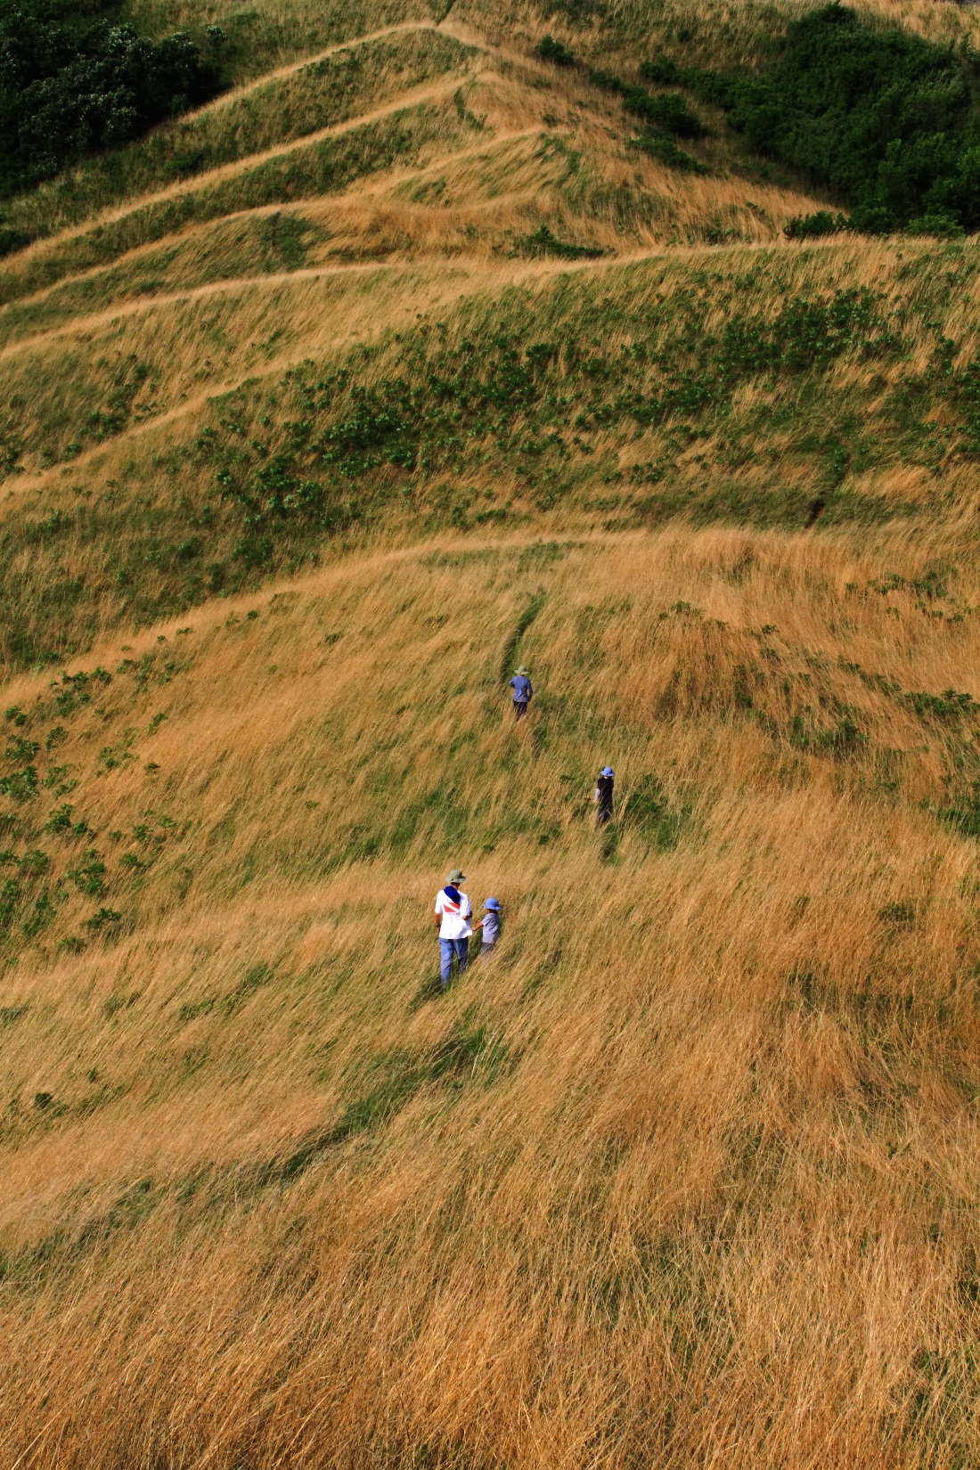
INHF’s Mission
To protect and restore Iowa’s land, water and wildlife for future generations.
Notes:
While providing spaces for families and individuals of all ages to get outdoors, have access to a healthy lifestyle and contribute to a diverse tourism economy.

Slide 3
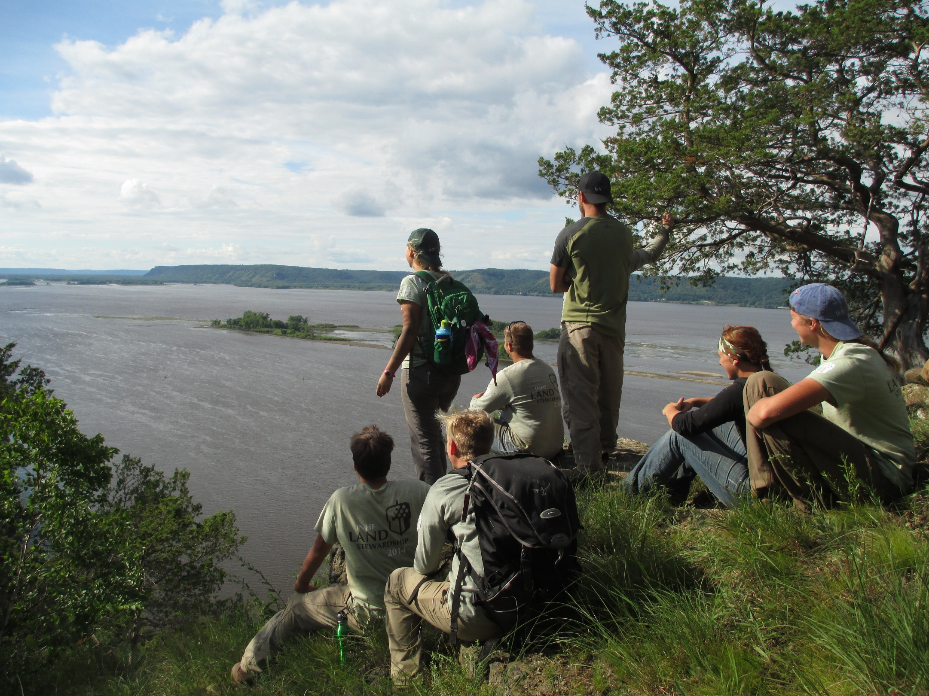
Notes:
We are a non profit, accredited by the Land Trust Alliance, a national organization. We currently have 28 staff positions across Iowa and offer internship opportunities for about 20 students each year. We are supported privately and have nearly 6,000 members. This year we are celebrating our 40th anniversary!

Slide 4
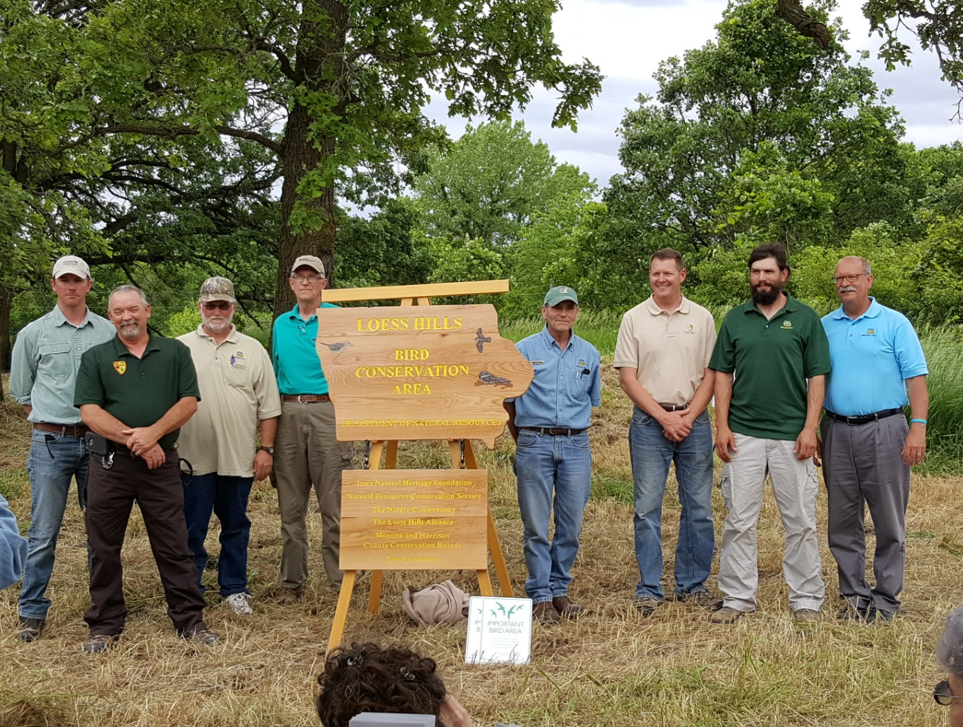
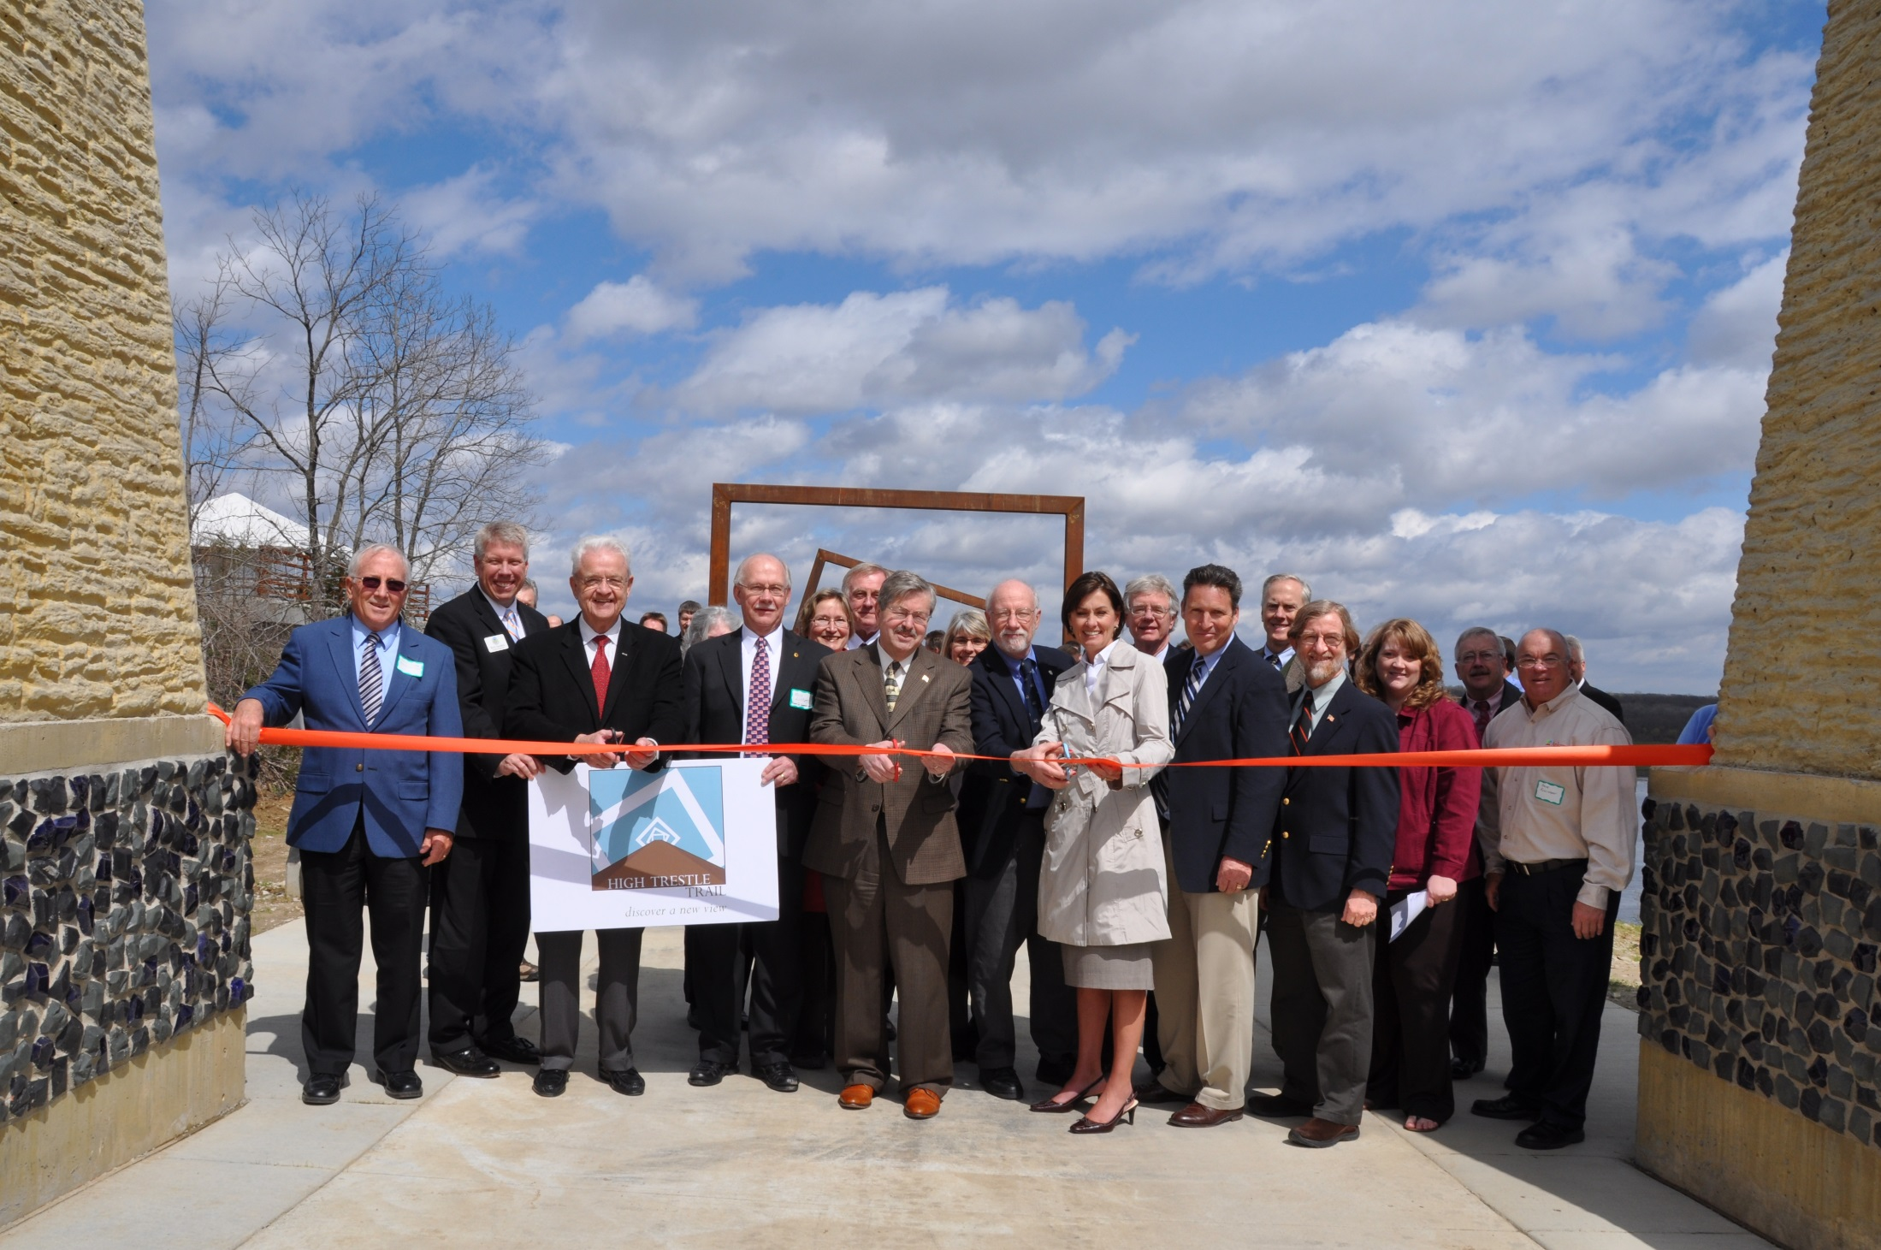
Notes:
We accomplish our projects with a positive partnership approach whether it be a land conservation projects or a trail project.

Slide 5
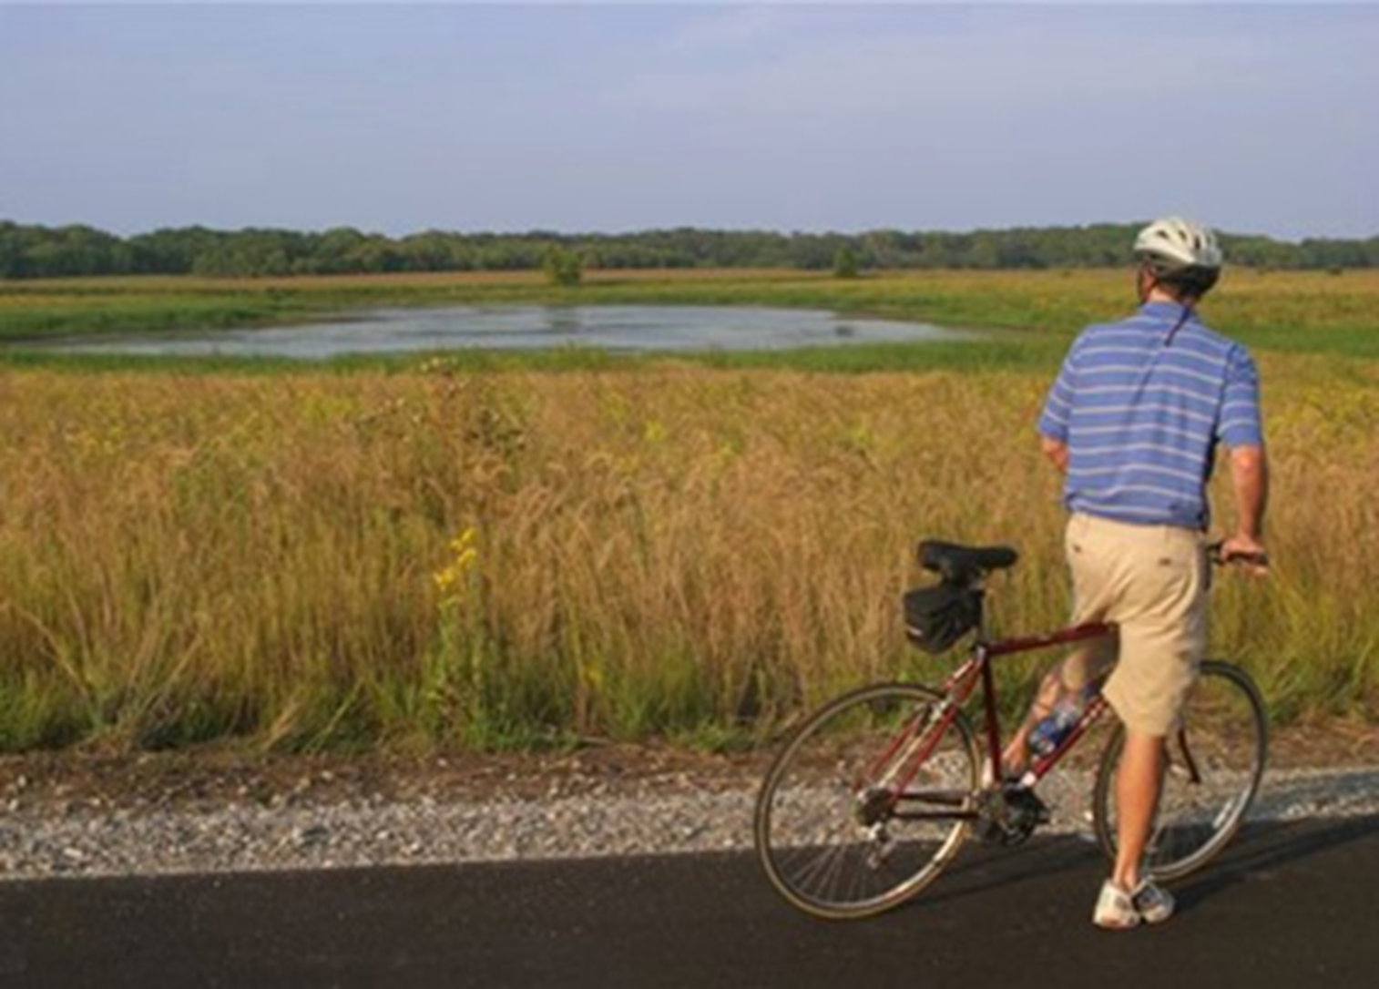
INHF and Trails
Discontinue railroad corridor acquisition
Grant writing
Community organizing
Private Fundraising
Technical assistance
Advocacy
Promotion
Notes:
INHF originally started working on trails in the 1980s with a focus on rails to trails. We helped communities and counties secure these discontinued corridors for future transportation purposes. We found, however, that there was a growing need for continued technical and fundraising assistance. So we continued to support our partners until the trail was completed and beyond. The Heritage Trail in Dubuque was one of our first trail projects followed by the Cedar Valley Nature Trail, the Wabash Trace Nature Trail, the High Trestle Trail and many more. Today, we provide all levels of support to communities and counties working on trail development based on their needs.

Slide 6
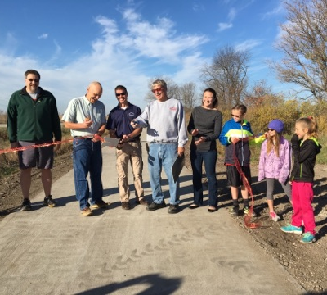
INHF and Trails
Assisted in the development of over 900 miles of trail corridors (mainly rail-trails)
Helped raise over $32 million in public and private funds for trails
Active in public policy at the state and federal level
Participate in regional trail planning efforts
Continue to provide technical assistance to counties and cities in trail development
Trails are some of the most difficult projects for an agency to undertake.
Notes:
I have been working with INHF on trail projects for over 13 years. I can attest that these are some of the most complex projects we work on. They often involve multiple jurisdictions of various sizes and capacities and can take years of fundraising to complete. But it is truly amazing to see communities- especially our rural communities come together to accomplish these facilities. And there’s always different motivating factors underlying their passion.

Slide 7
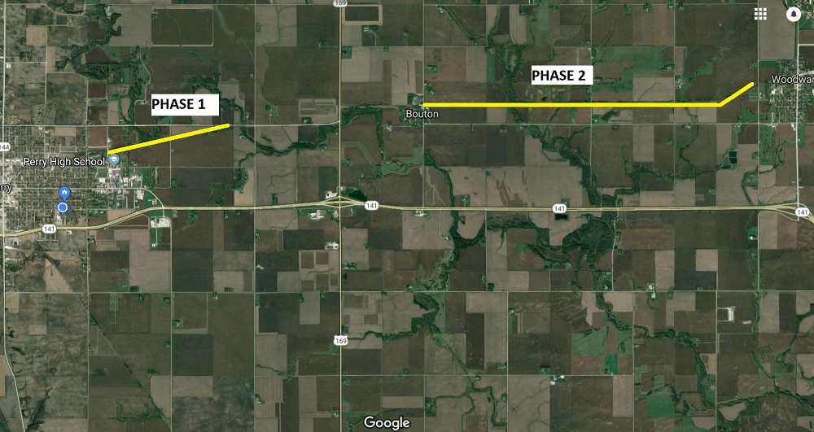
HTT/RRVT Connector
Notes:
One of the most popular projects that we have been assisting to secure land for is the connector between the High Trestle Trail and the Raccoon River Valley Trail. INHF was a part of the development of both these original trails and now we have the opportunity to be a part of the team to connect them. Phase one was completed in 2018. Phase 2 will start construction this year.

Slide 8
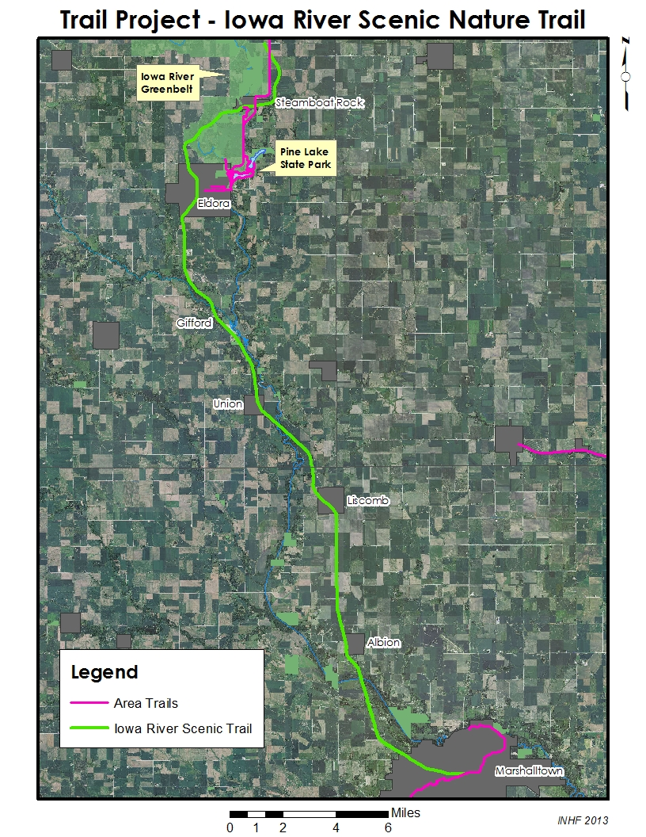
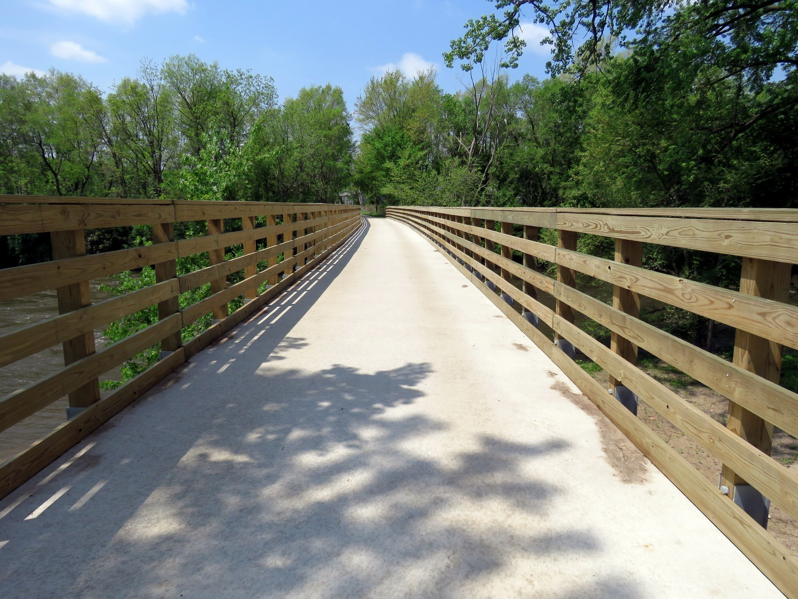
Iowa River Trail
Notes:
The Iowa River Trail is another exciting project. We helped to secure the 34 mile corridor between Steamboat Rock and Marshalltown in Marshall and Hardin Counties. We continue to assist project partners in its fundraising and development. Portions of the trail have been started from each north and south end. I believe it will rival the High Trestle Trail with its scenic views as it follows the Iowa River.

Slide 9
Red Rock Prairie Trail
Notes:
The Red Rock Prairie Trail is component of a 35 year old plan to connect Saylorville Lake to Lake Red Rock. This year construction will begin on an portion of the 17 mile corridor between Mitchellville and Monroe. Eight miles of this project connecting Neal Smith Wildlife Refuge through Prairie City to Monroe will be open this summer leaving roughly 9 miles to complete between Prairie City and Mitchellville. Then only a small gap between Mitchellville and the Central Iowa Trails as well as a small gap between Monroe and Lake Red Rock before that vision is complete.

Slide 10
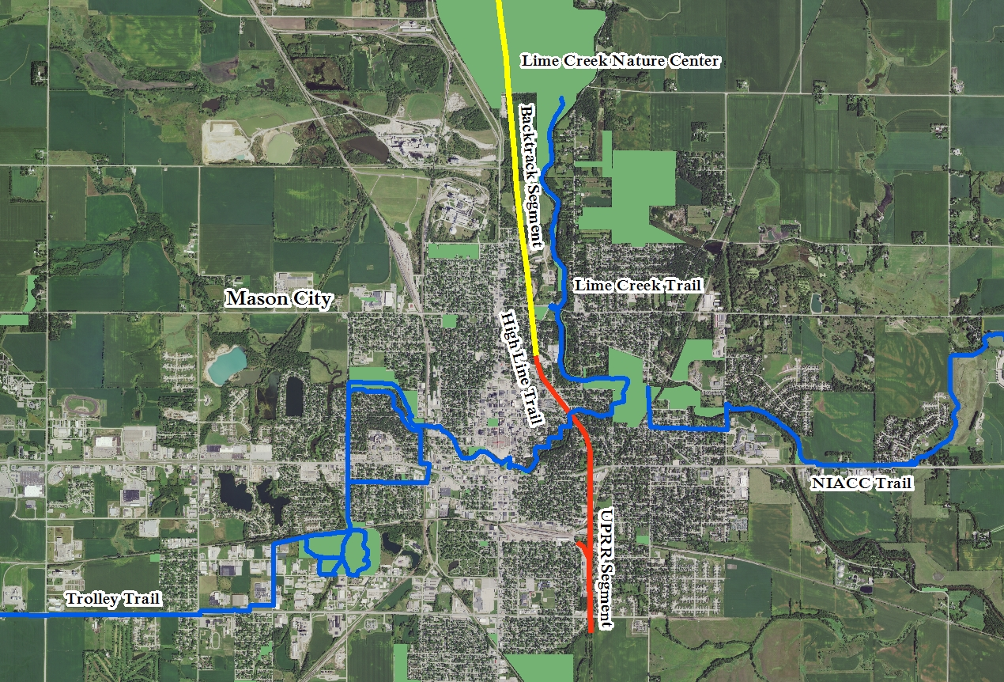
Mason City’s High Line Trail
Notes:
This project is about to really get kicked off. It’s about an 8 mile trail connected the south side of Mason City to Lime Creek Nature Center on the north side. This includes a 200 foot wide bridge over a local street that could be developed into a parklike space mimicking NYC High Line Trail.

Slide 11
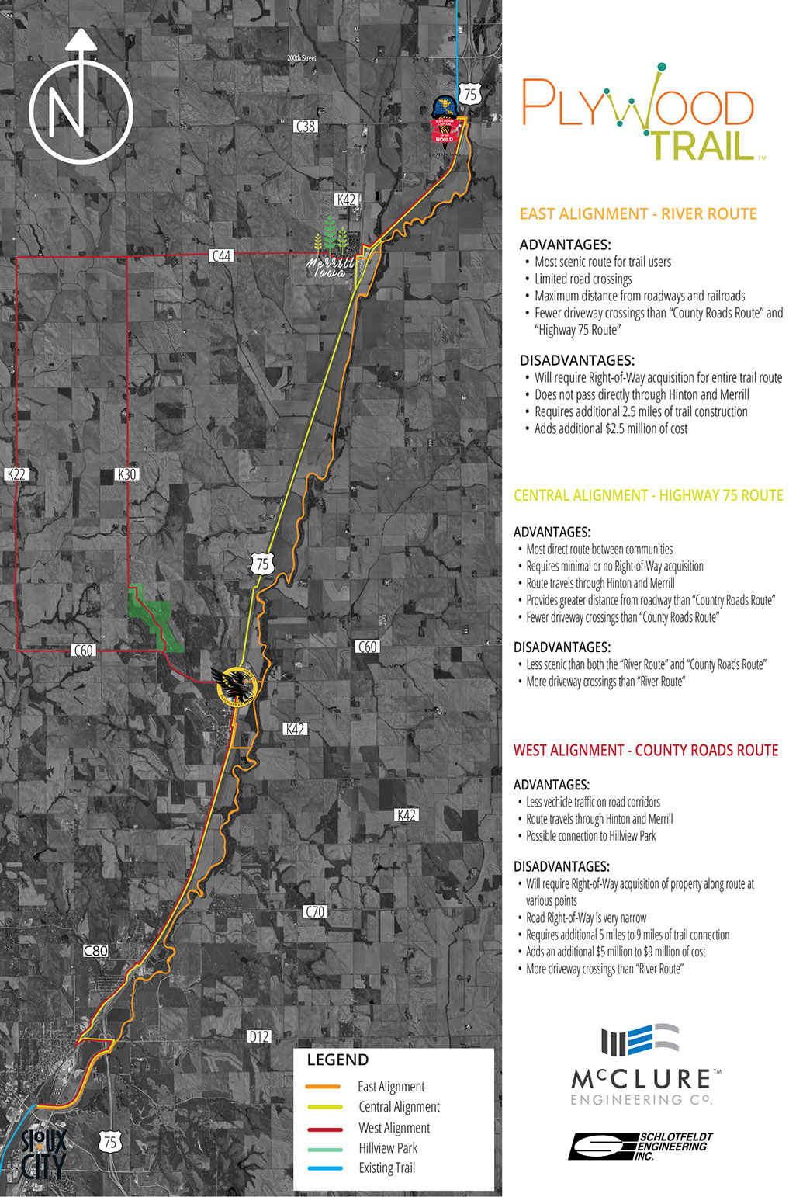
Plywood Trail
Notes:
The Plywood Trail connects Sioux City to Lemars. One of the driving forces behind this trail is the Wells Family of Blue Bunny ice cream. They see the potential workforce development benefits a regional trail could bring to their town. Blue Bunny staff, city leaders and community members have been leading this project and are soon to launch a major fundraising campaign. INHF has been providing technical assistance to partners.

Slide 12
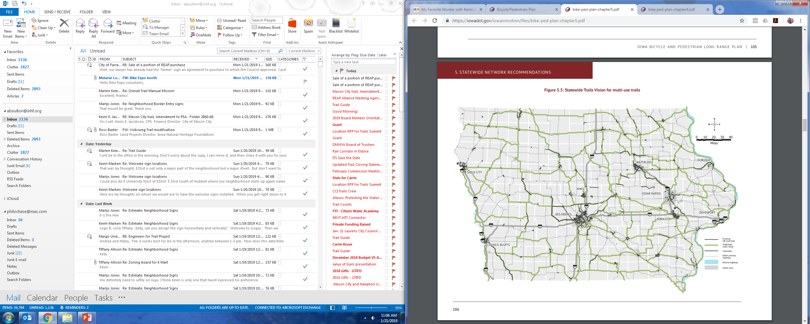
Iowa Trails – The Need
Notes:
Those are just a handful of projects that we are currently working on across the state. This map was included in the recently adopted DOT Bicycle and Pedestrian Plan. It shows the state’s vision for our trail network.

Slide 13
Iowa Trails – The Need
Trail Status | Mileage | % of Statewide Network
Existing | 1,990 miles | 36%
Planned or Programmed | 475 miles | 9%
Proposed | 3,047 miles | 55%
Total Vision | 5,512 miles | 100%
Iowa Bicycle and Pedestrian Long Range Plan; Table 5.1:Statewide Trails Vision – Current Status
Notes:
Review of the table.
What this says to me:
We have nearly 2,000 miles of trails that need access to maintenance funding
We have almost 500 miles of trails that could begin development if funding was available
We have a little over 3,000 miles that would be closer to a reality if funding could be used for feasibility studies and engineering

Slide 14
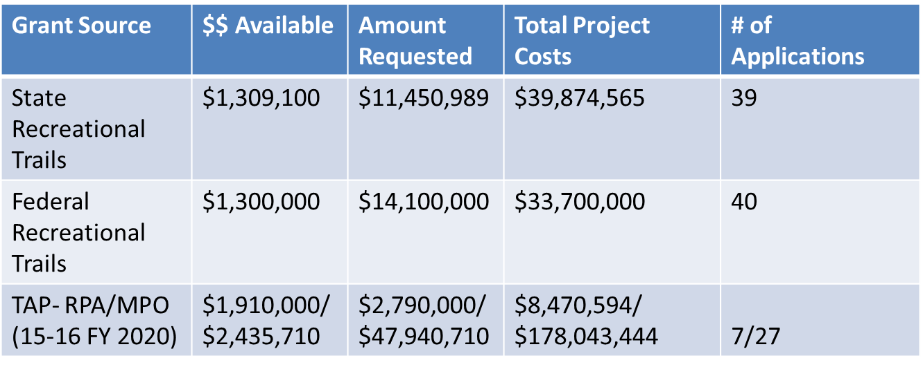
Iowa Trails – The Need
Notes:
Review of the table. We’ve watched SRT funding drop over the past few years from $6 million to $1 million.
SRT and FRT are the main sources of public funding for trails. There are other programs that “can” fund trails but they most compete against other major projects demanding attention.

Slide 15
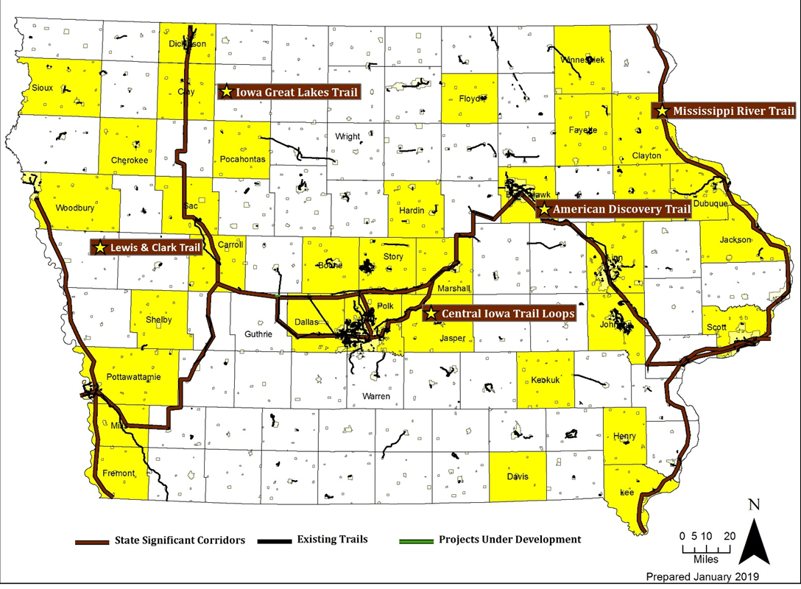
Iowa Trails – ’18 SRT & FRT Requests

Slide 16
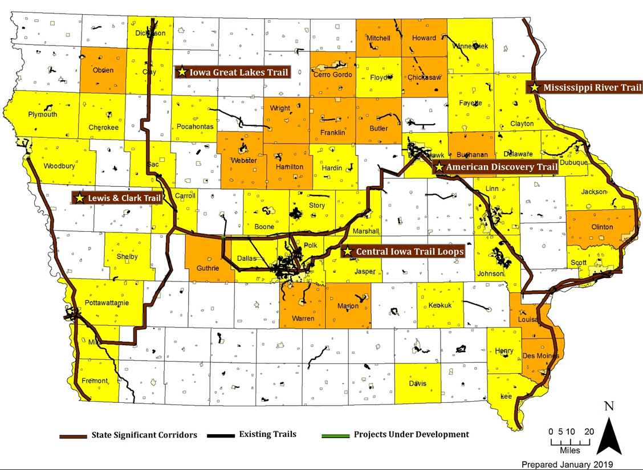
Iowa Trails – Additional Trail Projects
Notes:
You’ll notice that many of the projects going after these funding sources are in rural communities. Many of these communities do not have the population to privately fundraise these costly projects, nor corporate business partners that could assist. But that does not mean the demand is not there. It’s even more important that we increase and create access to funding for trail to support these projects.

Slide 17
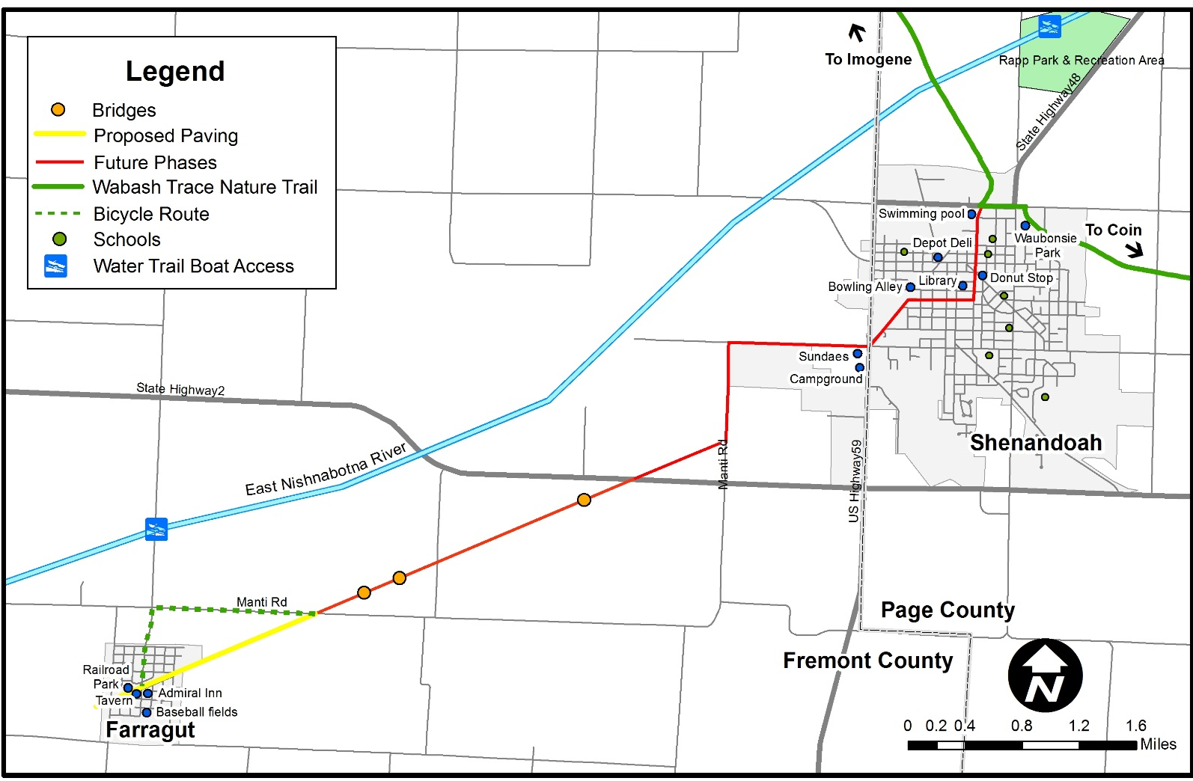
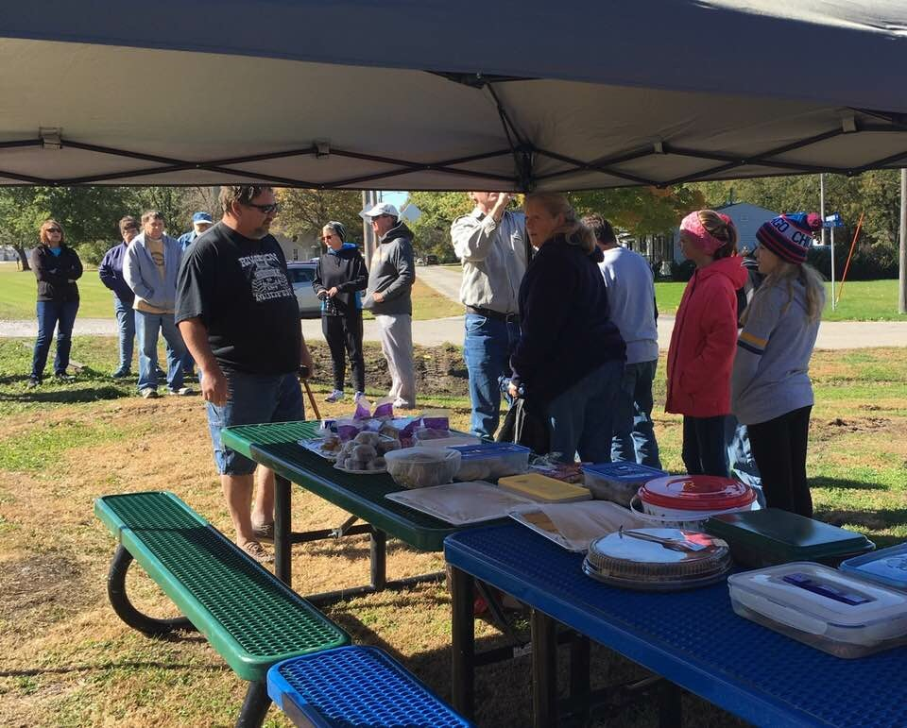
Farragut’s Admiral Trail
Notes:
The Admiral Trail is a 4 mile trail in Farragut. The trail will ultimately connect to the 63-mile Wabash Trace Nature Trail in Shenandoah when completed. Farragut is a town of a little more than 400 people. When the BNSF railroad deactivated it signaled the closure of their weight station and coop. Two years ago they lost their school. The city has come together and rallied around this project. They regularly has substantial turnouts to its monthly meetings, community open houses and events. This photo is of their first annual trail walk. Over 40 people attended. That is 10% of this town.
We are witnesses to the community building trails bring to towns, the pride they help to rediscover, and the growing of leadership they create.

Slide 18
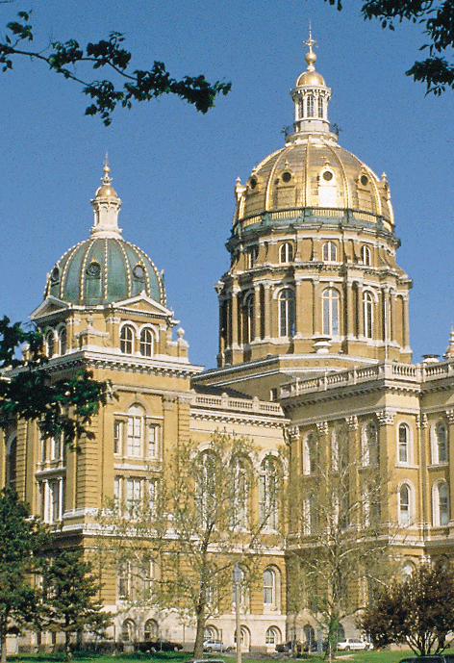
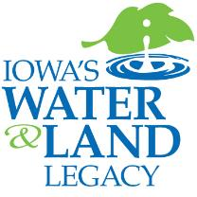
Iowa Trails – What’s Next
Notes:
INHF is excited and ready to continue to work with partners across the state to achieve the vision set out by the DOT in their Bicycle and Pedestrian Long Range Plan. We’re also actively educating our state legislators on the importance of continuing to support and fund existing program like the SRT and FRT, but also to funding Iowa’s Water and Land Legacy. The trust fund would create over $15 million annually allowing us to realize the vision put forward by the DOT’s long range plan.

Slide 19
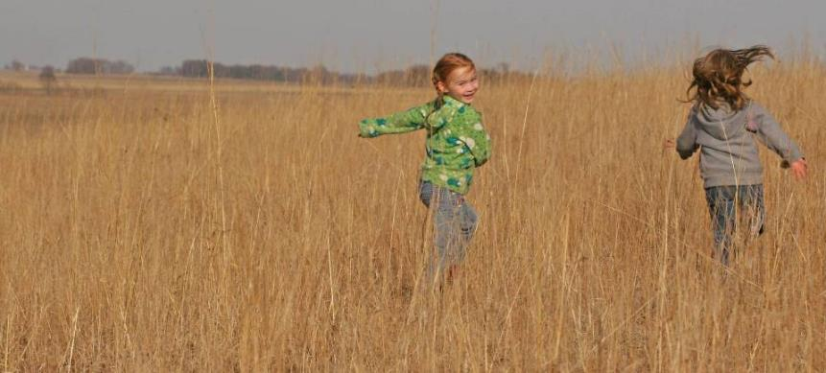
Thank you!
Thank you!
Questions?
Notes:
Handout about why- workforce development, economic impact, etc.

