Slide 1
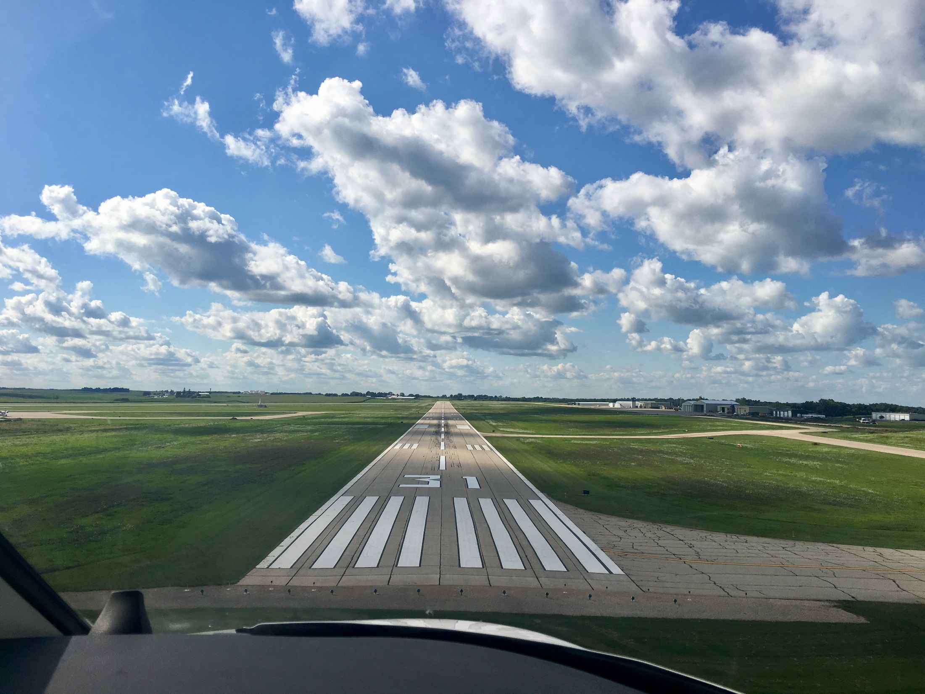
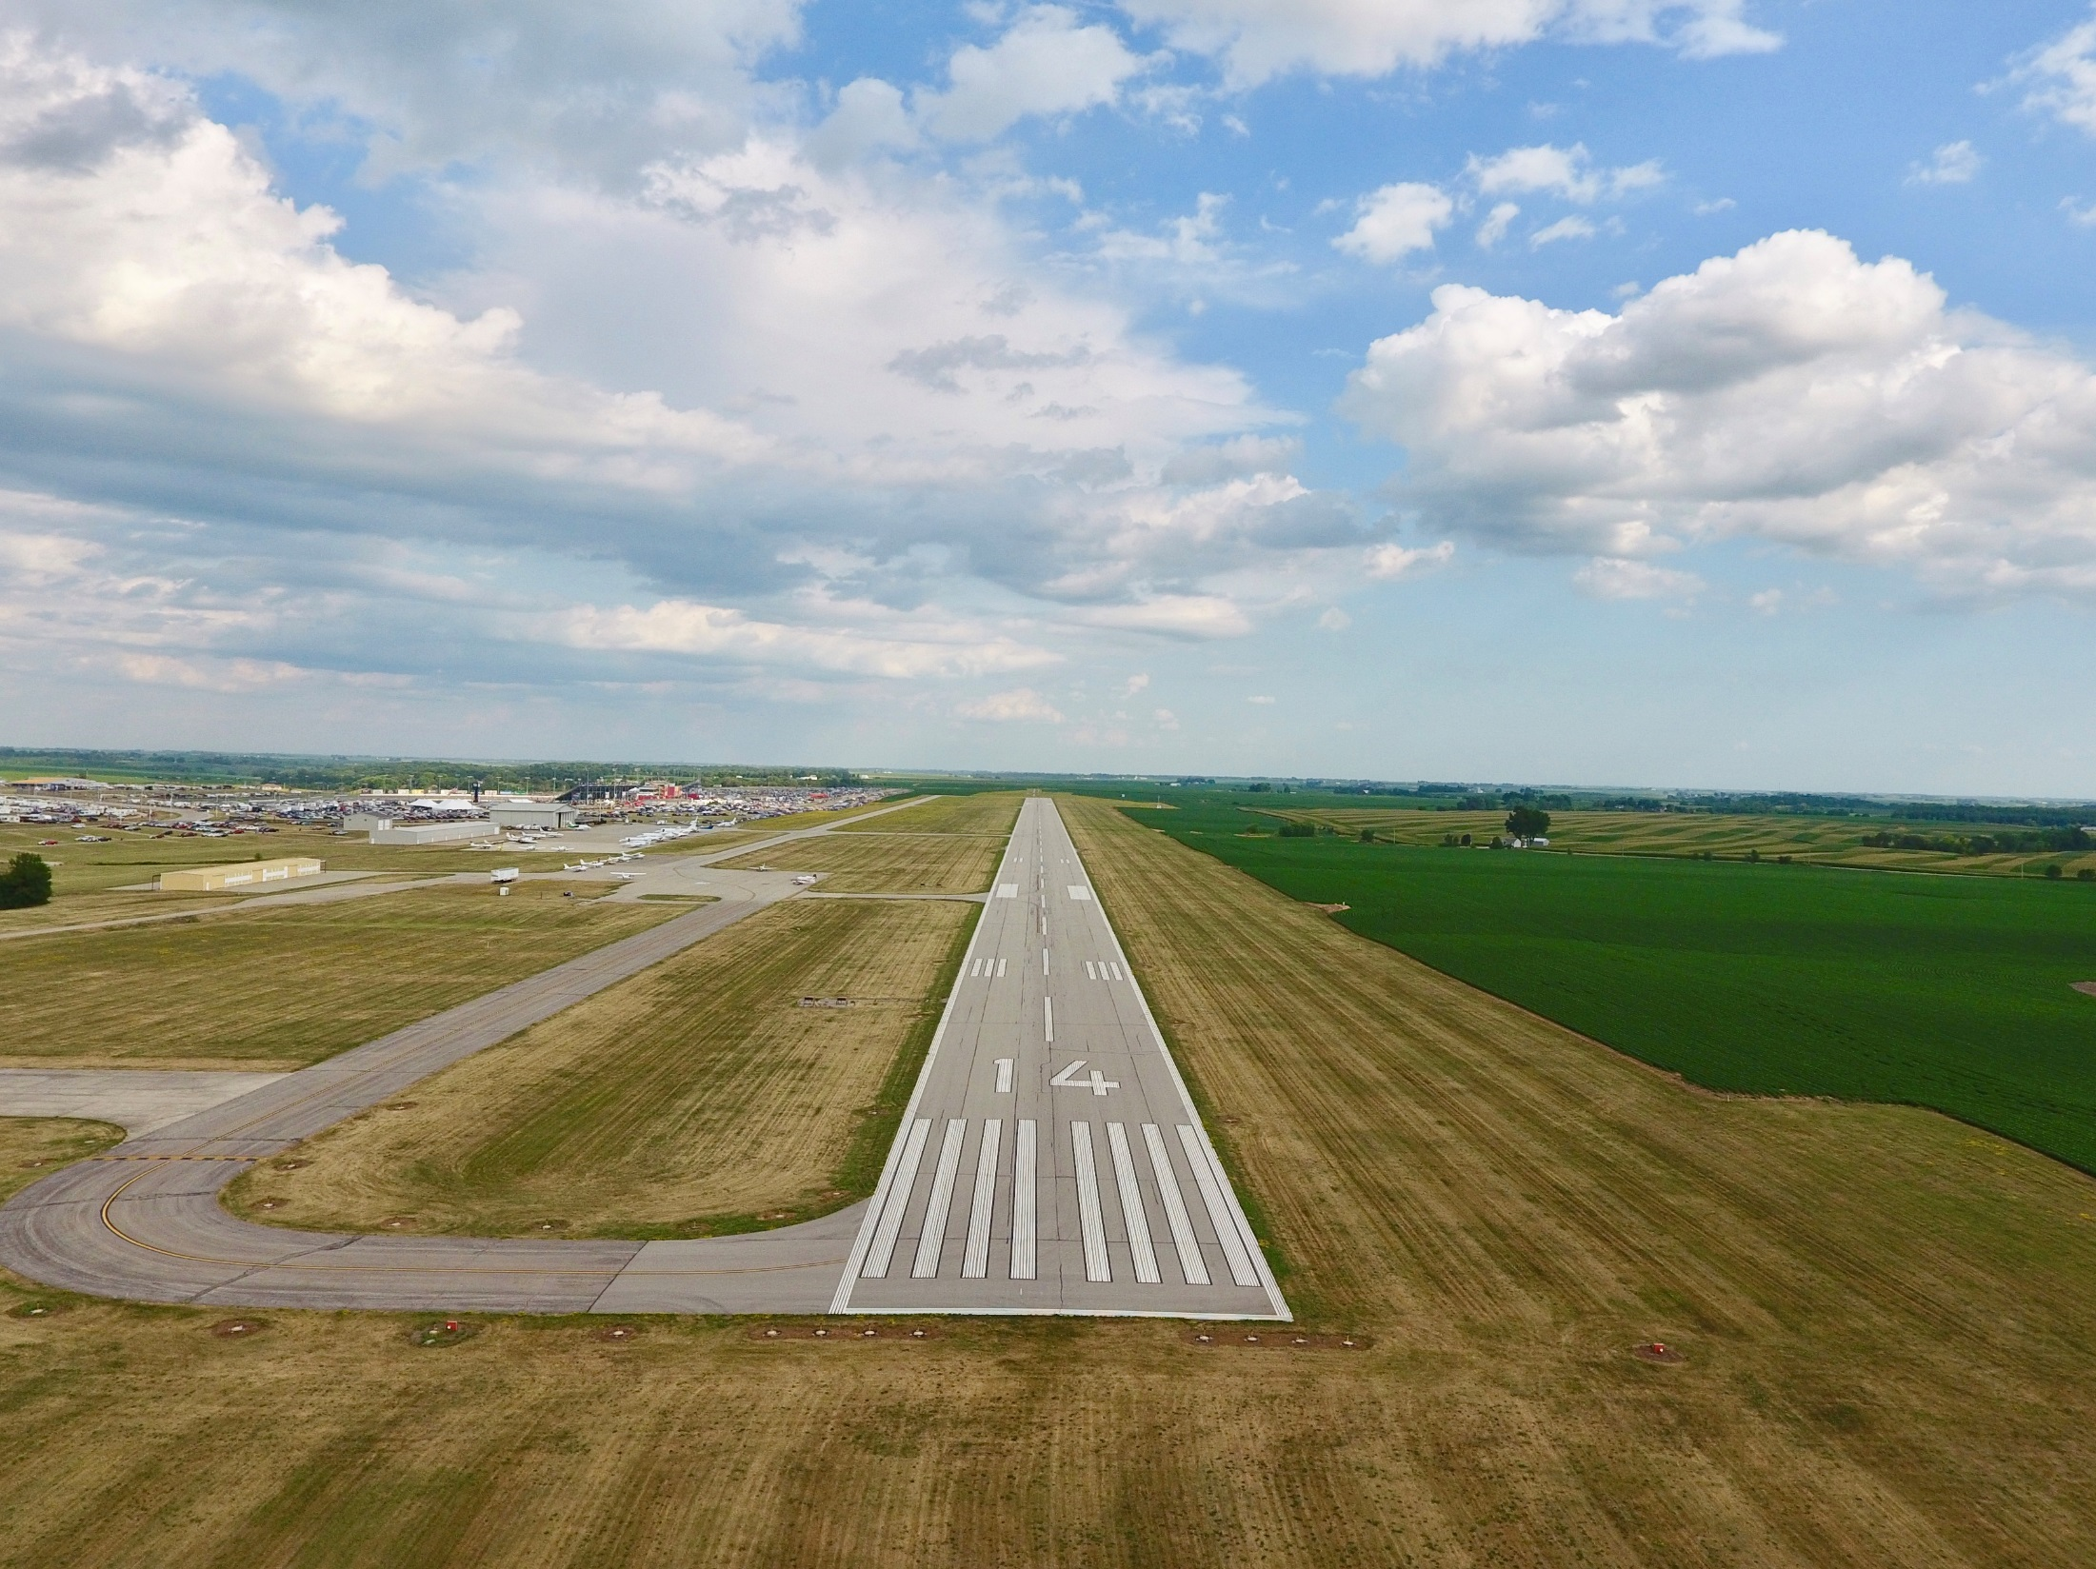

FFY 2021
Federal Aviation Administration
Funding Preapplications
Shane Wright
Aviation Bureau
February 11, 2020

Slide 2
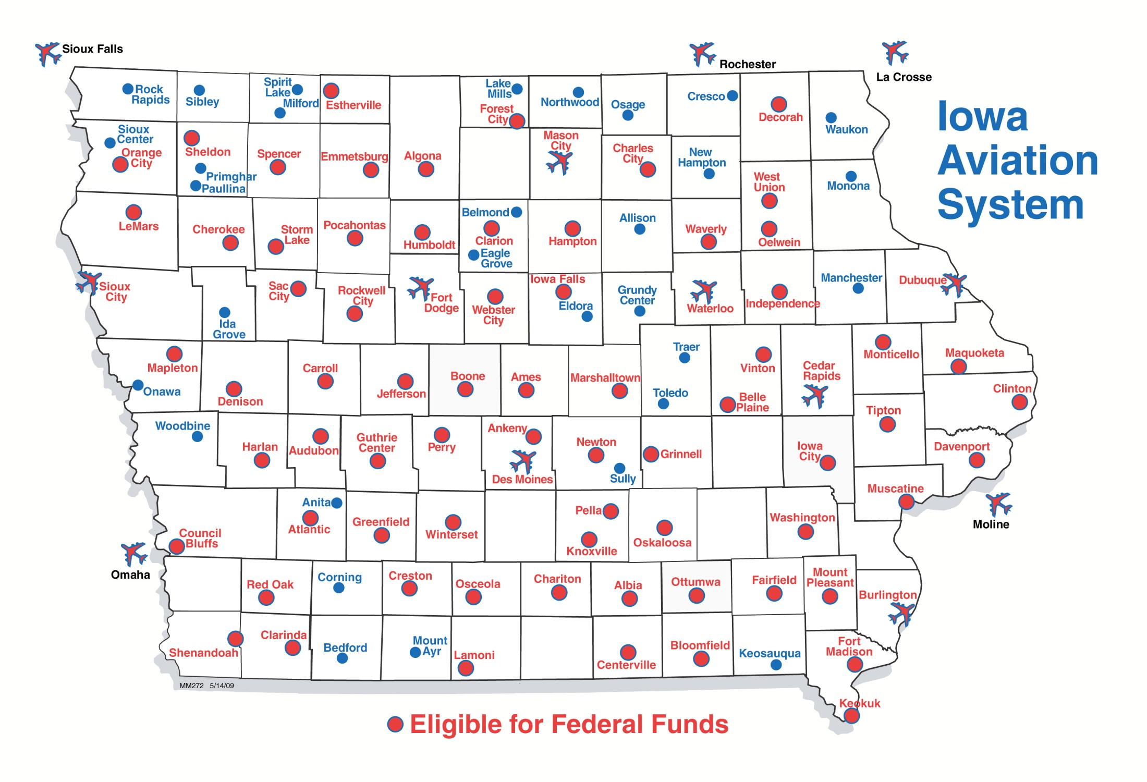
Airports in Iowa Eligible for Federal Funding
Notes:
70 general aviation airports and 3 non-primary commercial service airports – Burlington, Fort Dodge and Mason City
DSM, CID, DBQ, SUX, ALO primary airports (more than 10,000 enplanements) go directly to FAA
30 general aviation airports not eligible for federal funds

Slide 3
Federal Aviation Funding
Channeling Act of 1993 - Applies to all general aviation (GA) airports and commercial service airports that do not receive primary entitlement funds – Iowa Code Section 330.13
  Must submit federal preapplication to the Iowa DOT prior to submittal to FAA
Transportation Commission approves submittal of applications to FAA
Final approval and programming of projects responsibility of the FAA

Slide 4
Federal Aviation Funding
FAA Reauthorization Act of 2018
  $3.35 billion for five years
  90% federal share
Total available dollars remain subject to annual appropriations
Federal Airport Improvement Program (AIP)
  Nonprimary entitlement – Airports receive up to $150,000 each year, based on 5-year capital improvement plan included in the NPIAS (can accumulate 4 years)
  State apportionment – Based on population and land area
  Discretionary – Airport projects compete for funds based on FAA priority of project.
  Entitlement funds are available to airports for any qualifying project. If a grant request exceeds the entitlement available, the FAA may apply apportionment or discretionary to fund the difference.
Notes:
Passed February 2012 after 24 continuing resolutions
FY 2013 funding approp thru March 27

Slide 5
Summary of Federal Funding to Nonprimary Airports in Iowa
 | 2016 | 2017 | 2018 | 2019 | 2020*
Entitlement | $14,072,482 | $8,583,899 | $9,842,418 | $12,271,505 | $14,695,317
Apportionment | $3,142,459 | $3,086,621 | $3,038,967 | $2,801,570 | $2,354,771
Discretionary | $2,808,745 | $7,130,406 | $13,921,868 | $21,613,507** | $21,819,462**
 | $20,023,686 | $18,806,926 | $26,803,253 | $36,686,582 | $38,869,550
*Preliminary ** Includes Supplemental Discretionary
Notes:
2013 – Land purchases (Iowa City, Sioux County))
Washington rwy reconstructon
2014 – fewer projects requested that needed discretionary funding

Slide 6
FFY 2021 Federal Funding
Project Categories
Safety and Planning
  Projects that are safety or planning related
  These projects are a high priority as they help to ensure the immediate safety and long term viability of the Iowa air transportation system
Maintenance and Development Projects
  Projects that are to replace, repair, or expand airport infrastructure.
  Also include acquisition of snow removal equipment, fueling facilities, and buildings
Land acquisition
  All conditions must be satisfied for FAA to program a project that must compete for discretionary funding
  Justified, eligible project and shown on an airport layout plan
  Environmental process complete
  Must have purchased the land or have a formal negotiated agreement

Slide 7
FFY 2021 Federal Funding
Safety and Planning Projects
Safety projects
Airport | Project description | 90 percent federal level | Total amount
 | Total safety projects | $0 | $0
Planning projects
Airport | Project description | 90 percent federal level | Total amount
Algona Municipal | Design and Approach Survey | $162,000 | $180,000
Ankeny Regional | Environmental Assessment - Runway 18 Extension and South Corporate Development | $135,000 | $150,000
Grinnell Regional | Taxiway Rehabilitation Design | $90,000 | $100,000
Humboldt Municipal | Runway Pavement Rehabilitation and Lighting Improvement Design | $306,000 | $340,000
Iowa DOT | Economic Impact Study | $405,000 | $450,000
Iowa DOT | Pavement Condition Study | $135,000 | $150,000
Maquoketa Municipal | Reconstruct Runway 15 End - Design | $192,150 | $213,500
Monticello Regional | Environment Assessment - Runway 33 Approach Protection Land Acquisition | $130,500 | $145,000
Newton Municipal | Parallel Taxiway Reconstruction - Design | $180,000 | $200,000
Newton Municipal | Environmental Documentation For Runway 32 Extension | $90,000 | $100,000
Perry Municipal | Runway 14/32 Paving Design | $202,500 | $225,000
 | Total planning projects | $2,028,150 | $2,253,500
Notes:
The Iowa Aviation System Plan provides a detailed overview of the Iowa Aviation System. It evaluates existing conditions and makes recommendations for future development of the air transportation system.
Last Aviation System Plan was published in 2010.
Originally scheduled to receive FAA funding in FY2018, but FY2017 funds became available and offered to us to begin this effort early.
Estimated cost of $350,000 requiring a $35,000 state share.
Because this is a FAA FY2017 project, it does not appear on the list of projects, but we are requesting commission approval to move ahead with the project.

Slide 8
FFY 2021 Federal Funding
Maintenance and Development Projects
Maintenance and development projects
Airport | Project description | 90 percent federal level | Total amount
Ames Municipal | Runway 1/19 Electrical Improvements - Phase 1 | $509,610 | $566,233
Atlantic Municipal | Runway 12/30 and 2/20 Electrical Upgrades | $1,201,950 | $1,335,500
Atlantic Municipal | Runway 12/30 Approach Path Lighting Replacement | $133,200 | $148,000
Boone Municipal | Reconstruct Runway 15/33 - South 1,800 ft | $1,286,550 | $1,429,500
Centerville Municipal | Runway and Taxiway Lighting Rehabilitation | $429,300 | $477,000
Chariton Municipal | Jet A Fuel Facility and Card Reader | $238,500 | $265,000
Cherokee Regional | Partial Parallel Taxiway Electrical Upgrades | $265,500 | $295,000
Clarinda Municipal | Rehabilitate Runway 2/20 Pavement | $306,000 | $340,000
Clinton Municipal | Runway 14/32 Rehabilitation | $369,000 | $410,000
Davenport Municipal | Taxiway Reconstruction | $2,425,905 | $2,695,450
Emmetsburg Municipal | Fuel Farm Replacement | $491,760 | $546,400
Forest City Municipal | Taxiway LED Lighting Upgrade | $130,500 | $145,000
Fort Dodge Regional | Reconstruct Taxiway B West | $1,019,160 | $1,132,400
Fort Madison Municipal | Runway and Taxiway Lighting Rehabilitation | $310,500 | $345,000
Hampton Municipal | Runway Pavement Rehabilitation | $239,400 | $266,000
Hampton Municipal | Taxiway and Apron Rehabilitation | $135,360 | $150,400
Iowa City Municipal | Runway 25 Threshold Relocation | $362,970 | $403,300
Iowa City Municipal | Runway 7/25 Pavement Maintenance | $149,850 | $166,500
Keokuk Municipal | Rehabilitate Runway 14/32 Lighting | $666,000 | $740,000
Knoxville Municipal | Expand Apron | $457,245 | $508,050
Le Mars Municipal | Runway 18/36 Reconstruction | $3,676,590 | $4,085,100

Slide 9
FFY 2021 Federal Funding
Maintenance and Development Projects continued
Mason City Municipal | Acquire Snow Removal Equipment | $630,000 | $700,000
Ottumwa Regional | Runway 4/22 and Taxiway Pavement Maintenance | $442,746 | $491,940
Pella Municipal | Apron Expansion | $166,680 | $185,200
Pocahontas Municipal | Runway Rehabilitation | $302,931 | $336,590
Rockwell City Municipal | Runway Threshold Relocation | $376,470 | $418,300
Shenandoah Regional | Rehabilitate Runway 12/30 | $209,700 | $233,000
Sioux County Regional | Expand Snow Removal Equipment Building | $202,500 | $225,000
Southeast Iowa Regional | Rehabilitate Taxiway C | $1,378,395 | $1,531,550
Spencer Municipal | Snow Removal Building | $270,000 | $300,000
Vinton Veteran's Memorial | Runway 9/27 Rehabilitation - Phase 1 | $270,000 | $300,000
Waverly Municipal | Construct Taxiway Connector and Reconstruct Taxilanes | $368,640 | $409,600
 | Total maintenance and development projects | $19,422,912 | $21,581,013

Slide 10
FFY 2021 Federal Funding
Land acquisition
Land acquisition projects
Airport | Project description | 90 percent federal level | Total amount
Manchester Municipal | Land Acquisition - Safety Areas and Runway Protection Zone | $434,016 | $482,240
Mt. Pleasant Municipal | Land Acquisition for Runway 33 Extension | $686,700 | $763,000
Rockwell City Municipal | Land Acquisition | $343,080 | $381,200
South Central Regional | Land Acquisition | $1,527,878 | $1,697,642
South Central Regional | Land Acquisition | $541,530 | $601,700
South Central Regional | Land Acquisition | $346,378 | $378,442
 | Total land acquisition projects | $3,879,582 | $4,304,224
Notes:
Charles City finishing environmental – 13 parcels – not all likely to be ready for 2015
Only eligible for discretionary if agreement in place by April 2014

Slide 12
FFY 2021 Federal Funding
Preapplications Summary
 | Projects | Airports | Federal Share | Total Applications
Safety and Planning | 11 | 9 | $2,028,150 | $2,253,500
Maintenance and Development | 32 | 29 | $19,422,912 | $21,581,013
Land Acquisition | 6 | 4 | $3,879,582 | $4,304,224
Total Preapplications | 49 | 42 | $25,330,644 | $28,138,737
Notes:
Total eligible airports: 73 plus 2 new/replacement
No projects: 21 airports

Slide 13
FFY 2021 Federal Aviation Administration
Funding Preapplications
Questions??

