Slide 1
Revitalize Iowa’s Sound Economy Program

Slide 2
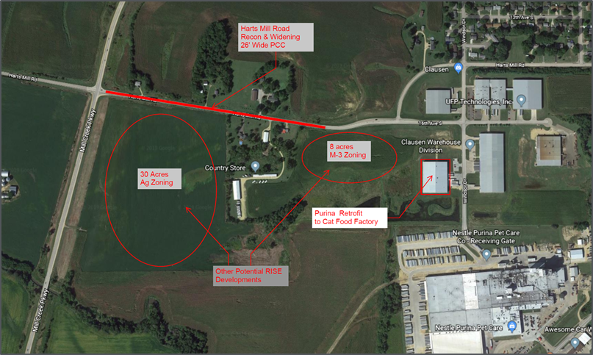
Immediate Opportunity Application Recommended for Award
PROJECT NAME
SPONSOR
JOBS
TOTAL PROJECT COST
PERCENT PARTICIPATION
RECOMMENDED AMOUNT
Reconstruction of approximately 1,882 feet of Harts Mill Road. | Clinton | 53 | $781,250 | 80% | $625,000
RISE Cost/Job Assisted: $11,792.45
Capital Investment/RISE $: $224.25
Company Average Wages: $30.20
Percent Laborshed Wage: 181%

