Slide 1
Revitalize Iowa’s Sound Economy Program

Slide 2
Revitalize Iowa’s Sound Economy Program
Created in 1985
Purpose: To promote economic development through roadway improvements.
Eligible development shall have value-adding activities that feed new dollars into the economy
Available to cities and counties through an application program

Slide 3
Available Funding and Application Summary
Available Funding
Funded annually with dedicated state motor fuel and special fuel tax revenues
Application Summary for SFY2020
Total number of projects awarded: 10
Total project costs: $29,015,279
Total amount awarded: $15,407,197
 | CITY | COUNTY
Average funding generated monthly | $997,556 | $498,778
SFY 2020 current Road Use Tax Revenue (as of 1/6/2020) | $5,981,743.29 | $2,990,871.66
Current Unobligated Balance (as of 1/6/2020) | $16,904,921.16 | $940,881.08

Slide 4
Immediate Opportunity Project Evaluation Criteria
Growth Potential
Average wages meet at least 100% laborshed wage
Quality of Jobs
No pattern of violations
In-state suppliers
Impact on import substitution
Few Iowa competitors
Operating expenditures spent in Iowa
Out-of-state sales
Hiring preferences to Iowa residents

Slide 5
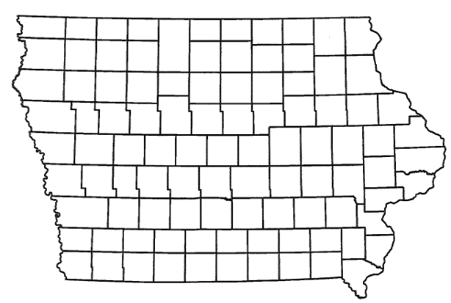
List of Immediate Opportunity Applications Recommended
PROJECT NAME
SPONSOR
JOBS
TOTAL PROJECT COST
PERCENT PARTICIPATION
RECOMMENDED AMOUNT
Reconstruction of approximately 1,882 feet of Harts Mill Road. | Clinton | 53 | $781,250 | 80% | $625,000

Slide 6
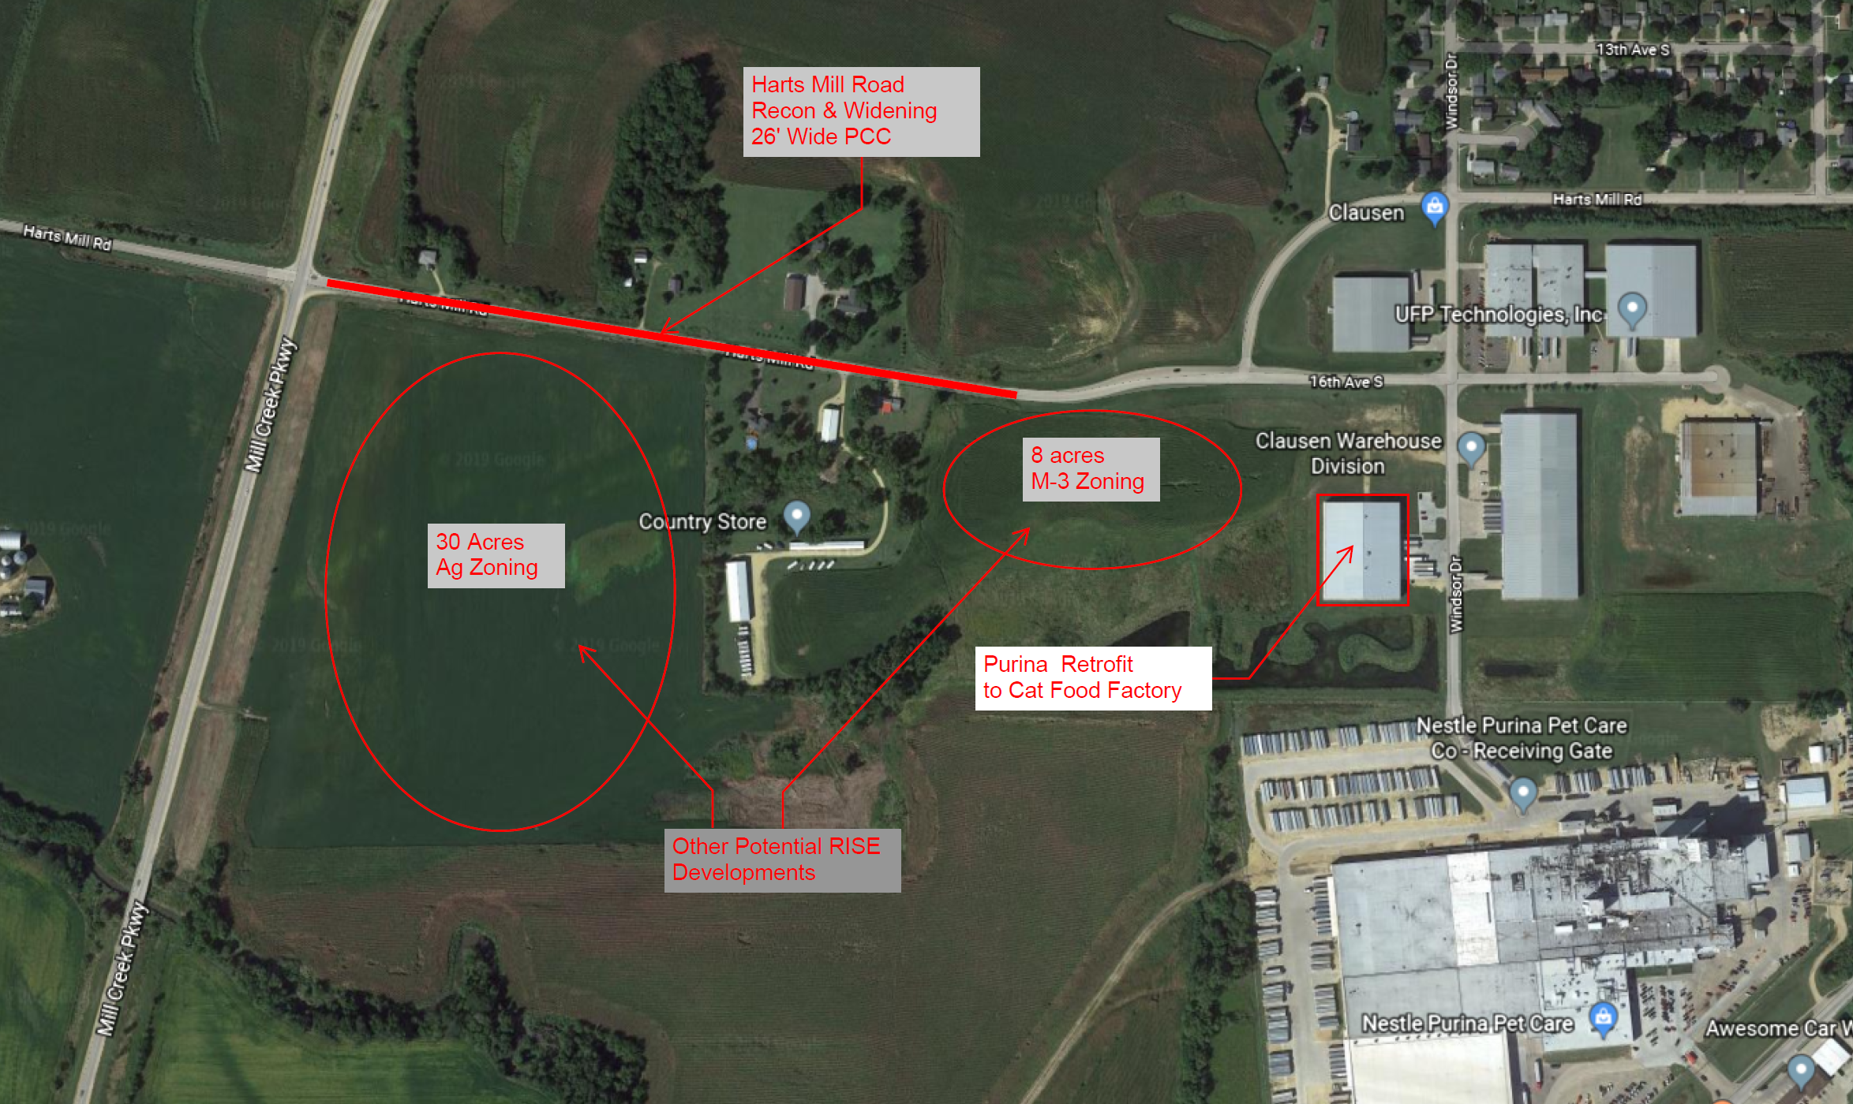
Clinton
(Immediate Opportunity)
Reconstruction of approximately 1,882 feet of Harts Mill Road located on the southwest side of town. This improvement is necessary to provide improved access to the proposed site of Nestle Purina PetCare Company, a producer of a variety of pet food options..
Total Cost: $781,250 RISE Cost/Job Assisted: $11,792.45
Requested: $625,000 (80%) Capital Investment/RISE $: $224.25
Jobs Created: 53 Company Average Wages: $30.20
(181% of laborshed)

Slide 7
QUESTIONS?
Craig Markley, Systems Planning Bureau
craig.markley@iowadot.us
515-239-1027

