Slide 1
Transportation Commission Workshop
February 11, 2020
Transportation Systems Management and Operations - TSMO
Donna Matulac, PE
Iowa DOT Traffic Operations Bureau

Slide 2
What is Transportation Systems Management and Operations (TSMO)?
A coordinated approach to managing and operating our roadways as safely and efficiently as possible, focused on maximizing existing infrastructure, addressing the causes of breakdowns in flow, and overall performance of the transportation system.

Slide 3
TSMO
Economics
Safety
Mobility
Transportation Systems Management and Operations

Slide 4
Safety
319 Iowa
Fatalities
in 2018
36,560 US Fatalities in 2018
Around 3,000 incidents per month
61 minutes average lane blockage

Slide 5
Interstate Delay - 2018
Cost of Total Interstate Delay statewide - $43.9 million

Slide 6
Efficiency
82% Goods shipped by Truck
$612B
Value of Goods Moving through Iowa
16% Projected Growth in Truck Tonnage
$182M in lost fuel and time (Des Moines metro)

Slide 7
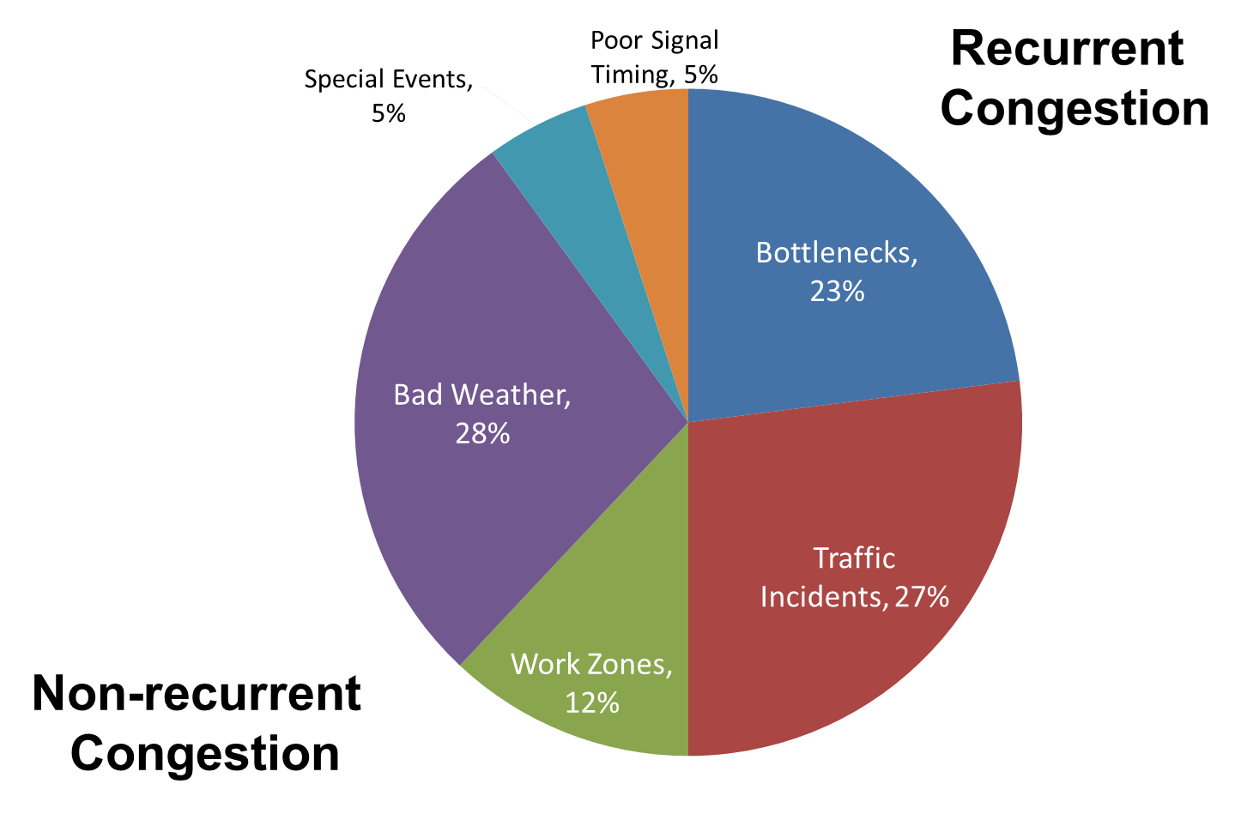
Mobility

Slide 8
TSMO Service Layer Plans
Intelligent Transportation Systems (ITS) & Communications
Work Zone Management
Active Transportation and Demand Management
Traffic Management Center
Emergency Management
Cooperative Automated Transportation
Traveler Information
Traffic Incident Management

Slide 9
TSMO Examples
Integrated Corridor Management Studies (ICM)
Des Moines Metro
I-380 between Iowa City and Cedar Rapids
Cooperative Automated Transportation (CAT) Service Layer Plan
Addition of cameras, sensors and fiber along the interstate system

Slide 10
TSMO Service Layer Plans
Intelligent Transportation Systems (ITS) & Communications
Work Zone Management
Active Transportation and Demand Management
Traffic Management Center
Emergency Management
Cooperative Automated Transportation
Traveler Information
Traffic Incident Management

Slide 11
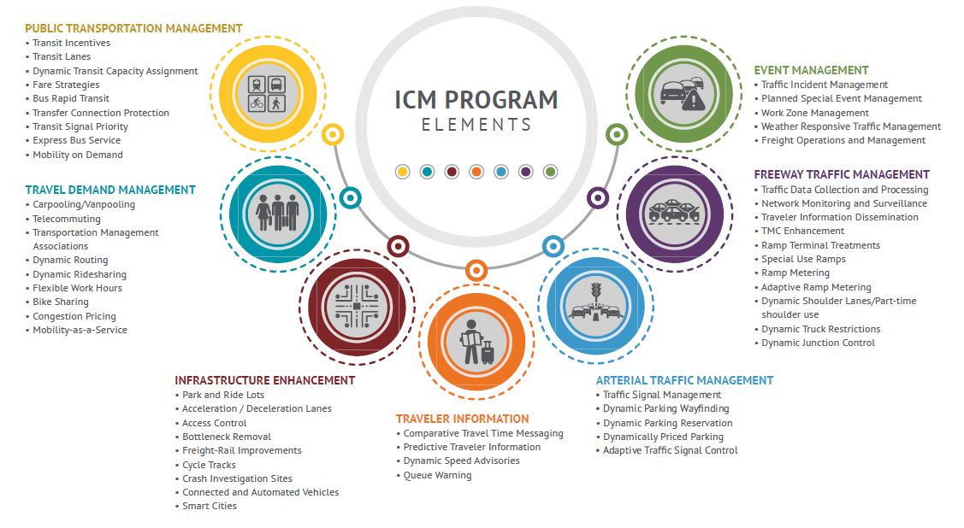
Des Moines Integrated Corridor Management

Slide 12
TSMO Service Layer Plans
Intelligent Transportation Systems (ITS) & Communications
Work Zone Management
Active Transportation and Demand Management
Traffic Management Center
Emergency Management
Cooperative Automated Transportation
Traveler Information
Traffic Incident Management

Slide 13
Cooperative Automated Transportation (CAT) Service Layer Plan
3 Basic Elements Working Together
Systems
Vehicles (CAVs & non-CAVs)
Infrastructure
Communications
Services
Operations
Roadway design
Licensing and registration
Training and education
Mobility Services
To improve safety, mobility, and efficiency of all modes
Automated Safety Features
On-board vehicle based
Hand-held devices
Dispatcher interface

Slide 14
video

Slide 15
Key Take-aways
Invest smarter by stretching funding further
Improve efficiency of the existing system
Investing smarter in the use of technology
Strategically investing in areas that help mitigate our non-recurring congestion

