Slide 1
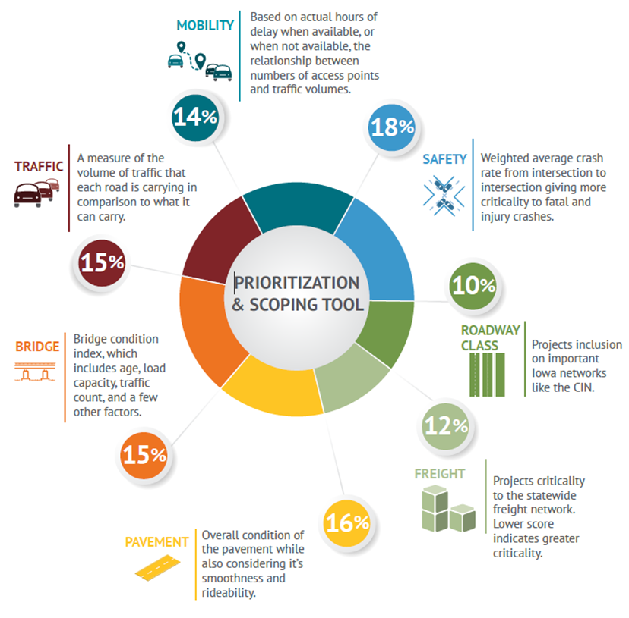
Project Prioritization Weighting (2021-2025 Highway Program)

