Slide 1
2021-2025 Highway Program Development
February 11, 2020

Slide 2
February 11, 2020
Overview
Discuss Highway Program Development Process
Discuss 2021-2025 Highway Program Development Schedule
Discuss Extended Highway Program Analysis
Discuss Statewide Line Items
At what levels should the line item targets be programmed?
Discuss Federal Funding
Discuss Program Objectives/Priorities/Considerations
Action Item: Project Prioritization Weighting

Slide 3
Highway Program Development Process
February 11, 2020
Public Policy and Input
What direction do we have?
Transportation Plans
What type of system do we need?
Performance Monitoring
Are we successful?
Five-Year Program
What projects will be done and when?

Slide 4
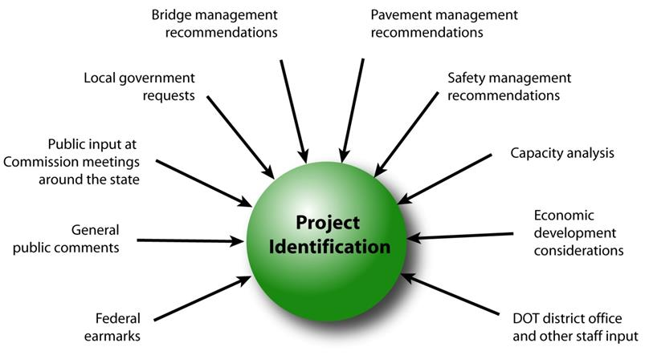
February 11, 2020
Step 1: Project identification

Slide 5
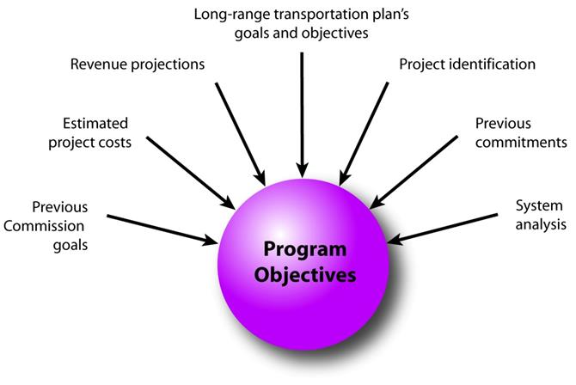
February 11, 2020
Step 2: Establishing the Transportation Commission’s annual programming objectives

Slide 6
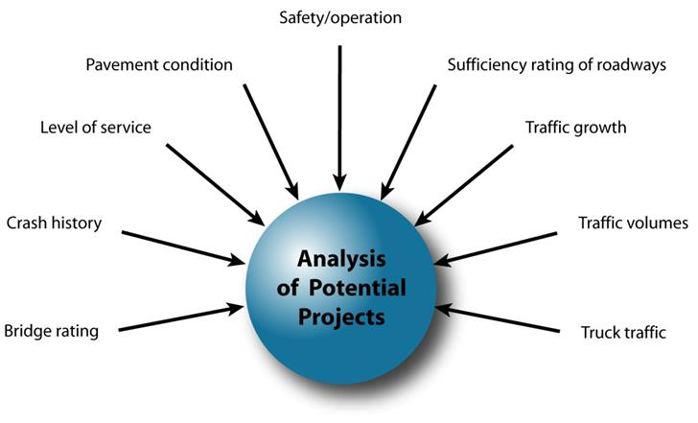
February 11, 2020
Step 3: Evaluating potential project candidates

Slide 7
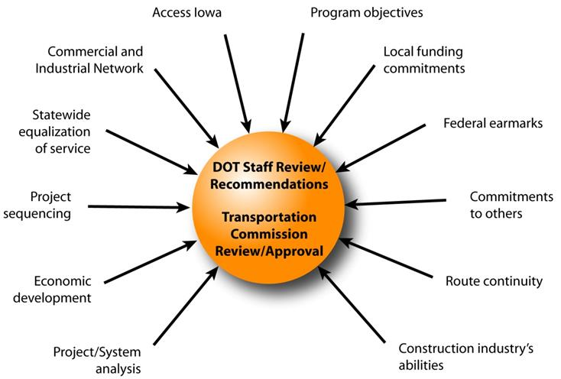
February 11, 2020
Step 4: Developing the final program

Slide 8
February 11, 2020
Commission Program Development Schedule (2021-2025)
February 2020
Discuss Highway Program Development Process
Discuss 2021-2025 Highway Program Development Schedule
Discuss Extended Highway Program Analysis
Discuss Statewide Line Items
At what levels should the line item targets be programmed?
Discuss Federal Funding
Discuss Program Objectives/Priorities/Considerations
Action Item: Project Prioritization Weighting
March 2020
Discuss 2021-2025 available Highway Program funding
Discuss 2021-2025 Highway Program Options
Determine 2021-2025 Highway Program Objectives
Action Item: Line Item Targets for Programming
April 2020
Develop the Draft 2021-2025 Highway Program
Action Item: 2021-2025 Highway Program Objectives
May 2020
Present the Draft 2021-2025 Iowa Transportation Improvement Program to the public
(including all previous program approvals and draft 2021–2025 Highway Program)
June 2020
Action Item: Approve the 2021–2025 Iowa Transportation Improvement Program

Slide 9
2020-2029 Highway Program Analysis
For Highway Planning Purposes Only (x $1,000,000)
February 11, 2020
as of May 13, 2019
Proposed Highway Program Extended Highway Program
2020 2021 2022 2023 2024 2025 2026 2027 2028 2029
Projected Funds as of March 2019 734.7 722.0 669.9 693.2 688.7 688.7 688.7 688.7 688.7 688.7
Highway Program Components
Interstate Stewardship 198.3 239.8 184.7 144.8 128.7 165.0 170.0 175.0 180.0 185.0
Non-Interstate Pavement Modernization 137.4 105.0 115.0 140.0 145.0 150.0 155.0 165.0 175.0 185.0
Non-Interstate Bridge Modernization 58.3 57.3 64.7 101.0 110.0 125.0 140.0 155.0 170.0 185.0
Safety Specific 25.0 25.0 25.0 25.0 25.0 25.0 25.0 25.0 25.0 25.0
Non-Interstate Capacity/System Enhancement 224.8 118.5 91.2 202.4 204.1
IA 17 Boone N of US 30 and E 3 mi 0.1
US 61 Des Moines from 210th St to N of Mediapolis 0.1
US 61 Des Moines N of Mediapolis to N of IA 78 2.8 22.3 0.1
US 30 Missouri Valley bypass 49.7 21.1 20.6
US 61 1 mi N of IA 78 to 2 mi S of IA 92 37.1 65.1
US 63 NW Oskaloosa bypass 18.7 0.3
US 218 Bremer Janesville to Waverly 12.9
Major Interstate Capacity/System Enhancement 142.6 204.0 194.7 106.1 83.1
I-35 Polk/Story 52.5 1.0
I-80 Cedar 56.3
I-80 Scott Mississippi River Bridge 150.0
Highway Program Balance (51.7) (27.6) (5.4) (26.1) (7.2) (137.8) 135.6 82.6 138.7 108.7
Black: Previous discussion
( ): Indicates Highway Program is over-programmed
Green: Changes since previous discussion

Slide 10
2021-2030 Highway Program Analysis
For Highway Planning Purposes Only (x $1,000,000)
February 11, 2020
Proposed Highway Program Extended Highway Program
2021 2022 2023 2024 2025 2026 2027 2028 2029 2030
Projected Funds as of March 2019 722.0 669.9 693.2 688.7 688.7 688.7 688.7 688.7 688.7 688.7
Highway Program Components
Interstate Stewardship 239.8 184.7 144.8 128.7 165.0 170.0 175.0 180.0 185.0 190.0
Non-Interstate Pavement Modernization 105.0 115.0 140.0 145.0 150.0 155.0 165.0 175.0 185.0 190.0
Non-Interstate Bridge Modernization 57.3 64.7 101.0 110.0 125.0 140.0 155.0 170.0 185.0 190.0
Safety Specific 25.0 25.0 25.0 25.0 25.0 25.0 25.0 25.0 25.0 25.0
Non-Interstate Capacity/System Enhancement 118.5 91.2 202.4 204.1
IA 17 Boone N of US 30 and E 3 mi 0.1
US 61 Des Moines from 210th St to N of Mediapolis 0.1
US 61 Des Moines N of Mediapolis to N of IA 78 2.8 22.3 0.1
US 30 Missouri Valley bypass 49.7 21.1 20.6
US 61 1 mi N of IA 78 to 2 mi S of IA 92 37.1 65.1
US 63 NW Oskaloosa bypass 18.7 0.3
US 218 Bremer Janesville to Waverly 12.9
Major Interstate Capacity/System Enhancement 204.0 194.7 106.1 83.1
I-35 Polk/Story 52.5 1.0
I-80 Cedar 56.3
I-80 Scott Mississippi River Bridge 150.0
Highway Program Balance (27.6) (5.4) (26.1) (7.2) (137.8) 135.6 82.6 138.7 108.7 93.7
Black: Previous discussion
( ): Indicates Highway Program is over-programmed
Green: Changes since previous discussion

Slide 11
 | DRAFT 2021 - 2025 IOWA HIGHWAY PROGRAM
 |  |  |  | PROJECT ESTIMATED COSTS X $1000
 | LOCATION | FUNDING | TYPE OF WORK | 2021 | 2022 | 2023 | 2024 | 2025
 | AMERICANS WITH DISABILITIES ACT |  | MISCELLANEOUS | 3000 | 3000 | 3000 | 3000 | 3000
 | CONSTRUCTION INDUSTRY TRAINING PROGRAM |  | MISCELLANEOUS | 500 | 500 | 500 | 500 | 500
 | CONSTRUCTION INDUSTRY TRAINING PROGRAM |  | MISCELLANEOUS | 500 | 500 | 500 | 500 | 500
 | COOPERATIVE CITY/COUNTY/STATE HIGHWAY RESEARCH |  | MISCELLANEOUS | 1500 | 1500 | 1500 | 1500 | 1500
 | EMERGENCY & CONTINGENCY - U-STEP/C-STEP |  | MISCELLANEOUS | 6000 | 6000 | 6000 | 6000 | 6000
 | POST LETTING PROJECT COST |  | MISCELLANEOUS | 10000 | 10000 | 10000 | 10000 | 10000
 | POST LETTING PROJECT COST |  | MISCELLANEOUS | 10000 | 10000 | 10000 | 10000 | 10000
 | PREVOCATIONAL TRAINING AND DBE SUPPORT SERVICES |  | MISCELLANEOUS | 300 | 300 | 300 | 300 | 300
 | PREVOCATIONAL TRAINING AND DBE SUPPORT SERVICES |  | MISCELLANEOUS | 60 | 60 | 60 | 60 | 60
 | SCENIC BYWAY PROGRAM |  | MISCELLANEOUS | 500 | 500 | 500 | 500 | 500
 | STATEWIDE CONSULTANT SERVICES |  | OUTSIDE SERV. ENGINEER | 82500 | 82500 | 82500 | 82500 | 82500
 | STATEWIDE CONSULTANT SERVICES |  | OUTSIDE SERV. ENGINEER | 2500 | 2500 | 2500 | 2500 | 2500
 | STATEWIDE CONTRACT MAINTENANCE |  | MISCELLANEOUS | 31350 | 31350 | 31350 | 31350 | 31350
 | STATEWIDE CONTRACT MAINTENANCE (BRIDGE) |  | MISCELLANEOUS | 2000 | 2000 | 2000 | 2000 | 2000
 | STATEWIDE CONTRACT MAINTENANCE (PAVEMENT) |  | MISCELLANEOUS | 2000 | 2000 | 2000 | 2000 | 2000
 | STATEWIDE RAILROAD CROSSINGS |  | MISCELLANEOUS | 500 | 500 | 500 | 500 | 500
 | STATEWIDE ROADSIDE IMPROVEMENT |  | LANDSCAPING | 2500 | 2500 | 2500 | 2500 | 2500
 | STATEWIDE TRAFFIC CONTROL DEVICES |  | TRAFFIC SIGNS | 10000 | 10000 | 10000 | 10000 | 10000
 | ABBREVIATIONS
 | 4R - INTERSTATE STEWARDSHIP
 | 3R - NON-INTERSTATE PAVEMENT MODERNIZATION
 | SR - SAFETY SPECIFIC
At what levels should the line item targets be programmed?

Slide 12
February 11, 2020
Federal Funding Status
The FAST Act authorizes federal funding through September 30, 2020.
FAST Act funding allocations were determined by Commission in 2016.
The next Highway Trust Fund cliff is in 2022, leaving uncertainty in all but one year of this next five-year program.
Contingency plan has been developed should significant reduction in federal funding occur. Continue to identify specific project impacts with this Program.
Recent annual appropriations have included additional funding beyond authorized levels.

Slide 13
Current Highway Program Objectives
February 11, 2020
as discussed
June 11, 2019
Stewardship Investments
Interstate (Pavement Reconstruction/Modernization, Bridges, Pavement Patching/Maint., Rest Areas/Misc.)
- Maintain scheduled completion of I-35 in Polk County from Oralabor Road to NE 36th St. in Ankeny
- Maintain scheduled completion of I-35/80 Interchange NE of Des Moines in Polk County
- Maintain scheduled completion of I-80 in Polk County at Iowa 141 interchange in Urbandale
- Maintain scheduled completion of I-80/380 interchange reconstruction in Johnson County
Non-Interstate Pavement Modernization
Non-Interstate Bridge Modernization
Safety
Major Interstate Capacity/System Enhancement Projects
Maintain scheduled completion of I-29/I-80/I-480 in Council Bluffs (CBIS)
Maintain scheduled completion of I-74 in Davenport/Bettendorf (Central Section)
Maintain scheduled completion of I-80 in Johnson/Cedar Counties
Maintain scheduled completion of I-380 in Linn County for Tower Terrace
Non-Interstate Capacity/System Enhancement Projects
Maintain scheduled completion of Iowa 1 in Jefferson County in Fairfield
Maintain scheduled completion of Iowa 3 in Dubuque County from Luxemburg to Sageville
Maintain scheduled completion of Iowa 13 in Linn County from N of County Home Rd to S of Central City
Maintain scheduled completion of Iowa 17 in Boone County north of U.S. 30
Maintain scheduled completion of U.S. 18 in Floyd County at the U.S. 218 intersection in Floyd
Maintain scheduled completion of U.S. 20 in Webster County from E of Co Rd P73 to Iowa 17
Maintain scheduled completion of U.S. 20 in Black Hawk County from U.S. 63 to Iowa 21 in Waterloo
Maintain scheduled completion of U.S. 20 in Dubuque County at Swiss Valley Road intersection
Maintain scheduled completion of U.S. 30 in Story County from 0.5 miles east of I-35 to east of 590th Ave
Maintain scheduled completion of U.S. 30 in Tama and Benton Counties
Maintain scheduled completion of U.S. 52 in Jackson County from the Mississippi River to Sabula
Maintain scheduled completion of U.S. 61 in Des Moines County from Burlington to N of Mediapolis
Maintain scheduled completion of U.S. 69 in Polk County from I-80 to SE 33rd St in Ankeny
Maintain scheduled completion of U.S. 69 in Wright County from N of UP RR to Co Rd C20
Maintain scheduled completion of U.S. 75 in Plymouth County from Woodbury Co to Merrill
Maintain scheduled completion of Iowa 92 in Washington and Louisa Counties

Slide 14
February 11, 2020
Program Development Considerations
Continue to increase stewardship investments on existing highway system (i.e., bridges, pavements, safety)
Balance capacity improvements with stewardship needs
Address increasing safety/operational needs on the Interstate
Address major river crossing needs
Continue to complete existing priority corridors
Significant cost increases for project estimates due to CY 2019 letting results

Slide 15
February 11, 2020
Program Development Considerations
Review existing priority corridors and determine if changes are necessary
U.S. 30 in Greene/Boone Counties from Jefferson to Ogden
U.S. 30 in Cedar County from Lisbon to Stanwood
U.S. 30 in Clinton County from Calamus to U.S. 61
U.S. 63 in Davis/Wapello Counties from North of Bloomfield to Ottumwa

Slide 16
Options of Projects to add to the Highway Program
For Highway Planning Purposes Only (x $1,000,000)
 | 2021 | 2022 | 2023 | 2024 | 2025 | 2026 | 2027 | 2028 | 2029 | Beyond | Total
Major Interstate Capacity/System Enhancement (MI funds)
I-35 Story: N of IA 210 to E 13th St in Ames |  |  |  |  |  | 4.9 | 30.7 | 39.3 | 67.6 | 1.2 | 143.7
I-80 Polk: Hickman Rd Interchange (4R) |  |  |  |  | 28.0 | 38.4 | 10.0 |  |  |  | 76.4
I-80 Scott: Mississippi River Bridge |  |  |  |  | 50.0 | 50.0 | 50.0 |  |  |  | 150.0
I-380 Johnson: Segment 1 N of Forevergreen Rd to N of Penn St |  |  |  |  |  |  |  | 9.9 | 12.5 | 13.0 | 35.4
I-380 Johnson: Segment 2 N of Penn St to N of Iowa River |  |  |  |  | 38.6 | 44.6 | 26.1 |  |  |  | 109.3
I-380 Johnson: Segment 3 N of Iowa River to N of 120th St NW |  |  |  |  |  |  |  | 16.6 | 9.5 |  | 26.1
I-380 Linn: Segment 4 N of 120th St NW to US 30 |  |  |  |  | 32.4 | 18.6 |  |  |  |  | 51.0
I-380 Linn: Blairs Ferry Road to County Home Rd (add lanes) |  |  |  |  |  | 14.8 |  | 12.4 |  |  | 27.2
Stewardship (Shelf-Ready) Projects |  | 100.0 | 100.0 | 100.0 | 100.0 | 100.0 |  |  |  |  | 500.0
Subject to change as additional information becomes available

Slide 17
Options of Projects to add to the Highway Program
For Highway Planning Purposes Only (x $1,000,000)
February 11, 2020
 |  |  |  |  |  |  |  |  |  | Score
 | 2021 | 2022 | 2023 | 2024 | 2025 | 2026 | Beyond |  | Score | Rank
Non-Interstate Capacity/System Enhancement (NR funds)
Stewardship
IA 2 Fremont: Missouri River Overflow to I-29 | TBD
US 6 Polk: NW 128th St in Clive/Urbandale | 0.6
IA 12 Woodbury: Gordon Drive bridge in Sioux City |  |  |  |  |  |  | TBD
IA 21 Iowa: South of Belle Plaine |  |  |  |  | TBD
US 34 Mills: Resiliency improvements (could be ER) | TBD
US 34 Wapello: Wildwood Dr to US 63 in Ottumwa |  |  |  |  |  | 30.8
US 67 Scott: Mississippi River Bridge |  |  |  |  |  |  | 110.0
US 75 Sioux: N of Sioux Center to US 18 |  |  |  |  | 10.0
Polk: Traffic Incident Management (TIM) Training Center |  |  |  | TBD | TBD
ITS (multiple locations statewide) |  |  | 0.1 | 2.2 | 0.3
Culverts (multiple locations statewide) | 1.4 | 0.3 | 0.4
Slide Repairs (multiple locations statewide) | 0.9 | 0.2 | 0.1
Subject to change as additional information becomes available

Slide 18
Options of Projects to add to the Highway Program
For Highway Planning Purposes Only (x $1,000,000)
February 11, 2020
 |  |  |  |  |  |  |  |  | Priority |  | Score
 | 2021 | 2022 | 2023 | 2024 | 2025 | 2026 | 2027 | Beyond | Corridor | Score | Rank
Non-Interstate Capacity/System Enhancement (NR funds)
Capacity
US 18 Hancock: E Branch Iowa River to Country Club Dr (Super-2) |  |  |  |  | 3.0 |  |  |  | N
US 30 Cedar/Clinton: Segment within Lisbon to De Witt Corridor (Super-2) |  |  |  |  | TBD |  |  |  | Y (part)
US 63 Tama: Toledo to Co Rd E29 (Super-2) |  |  |  |  | 9.0 |  |  |  | N
Potential Transfer of Jurisdictions (NR funds)
US 6 Pottawattamie: 6th St in Council Bluffs east to I-80 |  |  | TBD
IA 78 Henry: Olds to Louisa County | 13.7
IA 78 Louisa: Henry County to US 61 | 8.4
Subject to change as additional information becomes available

Slide 19
Next Steps
February 11, 2020
Discuss 2021-2025 available Highway Program funding
Discuss 2021-2025 Highway Program Options
Determine 2021-2025 Highway Program Objectives
Action Item: Line Item Targets for Programming

