Slide 1
Commission Tour
Benchmarks for Changing to Virtual
Transportation Commission Workshop
February 9, 2021

Slide 2
2021 Commission Tours
Should we plan for four tours (April, June, August, and October)? Yes
Should we develop benchmarks to assess when a tour should/should not be held (e.g. COVID-19 positivity rates) and what is the timing of those decisions? Yes, discuss benchmarks at February workshop.
Where should the tours/meetings be located? See map

Slide 3
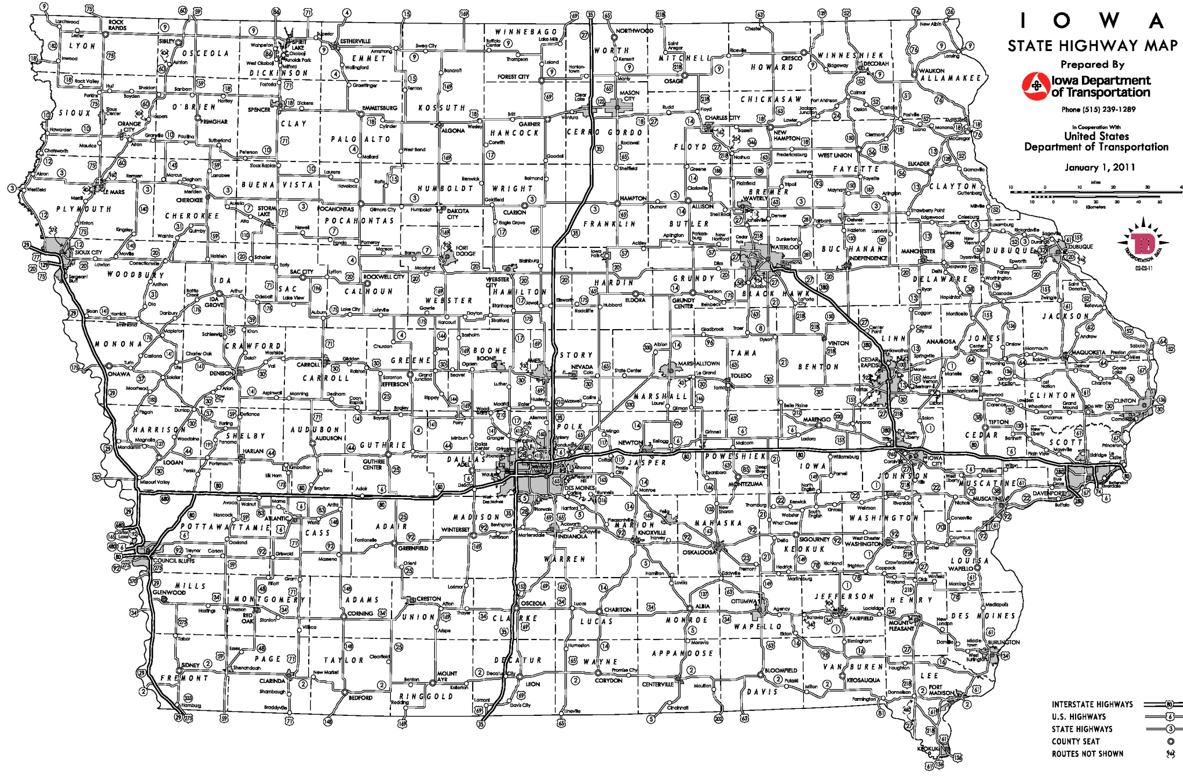
Possible 2021 Commission Tour Routes
December 2020
October-Waterloo
April-Dubuque
(had considered Maquoketa)
August-Carroll
June-Oskaloosa
= meeting location

Slide 4
Potential Benchmarks
Are there any Governor proclamations in place restricting/discouraging indoor public gatherings?
Are there any CDC and/or Iowa Department of Public Health guidance restricting/discouraging indoor public gatherings?
Is the COVID-19 fourteen-day positivity rate >= 15 percent in the host county for the Commission meetings?
If yes to any of these, hold the tour/meeting virtually
If no to all of these, proceed with tour; however, may still limit public attendance

Slide 5
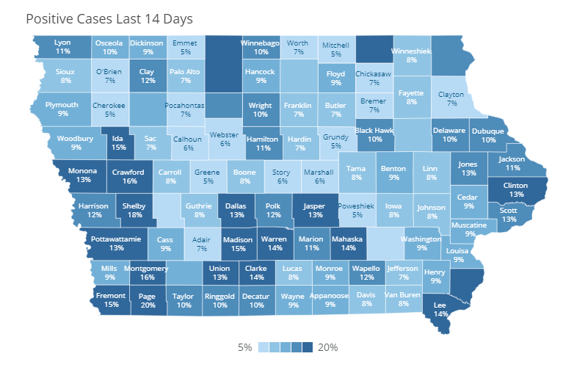




Sample Positivity Map (from 2/1/21)
https://coronavirus.iowa.gov/pages/case-counts

Slide 6
Timing
Recommend assessing benchmarks at meeting prior to tour and make the decision

Slide 7
Questions?

