Slide 1
Revitalize Iowa’s Sound Economy Program
Iowa Transportation Commission Workshop
February 9, 2021

Slide 2
Revitalize Iowa’s Sound Economy Program
Created in 1985
Purpose: To promote economic development through roadway improvements.
Eligible development shall have value-adding activities that feed new dollars into the economy
Available to cities and counties through an application program

Slide 3
Available Funding and Application Summary
Available Funding
Funded annually with dedicated state motor fuel and special fuel tax revenues
Application Summary for SFY2021
Total number of projects awarded: 4
Total project costs: $9,355,156
Total amount awarded: $5,807,636
 | CITY | COUNTY
Average funding generated monthly | $970,179 | $485,089
SFY 2021 current Road Use Tax Revenue (as of 1/4/2021) | $5,403,235.63 | $2,701,617.82
Current Unobligated Balance (as of 1/4/2021) | $12,827,952.80 | $2,701,617.82

Slide 4
Local Development Project Evaluation Criteria
Development Potential (35 points)
Economic impact and Cost Effectiveness (20 points)
Local Commitment and Initiative (33 points)
Transportation Need and Justification (4 points)
Local Economic Need (6 points)

Slide 5
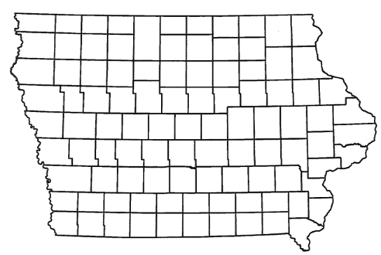
List of Local Development Applications Recommended
PROJECT NAME
SPONSOR
SCORE
TOTAL PROJECT COST
PERCENT PARTICIPATION
RECOMMENDED AMOUNT
Construction of approximately 1,000 feet of 15th Street NW. | Sioux Center | 57 | $780,981 | 50% | $390,491

Slide 6
Sioux Center
(Local Development)
Construction of approximately 1,000 feet of 15th Street NW located on the northwest side of town. This project is necessary to provide access to five lots totaling more than 14 acres for industrial purposes.
Total Cost: $780,981
Requested: $390,491 (50%)

Slide 7
Immediate Opportunity Project Evaluation Criteria
Growth Potential
Average wages meet at least 100% laborshed wage
Quality of Jobs
No pattern of violations
In-state suppliers
Impact on import substitution
Few Iowa competitors
Operating expenditures spent in Iowa
Out-of-state sales
Hiring preferences to Iowa residents

Slide 8
List of Immediate Opportunity Applications Recommended
PROJECT NAME
SPONSOR
JOBS
TOTAL PROJECT COST
PERCENT PARTICIPATION
RECOMMENDED AMOUNT
Paving of approximately 600 feet of 250th Avenue. | Pella | 21 | $305,750 | 80% | $244,600

Slide 9
Pella
(Immediate Opportunity)
Paving of approximately 600 feet of 250th Avenue located on the southeast side of town. This improvement is necessary to provide improved access to the proposed site of Lely North America, a leader in designing and manufacturing automated systems for dairy farmers.
Total Cost: $305,750 RISE Cost/Job Assisted: $11,647.62
Requested: $244,600 (80%) Capital Investment/RISE $: $97.22
Jobs Created: 15 Company Average Wages: $30.36 Jobs Retained: 6 (161% of laborshed)

Slide 10
QUESTIONS?
Craig Markley, Systems Planning Bureau
craig.markley@iowadot.us
515-239-1027

