Slide 1
Upper Mississippi Inland Waterway Infrastructure Mooring Cell Pilot Project
Iowa Transportation Commission
February 9, 2021

Slide 2
Alternative Financing Evaluation
2019 Study Objective
Develop range of viable investment alternatives to enhance Upper Mississippi inland waterway infrastructure
Study examined three upgrade scenarios
Micro Efficiency Upgrade (mooring cell)
System Reliability Improvements (major rehab program)
Large-Scale Capacity, Efficiency & Reliability Upgrade (1200 ft. lock)
Recommendation #1
Use State-Federal project partnership agreement and/or contributed funds to implement the Micro Efficiency Upgrade scenario of a mooring cell at L&D 14 (LeClaire, IA).
2

Slide 3
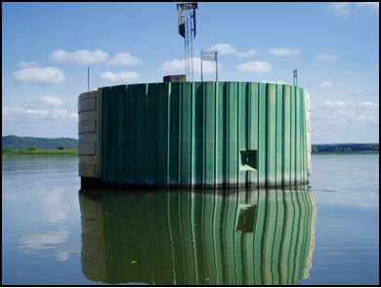
Micro Efficiency Upgrade
What is a mooring cell?
Efficient and environmentally friendly facility for tows approaching a L&D to moor (tie off) while waiting for the lock to be available
Typically located adjacent to main navigation channel
Constructed of sheet-piling driven into a circular cell and filled with earth and/or concrete
Without mooring facility, towboats must move close to shore and ground barges, tie off to bankline trees, or maintain engine power
Benefits
Improved lock approach times for
exchange lockages
Reduced environmental impacts
Improved operational safety
Replicability
3
Courtesy of US Army Corps of Engineers

Slide 4
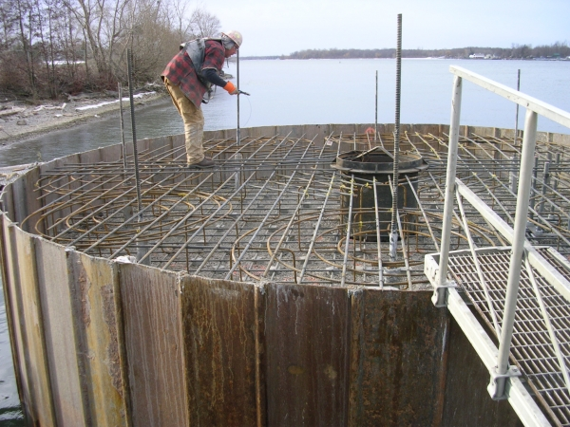
Micro Efficiency Upgrade
Mooring cells are authorized projects in WRDA 2007
USACE Mooring Cell UMR Working Group identified top priority locations: L&D 14 lower pool was #1
Waiting area currently 3.6 miles downstream
Proposed mooring cell location would be only 1.4 miles downstream
= 2.2 mile difference
4
Courtesy of US Army Corps of Engineers

Slide 5
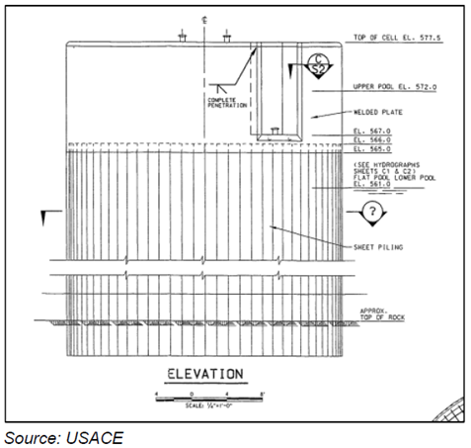
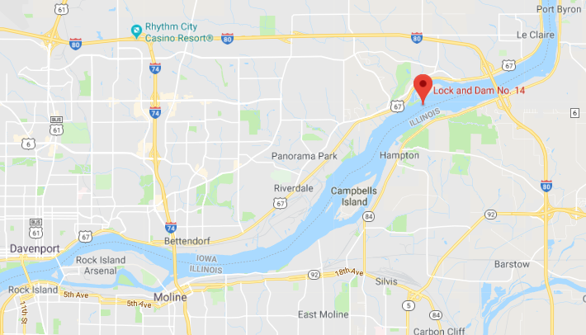
5

Slide 6
Economic Benefits
2.2 mile difference for waiting area = estimated 217 hours or 9 days time savings per navigation year
Relative to other scenarios, Micro Upgrade scenario yields the highest benefit-cost
*Includes 3% annual operating and maintenance costs
Importance to Iowa:
Inland waterways benefit landside transportation: congestion, safety, infrastructure damage, transportation costs, etc.
Demonstrated commitment to UMR infrastructure
Pilot can be replicated by other UMR states
 | Total discounted benefits | Total discounted costs* | Net present value | Benefit-cost ratio
Mooring cell | $8.7 million | $2.5 million | $6.2 million | 3.52
6

Slide 7
Funding
Costs
$2 million for L&D 14 lower pool site
Pilot funding proposal
Contributed funds agreement with USACE
80% National Highway Freight Program (NHFP)
20% State Infrastructure Bank
Use of NHFP funds will require an amendment to the State Freight Plan
Source | Amount
NHFP allocated funds (Federal) | $1,600,000
State Infrastructure Bank (Non-Federal) | $400,000
Total | $2,000,000
7

Slide 8
Schedule
April – June 2021
September 1, 2021
Finalize Plans & Specifications
Review Environmental Assessment
Award Contract
March 9, 2021
July 1, 2021
September 1, 2021 – September 1, 2022
Commission Action
To Contracting
(Ready to Advertise)
Construction (1 year)
8

Slide 9
Questions?
Craig Markley
Director, Systems Planning Bureau
craig.markley@iowadot.us
515-239-1027

