Slide 1
LIFTS Program Funding Recommendation
2021 Funding Cycle

Slide 2
Linking Iowa’s Freight Transportation System Program
Fixing America’s Surface Transportation (FAST) Act signed into law in 2015.
Expands the eligibility of multimodal freight projects for federal transportation funding through the establishment of the National Highway Freight Program (NHFP)
10% of Iowa’s NHFP apportionment may be used for freight intermodal or freight rail projects.
Transportation Commission chose to award this funding through the administration of the LIFTS program.
$1.46 million was previously awarded in the October 2019 funding cycle (includes two years worth of funding)
Roughly $1.4-$1.6 million annually thereafter.
Notes:
This current round of funding we bring to you today utilizes Federal funding which comes from Iowa’s 10% National Highway Freight Program apportionment set fourth in the FAST ACT, which was signed into law back in 2015. In early 2017, the Commission approved to award this funding through the administration of the LIFTS program. The LIFTS program is a competitive, application based grant program and it’s purpose is to provide grant funding for multi-modal freight projects that have economic and public benefit by enhancing the shipment of freight within the state, but are typically ineligible for traditional state or federal highway funding.
In 2017, we awarded our first round of lifts projects, which totaled two years worth of funding. For this 2021 round we have approximately 1.6 million dollars to award.

Slide 3
Project Evaluation Criteria
Freight mobility Benefits (25%)
Economic Benefits (25%)
Public Benefits (20%)
Project Readiness (20%)
Innovation/Process Improvement (10%)
Notes:
An application is required in order to submit for LIFTS funding. Once applications are received, an evaluation team is identified and we review each application and then score and evaluate them based on these five categories that are weighted as shown.
Freight Mobility Benefits (25%): applicant must document how the proposed project will increase freight mobility
Economic Benefits (25%): applicant must document how the proposed project will impact the local, regional, and or national economy, provide a cost savings to shippers.
Public Benefits (20%): Applicant must document how the proposed project will benefit other transportation users, provide environmental benefits, and enhance the quality of life or improve safety.
Project Readiness (20%): The applicant must realistically document how prepared the project is to begin – higher weight because of timelines to utilize federal funding
Innovation/Process Improvement (10%): The project must document any innovative/new technologies being used, how novel the construction/project management process.
Application incorporates questions for each category to help with the evaluation and scoring.

Slide 4
Available Funding and Application Summary
Available Funding
2021 $1.6 million
Application Summary
Total number of projects: 1
Total project costs: $1,920,000
Total amount requested: $1,536,000
Notes:
For this year’s round we received a total 1 application to evaluate. Total project cost for this project is $1.92 million, and the total amount requested is roughly $1.53 million. Today we are recommending this project for full award.

Slide 5
List of Applications Recommended
REQUESTED AMOUNT
(% of Total Project Cost)
RECOMMENDED AMOUNT
(% of Total Project Cost)
PROJECT NAME
SPONSOR
SCORE
TOTAL PROJECT COST
TSL Container Freight Station Phase 1 | TSL Company | 81.3 | $1,920,000 | $1,536,000 (80 %) | $1,536,000 (80%)
Notes:
Little bit more about the project we are recommending for award …
The applicant is TSL Company and is located in Council Bluffs Iowa. This project includes redevelopment and expansion of the existing container terminal in Council Bluffs, IA in three phases. This first phase, which LIFTS money is being recommended for, will upgrade the current lot to concrete. Doing so will minimize maintenance costs and ensure that tractors and yard equipment can operate safely and efficiently. In addition, TSL will construct a temporary transload, capable of transloading from hopper trailer to container. They will transload up to 300 containers of grain per week.
Staff recommends a full grant in the amount of $1,536,000.

Slide 6
Map of Applications Received

Slide 7
QUESTIONS?
Laura Hutzell, Office of Rail Transportation
Laura.Hutzell@iowadot.us
515-239-1066

Slide 8
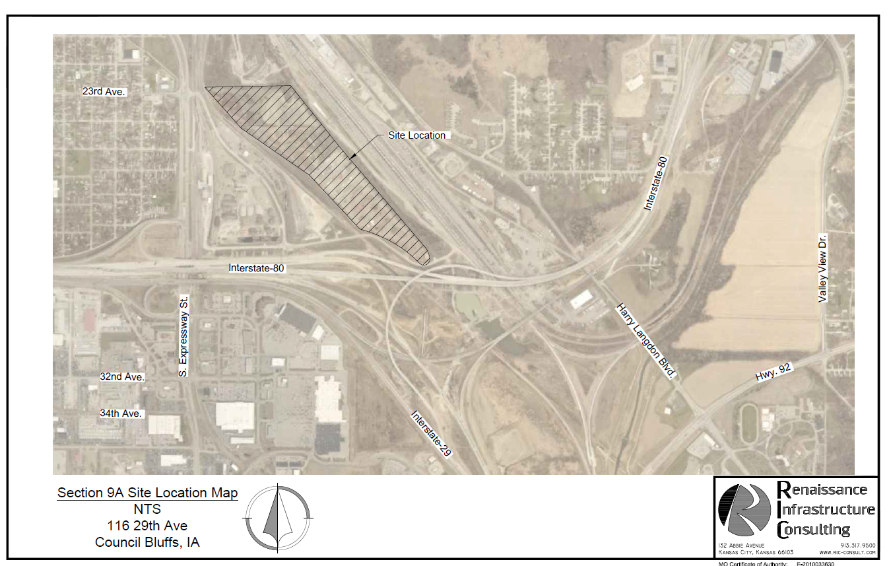
TSL Container Freight Station
The project includes redevelopment and expansion of the existing container terminal in Council Bluffs, IA in three phases. This first phase will upgrade the current lot to concrete. Doing so will minimize maintenance costs and ensure that tractors and yard equipment can operate safely and efficiently. In addition, TSL will construct a temporary transload, capable of transloading from hopper trailer to container. They will transload up to 300 containers of grain per week.
.
Total Cost: $1,9201000
Requested: $1,536,000 (80%)
Return to Recommendation Summary
Notes:
TSL plans to redevelop and expand the existing container terminal in three phases. This first phase will be to upgrade the current lot to concrete. Doing so will minimize maintenance costs and ensure that tractors and yard equipment can operate safely and efficiently. In addition, TSL will construct a temporary transload, capable of transloading from hopper trailer to container. They will transload up to 300 containers of grain per week.

