Slide 1
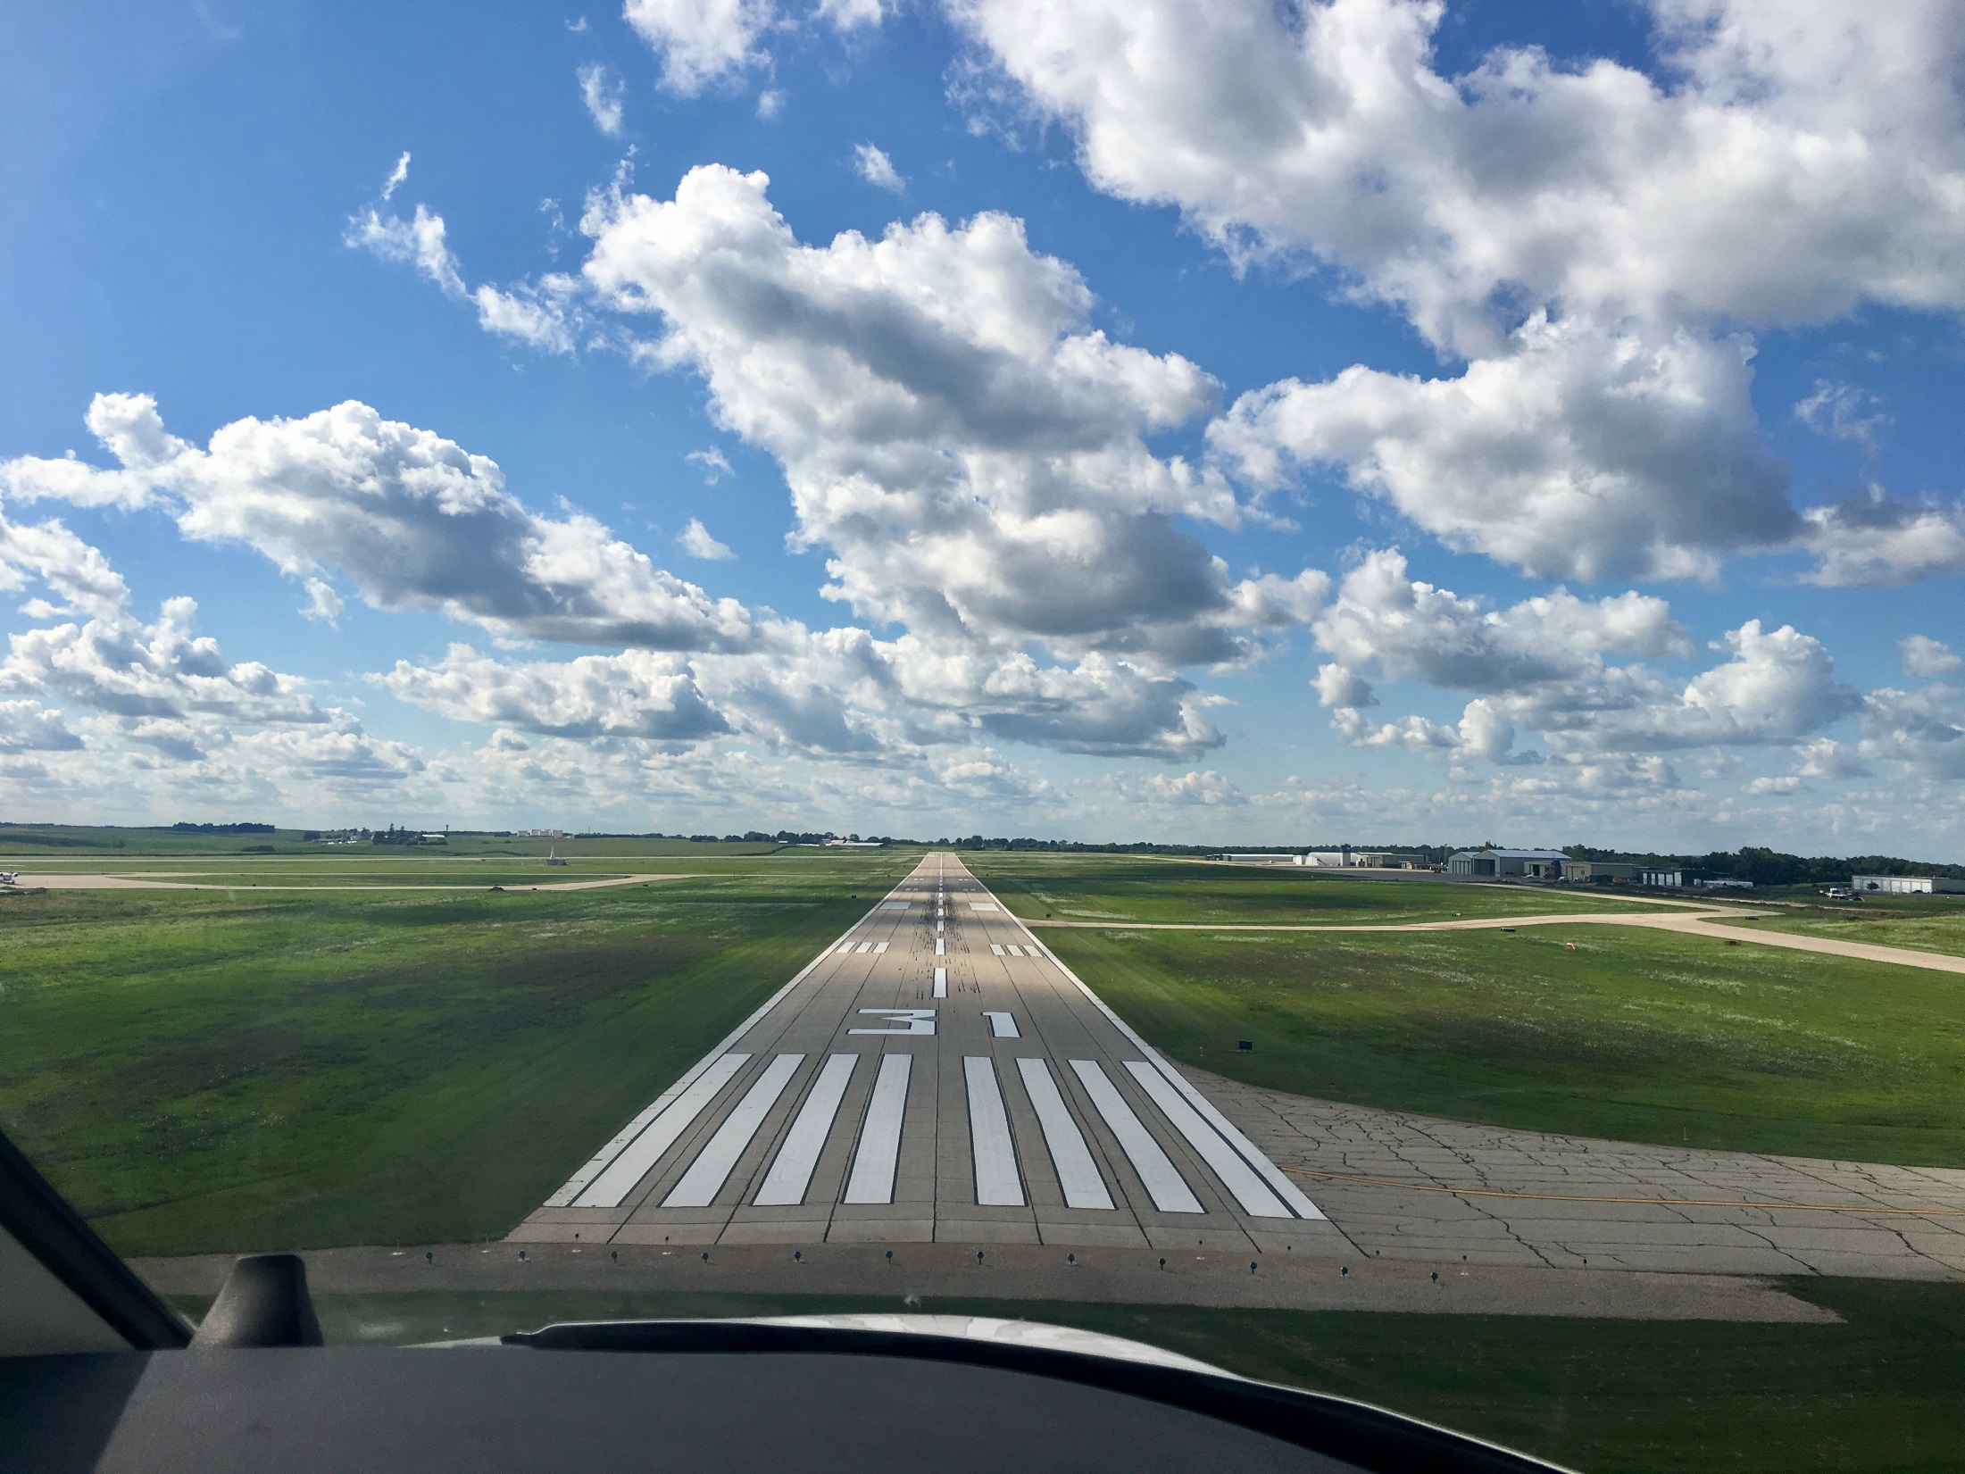
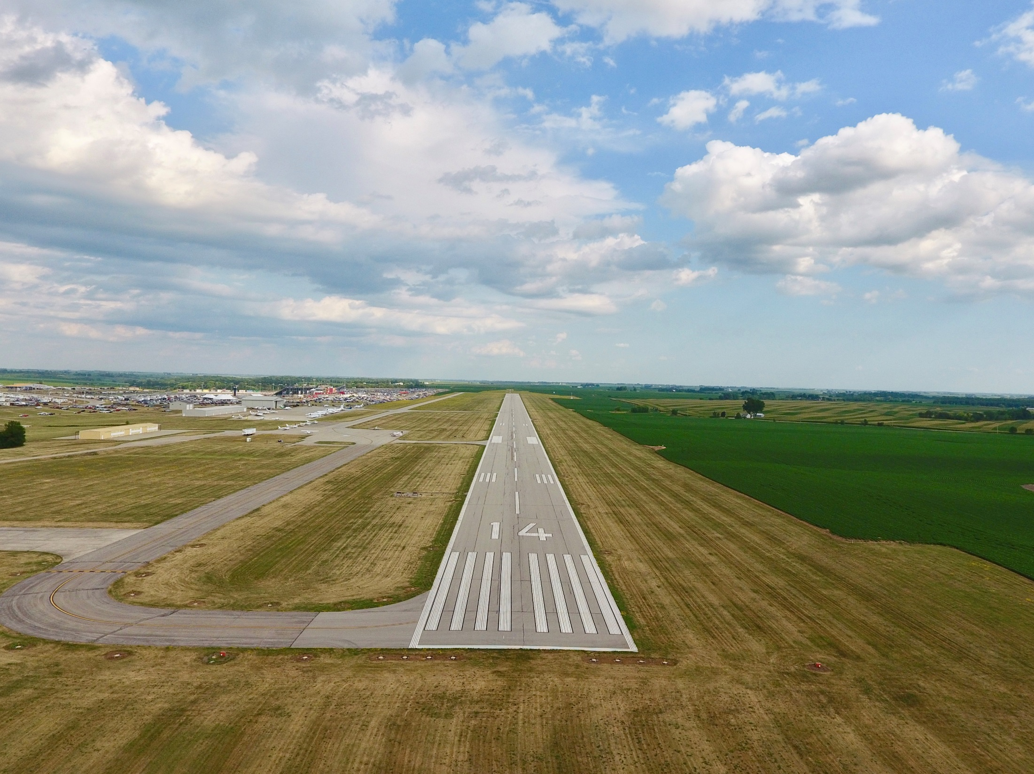

FFY 2022
Federal Aviation Administration
Funding Preapplications
Shane Wright
Aviation Bureau
February 9, 2021

Slide 2
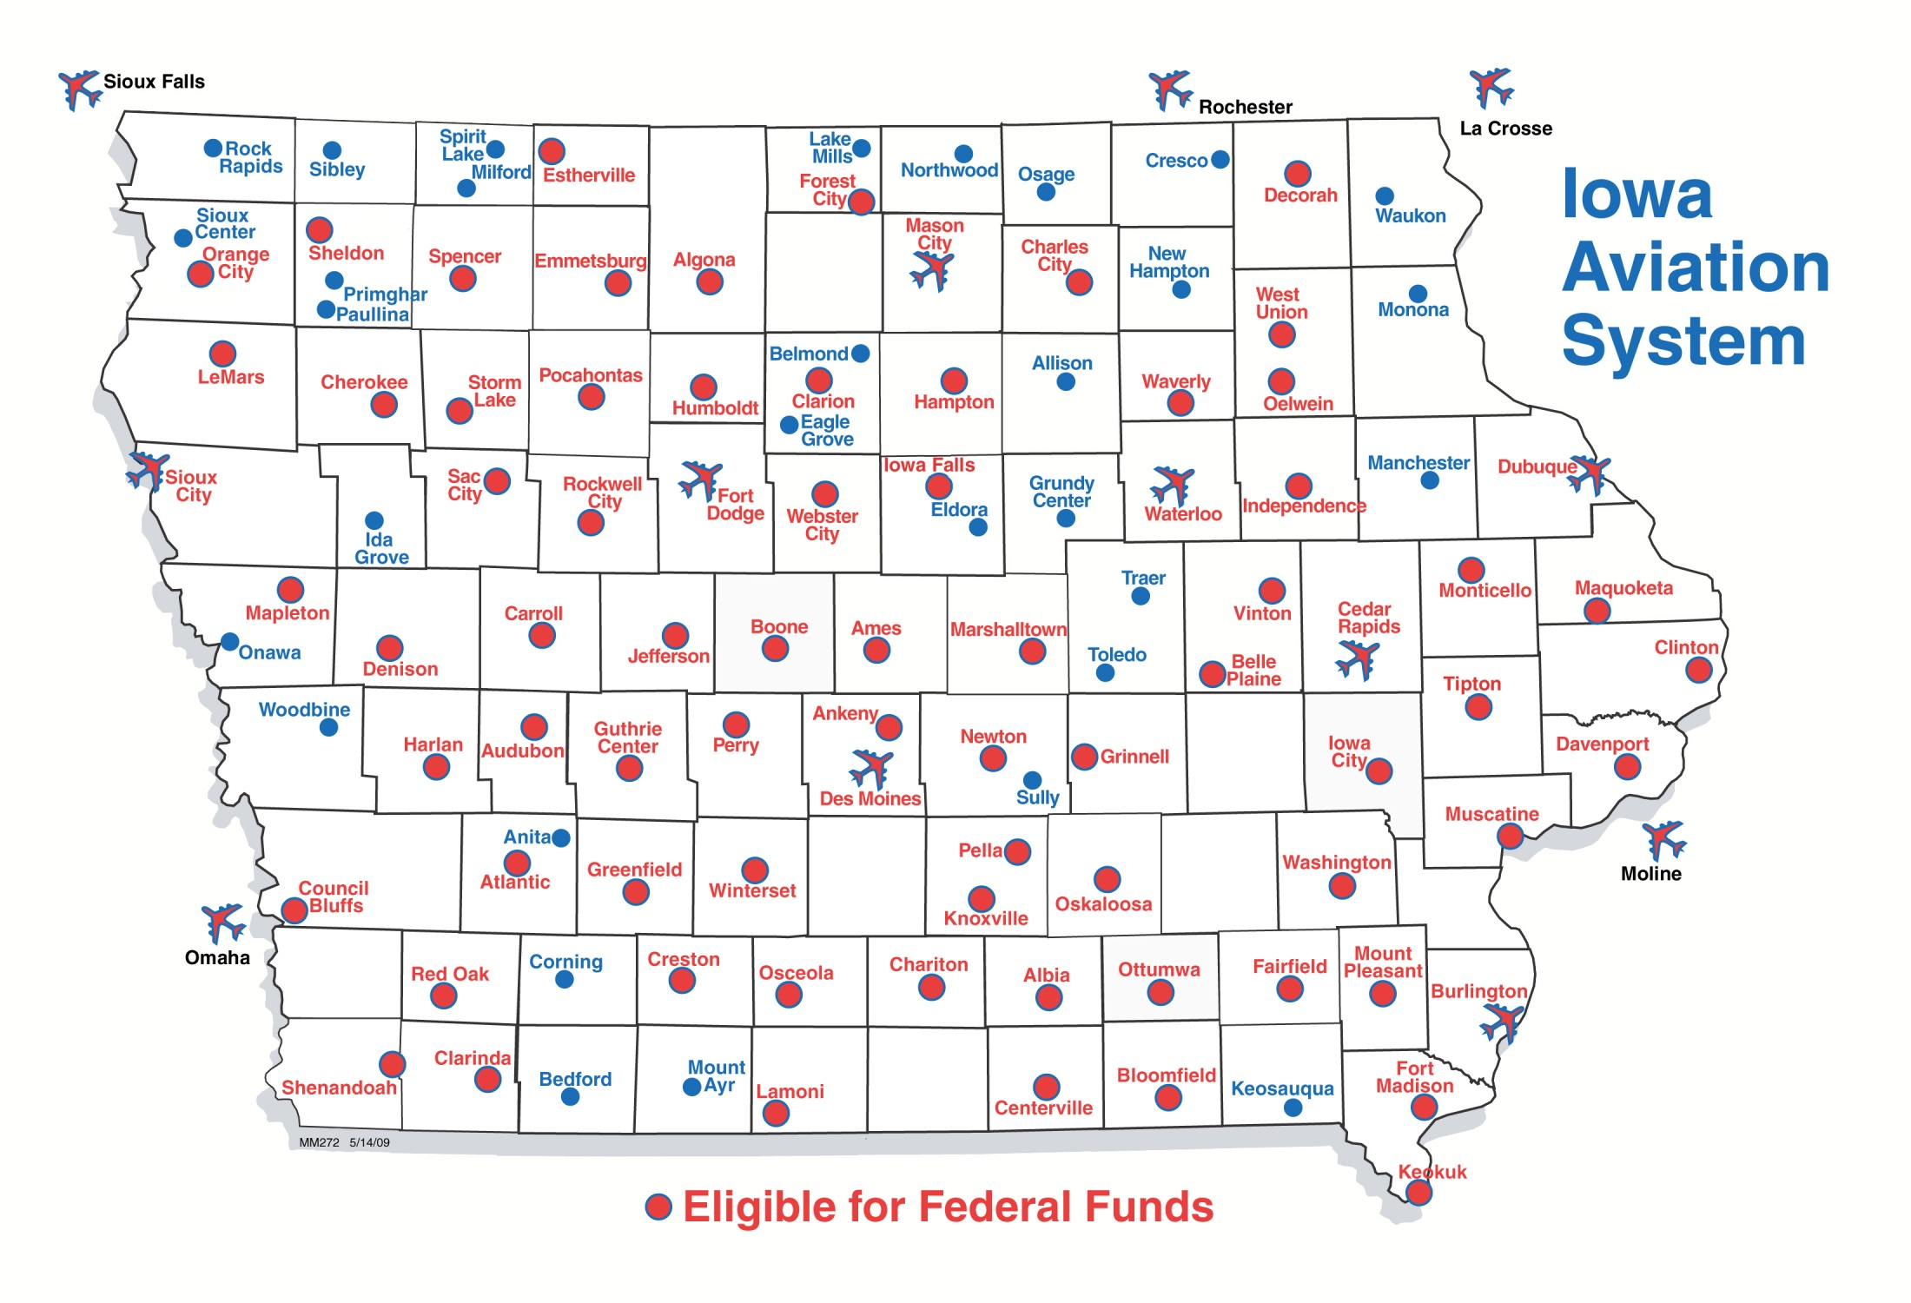
Airports in Iowa Eligible for Federal Funding
Notes:
70 general aviation airports and 3 non-primary commercial service airports – Burlington, Fort Dodge and Mason City
DSM, CID, DBQ, SUX, ALO primary airports (more than 10,000 enplanements) go directly to FAA
30 general aviation airports not eligible for federal funds

Slide 3
Federal Aviation Funding
Channeling Act of 1993 - Applies to all general aviation (GA) airports and commercial service airports that do not receive primary entitlement funds – Iowa Code Section 330.13
Must submit federal preapplication to the Iowa DOT prior to submittal to FAA
Transportation Commission approves submittal of applications to FAA
Final approval and programming of projects responsibility of the FAA

Slide 4
Federal Aviation Funding
FAA Reauthorization Act of 2018
$3.35 billion for five years
90% federal share
Total available dollars remain subject to annual appropriations
Federal Airport Improvement Program (AIP)
Nonprimary entitlement – Airports receive up to $150,000 each year, based on 5-year capital improvement plan included in the NPIAS (can accumulate 4 years)
State apportionment – Based on population and land area
Discretionary – Airport projects compete for funds based on FAA priority of project.
Entitlement funds are available to airports for any qualifying project. If a grant request exceeds the entitlement available, the FAA may apply apportionment or discretionary to fund the difference.
Notes:
Passed February 2012 after 24 continuing resolutions
FY 2013 funding approp thru March 27

Slide 5
Summary of Federal Funding to Nonprimary Airports in Iowa
 | 2017 | 2018 | 2019 | 2020 | 2021*
Entitlement | $8,583,899 | $9,842,418 | $12,271,505 | $11,529,965 | $9,556,273
Apportionment | $3,086,621 | $3,038,967 | $2,801,570 | $2,779,728 | $2,801,570
Discretionary | $7,130,406 | $13,921,868 | $21,613,507** | $15,157,647** | $19,158,275**
 | $18,806,926 | $26,803,253 | $36,686,582 | $29,467,340 | $31,516,118
*Preliminary ** Includes Supplemental Discretionary
Notes:
2013 – Land purchases (Iowa City, Sioux County))
Washington rwy reconstructon
2014 – fewer projects requested that needed discretionary funding

Slide 6
FFY 2022 Federal Funding Project Categories
Safety and Planning
Projects that are safety or planning related
These projects are a high priority as they help to ensure the immediate safety and long term viability of the Iowa air transportation system
Maintenance and Development Projects
Projects that are to replace, repair, or expand airport infrastructure.
Also include acquisition of snow removal equipment, fueling facilities, and buildings
Land acquisition
All conditions must be satisfied for FAA to program a project that must compete for discretionary funding
Justified, eligible project and shown on an airport layout plan
Environmental process complete
Must have purchased the land or have a formal negotiated agreement

Slide 7
FFY 2022 Federal Funding Safety and Planning Projects
Safety projects
Airport | Project description | 90 percent federal level | Total amount
Bloomfield Municipal | Eliminate North Pond | $270,900 | $301,000
 | Total safety projects | $270,900 | $301,000
Planning projects
Airport | Project description | 90 percent federal level | Total amount
Clarinda Municipal | Update ALP | $160,000 | $178,000
Davenport Municipal | Design North Apron Reconstruction | $131,400 | $146,000
Grinnell Regional | Taxiway Rehabilitation - Phase 1 - Design | $150,000 | $166,667
Iowa Falls Municipal | Conduct Airport Master Plan Study | $202,500 | $225,000
Mapleton Municipal | Airport Drainage & Levee Repairs - Design | $59,400 | $66,000
Maquoketa Municipal | Reconstruct Runway 15 End - Design | $210,600 | $234,000
Red Oak Municipal | Runway 5/23 and Taxiway Edge Lighting Upgrade Design Only | $108,000 | $120,000
Iowa DOT | Pavement Condition Study | $135,000 | $150,000
 | Total planning projects | $1,156,900 | $1,285,667
Notes:
The Iowa Aviation System Plan provides a detailed overview of the Iowa Aviation System. It evaluates existing conditions and makes recommendations for future development of the air transportation system.
Last Aviation System Plan was published in 2010.
Originally scheduled to receive FAA funding in FY2018, but FY2017 funds became available and offered to us to begin this effort early.
Estimated cost of $350,000 requiring a $35,000 state share.
Because this is a FAA FY2017 project, it does not appear on the list of projects, but we are requesting commission approval to move ahead with the project.

Slide 8
FFY 2022 Federal Funding Maintenance and Development Projects
Maintenance and development projects
Airport | Project description | 90 percent federal level | Total amount
Algona Municipal | Runway 12 Displacement and Runway 30 Extension (Grading) | $504,000 | $560,000
Ames Municipal | Runway 1/19 and Taxiway A (north portion) Lighting | $150,000 | $166,667
Atlantic Municipal | Runway 12/30 and Runway 2/20 Electrical Upgrade | $1,235,106 | $1,372,340
Atlantic Municipal | Runway 12/30 PAPI/REIL Equipment Replacement | $138,510 | $153,900
Belle Plaine Municipal | Pavement Rehavilitation - Runway and Taxiway | $90,000 | $100,000
Belle Plaine Municipal | Pavement Rehavilitation - Apron | $180,000 | $200,000
Belle Plaine Municipal | Entrance Road Improvements | $103,500 | $115,000
Southeast Iowa Regional | Reconstruct Taxiway B | $1,910,610 | $2,122,900
Chariton Municipal | Jet-A Aviation Fuel Facility with Card Reader | $261,000 | $290,000
Northeast Iowa Regional | Runway Pavement Maintenance | $148,500 | $165,000
Clarion Municipal | Replace Fuel System | $322,753 | $640,000
Decorah Municipal | Taxiway Lighting | $207,000 | $230,000
Fairfield Municipal | Reconstruct Taxiway to T-Hangars - Phase 3 | $444,627 | $494,030
Hampton Municipal | Runway Pavement Rehabilitation | $246,582 | $273,980
Hampton Municipal | Taxiway and Apron Rehabilitation | $139,410 | $154,900
Humboldt Municipal | Runway Pavement Rehabilitation, Line of sight correction and lighting improvements | $306,000 | $340,000
Iowa City Municipal | Runway 12 Threshold Displacement - Runway 30 Threshold Relocation | $433,800 | $482,000
Jefferson Municipal | 100'x100' Hangar | $600,000 | $958,900
Knoxville Municipal | Expand Apron | $450,000 | $500,000
Osceola Municipal | Turnarounds for Runway 18/36 | $612,504 | $680,560
Oskaloosa Municipal | Taxiway & Tee Hanger Taxilane Rehabilitation | $360,000 | $400,000

Slide 9
FFY 2022 Federal Funding Maintenance and Development Projects continued
Pella Municipal | Replace AWOS facility at existing location | $150,000 | $166,667
Perry Municipal | Runway 14/32 Construction | $6,242,040 | $6,935,600
Pocahontas Municipal | Regrade and Improve Drainage for Turf Runway 18/36 | $198,000 | $220,000
Shenandoah Regional | Rehabilitate Runway 12/30 | $209,700 | $233,000
Vinton Municipal | Runway 9/27 Rehabilitation - Phase II | $216,000 | $240,000
Washington Municipal | Runway 18/36 Lighting | $385,632 | $814,112
Washington Municipal | New PAPIs and REILs - Runway 18/36 | $202,644 | $225,160
Waverly Municipal | Construct Connector Taxiway | $329,310 | $365,900
West Union Municipal | Airfield Pavement Rehabilitation | $468,000 | $520,000
 | Total maintenance and development projects | $17,245,228 | $20,120,616

Slide 10
FFY 2022 Federal Funding Land acquisition
Land acquisition projects
Airport | Project description | 90 percent federal level | Total amount
Ankeny Regional | Land Acquisition | $150,000 | $150,000
Rockwell City Municipal | Acquire Tract 7 and Adjacent Ultimate RPZ | $55,800 | $62,000
Sheldon Regional | Construct/Extend/Improve Runway 33 Safety Area | $290,520 | $322,800
Winterset Municipal | Land Acquisition for Future Runway 18/36 | $1,656,000 | $1,840,000
South Central Regional | Land Acquisition | $904,604 | $1,005,116
South Central Regional | Land Acquisition | $1,397,470 | $1,552,116
South Central Regional | Land Acquisition | $297,865 | $330,961
South Central Regional | Land Acquisition | $247,500 | $275,000
 | Total land acquisition projects | $4,999,759 | $5,537,993
Notes:
Charles City finishing environmental – 13 parcels – not all likely to be ready for 2015
Only eligible for discretionary if agreement in place by April 2014

Slide 12
FFY 2022 Federal Funding Preapplications Summary
 | Projects | Airports | Federal Share | Total Applications
Safety and Planning | 9 | 9 | $1,427,800 | $1,586,667
Maintenance and Development | 30 | 26 | $17,245,228 | $20,120,616
Land Acquisition | 8 | 5 | $4,999,759 | $5,537,993
Total Preapplications | 47 | 40 | $23,672,787 | $27,245,276
Notes:
Total eligible airports: 73 plus 2 new/replacement
No projects: 21 airports

Slide 13
FFY 2022 Federal Aviation Administration Funding Preapplications
Questions??

