Slide 1
Revitalize Iowa’s Sound Economy Program
Iowa Transportation Commission Business Meeting
February 9, 2021

Slide 2
List of Local Development Applications Recommended
PROJECT NAME
SPONSOR
SCORE
TOTAL PROJECT COST
PERCENT PARTICIPATION
RECOMMENDED AMOUNT
Construction of approximately 1,000 feet of 15th Street NW. | Sioux Center | 57 | $780,981 | 50% | $390,491

Slide 3
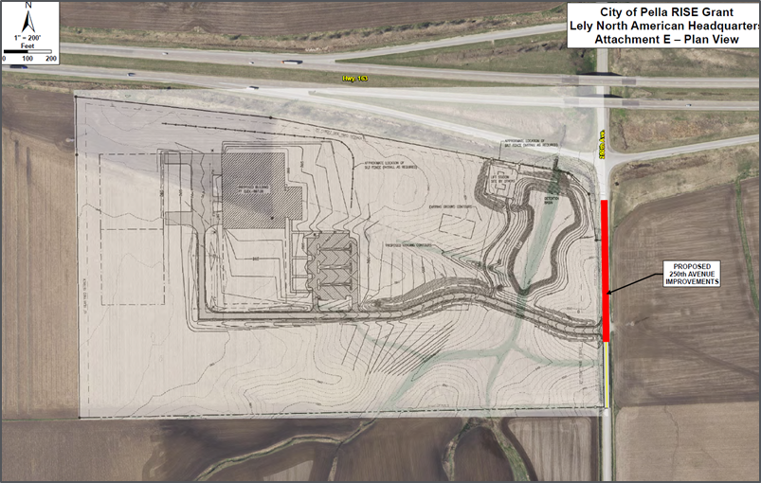
List of Immediate Opportunity Applications Recommended
PROJECT NAME
SPONSOR
JOBS
TOTAL PROJECT COST
PERCENT PARTICIPATION
RECOMMENDED AMOUNT
Paving of approximately 600 feet of 250th Avenue. | Pella | 21 | $305,750 | 80% | $244,600

